Slide 1
Chapter 1: Introduction

Slide 2
Chapter 1: Introduction
What Operating Systems Do
Computer-System Organization
Computer-System Architecture
Operating-System Structure
Operating-System Operations
Process Management
Memory Management
Storage Management
Protection and Security
Distributed Systems
Special-Purpose Systems
Computing Environments
Open-Source Operating Systems

Slide 3
Objectives
To provide a grand tour of the major operating systems components
To provide coverage of basic computer system organization

Slide 4
What is an Operating System?
A program that acts as an intermediary between a user of a computer and the computer hardware
Operating system goals:
  Execute user programs and make solving user problems easier
  Make the computer system convenient to use
  Use the computer hardware in an efficient manner

Slide 5
Computer System Structure
Computer system can be divided into four components:
  Hardware – provides basic computing resources
    CPU, memory, I/O devices
  Operating system
    Controls and coordinates use of hardware among various applications and users
  Application programs – define the ways in which the system resources are used to solve the computing problems of the users
    Word processors, compilers, web browsers, database systems, video games
  Users
    People, machines, other computers

Slide 6
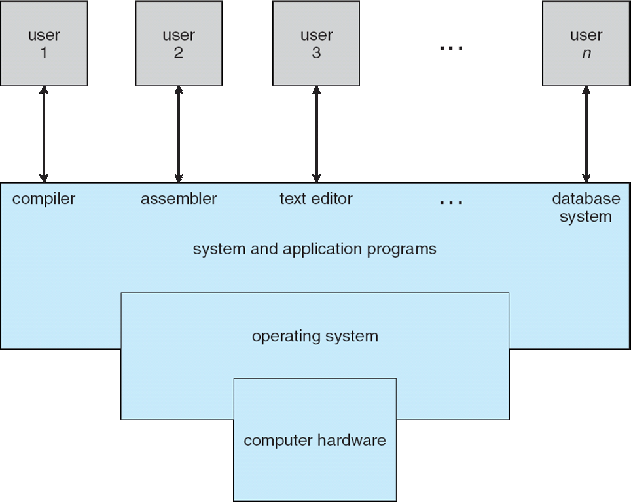
Four Components of a Computer System

Slide 7
What Operating Systems Do
Depends on the point of view
Users want convenience, ease of use
  Don’t care about resource utilization
But shared computer such as mainframe or minicomputer must keep all users happy
Users of dedicate systems such as workstations have dedicated resources but frequently use shared resources from servers
Handheld computers are resource poor, optimized for usability and battery life
Some computers have little or no user interface, such as embedded computers in devices and automobiles

Slide 8
Operating System Definition
OS is a resource allocator
  Manages all resources
  Decides between conflicting requests for efficient and fair resource use
OS is a control program
  Controls execution of programs to prevent errors and improper use of the computer

Slide 9
Operating System Definition (Cont.)
No universally accepted definition
“Everything a vendor ships when you order an operating system” is good approximation
  But varies wildly
“The one program running at all times on the computer” is the kernel. Everything else is either a system program (ships with the operating system) or an application program.

Slide 10
Computer Startup
bootstrap program is loaded at power-up or reboot
  Typically stored in ROM or EPROM, generally known as firmware
  Initializes all aspects of system
  Loads operating system kernel and starts execution

Slide 11
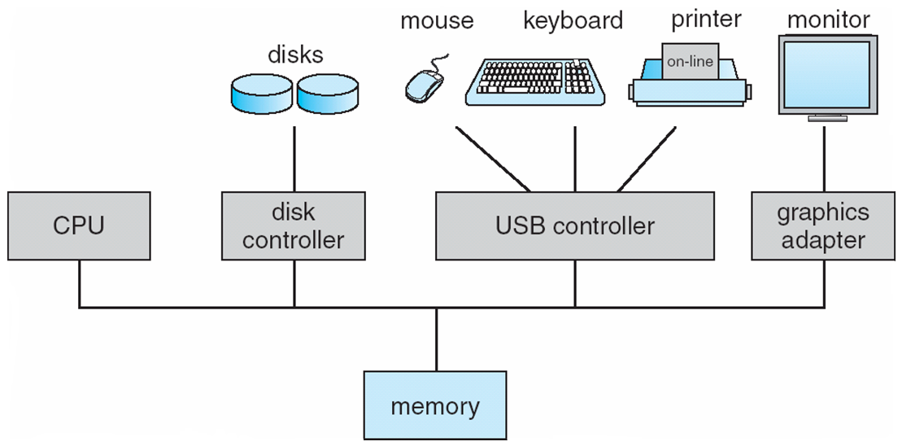
Computer System Organization
Computer-system operation
  One or more CPUs, device controllers connect through common bus providing access to shared memory
  Concurrent execution of CPUs and devices competing for memory cycles

Slide 12
Computer-System Operation
I/O devices and the CPU can execute concurrently
Each device controller is in charge of a particular device type
Each device controller has a local buffer
CPU moves data from/to main memory to/from local buffers
I/O is from the device to local buffer of controller
Device controller informs CPU that it has finished its operation by causing an interrupt

Slide 13
Common Functions of Interrupts
Interrupt transfers control to the interrupt service routine generally, through the interrupt vector, which contains the addresses of all the service routines
Interrupt architecture must save the address of the interrupted instruction
Incoming interrupts are disabled while another interrupt is being processed to prevent a lost interrupt
A trap is a software-generated interrupt caused either by an error or a user request
An operating system is interrupt driven

Slide 14
Interrupt Handling
The operating system preserves the state of the CPU by storing registers and the program counter
Determines which type of interrupt has occurred:
  polling
  vectored interrupt system
Separate segments of code determine what action should be taken for each type of interrupt

Slide 15
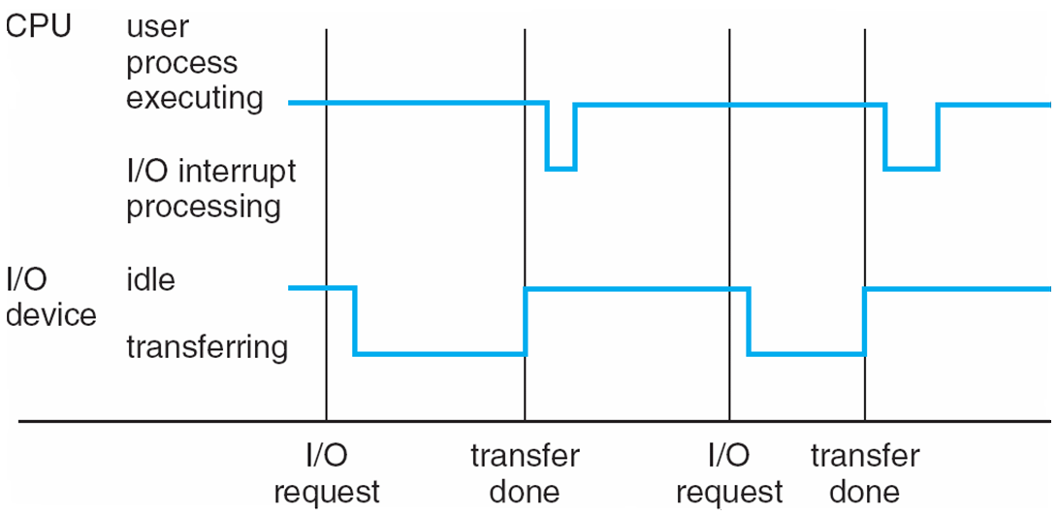
Interrupt Timeline

Slide 16
Storage Structure
Main memory – only large storage media that the CPU can access directly
  Random access
  Typically volatile
Secondary storage – extension of main memory that provides large nonvolatile storage capacity
Magnetic disks – rigid metal or glass platters covered with magnetic recording material
  Disk surface is logically divided into tracks, which are subdivided into sectors
  The disk controller determines the logical interaction between the device and the computer

Slide 17
Storage Hierarchy
Storage systems organized in hierarchy
  Speed
  Cost
  Volatility
Caching – copying information into faster storage system; main memory can be viewed as a cache for secondary storage

Slide 18
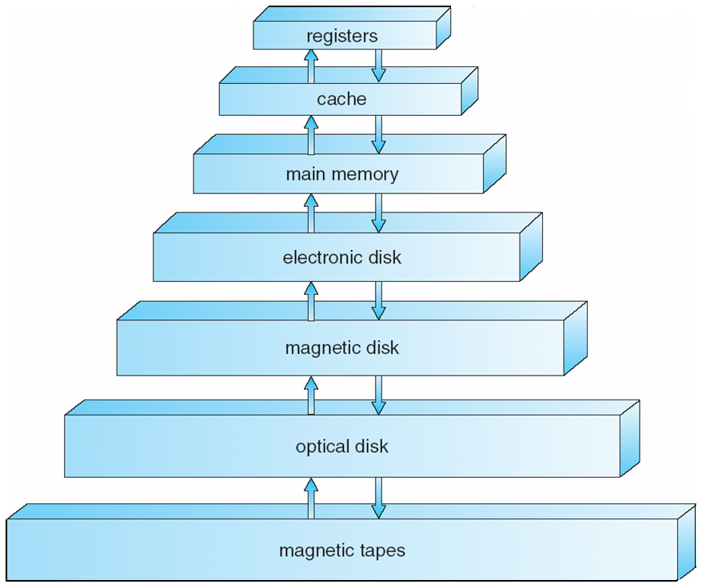
Storage-Device Hierarchy

Slide 19
Caching
Important principle, performed at many levels in a computer (in hardware, operating system, software)
Information in use copied from slower to faster storage temporarily
Faster storage (cache) checked first to determine if information is there
  If it is, information used directly from the cache (fast)
  If not, data copied to cache and used there
Cache smaller than storage being cached
  Cache management important design problem
  Cache size and replacement policy

Slide 20
I/O System
Device controllers – Manages an I/O device
Contains local buffers to temporarily hold data
Device drivers – OS has device drivers corresponding to each controller
Drivers interacts with controllers and provide uniform interface to OS
I/O Cycle

Slide 21
Direct Memory Access Structure
Used for high-speed I/O devices able to transmit information at close to memory speeds
Device controller transfers blocks of data from buffer storage directly to main memory without CPU intervention
Only one interrupt is generated per block, rather than the one interrupt per byte

Slide 22
Computer-System Architecture
Most systems use a single general-purpose processor (PDAs through mainframes)
  Most systems have special-purpose processors as well
Multiprocessors systems growing in use and importance
  Also known as parallel systems, tightly-coupled systems
  Advantages include:
    Increased throughput
    Economy of scale
    Increased reliability – graceful degradation or fault tolerance
  Two types:
    Asymmetric Multiprocessing
    Symmetric Multiprocessing

Slide 23
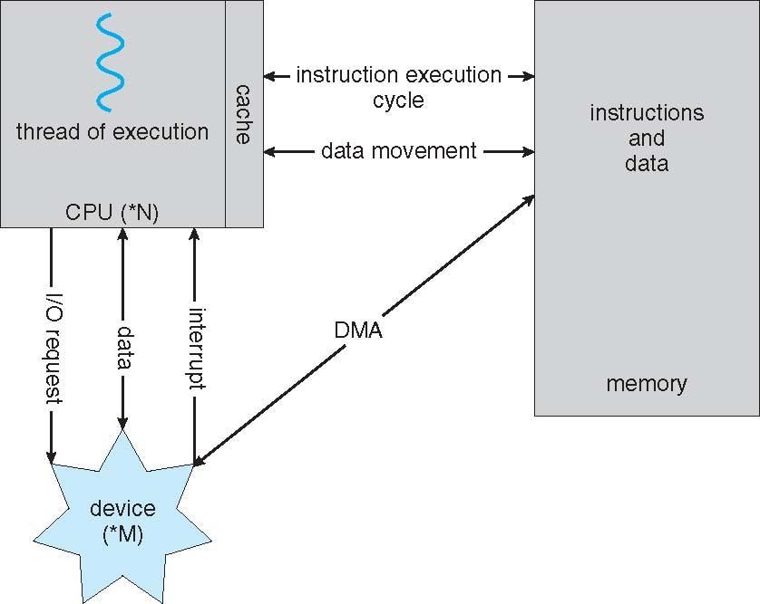
How a Modern Computer Works
A von Neumann architecture

Slide 24
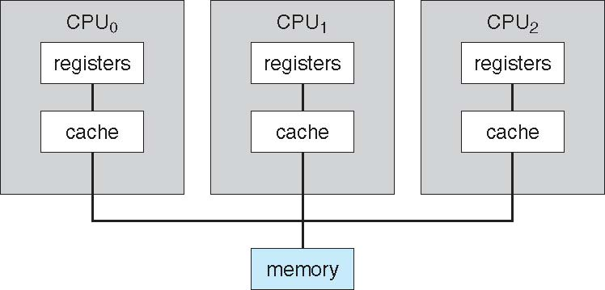
Symmetric Multiprocessing Architecture

Slide 25
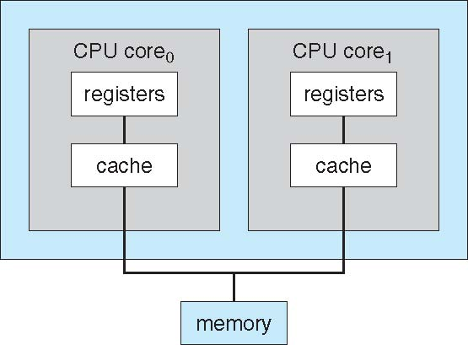
A Dual-Core Design

Slide 26
Clustered Systems
Like multiprocessor systems, but multiple systems working together
  Usually sharing storage via a storage-area network (SAN)
  Provides a high-availability service which survives failures
    Asymmetric clustering has one machine in hot-standby mode
    Symmetric clustering has multiple nodes running applications, monitoring each other
  Some clusters are for high-performance computing (HPC)
    Applications must be written to use parallelization

Slide 27
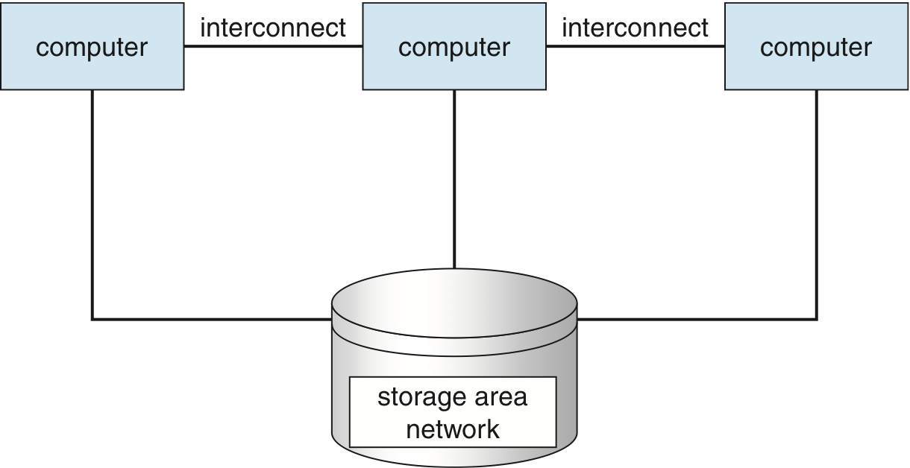
Clustered Systems

