Slide 1
Chapter 1: Introduction

Slide 2
Announcements
TA – Jennifer Rouan – jdrouan@uga.edu
  Office Hours -- TBA
Slides from last week on ELC new
Programming project 1 posted on course homepage
Homework to be posted by end of this week
Form Project-Presentation-Homework groups
  Inform me and TA via email
  Use heading [CSCI 4730/6730] Project Group

Slide 3
Clustered Systems
Like multiprocessor systems, but multiple systems working together
  Usually sharing storage via a storage-area network (SAN)
  Provides a high-availability service which survives failures
    Asymmetric clustering has one machine in hot-standby mode
    Symmetric clustering has multiple nodes running applications, monitoring each other
  Some clusters are for high-performance computing (HPC)
    Applications must be written to use parallelization

Slide 4
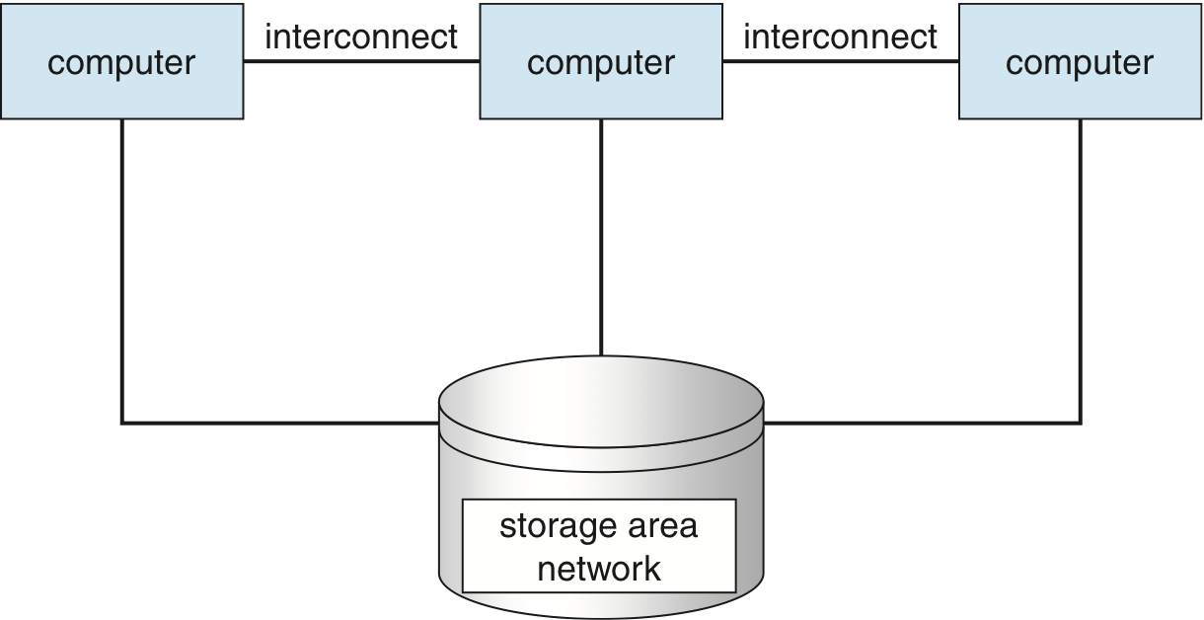
Clustered Systems

Slide 5
Operating System Structure
Multiprogramming needed for efficiency
  Single user cannot keep CPU and I/O devices busy at all times
  Multiprogramming organizes jobs (code and data) so CPU always has one to execute
  A subset of total jobs in system is kept in memory
  One job selected and run via job scheduling
  When it has to wait (for I/O for example), OS switches to another job
Timesharing (multitasking) is logical extension in which CPU switches jobs so frequently that users can interact with each job while it is running, creating interactive computing
  Response time should be < 1 second
  Each user has at least one program executing in memory process
  If several jobs ready to run at the same time  CPU scheduling
  If processes don’t fit in memory, swapping moves them in and out to run
  Virtual memory allows execution of processes not completely in memory

Slide 6
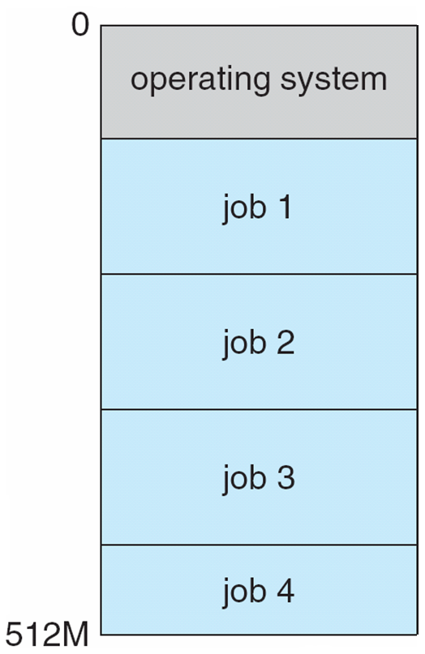
Memory Layout for Multiprogrammed System

Slide 7
Multiprogramming Issues
Job scheduling
  Process – A program in execution
CPU Scheduling
Swapping
Virtual memory

Slide 8
Modes of OS Operation
Software error or request creates exception or trap
  Division by zero, request for operating system service
Other process problems include infinite loop, processes modifying processes or data owned by them or the operating system
Dual-mode operation allows OS to protect itself and other system components
User mode and kernel mode
  Mode bit provided by hardware
  Provides ability to distinguish when system is running user code or kernel code
  Some instructions designated as privileged, only executable in kernel mode
System call – Mechanism for user programs to access system services
  Changes mode to kernel, return from call resets it to user

Slide 9
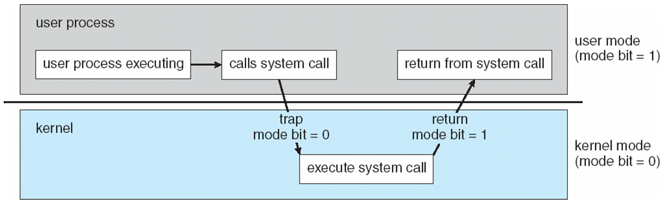
Transition from User to Kernel Mode

Slide 10
Timer
CPU must maintain control over CPU
Prevent infinite loop / process hogging resources
Set interrupt after specific period
Operating system decrements counter
When counter zero generate an interrupt
Set up before scheduling process to regain control or terminate program that exceeds allotted time

Slide 11
Process Management
A process is a program in execution. It is a unit of work within the system. Program is a passive entity, process is an active entity.
Process needs resources to accomplish its task
  CPU, memory, I/O, files
  Initialization data
Process termination requires reclaim of any reusable resources
Single-threaded process has one program counter specifying location of next instruction to execute
  Process executes instructions sequentially, one at a time, until completion
Multi-threaded process has one program counter per thread
Typically system has many processes, some user, some operating system running concurrently on one or more CPUs
  Concurrency by multiplexing the CPUs among the processes / threads

Slide 12
Process Management Activities
The operating system is responsible for the following activities in connection with process management:
Creating and deleting both user and system processes
Suspending and resuming processes
Providing mechanisms for process synchronization
Providing mechanisms for process communication
Providing mechanisms for deadlock handling

Slide 13
Memory Management
All data in memory before and after processing
All instructions in memory in order to execute
Memory management determines what is in memory when
  Optimizing CPU utilization and computer response to users
Memory management activities
  Keeping track of which parts of memory are currently being used and by whom
  Deciding which processes (or parts thereof) and data to move into and out of memory
  Allocating and deallocating memory space as needed

Slide 14
Storage Management
OS provides uniform, logical view of information storage
  Abstracts physical properties to logical storage unit - file
  Each medium is controlled by device (i.e., disk drive, tape drive)
    Varying properties include access speed, capacity, data-transfer rate, access method (sequential or random)
File-System management
  Files usually organized into directories
  Access control on most systems to determine who can access what
  OS activities include
    Creating and deleting files and directories
    Primitives to manipulate files and dirs
    Mapping files onto secondary storage
    Backup files onto stable (non-volatile) storage media

Slide 15
Mass-Storage Management
Usually disks used to store data that does not fit in main memory or data that must be kept for a “long” period of time
Proper management is of central importance
Entire speed of computer operation hinges on disk subsystem and its algorithms
OS activities
  Free-space management
  Storage allocation
  Disk scheduling
Some storage need not be fast
  Tertiary storage includes optical storage, magnetic tape
  Still must be managed – by OS or applications
  Varies between WORM (write-once, read-many-times) and RW (read-write)

Slide 16
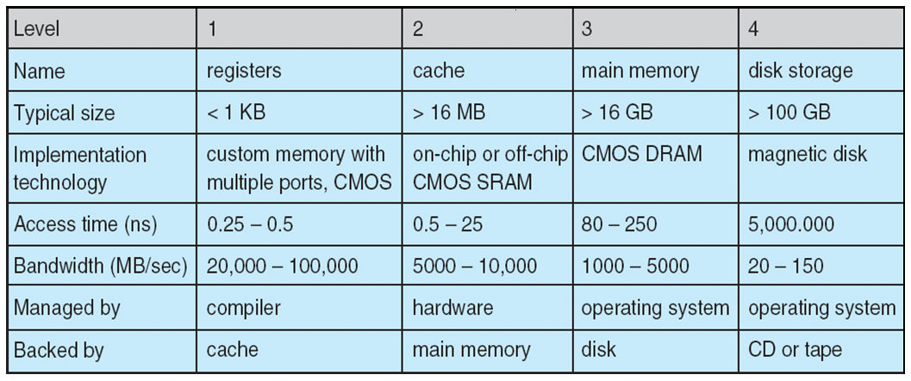
Performance of Various Levels of Storage
Movement between levels of storage hierarchy can be explicit or implicit

Slide 17
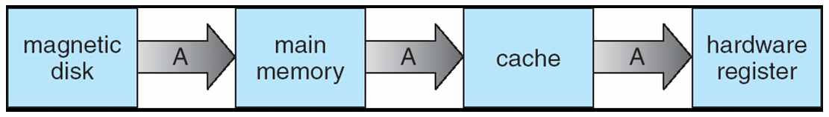
Migration of Integer A from Disk to Register
Multitasking environments must be careful to use most recent value, no matter where it is stored in the storage hierarchy
Multiprocessor environment must provide cache coherency in hardware such that all CPUs have the most recent value in their cache
Distributed environment situation even more complex
  Several copies of a datum can exist
  Various solutions covered in Chapter 17

Slide 18
I/O Subsystem
One purpose of OS is to hide peculiarities of hardware devices from the user
I/O subsystem responsible for
  Memory management of I/O including buffering (storing data temporarily while it is being transferred), caching (storing parts of data in faster storage for performance), spooling (the overlapping of output of one job with input of other jobs)
  General device-driver interface
  Drivers for specific hardware devices

Slide 19
Protection and Security
Protection – any mechanism for controlling access of processes or users to resources defined by the OS
Security – defense of the system against internal and external attacks
  Huge range, including denial-of-service, worms, viruses, identity theft, theft of service
Systems generally first distinguish among users, to determine who can do what
  User identities (user IDs, security IDs) include name and associated number, one per user
  User ID then associated with all files, processes of that user to determine access control
  Group identifier (group ID) allows set of users to be defined and controls managed, then also associated with each process, file
  Privilege escalation allows user to change to effective ID with more rights

Slide 20
Distributed Computing
Collection of separate, possibly heterogeneous, systems networked together
  Network is a communications path
      Local Area Network (LAN)
      Wide Area Network (WAN)
      Metropolitan Area Network (MAN)
Network Operating System provides features between systems across network
  Communication scheme allows systems to exchange messages
  Illusion of a single system

Slide 21
Special-Purpose Systems
Real-time embedded systems most prevalent form of computers
  Vary considerable, special purpose, limited purpose OS, real-time OS
Multimedia systems
  Streams of data must be delivered according to time restrictions
Handheld systems
  PDAs, smart phones, limited CPU, memory, power
  Reduced feature set OS, limited I/O

Slide 22
Computing Environments
Traditional computer
  Blurring over time
  Office environment
    PCs connected to a network, terminals attached to mainframe or minicomputers providing batch and timesharing
    Now portals allowing networked and remote systems access to same resources
  Home networks
    Used to be single system, then modems
    Now firewalled, networked

Slide 23
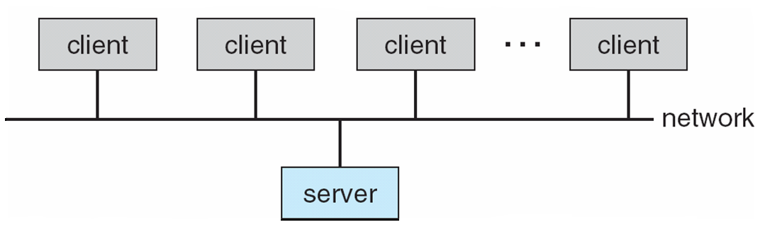
Computing Environments (Cont.)
Client-Server Computing
  Dumb terminals supplanted by smart PCs
  Many systems now servers, responding to requests generated by clients
    Compute-server provides an interface to client to request services (i.e., database)
    File-server provides interface for clients to store and retrieve files

Slide 24
Peer-to-Peer Computing
Another model of distributed system
P2P does not distinguish clients and servers
  Instead all nodes are considered peers
  May each act as client, server or both
  Node must join P2P network
    Registers its service with central lookup service on network, or
    Broadcast request for service and respond to requests for service via discovery protocol
  Examples include Napster and Gnutella

Slide 25
Web-Based Computing
Web has become ubiquitous
PCs most prevalent devices
More devices becoming networked to allow web access
New category of devices to manage web traffic among similar servers: load balancers
Use of operating systems like Windows 95, client-side, have evolved into Linux and Windows XP, which can be clients and servers

Slide 26
Open-Source Operating Systems
Operating systems made available in source-code format rather than just binary closed-source
Counter to the copy protection and Digital Rights Management (DRM) movement
Started by Free Software Foundation (FSF), which has “copyleft” GNU Public License (GPL)
Examples include GNU/Linux and BSD UNIX (including core of Mac OS X), and many more

Slide 27
End of Chapter 1

Slide 28
Chapter 2: Operating-System Structures
Operating System Services
User Operating System Interface
System Calls
Types of System Calls
System Programs
Operating System Design and Implementation
Operating System Structure
Virtual Machines
Operating System Debugging
Operating System Generation
System Boot

Slide 29
Objectives
To describe the services an operating system provides to users, processes, and other systems
To discuss the various ways of structuring an operating system
To explain how operating systems are installed and customized and how they boot

Slide 30
Operating System Services
One set of operating-system services provides functions that are helpful to the user:
  User interface - Almost all operating systems have a user interface (UI)
    Varies between Command-Line (CLI), Graphics User Interface (GUI), Batch
  Program execution - The system must be able to load a program into memory and to run that program, end execution, either normally or abnormally (indicating error)
  I/O operations - A running program may require I/O, which may involve a file or an I/O device
  File-system manipulation - The file system is of particular interest. Obviously, programs need to read and write files and directories, create and delete them, search them, list file Information, permission management.

Slide 31
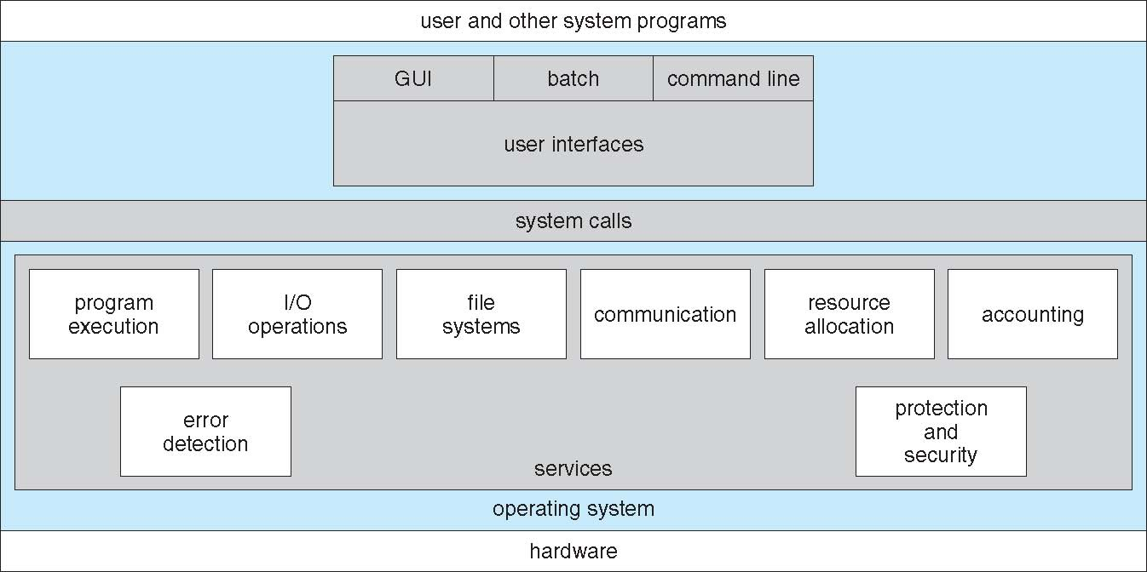
A View of Operating System Services

Slide 32
Services to Users
Communications – Processes may exchange information, on the same computer or between computers over a network
  Communications may be via shared memory or through message passing (packets moved by the OS)
Error detection – OS needs to be constantly aware of possible errors
  May occur in the CPU and memory hardware, in I/O devices, in user program
  For each type of error, OS should take the appropriate action to ensure correct and consistent computing
  Debugging facilities can greatly enhance the user’s and programmer’s abilities to efficiently use the system

Slide 33
System Maintenance Services
Resource allocation - When multiple users or multiple jobs running concurrently, resources must be allocated to each of them
  Many types of resources - Some (such as CPU cycles, main memory, and file storage) may have special allocation code, others (such as I/O devices) may have general request and release code
Accounting - To keep track of which users use how much and what kinds of computer resources
Protection and security - The owners of information stored in a multiuser or networked computer system may want to control use of that information, concurrent processes should not interfere with each other
  Protection involves ensuring that all access to system resources is controlled
  Security of the system from outsiders requires user authentication, extends to defending external I/O devices from invalid access attempts

Slide 34
User Operating System Interface - CLI
Command Line Interface (CLI) or command interpreter allows direct command entry.
Sometimes implemented in kernel, sometimes by systems program
Sometimes multiple flavors implemented – shells
Primarily fetches a command from user and executes it
  Sometimes commands built-in, sometimes just names of programs
    – If the latter, adding new features doesn’t require shell modification
Notes:
34

Slide 35
User Operating System Interface - GUI
User-friendly desktop metaphor interface
  Usually mouse, keyboard, and monitor
  Icons represent files, programs, actions, etc
  Various mouse buttons over objects in the interface cause various actions (provide information, options, execute function, open directory (known as a folder)
  Invented at Xerox PARC
Many systems now include both CLI and GUI interfaces
  Microsoft Windows is GUI with CLI “command” shell
  Apple Mac OS X as “Aqua” GUI interface with UNIX kernel underneath and shells available
  Solaris is CLI with optional GUI interfaces (Java Desktop, KDE)

Slide 36
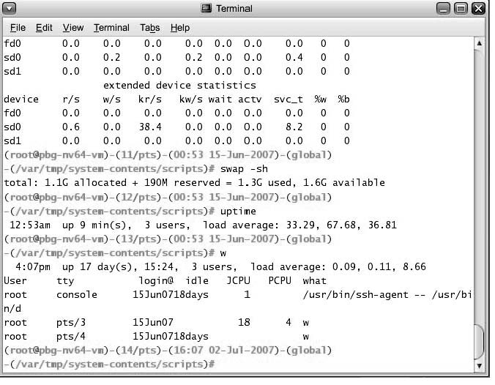
Bourne Shell Command Interpreter

Slide 37
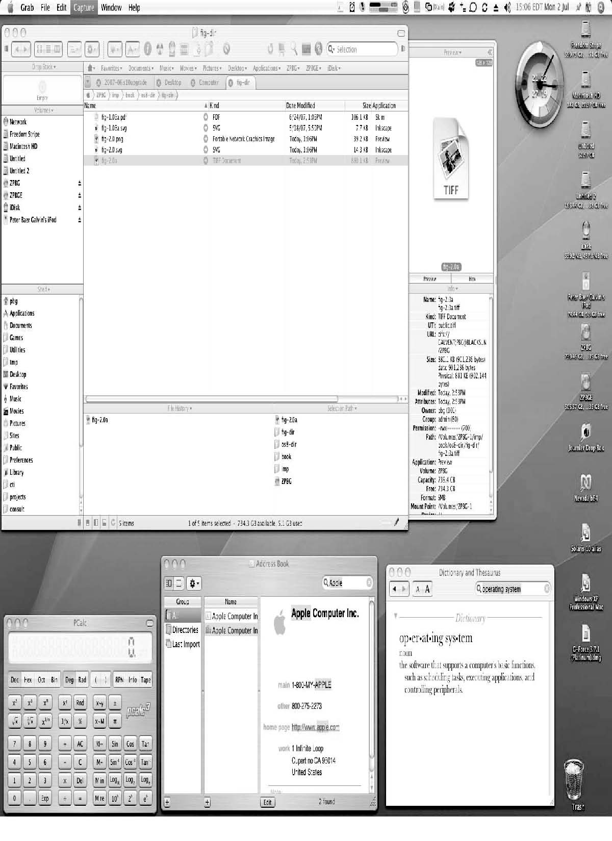
The Mac OS X GUI

Slide 38
System Calls
Programming interface to the services provided by the OS
Typically written in a high-level language (C or C++)
Mostly accessed by programs via a high-level Application Program Interface (API) rather than direct system call use
Three most common APIs are Win32 API for Windows, POSIX API for POSIX-based systems (including virtually all versions of UNIX, Linux, and Mac OS X), and Java API for the Java virtual machine (JVM)
Why use APIs rather than system calls?
(Note that the system-call names used throughout this text are generic)

Slide 39
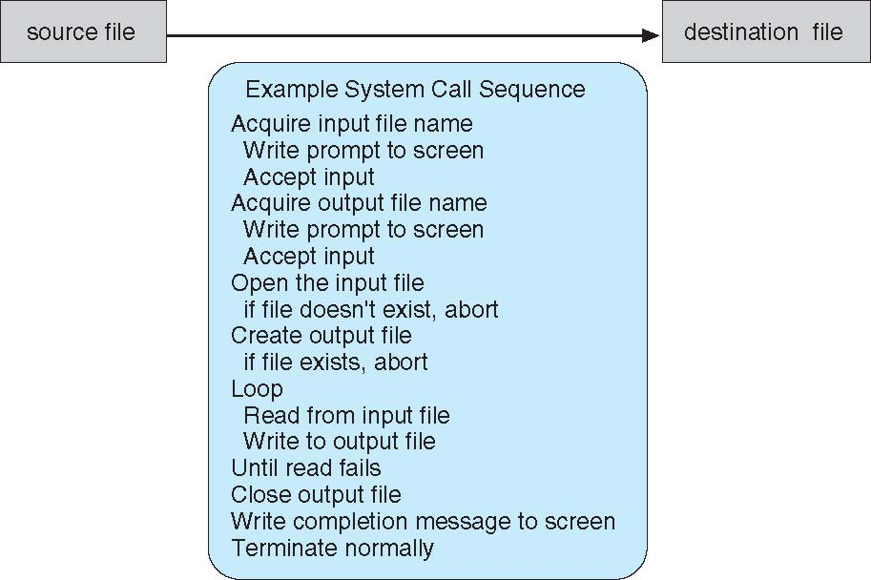
Example of System Calls
System call sequence to copy the contents of one file to another file
Notes:
Explain the sequence for copying source to detination

Slide 40
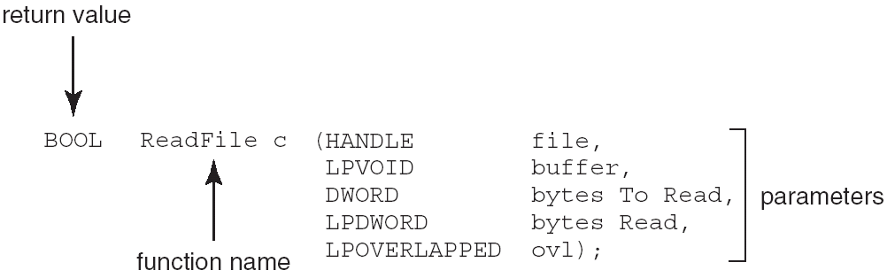
Example of Standard API
Consider the ReadFile() function in the
Win32 API—a function for reading from a file
A description of the parameters passed to ReadFile()
  HANDLE file—the file to be read
  LPVOID buffer—a buffer where the data will be read into and written from
  DWORD bytesToRead—the number of bytes to be read into the buffer
  LPDWORD bytesRead—the number of bytes read during the last read
  LPOVERLAPPED ovl—indicates if overlapped I/O is being used

Slide 41
System Call Implementation
Typically, a number associated with each system call
  System-call interface maintains a table indexed according to these numbers
The system call interface invokes intended system call in OS kernel and returns status of the system call and any return values
The caller need know nothing about how the system call is implemented
  Just needs to obey API and understand what OS will do as a result call
  Most details of OS interface hidden from programmer by API
    Managed by run-time support library (set of functions built into libraries included with compiler)

Slide 42
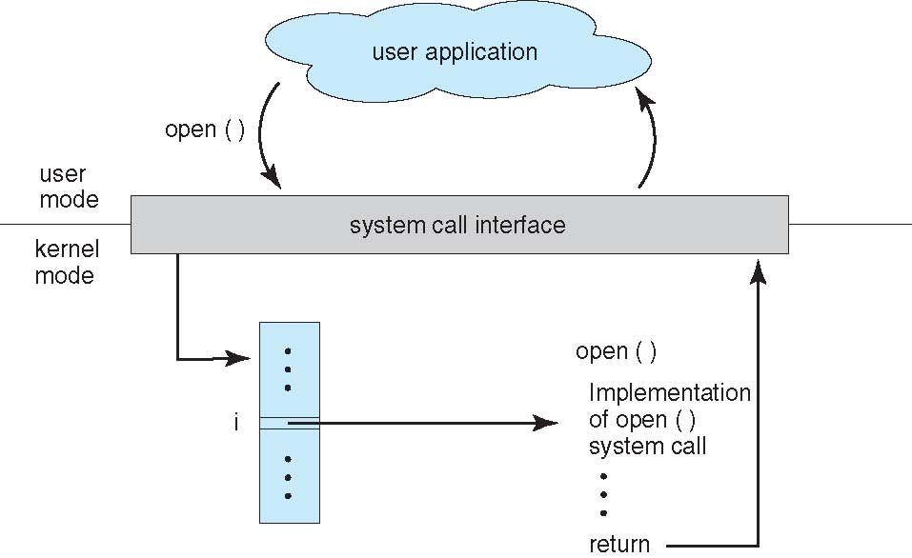
API – System Call – OS Relationship

