Slide 1
Files and Disks
Persistent Memory
John A. Miller

Slide 2
Types of Files
File = Collection of Blocks (4096 Bytes) containing Records (e.g., 200 bytes)
Fixed Length vs. Variable Length Records
Binary vs. Text File (typically encoded in ASCII or Unicode)
Sequential vs. Direct Access (e.g., RandomAccessFile in Java)
Spanning vs. Nonspanning (record may not cross a block boundary
Contiguous vs. Noncontiguous Files

Slide 3
Direct Access Files
Sequential Access: Open the file and read each record, one after the other
Direct Access: Seek directly to the i-th record and read it, skipping prior records
try {
var raf = new RandomAccessFile ("/tmp/rad.dbf", "rw");
var recSize = 12;
var record = new byte [recSize];
raf.write ("Record One ".getBytes ());
raf.write ("Record Two ".getBytes ());
raf.write ("Record Three".getBytes ());
raf.write ("Record Four ".getBytes ());
raf.seek (2 * recSize);
var nBytes = raf.read (record, 0, recSize);
out.println ("record = " + new String (record));
raf.close ();
} catch (Exception ex) {
} // try

Slide 4
Reading a Record
Nonspanning Case
Blocking factor bf = floor (sb/sr), e.g., floor (4096 / 200) = 20 records per block
Seek to i-th record: in block j = floor (i/bf), e.g., i = 57 => j = 2), block 0, block 1, block 2
Transfer block 2 from disk into main memory cache
Copy the 17-th record in block 2 from cache to user’ program
File offest: 3400 bytes from start of block

Slide 5
Components of Disk Drive
Cylinder - Region of Disk Drive accessible without moving the read/write head assembly
Surface - Drive may have 1 to 4 disks, giving 2 to 8 recording surfaces (on top and bottom of each disk)
Track - intersection of a cylinder and a surface or region accessible to one head without moving the read/write head assembly
Sector - smallest addressable/transferrable component of a disk drive, several sectors per track, common sector size 512B
Outer Tracks have move sectors than Inner Tracks

Slide 6
Time to Read a Record
Assume time to copy record from main memory cache of user’s program is negligible (main memory access time is in ns, while disk access time in ms)
Time to Read a Block from a disk drive into main memory
Tread = Tseek + Tlatency + Txfer = 5.041 ms
Tseek = 3 ms - time to move read/write heads
Tlatency = 2 ms - 15000 rpm => 250 rps => 4 ms rotation time (rotational latency is half that)
Txfer = 4096 B / 100 MB/s = 0.041 ms where 100 MB/s is the average sustained transfer rate

Slide 7
Time to Read a Record
Savio 15K
Model Number ST973451SS ST936751SS
Capacity
Formatted 512 Kbytes/Sector (GB) 73.4 36.7
Interface 3-Gb/s SAS 3-Gb/s SAS
External Transfer Rate (MB/s) 300 300
Performance
Spindle Speed (RPM) 15K 15K
Average Latency (ms) 2.0 2.0
Seek Time
- Average Read/Write (ms) 2.9 / 3.3 2.9 / 3.3
- Track-to-Track Read/Write (ms) 0.2 / 0.4 0.2 / 0.4
Sustained Transfer Rate
- Outer to Inner Diameter (MB/s) 112 to 79 112 to 79
Cache, Multisegmented (MB) 16 16
Configuration/Reliability
Disks 2 1
Heads 4 2

Slide 8
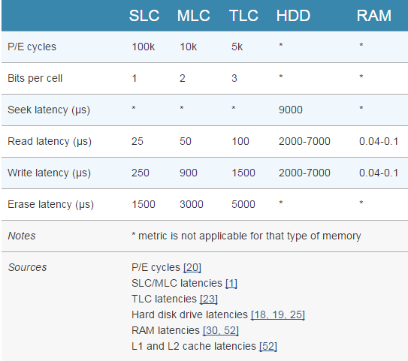
SSD vs. HDD
https://www.extremetech.com/extreme/210492-extremetech-explains-how-do-ssds-work

Slide 9
Time to Read a File
Noncontiguous Case
Let nr = 200,000 records, sr = 200 B, bf = floor (4096/200) = 20
nb = ceil (nr / bf) = ceil (200,000 / 20) = 10,000 blocks
Total read time = 10,000 * 5.041 = 50,410 ms
If the file content can be located in one cylinder and you have exclusive access to the disk drive, then seek times (the most costly of the three) can be eliminated

Slide 10
Execution Time for Point Queries
select * from customer where cname = ‘John Doe’
σ cname = ‘John Doe’ (customer)
Determine number of block accesses nba for best, expected and worst cases
Best: nba = 1 block accesses
Worst: nba = nb = 10,000 block accesses
Expected: nba = (nb + 1) / 2 = 5000.5 block accesses (derive this)
Too slow: using Hashing and B+trees to speed up queries

Slide 11
Complexity of Linear Search:
number of blocks nb = ceil (nr/bf)
Linear Search | Exact | Asymptotic
Best | 1 | O(1)
Expected | (nb + 1) / 2 | O(nb)
Worst | nb | O(nb)

