Slide 1
Relational Algebra

Slide 2
Relational Query Languages
Languages for describing queries on a relational database
Structured Query Language (SQL)
Predominant application-level query language
Declarative
Relational Algebra
Intermediate language used within DBMS
Procedural

Slide 3
What is an Algebra?
A language based on operators and a domain of values
Operators map values taken from the domain into other domain values
Hence, an expression involving operators and arguments produces a value in the domain
When the domain is a set of all relations (and the operators are as described later), we get the relational algebra
We refer to the expression as a query and the value produced as the query result

Slide 4
Relational Algebra
Domain: set of relations
Basic operators: select, project, union, set difference, Cartesian product
Derived operators: set intersection, division, join
Procedural: Relational expression specifies query by describing an algorithm (the sequence in which operators are applied) for determining the result of an expression

Slide 5
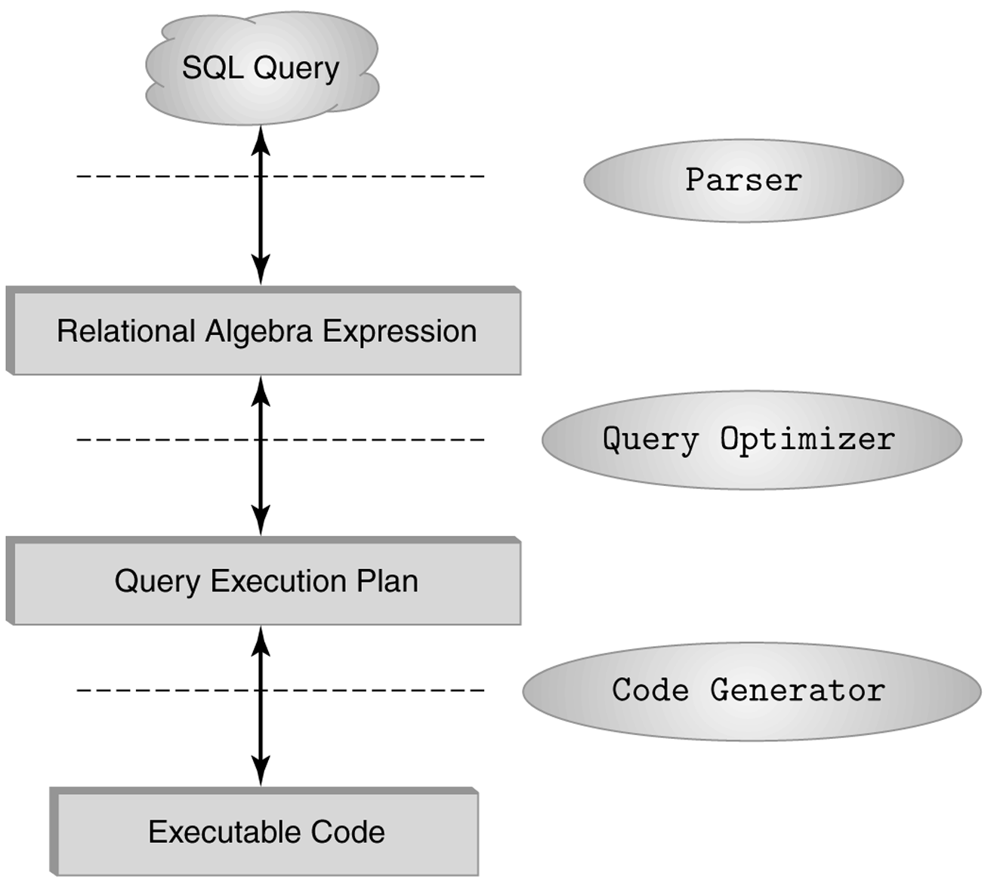
The Role of Relational Algebra in a DBMS

Slide 6
Select Operator
Produce table containing subset of rows of argument table satisfying condition
σ_{condition} (relation)
Example:
Person σ_{Hobby=‘stamps’}(Person)
Id Name Address Hobby
Id Name Address Hobby
1123 John 123 Main stamps
1123 John 123 Main coins
5556 Mary 7 Lake Dr hiking
9876 Bart 5 Pine St stamps
1123 John 123 Main stamps
9876 Bart 5 Pine St stamps

Slide 7
Selection Condition
Operators: <, ≤, ≥, >, =, ≠
Simple selection condition:
<attribute> operator <constant>
<attribute> operator <attribute>
<condition> AND <condition>
<condition> OR <condition>
NOT <condition>

Slide 8
Selection Condition - Examples
s _{Id>3000 OR Hobby=‘hiking’} (Person)
s _{Id>3000 AND Id <3999} (Person)
s _{NOT(Hobby=‘hiking’)} (Person)
s _{Hobby¹‘hiking’} (Person)

Slide 9
Project Operator
Produces table containing subset of columns of argument table
π_{attribute list}(relation)
Example:
Person π_{Name,Hobby}(Person)
Id Name Address Hobby Name Hobby
1123 John 123 Main stamps
1123 John 123 Main coins
5556 Mary 7 Lake Dr hiking
9876 Bart 5 Pine St stamps
John stamps
John coins
Mary hiking
Bart stamps

Slide 10
Project Operator
Example:
Person π_{Name,Address}(Person)
Id Name Address Hobby
Name Address
1123 John 123 Main stamps
1123 John 123 Main coins
5556 Mary 7 Lake Dr hiking
9876 Bart 5 Pine St stamps
John 123 Main
Mary 7 Lake Dr
Bart 5 Pine St
Result is a table (no duplicates); can have fewer tuples
than the original

Slide 11
Expressions
p _{Id, Name} (s Hobby=’stamps’ OR Hobby=’coins’ (Person) )
Id Name Address Hobby Id Name
1123 John 123 Main stamps
1123 John 123 Main coins
5556 Mary 7 Lake Dr hiking
9876 Bart 5 Pine St stamps
1123 John
9876 Bart
Result
Person

Slide 12
Set Operators
Relation is a set of tuples, so set operations should apply: ∩, ∪, − (set difference)
Result of combining two relations with a set operator is a relation => all its elements must be tuples having same structure
Hence, scope of set operations limited to union compatible relations

Slide 13
Union Compatible Relations
Two relations are union compatible if
Both have same number of columns
Names of attributes are the same in both
Attributes with the same name in both relations have the same domain
Union compatible relations can be combined using union, intersection, and set difference

Slide 14
Example
Tables:
Person (SSN, Name, Address, Hobby)
Professor (Id, Name, Office, Phone)
are not union compatible.
But
π _{Name} (Person) and π _{Name} (Professor)
are union compatible so
π _{Name} (Person) - π _{Name} (Professor)
makes sense.

Slide 15
Cartesian Product
If R and S are two relations, R × S is the set of all concatenated tuples <x,y>, where x is a tuple in R and y is a tuple in S
R and S need not be union compatible
R × S is expensive to compute:
Factor of two in the size of each row
Quadratic in the number of rows
A B C D A B C D
x1 x2 y1 y2 x1 x2 y1 y2
x3 x4 y3 y4 x1 x2 y3 y4
x3 x4 y1 y2
R S x3 x4 y3 y4
R× S

