Slide 1
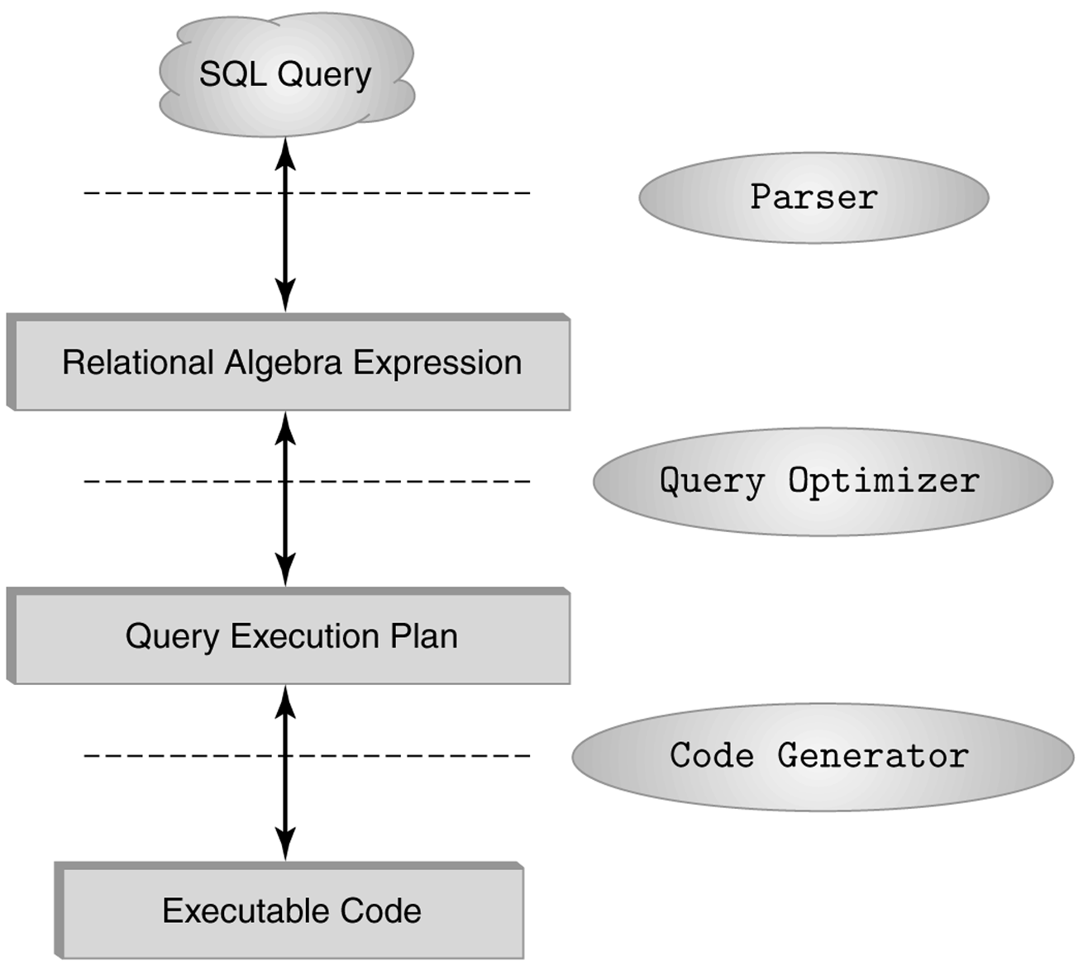
The Role of Relational Algebra in a DBMS

Slide 2
Select Operator
Produce table containing subset of rows of argument table satisfying condition
σ_{condition} (relation)
Example:
Person σ_{Hobby=‘stamps’}(Person)
Id Name Address Hobby
Id Name Address Hobby
1123 John 123 Main stamps
1123 John 123 Main coins
5556 Mary 7 Lake Dr hiking
9876 Bart 5 Pine St stamps
1123 John 123 Main stamps
9876 Bart 5 Pine St stamps

Slide 3
Selection Condition
Operators: <, ≤, ≥, >, =, ≠
Simple selection condition:
<attribute> operator <constant>
<attribute> operator <attribute>
<condition> AND <condition>
<condition> OR <condition>
NOT <condition>

Slide 4
Selection Condition - Examples
s _{Id>3000 OR Hobby=‘hiking’} (Person)
s _{Id>3000 AND Id <3999} (Person)
s _{NOT(Hobby=‘hiking’)} (Person)
s _{Hobby¹‘hiking’} (Person)

Slide 5
Project Operator
Produces table containing subset of columns of argument table
π_{attribute list}(relation)
Example:
Person π_{Name,Hobby}(Person)
Id Name Address Hobby Name Hobby
1123 John 123 Main stamps
1123 John 123 Main coins
5556 Mary 7 Lake Dr hiking
9876 Bart 5 Pine St stamps
John stamps
John coins
Mary hiking
Bart stamps

Slide 6
Project Operator
Example:
Person π_{Name,Address}(Person)
Id Name Address Hobby
Name Address
1123 John 123 Main stamps
1123 John 123 Main coins
5556 Mary 7 Lake Dr hiking
9876 Bart 5 Pine St stamps
John 123 Main
Mary 7 Lake Dr
Bart 5 Pine St
Result is a table (no duplicates); can have fewer tuples
than the original

