Slide 1
Division
Goal: Produce the tuples in one relation, r, that match all tuples in another relation, s
r (A₁, …A_{n}, B₁, …B_{m})
s (B₁ …B_{m})
r/s, with attributes A₁, …A_{n}, is the set of all tuples <a> such that for every tuple <b> in s, <a,b> is in r
Can be expressed in terms of projection, set difference, and cross-product

Slide 2
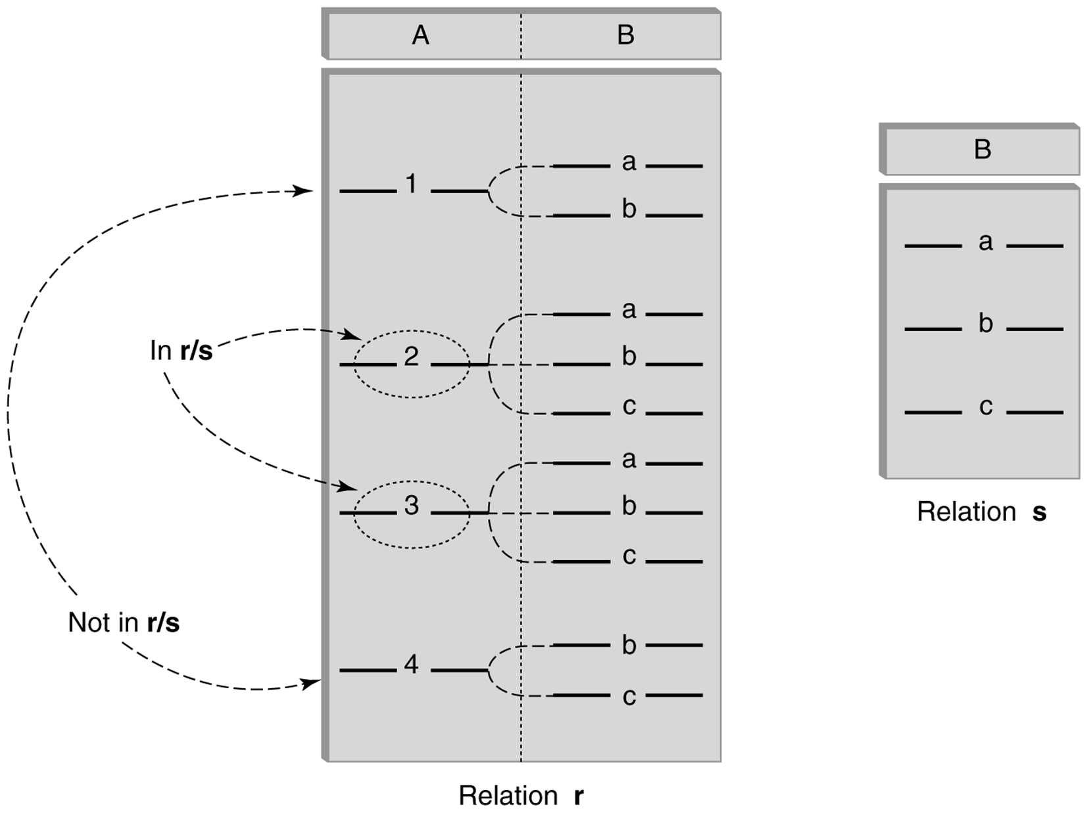
Division (cont’d)

Slide 3
Division - Example
List the Ids of students who have passed all courses that were taught in Spring 2017
Numerator:
StudId and CrsCode for every course passed by every student:
p_{StudId, CrsCode} (s_{Grade¹ ‘F’} (Transcript) )
Denominator:
CrsCode of all courses taught in Spring 2017
p_{CrsCode} (s_{Semester=‘S2017’} (Teaching) )
Result is numerator/denominator

Slide 4
Division Example r/s
R | A | B
 | 1 | A
 | 1 | B
 | 2 | A
 | 2 | C
The result table has 1 1-tuple
What is it?
S | B
 | A
 | B

Slide 5
Division Using Other Operators
r: R(A, B), s: S(B), q = r/s: Q(A)
Tuples missing from r
d = ∏A(r) x s - r = {<2, b>}
Take out the missing
q = ∏A(r) - ∏A(d) = {<1>, <2>} - {<2>}
Answer q = {<1>}

Slide 6
Division Example 2
r: R(A, B) = {<1, a>, <1, b>, <2, a>, <2, b>, <3, a>}
s: S(B) = {<a>, <b>}
Tuples missing from r
d = ∏A(r) x s - r = {<3, b>}
Take out the missing
q = ∏A(r) - ∏A(d) = {<1>, <2>, <3>} - {<3>}
Answer q = {<1>, <2>}

Slide 7
Division: One or Two Sided Inverse
Let r: R(A) and s: S(B)
What is
(r x s) / s = ?
Let r: R(A, B) and s: S(B)
What is
(r / s) x s = ?

Slide 8
Example Relational Algebra Queries
Enter this Schema in MySQL and in RA from Project 1
insert sample tuples: 12, 7, 8, 7 (see next slide)
Bank Schema
customer (cname, street, ccity)
- 1000 3-tuples
deposit (bname, accno, cname, balance)
- 2000 4-tuples
branch (bname, assets, bcity)
- 10 3-tuples
borrow (bname, loanno, cname, amount)
- 3000 4-tuples

Slide 9
Example Relational Algebra Queries
Populate from https://www.csee.umbc.edu/~mgrass2/cmsc461/Banking%20Database.pdf
customer (cname, street, ccity)
| Adams | Spring | Pittsfield |
11 more tuple
deposit (bname, accno, cname, balance)
| Downtown | A-101 | Johnson | 500 |
6 more tuples
branch (bname, assets, bcity)
| Brighton | 7100000 | Brooklyn |
7 more tuple
borrow (bname, loanno, cname, amount)
| Round Hill | L-11 | Smith | 900 |
6 more tuples

Slide 10
Example RA Queries (m n-tuples)
Run these in MySQL to check your answer
1. List customer information (don’t use unnecessary operations)
RA> customer
Has 1000 3-tuples
2. List customer names
RA> π came (customer)
Has 1000 1-tuples
3. List customer cities
RA> π ccity (customer)
Has 10 1-tuples

Slide 11
Example RA Queries (m n-tuples)
4. List the names of customers living in Athens
RA> π cname (σ ccity= ‘Athens’ (customer))
Has 100 1-tuples
5. List the cities the branches are located in
RA> Π bcity (branch)
Has 5 1-tuples
6. List the names and cities of customers with an account at the Alps branch
RA> Π cname, ccity (customer * σ bname=‘Alps’ (deposit))
Has 200 2-tuples, but duplicate elimination may reduce this

Slide 12
Example RA Queries
7. List the name and cities of customers with an account at a branch located in Athens
Π cname, ccity (customer * deposit * σ bcity =‘Athens’ (branch))
8. List the names of customers with an account or loan at the Alps branch
Π cname (σ bname=‘Alps’ (deposit) U σ bname=‘Alps’ (borrow))
9. List the names of customers who live and bank in the same city
RA> Π cname (σ ccity = bcity (customer * deposit * branch)

Slide 13
Example RA Queries
10. List the names of customers with a loan that is covered/secured by one of their deposits
RA> Π cname (deposit * borrow)
11. List the names of customers who only have loans that are covered/secured by their deposits
RA> ?
12. List the names of customers with an account at all branches located in Athens
RA> ?

