Slide 1
Division
Goal: Produce the tuples in one relation, r, that match all tuples in another relation, s
r (A₁, …A_{n}, B₁, …B_{m})
s (B₁ …B_{m})
r/s, with attributes A₁, …A_{n}, is the set of all tuples <a> such that for every tuple <b> in s, <a,b> is in r
Can be expressed in terms of projection, set difference, and cross-product

Slide 2
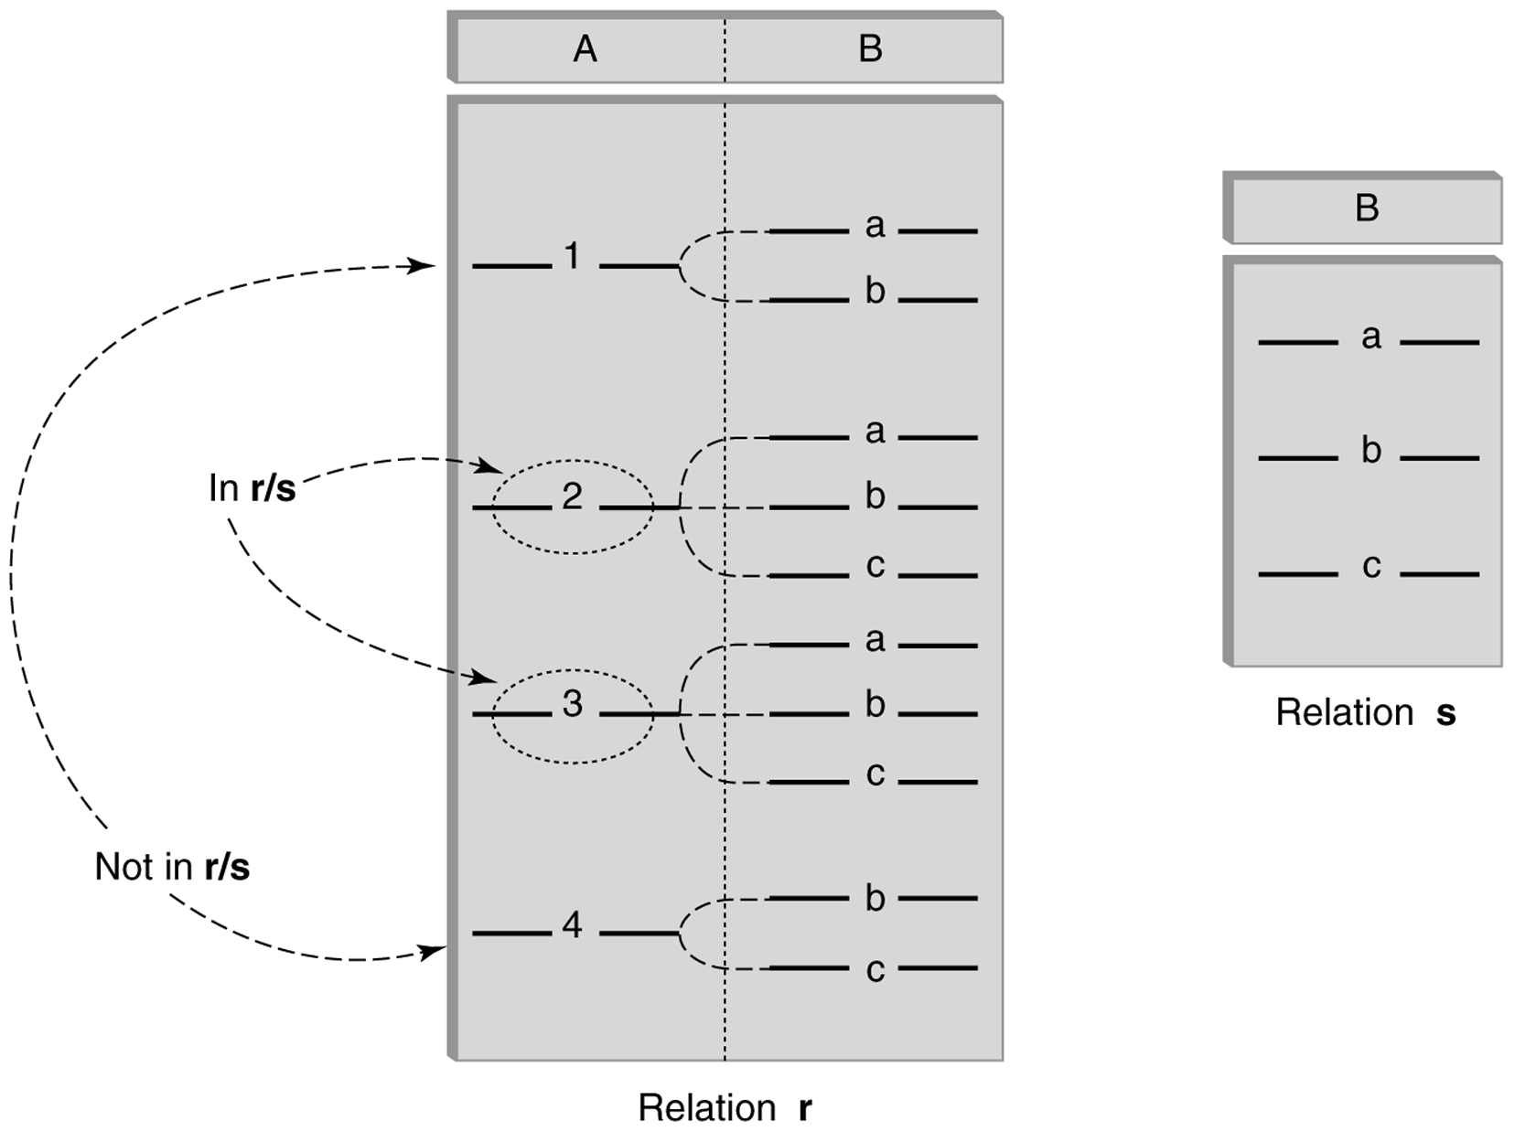
Division (cont’d)

Slide 3
Division - Example
List the Ids of students who have passed all courses that were taught in Spring 2017
Numerator:
StudId and CrsCode for every course passed by every student:
p_{StudId, CrsCode} (s_{Grade¹ ‘F’} (Transcript) )
Denominator:
CrsCode of all courses taught in Spring 2017
p_{CrsCode} (s_{Semester=‘S2017’} (Teaching) )
Result is numerator/denominator

Slide 4
Division Example r/s
R | A | B
 | 1 | A
 | 1 | B
 | 2 | A
 | 2 | C
The result table has 1 1-tuple
What is it?
S | B
 | A
 | B

Slide 5
Division Using Other Operators
r: R(A, B), s: S(B), q = r/s: Q(A)
Tuples missing from r
d = ∏A(r) x s - r = {<2, b>}
Take out the missing
q = ∏A(r) - ∏A(d) = {<1>, <2>} - {<2>}
Answer q = {<1>}

Slide 6
Division Example 2
r: R(A, B) = {<1, a>, <1, b>, <2, a>, <2, b>, <3, a>}
s: S(B) = {<a>, <b>}
Tuples missing from r
d = ∏A(r) x s - r = {<3, b>}
Take out the missing
q = ∏A(r) - ∏A(d) = {<1>, <2>, <3>} - {<3>}
Answer q = {<1>, <2>}

Slide 7
Division: One or Two Sided Inverse
Let r: R(A) and s: S(B)
What is
(r x s) / s = ?
Let r: R(A, B) and s: S(B)
What is
(r / s) x s = ?

