Slide 1
Forecasting Traffic Flow: Short Term, Long Term, and When It Rains
Hao Peng, Santosh U. Bobade, Michael E. Cotterell and John A. Miller
Department of Computer Science
University of Georgia

Slide 2
System Motivations
Performance parallel/distributed
Support Advanced Time Series Analysis with uniform interface
Provide Database storage and flexible queries
Provide support for automation through ontology
Exploit Theoretical and Simulation Models

Slide 3
Application Motivations
Availability of Big Data through sensors
Benefits of Research
Intelligent Transportation System
Traffic Apps
Advanced Trip Planning
Many existing studies
Tend to focus on the immediate short term (e.g., 1-step ahead forecasts)
Do not consider factors such as weather conditions
Notes:
Exogenous variable: ARIMAX, multivariate time series, downstream/upstream data, NN, FDA

Slide 4
Time Series Analysis in the Big Data Era
Database and Statistical Packages
MySQL + R
JVM based Big Data Frameworks
SparkSQL + Spark
ScalaTion TSDB + ScalaTion Analytics
Python based Big Data frameworks
pandas + tensorflow + keras

Slide 5
ScalaTion TSDB + Scalation Analytics
val start = new TimeNum("2017-01-01 -06:00", "yyyy-MM-dd Z")
val y = traffic.where[TimeNum](("Read Date",(x:TimeNum) => x >= start))
.select("Volume")
.toVectorD(0)
val model = SARIMA (y)
model.train().eval()
println(model.fit)
println(model.forecast(24))

Slide 6
Big Data
Research is progressing towards larger datasets
Current Study
traffic in GA, ~50MB
Volume, Rainfall
Next Study
Austin, TX, ~150MB
Volume, Speed, Occupancy, Temperature, Relative Humidity, Wind Speed, Rainfall, Dewpoints
Future Study
PeMS, San Francisco & Los Angeles, CA, ~GBs

Slide 7
Progress in Analyzing Traffic
Past: univariate time series, small number of datasets, immediate short term forecasts (e.g., minutes)
Current: deep learning, feed data into deep NNs
Research Agenda
Multivariate Time Series
Weather, Spatial Dependencies, Events, Accidents, Road Repair Schedule
Time Series Database (TSDB)
Easy to use, combine database queries with analytics
Theory driven models
Theories can help to guide/restrict the model building process

Slide 8
ScalaTion Project
A Scala-based project for analytics, simulation and optimization
Open source under an MIT License
Forecasting models used in this study include
Seasonal ARIMA
Dynamic Regression
Exponential Smoothing
Feedforward multi-layer Neural Networks
Long Short-Term Memory Neural Networks (under development)
www.cs.uga.edu/~jam/scalation.html

Slide 9
Seasonal ARIMA
Uses lagged and correlated values of the time series and errors to make forecasts
Differencing may be necessary to make the time series stationary
SARIMA(1,0,1)x(0,1,1)120 was the chosen model, as in [Williams and Hoel, 2003], [Shekhar and Williams, 2008] and [Lippi et. al, 2013].
Automated order search based on AICc as described in [Hyndman and Khandakar, 2007] was also attempted, but the automated models only yielded better results than SARIMA(1,0,1)x(0,1,1)120 for approximately one-third of the traffic sensor data.

Slide 10
Dynamic Regression
Uses external variables such as rainfall to further explain additional variabilities in the traffic flow time series
A simple, two-step process for forecasting using both a time series model and a regression model

Slide 11
Exponential Smoothing
Triple Exponential Smoothing with additive seasonality
12-step ahead within sample forecast SSE was minimized to find the 3 smoothing parameters
The default 1-step ahead SSE was attempted, but resulted in very poor forecasting results for higher steps, possibly due to the lack of need to rely on seasonal components make good forecasts for 1-step ahead.

Slide 12
Feedforward Neural Networks
Tanh activation function was used
Data were normalized to [-0.8, 0.8]
Back-propagation was used to learn the weights and biases that minimize MSE
4 layer structure
Input layer of size 50, including the data from previous 24-hr period, the 24-hr period in the previous week, the day of the week and time of the day
Two hidden layers of size 40 and 30
Output layer of size 24, corresponding to 24-step ahead forecasts
Other parameters were optimized using grid search

Slide 13
Dataset
Hourly traffic flow data
Georgia Department of Transportation
74 sensors (both directions), mostly urban areas and major freeways
Jan 2013 – June 2017
http://www.dot.ga.gov/DS/Data
Hourly Precipitation Data
Automated Surface Observing System (ASOS)
14 sensors that are paired with nearby traffic sensors
https://mesonet.agron.iastate.edu/request/download.phtml?network=GA_ASOS

Slide 14
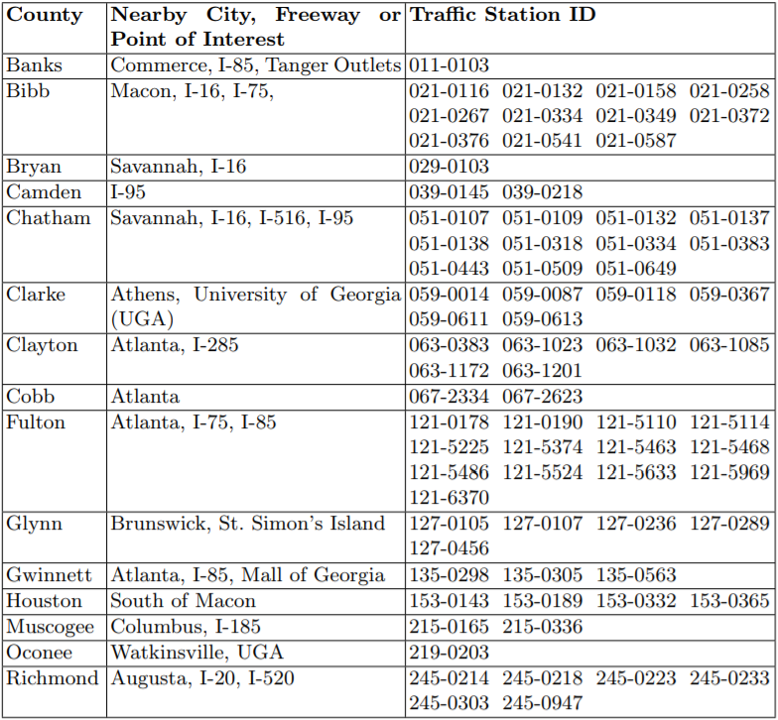
Traffic Sensors

Slide 15
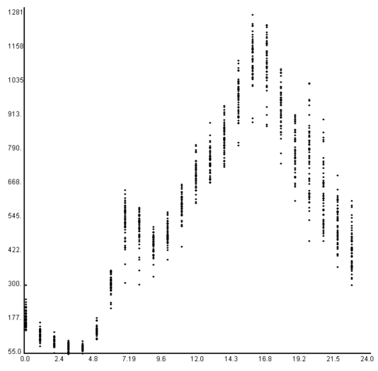
Friday Traffic on US 23 in Atlanta, GA
Much busier afternoon rush hours since everyone is getting off work and trying to go home
The same road but for the other direction has much busier morning rush hours

Slide 16
Testing Platform
Sapelo cluster from Georgia Advanced Computing Resource Center
48-core AMD Opteron Machine
Parallel training and testing were conducted per sensor per direction
https://gacrc.uga.edu/

Slide 17
Performance Evaluation
Rolling Forecasts
12 weeks of data as training set (24 weeks if considering rainfall)
8 weeks of data as testing set
Sliding window is 8 weeks
Forecasts were made for 24 hours/steps into the future
Models that incorporated rainfall data only made 1 hour/step ahead forecasts
Difficult to make reliable, long-term weather forecasts
Forecasts were only produced within the 7:00AM to 7:00PM range on weekdays
Weekly historical averages by hours were used as baselines
Mean Absolute Percentage Error (MAPE) was the metric of evaluation

Slide 18
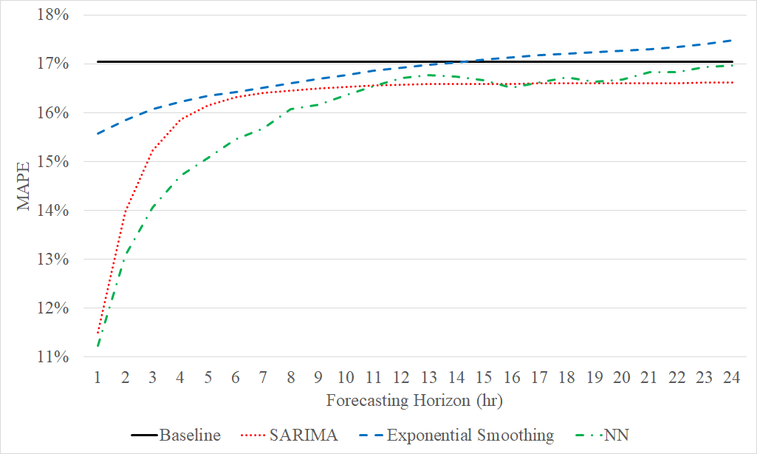
Performance Comparison

Slide 19
Performance Comparison in Rainy Weather

Slide 20
Conclusions and Future Work
Short and Long Term Traffic Flow Forecasting
Weather conditions including rainfall can help to further explain traffic conditions
Neural Networks performed well
Preliminary results show that LSTM can be very promising
Future Work
Larger datasets with higher resolutions
Additional models
Exogenous variables, Multivariate Time Series

Slide 21
Questions

