Slide 1
Traffic Flow Forecasting on Highways Evaluation and Comparison of Common Approaches
Hao Peng

Slide 2
Research Questions and Challenges
Data collection
Storage
Missing value imputation
What types of data to collect
Data analytics
Historical data
Predicative analytics
Real-time forecasting
Video/image analytics
Notes:
why imputing data? Models need it. Do most researchers do that? Fairly common
[Jacobson and Bender, 1990], Detecting erroneous loop detector data in a freeway traffic management system
PeMS automatically provides imputed data based on neighboring lanes and sensors.

Slide 3
Benefits of Research
Intelligent Transportation Systems
Road expansion
Traffic Apps developers
Everyday commuters/travelers
Notes:
ITS: car navigation, traffic signal, speed cameras, variable speed limit that changes with road congestion, congestion warnings

Slide 4
Contributions
To evaluate the effectiveness of commonly used statistical and machine learning models on univariate traffic flow forecasting using large amounts of temporal data
To study the impacts of incorporating spatially dependent data into multivariate forecasting models
To examine the performance of multi-step forecasts and the impacts of varying data resolutions
To explore the various trade-offs/pros and cons of the models in terms of accuracy, stability, computational cost, and ease of use

Slide 5
Progress in Traffic Forecasting
Univariate -> Multivariate
Single step ahead -> Multiple steps ahead
Few sensors -> Many sensors
Simple models/Few parameters -> Complex models/Deep learning

Slide 6
Big Data
Large amounts of high quality, high-resolution data
Caltrans Performance Measurement System (PeMS)
More than 39,000 sensors deployed in major urban areas and highways
5-minute resolution traffic flow, speed, occupancy of lanes, etc., available in real-time

Slide 7
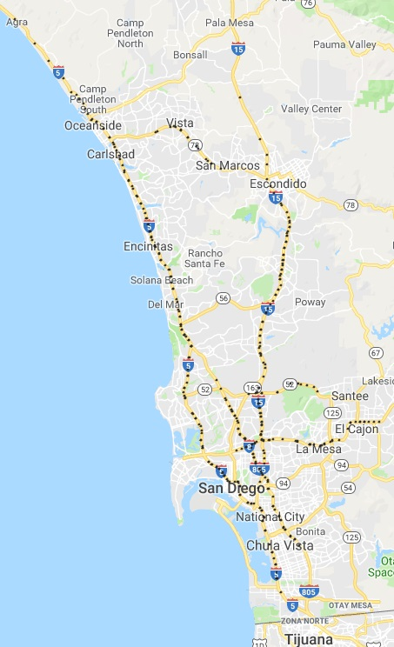
Our Focus
Southern California, San Diego area
373 sensors, ~1.5 Gigabytes.
Two data resolutions
5-min (original)
15-min (aggregated)
Forecasting horizon
12 steps
Equivalent of up to 1 hour and 3 hours ahead, for 5-min and 15-min data, respectively

Slide 8
Spatial Dependency
Downstream Sensor
Sensor of Focus
Upstream Sensor
Provides information on possible congestion down the road
Traffic flowing from this location, may include any highway exits
Notes:
Distance/speed, basic physics, could be used to build better models
Current study: fixed distance, simply approach
Future work: use MLN to infer and automatically determine the appropriate sensors.

Slide 9
Model

Slide 10
Our models
Seasonal Autoregressive Integrated Moving Average
Seasonal Vector Autoregressive Integrated Moving Average
Regression
QuadRegression
QuadXRegression
CubicRegressionNI
Support Vector Regression
Extreme Learning Machines
Feedforward Neural Networks (keras + tensorflow)
Long Short-Term Memory Neural Networks (keras + tensorflow)

Slide 11
Input and Output
Time Series models (e.g., SARIMA)
Directly use the time series of interests as input
Other models
Organize data from the time series into training instances x features
Input matrix V and output matrix W containing row vectors:
Notes:
Choose 12 because doing 12-step ahead forecasts

Slide 12
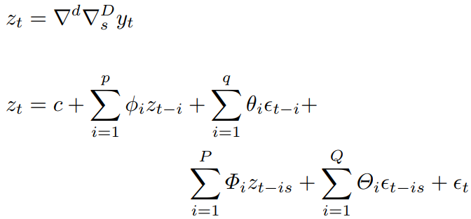
SARIMA
Classical time series model that uses lagged and correlated values of the time series and errors to make forecasts
Differencing may be necessary to make the time series stationary

Slide 13
Seasonal VARIMA
Multivariate generalization of the SARIMA model

Slide 14
Regression Family
Global minimization of SSE/MSE
Polynomial regression introduces non-linearity into the model by including additional input features such as the powers of the original input features
Interaction/cross terms, which are products of pairs of features, may also be included
Recent interest in polynomial regression as viable alternatives to feedforward neural networks [Cheng et al., 2018].

Slide 15
Support Vector Regression
minimize
subject to
A kernel function may be used to map the training instances into higher dimensional spaces to find the hyperplane
Slack variables may be added to the objective function and constraint to allow some points to lie outside the boundary

Slide 16
Support Vector Regression
$$y$$
$$y$$
Kernel function $φ$
transformation
$$v$$
$$φ(v)$$

Slide 17
Feedforward Neural Networks
Vanilla, 3-layer, feedforward neural network
Foundation for other deep neural network structures

Slide 18
Extreme Learning Machine
A special type of feedforward neural network, as follows
Input-to-Hidden: apply activation function to inputs with fixed, random weights. This introduces non-linearity into the data.
Hidden-to-Output: use linear regression to learn the outputs from the hidden features.
Compared with a standard feedforward neural network, ELM requires minimal parameter tuning and much lower computational costs.

Slide 19
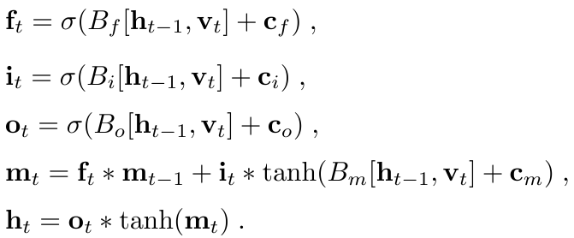
Long Short-Term Memory Neural Networks
Cell state memory is able to retain useful information from many time steps ago
Regained popularity for achievements in speech recognition, language translation, etc.

Slide 20
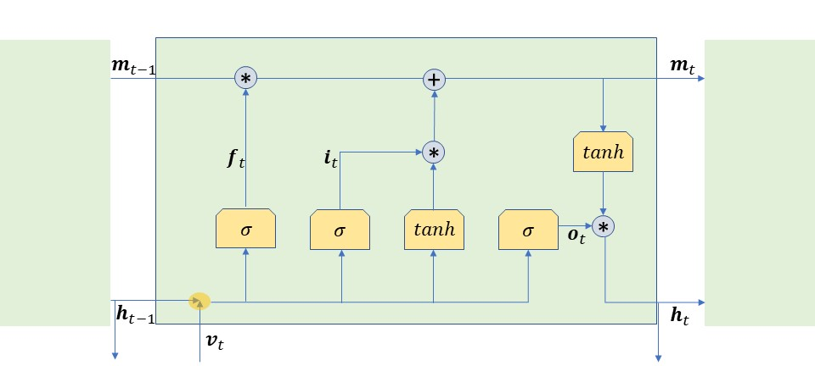
Long Short-Term Memory Neural Network

Slide 21
Other Deep Learning Models
Stacked Autoencoders
Dimensionality reduction when give large amounts of traffic data
Filtering out noise in input
Convolutional Neural Network
Models spatial dependencies using shared weights in a specific region
May be used to model spatially dependent traffic sensors
Gated Recurrent Unit
A variant of LSTM
Combined forget and input gates
Merged cell state and hidden state

Slide 22
Related Work using PeMS datasets
[Lv et al., 2015]: forecast up to one hour ahead, 15-min resolution, first 3 months of 2013, SAE deep neural networks with 2-4 hidden layers, 200-500 neurons per hidden layer, 6%-7% MAPE
Compared to our MAPE values, we have slightly lower MAPE values for the first 2 steps and slightly higher MAPE values for the next 2 steps.
[Shao and Soong, 2016]: small scaled study using a single sensor in Irvine, CA, Encoder-Decoder LSTM NN, one-step ahead, 5.4% MAPE
Difficult to conclude anything in comparing with our work
[Wu et al., 2018]: 33 sensors on I-405, deep neural networks built with convolutional neural network and gated recurrent unit, training data available from 4/1/2014 to 6/20/2015, tested on the remaining 10 days in June 2015, concurrent forecasts for all sensors, 9-steps (45 minutes) ahead, MAPE from 7% to 9%.
The MAPE values of our best models are 6% to 8%.
[Yang et al., 2019]: 50 sensors from San Diego/Imperial area, LSTM trained on March-April 2017 data, tested on May’s, one step-ahead MAPE in 15-min resolution was 6.54%
Our best MAPE was 5.5%.

Slide 23
Evaluation Metrics and Platform
Metrics
MAPE
NRMSE
$R^{2}$
Platform
Sapelo2 cluster of Georgia Advanced Computing Resource Center
32-core Intel Xeon Skylake processor and 187GB of RAM

Slide 24
Problem Analysis and Modeling
Training data: Jan – Aug 2018
Testing data: Sep – Dec 2018
Only weekdays are considered
Evaluation includes 7:00 AM to 7:00 PM daytime traffic only
Weekly historical average, for 4 weeks, as baseline

Slide 25
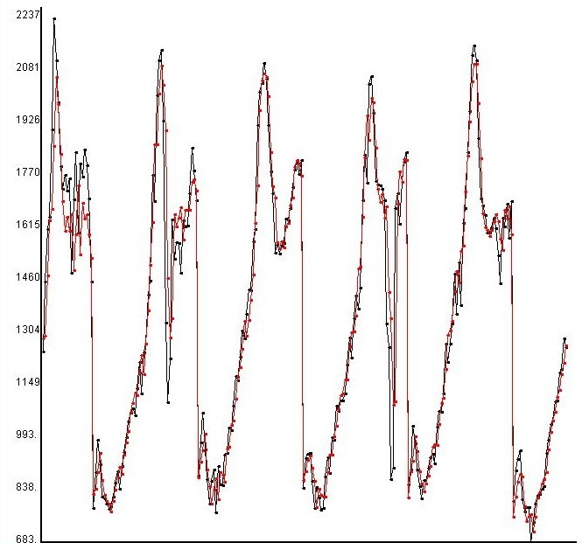
Baseline
Actual (Black) vs. Baseline (Red)
Actual (Black) vs. Regression (Red)
flow
flow
M T W R F
M T W R F
Notes:
Actual Traffic Flow (Black) vs. Baseline Forecasts (Red), Sep 10-14 (M-F), 2018, 7:00 AM-7:00 PM only, sensor ID 1111542 on I-805 S near intersection with El Cajon Blvd in San Diego

Slide 26
Univariate Experiments
SARIMA (1, 0, 1)×(0, 1, 1), a simple traffic flow forecasting model found in [Williams and Hoel, 2003], [Shekhar and Williams, 2008], [Lippi et al., 2013], [Peng et al., 2018].
SARIMA2, BIC based search
SARIMA (12, 1, 4)×(1, 1, 1)₁₄₄₀ , 5-min resolution data
SARIMA (5, 0, 3)×(1, 1, 1)₄₈₀ , 15-min resolution data
Regression family
Parameters are solved using QR factorization
SVR, based on LIBSVM implementation
$ν$-SVR works better than $ε$-SVR
RBF kernel

Slide 27
Univariate Experiments
Extreme Learning Machine
tanh activation function
Hidden layer size tuned to be 8 times the size of input layer
Feedforward NN
4 layer structure, can extract features better than a shallow NN [Schmidhuber, 2015]
Two leaky ReLU activation functions and the identity/linear activation function in the output layer

Slide 28
Univariate Experiments
LSTM
Similar to a vanilla LSTM, but with one additional leaky ReLU layer before the output layer
Requires 3-dimensional input, instances x time steps x features
To preserve the features in V, the temporal evolution of the feature values for 4 weeks are used to generate the additional time steps dimension.
Encoder-Decoder LSTM
The feature dimension is redefined to represent a time series
Temporal lagged values are moved to the time steps dimension
12 most recent obs + 12 obs from last week => 24 temporal layers

Slide 29
Multivariate Experiments
Expand input features with data from one upstream and one downstream sensor, each at least 5 miles apart
VARIMA2 (high order) omitted due to high computational cost and relatively low performance of its univariate counterpart comparing with most other models
Response Surface omitted due to excessive interaction/cross terms that significantly increased computational cost and decreased accuracy
Feature selection to extract 72 (one-third) most useful features based on the adjusted $R^{2}$ metric training linear regression models to forecast step 12 (the most difficult to forecast)

Slide 30
5-min resolution data univariate (left) vs. multivariate (right) (bottom image zooms in on the top performers)

Slide 31
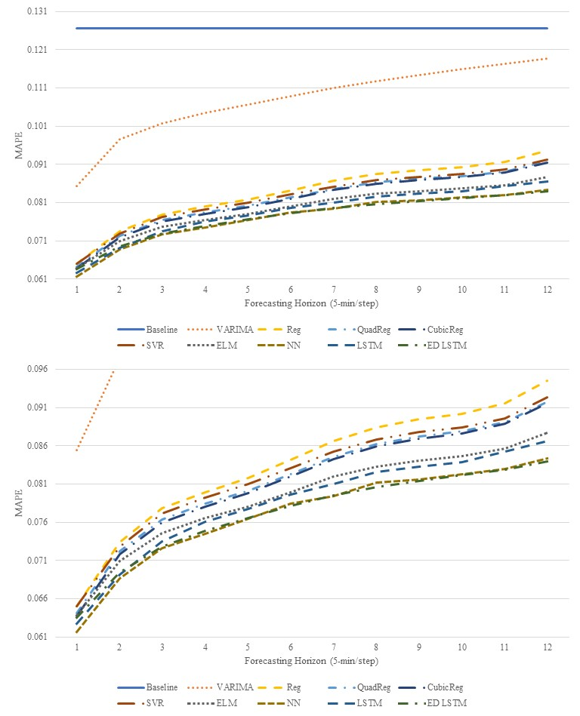
Notes:
MAPE, 5-min, uni vs multi

Slide 32
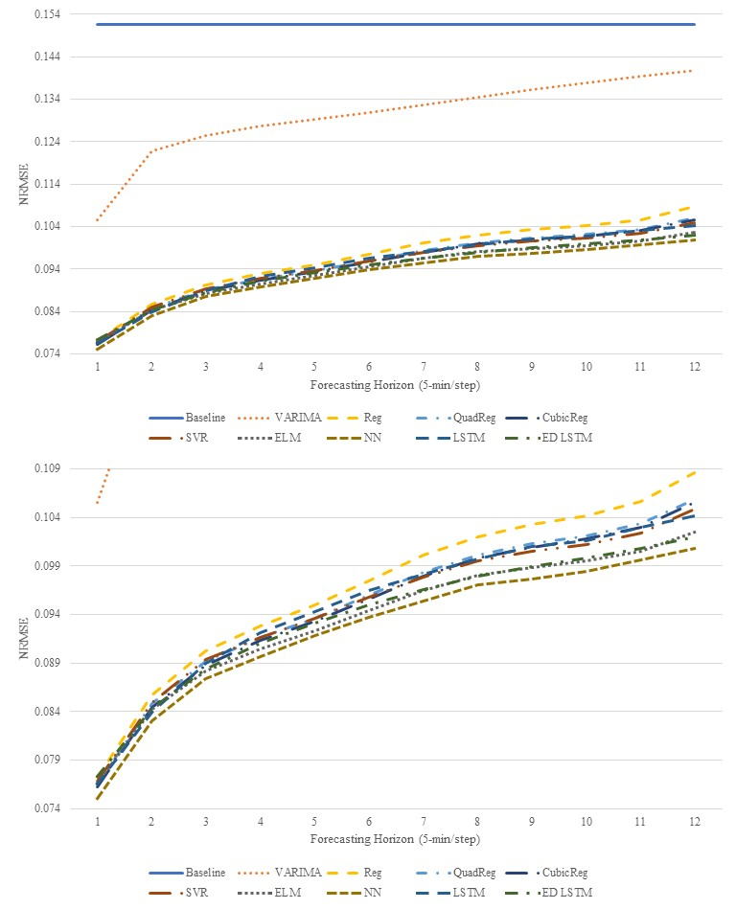
Notes:
NRMSE, 5-min, uni vs multi

Slide 33
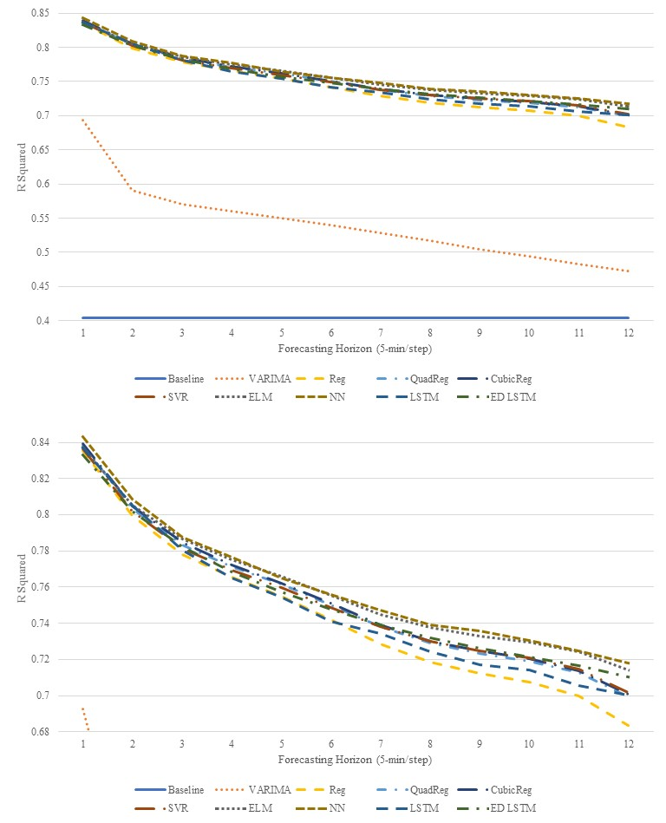
Notes:
R^2, 5-min, uni vs multi

Slide 34
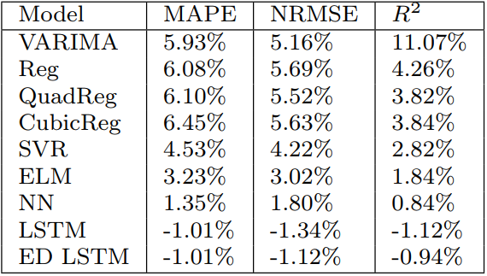
Average improvements of multivariate models over their univariate counterparts 5-min resolution

Slide 35
15-min resolution data univariate (left) vs. multivariate (right)

Slide 36
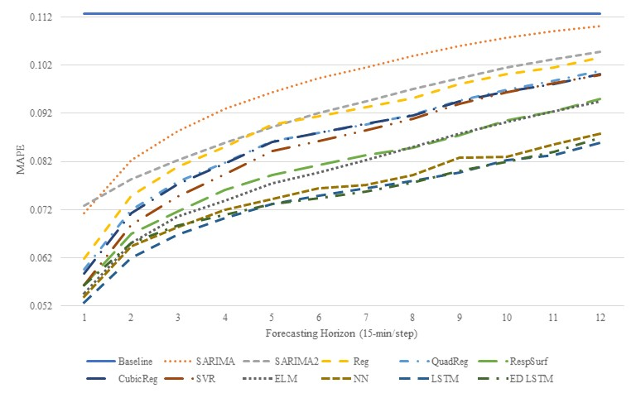
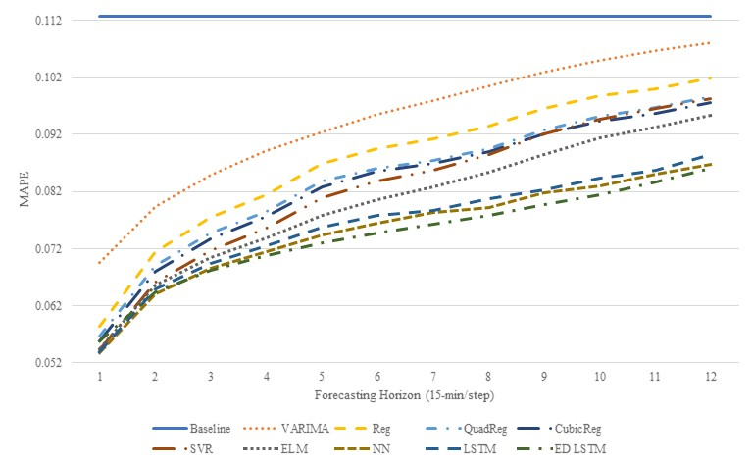

Slide 37
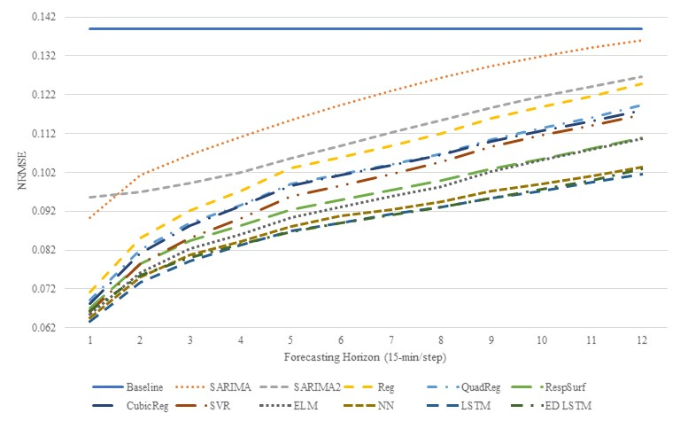
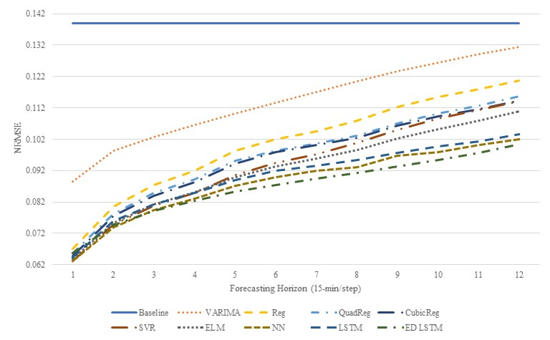

Slide 38
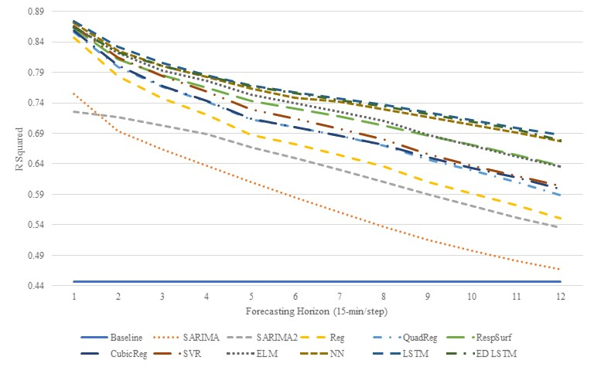
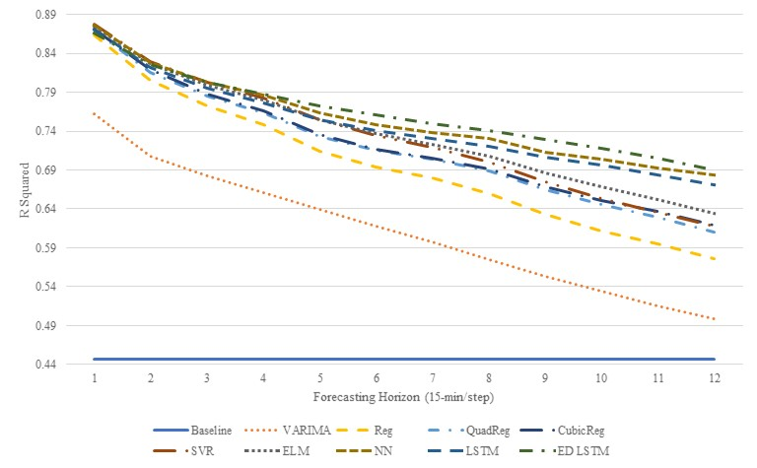

Slide 39
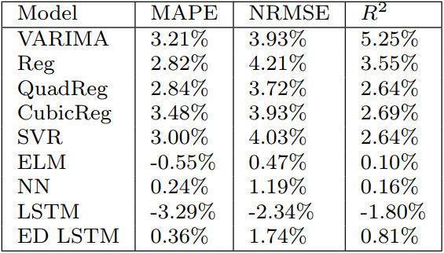
Average improvements of multivariate models over their univariate counterparts 15-min resolution

Slide 40
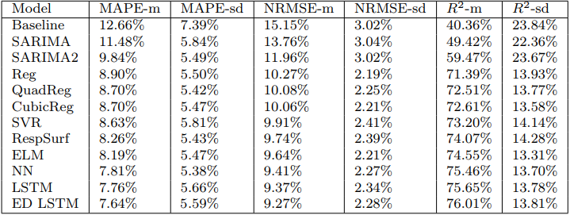
Average means and standard deviations (across all sensors and forecasting steps) Ranked by mean MAPE, univariate 5-min resolution

Slide 41
Average means and standard deviations (across all sensors and forecasting steps) Ranked by mean MAPE, multivariate 5-min resolution

Slide 42
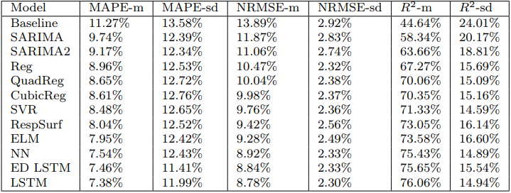
Average means and standard deviations (across all sensors and forecasting steps) Ranked by mean MAPE, univariate 15-min resolution

Slide 43
Average means and standard deviations (across all sensors and forecasting steps) Ranked by mean MAPE, multivariate 15-min resolution

Slide 44
Effects of Data Resolution
Aggregating time series into 15-minute resolution has an inherent smoothing effects
One-step ahead MAPE in 15-min resolution: ~5%
Three-step ahead MAPE in 5-min resolution: ~6-7%
Time series models like SARIMA can be sensitive to sudden fluctuations

Slide 45
Parameter tuning
Models that require effort in tuning parameters
SVR
NN
LSTM
Models that require little effort in tuning parameters
Time series models
Regression family
ELM

Slide 46
Overfitting
NN: slight improvements in multivariate experiment
LSTM: minor decrease in accuracy in multivariate experiment, seems to suggest that data for the past 4 weeks may be a bit “excessive”, and causing models to unnecessarily overfitted to the traffic patterns that may not be current/useful for the immediate short terms.
ED LSTM: minor decrease in 5-min multivariate experiment, minor improvements in 15-minute multivariate experiment. It’s possible that it is easier for ED LSTM to fit the smoother 15-minute resolution data, especially since it has 24 temporal layers. The 5-minute resolution data are subject to more sudden fluctuations, and causing the model to be more distracted by such fluctuations.
All 3 keras+tensorflow neural networks use random 20% validation sets during training

Slide 47
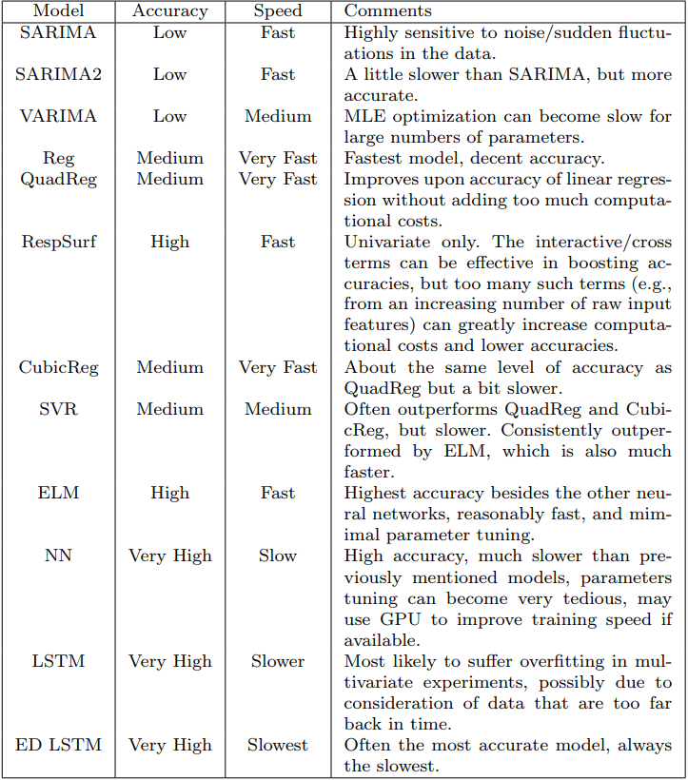
Summary of Models

Slide 48
Conclusion
Incorporation of spatially dependent data generally help
Various neural networks have the highest accuracy, but are also the most computationally expensive
ELM is fairly fast, requires little parameter tuning, and has the best accuracy besides the other neural networks.
The cell state in ED LSTM helps forecasting accuracy at higher steps (more distant future), while the stateless NN may be able to do better in the first couple of steps but its accuracy depreciates more quickly than ED LSTM.
In comparing with similar traffic forecasting studies that used huge/deep neural networks, their performance does not seem to be significantly different from ours.
Notes:
Contributions (different from other papers):
A plethora of diverse models tested, more than most paper, good reference for someone interested in applying a specific model
Addresses Trade-Offs b/w accuracy and computational cost, rarely done in deep learning paper
Recent deep learning papers tend to give lots of data to the deep NNs (tons of neurons) and let the model figure out everything, we break down into what univariate models can achieve, and what multivariate models can achieve, how resolution affects forecasting performance, etc. And we are able to achieve similar accuracy with other deep learning papers

Slide 49
Next Steps
Use Markov Logic Network to model traffic conditions and First Order Logic to reason
Determination of upstream sensors where traffic is likely to flow from. If a upstream sensor location is congested, choose closer sites.
Determination of sensor sites similarity to apply transfer learning, which will significantly reduce training time of neural networks.
Real-time forecasting by repeatedly re-training on the most recent data. Preliminary work shows improved accuracy.
Notes:
Model highway, sensors, exists, interchanges/connections

Slide 50
Questions?

Slide 51
Software used

Slide 52
ScalaTion Project
A Scala-based project for analytics, simulation and optimization
Open source under an MIT License
www.cs.uga.edu/~jam/scalation.html
Support for TSDB, analytics, simulation, optimization, etc.

Slide 53
ScalaTion TSDB + Analytics
var rel = new RelationSQL (Relation (dataPath + filename, filename, colName, key = 0, domain = "TIDDD", skip = 0, sep = ","))
if (removeWeekends) rel = rel.where [TimeNum] (("time", (x: TimeNum) => x.getChrono(ChronoField.DAY_OF_WEEK) < 6))
rel = rel.downSample (dsFreq = 3, dsMethod = "FMSMM")
val y_train = rel.repr.column ("flow").asInstanceOf[VectoD]
val model = SARIMA (y_train)
model.train().eval()
println(model.fitMap)
println(model.forecast(12))

Slide 54
Other Database + Analytics Frameworks
Database and Statistical Packages
MySQL + R
JVM based Big Data Frameworks
SparkSQL + Spark
Python based Big Data Frameworks
pandas + scipy + keras + tensorflow

