Slide 1
Monte Carlo Simulation of Interacting Electron Models by a New Determinant Approach
Mucheng Zhang
(Under the direction of Robert W. Robinson and Heinz-Bernd Schüttler)

Slide 2
INTRODUCTION

Slide 3
Hubbard model
Hubbard model
describe magnetism and super conductivity in strongly correlated electron systems.
originally developed to explain metal-insulator transition in strongly correlated electronic materials.
has been applied to the study of magnetism.

Slide 4
2D Hubbard model
used as “minimal” model to describe high- temperature superconductors
has been applied extensively.

Slide 5
Some Methods
Some reliable numerical solution methods ([2])
quantum Monte Carlo
exact diagonalization
density matrix renormalization
these methods are limited to only small 2D clusters.

Slide 6
Cluster mean–field embedding approaches
allow small cluster calculations to be effectively extrapolated to larger and even infinite lattice sizes ([4],[5],[7] and [1]).
A determinant formalism ([10])
derived by functional integral techniques
used for Monte Carlo simulations of small 2D Hubbard model clusters.

Slide 7
Our New Method
A new determinant approach is derived from a Feynman diagram expansion for the single particle Green’s function of the Hubbard model.

Slide 8
Green’s functions
mathematical objects of particular interest in the quantum theory of many-electron systems
model predictions can be directly compared to the data obtained in real materials .
The single-particle Green’s function
used to predict the result of photo-emission spectroscopy experiments.

Slide 9
Determinant formalism for the extended Hubbard model.
Monte Carlo summation algorithm to evaluate the relevant determinant diagram sums.
We have tested it on small 2 × 2 Hubbard clusters.

Slide 10
CALCULATION OF DETERMINANTS

Slide 11
Four Algorithms
Gaussian Elimination With Partial Pivoting (GEP)
Givens Rotation (GR)
Householder Reflection (HR)
Fast Givens Transformation (FGT)

Slide 12
Conclusion
GEP
the most efficient.
in most cases, the most accurate.
In terms of efficiency and accuracy, GEP is a good algorithm for evaluating determinants.

Slide 13
FEYNMAN DIAGRAM EXPANSIONS

Slide 14
Notation

Slide 15
Integral Padding Function

Slide 16
EXTENDED HUBBARD MODEL (EHM)

Slide 17
The Lattice

Slide 19
Interaction Potential Function

Slide 20
The Simplest EHM For

Slide 22
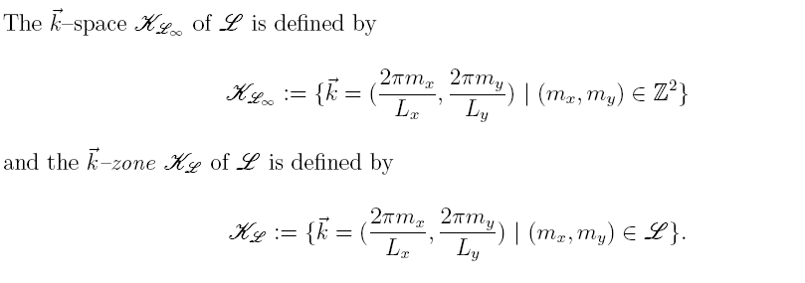
The -Space

Slide 24
Reciprocal lattice

Slide 25
Energy Band

Slide 26
Fourier Sum Over Matsubara Frequencies

Slide 29
The Function g

Slide 30
Notation

Slide 31
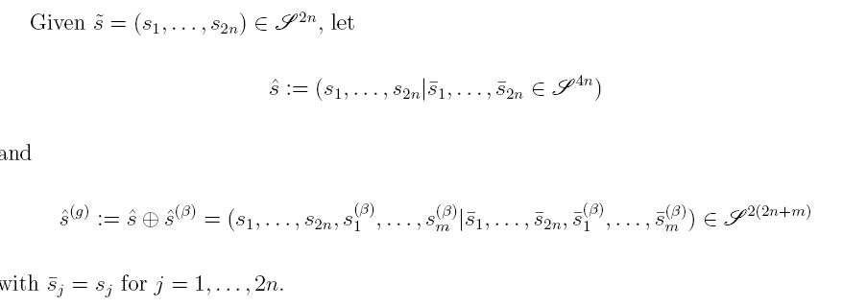

Slide 34
The m–electron Green’s Function

Slide 36
MONTE CARLO EVALUATION OF EHM

Slide 37
Notation

Slide 38
Score and Weight

Slide 39
Probability Function For EHM

Slide 40
Monte Carlo Evaluation

Slide 42
Evaluation of Determinants

Slide 44
Metropolis MCMC method

Slide 46
Generating The Chain

Slide 47
MC Move Types

Slide 49
Type 1: Move a Pair of V-Lines

Slide 50
Type 2: Flip a Spin at a Vertex

Slide 51
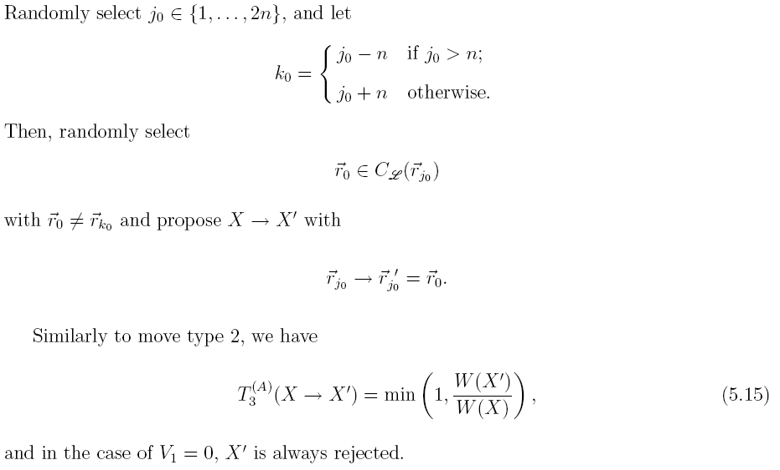
Type 3: Move at a Vertex

Slide 52
Type 5: Update τ–Padding Variable ψ

Slide 53
Type 6: Raise/Lower Diagram Order

Slide 54
Type 6+: Raise Diagram Order

Slide 55
Type 6-: Lower Diagram Order

Slide 56
Acceptance Probability of Type 6

Slide 58
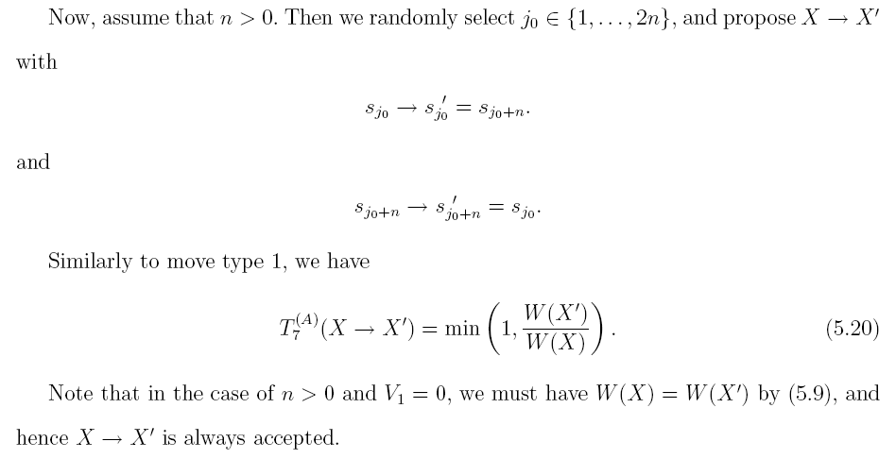
Type 7: Exchange a pair of Spins

Slide 59
RESULTS

Slide 60
The Experiments

Slide 62
Continuous Time Scheme

Slide 65
Parameter Sets

Slide 67
Accept Ratio

Slide 68
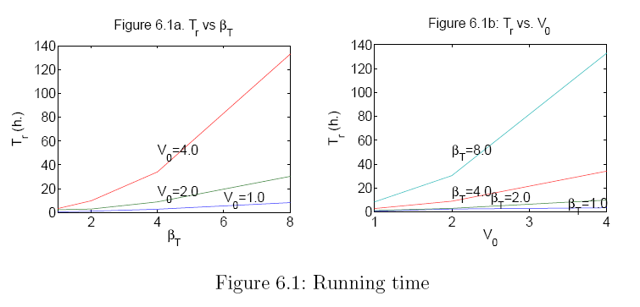
Running Time

Slide 69
Order Frequency

Slide 72
Convergence of Parameter Set 3b

Slide 74
Scores VS. 1/T

Slide 76
The Green’s Function

Slide 80
Conclusion
Our new method works well.
Our program can be used
for any rectangle lattice
for m–electron system with m > 1 after slight modification.

