Slide 1
Classification on high octane (1): Naïve Bayes (hopefully, with Hadoop)
COSC 526 Class 3
Arvind Ramanathan
Computational Science & Engineering Division
Oak Ridge National Laboratory, Oak Ridge
Ph: 865-576-7266
E-mail: ramanathana@ornl.gov
Notes:
Start with ebola…

Slide 2
Hadoop Installation Issues

Slide 3
Different operating systems have different requirements
My experience is purely based on Linux:
  I don’t know anything about Mac/Windows Installation!
Windows install is not stable:
  Hacky install tips abound on web!
  You will have a small linux based Hadoop installation available to develop and test your code
  A much bigger virtual environment is underway!

Slide 4
What to do if you are stuck?
Read over the internet! ☺
Many suggestions are specific to a specific version
  Hadoop install becomes an “art” rather than following a typical program “install”
If you are still stuck:
  let’s learn
  I will point you to a few people that have had experience with Hadoop

Slide 5
Basic Probability Theory

Slide 6
Overview
Review of Probability Theory
Naïve Bayes (NB)
  The basic learning algorithm
  How to implement NB on Hadoop
Logistic Regression
  Basic algorithm
  How to implement LR on Hadoop

Slide 7
What you need to know
Probabilities are cool
Random variables and events
The axioms of probability
Independence, Binomials and Multinomials
Conditional Probabilities
Bayes Rule
Maximum Likelihood Estimation (MLE), Smoothing, and Maximum A Posteriori (MAP)
Joint Distributions

Slide 8
Independent Events
Definition: two events A and B are independent if Pr(A and B)=Pr(A)*Pr(B).
Intuition: outcome of A has no effect on the outcome of B (and vice versa).
  E.g., different rolls of a dice are independent.
  You frequently need to assume the independence of something to solve any learning problem.

Slide 9
Multivalued Discrete Random Variables
Suppose A can take on more than 2 values
A is a random variable with arity k if it can take on exactly one value out of {v₁,v₂, .. v_{k}}
  Example: V={aaliyah, aardvark, …., zymurge, zynga}
Thus…

Slide 10
Terms: Binomials and Multinomials
Suppose A can take on more than 2 values
A is a random variable with arity k if it can take on exactly one value out of {v₁,v₂, .. v_{k}}
  Example: V={aaliyah, aardvark, …., zymurge, zynga}
The distribution Pr(A) is a multinomial
For k=2 the distribution is a binomial

Slide 11
More about Multivalued Random Variables
Using the axioms of probability and assuming that A obeys axioms of probability:

Slide 12
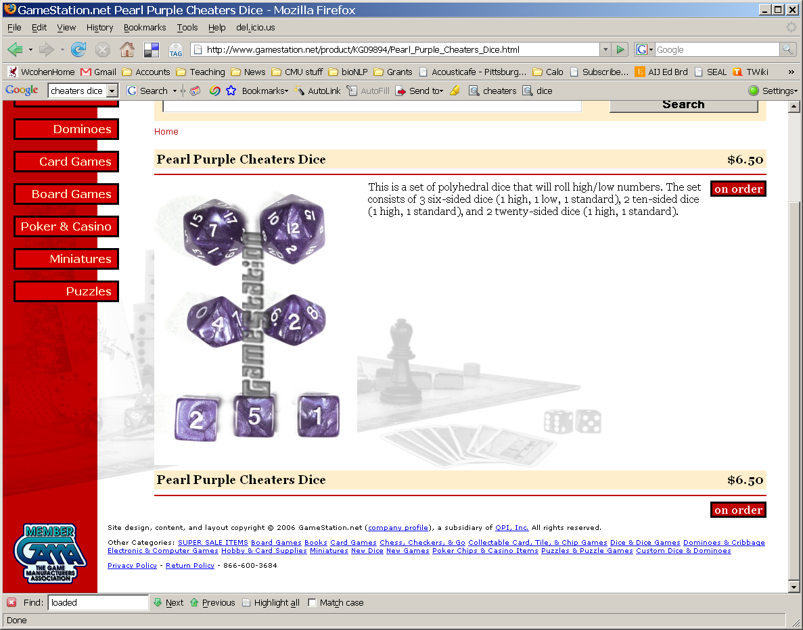
A practical problem
I have lots of standard d20 die, lots of loaded die, all identical.
Loaded die will give a 19/20 (“critical hit”) half the time.
In the game, someone hands me a random die, which is fair (A) or loaded (~A), with P(A) depending on how I mix the die. Then I roll, and either get a critical hit (B) or not (~B)
. Can I mix the dice together so that P(B) is anything I want - say, p(B)= 0.137 ?
P(B) = P(B and A) + P(B and ~A)
= 0.1*λ + 0.5*(1- λ) = 0.137
“mixture model”
λ = (0.5 - 0.137)/0.4 = 0.9075

Slide 13
Another picture for this problem
It’s more convenient to say
“if you’ve picked a fair die then …” i.e. Pr(critical hit|fair die)=0.1
“if you’ve picked the loaded die then….” Pr(critical hit|loaded die)=0.5
Conditional probability:
Pr(B|A) = P(B^A)/P(A)
A (fair die)
~A (loaded)
~A and B
P(B|A)
P(B|~A)
A and B

Slide 14
Definition of Conditional Probability
P(A ^ B)
P(A|B) = -----------
P(B)
Corollary: The Chain Rule
P(A ^ B) = P(A|B) P(B)

Slide 15
Some practical problems
“marginalizing out” A
I have 3 standard d20 dice, 1 loaded die.
Experiment: (1) pick a d20 uniformly at random then (2) roll it. Let A=d20 picked is fair and B=roll 19 or 20 with that die. What is P(B)?
P(B) = P(B|A) P(A) + P(B|~A) P(~A)
= 0.1*0.75 + 0.5*0.25 = 0.2

Slide 16
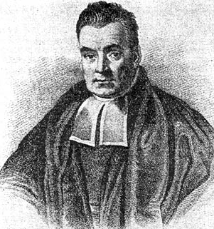
posterior
prior
P(B|A) * P(A)
P(A|B) =
Bayes’ rule
P(B)
P(A|B) * P(B)
P(B|A) =
P(A)
Bayes, Thomas (1763) An essay towards solving a problem in the doctrine of chances. Philosophical Transactions of the Royal Society of London, 53:370-418
…by no means merely a curious speculation in the doctrine of chances, but necessary to be solved in order to a sure foundation for all our reasonings concerning past facts, and what is likely to be hereafter…. necessary to be considered by any that would give a clear account of the strength of analogical or inductive reasoning…

Slide 17
Some practical problems
I bought a loaded d20 on EBay…but it didn’t come with any specs. How can I find out how it behaves?
1. Collect some data (20 rolls)
2. Estimate Pr(i)=C(rolls of i)/C(any roll)

Slide 18
One solution
I bought a loaded d20 on EBay…but it didn’t come with any specs. How can I find out how it behaves?
P(1)=0
P(2)=0
P(3)=0
P(4)=0.1
…
P(19)=0.25
P(20)=0.2
MLE = maximum
likelihood estimate
But: Do you really think it’s impossible to roll a 1,2 or 3?
Would you bet your life on it?

Slide 19
A better solution
I bought a loaded d20 on EBay…but it didn’t come with any specs. How can I find out how it behaves?
0. Imagine some data (20 rolls, each i shows up once)
1. Collect some data (20 rolls)
2. Estimate Pr(i)=C(rolls of i)/C(any roll)

Slide 20
A better solution
I bought a loaded d20 on EBay…but it didn’t come with any specs. How can I find out how it behaves?
P(1)=1/40
P(2)=1/40
P(3)=1/40
P(4)=(2+1)/40
…
P(19)=(5+1)/40
P(20)=(4+1)/40=1/8
0.25 vs. 0.125 – really different! Maybe I should “imagine” less data?

Slide 21
A better solution?
P(1)=1/40
P(2)=1/40
P(3)=1/40
P(4)=(2+1)/40
…
P(19)=(5+1)/40
P(20)=(4+1)/40=1/8
0.25 vs. 0.125 – really different! Maybe I should “imagine” less data?

Slide 22
A better solution?
Q: What if I used m rolls with a probability of q=1/20 of rolling any i?
I can use this formula with m>20, or even with m<20 … say with m=1

Slide 23
A better solution
Q: What if I used m rolls with a probability of q=1/20 of rolling any i?
If m>>C(ANY) then your imagination q rules
If m<<C(ANY) then your data rules BUT you never ever ever end up with Pr(i)=0

Slide 24
Terminology – more later
This is called a uniform Dirichlet prior
C(i), C(ANY) are sufficient statistics
MLE = maximum
likelihood estimate
MAP= maximum
a posteriori estimate

Slide 25
The Joint Distribution
Example: Boolean variables A, B, C
Recipe for making a joint distribution of M variables:

Slide 26
The Joint Distribution
Example: Boolean variables A, B, C
Recipe for making a joint distribution of M variables:
Make a truth table listing all combinations of values of your variables (if there are M Boolean variables then the table will have 2^{M} rows).
A | B | C
0 | 0 | 0
0 | 0 | 1
0 | 1 | 0
0 | 1 | 1
1 | 0 | 0
1 | 0 | 1
1 | 1 | 0
1 | 1 | 1

Slide 27
The Joint Distribution
Example: Boolean variables A, B, C
Recipe for making a joint distribution of M variables:
Make a truth table listing all combinations of values of your variables (if there are M Boolean variables then the table will have 2^{M} rows).
For each combination of values, say how probable it is.
A | B | C | Prob
0 | 0 | 0 | 0.30
0 | 0 | 1 | 0.05
0 | 1 | 0 | 0.10
0 | 1 | 1 | 0.05
1 | 0 | 0 | 0.05
1 | 0 | 1 | 0.10
1 | 1 | 0 | 0.25
1 | 1 | 1 | 0.10

Slide 28
The Joint Distribution
Example: Boolean variables A, B, C
Recipe for making a joint distribution of M variables:
Make a truth table listing all combinations of values of your variables (if there are M Boolean variables then the table will have 2^{M} rows).
For each combination of values, say how probable it is.
If you subscribe to the axioms of probability, those numbers must sum to 1.
A | B | C | Prob
0 | 0 | 0 | 0.30
0 | 0 | 1 | 0.05
0 | 1 | 0 | 0.10
0 | 1 | 1 | 0.05
1 | 0 | 0 | 0.05
1 | 0 | 1 | 0.10
1 | 1 | 0 | 0.25
1 | 1 | 1 | 0.10
A
0.05
0.10
0.05
0.10
0.25
0.05
C
B
0.10
0.30

Slide 29
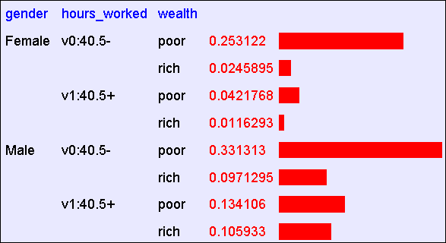
Using the Joint
One you have the JD you can ask for the probability of any logical expression involving your attribute
Abstract: Predict whether income exceeds $50K/yr based on census data. Also known as "Census Income" dataset. [Kohavi, 1996]
Number of Instances: 48,842
Number of Attributes: 14 (in UCI’s copy of dataset); 3 (here)

Slide 30
Using the Joint
P(Poor Male) = 0.4654

Slide 31
Using the Joint
P(Poor) = 0.7604

Slide 32
Inference with the Joint

Slide 33
Inference with the Joint
P(Male | Poor) = 0.4654 / 0.7604 = 0.612

Slide 34
Estimating the joint distribution
Collect some data points
Estimate the probability P(E1=e1 ^ … ^ En=en) as #(that row appears)/#(any row appears)
….
Gender | Hours | Wealth
g1 | h1 | w1
g2 | h2 | w2
.. | … | …
gN | hN | wN

Slide 35
Estimating the joint distribution
Complexity?
O(2^{d})
For each combination of values r:
  Total = C[r] = 0
For each data row r_{i}
  C[r_{i}] ++
  Total ++
d = #attributes (all binary)
Complexity?
O(n)
n = total size of input data
Gender | Hours | Wealth
g1 | h1 | w1
g2 | h2 | w2
.. | … | …
gN | hN | wN
= C[r_{i}]/Total
r_{i} is “female,40.5+, poor”

Slide 36
Estimating the joint distribution
Complexity?
For each combination of values r:
  Total = C[r] = 0
For each data row r_{i}
  C[r_{i}] ++
  Total ++
k_{i} = arity of attribute i
Complexity?
O(n)
n = total size of input data
Gender | Hours | Wealth
g1 | h1 | w1
g2 | h2 | w2
.. | … | …
gN | hN | wN

Slide 37
Estimating the joint distribution
For each combination of values r:
  Total = C[r] = 0
For each data row r_{i}
  C[r_{i}] ++
  Total ++
Complexity?
k_{i} = arity of attribute i
Complexity?
O(n)
n = total size of input data
Gender | Hours | Wealth
g1 | h1 | w1
g2 | h2 | w2
.. | … | …
gN | hN | wN

Slide 38
Estimating the joint distribution
Complexity?
O(m)
For each data row r_{i}
  If r_{i} not in hash tables C,Total:
    Insert C[r_{i}] = 0
  C[r_{i}] ++
  Total ++
m = size of the model
Complexity?
O(n)
n = total size of input data
Gender | Hours | Wealth
g1 | h1 | w1
g2 | h2 | w2
.. | … | …
gN | hN | wN

Slide 39
Naïve Bayes (NB)

Slide 40
Bayes Rule
Probability of D given h
prior probability of hypothesis h
Probability of h given D
prior probability of training data D

Slide 41
A simple shopping cart example
What is the probability that a person is in zipcode 37923?
3/10
What is the probability that the person is from 37923 knowing that he bought green tea?
1/5
Now, if we want to display an ad only if the person is likely to buy tea. We know that the person lives in 37922. Two competing hypothesis exist:
  The person will buy green tea
  P(buyGreenTea|37922) = 0.6
  The person will not buy green tea
  P(~buyGreenTea|37922) = 0.4
We will show the ad!
Customer | Zipcode | bought organic | bought green tea
1 | 37922 | Yes | Yes
2 | 37923 | No | No
3 | 37923 | Yes | Yes
4 | 37916 | No | No
5 | 37993 | Yes | No
6 | 37922 | No | Yes
7 | 37922 | No | No
8 | 37923 | No | No
9 | 37916 | Yes | Yes
10 | 37993 | Yes | Yes

Slide 42
Maximum a Posteriori (MAP) hypothesis
Let D represent the data I know about a particular customer: E.g., Lives in zipcode 37922, has a college age daughter, goes to college
Suppose, I want to send a flyer (from three possible ones: laptop, desktop, tablet), what should I do?
Bayes Rule to the rescue:

Slide 43
MAP hypothesis: (2) Formal Definition
Given a large number of hypotheses h₁, h₂, …, h_{n}, and data D, we can evaluate:

Slide 44
MAP : Example (1)
A patient takes a cancer lab test and it comes back positive. The test returns a correct positive result 98% of the cases, in which case the disease is actually present. It also returns a correct negative result 97% of the cases, in which case the disease is not present. Further, 0.008 of the entire population actually have the cancer.
Example source: Dr. Tom Mitchell, Carnegie Mellon

Slide 45
MAP: Example (2)
Suppose Alice comes in for a test. Her result is positive. Does she have to worry about having cancer?
Alice may not have cancer!!
Making our answers pretty: 0.0072/(0.0072 + 0.0298) = 0.21
Alice may have a chance of 21% in actually having cancer!!

Slide 46
Basic Formula of Probabilities
Product rule: Probability P(A ∧ B) – conjunction of two events:
Sum rule: Disjunction of two events:
Theorem of Total Probability: if events A1, A2, … An are mutually exclusive, with sum(A{1,n}) = 1:

Slide 47
A Brute force MAP Hypothesis learner
For each hypothesis h in H, calculate the posterior probability
Output the hypothesis h_{MAP} with the highest probability

Slide 48
Naïve Bayes Classifier
One of the most practical learning algorithms
Used when:
  Moderate to large training set available
  Attributes that describe instances are conditionally independent given the classification
Surprisingly gives rise to good performance:
  Accuracy can be high (sometimes suspiciously!!)
  Applications include clinical decision making

Slide 49
Naïve Bayes Classifier
Assume a target function with f: X→V, where each instance x is described by <x₁, x₂, …, x_{n}>. Most probable value of f(x) is:
Using the Naïve Bayes assumption:

Slide 50
Naïve Bayes Algorithm
NaiveBayesLearn(examples):
for each target value v_j:
Phat(v_j) ← estimate P(v_j)
for each attribute value x_i in x
Phat(x_i|v_j) ← estimate P(x_i|v_j)
NaiveBayesClassifyInstance(x):
v_NB = argmax Phat(v_j)Π_iPhat(a_i|v_j)

Slide 51
Notes of caution! (1)
Conditional independence is often violated
We don’t need the estimated posteriors to be correct, only need:
Usually, posteriors are close to 0 or 1

Slide 52
Notes of caution! (2)
We may not observe training data with the target value v_i, having attribute x_i. Then:
To overcome this:
nc is the number of examples where v = v_j and x = x_i
m is weight given to prior (e.g, no. of virtual examples)
p is the prior estimate
n is total number of training examples where v=v_j

Slide 53
Learning the Naïve Density Estimator
MLE
MAP

Slide 54
Putting it all together
Training:
for each example [id, y, x1, … xd]:
C(Y=any)++;
C(Y=y)++
for j in 1…d:
C(Y=y and Xj=xj)++;
Testing:
for each example [id, y, x1, …xd]:
for each y’ in dom(Y):
compute PR(y’, x1, …,xd) =
return best PR

Slide 55
So, now how do we implement NB on Hadoop?
Remember, NB has two phases:
  Training
  Testing
Training:
  #(Y = *): total number of documents
  #(Y=y): number of documents that have the label y
  #(Y=y, X=*): number of words with label y in all documents we have
  #(Y=y, X=x): number of times word x has occurred in document Y with the label y
  dom(X): number of unique words across all documents
  dom(Y): number of unique labels across all documents

Slide 56
Map Reduce process
Mappers
Reducer

Slide 57
Code Snippets: Training
Training_map(key, value):
for each sample:
parse category and value for each word
count ← frequency of word
for each label:
key’, value’ ← label, count
return <key’, value’>
Training_reduce(key’, value’):
sum ← 0
for each label:
sum += value’;

