Slide 1







Oak Ridge Bio-surveillance Toolkit: Statistical Inference Tools for Public Health Dynamics
ORBiT
Dr. Arvind Ramanathan*
Oak Ridge National Lab
Dr. Laura L.
Pullum*
Oak Ridge National Lab
Dr. Chad A.
Steed
Oak Ridge National Lab
Tanner
Hobson
Farragut High School
Dr. Chakra S. Chennubhotla
University of Pittsburgh
Shannon Quinn
University of Georgia
*Health Data Sciences Institute

Slide 2

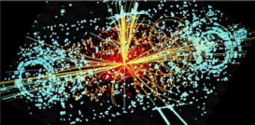


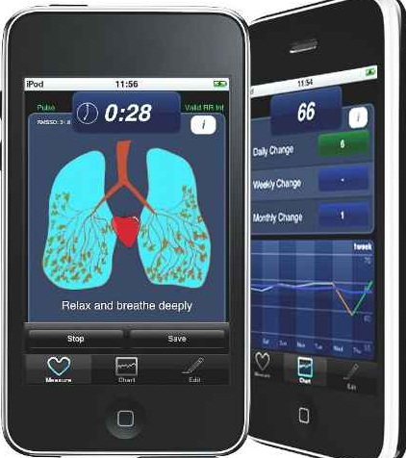
Digital Bio-surveillance as a Big Data Problem
  Experiments
  Simulations
  Archives
  Social Media
  Devices
genome scale experiments
proteomics
structural biology,
clinical studies
disease spread models
Transport models
social networks
history of communicable diseases
Public health records
twitter,
facebook
environmental monitors,
weather/climate monitors
hospital sensors,
other sources
Integrate, Analyze, Visualize
Enabling Discovery from massive datasets
Assist Decision making from evaluating Scenarios
Deliver the capability to mine, search and analyze data in near real time
Information presented to stakeholder customized views
Data → Insights → Discovery

Slide 3
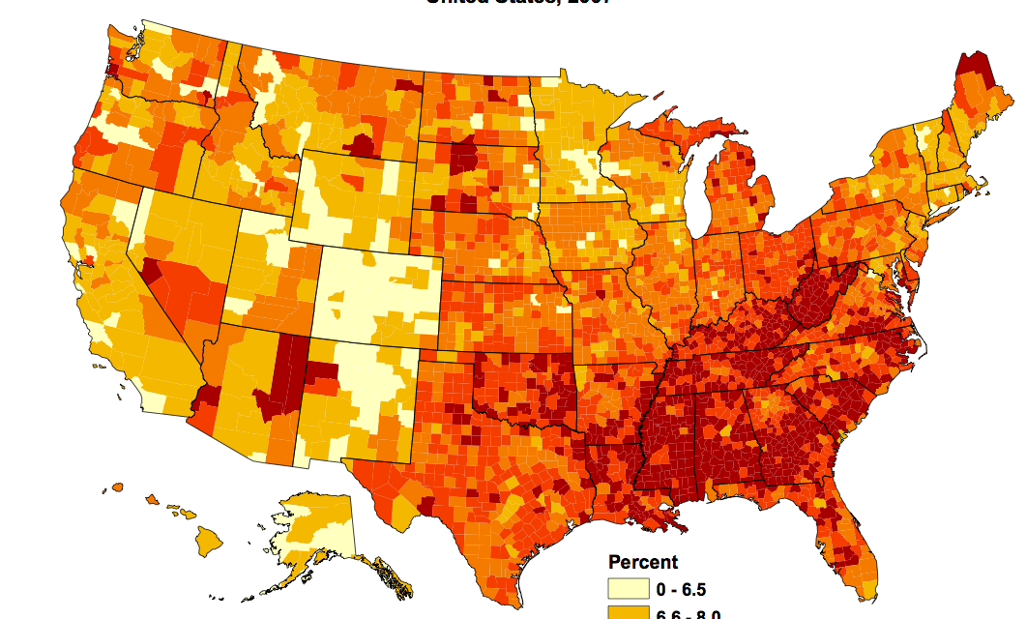
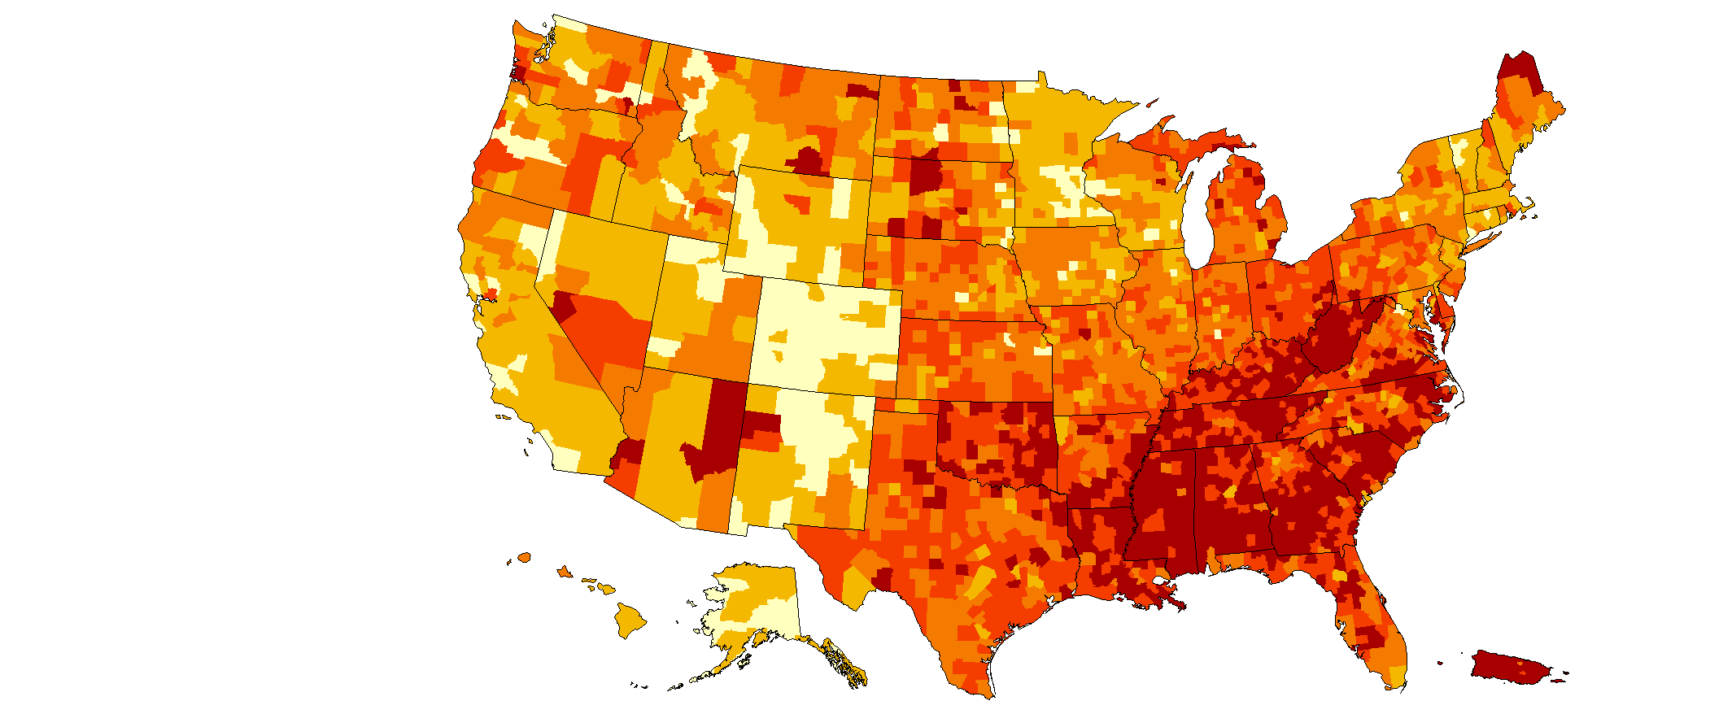
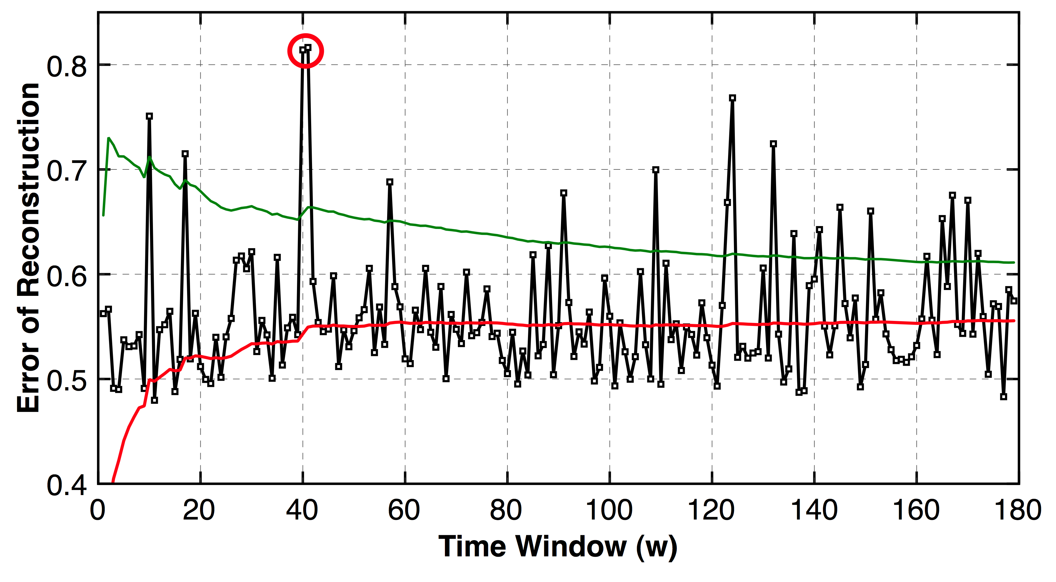
Big Data Challenges in Bio-surveillance
Data Challenges
Analytic Challenges
Unstructured
Heterogeneous Data Sources
Streaming vs. Static Data Analytics
Structured
Discover Hidden/Latent Relationships between Data sources
Multi-scale Data
Spatial: Nation-wide
State-wide
County-wide
Multi-scale Probabilistic Modeling
Temporal: Yearly → Monthly → Daily…
Reveal patterns from datasets; Analyze complex data
Noisy Data
Source type
Size/history
Completeness
Data integrity
Credibility
Data-trust models for data sources
Uncertainty quantification

Slide 4
What this talk is about
Oak Ridge Bio-surveillance Toolkit (ORBiT)
Using Electronic Healthcare Claim Reimbursements (eHCR) for discovering:
  Multi-scale Spatial and Temporal Patterns during the 2009-2010 H1N1 Flu Pandemic
  Co-occurrence patterns of asthma and flu
Summary

Slide 5
Part 1: Oak Ridge Bio-surveillance Toolkit
ORBiT

Slide 6
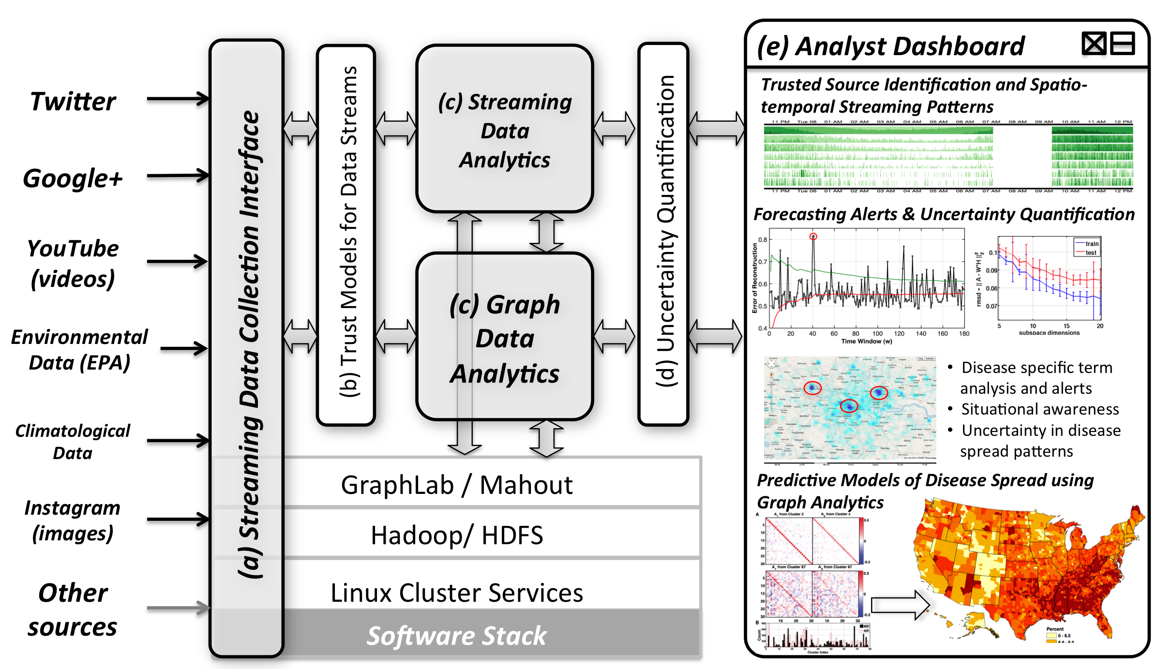
Platform Overview:
A Scalable Machine Learning Platform for Bio-surveillance

Slide 7
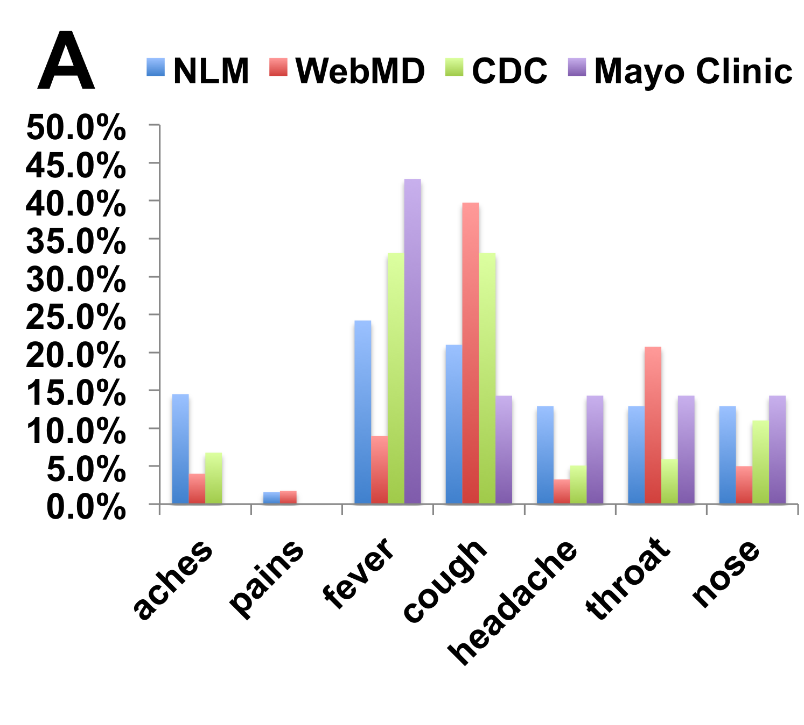
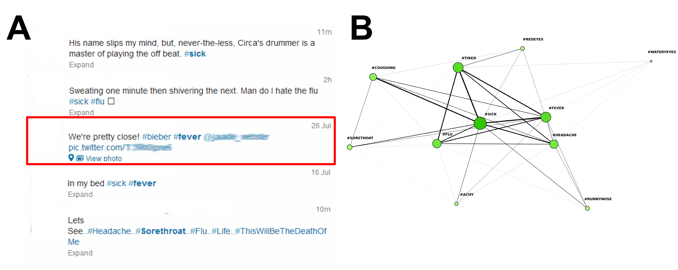
Natural language processing tools to filter text/data streams for disease relevant terms
Priors
Data Streams
Term association
Keyword based filtering
Semantic filtering
Other machine learning tools under development

Slide 8
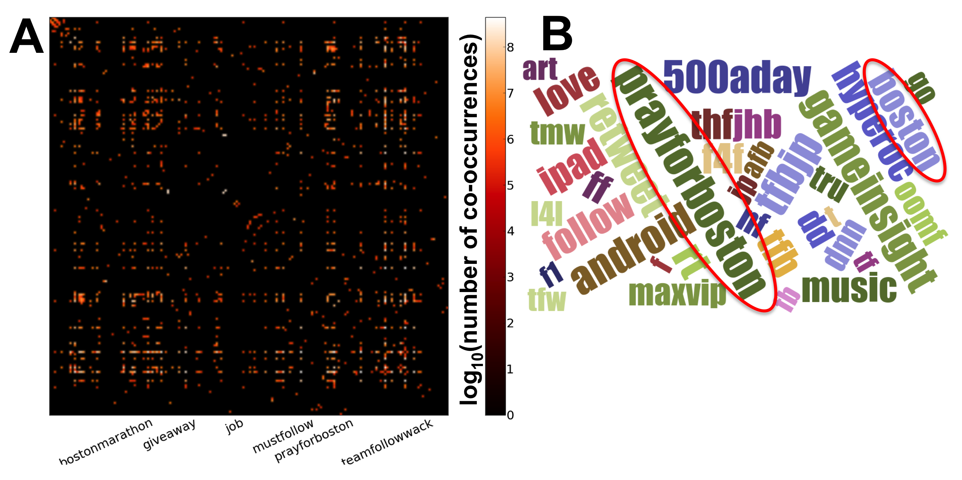
Visual Topic Modeling: Summarizing web of tweets with spectral graph analysis
Big Data: > 6 million tweets; 1.4 million hashtags
How are tweets referring to each other?
  Applications to identifying mood
  Conversational dominance
Natural structure in twitter conversations

Slide 9
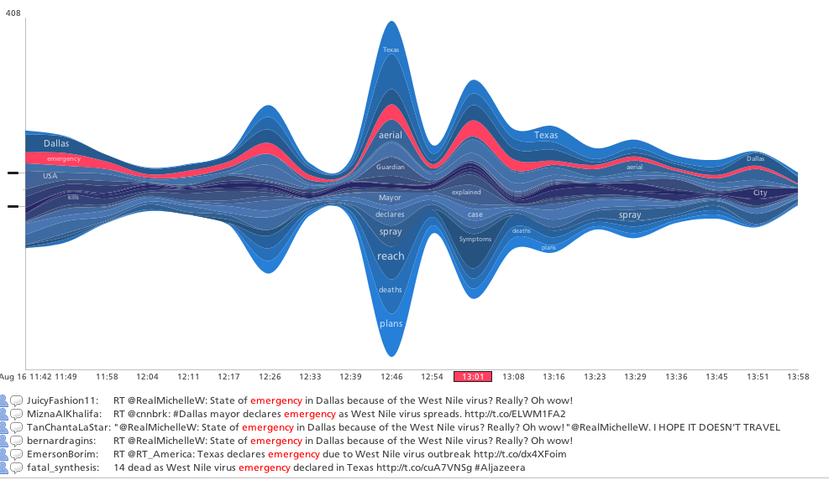
Streaming Data Analytics:
Detecting spatio-temporally correlated patterns in real-time from multi-modal data
Outbreak:
  Flu, dengue, west Nile virus, etc
GPS Location:
  Multi-scale: local to regional to national
Point-of-care Diagnosis information
Which geographic regions exhibit correlated patterns in twitter patterns?
  Indicative of emergent patterns in spread of disease/ outbreak
  Can be across diseases or regions or along time
At what time-points do these patterns change?
  Anomalies indicative of sudden surges in infections
Point-of-Care
Flu associated markers
Fever
Pain
Death
Emergency
…
Temp
Scale
PCR
Strain
…
Visualizing terms associated with west nile virus as a stacked graph, indicating distinct time-varying patterns in disease association.
Time
L₁
GPS position
L₂
GPS position
L₃
Neoformix: Visualizing Twitter data
L₄
L₅
Notes:
Let me motivate this part of my talk by telling you about a real scenario… Let’s say we get access to a wide range of text data from data streams, in particular from Twitter and other social media. I am talking about twitter mostly because it is a data set that we are working currently; however, the technique can be used with any other source of text streams. Let’s say we are interested in understanding how a disease outbreak is evolving over time from this dataset. one way to think about this problem is a way by which we can relate all of the data feeds that we obtain

Slide 10
Oak Ridge Bio-surveillance Toolkit:
A Scalable Machine Learning Platform for Bio-surveillance

Slide 11
Linking Heterogeneous datasets from Centers for Medicaid/Medicare Services Claims Data
Data: Describing intrinsic properties that make it linked
  External data sets used
  DE-SynPUF
Approach: Building linked structures via massive dictionaries
Use-cases/Demonstrations:
  Clinical Practice Centered Questions
Deidentified data:
  coarsened and correlations lost
  development purposes only not used to draw conclusions about medical practices
Made up of five separate data sets:
  Carrier Claims
  Inpatient Claims
  Outpatient Claims
  Prescription Drug Events
  Beneficiary Summary

Slide 12
Approach: Integrating DeSynPUF data with external data
DESYNPUF DATA
Carrier Claims
Inpatient Claims
Outpatient Claims
Drug Events
Beneficiary Summary
Define Relationships between Nodes
Identify Node information
Identify External Data
Define Hierarchies of Codes/ Data
HCPCS
Inpatient
Carrier
Outpatient
Provider
Drug
Beneficiary
County
State
ICD9 codebook
NDC Registry
Census Data
Joint work: Maggie Mamantov, Tara L. Parker, Eric Mitchell (SULI interns 2013)
Notes:
HCPCS – healthcare practitioners code and symbols
NDC National Drug Codes

Slide 13
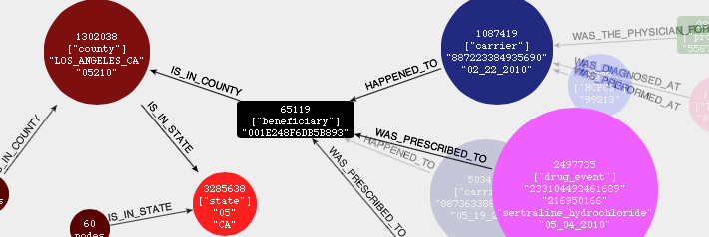
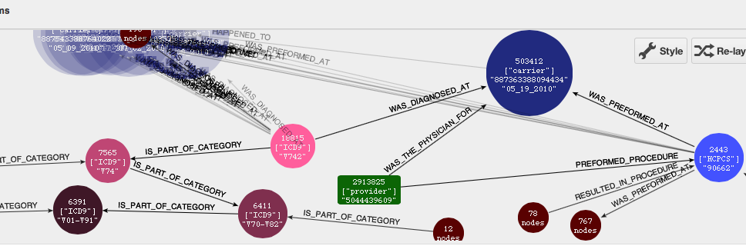
Example Graph depicting the CMS Claims Data

Slide 14
Clinical Practice Centered Queries
Patterns of HCPCS procedures:
  What percentage of influenza vaccines are high dose?
Patterns of ICD9 diagnosis associated with HCPCS procedure codes:
  Example 1: Under what conditions are influenza vaccines given to patients?
  Example 2: What is the frequency of co-diagnosis that lead to the influenza vaccine?

Slide 15
Notes:
V481 influenza vaccine
With flu what are the different diagnostics together
Screening for leprosy highest co-diagnosis with flu
DeSynPuf

Slide 16
79.2%
Notes:
2008 data
Patterns similar urban and rural
Majority no vacc

Slide 17
Part 2: Applications of ORBiT
ORBiT
Electronic Healthcare Claim Reimbursements (eHCR)
Discovering multi-scale patterns during the 2009-2010 H1N1 Flu Pandemic
Discovering co-occurrence patterns for flu and asthma

Slide 18
Oak Ridge Bio-surveillance Toolkit:
A Scalable Machine Learning Platform for Bio-surveillance

Slide 19







IMS Health Analytics Workflow
Payers adjudicates claim for reimbursement
Adjudicate the claim for the payer
Adjudicate the claim for the payer
Pharmacy Data (Rx)
Patient (P) Identifier
Fill date
P. Age, P.gender, P.zip
Drug
Quantity + supply
Prescriber identifier
Prescriber specialty
Pharmacy zip
Clearinghouse processes the claim
Can eHCR data be used for public health dynamics?
Over 1 billion + eHCRs / year
500,000 physicians
~200 million patients
Prescription (Rx)
Patient
Pharmacy submits claim for reimbursements
Diagnostic Data (Dx)
Patient Identifier
Date of service
Age, gender, zip
ICD-9 diagnoses
Procedure codes
Provider identifier
Provider specialty
Provider zip
Over 3 billion + eHCRs / year
~70-80% of all dispensed Rx
~200 million patients
Clearinghouse processes claim
Patient goes to the pharmacy to fill in prescription
Diagnostic (Dx)
Anonymized patient data
HIPAA compliant
High fidelity
Thorough coverage
Provider/Facility submits claim for reimbursement
Patient visits Healthcare provider
(Office/Clinic, ED, Hospital)

Slide 20
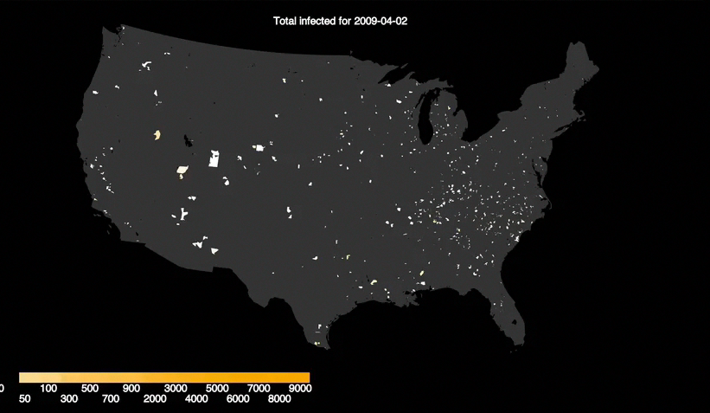
eHCR diagnostic (Dx) data over 2009-2010

Slide 21
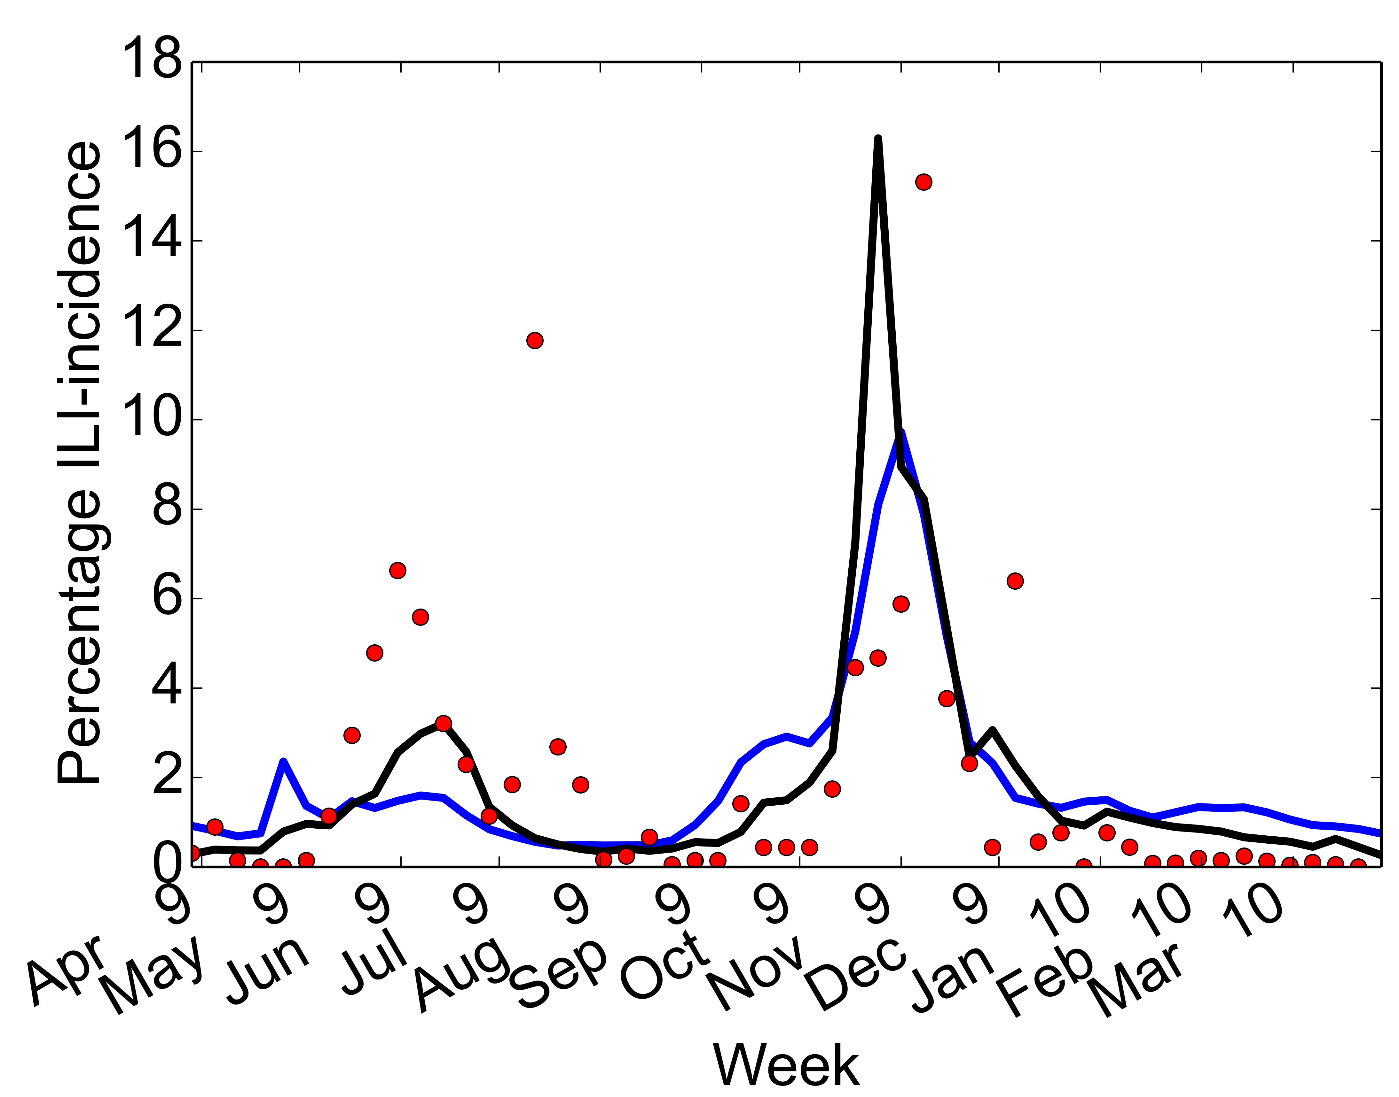
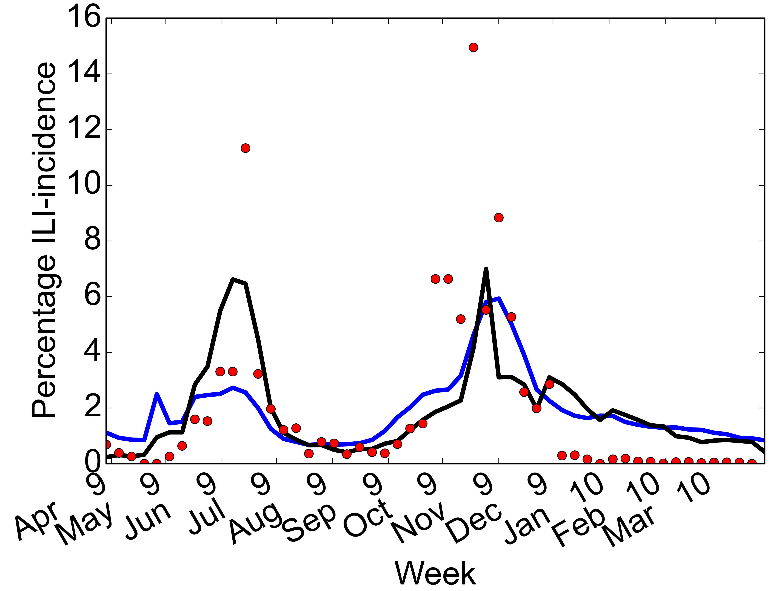
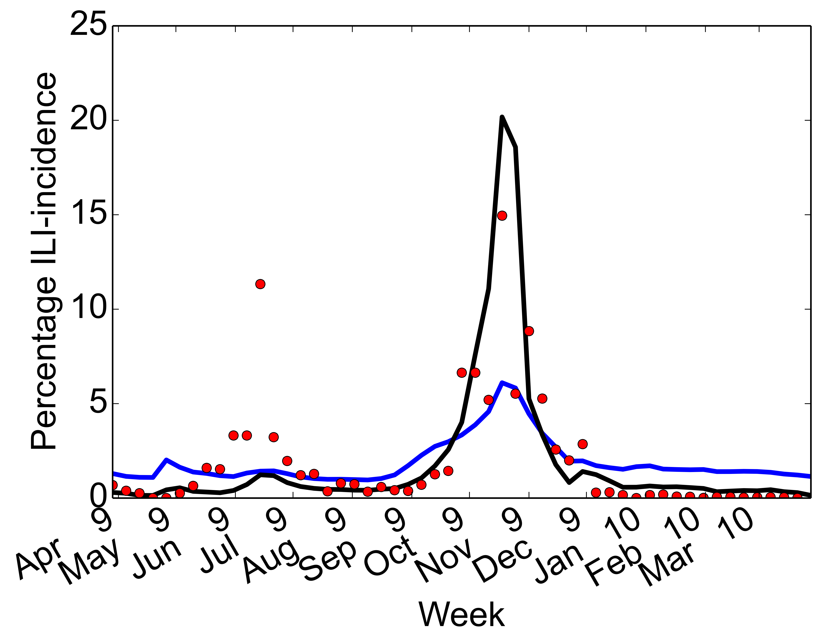
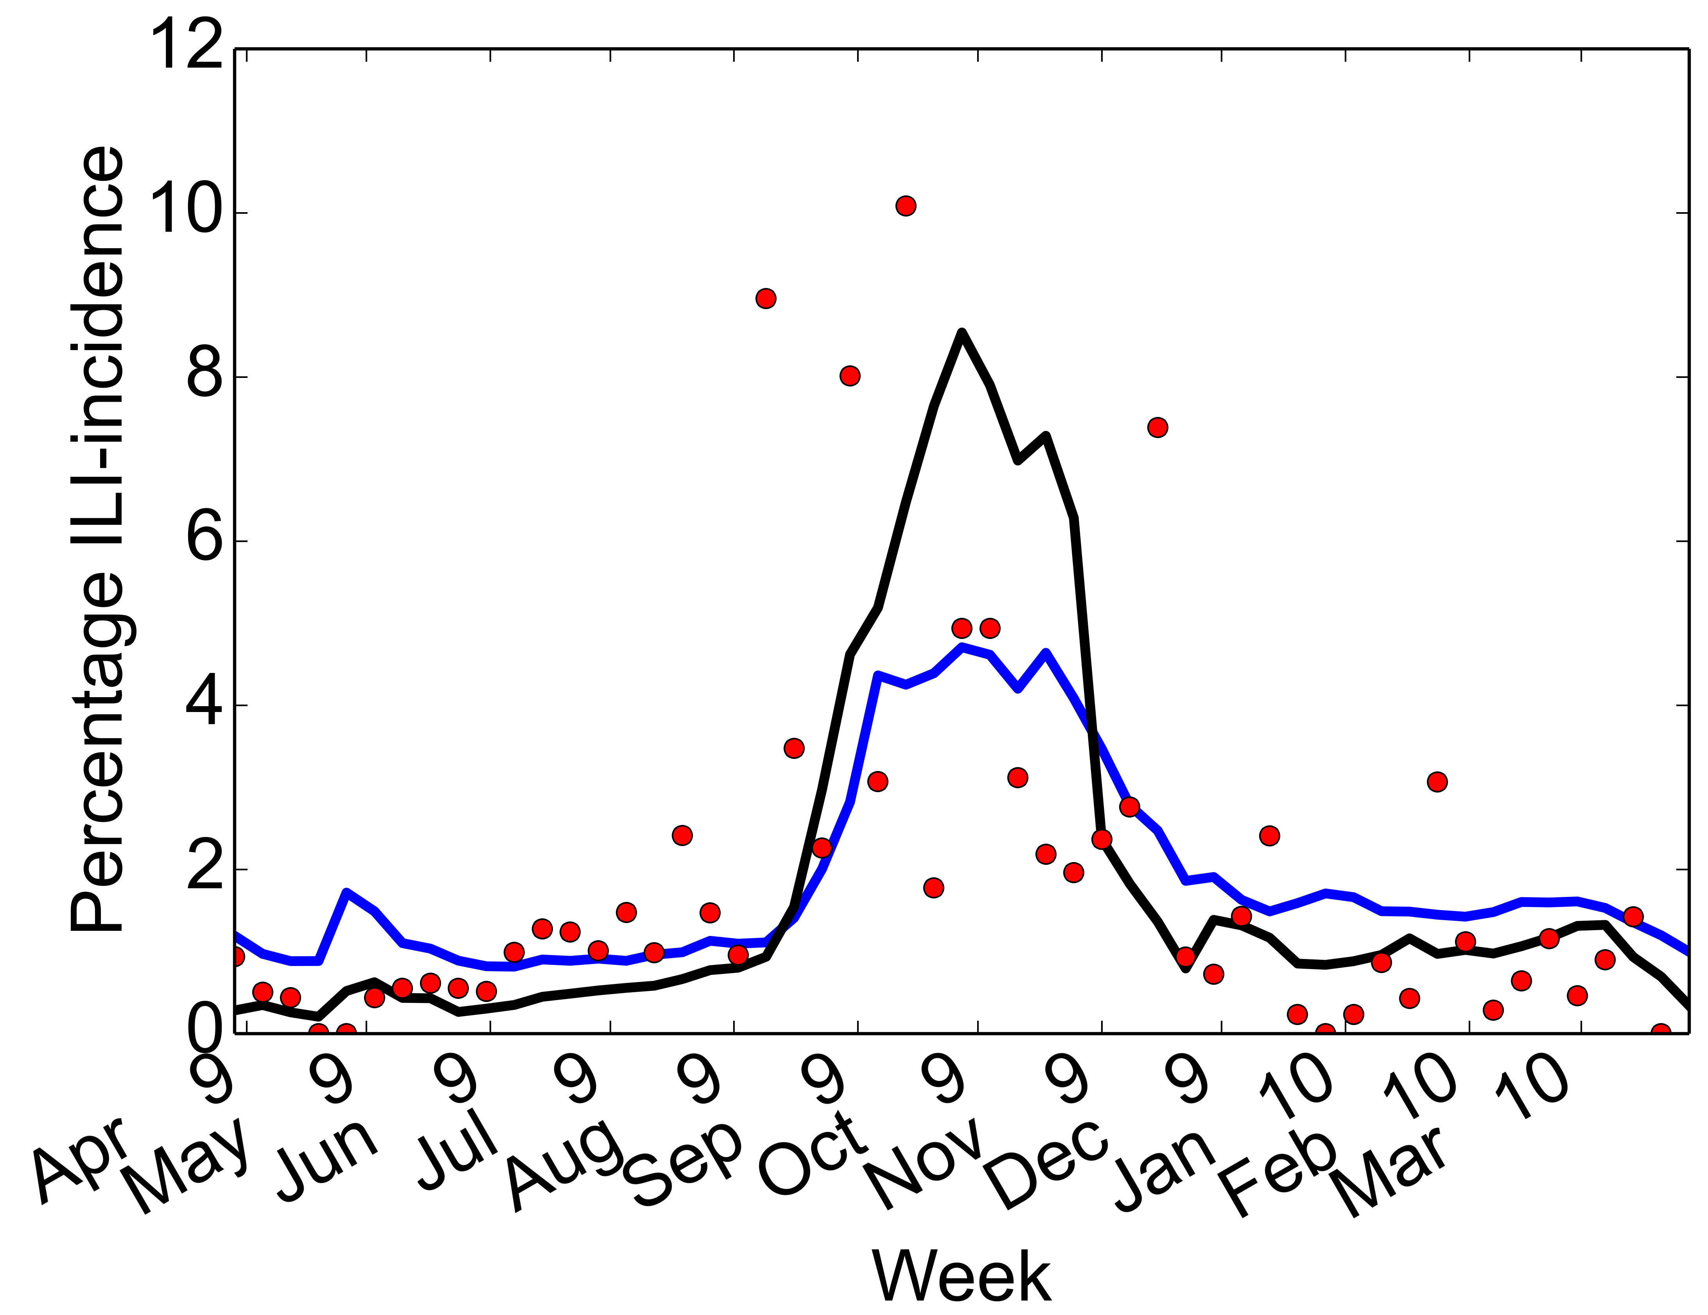
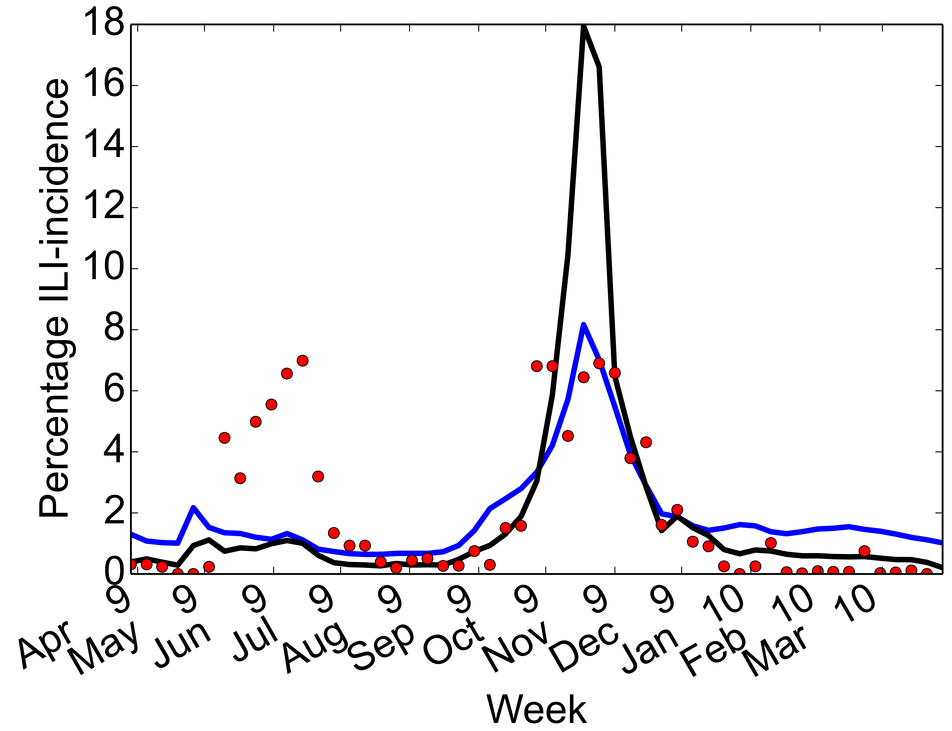
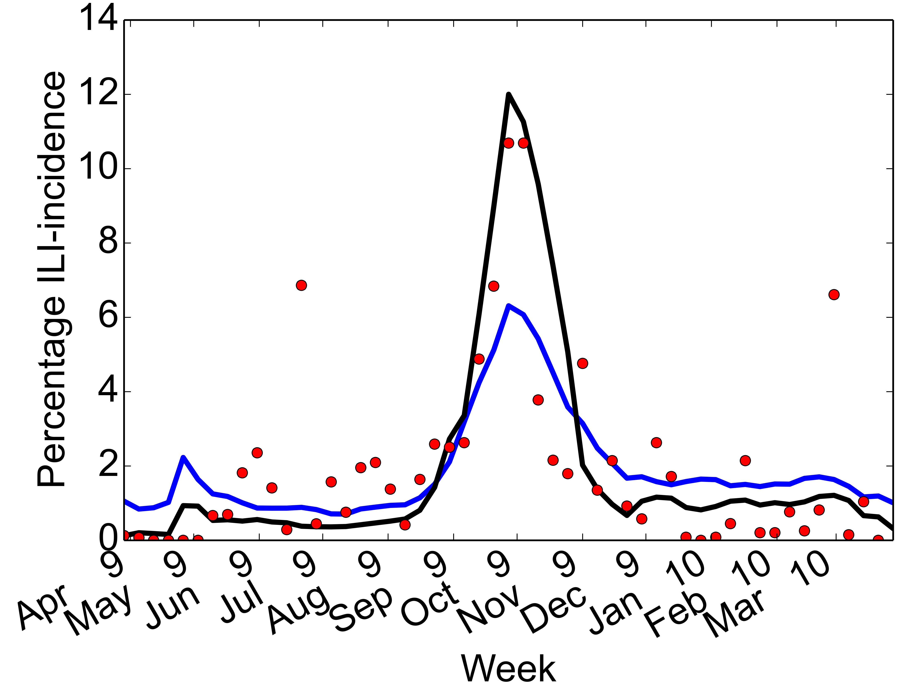
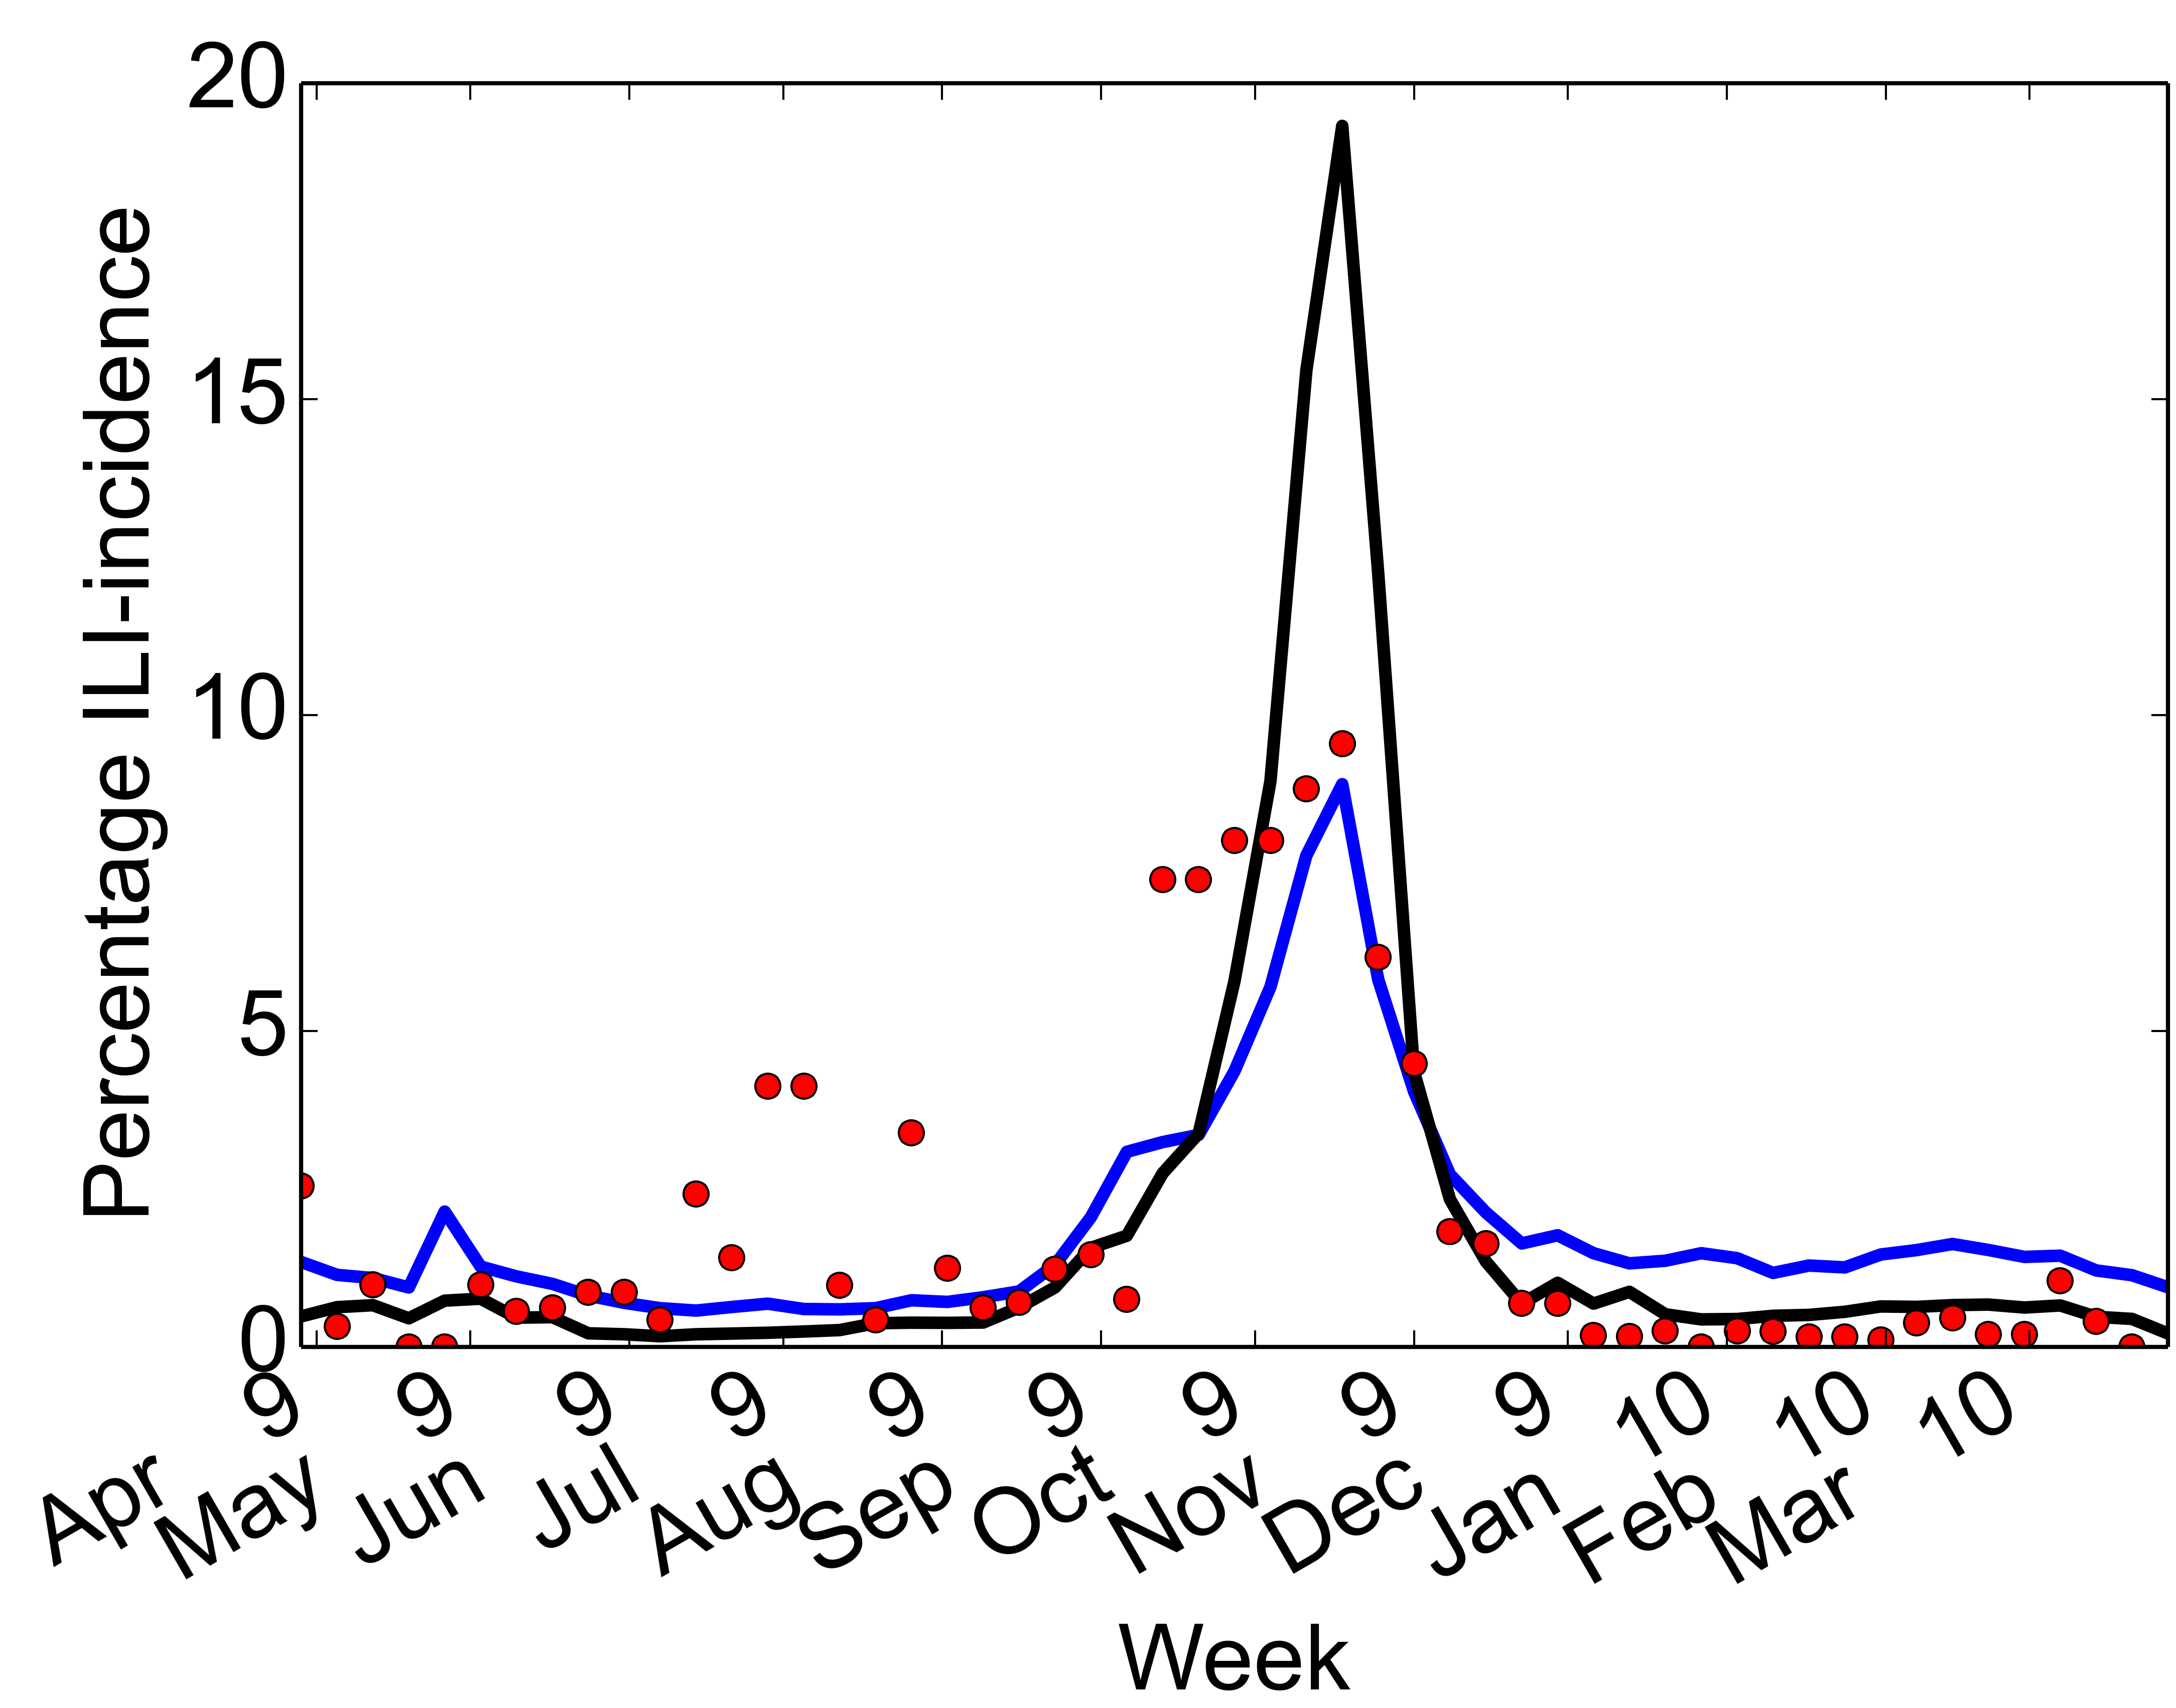
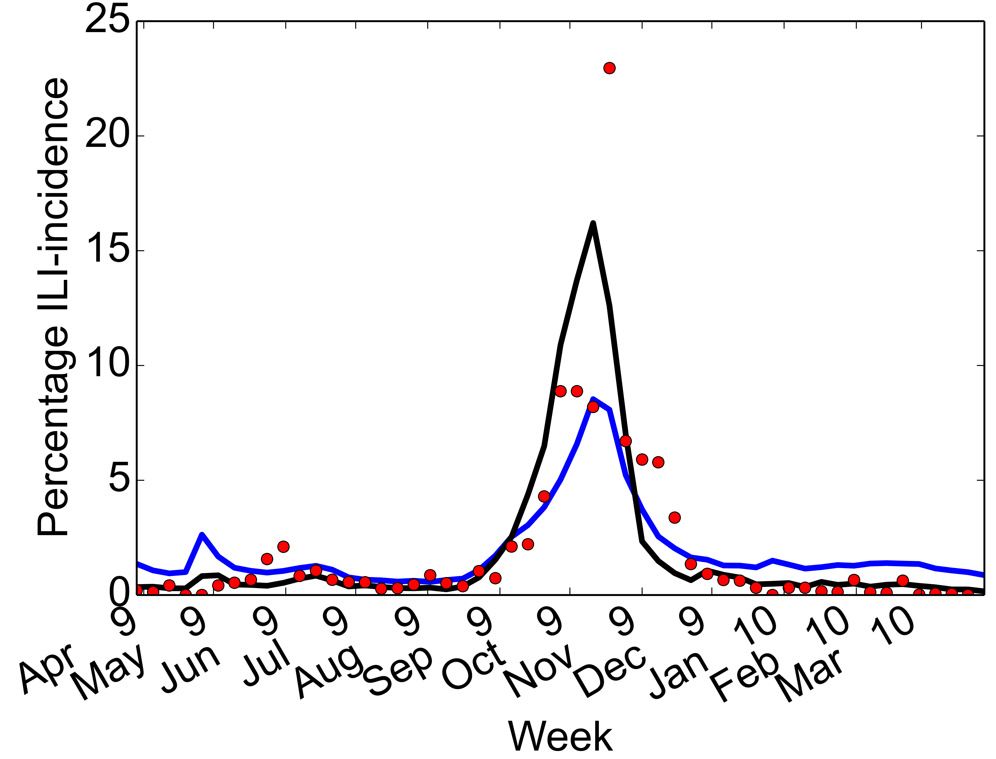
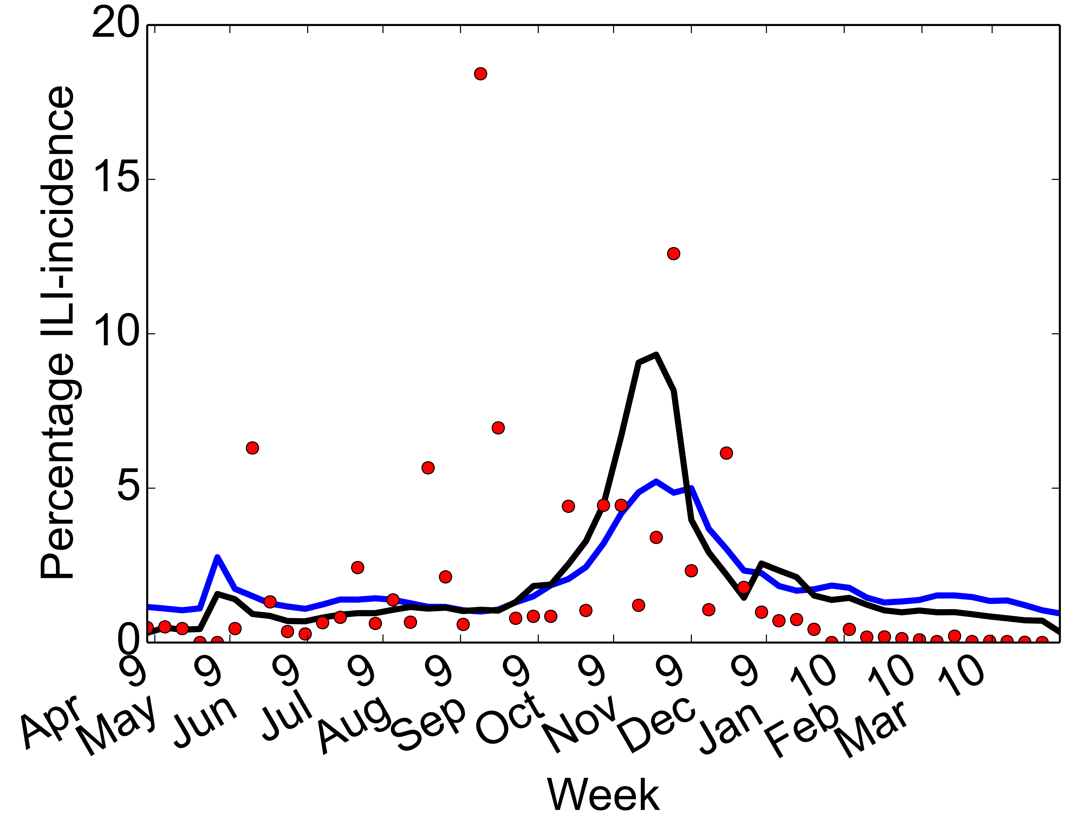
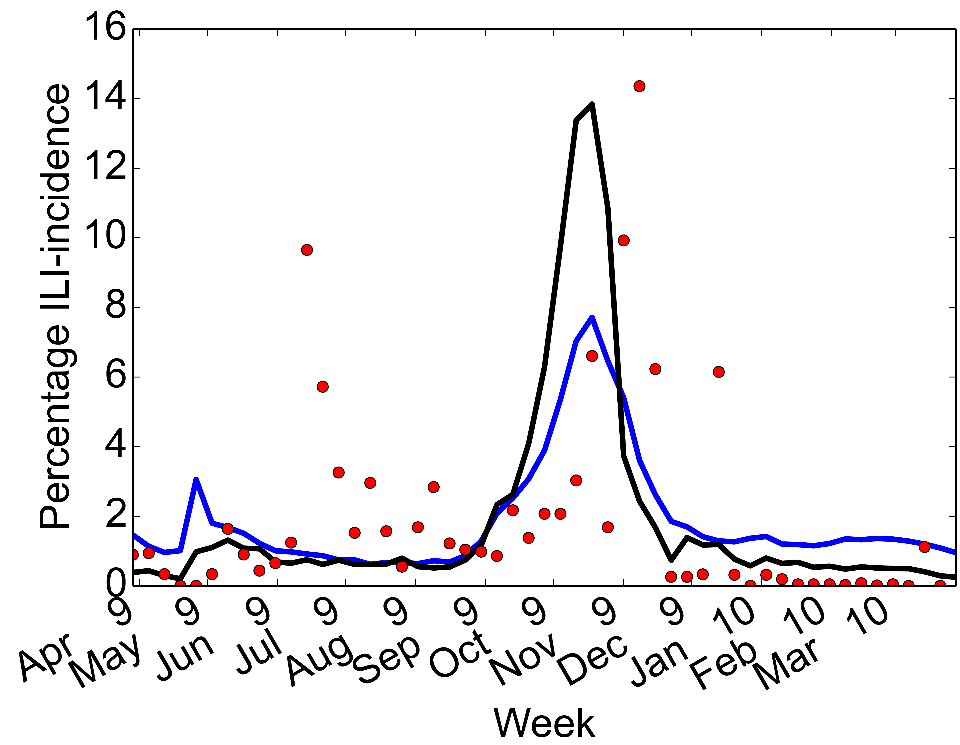
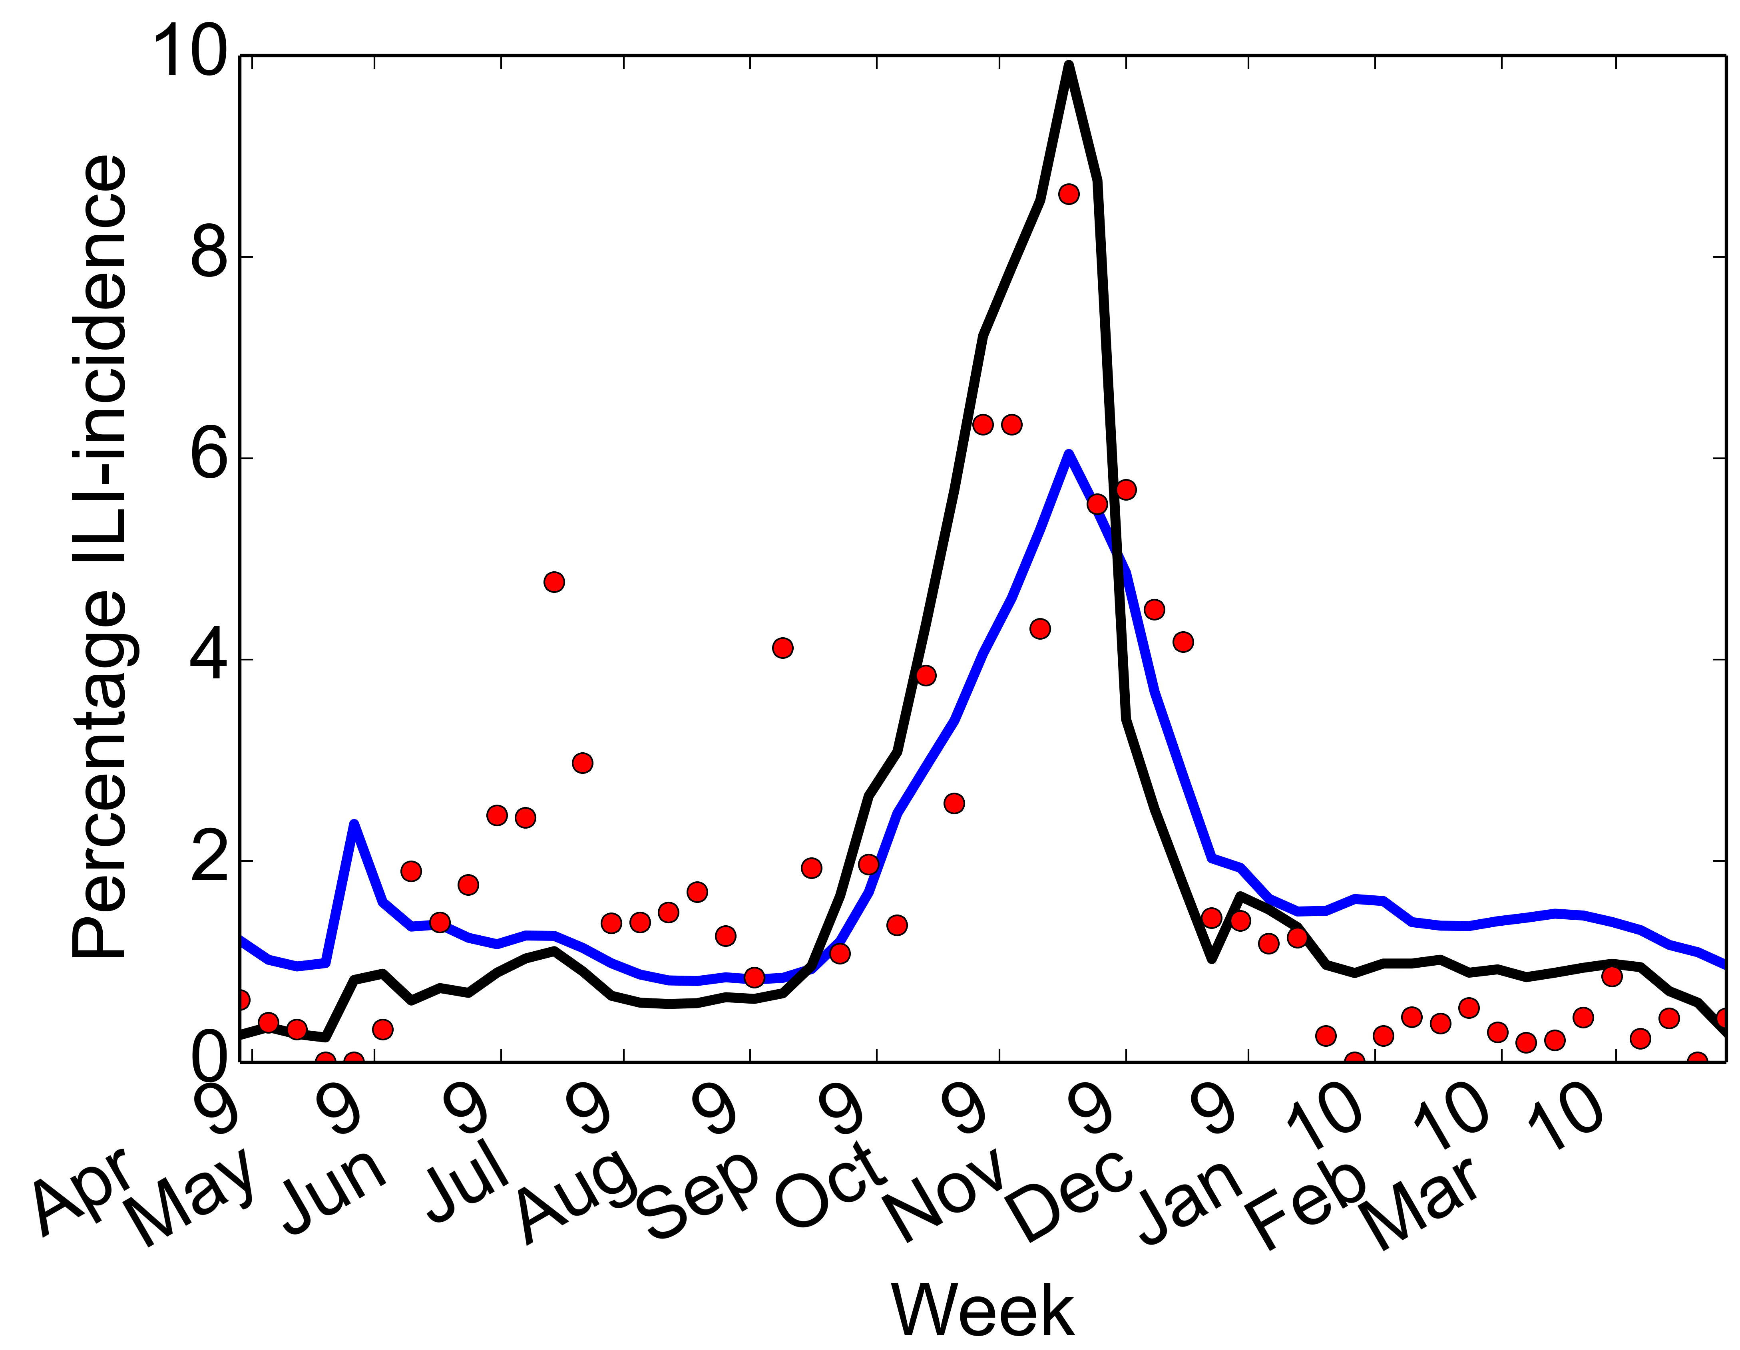
IMS Dx Data correlates well with CDC ILINet and Google Flu Trends (GFT)
HHS-I
HHS-II
HHS-III
HHS-IV
HHS-V
HHS-VI
HHS-VII
HHS-VIII
HHS-IX
HHS-X
Higher correlations between GFT and Dx (0.9 average)
CDC ILINet:
  Segments without missing data 0.86 average
  All data, 0.6 average
Correlations hold even within metropolitan areas (>0.9 on average for top 10 cities)
US
Notes:
CDC average across HHS zones

Slide 22
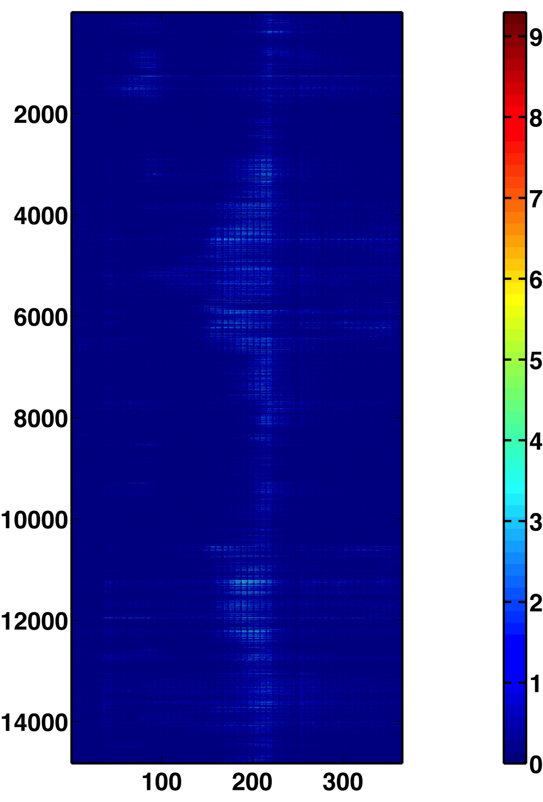
Organizing the data: What granularity of information to examine?
Key Questions:
  Is the data multi-scale?
  How to capture multi-scale properties from the data?
  Are there spatial and temporal patterns in the data?
  How to organize data for maximum analytic flexibility?
Northeast
Southeast
Midwest
Zip Codes
Log(ILI incidence)
Days

Slide 23
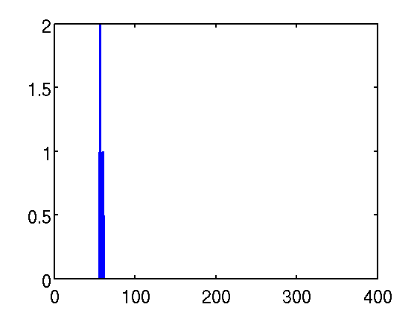
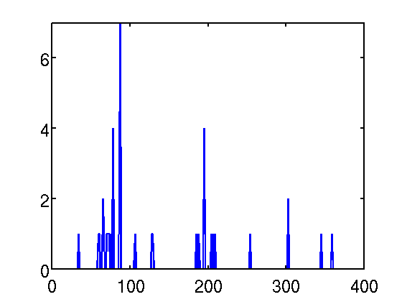
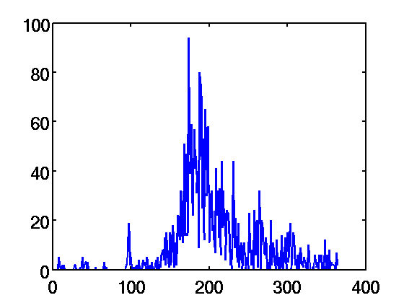
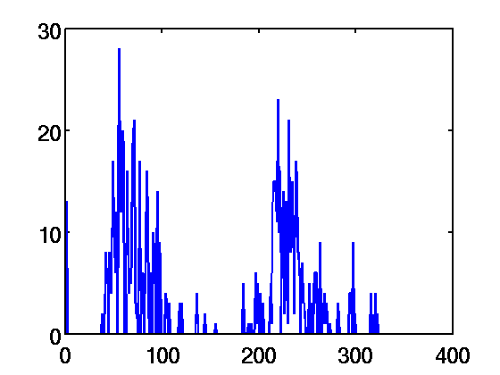
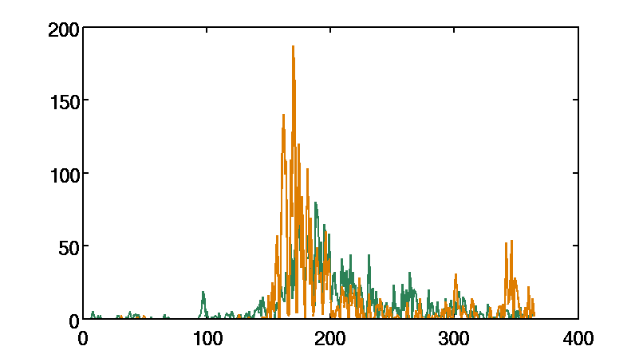
Spatial and Temporal Correlations within IMS Health Dx Data
Time-base visualization:
  Varied behaviors across zip codes
  Large-variations in flu incidences
However, correlations are observed across different geographic locations:
  Nearby vs. geographically separate regions
  Correlations observed in time (in a similar manner)

Slide 24
Non-negative matrix factorization (NMF)¹:
Discovering intrinsic structure of Dx Data
A_{(n x t)} ≈ W(n x s) H(s x t)
A₁₁ A₁₂ … A_{1t}
W₁₁ W₁₂ … W_{1s}
H₁₁ H₁₂ … H_{1n}
≈
A₂₁ A₂₂ … A_{2t}
W₂₁ W₂₂ … W_{2s}
H₂₁ H₂₂ … H_{2n}
…
…
…
…
…
…
…
…
…
A_{n1} A₂₂ … A_{nt}
W_{m1} W₂₂ … W_{ms}
H_{s1} H₂₂ … H_{sn}
Profile of ILI in a location
Spatial Patterns
Temporal Patterns
t: time (days)
n: location (zipcode)
s: reduced dimensions
¹Castro, J.B., Ramanathan, A., Chennubhotla, C.S., PLoS ONE (2013).

Slide 25
How do we go about solving this?
Objective Function:
Many options:
  Multiplicative update for NMF [Sebastian and Seung 1999]
  Gradient Descent [Chu et al 2004; Lee & Seung 2001]
  Alternating Least Squares [Langville et al 2006]

Slide 26
Flavor 2: Basic Gradient Descent
Pros
W = random(m, r); % initialize W as a random dense matrix
H = random(r, n); % initialize H as a random dense matrix
for i = 1:maxiter
  H = H – εH df/dH
  W = W – εW df/dW
Guaranteed to converge
With proper initialization of W and H, we can get good speed
Cons
Can converge to a “local” minimum, not optimal
Slow!
W and H are both dense matrices

Slide 27
Flavor 3: Alternating Least Squares
Pros
W = random(m, r)
for i = 1 : maxiter
  Solve for H in the matrix equation W^{T}WH = W^{T}A
  Set all negative elements of H to zero
  Solve for W in the matrix equation HH^{T}W^{T} = HA^{T}
  Set all negative elements of W to zero
Converges rather quickly
Works well in practice
Fast
Only need to initialize W
Cons
No sparsity of W and H incorporated
Ad-hoc non-negativity
no real guarantees on convergence

Slide 28
Flavor 1: Multiplicative Update Algorithm
Pros
W = random(m, r); % initialize W as a random dense matrix
H = random(r, n); % initialize H as a random dense matrix
for i = 1:maxiter
  H = H .* (W^{T}A) ./ (W^{T}WH + 10⁻⁹)
  W = W .* (AH^{T}) ./ (WHH^{T} + 10⁻⁹)
Very Fast!!
Include a sparsity parameter for H
No undue tweaks necessary
Cons
No sparsity parameter for W
ad hoc non-negativity
No convergence theory!

Slide 29
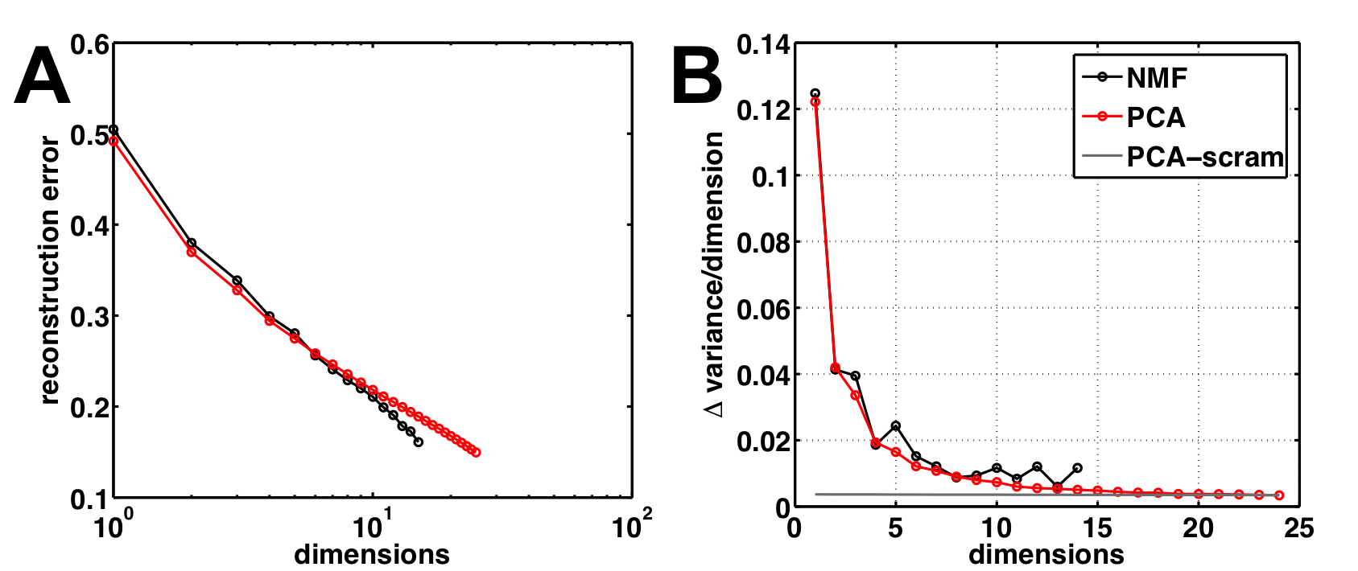
Finding the intrinsic dimensionality of Dx Data
Train and Test using NMF:
  dimensions from 2-15; s = 12 is where both PCA and NMF explain correlations within the data
  We chose s = 5 based on significant patterns

Slide 30
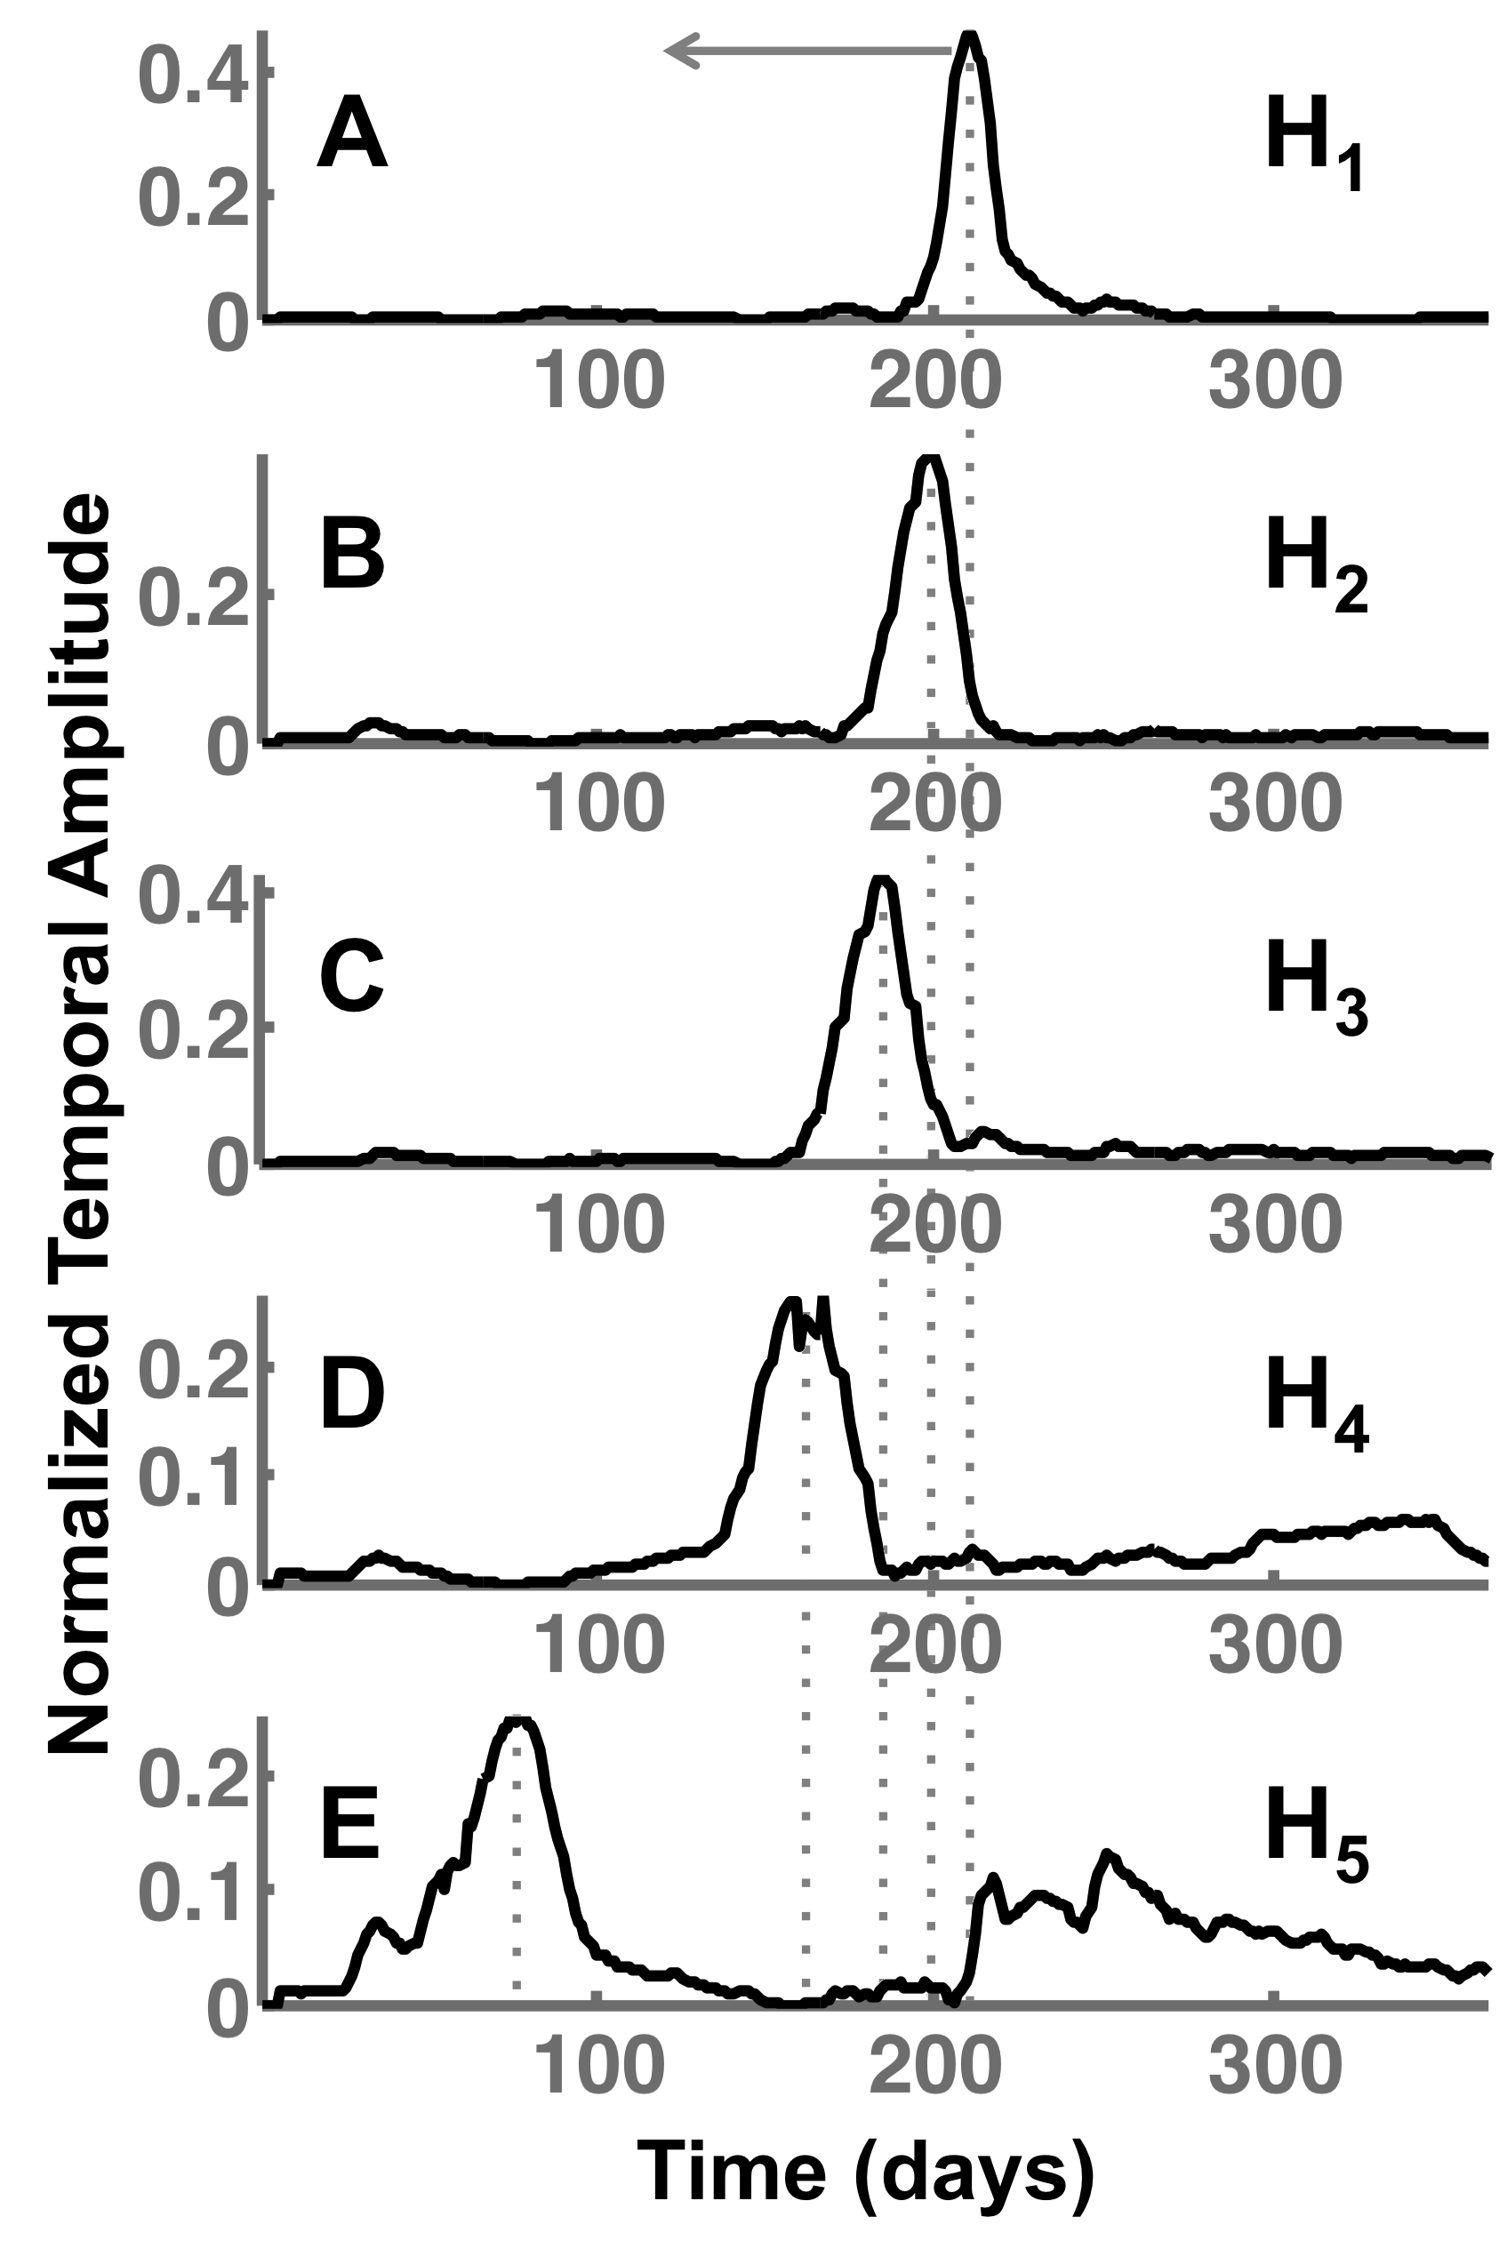
Temporal patterns indicate distinct phases of the H1N1 pandemic
H₁: “Background” – up to 60 cases in a location represent presence of the flu
H₂: “At the pandemic” – About 800 cases and a sharp increase around Oct-Nov 2009 time-frame
H₃: “Before the pandemic” – About 500 cases increasing gradually from Aug-Sep 2009 time-frame
  School re-opening at different locations
H₄: “After the pandemic” – After Nov 2009, a peak of secondary wave/ sustained infections still observed
H₅: “Early/Late epidemic” – The summer season, and late winter season

Slide 31
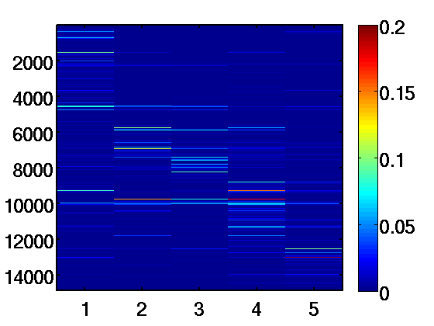
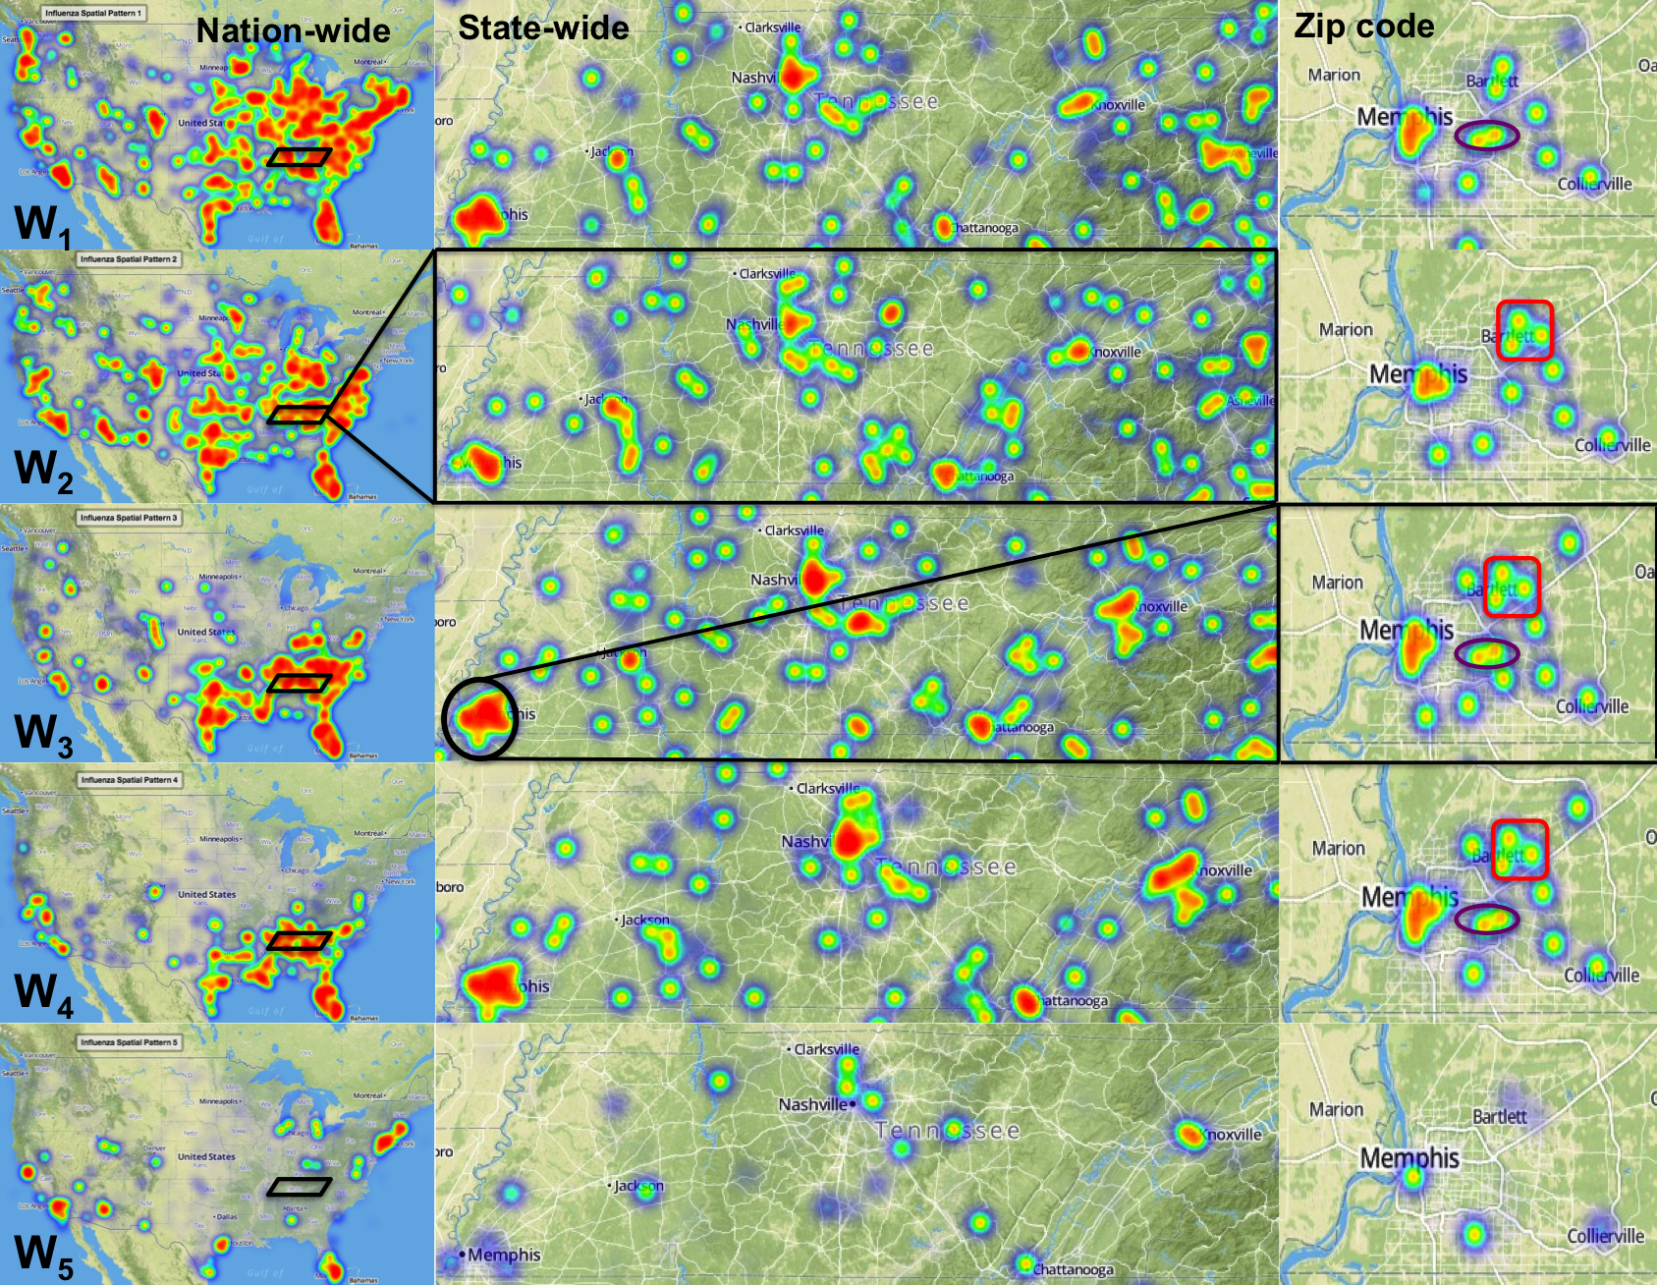
Multi-scale Spatial Patterns of H1N1 Flu
Block-diagonal structure of the spatial coupling:
  W2, W3, W4 show dependence across midwest and southeast and south-central regions
  W4 mostly south-central and west
Early coupling of epidemic between north-east and south-central regions

Slide 32
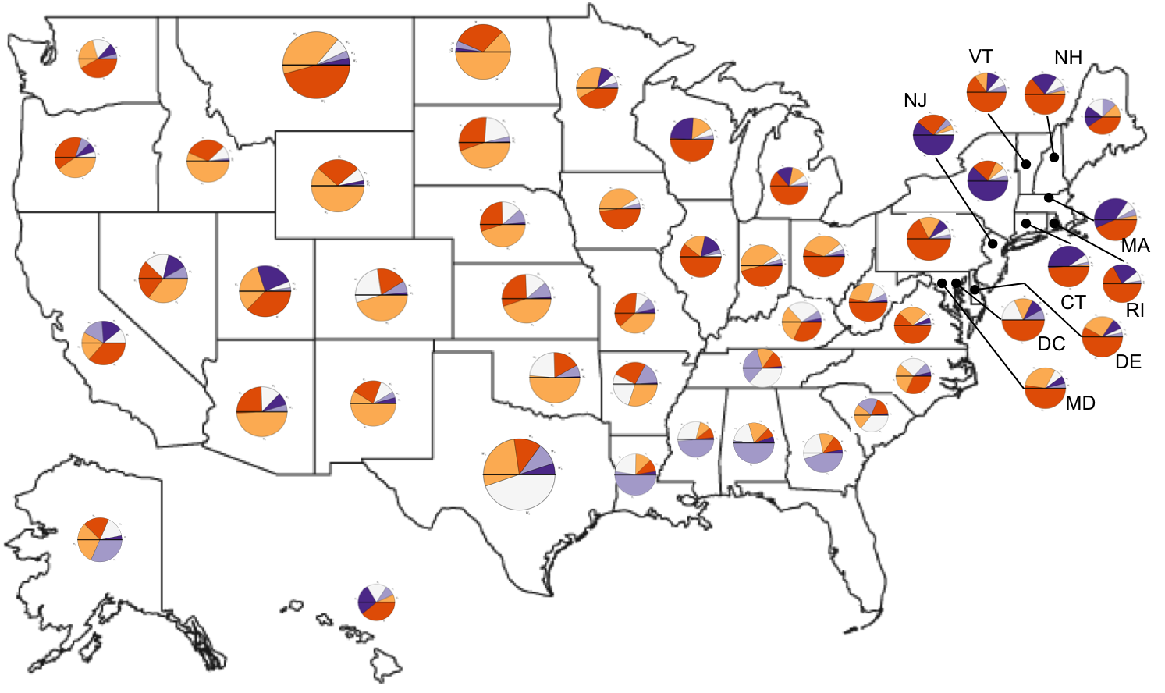
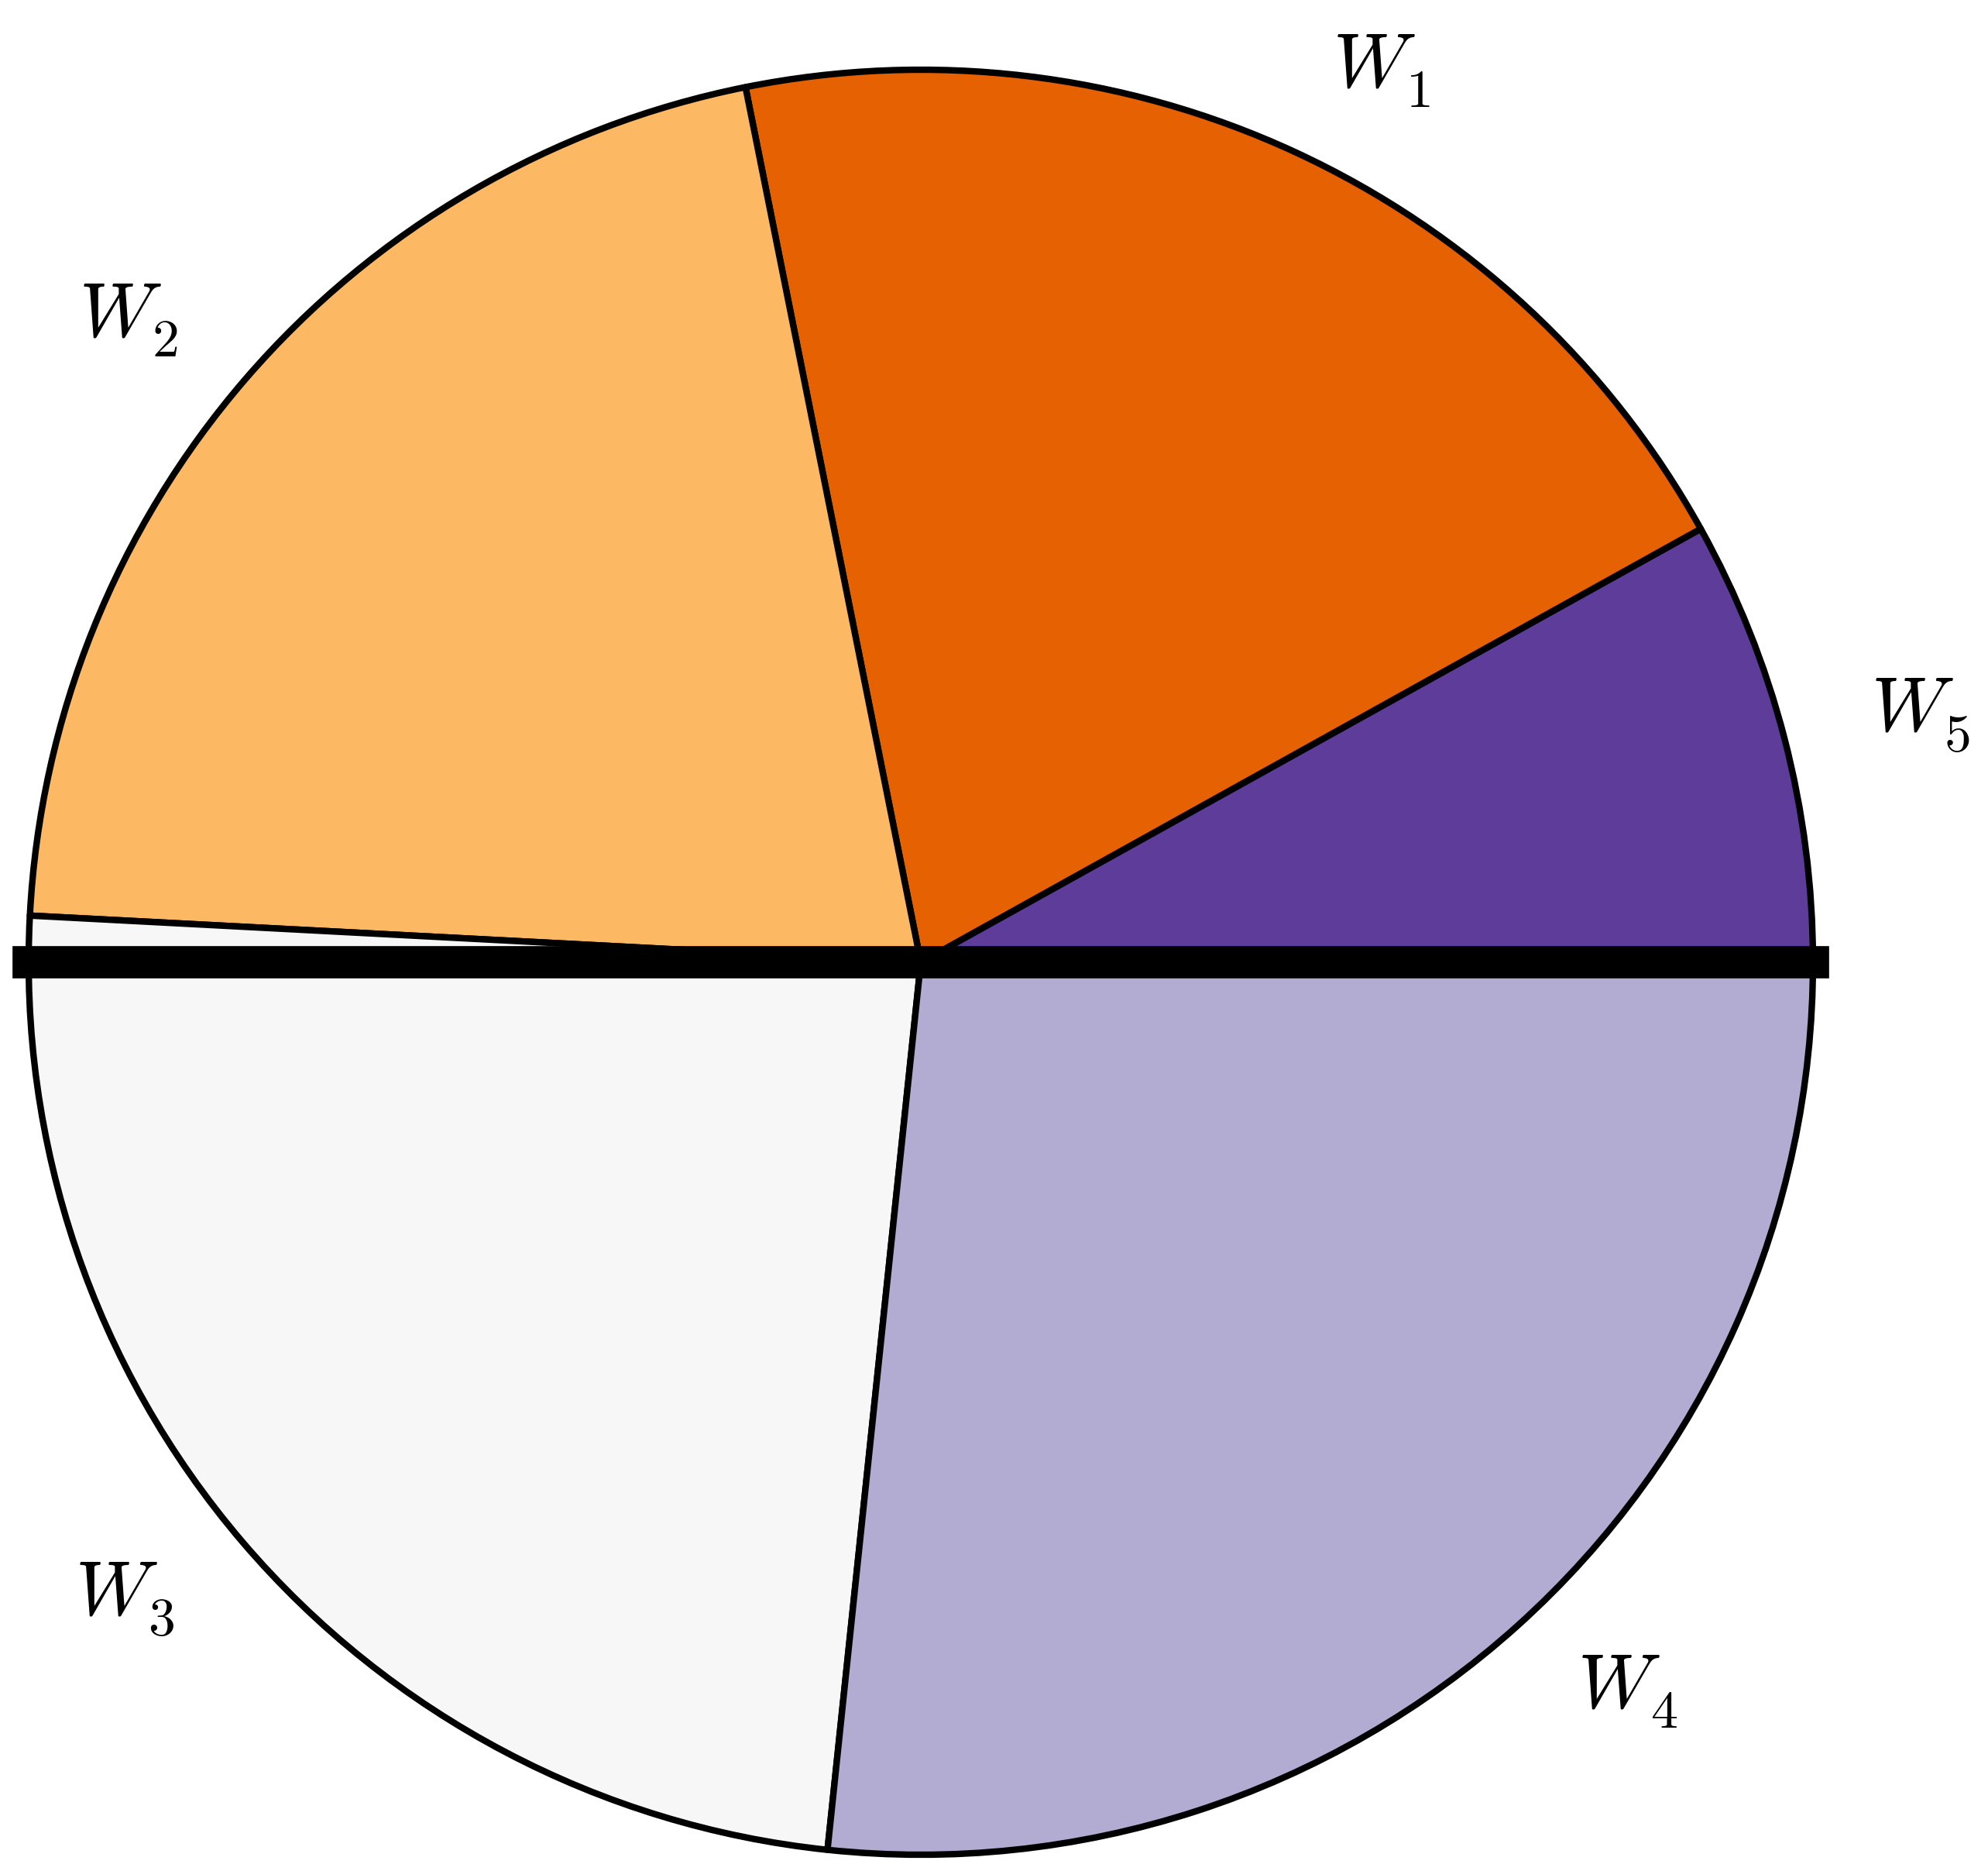
Identifying “bridge regions” using the multi-scale patterns

Slide 33
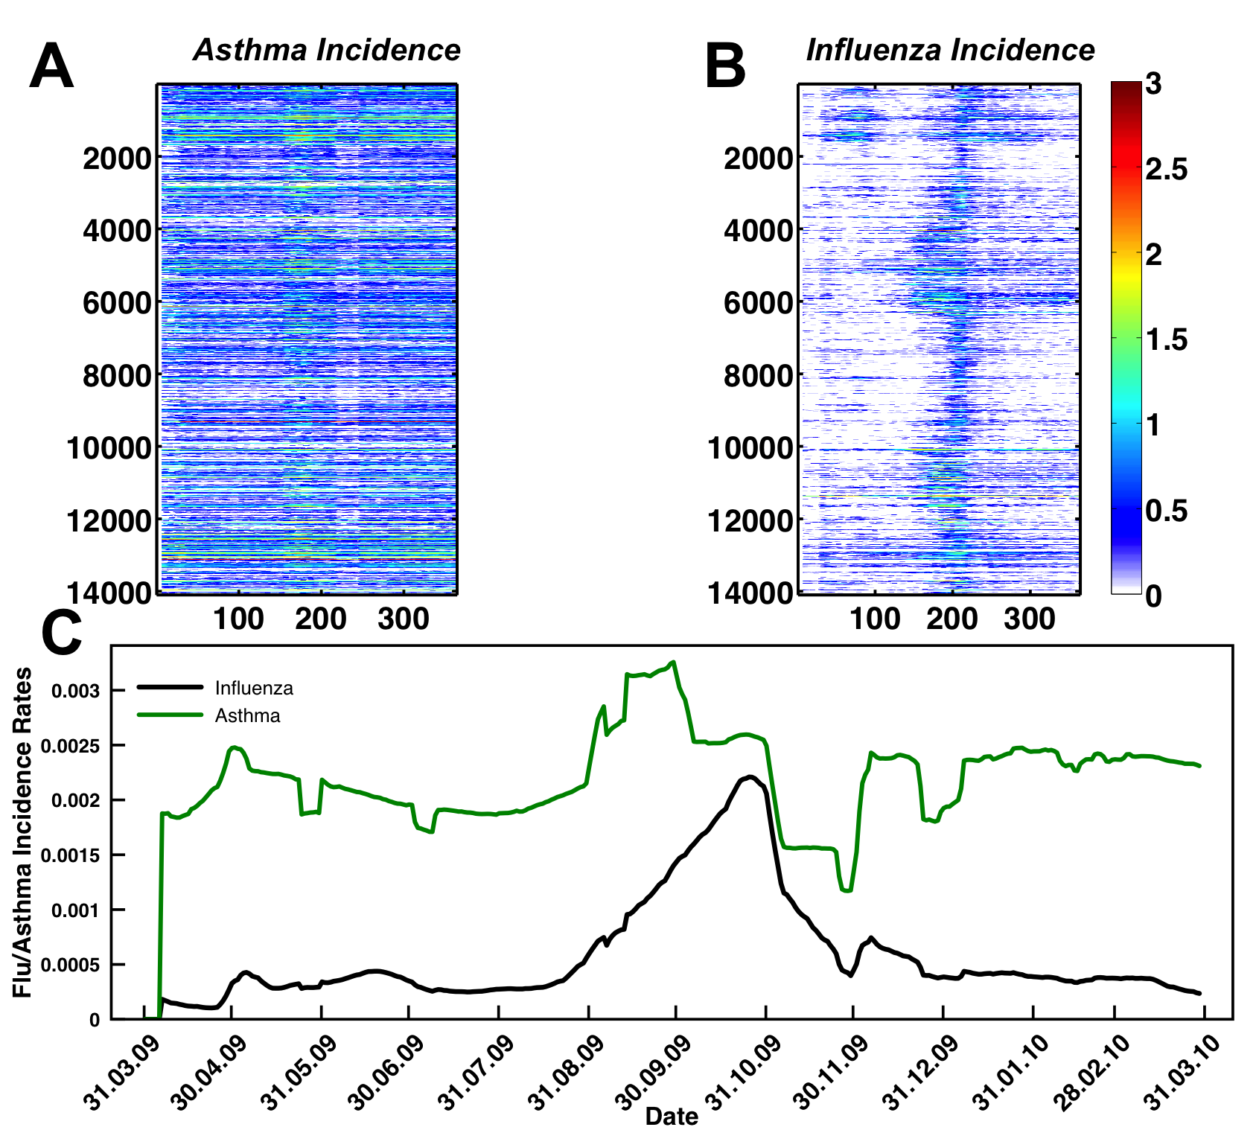
Co-occurrence of Flu and Asthma
Hypothesis: Are patterns in the flu preceded by an increase in asthma?
Overall for the US, the 2009 pandemic preceded a peak from asthma incidences
Regional patterns and their variations:
  how do they affect the total number of infected?
  Susceptible populations
Temporal behaviors

Slide 34
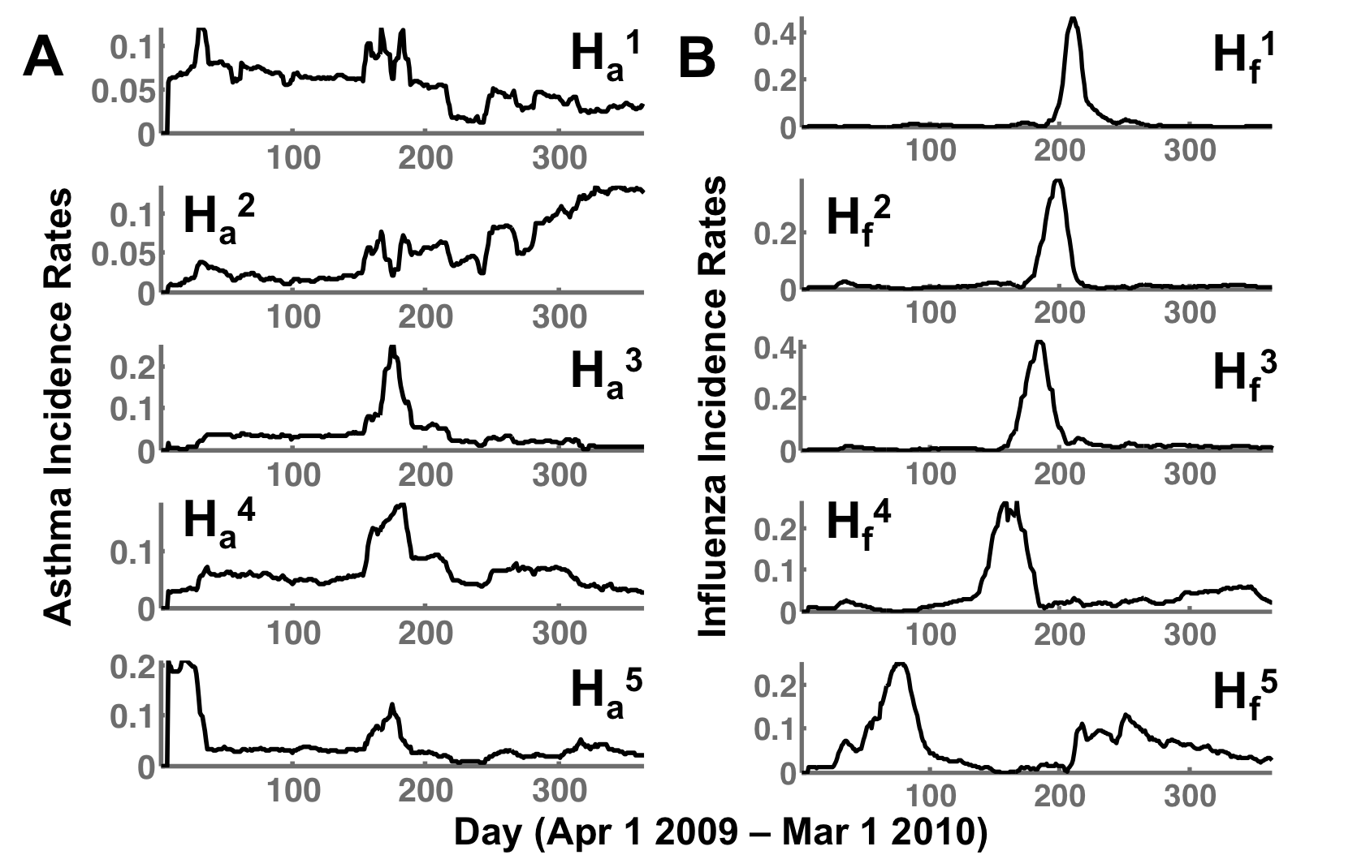
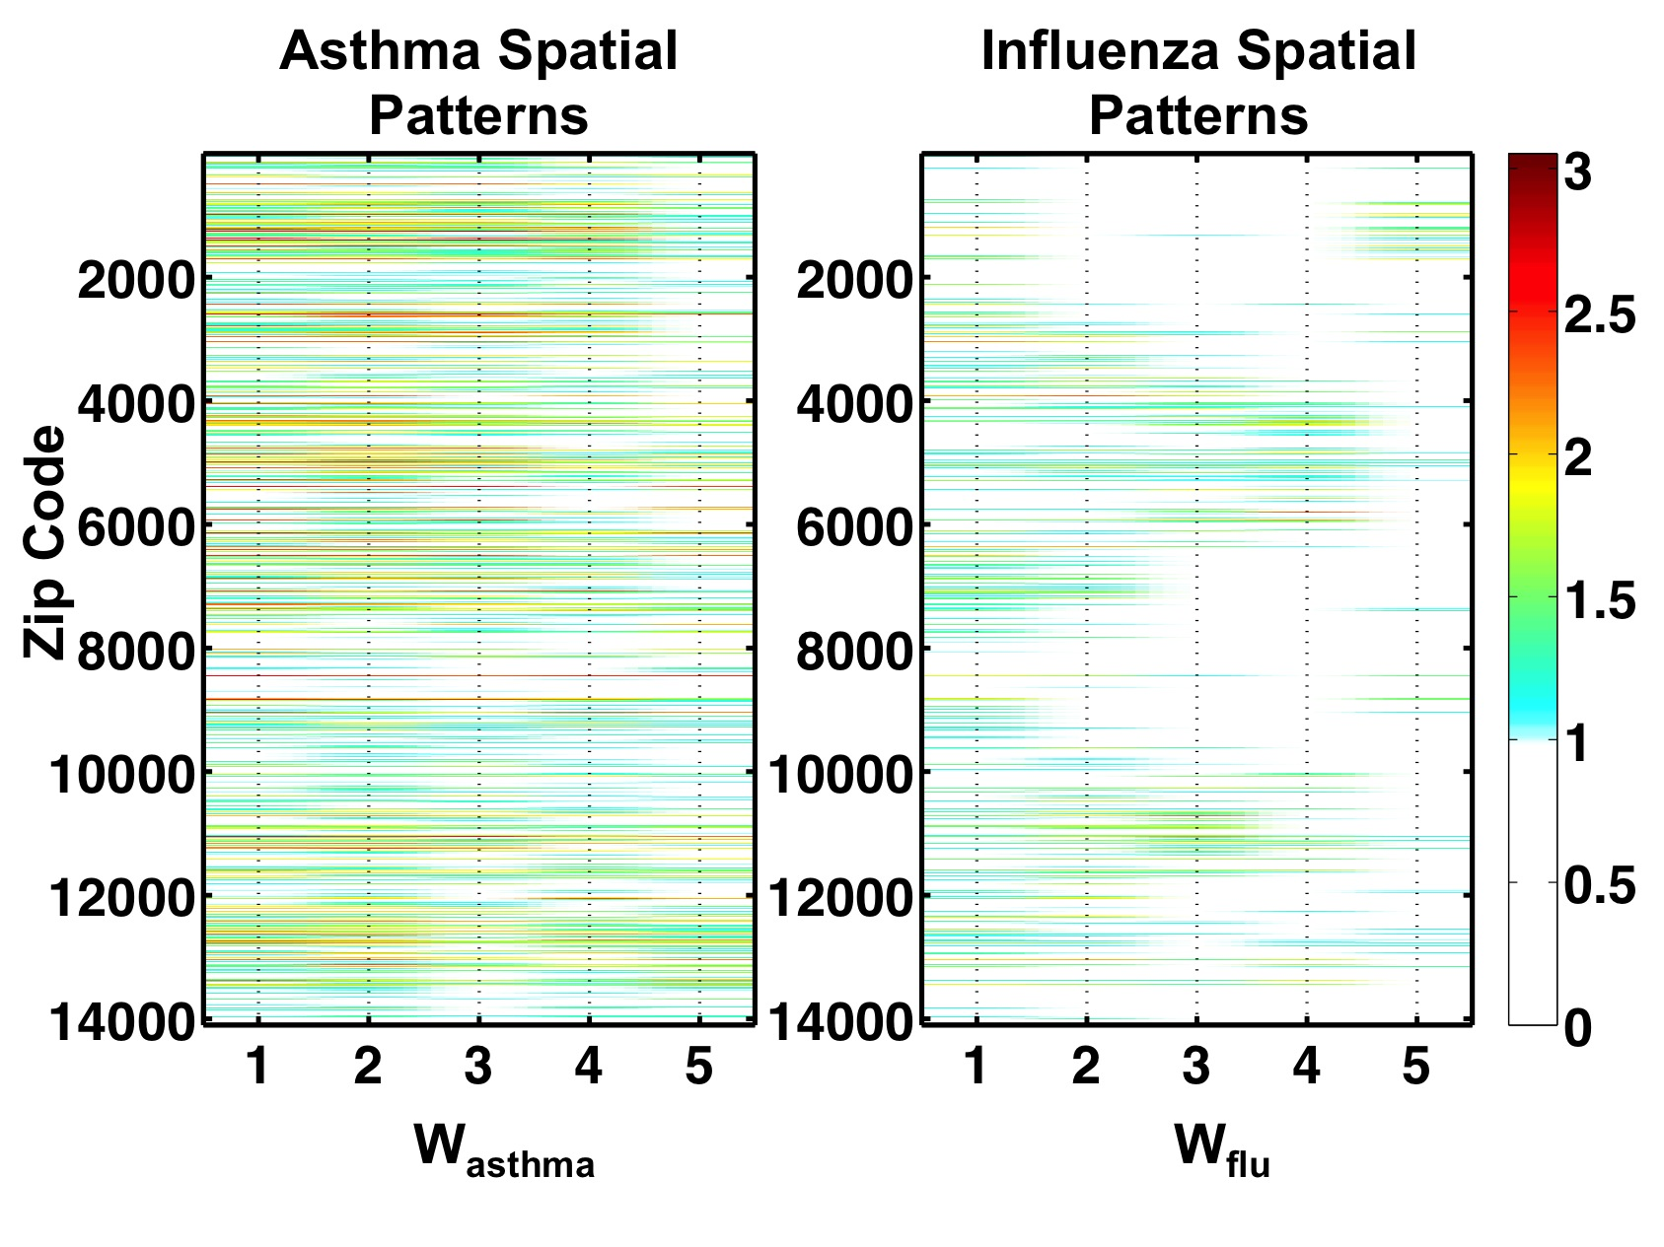
Temporal patterns in asthma and flu indicate a distinct time lag between flu and asthma
Unlike flu, two temporal signatures for early (H_{a}¹) and late asthma (H_{a}²) seasons
Two patterns (H_{a}³ and H_{a}⁴) precede the flu season peaks; H_{a}⁵ precedes the early onset of the flu season
Spatially – asthma is more spread out (commonly occurring)

Slide 35
Lessons Learned/Summary
Novel data and analytic techniques can provide unique insights into public health dynamics
Patterns show unique temporal and spatial “signatures”:
  integrated with disease spread models
  rapid modeling of “what if” scenarios
Further work analyzing with prescription records and socio-economic data

Slide 36
Future Work
Integrating Census, Climate, Transportation and Environmental data with Claims data:
  Generate novel hypothesis of how climate/environmental factors affect treatments
Integrating with genome data:
  Novel hypotheses for analyzing how genome variation in west-nile virus affects incidences*
A platform for integrating heterogeneous data sources
*Joint work with: Kamaleshwar Singh, Texas Tech University

Slide 37
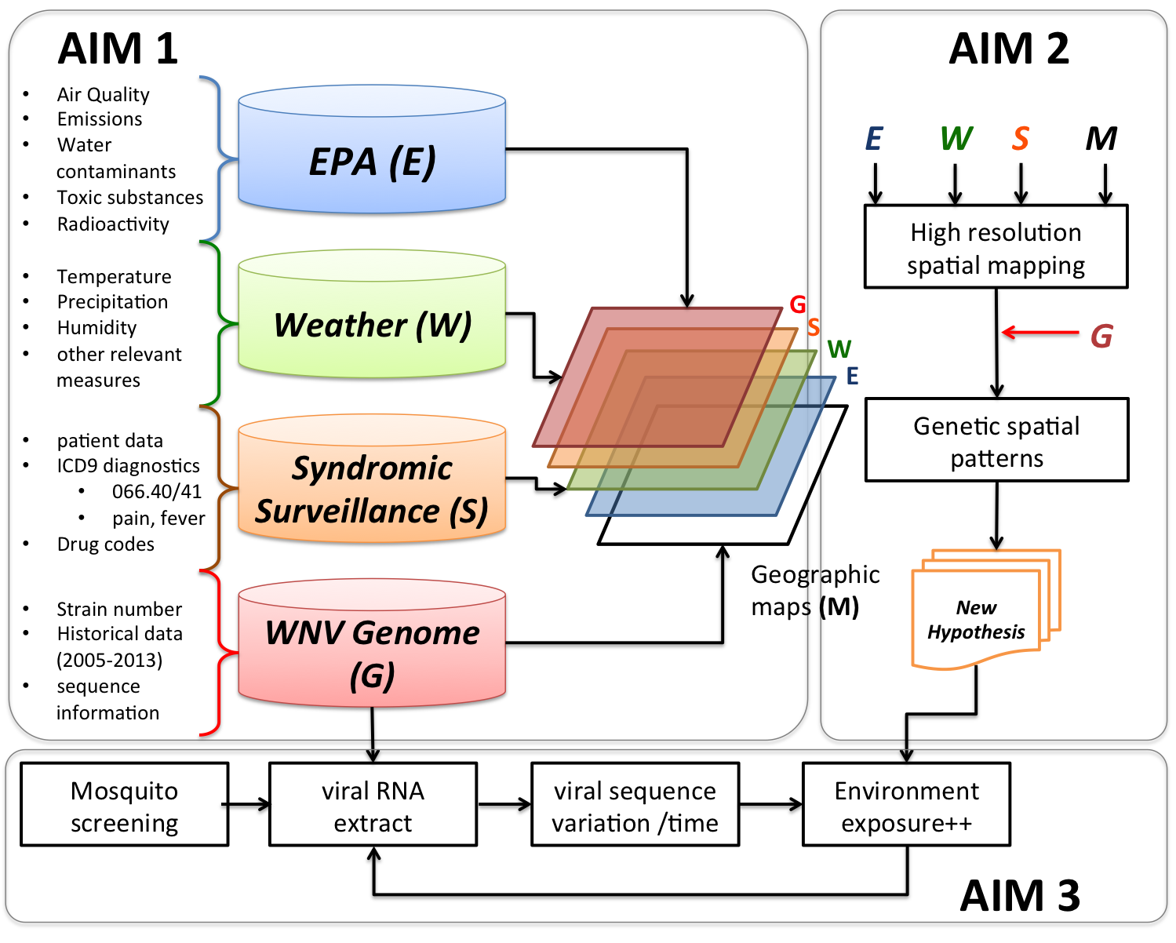
Integrating environmental and climate exposures to eco-epidemiology of WNV

Slide 38

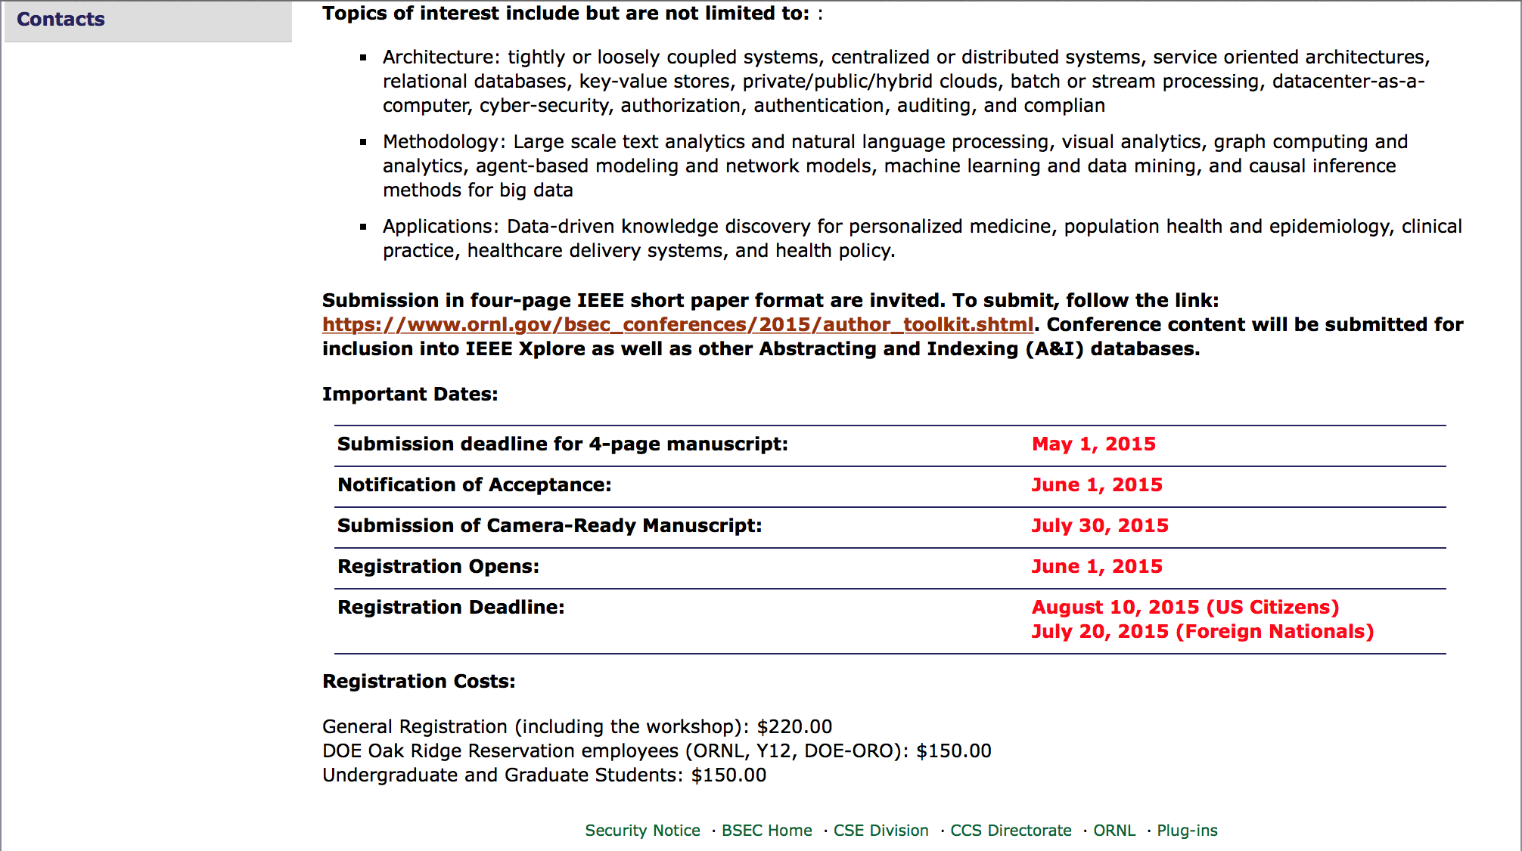
Shameless Promotion – BSEC 2015

Slide 39
THANK YOU!!!
Contacts:
Arvind Ramanathan (ramanathana@ornl.gov) 865-576-7266

