Slide 1
Naïve Bayes (HW1): Tips and Tricks
Shannon Quinn

Slide 2
Git
Basics
http://git-scm.com/docs/gittutorial
[Advanced] Cheat sheet
https://github.com/tiimgreen/github-cheat-sheet

Slide 3
Some useful Hadoop-isms
Testing and setup
Excellent Hadoop 2.x setup and testing tutorial: http://www.highlyscalablesystems.com/3597/hadoop-installation-tutorial-hadoop-2-x/
You won’t need to worry about setup!
On GACRC, I’m setting up the VMs
On AWS, Amazon handles it
But the testing tips near the bottom are excellent
Putting files into HDFS
Reading existing content/results in HDFS
Submitting Hadoop jobs on the command line
If you use AWS GUI, you won’t need to worry about any of this

Slide 4
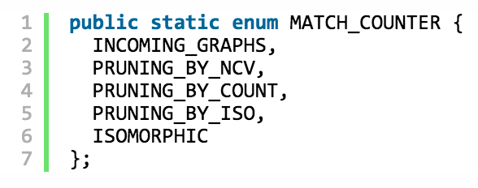
Some useful Hadoop-isms
Counters
Initialize in main() / run()
Increment in mapper / reducer
Read in main() / run()
Example: http://diveintodata.org/2011/03/15/an-example-of-hadoop-mapreduce-counter/

Slide 5
Some useful Hadoop-isms
Joins
Join values together that have the same key
Map-side
Faster and more efficient
Harder to implement—requires custom Partitioner and Comparator
http://codingjunkie.net/mapside-joins/
Reduce-side
Easy to implement—shuffle step does the work for you!
Less efficient as data is pushed to the network
http://codingjunkie.net/mapreduce-reduce-joins/
MultipleInputs
Specify a specific mapper class for a specific input path
https://hadoop.apache.org/docs/current/api/org/apache/hadoop/mapreduce/lib/input/MultipleInputs.html

Slide 6
Some useful Hadoop-isms
setup()
Optional method override in Mapper / Reducer subclass
Executed before map() / reduce()
Useful for initializing variables…

Slide 7
Some useful Hadoop-isms
DistributedCache
Read-only cache of information accessible by each node in the cluster
Very useful for broadcasting small amounts of read-only information
Tricky to implement
http://stackoverflow.com/questions/21239722/hadoop-distributedcache-is-deprecated-what-is-the-preferred-api

Slide 8
WARNING!!!
Hadoop 1.2.1 vs Hadoop 2.2.0

Slide 9
A little MapReduce: NB Variables
|V|
|L|
Y=*
Y=y
Y=y, W=*
Y=y, W=w
Size of vocabulary (unique words)
Size of label space (unique labels)
Number of documents
Number of documents with label y
Number of words in a document with label y
Number of times w appears in a document with label y

