Slide 1
Spectral Clustering
Shannon Quinn
(with thanks to William Cohen of Carnegie Mellon University, and J. Leskovec, A. Rajaraman, and J. Ullman of Stanford University)

Slide 2
Graph Partitioning
5
Undirected graph
Bi-partitioning task:
Divide vertices into two disjoint groups
Questions:
How can we define a “good” partition of ?
How can we efficiently identify such a partition?
1
2
6
4
3
A
5
B
1
2
6
3
4

Slide 3
Graph Partitioning
What makes a good partition?
Maximize the number of within-group connections
Minimize the number of between-group connections
5
1
2
6
4
3
A
B

Slide 4
Graph Cuts
Express partitioning objectives as a function of the “edge cut” of the partition
Cut: Set of edges with only one vertex in a group:
A
B
5
1
cut(A,B) = 2
2
6
4
3

Slide 5
Graph Cut Criterion
Criterion: Minimum-cut
Minimize weight of connections between groups
Degenerate case:
Problem:
Only considers external cluster connections
Does not consider internal cluster connectivity
arg min_{A,B} cut(A,B)
“Optimal cut”
Minimum cut

Slide 6
Graph Cut Criteria
[Shi-Malik]
Criterion: Normalized-cut [Shi-Malik, ’97]
Connectivity between groups relative to the density of each group
: total weight of the edges with at least one endpoint in :
Why use this criterion?
Produces more balanced partitions
How do we efficiently find a good partition?
Problem: Computing optimal cut is NP-hard

Slide 7
Spectral Graph Partitioning
A: adjacency matrix of undirected G
A_{ij} =1 if is an edge, else 0
x is a vector in ℜ^{n} with components
Think of it as a label/value of each node of
What is the meaning of A⋅ x?
Entry y_{i} is a sum of labels x_{j} of neighbors of i

Slide 8
What is the meaning of Ax?
j^{th} coordinate of A⋅ x :
Sum of the x-values of neighbors of j
Make this a new value at node j
Spectral Graph Theory:
Analyze the “spectrum” of matrix representing
Spectrum: Eigenvectors of a graph, ordered by the magnitude (strength) of their corresponding eigenvalues :
$$A⋅x=λ⋅x$$

Slide 9
Matrix Representations
Adjacency matrix (A):
n× n matrix
A=[a_{ij}], a_{ij}=1 if edge between node i and j
Important properties:
Symmetric matrix
Eigenvectors are real and orthogonal
 | 1 | 2 | 3 | 4 | 5 | 6
1 | 0 | 1 | 1 | 0 | 1 | 0
2 | 1 | 0 | 1 | 0 | 0 | 0
3 | 1 | 1 | 0 | 1 | 0 | 0
4 | 0 | 0 | 1 | 0 | 1 | 1
5 | 1 | 0 | 0 | 1 | 0 | 1
6 | 0 | 0 | 0 | 1 | 1 | 0
5
1
2
6
4
3

Slide 10
Matrix Representations
Degree matrix (D):
n× n diagonal matrix
D=[d_{ii}], d_{ii} = degree of node i
 | 1 | 2 | 3 | 4 | 5 | 6
1 | 3 | 0 | 0 | 0 | 0 | 0
2 | 0 | 2 | 0 | 0 | 0 | 0
3 | 0 | 0 | 3 | 0 | 0 | 0
4 | 0 | 0 | 0 | 3 | 0 | 0
5 | 0 | 0 | 0 | 0 | 3 | 0
6 | 0 | 0 | 0 | 0 | 0 | 2
5
1
2
6
4
3

Slide 11
Matrix Representations
 | 1 | 2 | 3 | 4 | 5 | 6
1 | 3 | -1 | -1 | 0 | -1 | 0
2 | -1 | 2 | -1 | 0 | 0 | 0
3 | -1 | -1 | 3 | -1 | 0 | 0
4 | 0 | 0 | -1 | 3 | -1 | -1
5 | -1 | 0 | 0 | -1 | 3 | -1
6 | 0 | 0 | 0 | -1 | -1 | 2
Laplacian matrix (L):
n× n symmetric matrix
What is trivial eigenpair?
Important properties:
Eigenvalues are non-negative real numbers
Eigenvectors are real and orthogonal
1
5
2
6
4
3
$$L = D − A$$

Slide 12
Spectral Clustering: Graph = Matrix W*v₁ = v₂ “propogates weights from neighbors”
e₂
0.4
0.2
x
x
x
x
x
x
x
x
0.0
x
x
x
x
-0.2
y
z
y
y
z
-0.4
y
z
z
z
e₃
z
z
z
z
z
y
z
e₁
e₂
-0.4
-0.2
0
0.2
[Shi & Meila, 2002]

Slide 13
Spectral Clustering: Graph = Matrix W*v₁ = v₂ “propagates weights from neighbors”
If Wis connected but roughly block diagonal with k blocks then
the top eigenvector is a constant vector
the next k eigenvectors are roughly piecewise constant with “pieces” corresponding to blocks
M

Slide 14
Spectral Clustering: Graph = Matrix W*v₁ = v₂ “propagates weights from neighbors”
If W is connected but roughly block diagonal with k blocks then
the “top” eigenvector is a constant vector
the next k eigenvectors are roughly piecewise constant with “pieces” corresponding to blocks
Spectral clustering:
Find the top k+1 eigenvectors v₁,…,v_{k+1}
Discard the “top” one
Replace every node a with k-dimensional vector x_{a} = <v₂(a),…,v_{k+1} (a) >
Cluster with k-means
M

Slide 15
Spectral Clustering: Graph = Matrix W*v₁ = v₂ “propogates weights from neighbors”
smallest eigenvecs of D-A are largest eigenvecs of A
smallest eigenvecs of I-W are largest eigenvecs of W
Suppose each y(i)=+1 or -1:
Then y is a cluster indicator that splits the nodes into two
what is y^{T}(D-A)y ?

Slide 16
= size of CUT(y)
NCUT: roughly minimize ratio of transitions between classes vs transitions within classes

Slide 17
So far…
How to define a “good” partition of a graph?
Minimize a given graph cut criterion
How to efficiently identify such a partition?
Approximate using information provided by the eigenvalues and eigenvectors of a graph
Spectral Clustering

Slide 18
Spectral Clustering Algorithms
Three basic stages:
1) Pre-processing
Construct a matrix representation of the graph
2) Decomposition
Compute eigenvalues and eigenvectors of the matrix
Map each point to a lower-dimensional representation based on one or more eigenvectors
3) Grouping
Assign points to two or more clusters, based on the new representation

Slide 19
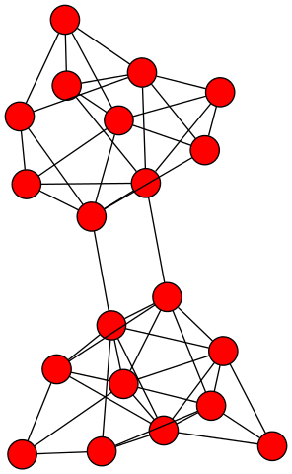
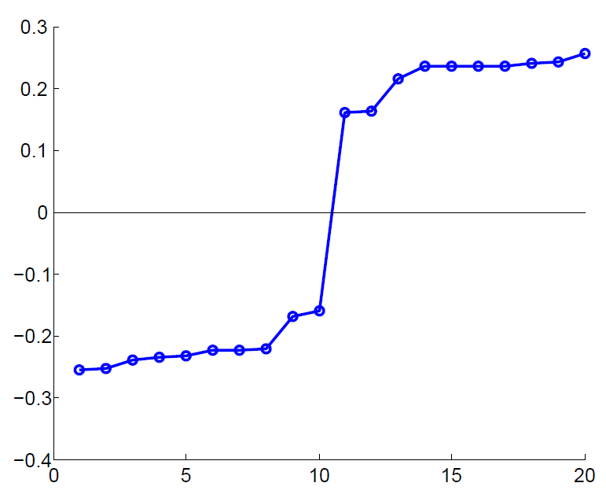
Example: Spectral Partitioning
Value of x₂
Rank in x₂

Slide 20
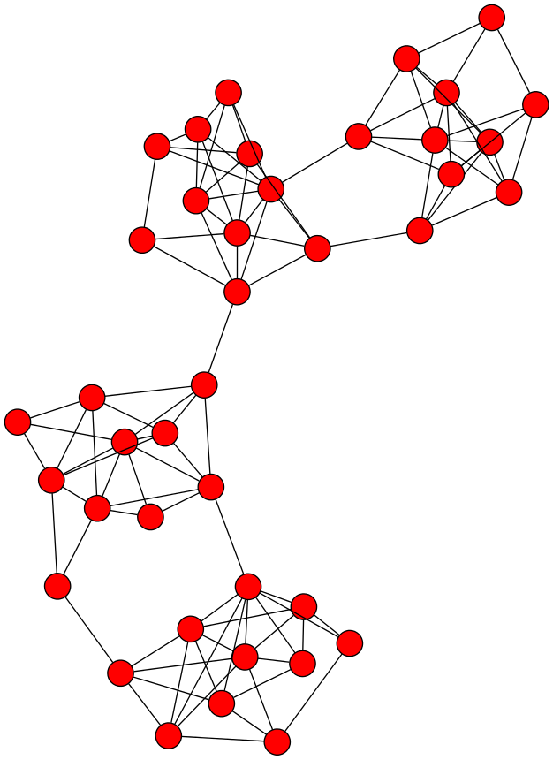
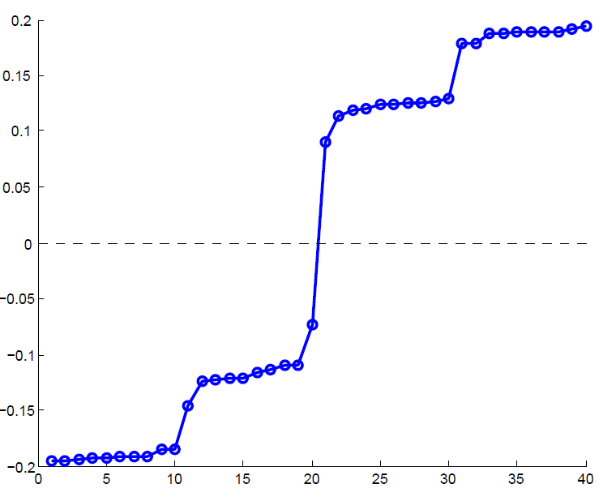
Example: Spectral Partitioning
Components of x₂
Value of x₂
Rank in x₂

Slide 21
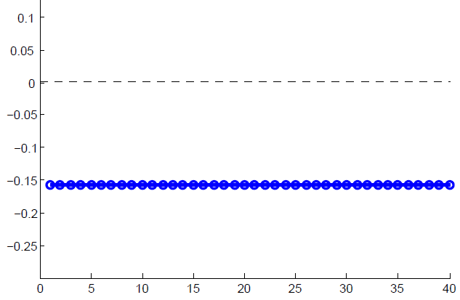
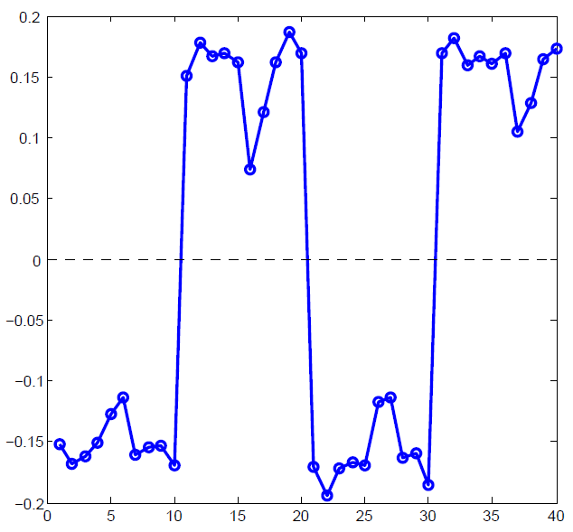
Example: Spectral partitioning
Components of x₁
Components of x₃

Slide 22
k-Way Spectral Clustering
How do we partition a graph into k clusters?
Two basic approaches:
Recursive bi-partitioning [Hagen et al., ’92]
Recursively apply bi-partitioning algorithm in a hierarchical divisive manner
Disadvantages: Inefficient, unstable
Cluster multiple eigenvectors [Shi-Malik, ’00]
Build a reduced space from multiple eigenvectors
Commonly used in recent papers
A preferable approach…

Slide 23
Why use multiple eigenvectors?
Approximates the optimal cut [Shi-Malik, ’00]
Can be used to approximate optimal k-way normalized cut
Emphasizes cohesive clusters
Increases the unevenness in the distribution of the data
Associations between similar points are amplified, associations between dissimilar points are attenuated
The data begins to “approximate a clustering”
Well-separated space
Transforms data to a new “embedded space”, consisting of k orthogonal basis vectors
Multiple eigenvectors prevent instability due to information loss

Slide 24
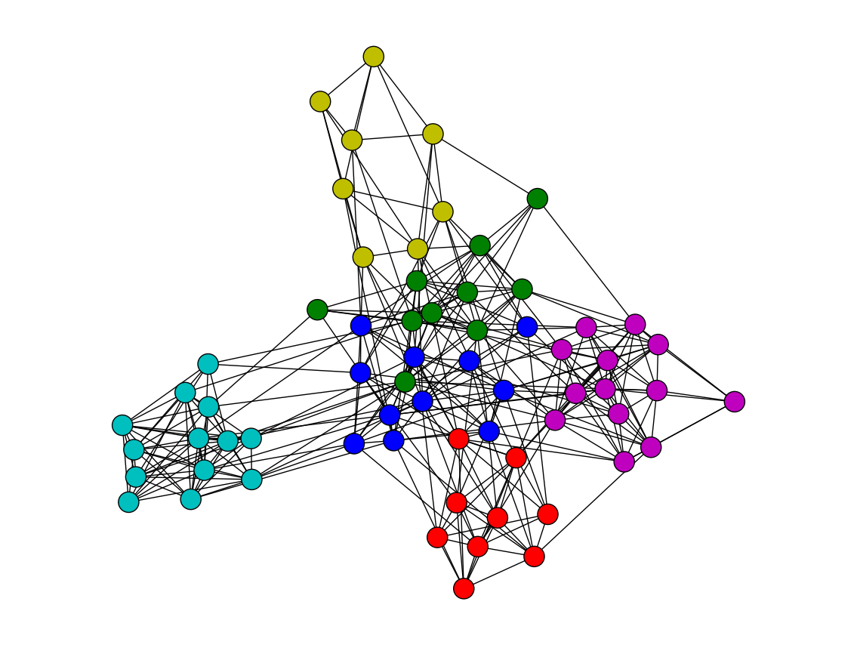
Spectral Clustering: Graph = Matrix W*v₁ = v₂ “propogates weights from neighbors”
smallest eigenvecs of D-A are largest eigenvecs of A
smallest eigenvecs of I-W are largest eigenvecs of W
Q: How do I pick v to be an eigenvector for a block-stochastic matrix?

Slide 25
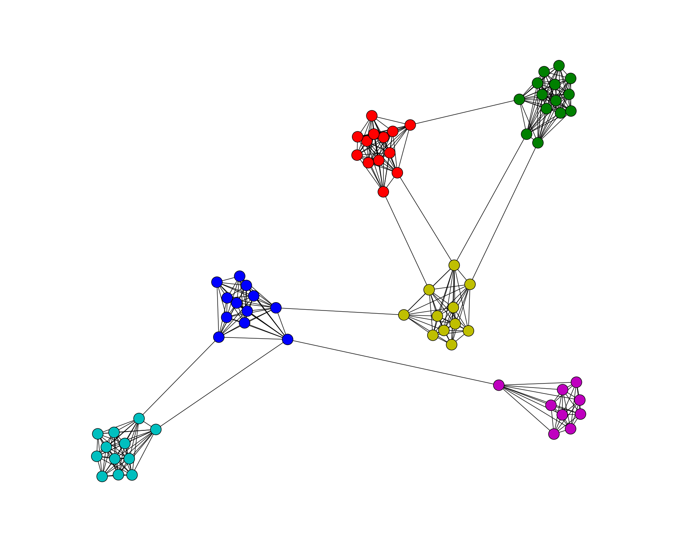
Spectral Clustering: Graph = Matrix W*v₁ = v₂ “propogates weights from neighbors”
How do I pick v to be an eigenvector for a block-stochastic matrix?

Slide 26
Spectral Clustering: Graph = Matrix W*v₁ = v₂ “propogates weights from neighbors”
smallest eigenvecs of D-A are largest eigenvecs of A
smallest eigenvecs of I-W are largest eigenvecs of W
Suppose each y(i)=+1 or -1:
Then y is a cluster indicator that cuts the nodes into two
what is y^{T}(D-A)y ? The cost of the graph cut defined by y
what is y^{T}(I-W)y ? Also a cost of a graph cut defined by y
How to minimize it?
Turns out: to minimize y^{T} X y / (y^{T}y) find smallest eigenvector of X
But: this will not be +1/-1, so it’s a “relaxed” solution

Slide 27
Spectral Clustering: Graph = Matrix W*v₁ = v₂ “propogates weights from neighbors”
λ₁
e₁
λ₂
e₃
λ₃
“eigengap”
λ₄
e₂
λ₅,_{6,7,….}
[Shi & Meila, 2002]

Slide 28
Some more terms
If A is an adjacency matrix (maybe weighted) and D is a (diagonal) matrix giving the degree of each node
Then D-A is the (unnormalized) Laplacian
W=AD⁻¹ is a probabilistic adjacency matrix
I-W is the (normalized or random-walk) Laplacian
etc….
The largest eigenvectors of W correspond to the smallest eigenvectors of I-W
So sometimes people talk about “bottom eigenvectors of the Laplacian”

Slide 29
A
W
K-nn graph
(easy)
A
Fully connected graph,
weighted by distance
W

Slide 30
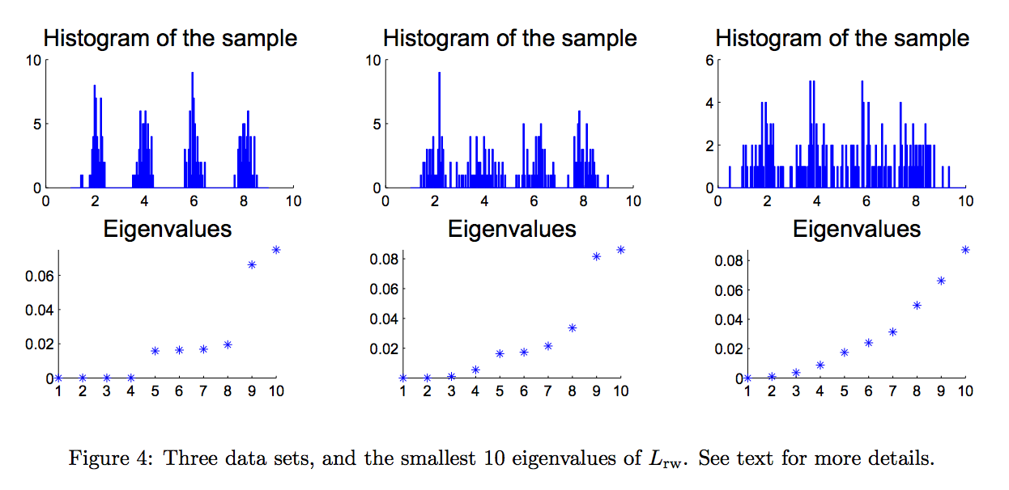

Slide 31
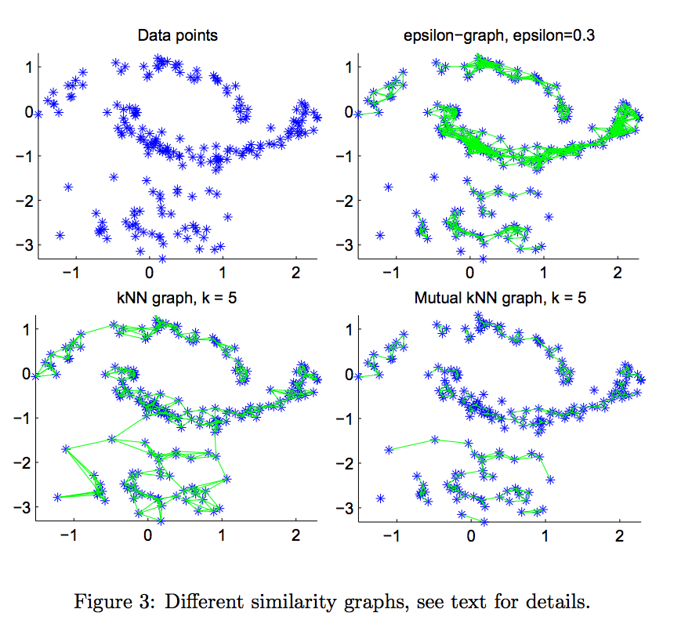

Slide 32
Spectral Clustering: Pros and Cons
Elegant, and well-founded mathematically
Works quite well when relations are approximately transitive (like similarity)
Very noisy datasets cause problems
“Informative” eigenvectors need not be in top few
Performance can drop suddenly from good to terrible
Expensive for very large datasets
Computing eigenvectors is the bottleneck

Slide 33
Use cases and runtimes
K-Means
FAST
“Embarrassingly parallel”
Not very useful on anisotropic data
Spectral clustering
Excellent quality under many different data forms
Much slower than K-Means

Slide 34
Further Reading
Spectral Clustering Tutorial: http://www.informatik.uni-hamburg.de/ML/contents/people/luxburg/publications/Luxburg07_tutorial.pdf

