Slide 1
Semi-Supervised Learning With Graphs
Shannon Quinn
(with thanks to William Cohen at CMU)

Slide 2
Semi-supervised learning
A pool of labeled examples L
A (usually larger) pool of unlabeled examples U
Can you improve accuracy somehow using U?

Slide 3
Semi-Supervised Bootstrapped Learning/Self-training
Extract cities:
Paris
Pittsburgh
Seattle
Cupertino
San Francisco
Austin
denial
anxiety
selfishness
Berlin
mayor of arg1
live in arg1
arg1 is home of
traits such as arg1

Slide 4
Semi-Supervised Bootstrapped Learning via Label Propagation
mayor of arg1
arg1 is home of
San Francisco
Austin
Paris
Pittsburgh
anxiety
live in arg1
traits such as arg1
denial
selfishness
Seattle

Slide 5
Semi-Supervised Bootstrapped Learning via Label Propagation
mayor of arg1
arg1 is home of
Information from other categories tells you “how far” (when to stop propagating)
San Francisco
Austin
Paris
Pittsburgh
anxiety
traits such as arg1
live in arg1
traits such as arg1
arrogance
denial
selfishness
denial
selfishness
Seattle
Nodes “near” seeds
Nodes “far from” seeds

Slide 6
Semi-Supervised Learning as Label Propagation on a (Bipartite) Graph
mayor of arg1
Propagation methods: “personalized PageRank” (aka damped PageRank, random-walk-with-reset)
arg1 is home of
San Francisco
Austin
Paris
Pittsburgh
Propagate labels to nearby nodes
X is “near” Y if there is a high probability of reaching X from Y with a random walk where each step is either (a) move to a random neighbor or (b) jump back to start node Y, if you’re at an NP node
  rewards multiple paths
  penalizes long paths
  penalizes high-fanout paths
anxiety
live in arg1
traits such as arg1
denial
selfishness
Seattle
I like arg1
beer

Slide 7

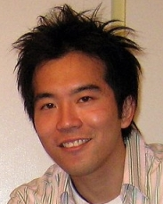
ASONAM-2010 (Advances in Social Networks Analysis and Mining)

Slide 8
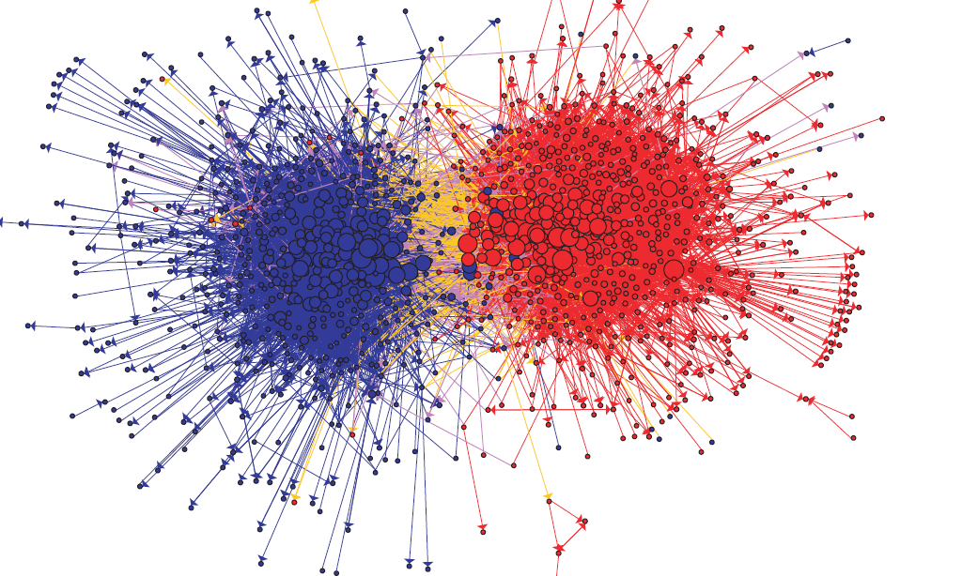
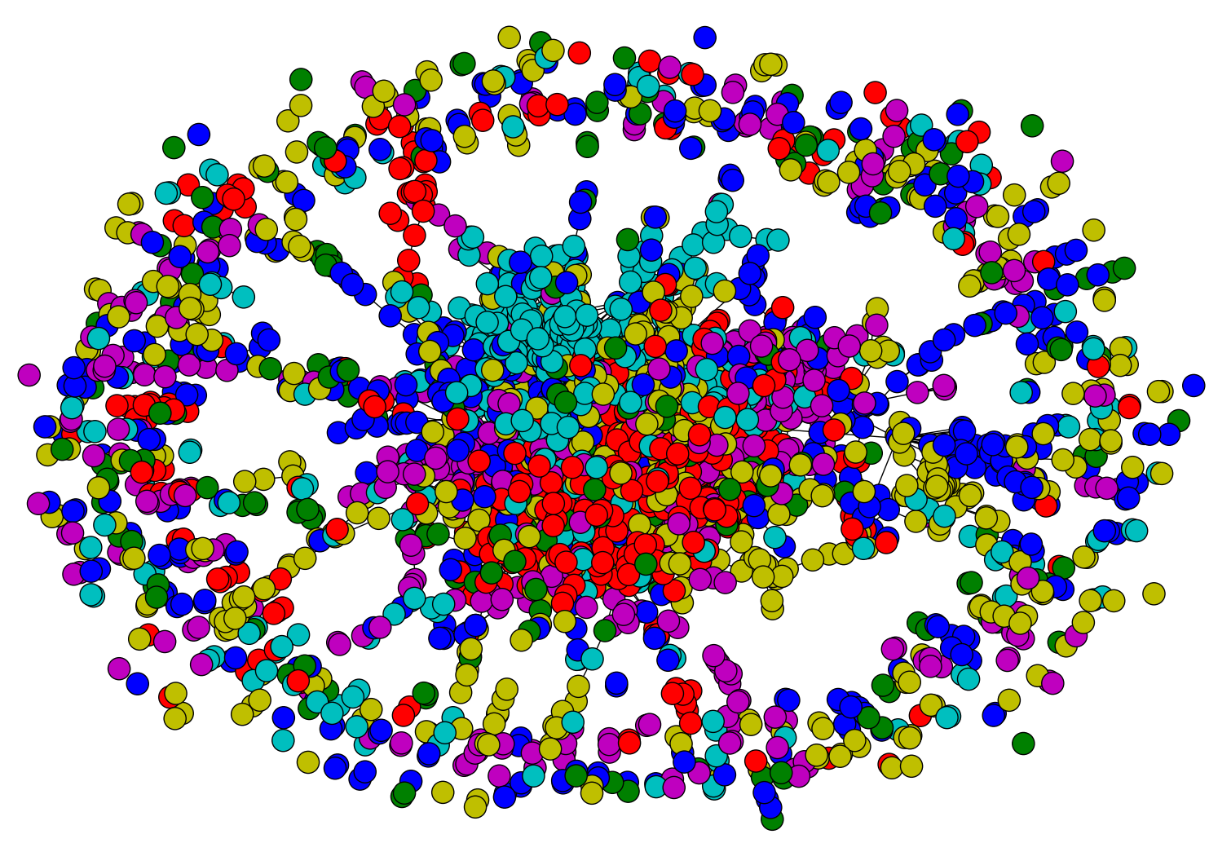
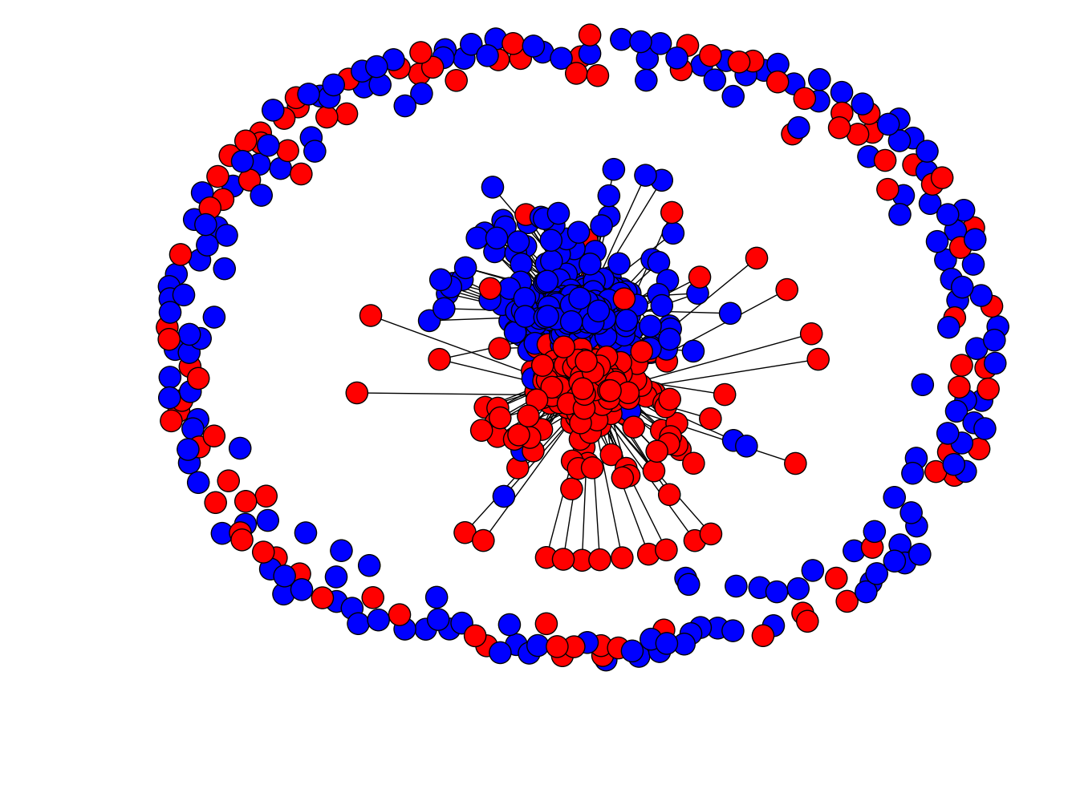
Network Datasets with Known Classes
UBMCBlog
AGBlog
MSPBlog
Cora
Citeseer

Slide 9
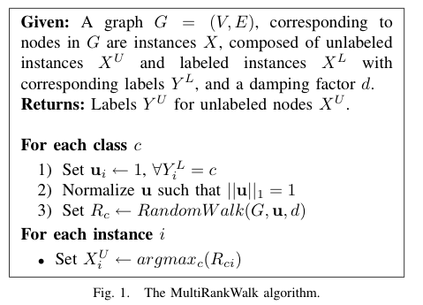

RWR - fixpoint of:
Seed selection
order by PageRank, degree, or randomly
go down list until you have at least k examples/class

Slide 10
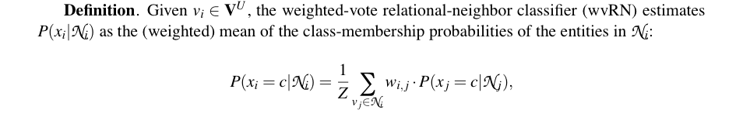
CoEM/HF/wvRN
One definition [MacSkassy & Provost, JMLR 2007]:…

Slide 11
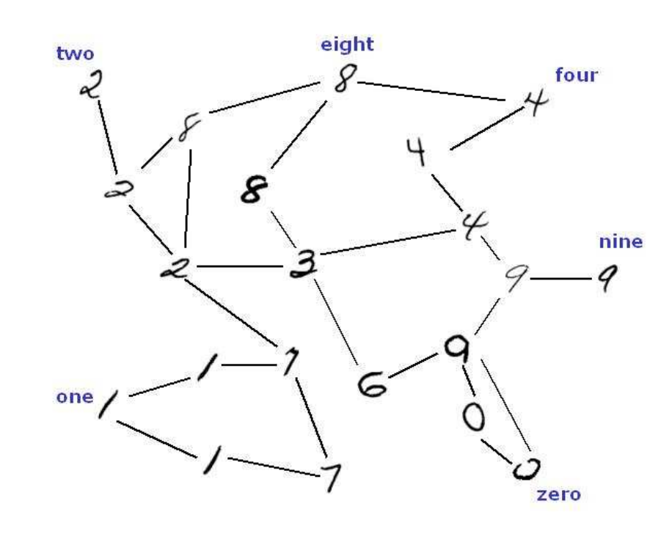
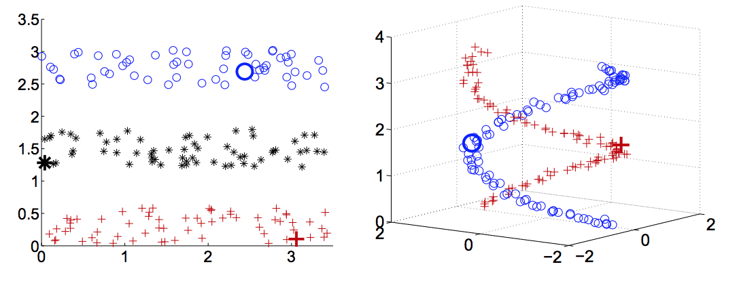
CoEM/HF/wvRN
Another definition in [X. Zhu, Z. Ghahramani, and J. Lafferty, ICML 2003]
  A harmonic field – the score of each node in the graph is the harmonic, or linearly weighted, average of its neighbors’ scores (harmonic field, HF)

Slide 12
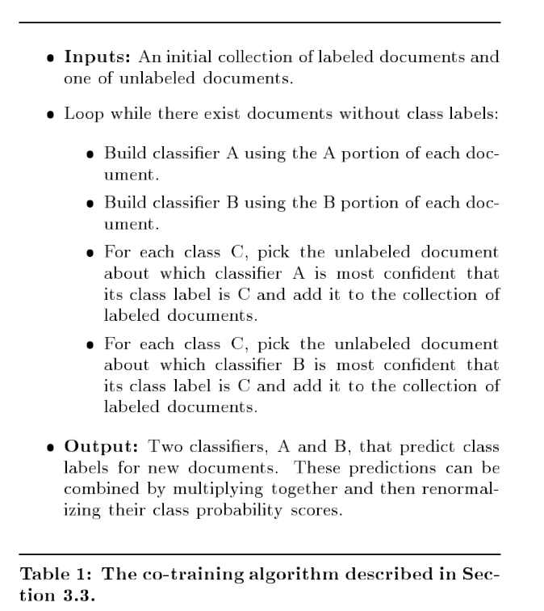
CoEM/HF/wvRN
Another justification of the same algorithm….
… start with co-training with a naïve Bayes learner

Slide 13
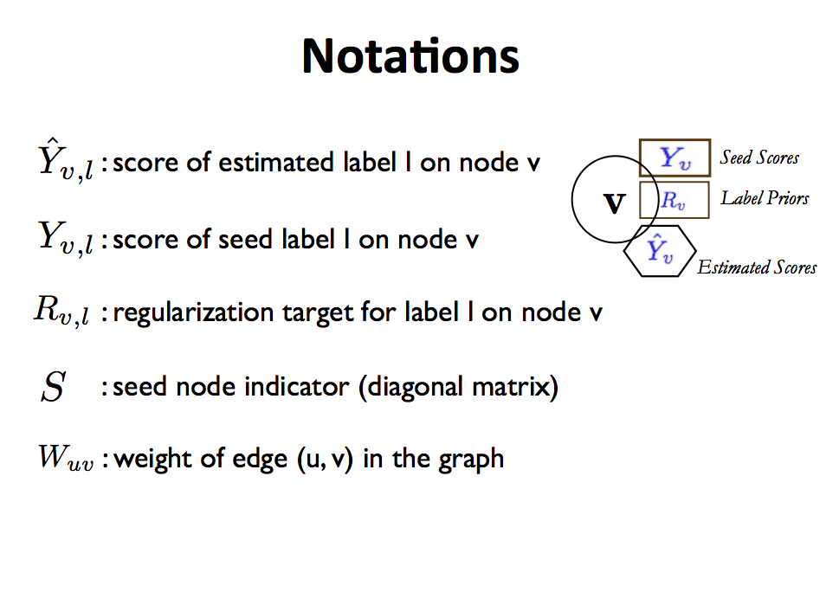

Slide 14
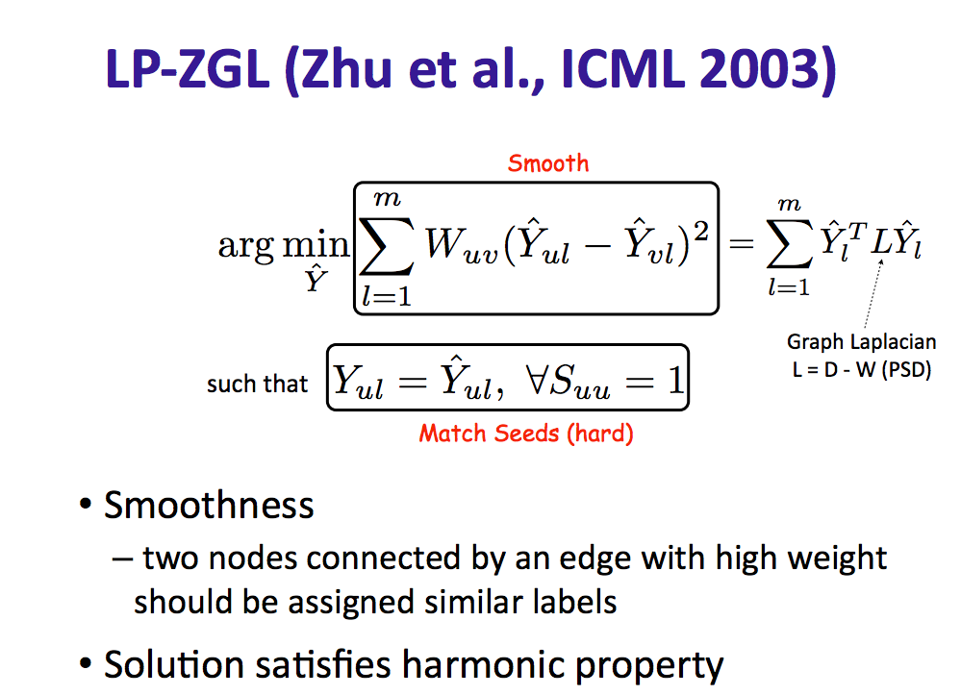

Slide 15
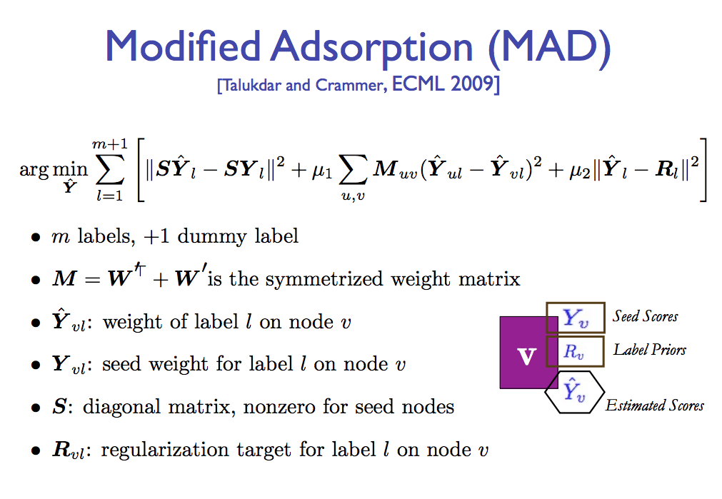

Slide 16


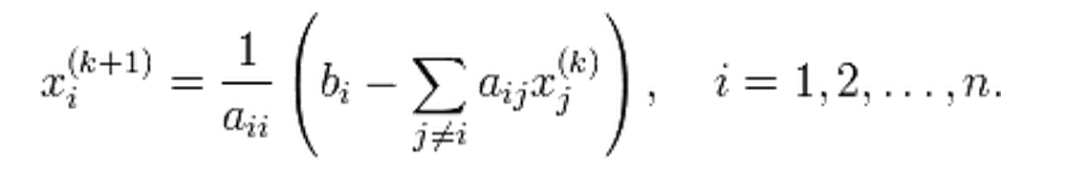
How to do this minimization?
First, differentiate to find min is at
Jacobi method:
To solve Ax=b for x
Iterate:
… or:

Slide 17
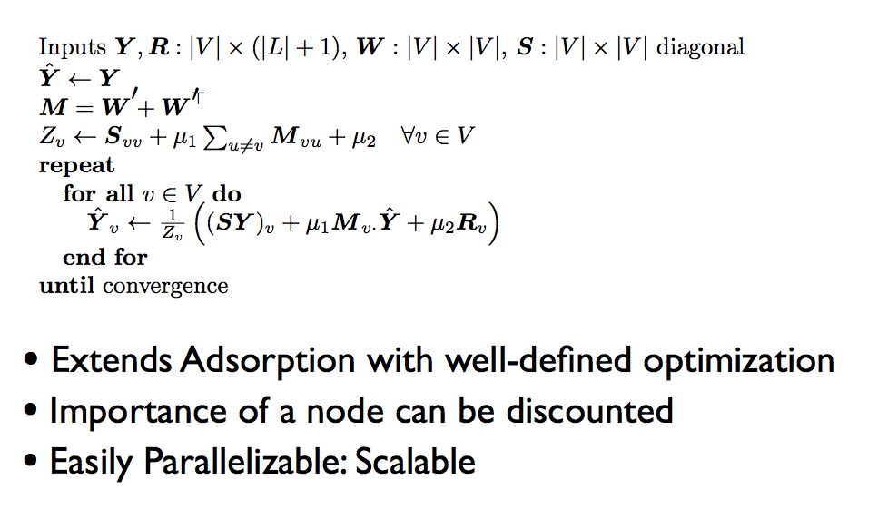

Slide 18
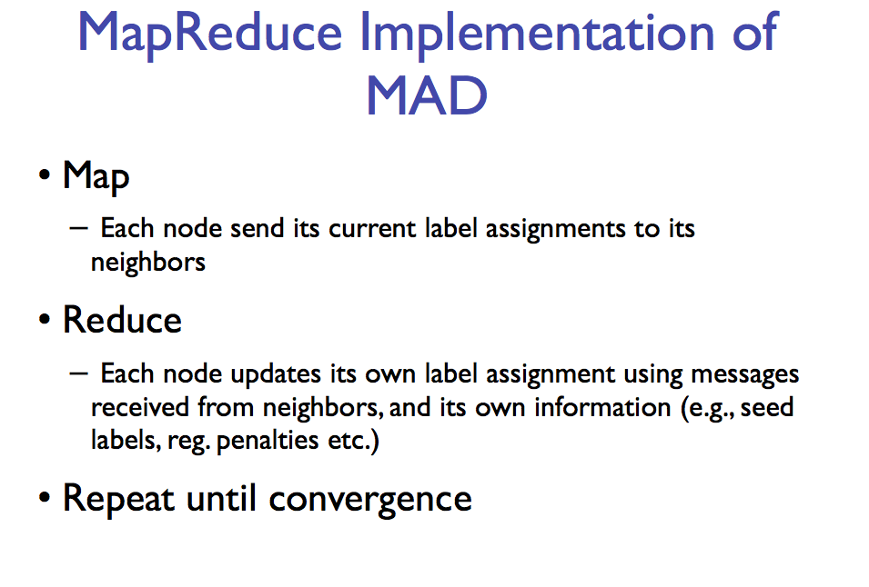
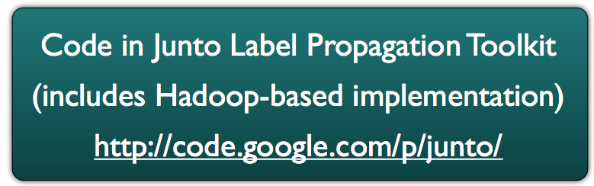

Slide 19
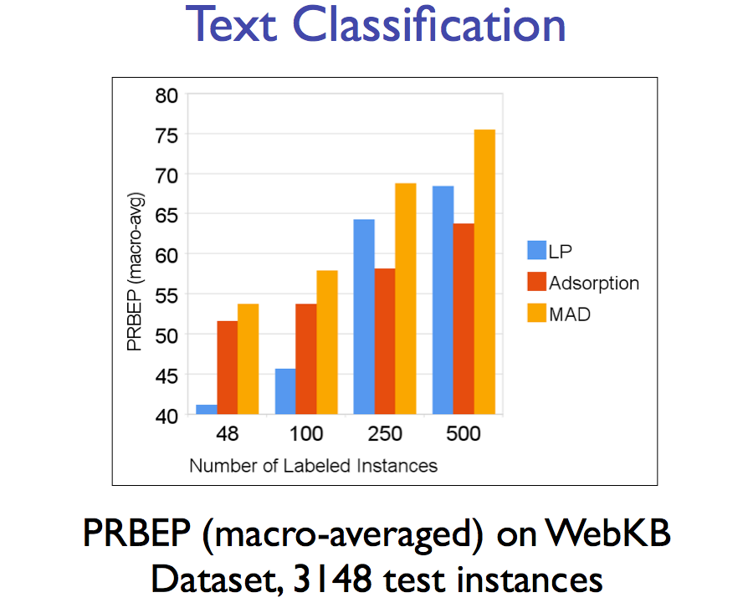

Slide 20
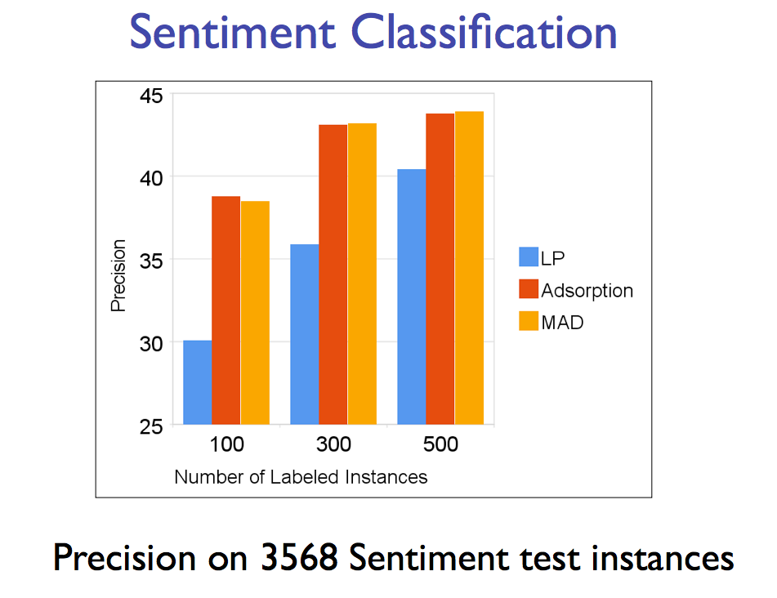

Slide 21
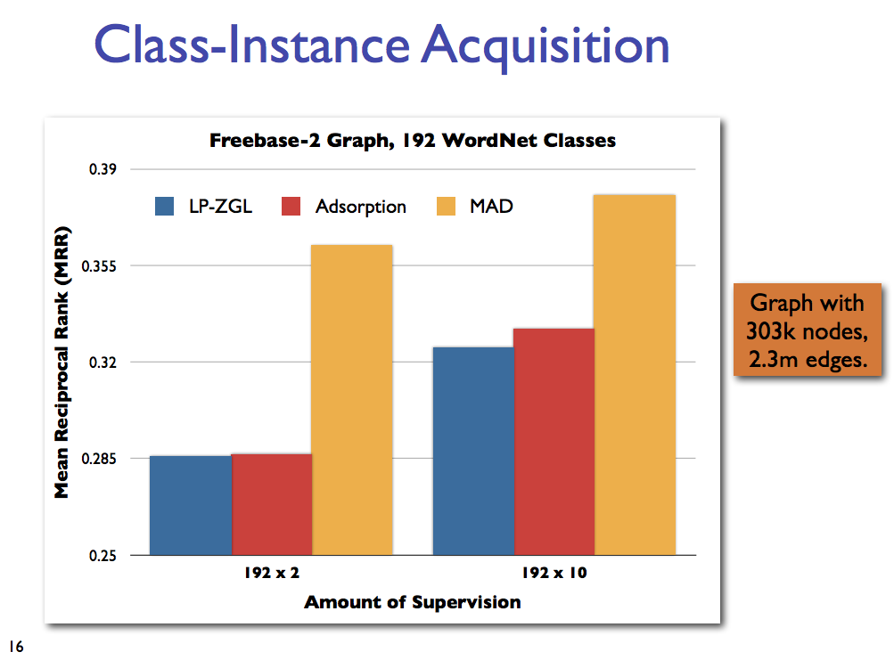

Slide 22
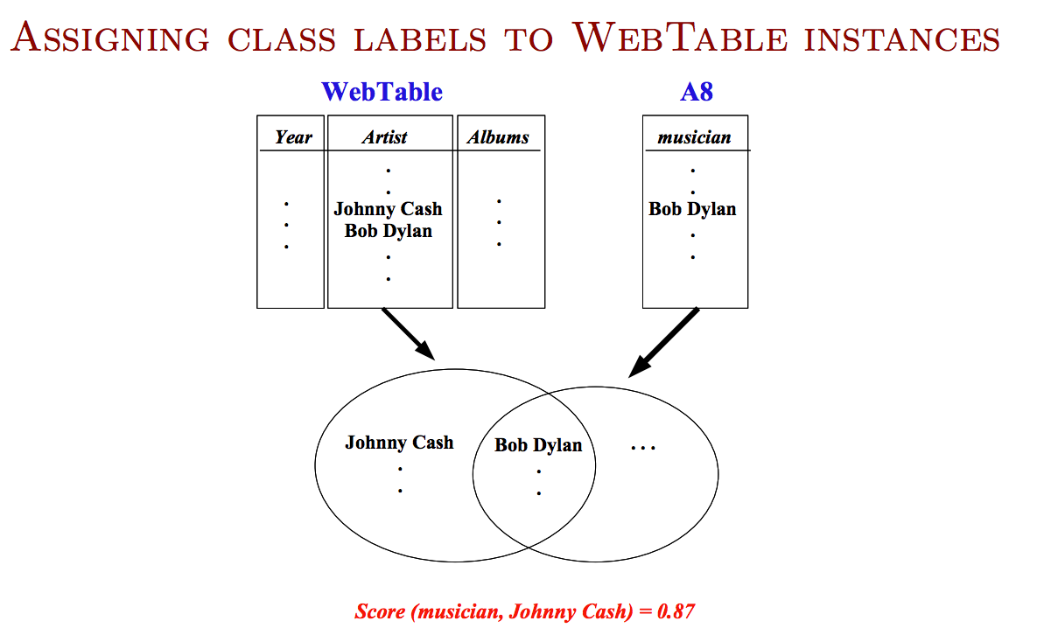

Slide 23
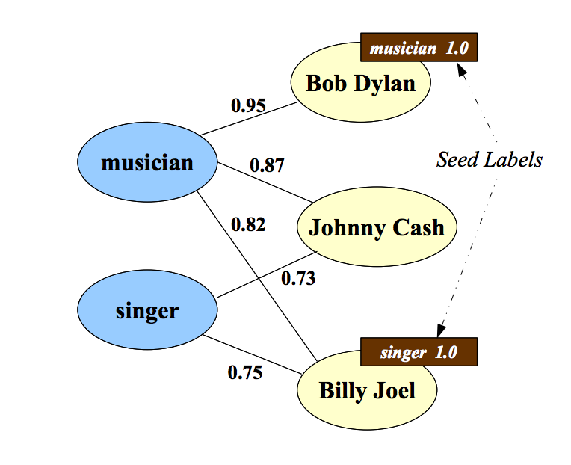

Slide 24
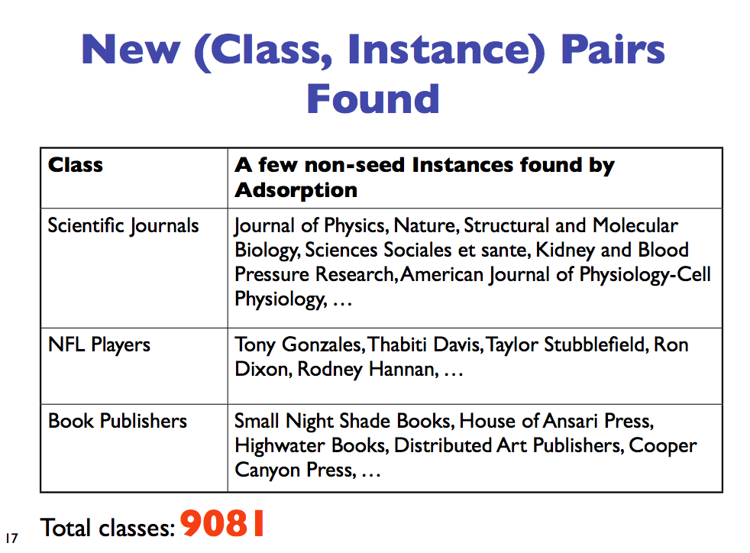

Slide 25
From SemiSupervised to Unsupervised Learning

Slide 26
Spectral Clustering: Graph = Matrix
M*v₁ = v₂ “propogates weights from neighbors”
M
*
v₁
=
v₂
 | A | B | C | D | E | F | G | H | I | J
A | _ | 1 | 1 |  |  | 1
B | 1 | _ | 1
C | 1 | 1 | _
D |  |  |  | _ | 1 | 1
E |  |  |  | 1 | _ | 1
F |  |  |  | 1 | 1 | _
G |  |  |  |  |  |  | _ |  | 1 | 1
H |  |  |  |  |  |  |  | _ | 1 | 1
I |  |  |  |  |  |  | 1 | 1 | _ | 1
J |  |  |  |  |  |  | 1 | 1 | 1 | _
A | 3
B | 2
C | 3
D
E
F
G
H
I
J
A | 5
B | 6
C | 5
D
E
F
G
H
I
J
C
A
B
G
I
H
J
F
D
E
M

Slide 27
Repeated averaging with neighbors as a clustering method
Pick a vector v⁰ (maybe at random)
Compute v¹ = Wv⁰
  i.e., replace v⁰[x] with weighted average of v⁰[y] for the neighbors y of x
Plot v¹[x] for each x
Repeat for v², v³, …
Variants widely used for semi-supervised learning
  clamping of labels for nodes with known labels
Without clamping, will converge to constant v^{t}
What are the dynamics of this process?

Slide 28
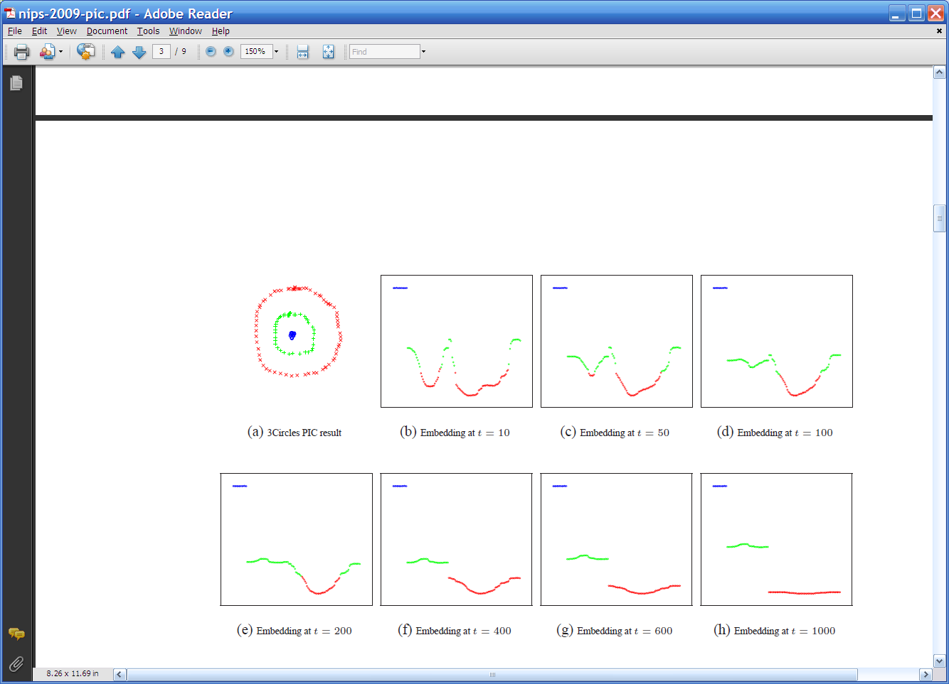
Repeated averaging with neighbors on a sample problem…
blue
green
___red___
Create a graph, connecting all points in the 2-D initial space to all other points
  Weighted by distance
Run power iteration for 10 steps
Plot node id x vs v¹⁰(x)
  nodes are ordered by actual cluster number
g
g
g
g
g
g
g
g
g
r
r
r
r
…
b
b
r
r
r
b
b
b

Slide 29
Repeated averaging with neighbors on a sample problem…
blue
green
___red___
blue
green
___red___
blue
green
___red___
larger
smaller

Slide 30
Repeated averaging with neighbors on a sample problem…
blue
green
___red___
blue
green
___red___
blue
green
___red___
blue
green
___red___
blue
green
___red___

Slide 31
Repeated averaging with neighbors on a sample problem…
very small

Slide 32
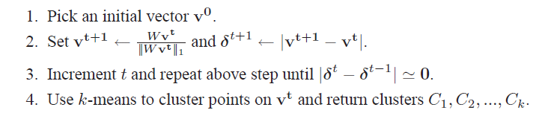
PIC: Power Iteration Clustering run power iteration (repeated averaging w/ neighbors) with early stopping
  V⁰: random start, or “degree matrix” D, or …
  Easy to implement and efficient
  Very easily parallelized
  Experimentally, often better than traditional spectral methods
  Surprising since the embedded space is 1-dimensional!

