Slide 1
Dimensionality Reduction
Shannon Quinn
(with thanks to William Cohen of Carnegie Mellon University, and J. Leskovec, A. Rajaraman, and J. Ullman of Stanford University)

Slide 2
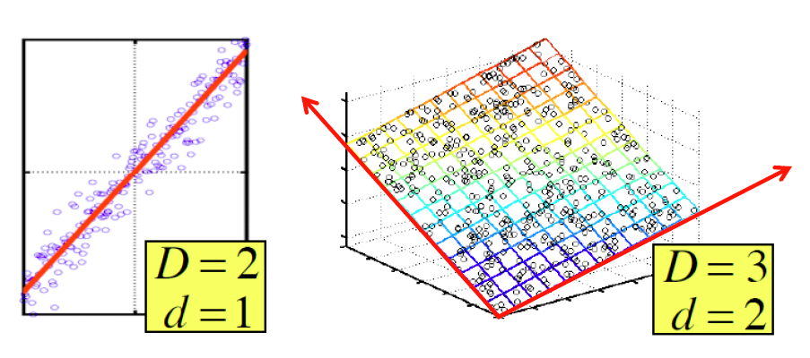
Dimensionality Reduction
Assumption: Data lies on or near a low
d-dimensional subspace
Axes of this subspace are effective representation of the data

Slide 3

Rank of a Matrix
Q: What is rank of a matrix A?
A: Number of linearly independent columns of A
For example:
  Matrix A = has rank r=2
    Why? The first two rows are linearly independent, so the rank is at least 2, but all three rows are linearly dependent (the first is equal to the sum of the second and third) so the rank must be less than 3.
Why do we care about low rank?
  We can write A as two “basis” vectors: [1 2 1] [-2 -3 1]
  And new coordinates of : [1 0] [0 1] [1 1]

Slide 4
Rank is “Dimensionality”
Cloud of points 3D space:
  Think of point positions
  as a matrix:
We can rewrite coordinates more efficiently!
  Old basis vectors: [1 0 0] [0 1 0] [0 0 1]
  New basis vectors: [1 2 1] [-2 -3 1]
  Then A has new coordinates: [1 0]. B: [0 1], C: [1 1]
    Notice: We reduced the number of coordinates!
A
B
C
A
1 row per point:

Slide 5
Dimensionality Reduction
Goal of dimensionality reduction is to
discover the axis of data!
Rather than representing
every point with 2 coordinates
we represent each point with
1 coordinate (corresponding to
the position of the point on
the red line).
By doing this we incur a bit of
error as the points do not
exactly lie on the line

Slide 6
Why Reduce Dimensions?
Why reduce dimensions?
Discover hidden correlations/topics
  Words that occur commonly together
Remove redundant and noisy features
  Not all words are useful
Interpretation and visualization
Easier storage and processing of the data

Slide 7
SVD - Definition
A_{[m x n]} = U_{[m x r]} Σ _{[ r x r]} (V_{[n x r]})^{T}
A: Input data matrix
  m x n matrix (e.g., m documents, n terms)
U: Left singular vectors
  m x r matrix (m documents, r concepts)
Σ: Singular values
  r x r diagonal matrix (strength of each ‘concept’)
  (r : rank of the matrix A)
V: Right singular vectors
  n x r matrix (n terms, r concepts)

Slide 8
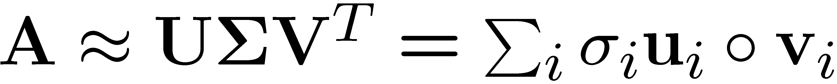
SVD
T
n
n
A
≈
Σ
V^{T}
m
m
U

Slide 9
SVD
T
n
σ₁u₁v₁
σ₂u₂v₂
A
≈
m
+
σ_{i} … scalar
u_{i} … vector
v_{i} … vector

Slide 10
SVD - Properties
It is always possible to decompose a real
matrix A into A = U Σ V^{T} , where
U, Σ, V: unique
U, V: column orthonormal
  U^{T} U = I; V^{T} V = I (I: identity matrix)
  (Columns are orthogonal unit vectors)
Σ: diagonal
  Entries (singular values) are positive,
  and sorted in decreasing order (σ₁ ≥ σ₂ ≥ ... ≥ 0)
Nice proof of uniqueness: http://www.mpi-inf.mpg.de/~bast/ir-seminar-ws04/lecture2.pdf

Slide 11
SVD – Example: Users-to-Movies
A = U Σ V^{T} - example: Users to Movies
Matrix
Alien
Serenity
Casablanca
Amelie
n
1 1 1 0 0
3 3 3 0 0
4 4 4 0 0
5 5 5 0 0
0 2 0 4 4
0 0 0 5 5
0 1 0 2 2
SciFi
Σ
V^{T}
=
m
Romance
U
“Concepts”
AKA Latent dimensions
AKA Latent factors

Slide 12
SVD – Example: Users-to-Movies
A = U Σ V^{T} - example: Users to Movies
Matrix
Alien
Serenity
Casablanca
Amelie
1 1 1 0 0
3 3 3 0 0
4 4 4 0 0
5 5 5 0 0
0 2 0 4 4
0 0 0 5 5
0 1 0 2 2
0.13 0.02 -0.01
0.41 0.07 -0.03
0.55 0.09 -0.04
0.68 0.11 -0.05
0.15 -0.59 0.65
0.07 -0.73 -0.67
0.07 -0.29 0.32
SciFi
12.4 0 0
0 9.5 0
0 0 1.3
=
x
x
Romnce
0.56 0.59 0.56 0.09 0.09
0.12 -0.02 0.12 -0.69 -0.69
0.40 -0.80 0.40 0.09 0.09

Slide 13
SVD – Example: Users-to-Movies
A = U Σ V^{T} - example: Users to Movies
Matrix
Alien
Serenity
Casablanca
Amelie
SciFi-concept
Romance-concept
1 1 1 0 0
3 3 3 0 0
4 4 4 0 0
5 5 5 0 0
0 2 0 4 4
0 0 0 5 5
0 1 0 2 2
0.13 0.02 -0.01
0.41 0.07 -0.03
0.55 0.09 -0.04
0.68 0.11 -0.05
0.15 -0.59 0.65
0.07 -0.73 -0.67
0.07 -0.29 0.32
SciFi
12.4 0 0
0 9.5 0
0 0 1.3
=
x
x
Romnce
0.56 0.59 0.56 0.09 0.09
0.12 -0.02 0.12 -0.69 -0.69
0.40 -0.80 0.40 0.09 0.09

Slide 14
SVD – Example: Users-to-Movies
U is “user-to-concept”
similarity matrix
A = U Σ V^{T} - example:
Matrix
Alien
Serenity
Casablanca
Amelie
SciFi-concept
Romance-concept
1 1 1 0 0
3 3 3 0 0
4 4 4 0 0
5 5 5 0 0
0 2 0 4 4
0 0 0 5 5
0 1 0 2 2
0.13 0.02 -0.01
0.41 0.07 -0.03
0.55 0.09 -0.04
0.68 0.11 -0.05
0.15 -0.59 0.65
0.07 -0.73 -0.67
0.07 -0.29 0.32
SciFi
12.4 0 0
0 9.5 0
0 0 1.3
=
x
x
Romnce
0.56 0.59 0.56 0.09 0.09
0.12 -0.02 0.12 -0.69 -0.69
0.40 -0.80 0.40 0.09 0.09

Slide 15
SVD – Example: Users-to-Movies
A = U Σ V^{T} - example:
Matrix
Alien
Serenity
Casablanca
Amelie
SciFi-concept
“strength” of the SciFi-concept
1 1 1 0 0
3 3 3 0 0
4 4 4 0 0
5 5 5 0 0
0 2 0 4 4
0 0 0 5 5
0 1 0 2 2
0.13 0.02 -0.01
0.41 0.07 -0.03
0.55 0.09 -0.04
0.68 0.11 -0.05
0.15 -0.59 0.65
0.07 -0.73 -0.67
0.07 -0.29 0.32
SciFi
SciFi
12.4 0 0
0 9.5 0
0 0 1.3
=
x
x
Romnce
Romnce
0.56 0.59 0.56 0.09 0.09
0.12 -0.02 0.12 -0.69 -0.69
0.40 -0.80 0.40 0.09 0.09

Slide 16
SVD – Example: Users-to-Movies
A = U Σ V^{T} - example:
Matrix
Alien
Serenity
Casablanca
Amelie
V is “movie-to-concept”
similarity matrix
SciFi-concept
1 1 1 0 0
3 3 3 0 0
4 4 4 0 0
5 5 5 0 0
0 2 0 4 4
0 0 0 5 5
0 1 0 2 2
0.13 0.02 -0.01
0.41 0.07 -0.03
0.55 0.09 -0.04
0.68 0.11 -0.05
0.15 -0.59 0.65
0.07 -0.73 -0.67
0.07 -0.29 0.32
SciFi
12.4 0 0
0 9.5 0
0 0 1.3
=
x
x
Romnce
0.56 0.59 0.56 0.09 0.09
0.12 -0.02 0.12 -0.69 -0.69
0.40 -0.80 0.40 0.09 0.09
SciFi-concept

Slide 17
SVD - Interpretation #1
‘movies’, ‘users’ and ‘concepts’:
U: user-to-concept similarity matrix
V: movie-to-concept similarity matrix
Σ: its diagonal elements:
‘strength’ of each concept

Slide 18
SVD - Interpretation #2
More details
Q: How exactly is dim. reduction done?
A: Set smallest singular values to zero
1 1 1 0 0
3 3 3 0 0
4 4 4 0 0
5 5 5 0 0
0 2 0 4 4
0 0 0 5 5
0 1 0 2 2
0.13 0.02 -0.01
0.41 0.07 -0.03
0.55 0.09 -0.04
0.68 0.11 -0.05
0.15 -0.59 0.65
0.07 -0.73 -0.67
0.07 -0.29 0.32
12.4 0 0
0 9.5 0
0 0 1.3
=
x
x
0.56 0.59 0.56 0.09 0.09
0.12 -0.02 0.12 -0.69 -0.69
0.40 -0.80 0.40 0.09 0.09

Slide 19
SVD - Interpretation #2
More details
Q: How exactly is dim. reduction done?
A: Set smallest singular values to zero
1 1 1 0 0
3 3 3 0 0
4 4 4 0 0
5 5 5 0 0
0 2 0 4 4
0 0 0 5 5
0 1 0 2 2
0.13 0.02 -0.01
0.41 0.07 -0.03
0.55 0.09 -0.04
0.68 0.11 -0.05
0.15 -0.59 0.65
0.07 -0.73 -0.67
0.07 -0.29 0.32
12.4 0 0
0 9.5 0
0 0 1.3
≈
x
x
0.56 0.59 0.56 0.09 0.09
0.12 -0.02 0.12 -0.69 -0.69
0.40 -0.80 0.40 0.09 0.09

Slide 20
SVD - Interpretation #2
More details
Q: How exactly is dim. reduction done?
A: Set smallest singular values to zero
1 1 1 0 0
3 3 3 0 0
4 4 4 0 0
5 5 5 0 0
0 2 0 4 4
0 0 0 5 5
0 1 0 2 2
0.13 0.02 -0.01
0.41 0.07 -0.03
0.55 0.09 -0.04
0.68 0.11 -0.05
0.15 -0.59 0.65
0.07 -0.73 -0.67
0.07 -0.29 0.32
12.4 0 0
0 9.5 0
0 0 1.3
≈
x
x
0.56 0.59 0.56 0.09 0.09
0.12 -0.02 0.12 -0.69 -0.69
0.40 -0.80 0.40 0.09 0.09

Slide 21
SVD - Interpretation #2
More details
Q: How exactly is dim. reduction done?
A: Set smallest singular values to zero
1 1 1 0 0
3 3 3 0 0
4 4 4 0 0
5 5 5 0 0
0 2 0 4 4
0 0 0 5 5
0 1 0 2 2
0.13 0.02
0.41 0.07
0.55 0.09
0.68 0.11
0.15 -0.59
0.07 -0.73
0.07 -0.29
12.4 0
0 9.5
≈
x
x
0.56 0.59 0.56 0.09 0.09
0.12 -0.02 0.12 -0.69 -0.69

Slide 22
SVD - Interpretation #2
More details
Q: How exactly is dim. reduction done?
A: Set smallest singular values to zero
1 1 1 0 0
3 3 3 0 0
4 4 4 0 0
5 5 5 0 0
0 2 0 4 4
0 0 0 5 5
0 1 0 2 2
0.92 0.95 0.92 0.01 0.01
2.91 3.01 2.91 -0.01 -0.01
3.90 4.04 3.90 0.01 0.01
4.82 5.00 4.82 0.03 0.03
0.70 0.53 0.70 4.11 4.11
-0.69 1.34 -0.69 4.78 4.78
0.32 0.23 0.32 2.01 2.01
≈
Frobenius norm:
ǁMǁ_{F} = √Σ_{ij} M_{ij}²
ǁA-Bǁ_{F} = √ Σ_{ij} (A_{ij}-B_{ij})²
^{is “small”}

Slide 23
SVD – Best Low Rank Approx.
A
U
Sigma
=
V^{T}
B is best approximation of A
B
U
Sigma
=
V^{T}

Slide 24
SVD - Interpretation #2
Equivalent:
‘spectral decomposition’ of the matrix:
1 1 1 0 0
3 3 3 0 0
4 4 4 0 0
5 5 5 0 0
0 2 0 4 4
0 0 0 5 5
0 1 0 2 2
x
σ₁
x
=
u₁
u₂
σ₂
v₁
v₂

Slide 25
SVD - Interpretation #2
Equivalent:
‘spectral decomposition’ of the matrix
m
1 1 1 0 0
3 3 3 0 0
4 4 4 0 0
5 5 5 0 0
0 2 0 4 4
0 0 0 5 5
0 1 0 2 2
k terms
=
σ₁
u₁
v^{T}₁
+
σ₂
u₂
v^{T}₂
+...
n x 1
1 x m
n
Assume: σ₁ ≥ σ₂ ≥ σ₃ ≥ ... ≥ 0
Why is setting small σ_{i} to 0 the right thing to do?
Vectors u_{i} and v_{i} are unit length, so σ_{i} scales them.
So, zeroing small σ_{i} introduces less error.

Slide 26
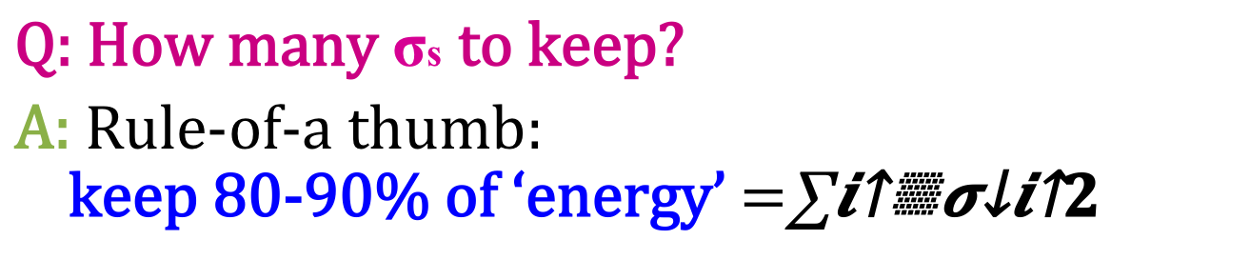
SVD - Interpretation #2
Q: How many σs to keep?
A: Rule-of-a thumb:
keep 80-90% of ‘energy’ $=\sum_{i}{σ_{i}^{2}}$
m
1 1 1 0 0
3 3 3 0 0
4 4 4 0 0
5 5 5 0 0
0 2 0 4 4
0 0 0 5 5
0 1 0 2 2
=
σ₁
u₁
v^{T}₁
+
σ₂
u₂
v^{T}₂
+...
n
Assume: σ₁ ≥ σ₂ ≥ σ₃ ≥ ...

Slide 27
Computing SVD
(especially in a MapReduce setting…)
Stochastic Gradient Descent (today)
Stochastic SVD (not today)
Other methods (not today)

Slide 28
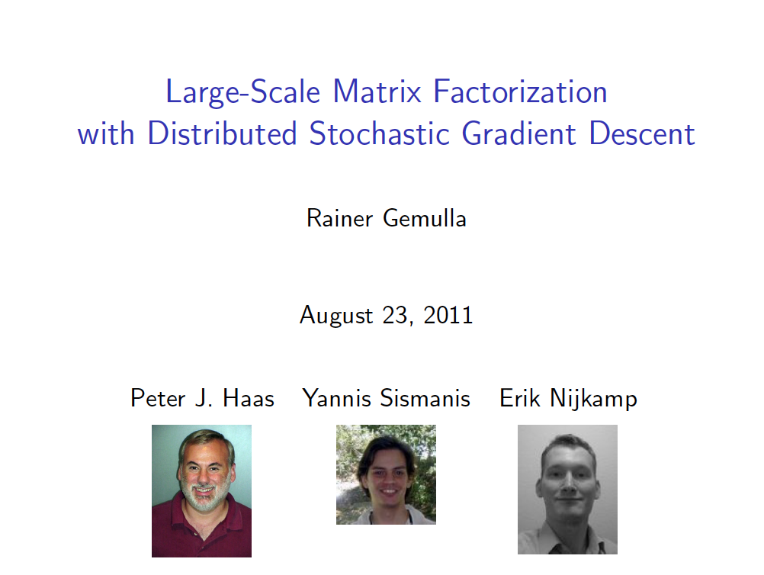

KDD 2011
talk pilfered from → …..

Slide 29
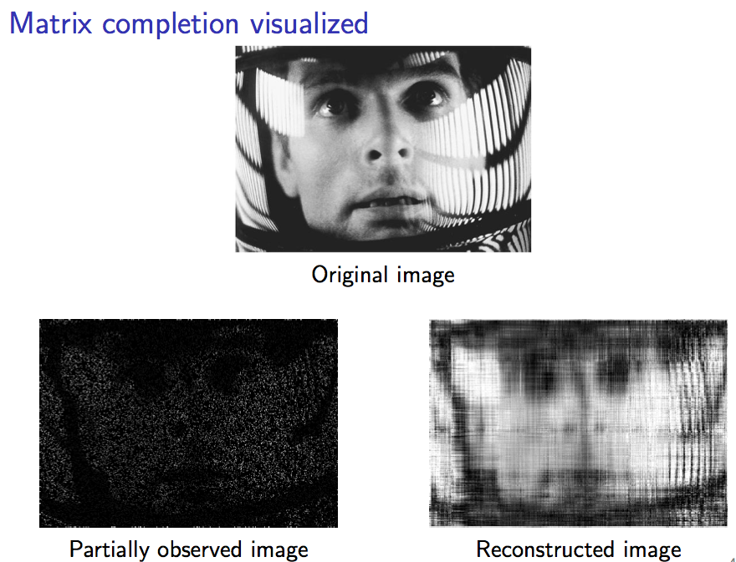
for image denoising

Slide 30
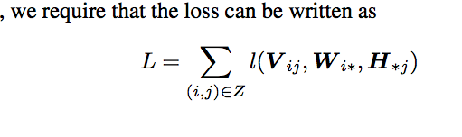
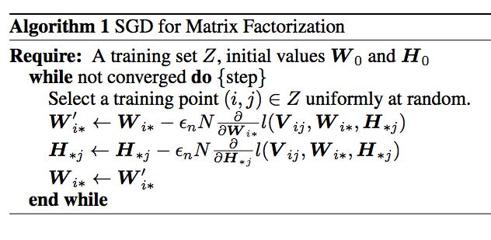
Matrix factorization as SGD
step size

Slide 31
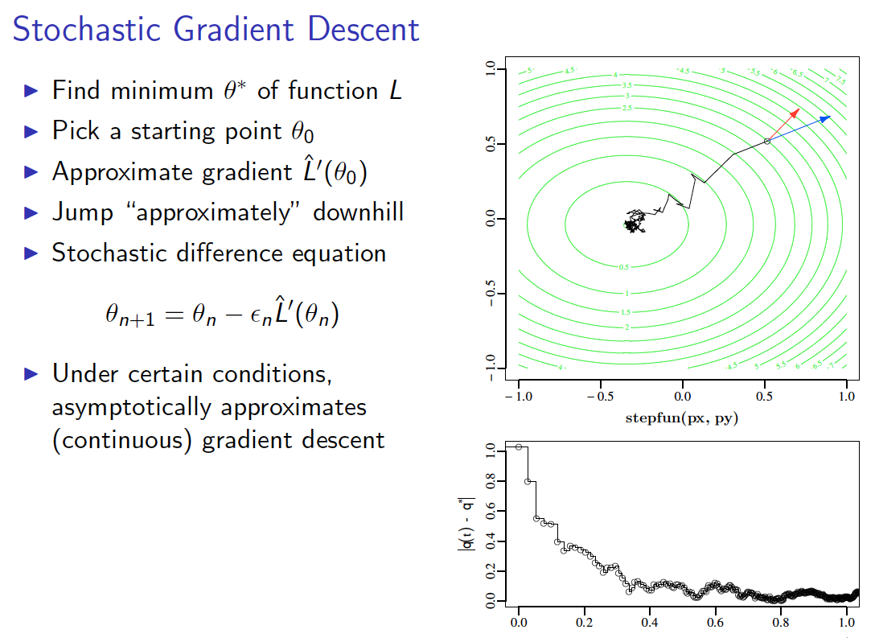

Slide 32
Matrix factorization as SGD - why does this work?
step size

Slide 33
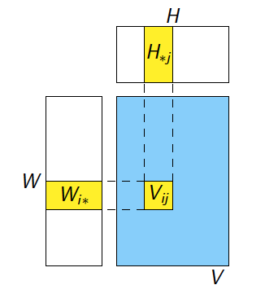
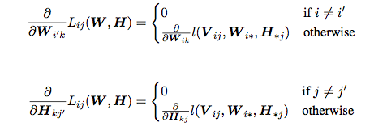
Matrix factorization as SGD - why does this work? Here’s the key claim:

Slide 34




Checking the claim
Think for SGD for logistic regression
LR loss = compare y and ŷ = dot(w,x)
similar but now update w (user weights) and x (movie weight)

Slide 35
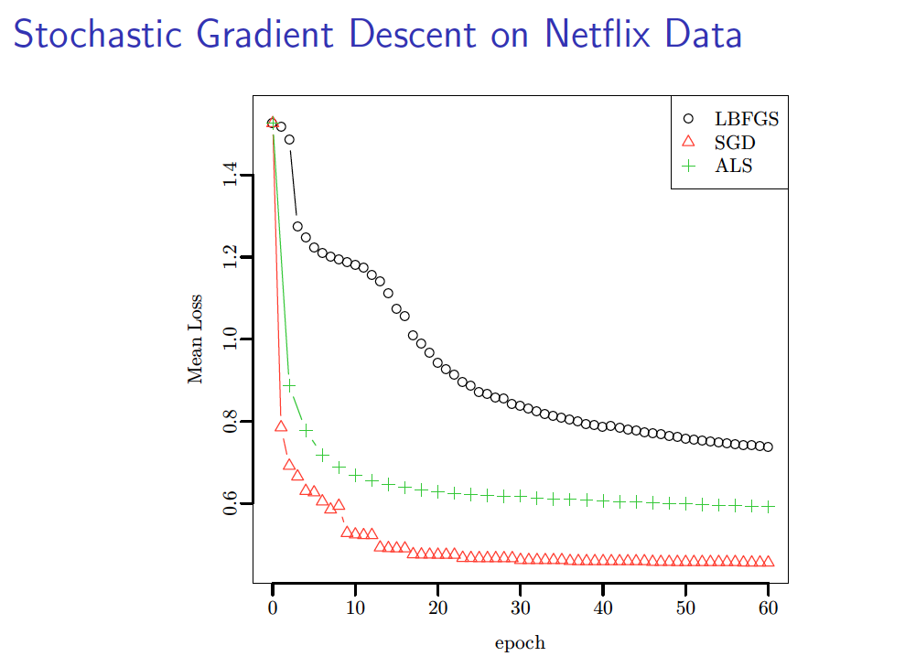
ALS = alternating least squares
Notes:
L-BFGS
-iterative quasi-Newton optimization algorithm for nonlinear unconstrained problems
-approximates an inverse Hessian and takes a step

Slide 36
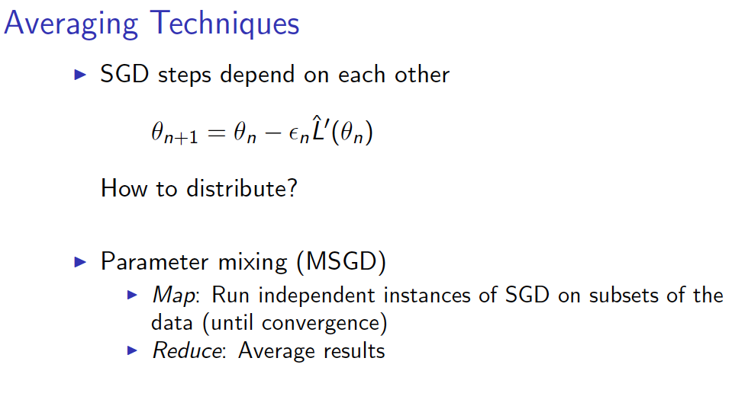

Slide 37
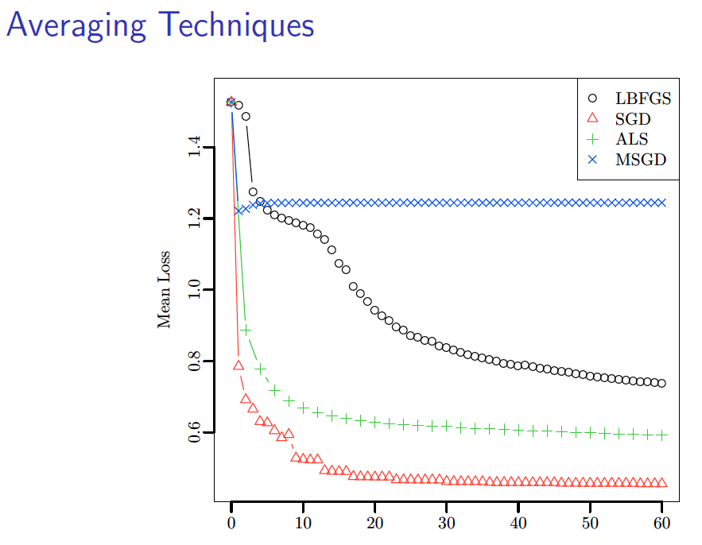

Slide 38
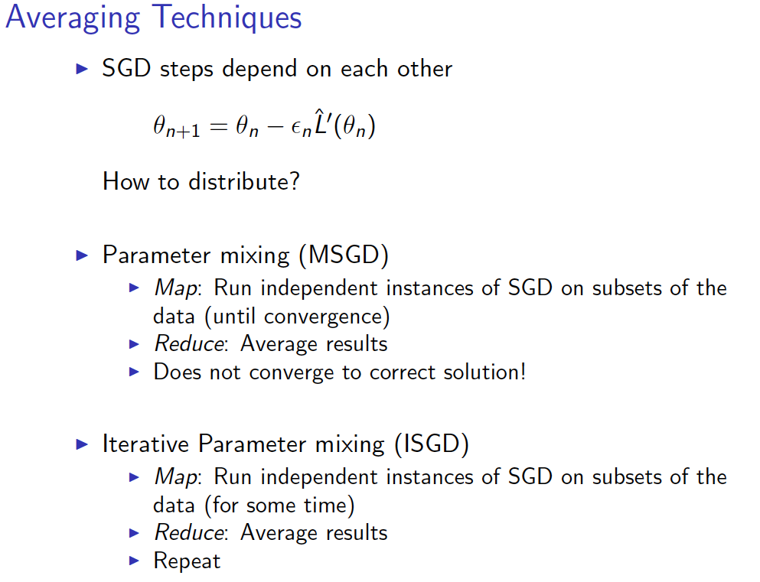
Similar to McDonnell et al with perceptron learning

Slide 39
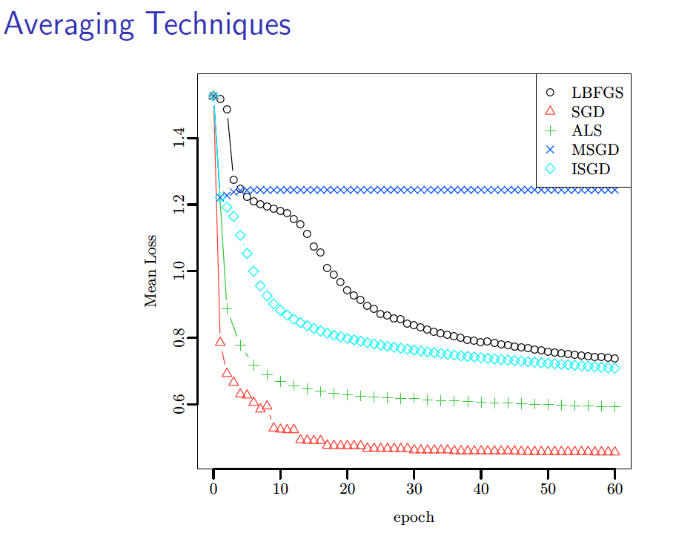
Slow convergence…..

Slide 40
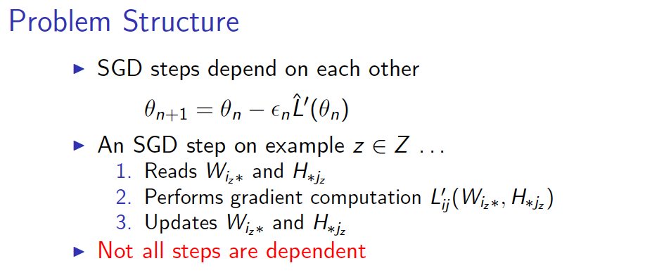
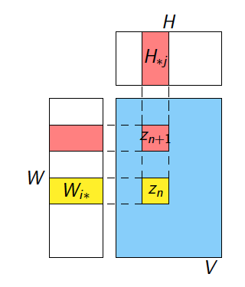
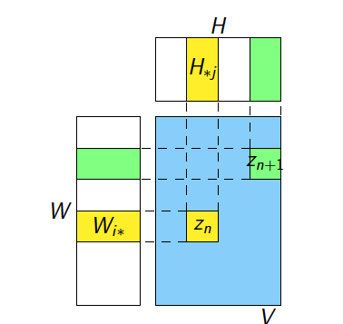
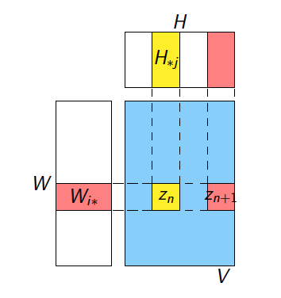

Slide 41
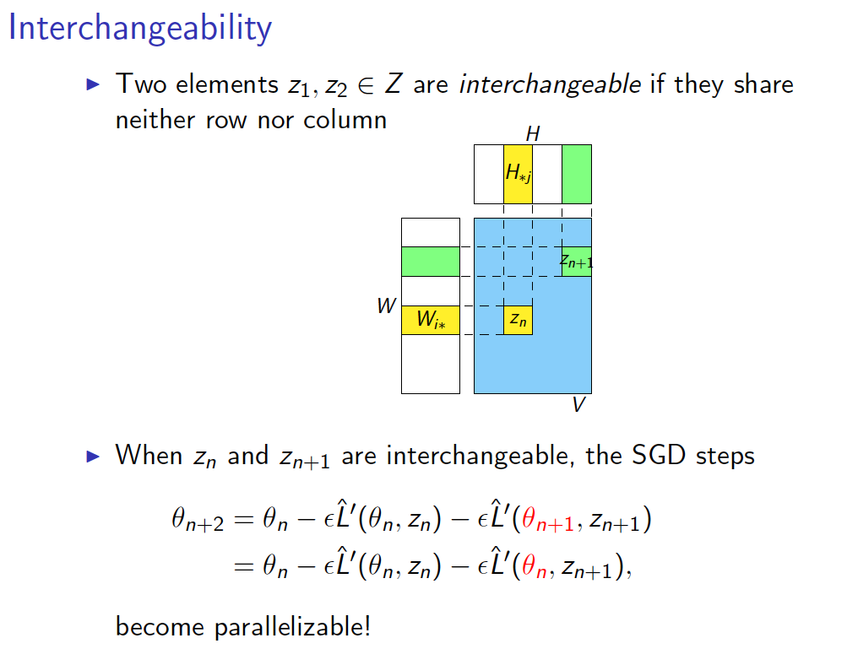

Slide 42
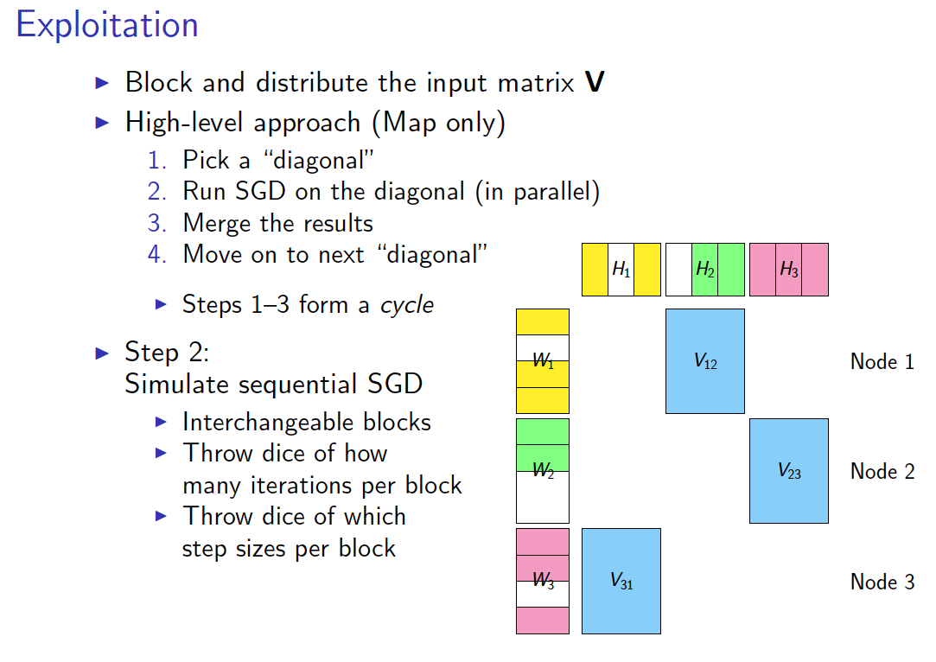
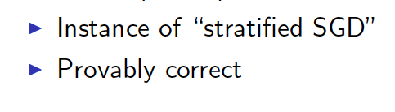

Slide 43
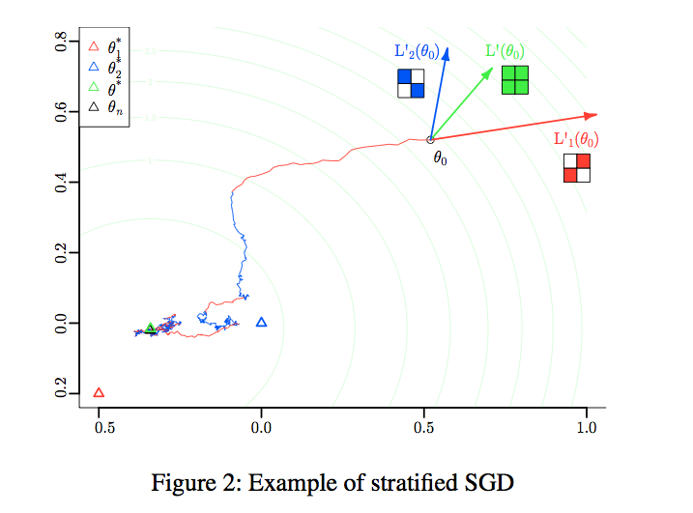

Slide 44
More detail….
Randomly permute rows/cols of matrix
Chop V,W,H into blocks of size d x d
  m/d blocks in W, n/d blocks in H
Group the data:
  Pick a set of blocks with no overlapping rows or columns (a stratum)
  Repeat until all blocks in V are covered
Train the SGD
  Process strata in series
  Process blocks within a stratum in parallel

Slide 45
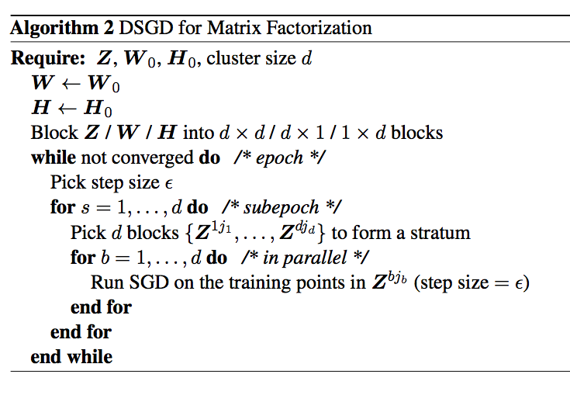
More detail….
Z was V

Slide 46
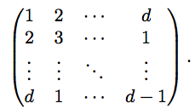
More detail….
M=
Initialize W,H randomly
  not at zero ☺
Choose a random ordering (random sort) of the points in a stratum in each “sub-epoch”
Pick strata sequence by permuting rows and columns of M, and using M’[k,i] as column index of row i in subepoch k
Use “bold driver” to set step size:
  increase step size when loss decreases (in an epoch)
  decrease step size when loss increases
Implemented in Hadoop and R/Snowfall

Slide 47
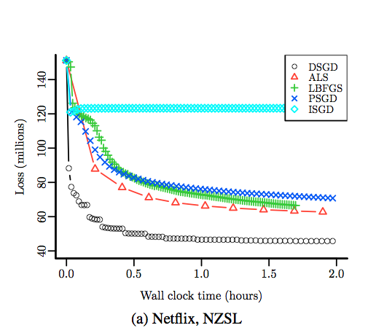

Slide 48
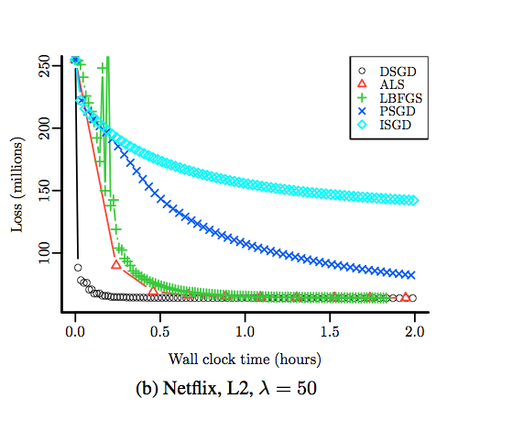

Slide 49
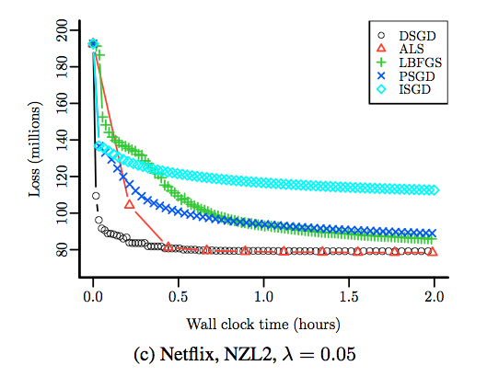

Slide 50
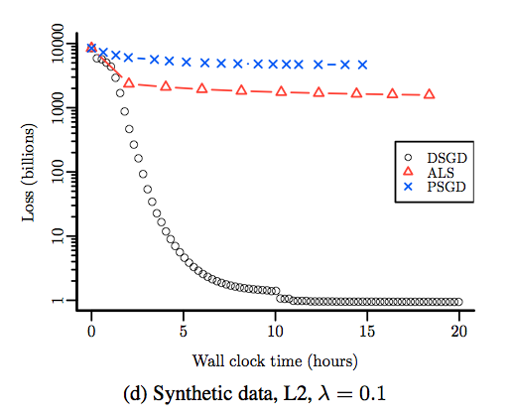

Slide 51
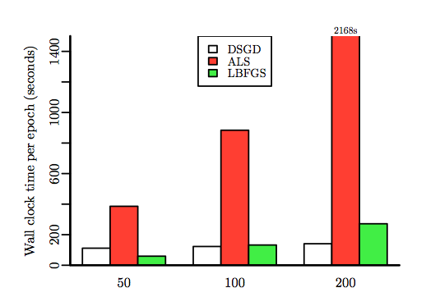
Varying rank
100 epochs for all

Slide 52
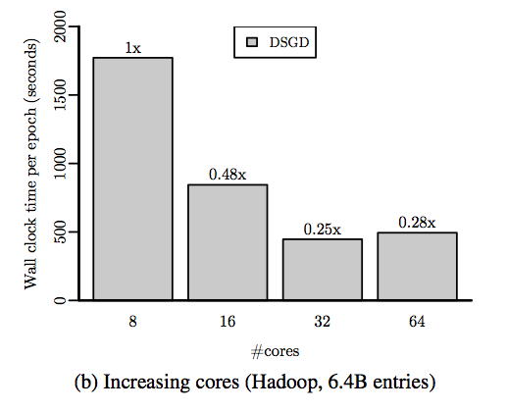
Hadoop scalability
Hadoop process setup time starts to dominate

Slide 53
SVD - Conclusions so far
SVD: A= U Σ V^{T}: unique
  U: user-to-concept similarities
  V: movie-to-concept similarities
  Σ : strength of each concept
Dimensionality reduction:
  keep the few largest singular values
  (80-90% of ‘energy’)
  SVD: picks up linear correlations

Slide 54
Relation to Eigen-decomposition
SVD gives us:
  A = U Σ V^{T}
Eigen-decomposition:
  A = X Λ X^{T}
    A is symmetric
    U, V, X are orthonormal (U^{T}U=I),
    Λ, Σ are diagonal
Now let’s calculate:
Notes:
the columns of U are orthonormal eigenvectors of AAT
the columns of V are orthonormal eigenvectors of ATA,
S is a diagonal matrix containing the square roots of eigenvalues from U or V in descending order.

Slide 55
Relation to Eigen-decomposition
SVD gives us:
  A = U Σ V^{T}
Eigen-decomposition:
  A = X Λ X^{T}
    A is symmetric
    U, V, X are orthonormal (U^{T}U=I),
    Λ, Σ are diagonal
Now let’s calculate:
Shows how to compute
SVD using eigenvalue
decomposition!
X Λ² X^{T}
X Λ² X^{T}
Notes:
the columns of U are orthonormal eigenvectors of AAT
the columns of V are orthonormal eigenvectors of ATA,
S is a diagonal matrix containing the square roots of eigenvalues from U or V in descending order.
If A = A^T is a symmetric matrix, its singular values are the absolute values of its nonzero eigenvalues: σi = | λi| > 0; its singular vectors coincide with the associated non-null eigenvectors.

Slide 56
SVD: Drawbacks
Optimal low-rank approximation
in terms of Frobenius norm
Interpretability problem:
  A singular vector specifies a linear
  combination of all input columns or rows
Lack of sparsity:
  Singular vectors are dense!
V^{T}
Σ
=
U

Slide 57
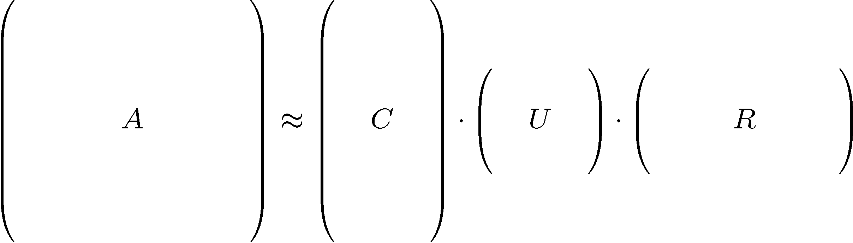
CUR Decomposition
Frobenius norm:
ǁXǁ_{F} = √ Σ_{ij} X_{ij}²
Goal: Express A as a product of matrices C,U,R
Make ǁA-C·U·Rǁ_{F} small
“Constraints” on C and R:
A
C
U
R

Slide 58
CUR Decomposition
Frobenius norm:
ǁXǁ_{F} = √ Σ_{ij} X_{ij}²
Goal: Express A as a product of matrices C,U,R
Make ǁA-C·U·Rǁ_{F} small
“Constraints” on C and R:
Pseudo-inverse of
the intersection of C and R
A
C
U
R

Slide 59
CUR: Provably good approx. to SVD
Let:
A_{k} be the “best” rank k approximation
to A (that is, A_{k} is SVD of A)
Theorem [Drineas et al.]
CUR in O(m·n) time achieves
  ǁA-CURǁ_{F} ≤ ǁA-A_{k}ǁ_{F} + εǁAǁ_{F}
  with probability at least 1-δ, by picking
  O(k log(1/δ)/ε²) columns, and
  O(k² log³(1/δ)/ε⁶) rows
In practice:
Pick 4k cols/rows
Notes:
HOW TO PICK NUMBER of COS/ROWS In practice. Mahoney’s slides say pick 4k cols/rows

Slide 60
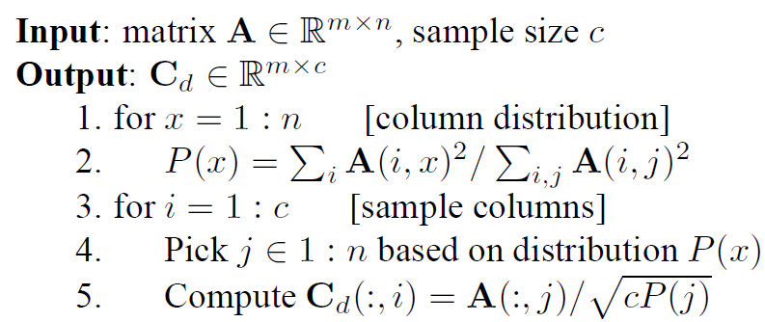
CUR: How it Works
Sampling columns (similarly for rows):
Note this is a randomized algorithm, same column can be sampled more than once

Slide 61
Computing U
Let W be the “intersection” of sampled columns C and rows R
  Let SVD of W = X Z Y^{T}
Then: U = W⁺ = Y Z⁺ X^{T}
  Ζ⁺: reciprocals of non-zero
  singular values: Ζ⁺_{ii} =1/ Ζ_{ii}
  W⁺ is the “pseudoinverse”
Why pseudoinverse works?
W = X Z Y then W⁻¹ = X⁻¹ Z⁻¹ Y⁻¹
Due to orthonomality
X⁻¹=X^{T} and Y⁻¹=Y^{T}
Since Z is diagonal Z⁻¹ = 1/Z_{ii}
Thus, if W is nonsingular,
pseudoinverse is the true inverse
A
C
R
W
≈
U = W⁺

Slide 62
CUR: Pros & Cons
Easy interpretation
  Since the basis vectors are actual
  columns and rows
Sparse basis
  Since the basis vectors are actual
  columns and rows
Duplicate columns and rows
  Columns of large norms will be sampled many times
Actual column
Singular vector

Slide 63
Solution
If we want to get rid of the duplicates:
  Throw them away
  Scale (multiply) the columns/rows by the
  square root of the number of duplicates
A
C_{d}
R_{d}
C_{s}
R_{s}
Construct a small U

Slide 64
SVD vs. CUR
sparse and small
SVD: A = U Σ V^{T}
Huge but sparse
Big and dense
dense but small
CUR: A = C U R
Huge but sparse
Big but sparse

Slide 65
Stochastic SVD
“Randomized methods for computing low-rank approximations of matrices”, Nathan Halko 2012
“Finding Structure with Randomness: Probabilistic Algorithms for Constructing Approximate Matrix Decompositions”, Halko, Martinsson, and Tropp, 2011
“An Algorithm for the Principal Component Analysis of Large Data Sets”, Halko, Martinsson, Shkolnisky, and Tygert, 2010

