Slide 1
Introduction to Spark
Shannon Quinn
(with thanks to Paco Nathan and Databricks)

Slide 2
Quick Demo

Slide 3
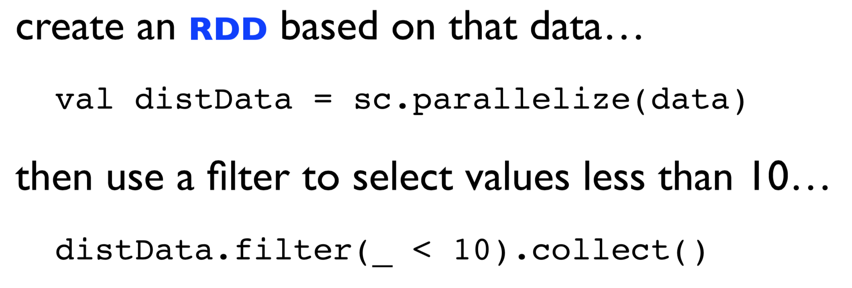
Quick Demo

Slide 4
API Hooks
Scala / Java
All Java libraries
*.jar
http://www.scala-lang.org
Python
Anaconda: https://store.continuum.io/cshop/anaconda/

Slide 5
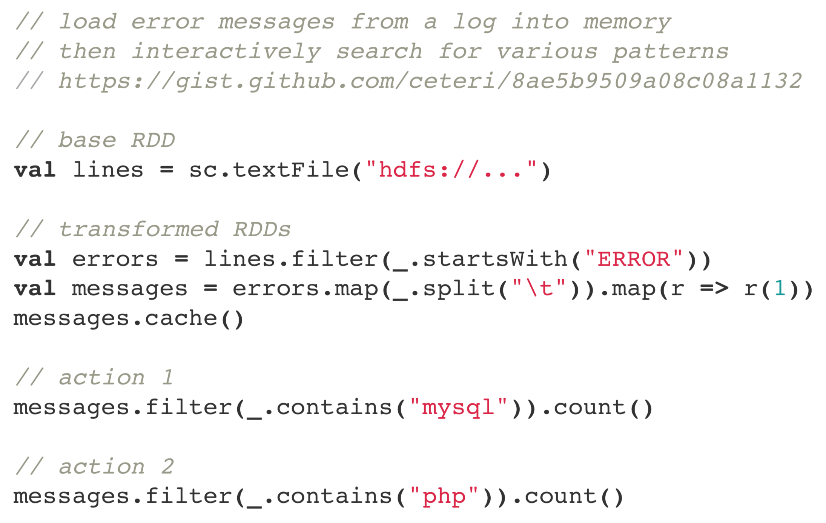
Introduction

Slide 6
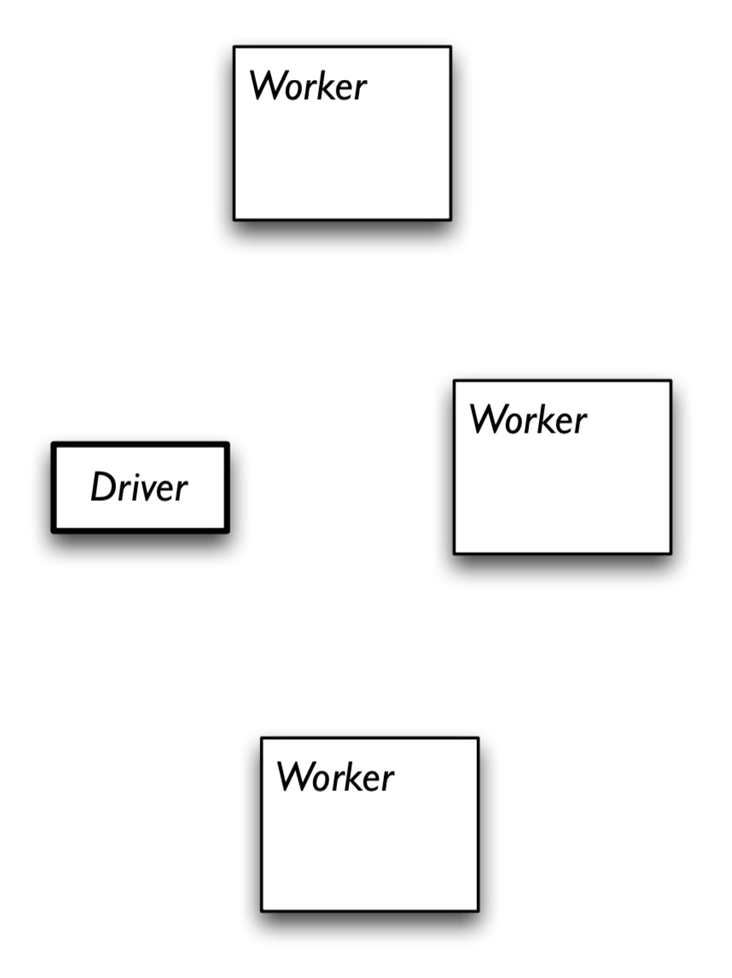
Spark Structure
Start Spark on a cluster
Submit code to be run on it

Slide 16
Another Perspective

Slide 17
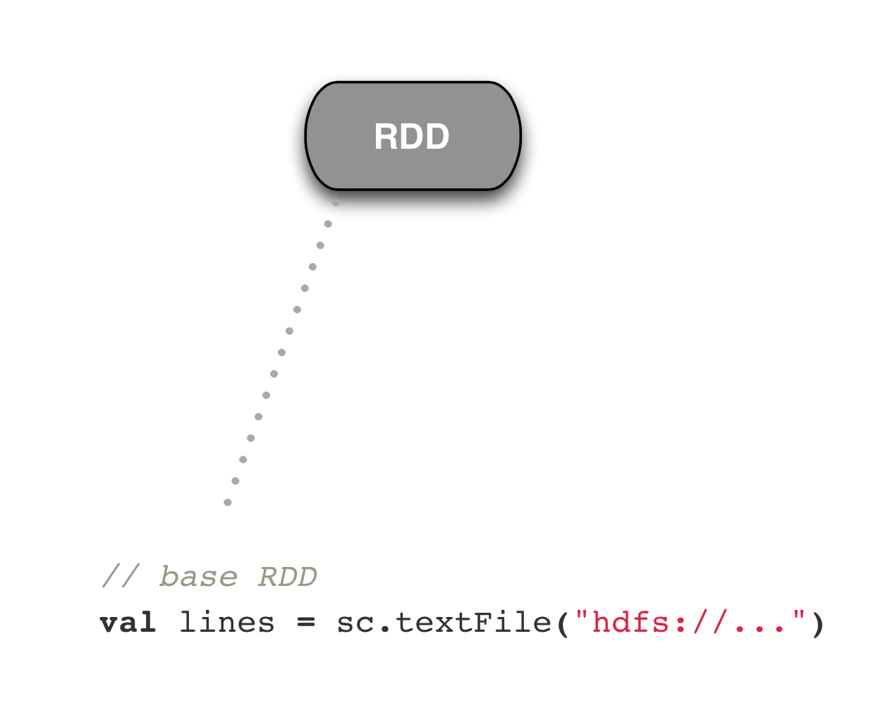
Step by step

Slide 18
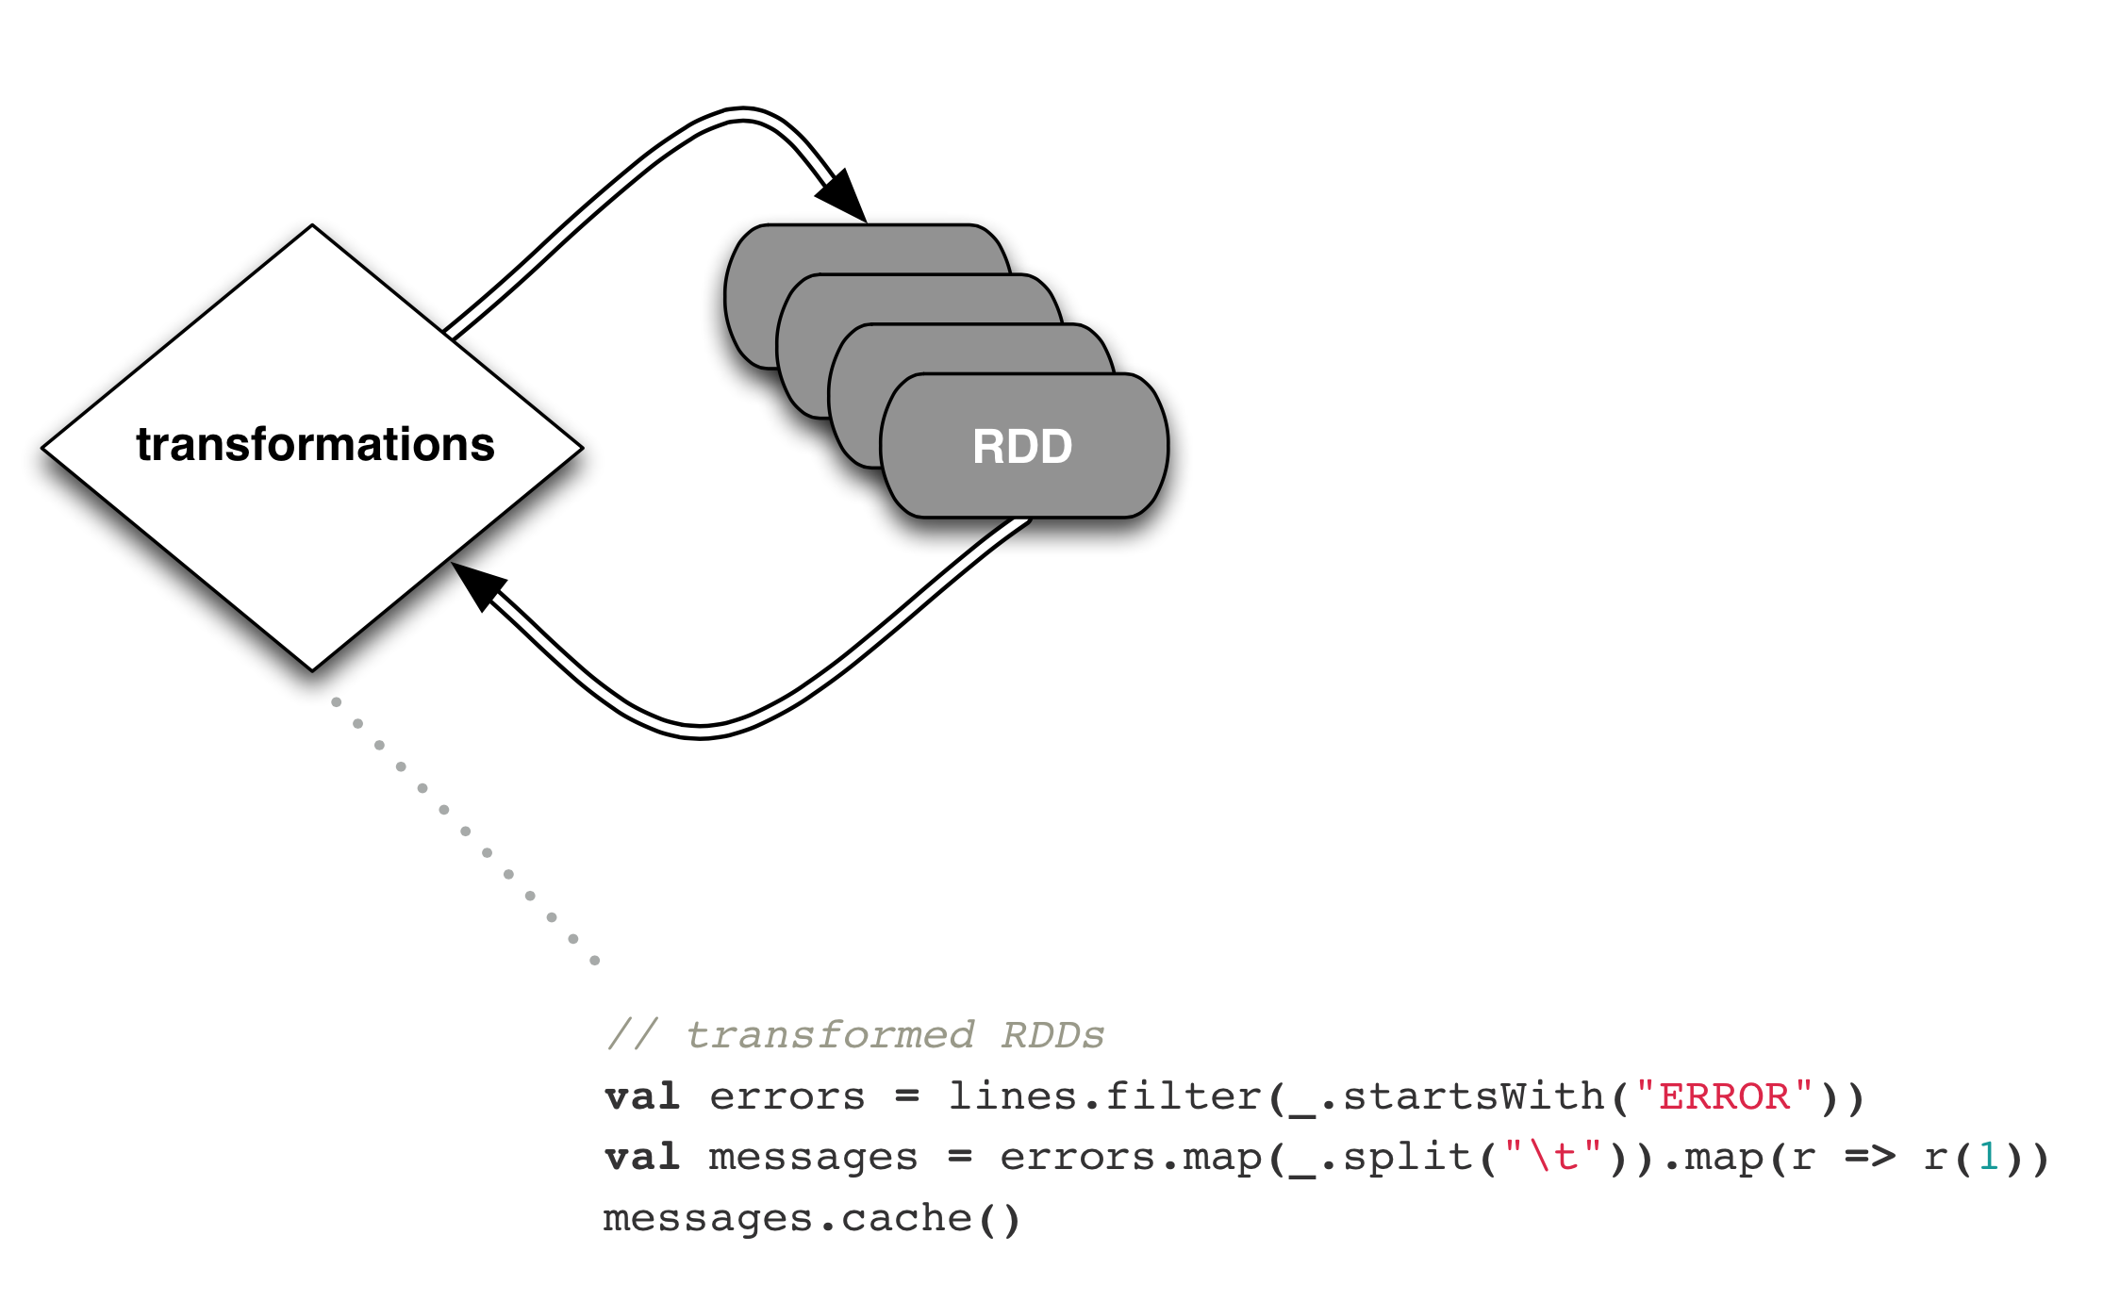
Step by step

Slide 19
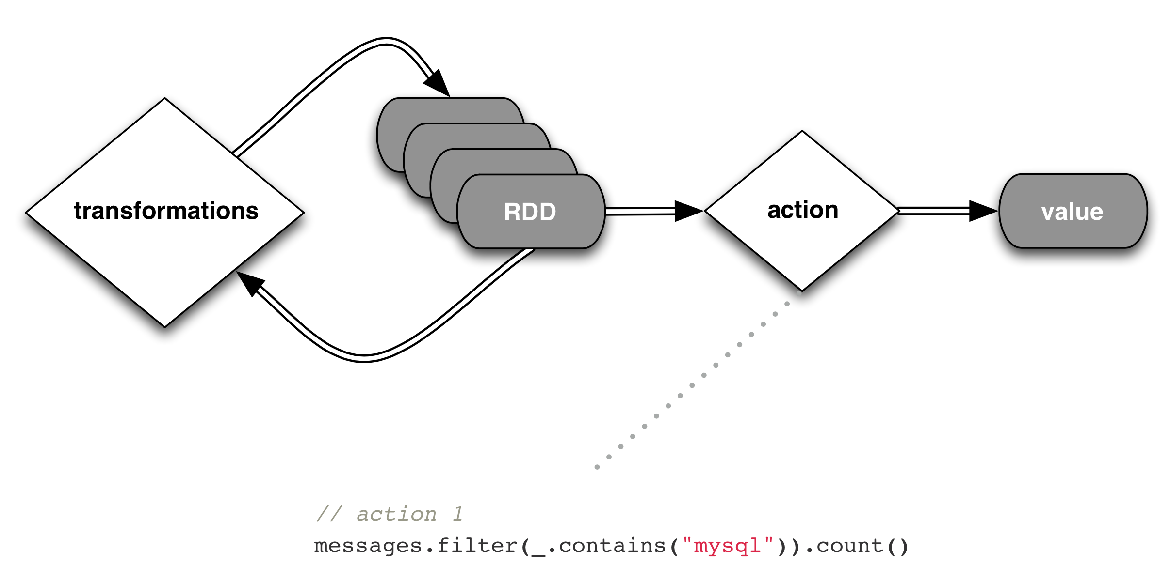
Step by step

Slide 20
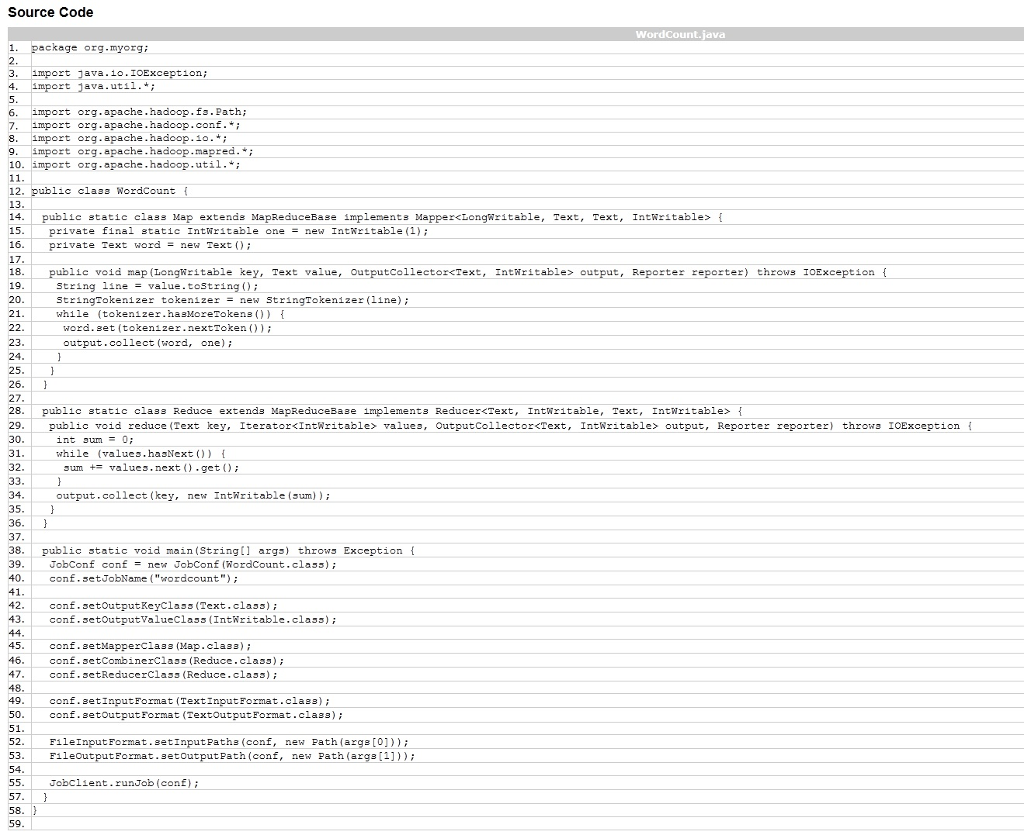
Example: WordCount

Slide 21
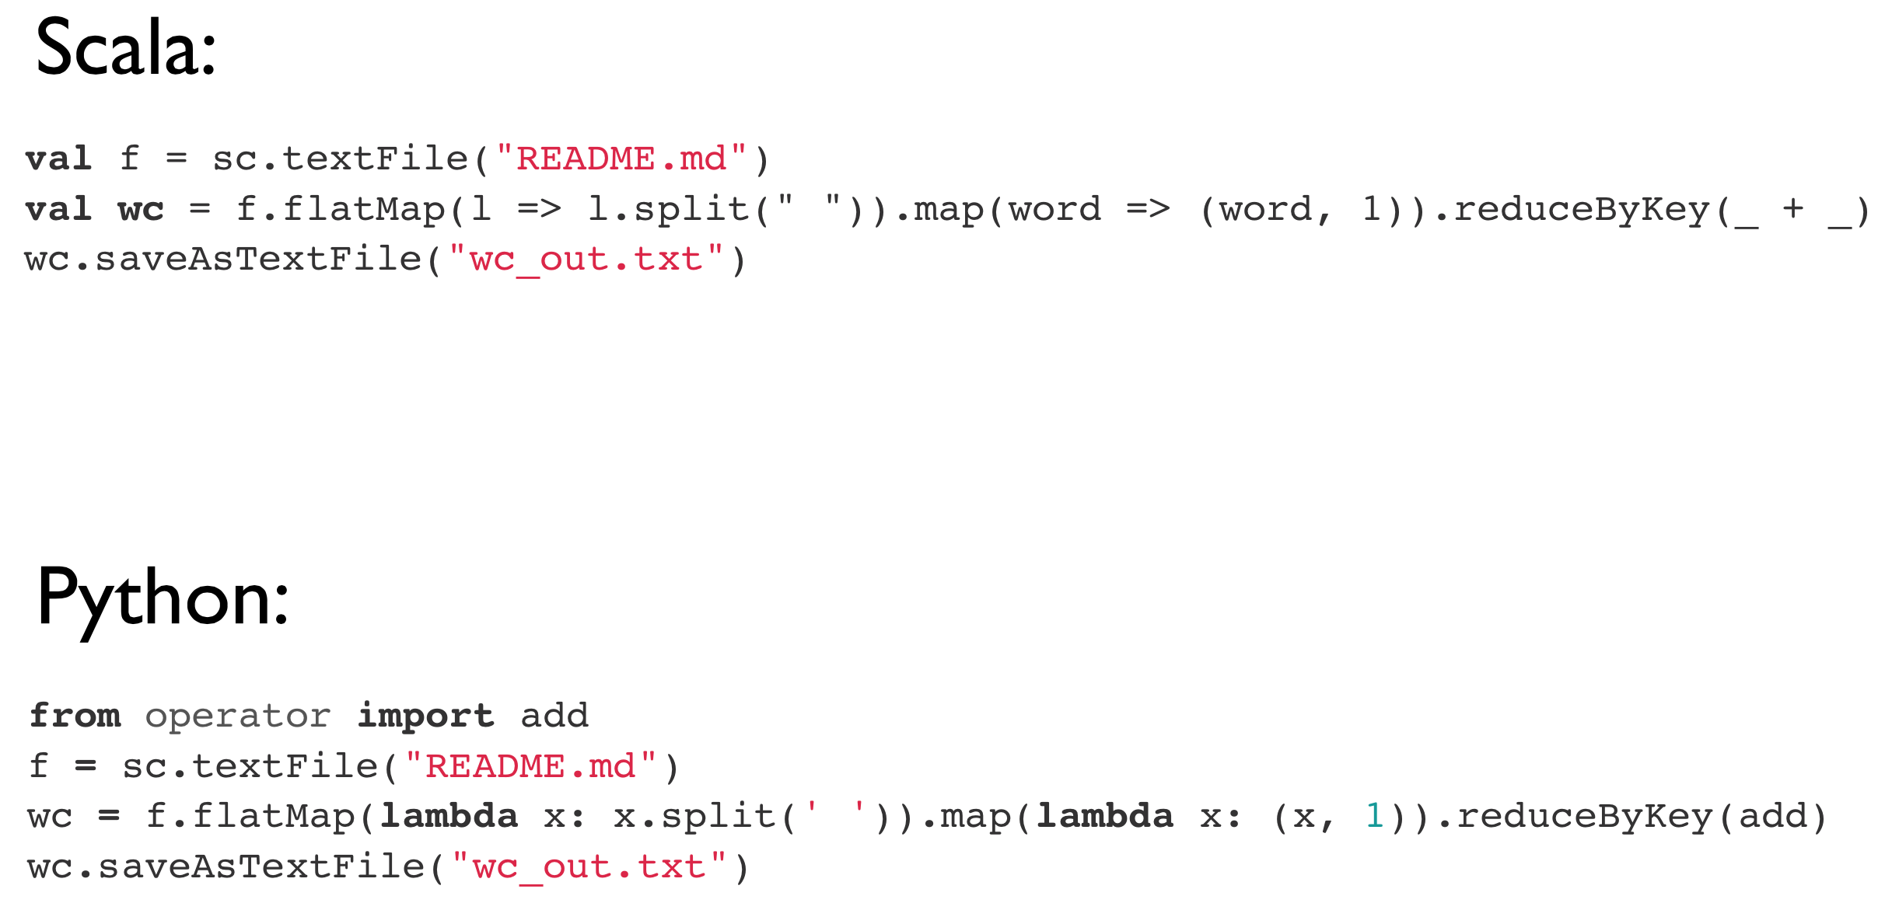
Example: WordCount

Slide 22
Limitations of MapReduce
Performance bottlenecks—not all jobs can be cast as batch processes
Graphs?
Programming in Hadoop is hard
Boilerplate boilerplate everywhere

Slide 23
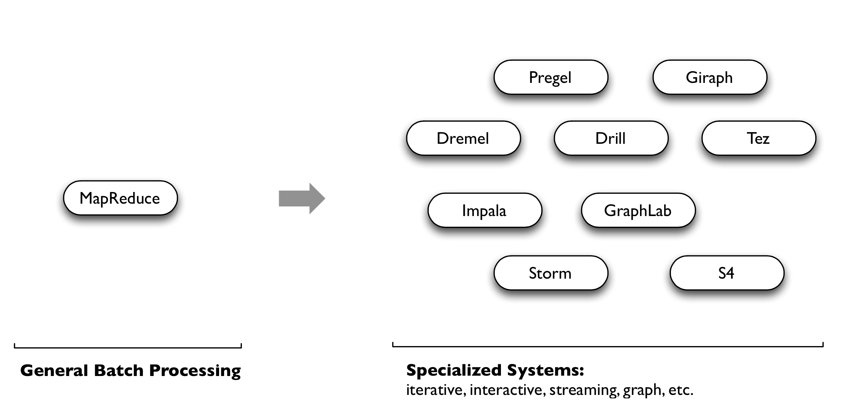
Initial Workaround: Specialization

Slide 24
Along Came Spark
Spark’s goal was to generalize MapReduce to support new applications within the same engine
Two additions:
Fast data sharing
General DAGs (directed acyclic graphs)
Best of both worlds: easy to program & more efficient engine in general

Slide 25
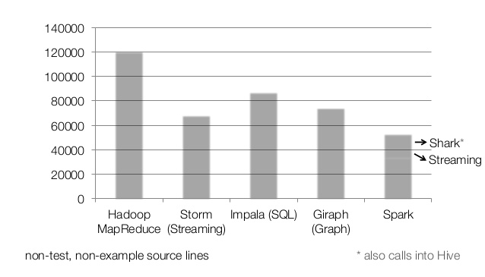
Codebase Size

Slide 26
More on Spark
More general
Supports map/reduce paradigm
Supports vertex-based paradigm
General compute engine (DAG)
More API hooks
Scala, Java, and Python
More interfaces
Batch (Hadoop), real-time (Storm), and interactive (???)

Slide 27
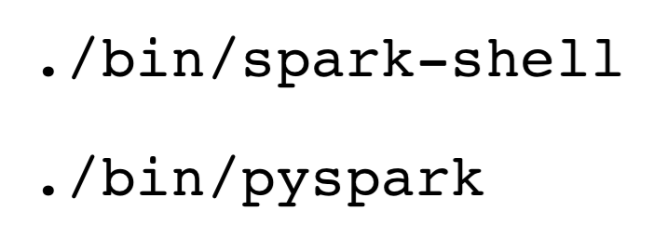
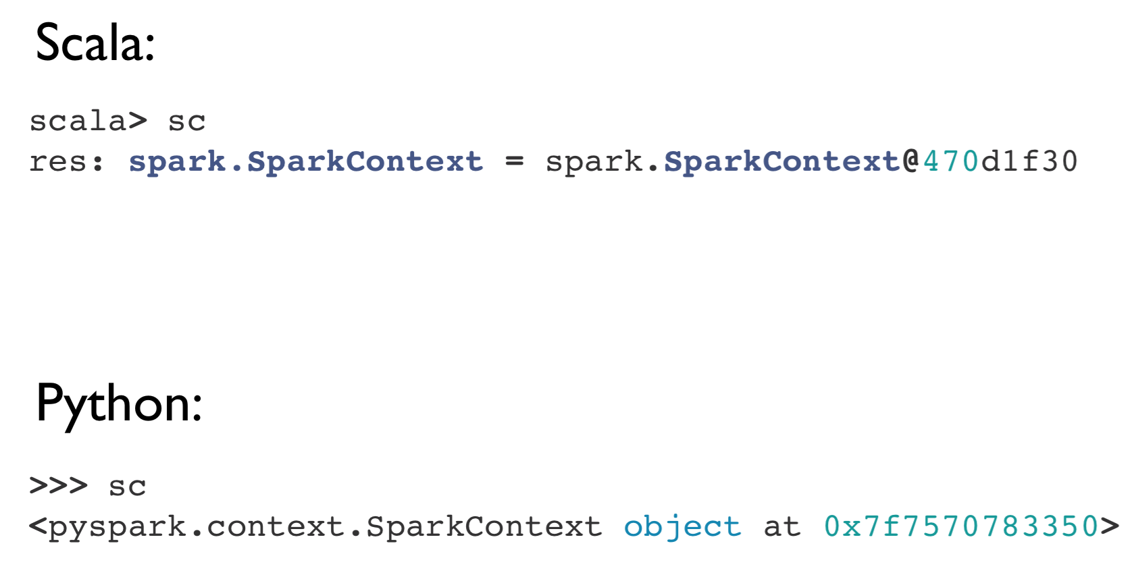
Interactive Shells
Spark creates a SparkContext object (cluster information)
For either shell: sc
External programs use a static constructor to instantiate the context

Slide 28
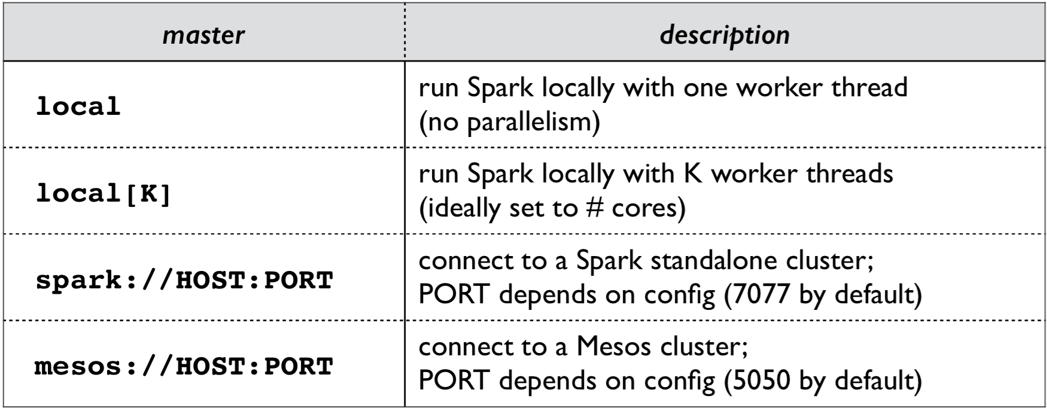
Interactive Shells
spark-shell --master

Slide 29
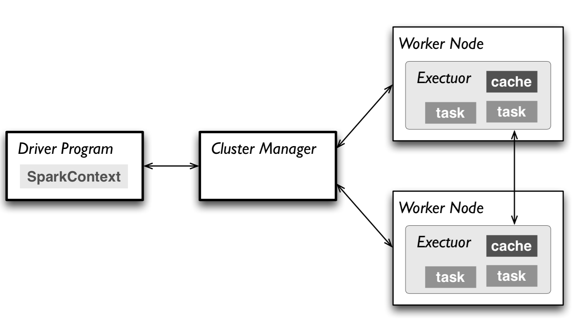
Interactive Shells
Master connects to the cluster manager, which allocates resources across applications
Acquires executors on cluster nodes: worker processes to run computations and store data
Sends app code to executors
Sends tasks for executors to run

Slide 30
Resilient Distributed Datasets (RDDs)
Resilient Distributed Datasets (RDDs) are primary data abstraction in Spark
Fault-tolerant
Can be operated on in parallel
Parallelized Collections
Hadoop datasets
Two types of RDD operations
Transformations (lazy)
Actions (immediate)

Slide 31
Resilient Distributed Datasets (RDDs)

Slide 32
Resilient Distributed Datasets (RDDs)
Can create RDDs from any file stored in HDFS
Local filesystem
Amazon S3
HBase
Text files, SequenceFiles, or any other Hadoop InputFormat
Any directory or glob
/data/201414*

Slide 33
Resilient Distributed Datasets (RDDs)
Transformations
Create a new RDD from an existing one
Lazily evaluated: results are not immediately computed
Pipeline of subsequent transformations can be optimized
Lost data partitions can be recovered

Slide 34
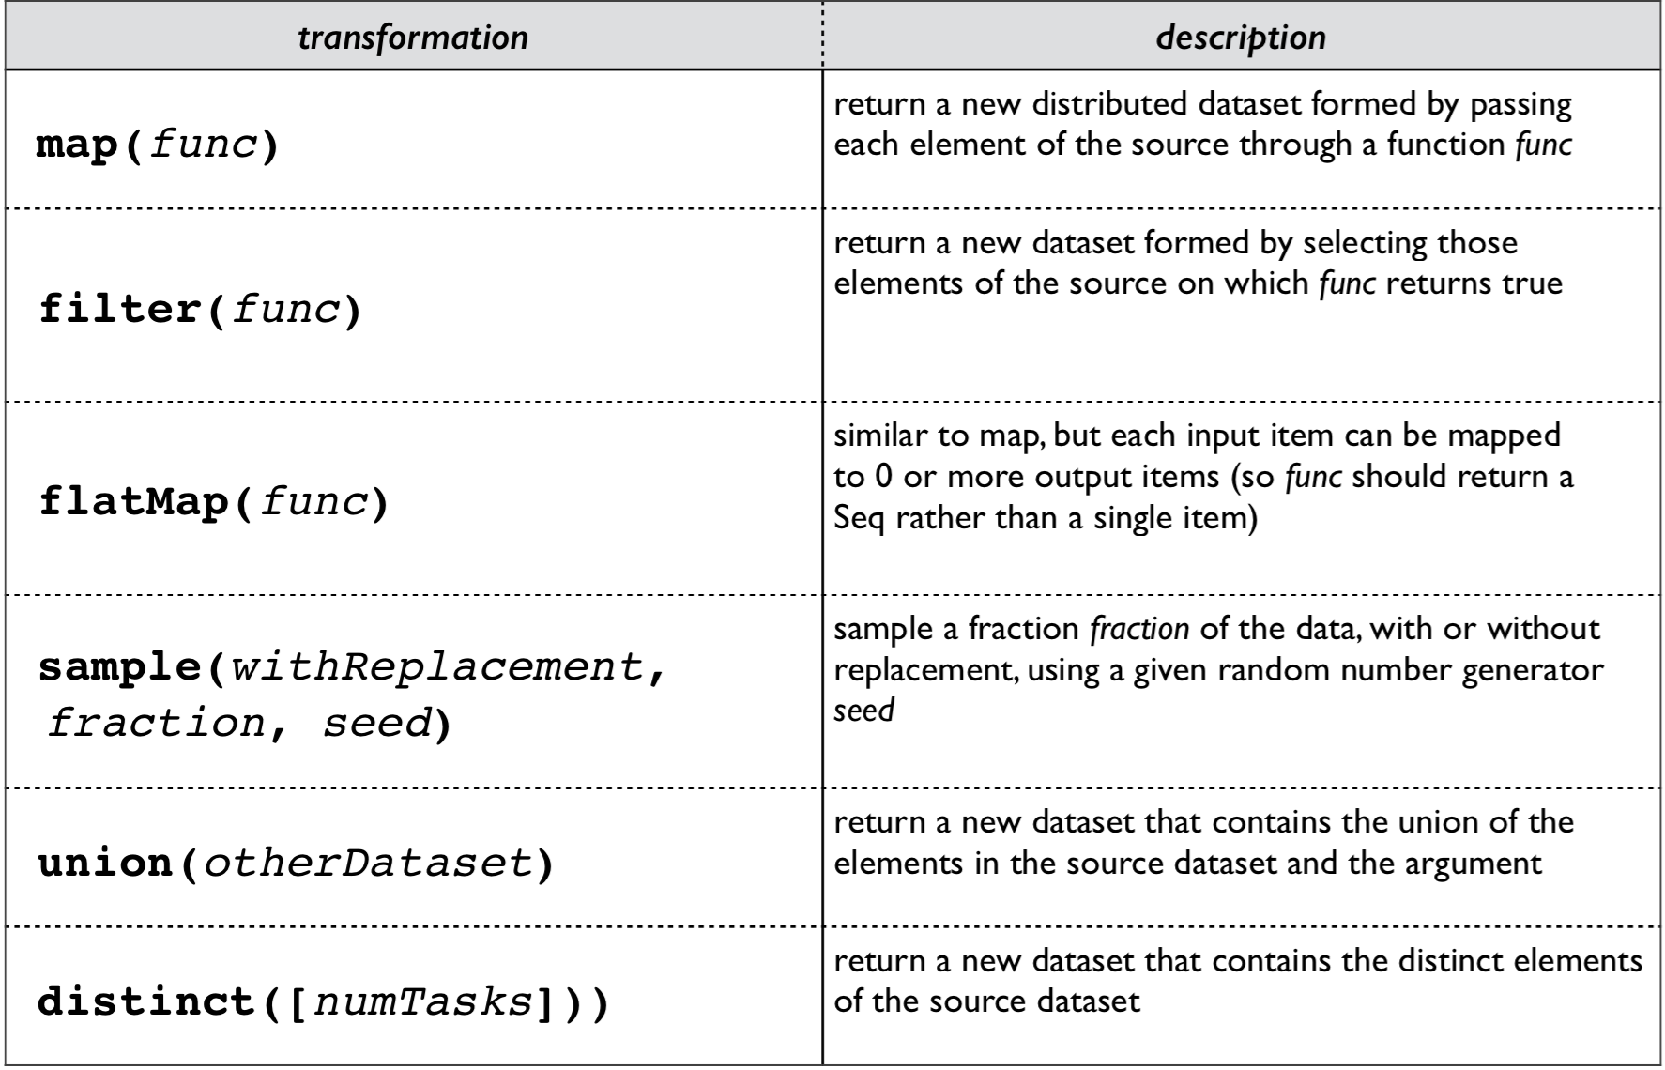
Resilient Distributed Datasets (RDDs)

Slide 35
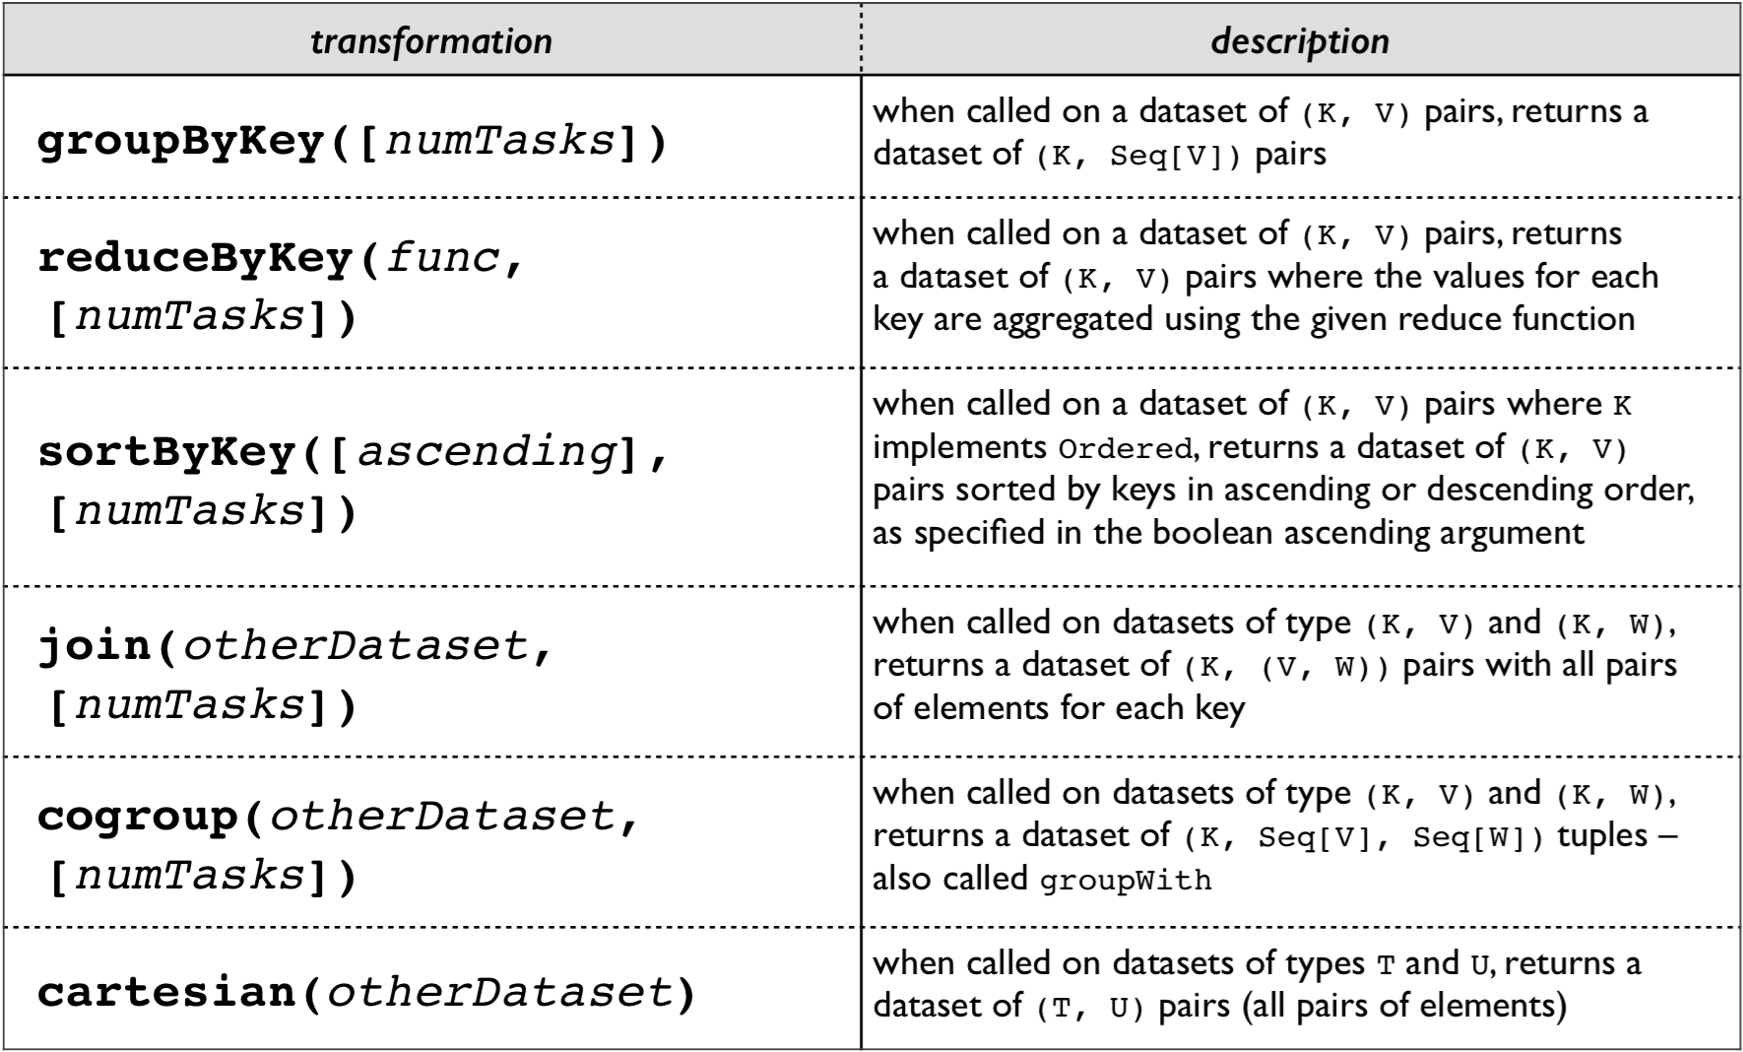
Resilient Distributed Datasets (RDDs)

Slide 36
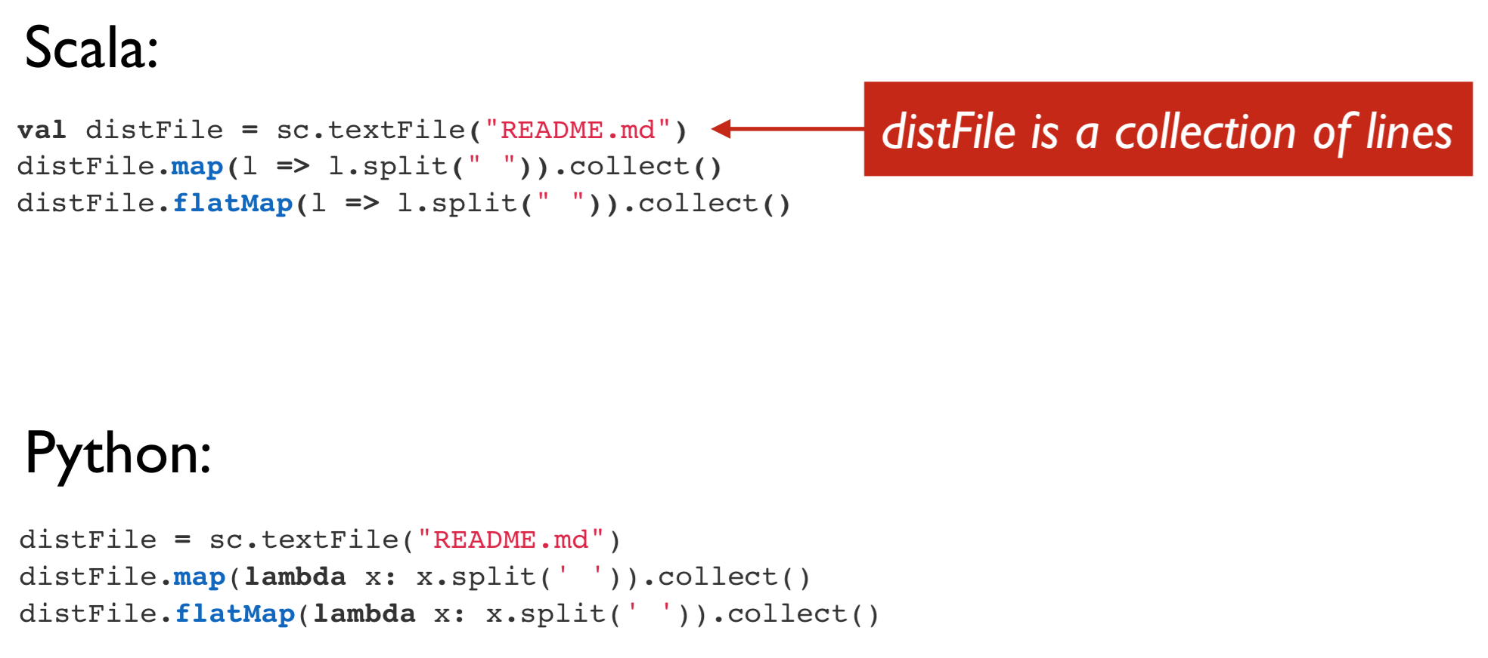
Resilient Distributed Datasets (RDDs)

Slide 37
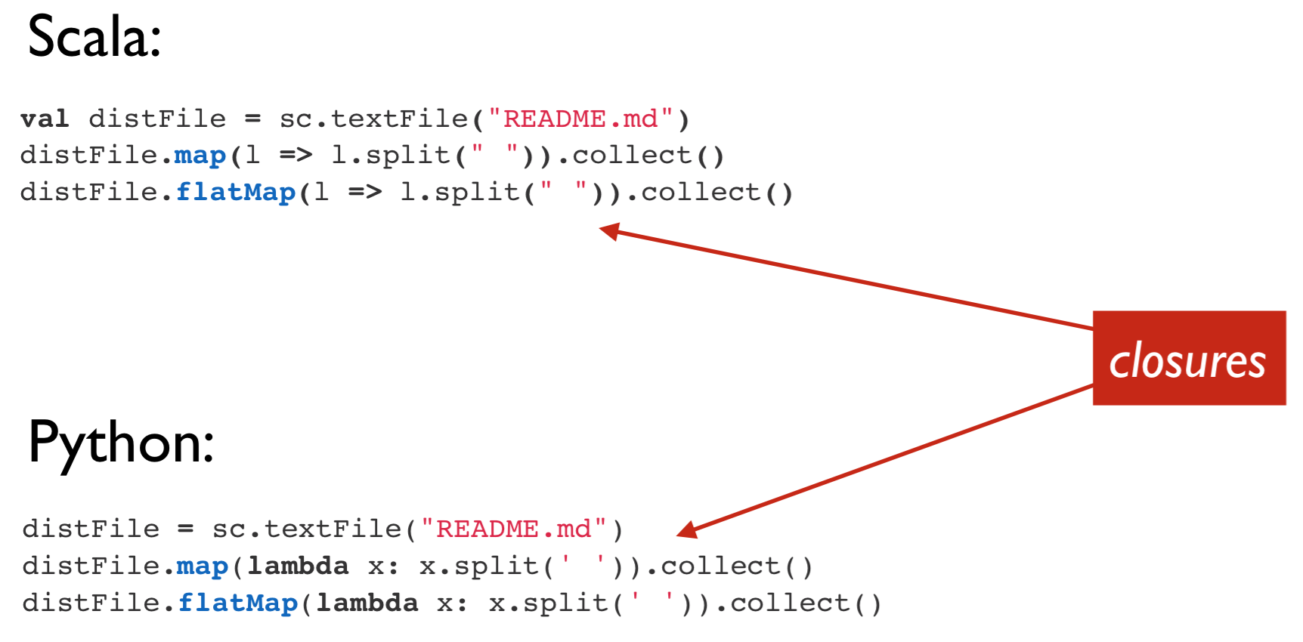
Resilient Distributed Datasets (RDDs)

Slide 38
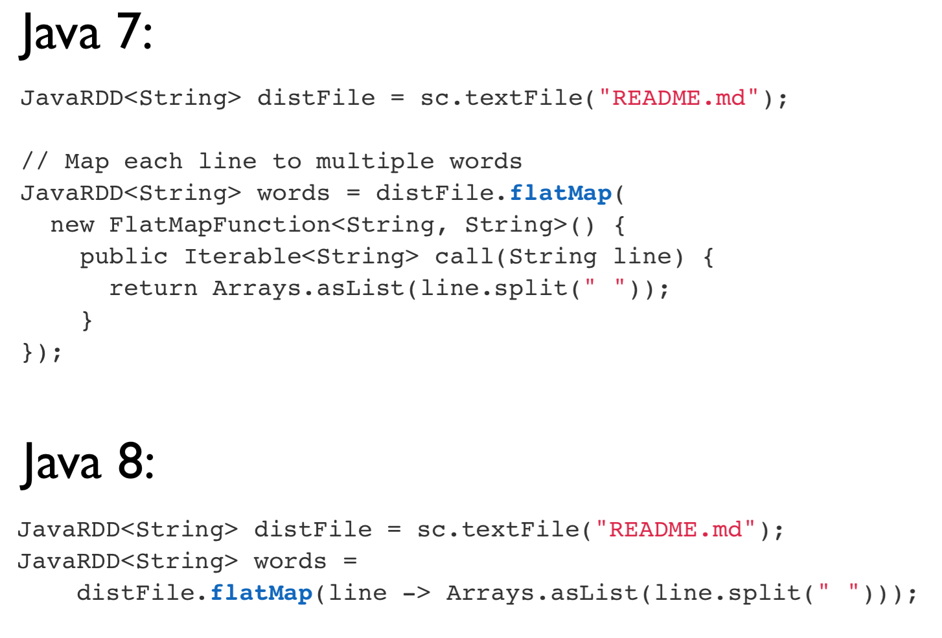
Closures in Java

Slide 39
Resilient Distributed Datasets (RDDs)
Actions
Create a new RDD from an existing one
Eagerly evaluated: results are immediately computed
Applies previous transformations
(cache results?)

Slide 40
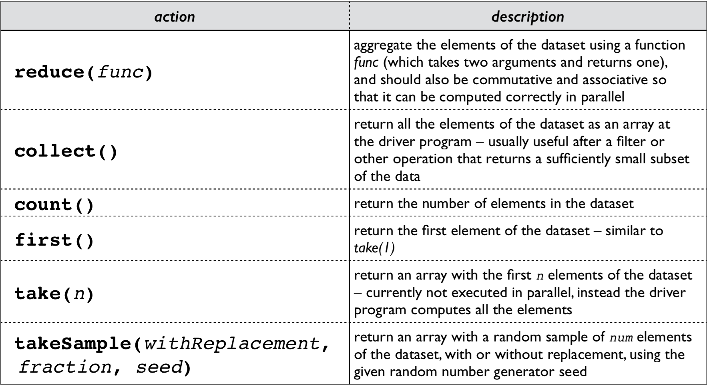
Resilient Distributed Datasets (RDDs)

Slide 41
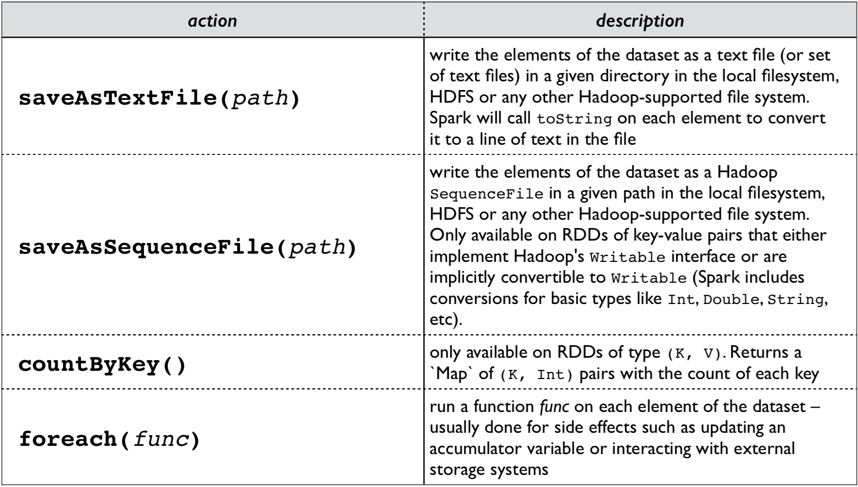
Resilient Distributed Datasets (RDDs)

Slide 42
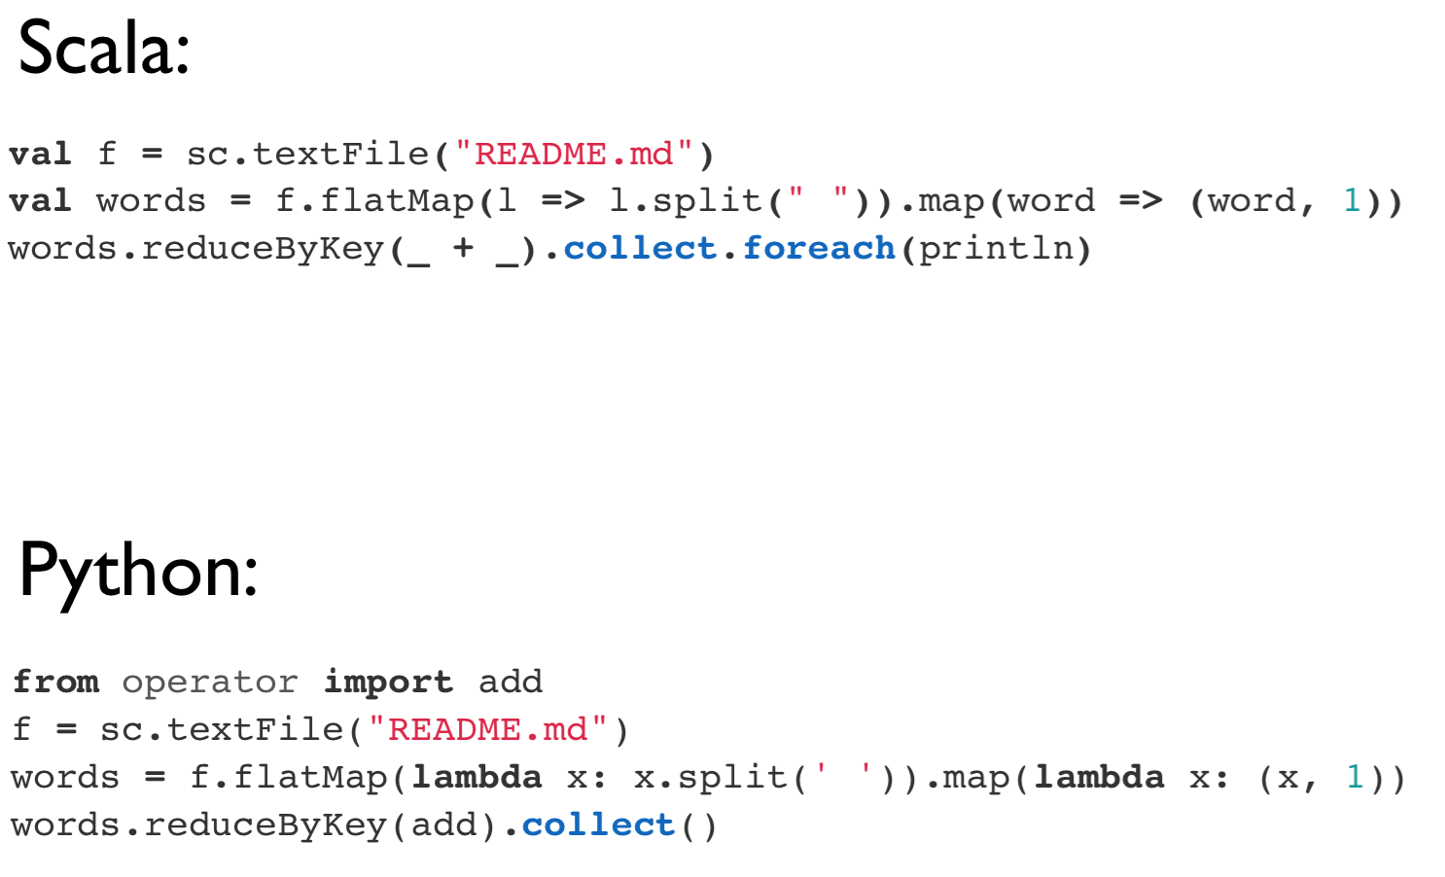
Resilient Distributed Datasets (RDDs)

Slide 43
Resilient Distributed Datasets (RDDs)
Spark can persist / cache an RDD in memory across operations
Each slice is persisted in memory and reused in subsequent actions involving that RDD
Cache provides fault-tolerance: if partition is lost, it will be recomputed using transformations that created it

Slide 44
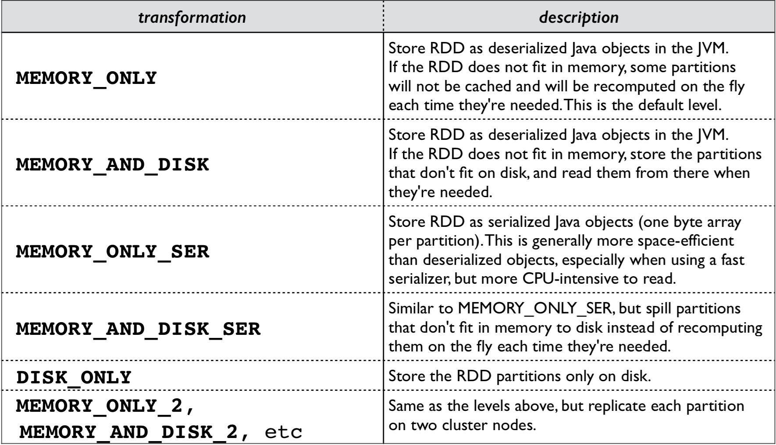
Resilient Distributed Datasets (RDDs)

Slide 45
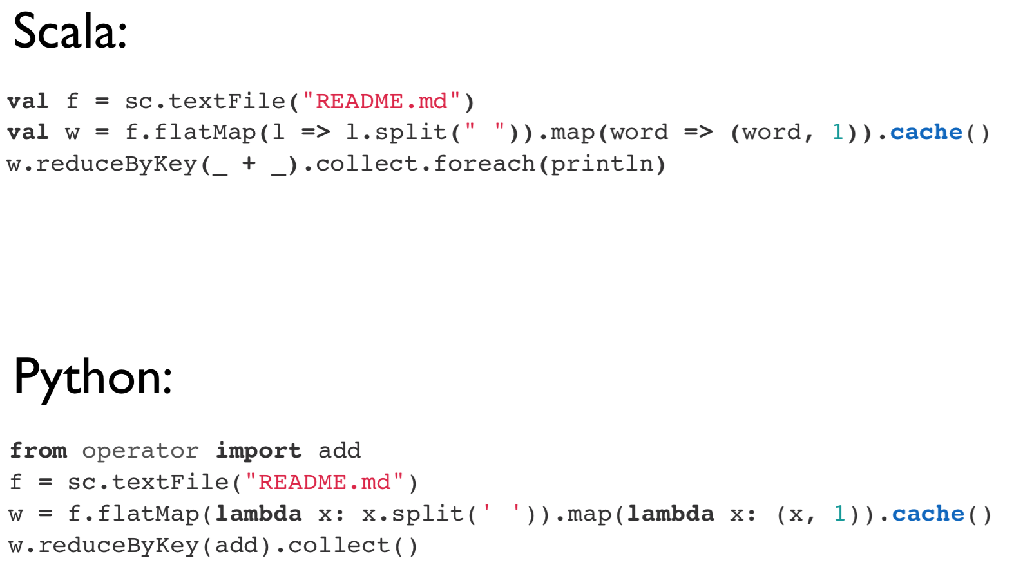
Resilient Distributed Datasets (RDDs)

Slide 46
Broadcast Variables
Spark’s version of Hadoop’s DistributedCache
Read-only variable cached on each node
Spark [internally] distributed broadcast variables in such a way to minimize communication cost

Slide 47
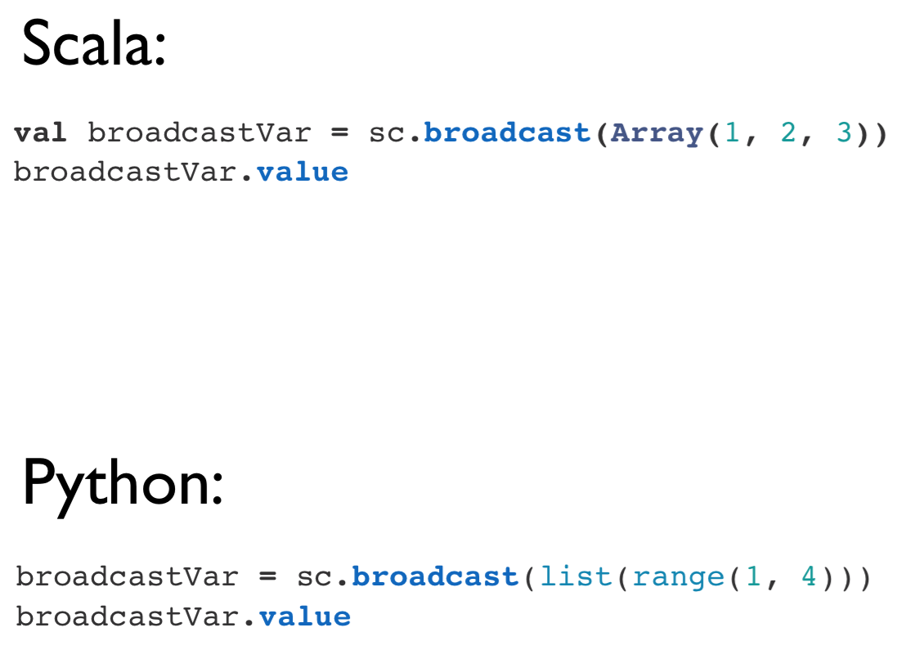
Broadcast Variables

Slide 48
Accumulators
Spark’s version of Hadoop’s Counter
Variables that can only be added through an associative operation
Native support of numeric accumulator types and standard mutable collections
Users can extend to new types
Only driver program can read accumulator value

Slide 49
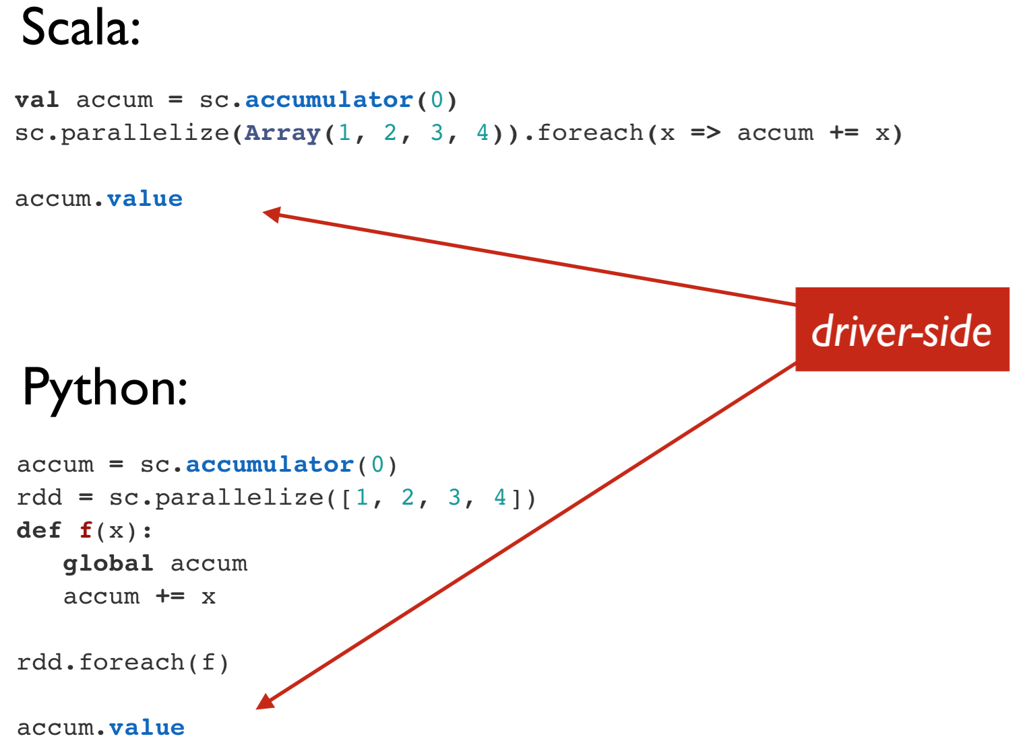
Accumulators

Slide 50
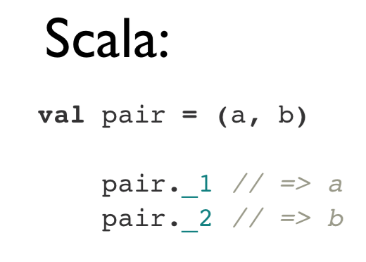
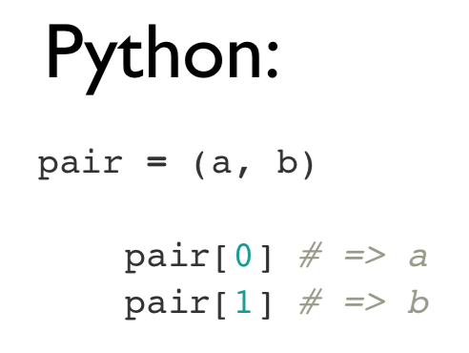
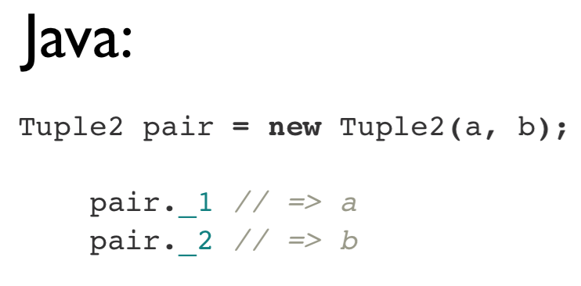
Key/Value Pairs

Slide 51
Resources
Original slide deck: http://cdn.liber118.com/workshop/itas_workshop.pdf
Code samples:
https://gist.github.com/ceteri/f2c3486062c9610eac1d
https://gist.github.com/ceteri/8ae5b9509a08c08a1132
https://gist.github.com/ceteri/11381941

