Slide 1
Latent Dirichlet Allocation (LDA)
Shannon Quinn
(with thanks to William Cohen of Carnegie Mellon University and Arvind Ramanathan of Oak Ridge National Laboratory)

Slide 2
Processing Natural Language Text
Collection of documents
Each document consists of a set of word tokens, from a set of word types
  The big dog ate the small dog
Goal of Processing Natural Language Text
Construct models of the domain via unsupervised learning
“Learn the structure of the domain”

Slide 3
Structure of a Domain: What does it mean?
Obtain a compact representation of each document
Obtain a generative model that produces observed documents with high probability
  others with low probability!

Slide 4
Generative Models
Topic 1
.8
DOCUMENT 1: money¹ bank¹ bank¹ loan¹ river² stream² bank¹ money¹ river² bank¹ money¹ bank¹ loan¹ money¹ stream² bank¹ money¹ bank¹ bank¹ loan¹ river² stream² bank¹ money¹ river² bank¹ money¹ bank¹ loan¹ bank¹ money¹ stream²
bank
loan
loan
.2
bank
Topic 2
.3
DOCUMENT 2: river² stream² bank² stream² bank² money¹ loan¹ river² stream² loan¹ bank² river² bank² bank¹ stream² river² loan¹ bank² stream² bank² money¹ loan¹ river² stream² bank² stream² bank² money¹ river² stream² loan¹ bank² river² bank² money¹ bank¹ stream² river² bank² stream² bank² money¹
.7
stream
river
river
bank
Dennis, and W. Kintsch (eds), Latent Semantic Analysis: A Road to Meaning. Laurence
Steyvers, M. & Griffiths, T. (2006). Probabilistic topic models. In T. Landauer, D McNamara, S.

Slide 5
The inference problem
Topic 1
DOCUMENT 1: money? bank? bank? loan? river? stream? bank? money? river? bank? money? bank? loan? money? stream? bank? money? bank? bank? loan? river? stream? bank? money? river? bank? money? bank? loan? bank? money? stream?
?
Topic 2
DOCUMENT 2: river? stream? bank? stream? bank? money? loan? river? stream? loan? bank? river? bank? bank? stream? river? loan? bank? stream? bank? money? loan? river? stream? bank? stream? bank? money? river? stream? loan? bank? river? bank? money? bank? stream? river? bank? stream? bank? money?

Slide 6
Obtaining a compact representation: LSA
Latent Semantic Analysis (LSA)
  Mathematical model
  Somewhat hacky!
Topic Model with LDA
  Principled
  Probabilistic model
  Additional embellishments possible!

Slide 7
Set up for LDA: Co-occurrence matrix
D documents
W (distinct) words
F = W x D matrix
f_{wd} = frequency of word w in document d
d₁
d₂
…
…
…
d_{D}
w₁
w₂
f_{wd}
…
w_{W}

Slide 8
LSA: Transforming the Co-occurrence matrix
Compute the relative entropy of a word across documents:
  Are terms document specific?
  Occurrence reveals something specific about the document itself
  Hw = 0 → word occurs in only one document
  Hw = 1 → word occurs across all documents
P(d|w)
[0, 1]

Slide 9
Transforming the Co-occurrence matrix
G = W x D [normalized Co-occurrence matrix]
(1-Hw) is a measure of specificity:
  0 → word tells you nothing about the document
  1 → word tells you something specific about the document
G = weighted matrix (with specificity)
  High dimensional
  Does not capture similarity across documents

Slide 10
What do you do after constructing G?
G (W x D) = U_{(W x r)} Σ _{(r x r)} V^{T} _{(r x D)}
  Singular Value decomposition
if r = min(W,D) reconstruction is perfect
if r < min(W, D), capture whatever structure there is in matrix with a reduced number of parameters
Reduced representation of word i: row i of matrix UΣ
Reduced representation of document j: column j of matrix ΣV^{T}

Slide 11
Some issues with LSA
Finding optimal dimension for semantic space
  precision-recall improve as dimension is increased until hits optimal, then slowly decreases until it hits standard vector model
  run SVD once with big dimension, say k = 1000
    then can test dimensions <= k
  in many tasks 150-350 works well, still room for research
SVD assumes normally distributed data
  term occurrence is not normally distributed
  matrix entries are weights, not counts, which may be normally distributed even when counts are not
Notes:
-Term occurrence is usually Poisson, not Gaussian
-SVD basis vectors are usually difficult to interpret (think back to Etsy paper)

Slide 12
Intuition to why LSA is not such a good idea…
Topic 1
.8
DOCUMENT 1: money¹ bank¹ bank¹ loan¹ river² stream² bank¹ money¹ river² bank¹ money¹ bank¹ loan¹ money¹ stream² bank¹ money¹ bank¹ bank¹ loan¹ river² stream² bank¹ money¹ river² bank¹ money¹ bank¹ loan¹ bank¹ money¹ stream²
bank
loan
loan
.2
bank
Topic 2
.3
DOCUMENT 2: river² stream² bank² stream² bank² money¹ loan¹ river² stream² loan¹ bank² river² bank² bank¹ stream² river² loan¹ bank² stream² bank² money¹ loan¹ river² stream² bank² stream² bank² money¹ river² stream² loan¹ bank² river² bank² money¹ bank¹ stream² river² bank² stream² bank² money¹
.7
stream
river
river
bank
Topics are most often generated by “mixtures” of topics
Not great at “finding documents that come from a similar topic”
Topics and words can change over time!
Difficult to create a generative model

Slide 13
Topic models
Motivating questions:
  What are the topics that a document is about?
  Given one document, can we find similar documents about the same topic?
  How do topics in a field change over time?
We will use a Hierarchical Bayesian Approach
  Assume that each document defines a distribution over (hidden) topics
  Assume each topic defines a distribution over words
  The posterior probability of these latent variables given a document collection determines a hidden decomposition of the collection into topics.

Slide 14

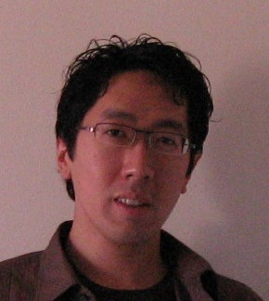

http://dl.acm.org/citation.cfm?id=944937

Slide 15
LDA
Motivation
Assumptions: 1) documents are i.i.d 2) within a document, words are i.i.d. (bag of words)
For each document d = 1,☹,M
  Generate θ_{d} ~ D₁(…)
  For each word n = 1,☹, N_{d}
    generate w_{n} ~ D₂( ¢ | θ_{dn})
Now pick your favorite distributions for D₁, D₂
θ
w
N
M
Notes:
Documents and words are exchangeable

Slide 16
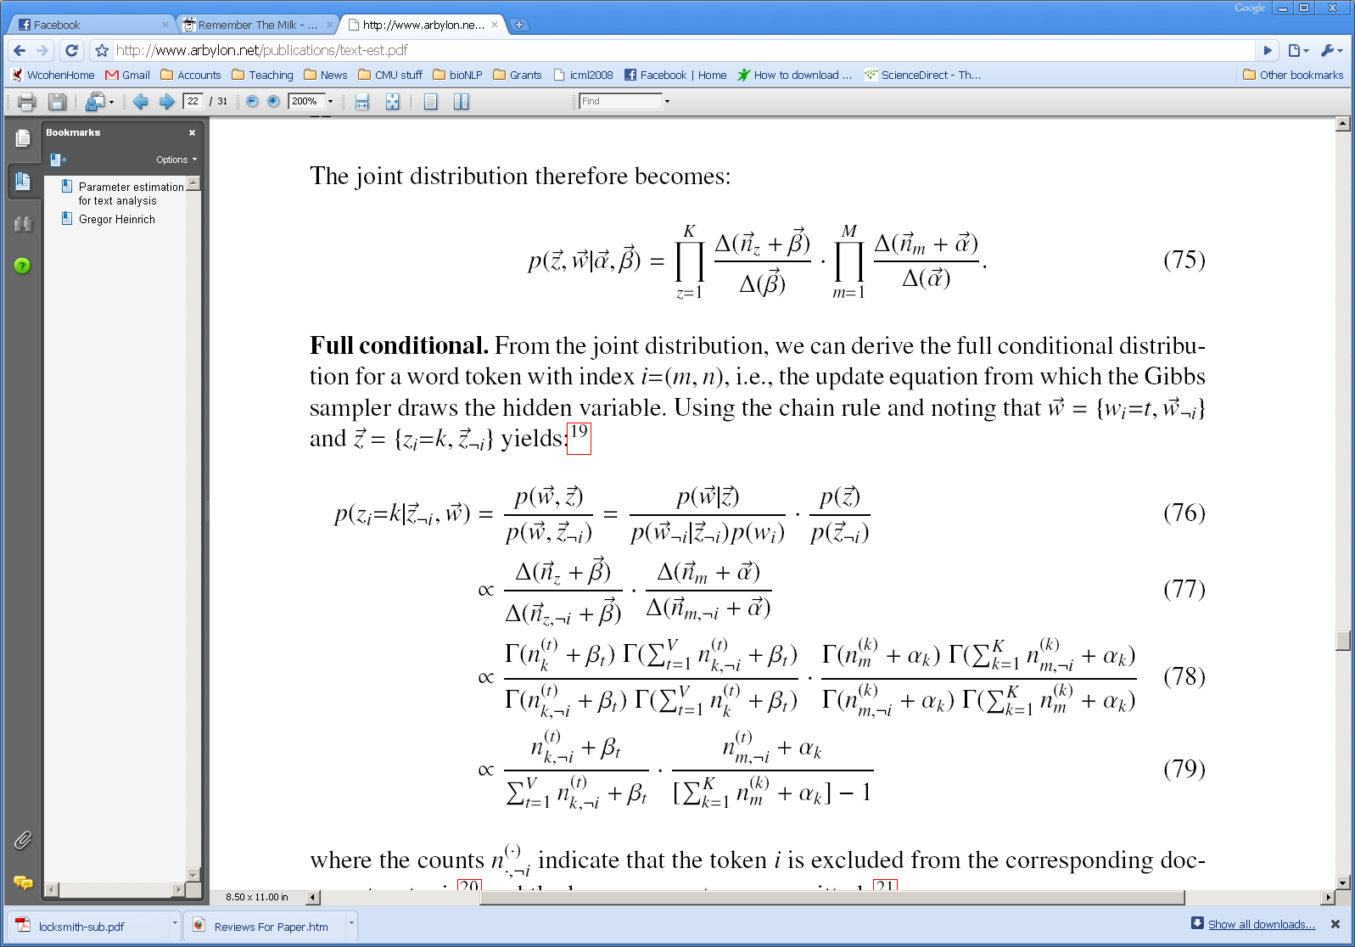
LDA
“Mixed membership”
θ
α
Randomly initialize each z_{m,n}
Repeat for t=1,….
  For each doc m, word n
    Find Pr(z_{mn}=k|other z’s)
    Sample z_{mn} according to that distr.
30? 100?
z
w
N
M
(k)
β

Slide 17
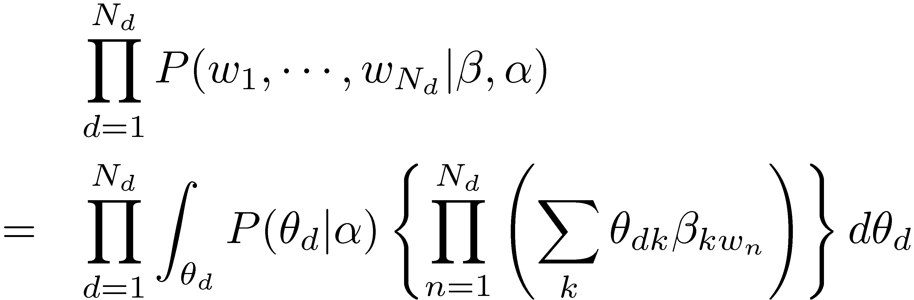
LDA
“Mixed membership”
θ
α
For each document d = 1,☹,M
  Generate θ_{d} ~ Dir(¢ | α)
  For each position n = 1,☹, N_{d}
    generate z_{n} ~ Mult( . | θ_{d})
    generate w_{n} ~ Mult( . | β_{zn})
z
w
N
M
β
K

Slide 18
How an LDA document looks

Slide 19
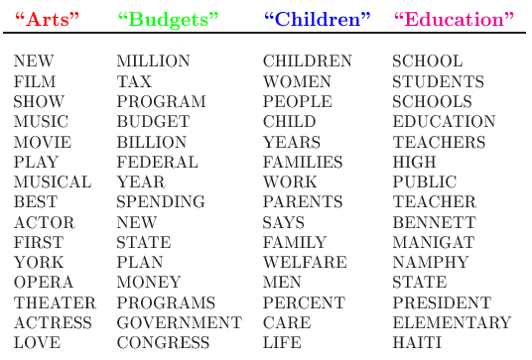
LDA topics

Slide 20
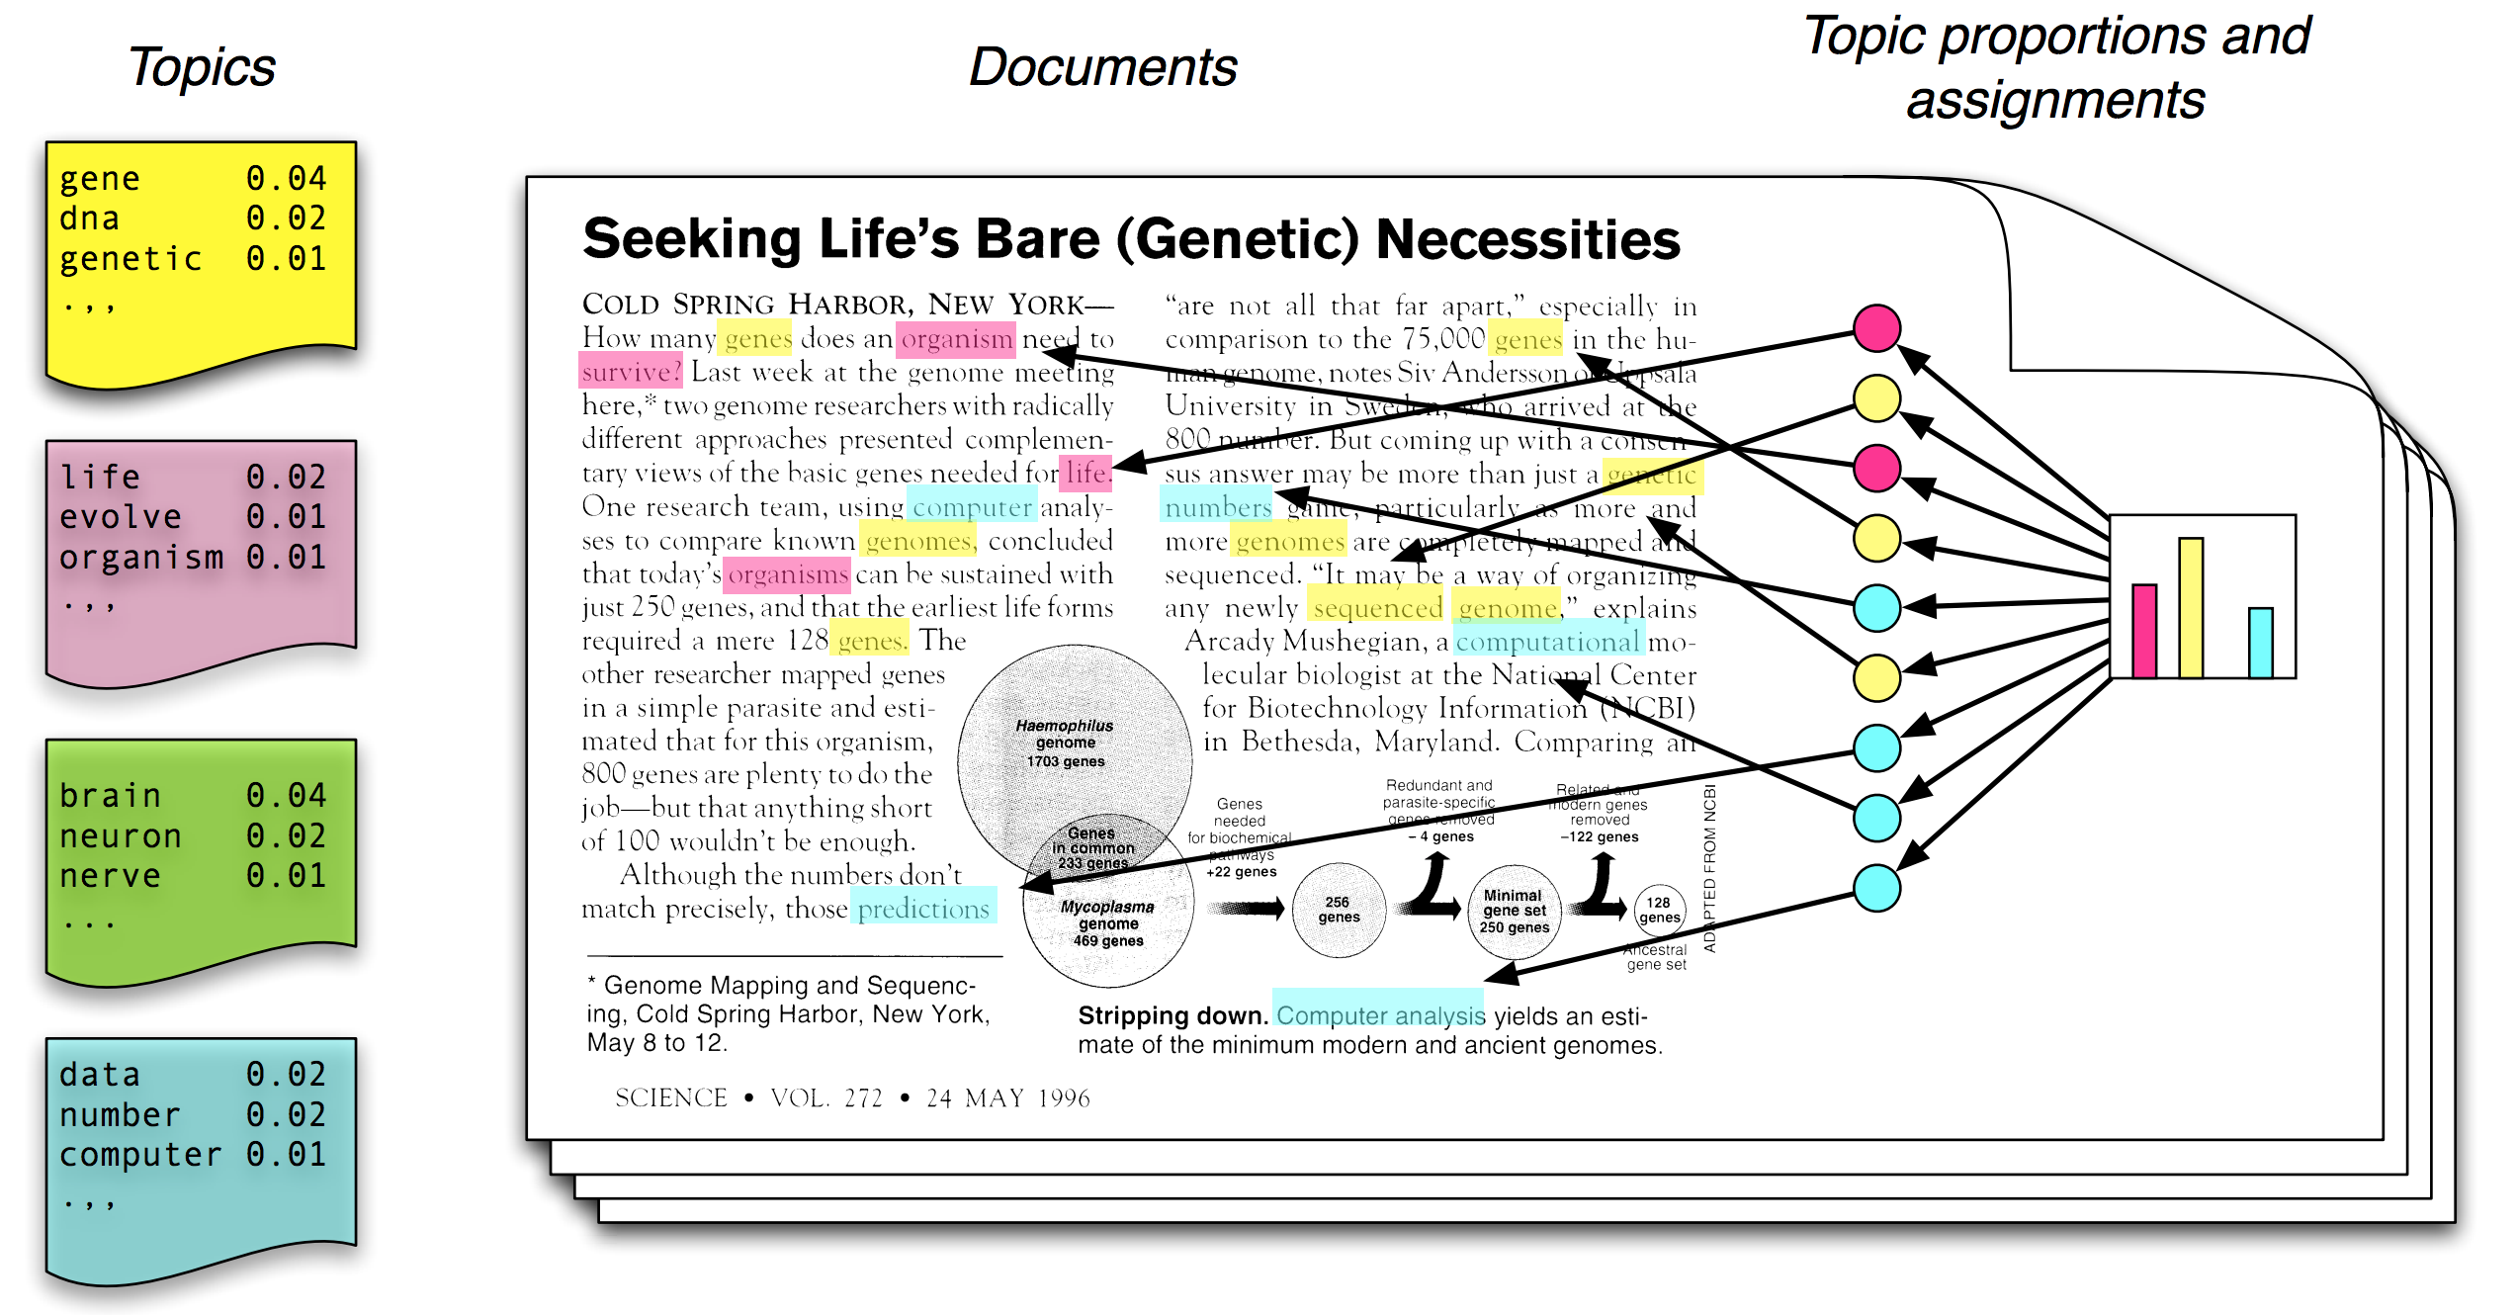
The intuitions behind LDA
http://www.cs.princeton.edu/~blei/papers/Blei2011.pdf
Notes:
The intuitions behind latent Dirichlet allocation. We assume that some number of “topics,” which are distributions over words, exist for the whole collection (far left). Each document is assumed to be generated as follows. First choose a distribution over the topics (the histogram at right); then, for each word, choose a topic assignment (the colored coins) and choose the word from the corresponding topic. The topics and topic assignments in this figure are illustrative—they are not fit from real data.

Slide 21
Let’s set up a generative model…
We have D documents
Vocabulary of V word types
Each document contains up to N word tokens
Assume K topics
Each document has a K-dimensional multinomial θ_{d} over topics with a common Dirichlet prior, Dir(α)
Each topic has a V-dimensional multinomial β_{k} over with a common symmetric Dirichlet prior, D(η)

Slide 22
What is a Dirichlet distribution?
Remember we called a multinomial distribution for both topic and word distributions?
The space is of all of these multinomials has a nice geometric interpretation as a (k-1)-simplex, which is just a generalization of a triangle to (k-1) dimensions.
Criteria for selecting our prior:
  It needs to be defined for a (k-1)-simplex.
  Algebraically speaking, we would like it to play nice with the multinomial distribution.

Slide 23
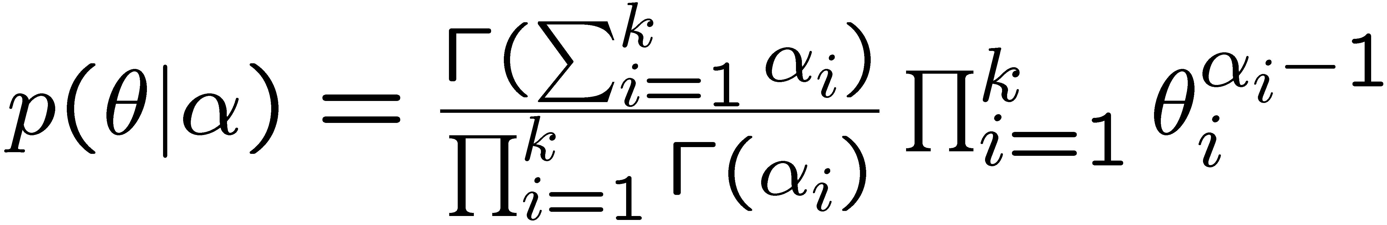
More on Dirichlet Distributions
Useful Facts:
  This distribution is defined over a (k-1)-simplex. That is, it takes k non-negative arguments which sum to one. Consequently it is a natural distribution to use over multinomial distributions.
  In fact, the Dirichlet distribution is the conjugate prior to the multinomial distribution. (This means that if our likelihood is multinomial with a Dirichlet prior, then the posterior is also Dirichlet!)
  The Dirichlet parameter α_{i} can be thought of as a prior count of the i^{th} class.

Slide 24
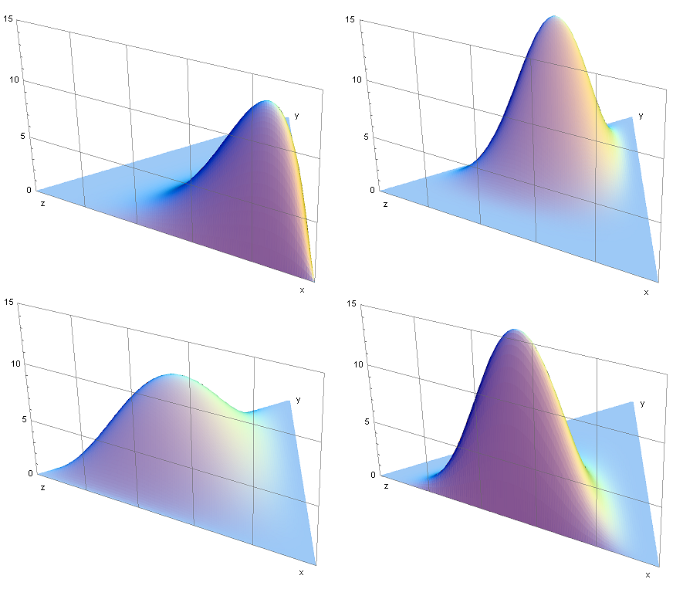
More on Dirichlet Distributions

Slide 25
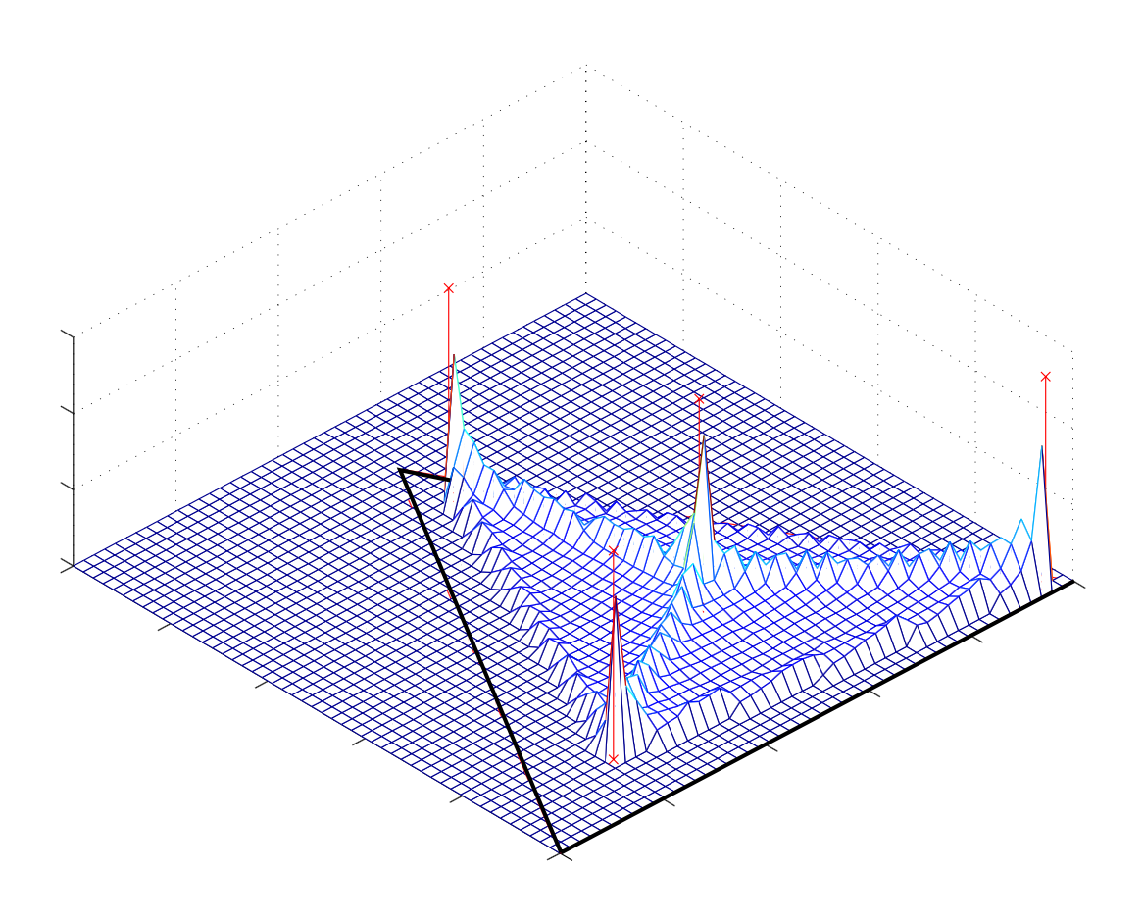
Dirichlet Distribution
Notes:
A multivariate generalization of the beta distribution.
An example density on unigram distributions p(w|θ,β) under LDA for three words and four topics. The triangle embedded in the x-y plane is the 2-D simplex representing all possible multinomial distributions over three words. Each of the vertices of the trian- gle corresponds to a deterministic distribution that assigns probability one to one of the words; the midpoint of an edge gives probability 0.5 to two of the words; and the centroid of the triangle is the uniform distribution over all three words. The four points marked with an x are the locations of the multinomial distributions p(w | z) for each of the four topics, and the surface shown on top of the simplex is an example of a density over the (V − 1)-simplex (multinomial distributions of words) given by LDA.

Slide 26
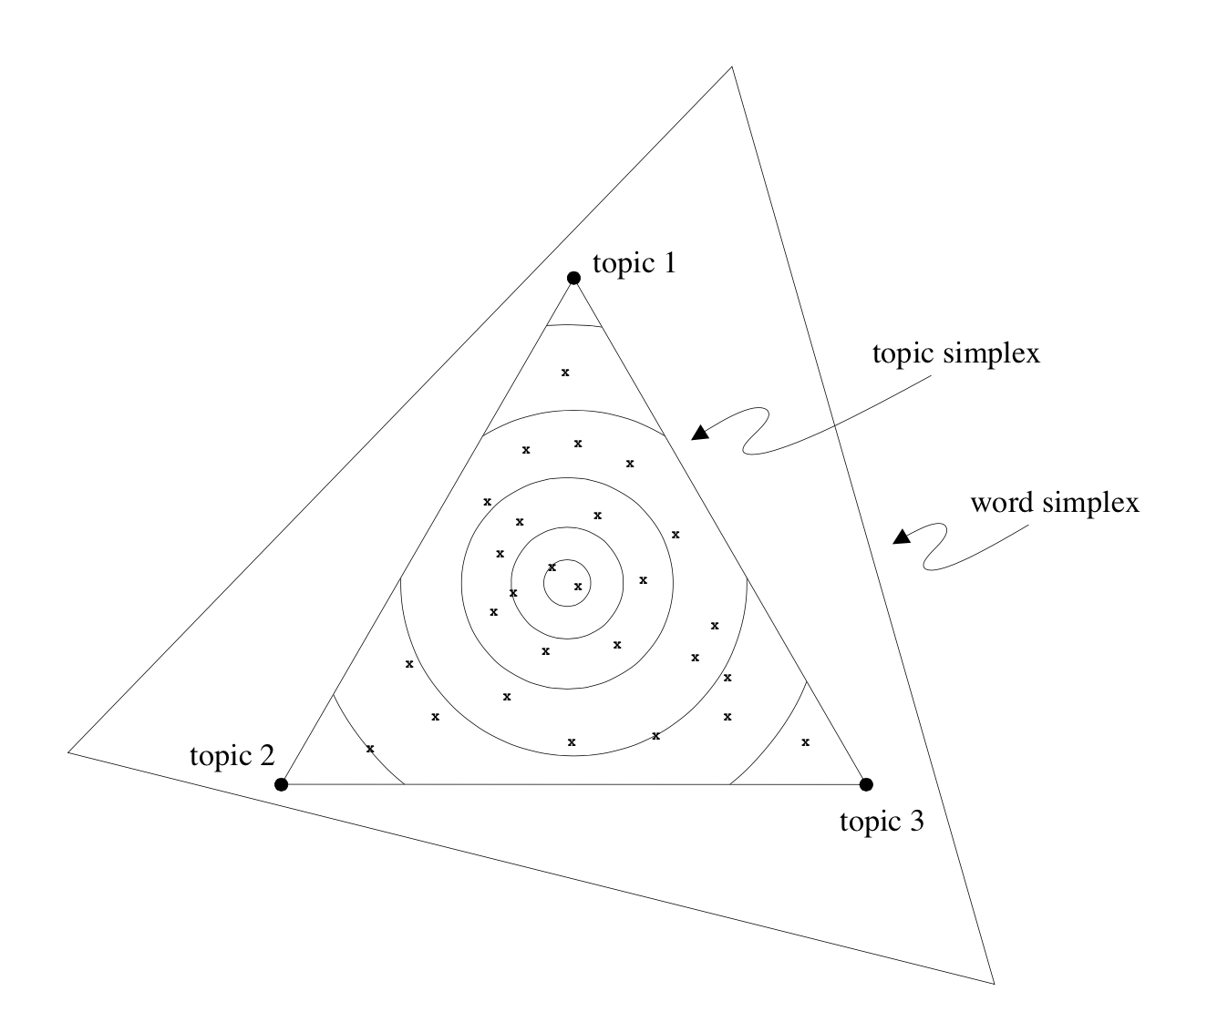
Dirichlet Distribution
Notes:
The topic simplex for three topics embedded in the word simplex for three words. The corners of the word simplex correspond to the three distributions where each word (re- spectively) has probability one. The three points of the topic simplex correspond to three different distributions over words. The mixture of unigrams places each document at one of the corners of the topic simplex. The pLSI model induces an empirical distribution on the topic simplex denoted by x. LDA places a smooth distribution on the topic simplex denoted by the contour lines.

Slide 27
How does the generative process look like?
For each topic 1…k:
  Draw a multinomial over words β_{k} ~ Dir(η)
For each document 1…d:
  Draw multinomial over topics θ_{d} ~ Dir(α)
  For each word w_{dn}:
    Draw a topic Z_{dn} ~ Mult(θ_{d}) with Z_{dn} from [1…k]
    Draw a word w_{dn} ~ Mult(β_{Zdn})

Slide 28
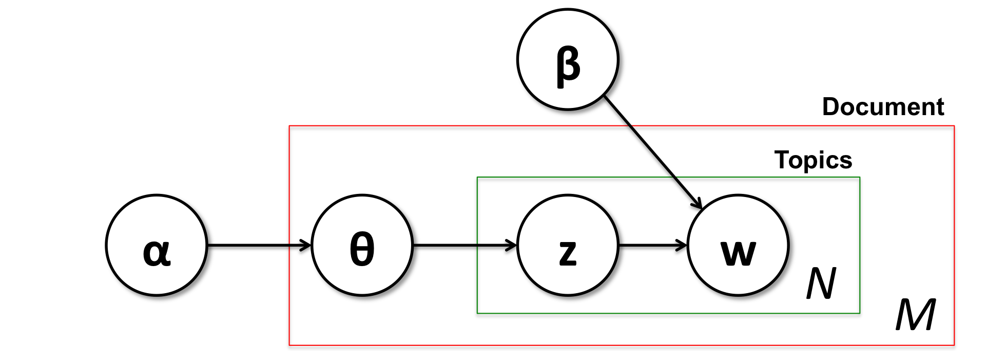
The LDA Model
α
θ
θ
θ
z₁
z₂
z₃
z₄
z₁
z₂
z₃
z₄
z₁
z₂
z₃
z₄
w₁
w₂
w₃
w₄
w₁
w₂
w₃
w₄
w₁
w₂
w₃
w₄
β

Slide 29
What is the posterior of the hidden variables given the observed variables (and hyper-parameters)?
Problem:
  the integral in the denominator is intractable!
Solution: Approximate inference
  Gibbs Sampling [Griffith and Steyvers]
  Variational inference [Blei, Ng, Jordan]

Slide 30
LDA Parameter Estimation
Variational EM
  Numerical approximation using lower-bounds
  Results in biased solutions
  Convergence has numerical guarantees
Gibbs Sampling
  Stochastic simulation
  unbiased solutions
  Stochastic convergence

Slide 31
Gibbs Sampling
Represent corpus as an array of words w[i], document indices d[i] and topics z[i]
Words and documents are fixed:
  Only topics z[i] will change
States of Markov chain = topic assignments to words.
“Macrosteps”: assign a new topic to all of the words
“Microsteps”: assign a new topic to each word w[i].

Slide 32
LDA Parameter Estimation
Gibbs sampling
  Applicable when joint distribution is hard to evaluate but conditional distribution is known
  Sequence of samples comprises a Markov Chain
  Stationary distribution of the chain is the joint distribution
Key capability: estimate distribution of one latent variables given the other latent variables and observed variables.

Slide 33
Assigning a new topic to w_{i}
The probability is proportional to the probability of w_{i} under topic j times the probability of topic j given document d_{i}
Define as the frequency of w_{i} labeled as topic j
Define as the number of words in d_{i} labeled as topic j
Prob of wi under topic zi
Prob of topic zi in document di

Slide 34
What other quantities do we need?
We want to compute the expected value of the parameters given the observed data.
Our data is the set of words w{1:D,1:N}
  Hence we need to compute E[…|w{1:D,1:N}

Slide 35
Running LDA with the Gibbs sampler
A toy example from Griffiths, T., & Steyvers, M. (2004):
25 words.
10 predefined topics
2000 documents generated according to known distributions.
Each document = 5x5 image.
Pixel intensity = Frequency of word.

Slide 36
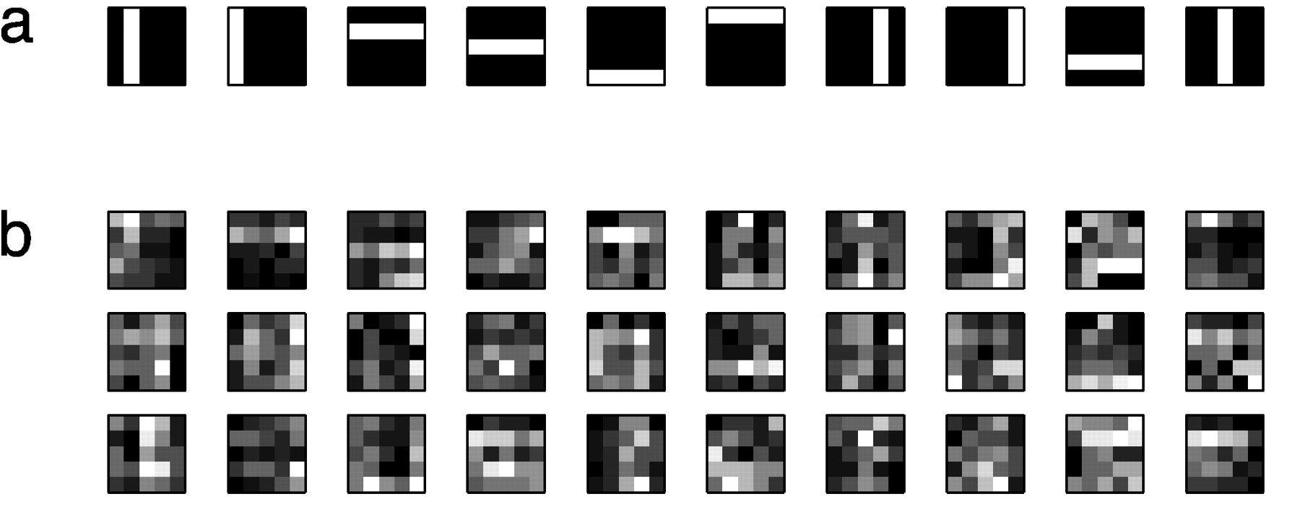
(a) Graphical representation of 10 topics, combined to produce “documents” like those shown in b, where each image is the result of 100 samples from a unique mixture of these topics.
Thomas L. Griffiths, and Mark Steyvers PNAS 2004;101:5228-5235
Notes:
(a) Graphical representation of 10 topics, combined to produce “documents” like those shown in b, where each image is the result of 100 samples from a unique mixture of these topics. (c) Performance of three algorithms on this dataset: variational Bayes (VB), expectation propagation (EP), and Gibbs sampling. Lower perplexity indicates better performance, with chance being a perplexity of 25. Estimates of the standard errors are smaller than the plot symbols, which mark 1, 5, 10, 20, 50, 100, 150, 200, 300, and 500 iterations.

Slide 37
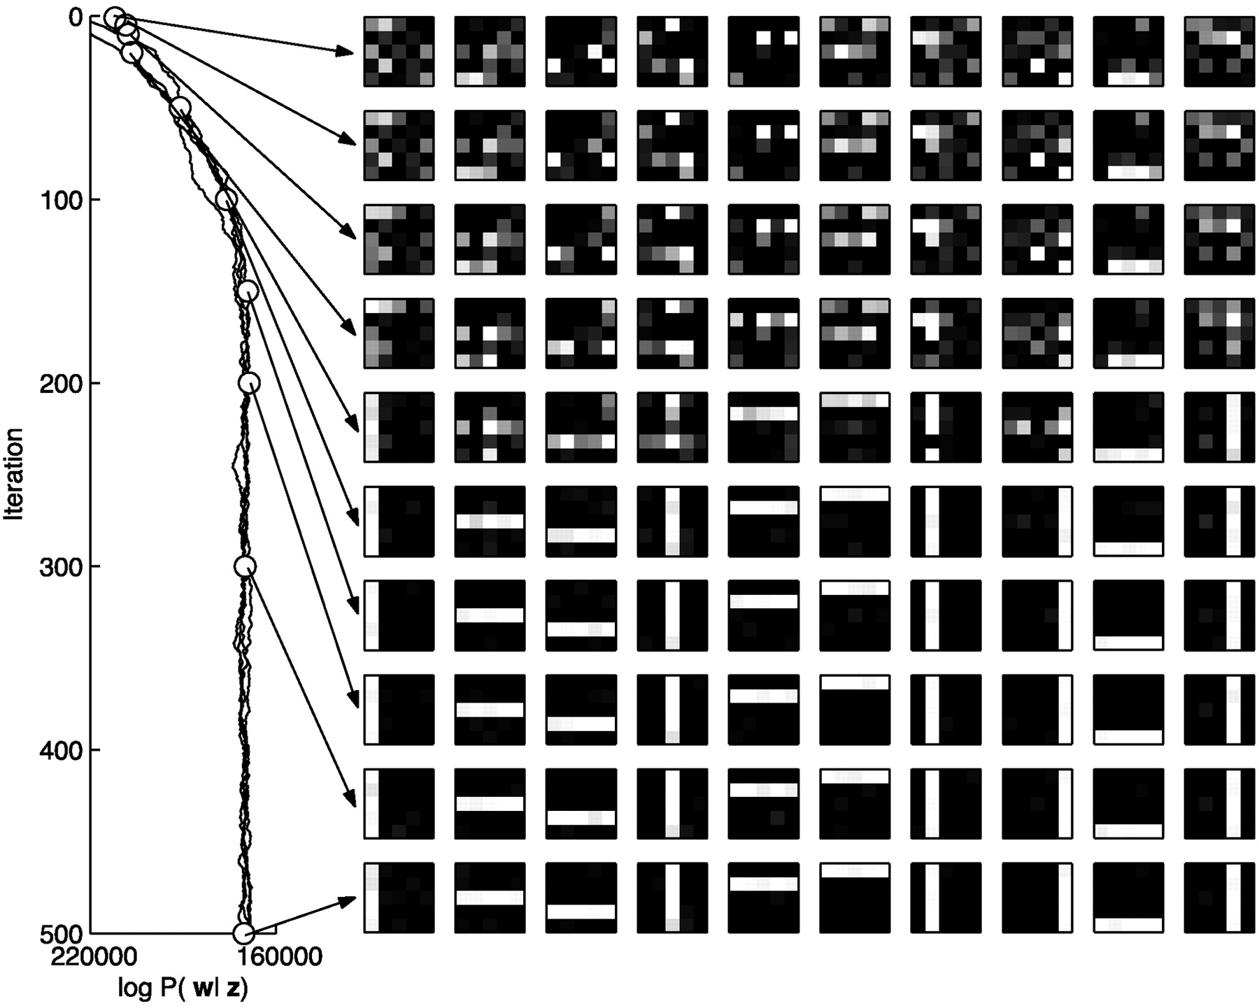
How does it converge?
Notes:
Results of running the Gibbs sampling algorithm. The log-likelihood, shown on the left, stabilizes after a few hundred iterations. Traces of the log-likelihood are shown for all four runs, illustrating the consistency in values across runs. Each row of images on the right shows the estimates of the topics after a certain number of iterations within a single run, matching the points indicated on the left. These points correspond to 1, 2, 5, 10, 20, 50, 100, 150, 200, 300, and 500 iterations. The topics expressed in the data gradually emerge as the Markov chain approaches the posterior distribution.

Slide 38
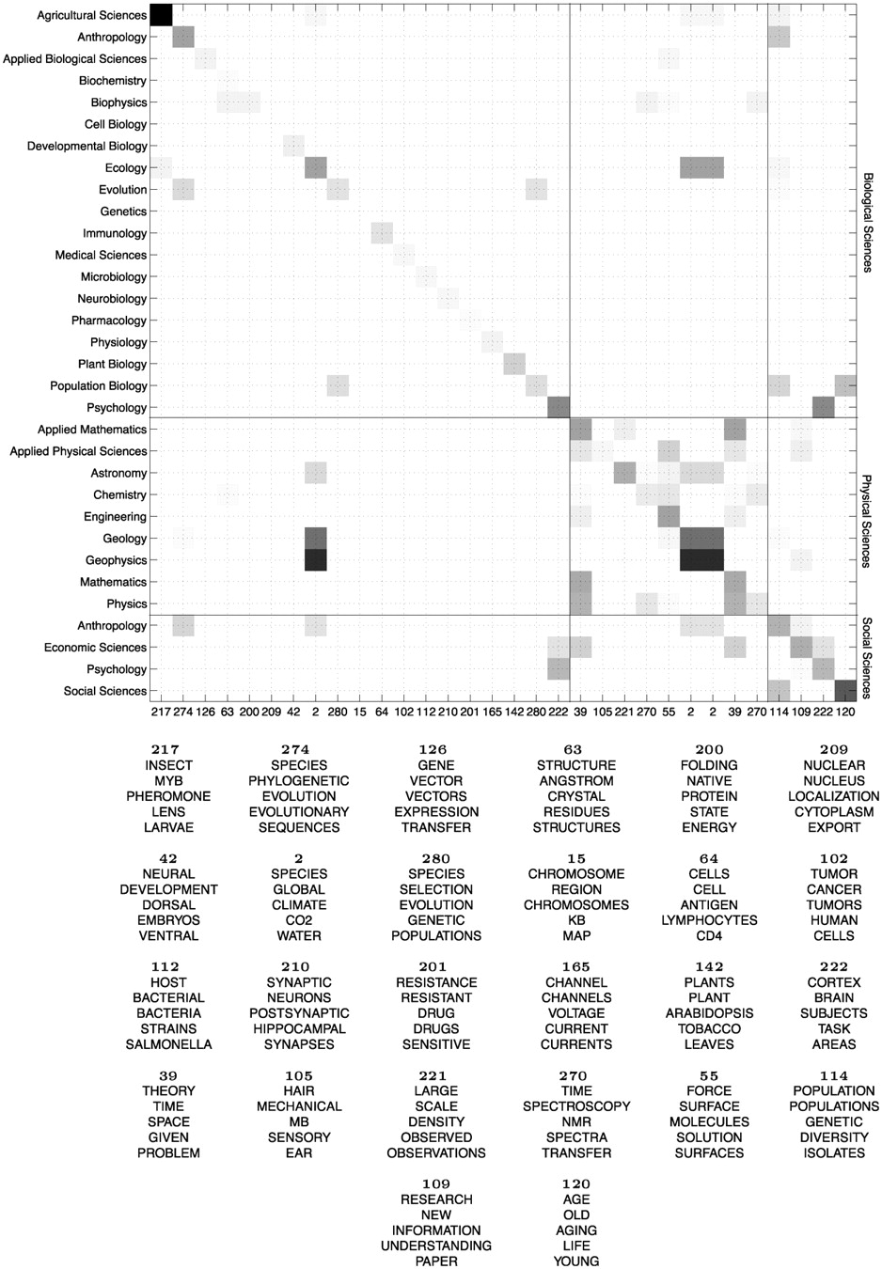
What do we discover?
(Upper) Mean values of θ at each of the diagnostic topics for all 33 PNAS minor categories, computed by using all abstracts published in 2001.
Provides an intuitive representation of how topics and words are associated with each other
  Meaningful associations
Cross interactions across disciplines!

Slide 39
Why does Gibbs sampling work?
What’s the fixed point?
  Stationary distribution of the chain is the joint distribution
When will it converge (in the limit)?
  Graph defined by the chain is connected
How long will it take to converge?
  Depends on second eigenvector of that graph
Notes:
Usually called “collapsed” gibbs sampling, as some variables are marginalized out

Slide 40
Observation
How much does the choice of z depend on the other z’s in the same document?
  quite a lot
How much does the choice of z depend on the other z’s in elsewhere in the corpus?
  maybe not so much
  depends on Pr(w|t) but that changes slowly
Can we parallelize Gibbs and still get good results?

Slide 41
Question
Can we parallelize Gibbs sampling?
  formally, no: every choice of z depends on all the other z’s
  Gibbs needs to be sequential
    just like SGD

Slide 42
Discussion….
Where do you spend your time?
  sampling the z’s
  each sampling step involves a loop over all topics
  this seems wasteful
    even with many topics, words are often only assigned to a few different topics
      low frequency words appear < K times … and there are lots and lots of them!
      even frequent words are not in every topic

Slide 43
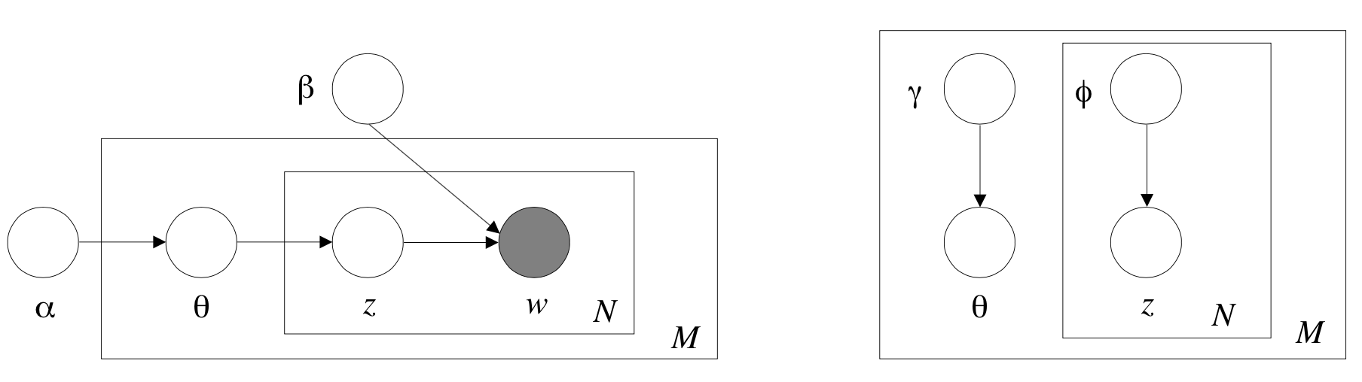
Variational Inference
Alternative to Gibbs sampling
  Clearer convergence criteria
  Easier to parallelize (!)
Notes:
The basic idea of convexity-based variational inference is to make use of Jensen’s inequality to obtain an adjustable lower bound on the log likelihood (Jordan et al., 1999). Essentially, one considers a family of lower bounds, indexed by a set of variational parameters. The variational parameters are chosen by an optimization procedure that attempts to find the tightest possible lower bound.
A simple way to obtain a tractable family of lower bounds is to consider simple modifications of the original graphical model in which some of the edges and nodes are removed. Consider in particular the LDA model shown on the left. The problematic coupling between θ and β arises due to the edges between θ, z, and w. By dropping these edges and the w nodes, and endowing the resulting simplified graphical model with free variational parameters, we obtain a family of distributions on the latent variables.
The Dirichlet parameter γ and the multinomial parameters (φ1 , . . . , φN ) are the free variational parameters.

Slide 44
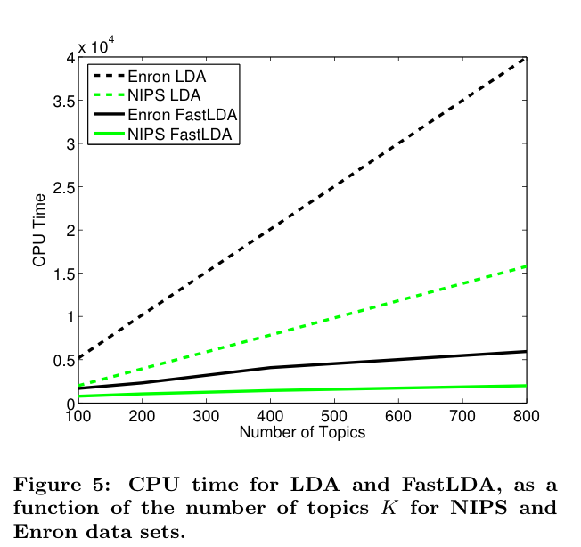
Results

Slide 45
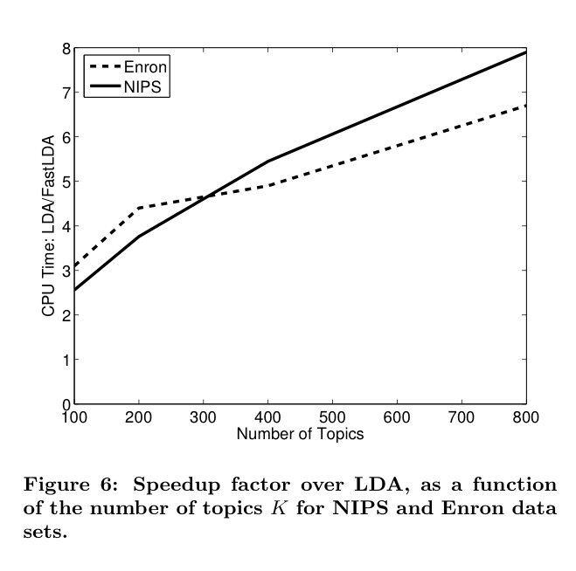
Results

Slide 46
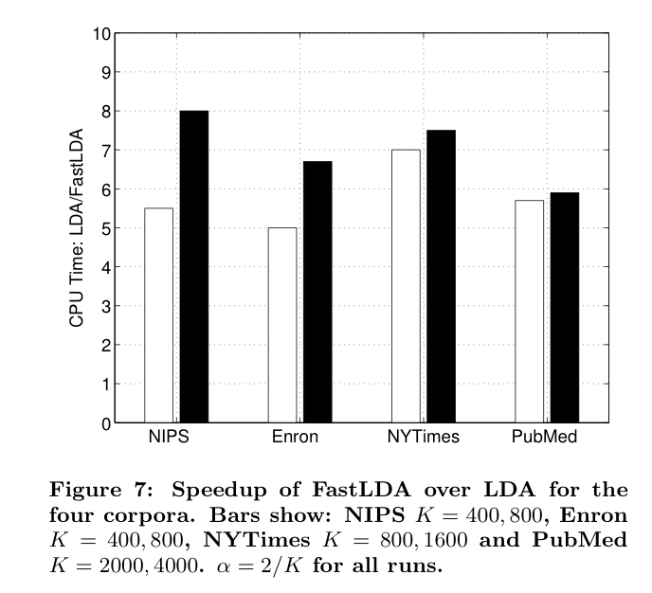
Results

Slide 47
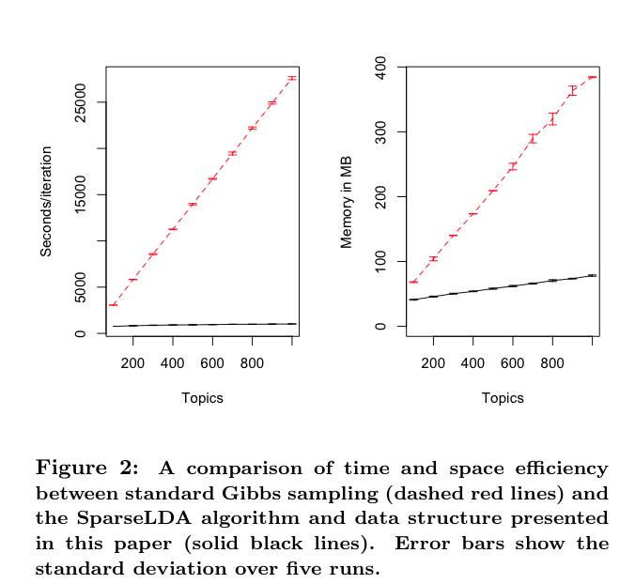

Slide 48
LDA Implementations
Yahoo_LDA
  NOT Hadoop
  Custom MPI for synchronizing global counts
Mahout LDA
  Hadoop-based
  Lacks some mature features
Mr. LDA
  Hadoop-based
  https://github.com/lintool/Mr.LDA
Notes:
Mahout lacks features required by mature LDA implementations such as supplying per-document topic distributions and optimizing hyperparameters .

Slide 49
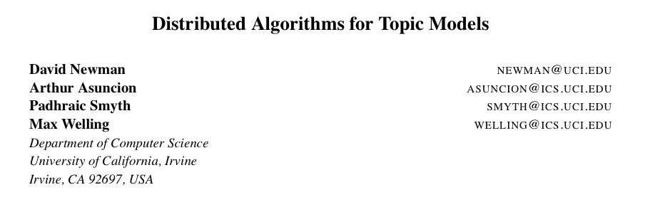
JMLR 2009

Slide 50
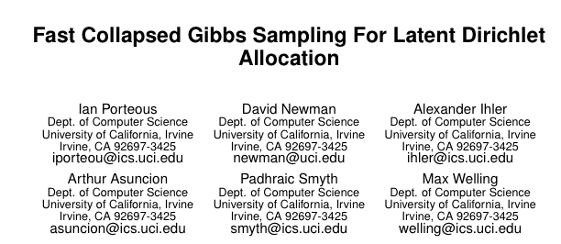

Slide 51
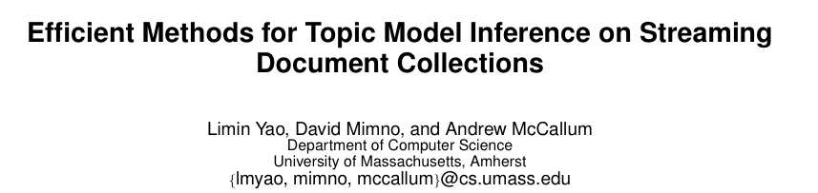
KDD 09

Slide 52
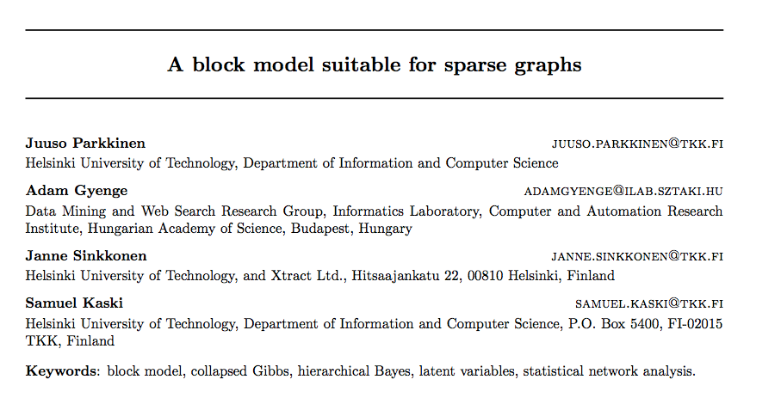
originally - PSK MLG 2009

Slide 53
Assignment 4!
Out on Thursday!
LDA on Spark
  Yes, Spark 1.3 includes an experimental LDA
  Yes, you have to implement your own
  Yes, you can use the Spark version to help you (as long as you cite it, as with any external source of assistance…and as long as your code isn’t identical)

