Slide 1
Factorbird: a Parameter Server Approach to Distributed Matrix Factorization
Sebastian Schelter, Venu Satuluri, Reza Zadeh
Distributed Machine Learning and Matrix Computations workshop in conjunction with NIPS 2014

Slide 2
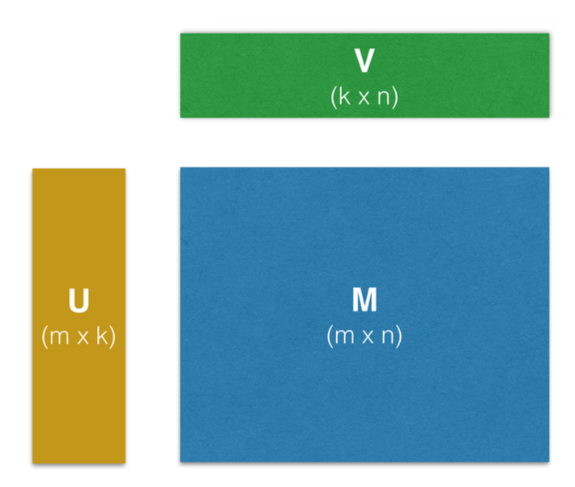
Latent Factor Models
Given M
  sparse
  n x m
Returns U and V
  rank k
Applications
  Dimensionality reduction
  Recommendation
  Inference

Slide 3
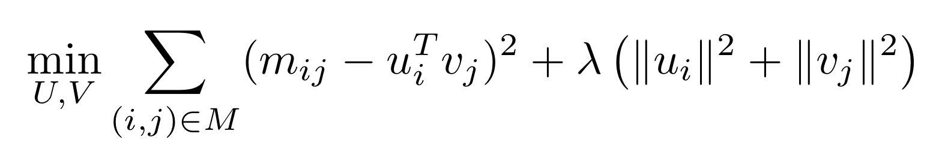
Seem familiar?
SVD!
So why not just use SVD?

Slide 4
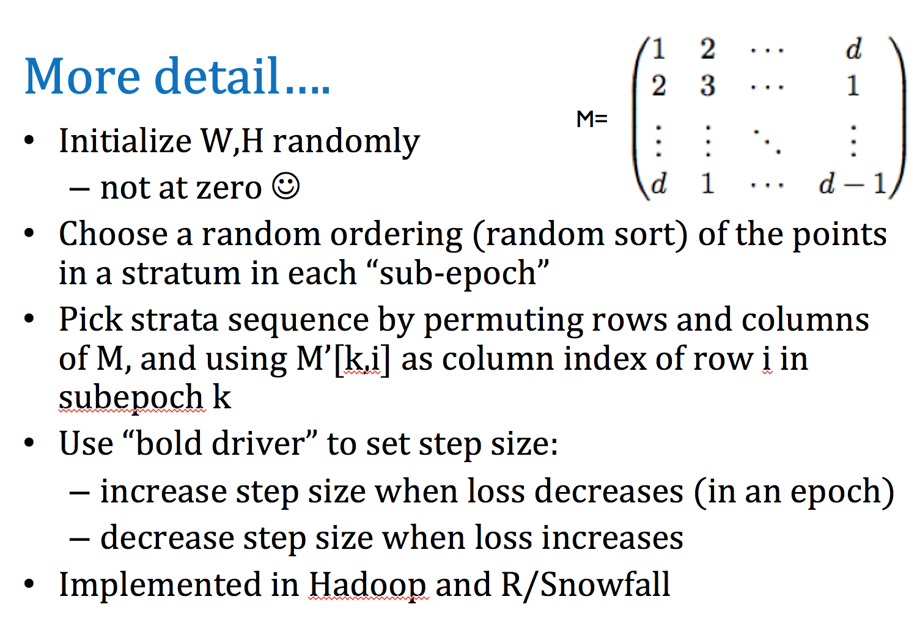
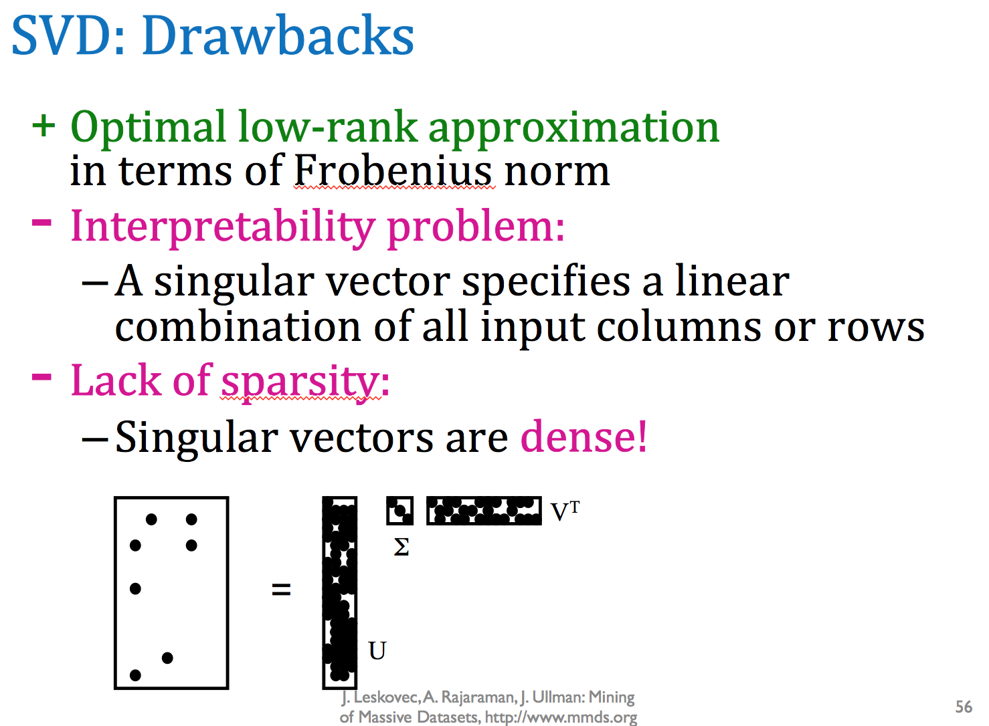
Problems with SVD
(Feb 24, 2015 edition)
Notes:
Resulting SVD basis vectors are *dense*
Not terribly helpful if we’re assuming our parameters are sparse
Not just assuming, RELYING on sparse parameters

Slide 5
Revamped loss function
g – global bias term
b^{U}_{i} – user-specific bias term for user i
b^{V}_{j} – item-specific bias term for item j
prediction function
p(i, j) = g + b^{U}_{i} + b^{V}_{j} + u^{T}_{i}v_{j}
a(i, j) – analogous to SVD’s m_{ij} (ground truth)
New loss function:
Notes:
g: captures the average interaction strength between a user and an item in the dataset
User and item specific biases: model how strongly the interactions of certain users and items tend to deviate from the global average.
Replace dot product from SVD with prediction function p(i, j) which takes the bias terms into account when predicting the strength of interaction between user and item
a(i, j) is different enough to allow for imputation of missing values (transform observed entries)

Slide 6
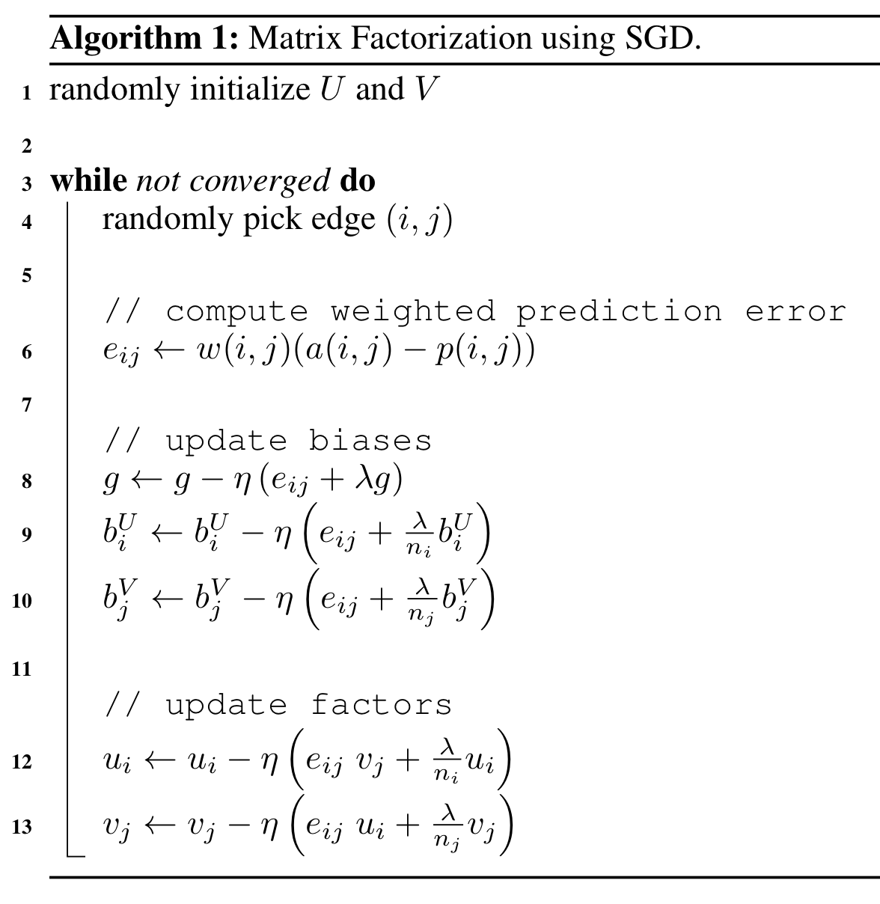
Algorithm

Slide 7
Problems
Resulting U and V, for graphs with millions of vertices, still equate to hundreds of gigabytes of floating point values.
SGD is inherently sequential; either locking or multiple passes are required to synchronize.

Slide 8
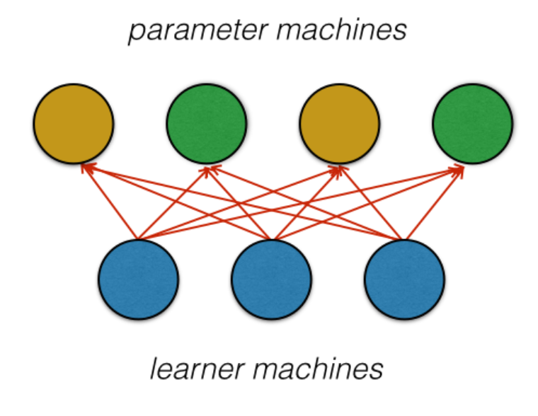
Problem 1: size of parameters
Solution: Parameter Server architecture
Notes:
Partition factor matrices (U and V) over machines called parameter servers
These are updated as the learner machines distributed the graph (data itself) and perform SGD
For each observation, learner fetches corresponding factor vectors from parameter machines, updates them, and writes them back

Slide 9
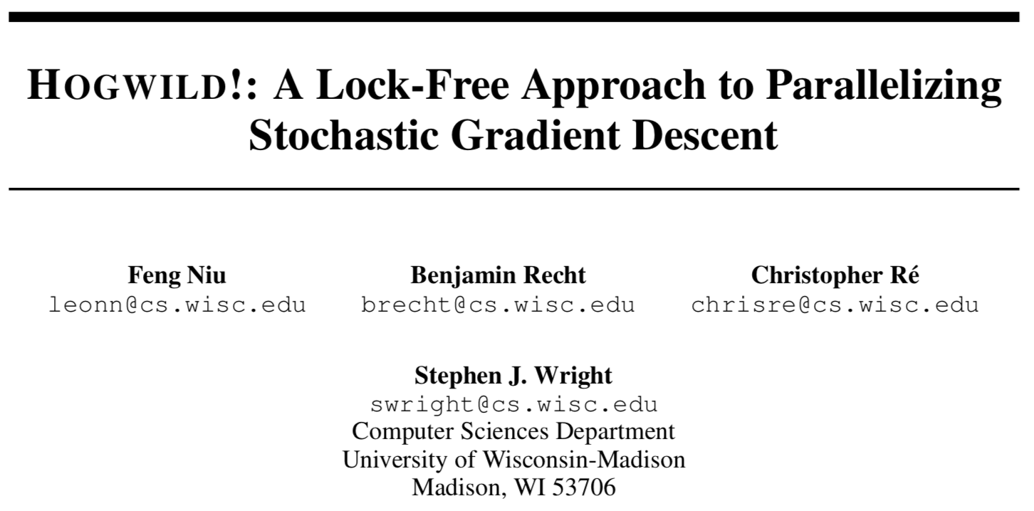
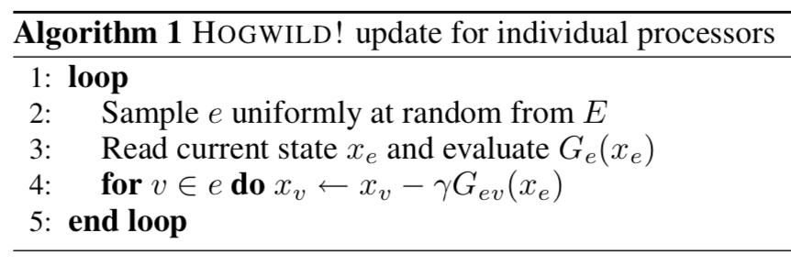
Problem 2: simultaneous writes
Solution:
…so what?

Slide 10
Lock-free concurrent updates?
Assumptions
f is Lipshitz continuously differentiable
f is strongly convex
Ω (size of hypergraph) is small
Δ (fraction of edges that intersect any variable) is small
ρ (sparsity of hypergraph) is small
Notes:
Hypergraph induced by non-zero elements of each vector
If hypergraph is small then there is small chance of collision between concurrent updates
- If hypergraph is small then “stale” versions of x will not have large impact on concurrent updates elsewhere

Slide 11
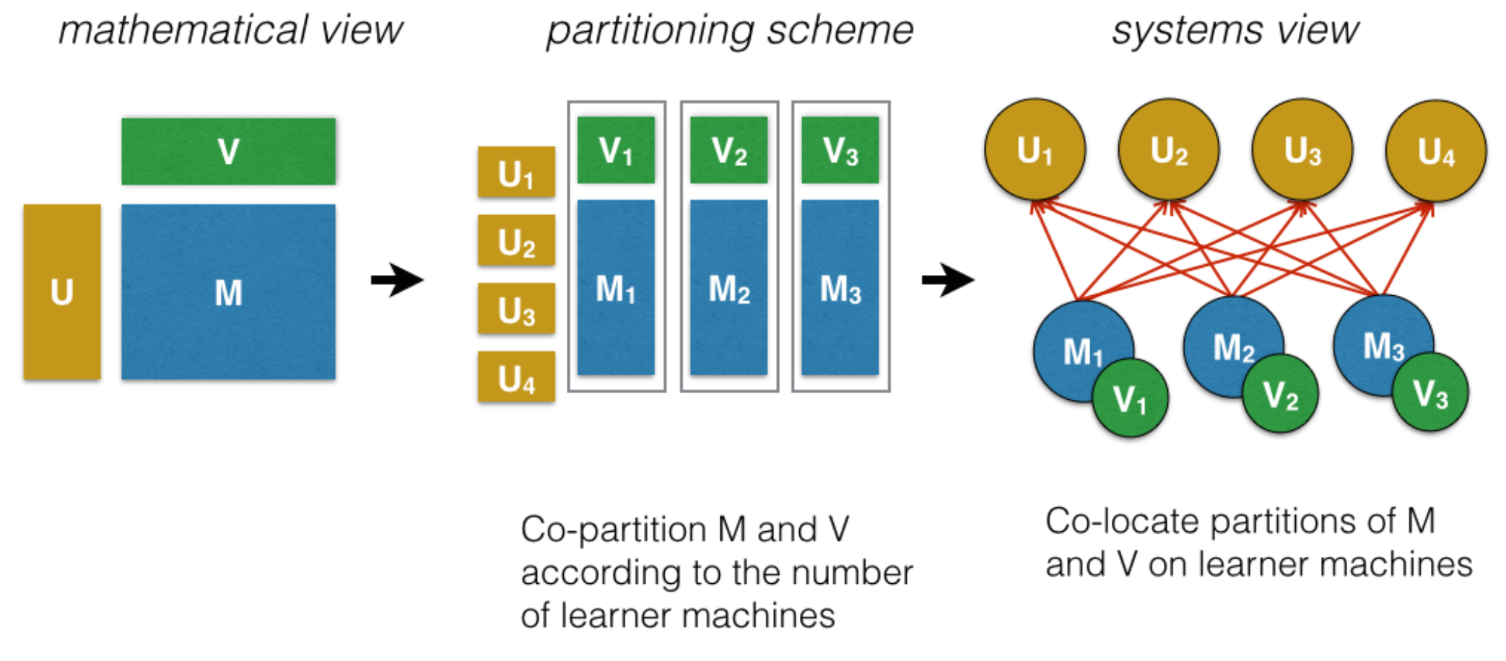
Factorbird Architecture
Notes:
Still use intelligent partitioning to reduce network latency between learners and parameters, and to further reduce collisions
Partition M by either rows or columns across learners
Can partition V or U identically (U -> rows, V -> columns) on the same machines, making updates local relative to M
Authors co-located V with M
In-degree distribution (V) has much higher skew than out-degree (U) distribution
Gives higher reduction in potential conflicts, compared to localizing U

Slide 12
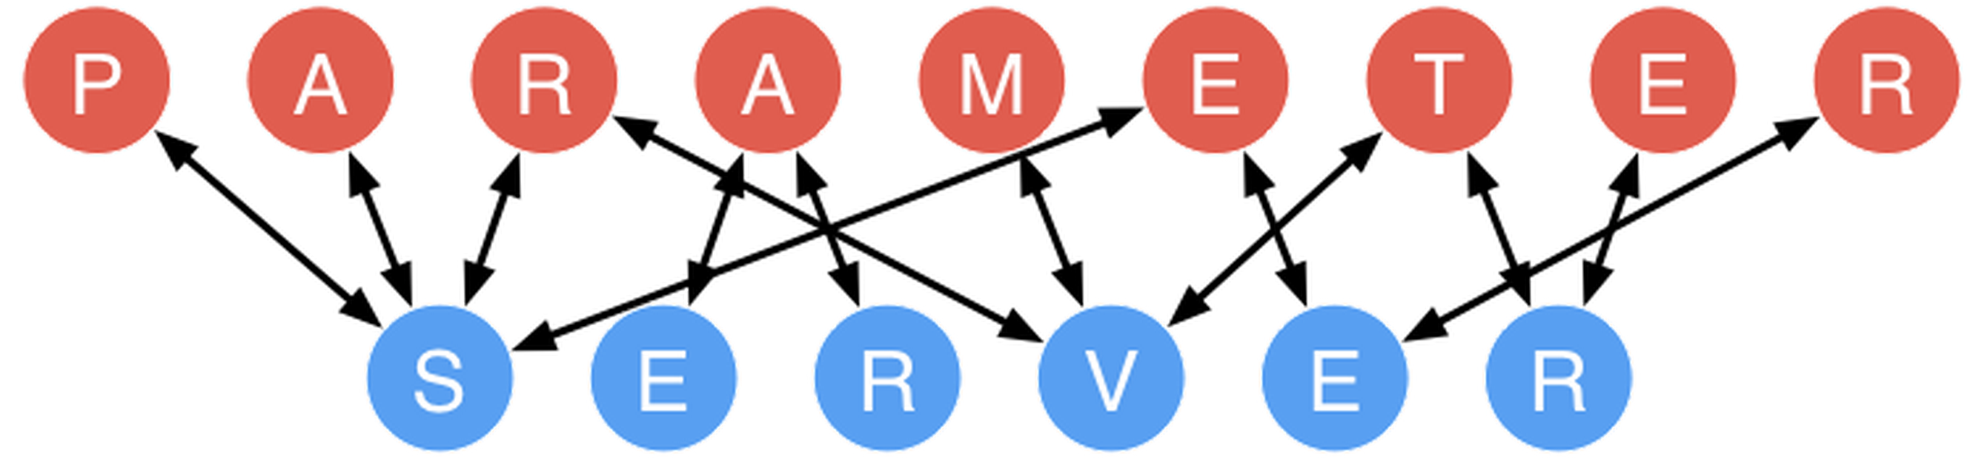
Parameter server architecture
Open source!
  http://parameterserver.org/

Slide 13
Factorbird Machinery
memcached – Distributed memory object caching system
finagle – Twitter’s RPC system
HDFS – persistent filestore for data
Scalding – Scala front-end for Hadoop MapReduce jobs
Mesos – resource manager for learner machines

Slide 14
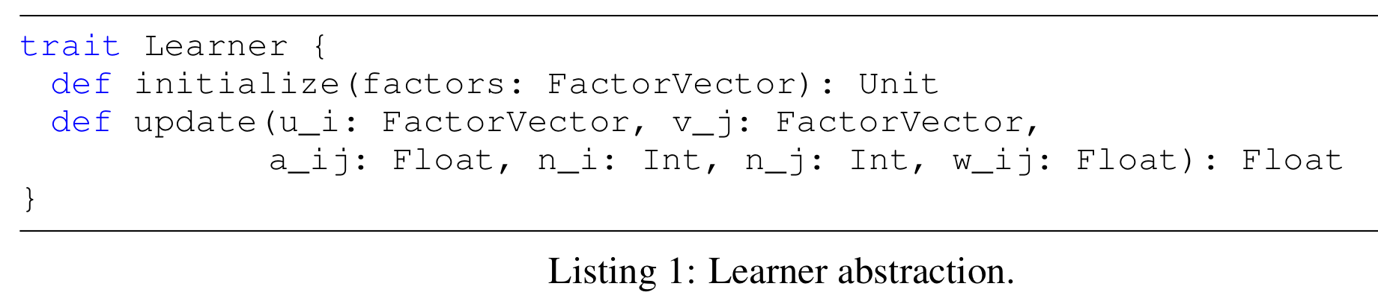
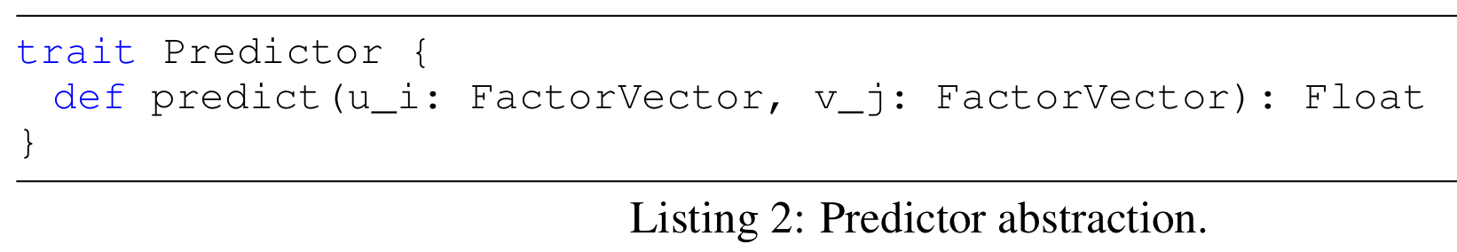
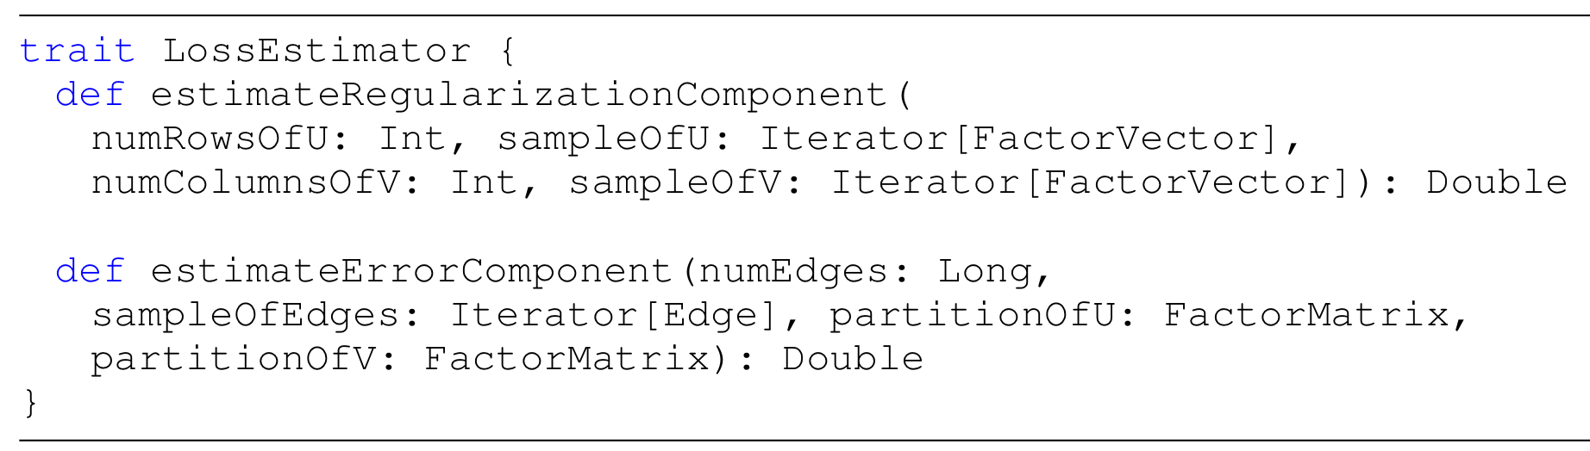
Factorbird stubs

Slide 15
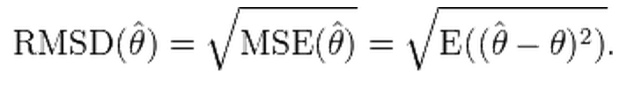
Model assessment
Matrix factorization using RMSE
  Root-mean squared error
SGD performance often a function of hyperparameters
  λ: regularization
  η: learning rate
  k: number of latent factors

Slide 16
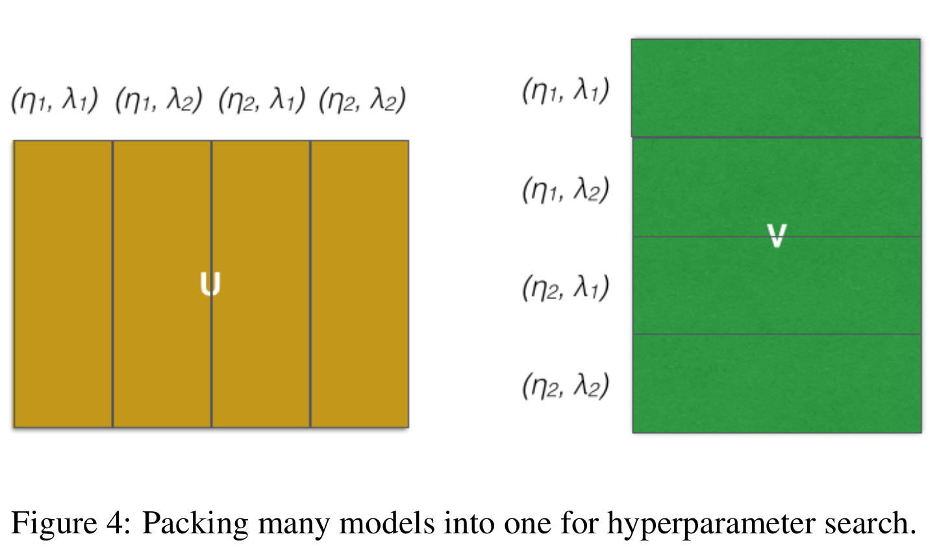
[Hyper]Parameter grid search
aka “parameter scans:” finding the optimal combination of hyperparameters
  Parallelize!
Notes:
For a factorization of rank k, we do all the grid search parameters at once:
c factor vectors
U becomes m x (c * k)
V becomes (c * k) x n

Slide 17
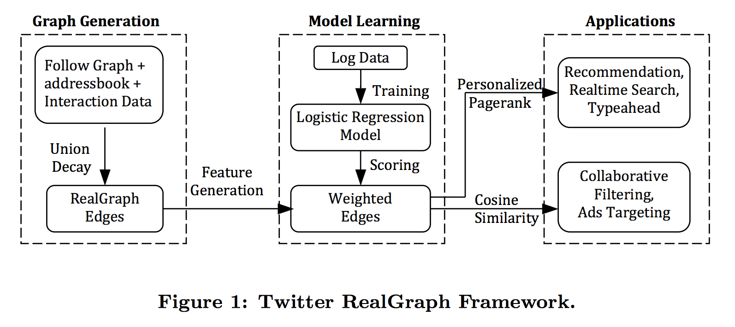
Experiments
“RealGraph”
  Not a dataset; a framework for creating graph of user-user interactions on Twitter
Kamath, Krishna, et al. "RealGraph: User Interaction Prediction at Twitter." User Engagement Optimization Workshop@ KDD. 2014.
Notes:
The proposed framework, called RealGraph, produces a directed and weighted graph where the nodes are Twitter users, and the edges are labeled with interactions between a directed pair of users. Further, each directed edge also has a weight that is the probability of any interaction going from the edge source to the edge destination in the future. The framework learns a logistic regression based model using historical data and then scores the edge features using the model to produce the weight.

Slide 18
Experiments
Data: binarized adjacency matrix of subset of Twitter follower graph
  a(i, j) = 1 if user i interacted with user j, 0 otherwise
All prediction errors weighted equally (w(i, j) = 1)
100 million interactions
440,000 [popular] users

Slide 19
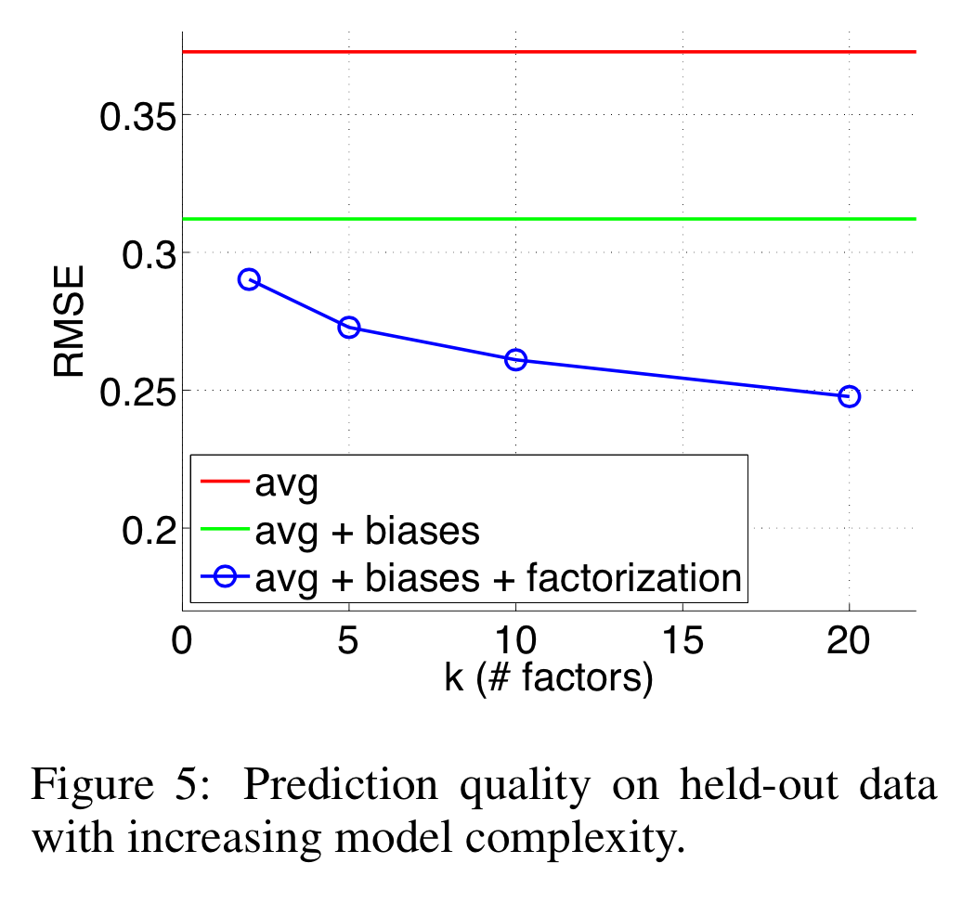
Experiments
80% training, 10% validation, 10% testing
Notes:
Training: for training biased factorization models
Validation: for choosing the hyperparameters (grid search)
Testing: plotted curves
Avg = using only global bias (average edge strength)
Avg + biases = using global and vertex-specific bias terms
Avg + biases + factorization = incorporating factors

Slide 20
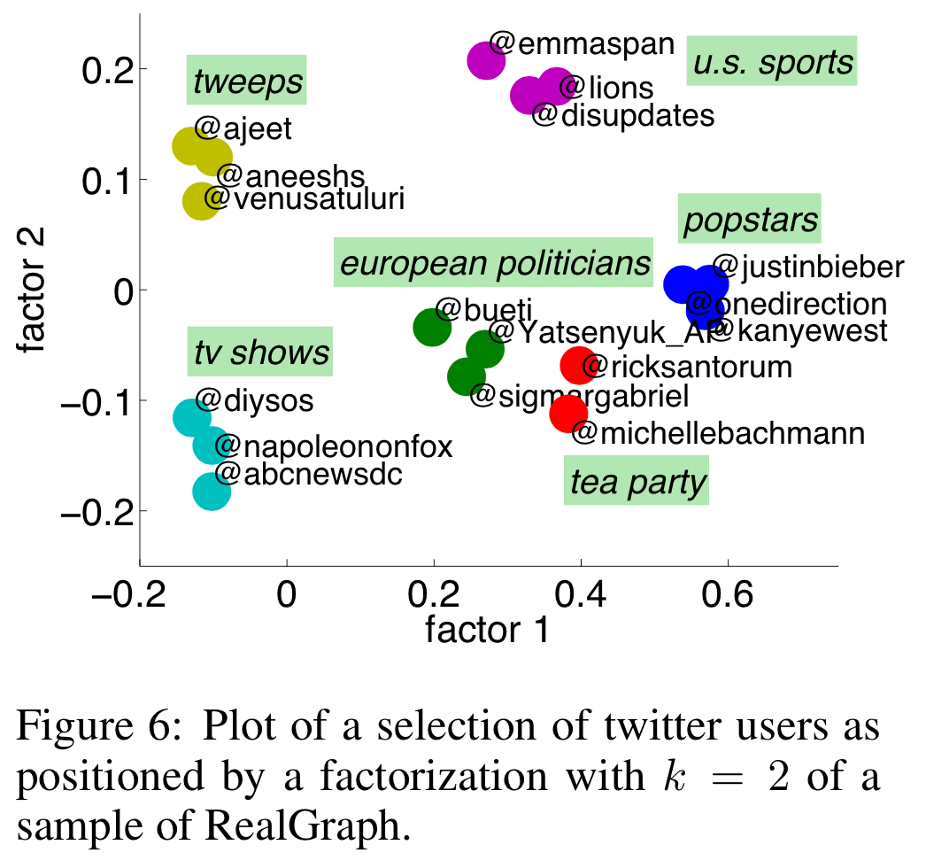
Experiments
k = 2
Homophily
Notes:
Two users will be “close” in this two-dimensional space if their follower vectors m_i and m_j are roughly linear combinations of each other
- homophily! (aka “birds of a feather”)

Slide 21
Experiments
Scalability of Factorbird
  large RealGraph subset
  229M x 195M (44.6 quadrillion)
  38.5 billion non-zero entries
Single SGD pass through training set: ~2.5 hours
~ 40 billion parameters
Notes:
50 instances of learner machines (16 cores and 16GB memory each)
Run 2 passes of hyperparameter search

Slide 22
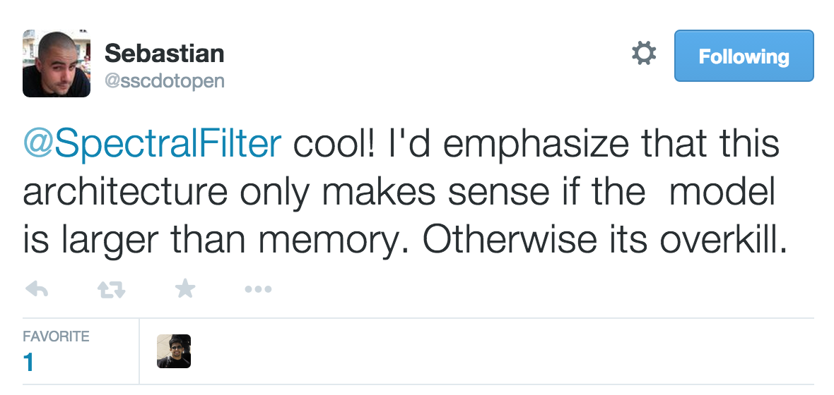
Important to note
As with most (if not all) distributed platforms:

Slide 23
Future work
Support streaming (user follows)
Simultaneous factorization
Fault tolerance
Reduce network traffic
s/memcached/custom application/g
Load balancing
Notes:
Simultaneous factorization of multiple matrices
Incorporate different types of interactions in a single factorization model
Asynchronous checkpointing of partitions with U and V matrices
Reduce network traffic
Compression
Factor vector caching
Biased edge sampling to use retrieved vectors for more than a single update
Replace memcached with a customized application to achieve higher throughput and conduct true Hogwild-style updates on parameter servers
Dynamic load balancing to mitigate effects of stragglers in overall runtime

Slide 24
Strengths
Excellent extension of prior work
  Hogwild, RealGraph
Current and [mostly] open technology
  Hadoop, Scalding, Mesos, memcached
Clear problem, clear solution, clear validation

Slide 25
Weaknesses
Lack of detail, lack of detail, lack of detail
  How does number of machines affect runtime?
  What were performance metrics of the large RealGraph subset?
  What were some of the properties of the dataset (when was it collected, how were edges determined, what does “popular” mean, etc)?
  How did other factorization methods perform by comparison?
Notes:
Lack of details likely a result of this being an internal Twitter project

Slide 26

Questions?

