Slide 1
Randomized / Hashing Algorithms
Shannon Quinn
(with thanks to William Cohen of Carnegie Mellon University, and J. Leskovec, A. Rajaraman, and J. Ullman of Stanford University)

Slide 2
Outline
Bloom filters
Locality-sensitive hashing
Stochastic gradient descent
Stochastic SVD
Already covered
Next Wednesday’s lecture

Slide 3
Hash Trick - Insights
Save memory: don’t store hash keys
Allow collisions
  even though it distorts your data some
Let the learner (downstream) take up the slack
Here’s another famous trick that exploits these insights….

Slide 4
Bloom filters
Interface to a Bloom filter
  BloomFilter(int maxSize, double p);
  void bf.add(String s); // insert s
  bool bd.contains(String s);
    // If s was added return true;
    // else with probability at least 1-p return false;
    // else with probability at most p return true;
  I.e., a noisy “set” where you can test membership (and that’s it)
Notes:
note a hash table would do this in constant time and storage
the hash trick does this as well

Slide 5
One possible implementation
BloomFilter(int maxSize, double p) {
  set up an empty length-m array bits[];
}
void bf.add(String s) {
  bits[hash(s) % m] = 1;
}
bool bd.contains(String s) {
  return bits[hash(s) % m];
}

Slide 6
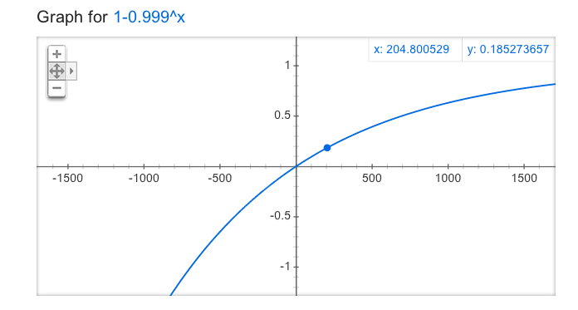
How well does this work?
m=1,000, x~=200, y~=0.18

Slide 7
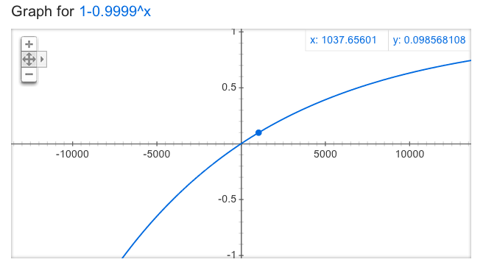
How well does this work?
m=10,000, x~=1,000, y~=0.10

Slide 8
A better??? implementation
BloomFilter(int maxSize, double p) {
  set up an empty length-m array bits[];
}
void bf.add(String s) {
  bits[hash1(s) % m] = 1;
  bits[hash2(s) % m] = 1;
}
bool bd.contains(String s) {
  return bits[hash1(s) % m] && bits[hash2(s) % m];
}

Slide 9
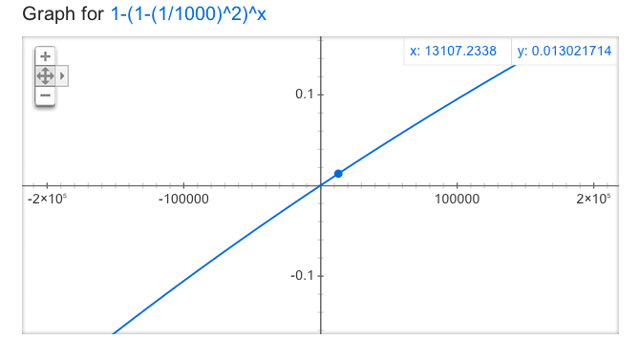
How well does this work?
m=1,000, x~=13,000, y~=0.01
m=1,000, x~=200, y~=0.18

Slide 10
Bloom filters
An example application
  Finding items in “sharded” data
    Easy if you know the sharding rule
    Harder if you don’t (like Google n-grams)
Simple idea:
  Build a BF of the contents of each shard
  To look for key, load in the BF’s one by one, and search only the shards that probably contain key
  Analysis: you won’t miss anything, you might look in some extra shards
  You’ll hit O(1) extra shards if you set p=1/#shards

Slide 11
Bloom filters
An example application
  discarding rare features from a classifier
  seldom hurts much, can speed up experiments
Scan through data once and check each w:
  if bf1.contains(w):
    if bf2.contains(w): bf3.add(w)
    else bf2.add(w)
  else bf1.add(w)
Now:
  bf2.contains(w) ⬄ w appears >= 2x
  bf3.contains(w) ⬄ w appears >= 3x
Then train, ignoring words not in bf3

Slide 12



Bloom filters
Analysis (m bits, k hashers):
  Assume hash(i,s) is a random function
  Look at Pr(bit j is unset after n add’s):
  … and Pr(collision):
  …. fix m and n and minimize k:
p =
k =

Slide 13


Bloom filters
Analysis:
  Plug optimal k=m/n*ln(2) back into Pr(collision):
  Now we can fix any two of p, n, m and solve for the 3rd:
  E.g., the value for m in terms of n and p:
p =

Slide 14
Bloom filters: demo
http://www.jasondavies.com/bloomfilter/

Slide 15
Locality Sensitive Hashing (LSH)
Two main approaches
  Random Projection
  Minhashing

Slide 16
LSH: key ideas
Goal:
  map feature vector x to bit vector bx
  ensure that bx preserves “similarity”

Slide 17
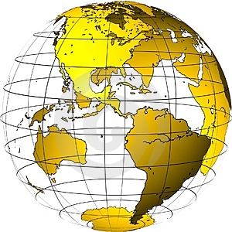
Random Projections

Slide 18
Random projections
To make those points “close” we need to project to a direction orthogonal to the line between them
u
+
+
+
+
+
+
+
+
+
-
-
-
-
-
-
-
-
-
-u
2γ

Slide 19
Random projections
Any other direction will keep the distant points distant.
u
+
+
+
+
+
+
+
+
+
-
-
-
-
-
-
-
-
-
So if I pick a random r and r.x and r.x’ are closer than γ then probably x and x’ were close to start with.
-u
2γ

Slide 20
LSH: key ideas
Goal:
  map feature vector x to bit vector bx
  ensure that bx preserves “similarity”
Basic idea: use random projections of x
  Repeat many times:
    Pick a random hyperplane r
    Compute the inner product of r with x
    Record if x is “close to” r (r.x>=0)
      the next bit in bx
    Theory says that is x’ and x have small cosine distance then bx and bx’ will have small Hamming distance

Slide 21
LSH: key ideas
Naïve algorithm:
  Initialization:
    For i=1 to outputBits:
      For each feature f:
        Draw r(f,i) ~ Normal(0,1)
  Given an instance x
    For i=1 to outputBits:
      LSH[i] =
      sum(x[f]*r[i,f] for f with non-zero weight in x) > 0 ? 1 : 0
    Return the bit-vector LSH
  Problem:
    the array of r’s is very large

Slide 22
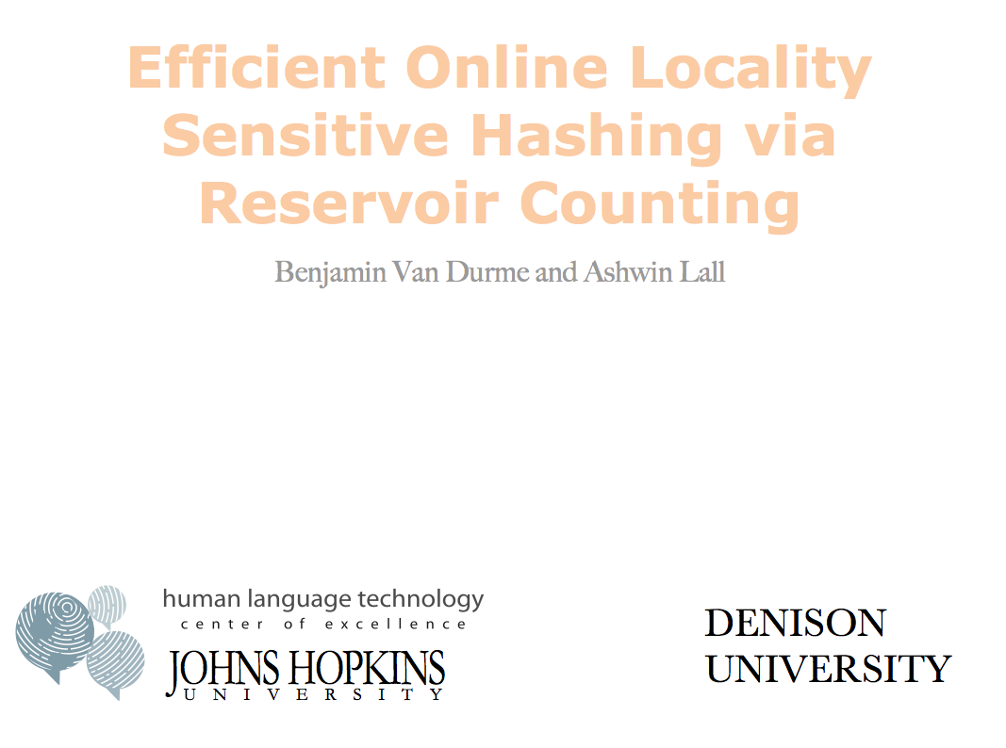



Slide 23
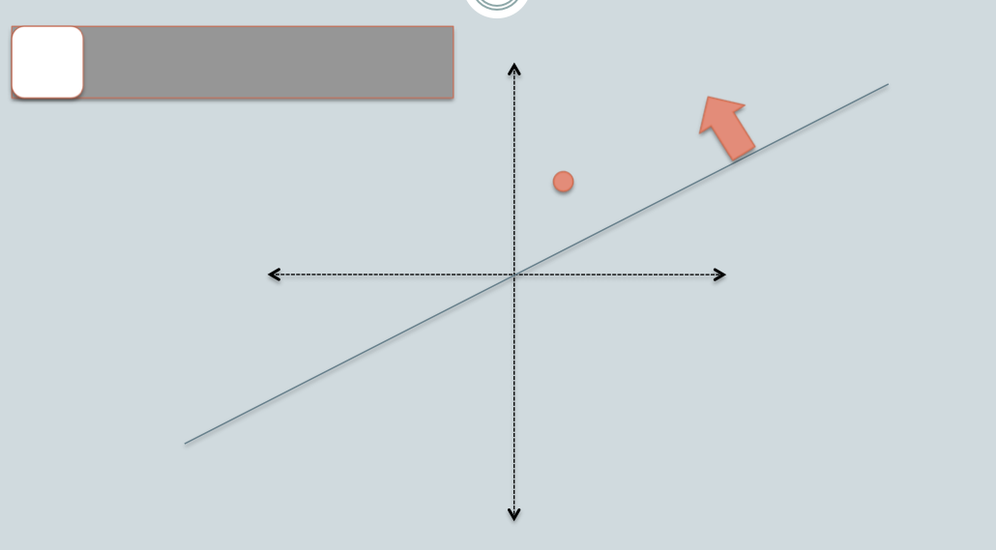

Slide 24
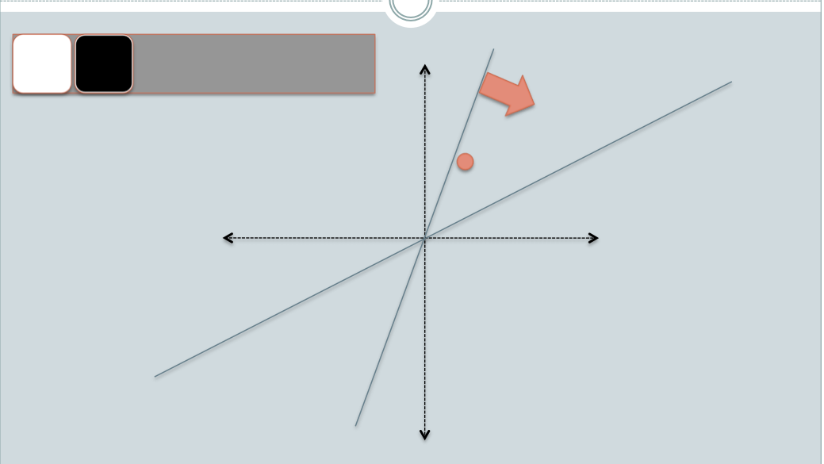

Slide 25
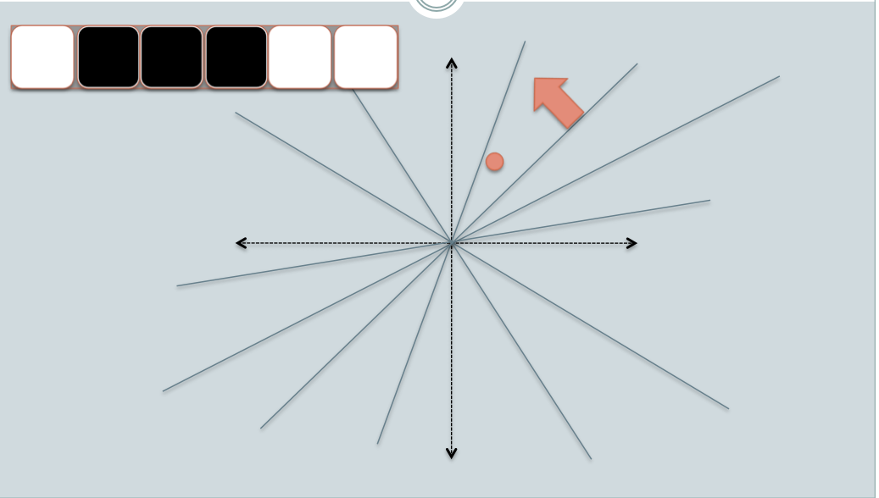

Slide 26
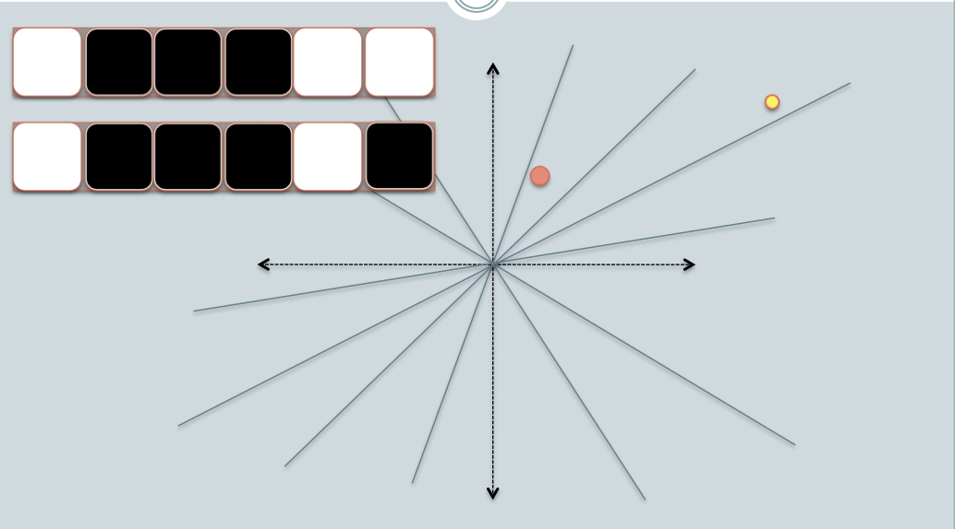

Slide 27
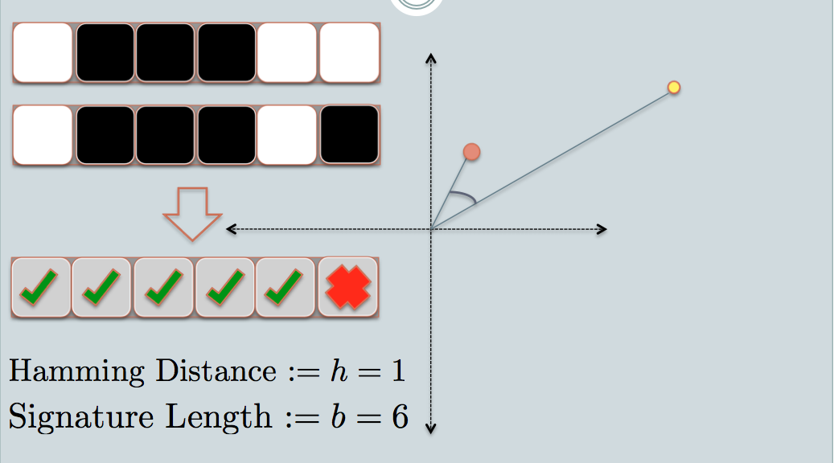
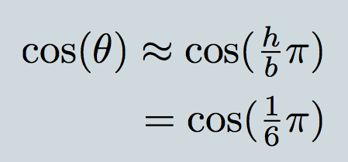

Slide 28
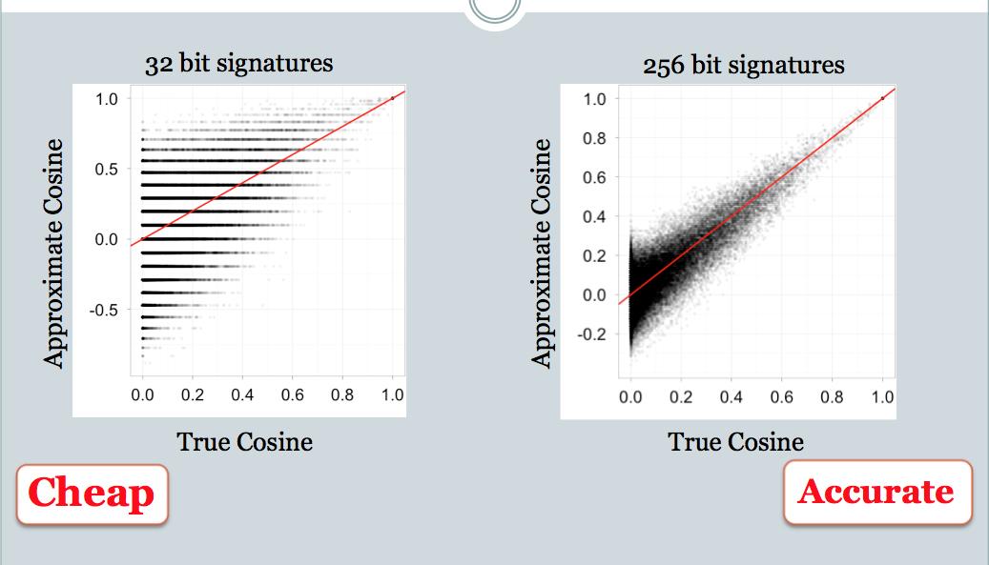

Slide 29
Distance Measures
  Goal: Find near-neighbors in high-dim. space
  We formally define “near neighbors” as
  points that are a “small distance” apart
For each application, we first need to define what “distance” means
Today: Jaccard distance/similarity
  The Jaccard similarity of two sets is the size of their intersection divided by the size of their union:
  sim(C₁, C₂) = |C₁∩C₂|/|C₁∪C₂|
  Jaccard distance: d(C₁, C₂) = 1 - |C₁∩C₂|/|C₁∪C₂|
3 in intersection
8 in union
Jaccard similarity= 3/8
Jaccard distance = 5/8

Slide 30
LSH: “pooling” (van Durme)
Better algorithm:
  Initialization:
    Create a pool:
      Pick a random seed s
      For i=1 to poolSize:
        Draw pool[i] ~ Normal(0,1)
    For i=1 to outputBits:
      Devise a random hash function hash(i,f):
        E.g.: hash(i,f) = hashcode(f) XOR randomBitString[i]
  Given an instance x
    For i=1 to outputBits:
      LSH[i] = sum(
      x[f] * pool[hash(i,f) % poolSize] for f in x) > 0 ? 1 : 0
    Return the bit-vector LSH

Slide 31
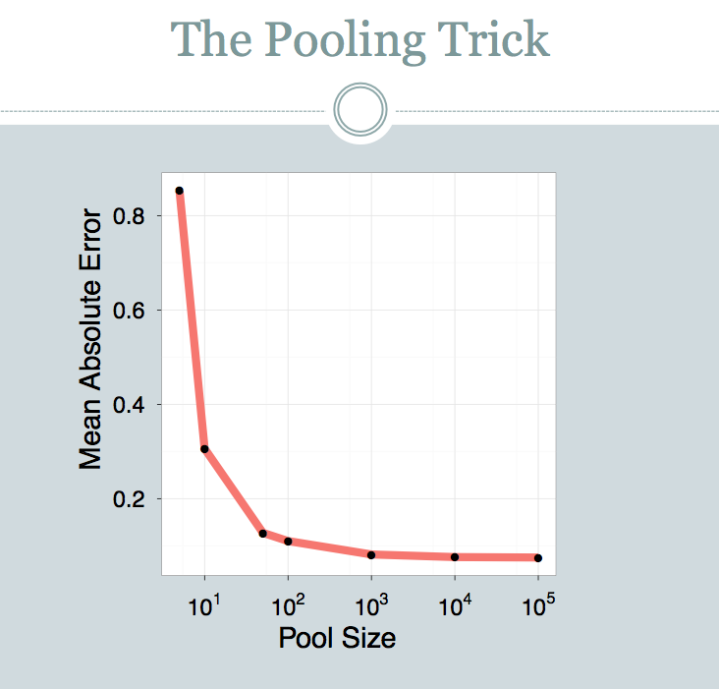

Slide 32
LSH: key ideas: pooling
Advantages:
  with pooling, this is a compact re-encoding of the data
    you don’t need to store the r’s, just the pool
  leads to very fast nearest neighbor method
    just look at other items with bx’=bx
    also very fast nearest-neighbor methods for Hamming distance
  similarly, leads to very fast clustering
    cluster = all things with same bx vector

Slide 33
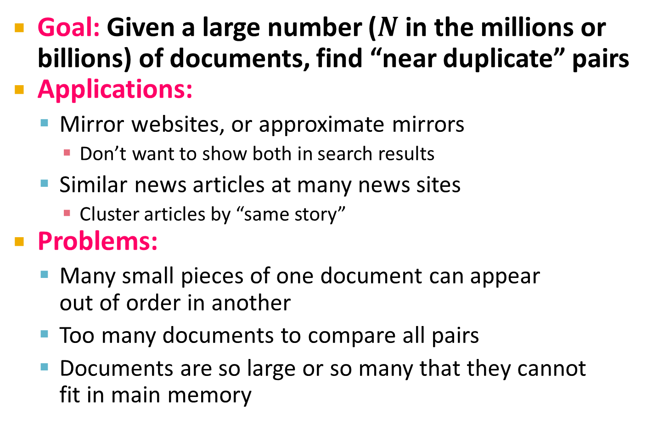
Finding Similar Documents with Minhashing
Goal: Given a large number ( in the millions or billions) of documents, find “near duplicate” pairs
Applications:
  Mirror websites, or approximate mirrors
    Don’t want to show both in search results
  Similar news articles at many news sites
    Cluster articles by “same story”
Problems:
  Many small pieces of one document can appear
  out of order in another
  Too many documents to compare all pairs
  Documents are so large or so many that they cannot
  fit in main memory

Slide 34
3 Essential Steps for Similar Docs
Shingling: Convert documents to sets
Min-Hashing: Convert large sets to short signatures, while preserving similarity
Locality-Sensitive Hashing: Focus on
pairs of signatures likely to be from
similar documents
  Candidate pairs!

Slide 35
The Big Picture
Candidate
pairs:
those pairs
of signatures
that we need
to test for
similarity
Shingling
Min
Hashing
Locality-
Sensitive
Hashing
Docu-
ment
The set
of strings
of length k
that appear
in the doc-
ument
Signatures:
short integer
vectors that
represent the
sets, and
reflect their
similarity

Slide 36
Shingling
Shingling
Docu-
ment
The set
of strings
of length k
that appear
in the doc-
ument
Step 1: Shingling: Convert documents to sets

Slide 37
Define: Shingles
A k-shingle (or k-gram) for a document is a sequence of k tokens that appears in the doc
  Tokens can be characters, words or something else, depending on the application
  Assume tokens = characters for examples
Example: k=2; document D₁ = abcab
Set of 2-shingles: S(D₁) = {ab, bc, ca}
  Option: Shingles as a bag (multiset), count ab twice: S’(D₁) = {ab, bc, ca, ab}

Slide 38
Working Assumption
Documents that have lots of shingles in common have similar text, even if the text appears in different order
Caveat: You must pick k large enough, or most documents will have most shingles
  k = 5 is OK for short documents
  k = 10 is better for long documents

Slide 39
MinHashing
Shingling
Min-Hash-
ing
Docu-
ment
The set
of strings
of length k
that appear
in the doc-
ument
Signatures:
short integer
vectors that
represent the
sets, and
reflect their
similarity
Step 2: Minhashing: Convert large sets to short signatures, while preserving similarity

Slide 40
Encoding Sets as Bit Vectors
Many similarity problems can be
formalized as finding subsets that
have significant intersection
Encode sets using 0/1 (bit, boolean) vectors
  One dimension per element in the universal set
Interpret set intersection as bitwise AND, and
set union as bitwise OR
Example: C₁ = 10111; C₂ = 10011
  Size of intersection = 3; size of union = 4,
  Jaccard similarity (not distance) = 3/4
  Distance: d(C₁,C₂) = 1 – (Jaccard similarity) = 1/4

Slide 41
From Sets to Boolean Matrices
Rows = elements (shingles)
Columns = sets (documents)
  1 in row e and column s if and only if e is a member of s
  Column similarity is the Jaccard similarity of the corresponding sets (rows with value 1)
  Typical matrix is sparse!
Each document is a column:
  Example: sim(C₁ ,C₂) = ?
    Size of intersection = 3; size of union = 6,
    Jaccard similarity (not distance) = 3/6
    d(C₁,C₂) = 1 – (Jaccard similarity) = 3/6
Documents
1
1
1
0
1
1
0
1
0
1
0
1
0
0
0
1
Shingles
1
0
0
1
1
1
1
0
1
0
1
0

Slide 42
Min-Hashing
Goal: Find a hash function h(·) such that:
  if sim(C₁,C₂) is high, then with high prob. h(C₁) = h(C₂)
  if sim(C₁,C₂) is low, then with high prob. h(C₁) ≠ h(C₂)
Clearly, the hash function depends on
the similarity metric:
  Not all similarity metrics have a suitable
  hash function
There is a suitable hash function for
the Jaccard similarity: It is called Min-Hashing

Slide 43
Min-Hashing
Imagine the rows of the boolean matrix permuted under random permutation π
Define a “hash” function h_{π}(C) = the index of the first (in the permuted order π) row in which column C has value 1:
h_{π} (C) = min_{π} π(C)
Use several (e.g., 100) independent hash functions (that is, permutations) to create a signature of a column

Slide 44
Locality Sensitive Hashing
Candidate
pairs:
those pairs
of signatures
that we need
to test for
similarity
Shingling
Min-Hash-
ing
Locality-
Sensitive
Hashing
Docu-
ment
The set
of strings
of length k
that appear
in the doc-
ument
Signatures:
short integer
vectors that
represent the
sets, and
reflect their
similarity
Step 3: Locality-Sensitive Hashing:
Focus on pairs of signatures likely to be from similar documents

Slide 45
LSH: First Cut
2
1
4
1
1
2
1
2
2
1
2
1
Goal: Find documents with Jaccard similarity at least s (for some similarity threshold, e.g., s=0.8)
LSH – General idea: Use a function f(x,y) that tells whether x and y is a candidate pair: a pair of elements whose similarity must be evaluated
For Min-Hash matrices:
  Hash columns of signature matrix M to many buckets
  Each pair of documents that hashes into the
  same bucket is a candidate pair

Slide 46
Partition M into b Bands
2
1
4
1
1
2
1
2
2
1
2
1
r rows
per band
b bands
One
signature
Signature matrix M

Slide 47
Partition M into Bands
Divide matrix M into b bands of r rows
For each band, hash its portion of each column to a hash table with k buckets
  Make k as large as possible
Candidate column pairs are those that hash to the same bucket for ≥ 1 band
Tune b and r to catch most similar pairs,
but few non-similar pairs

Slide 48
Hashing Bands
Buckets
Columns 2 and 6
are probably identical
(candidate pair)
Columns 6 and 7 are
surely different.
Matrix M
r rows
b bands

Slide 49
Example of Bands
2
1
4
1
1
2
1
2
2
1
2
1
Assume the following case:
Suppose 100,000 columns of M (100k docs)
Signatures of 100 integers (rows)
Therefore, signatures take 40Mb
Choose b = 20 bands of r = 5 integers/band
Goal: Find pairs of documents that
are at least s = 0.8 similar

Slide 50
C₁, C₂ are 80% Similar
2
1
4
1
1
2
1
2
2
1
2
1
Find pairs of ≥ s=0.8 similarity, set b=20, r=5
Assume: sim(C₁, C₂) = 0.8
  Since sim(C₁, C₂) ≥ s, we want C₁, C₂ to be a candidate pair: We want them to hash to at least 1 common bucket (at least one band is identical)
Probability C₁, C₂ identical in one particular
band: (0.8)⁵ = 0.328
Probability C₁, C₂ are not similar in all of the 20 bands: (1-0.328)²⁰ = 0.00035
  i.e., about 1/3000th of the 80%-similar column pairs
  are false negatives (we miss them)
  We would find 99.965% pairs of truly similar documents

Slide 51
C₁, C₂ are 30% Similar
2
1
4
1
1
2
1
2
2
1
2
1
Find pairs of ≥ s=0.8 similarity, set b=20, r=5
Assume: sim(C₁, C₂) = 0.3
  Since sim(C₁, C₂) < s we want C₁, C₂ to hash to NO
  common buckets (all bands should be different)
Probability C₁, C₂ identical in one particular band: (0.3)⁵ = 0.00243
Probability C₁, C₂ identical in at least 1 of 20 bands: 1 - (1 - 0.00243)²⁰ = 0.0474
  In other words, approximately 4.74% pairs of docs with similarity 0.3% end up becoming candidate pairs
    They are false positives since we will have to examine them (they are candidate pairs) but then it will turn out their similarity is below threshold s

Slide 52
LSH Involves a Tradeoff
2
1
4
1
1
2
1
2
2
1
2
1
Pick:
  The number of Min-Hashes (rows of M)
  The number of bands b, and
  The number of rows r per band
to balance false positives/negatives
Example: If we had only 15 bands of 5 rows, the number of false positives would go down, but the number of false negatives would go up

Slide 53
Analysis of LSH – What We Want
Probability = 1 if t > s
Probability
of sharing
a bucket
No chance
if t < s
Similarity threshold s
Similarity t =sim(C₁, C₂) of two sets

Slide 54
b bands, r rows/band
Columns C₁ and C₂ have similarity t
Pick any band (r rows)
  Prob. that all rows in band equal = t^{r}
  Prob. that some row in band unequal = 1 - t^{r}
Prob. that no band identical = (1 - t^{r})^{b}
Prob. that at least 1 band identical = 1 - (1 - t^{r})^{b}

Slide 55
What b Bands of r Rows Gives You
No bands
identical
At least
one band
identical
(
)^{b}
Probability
of sharing
a bucket
s ~ (1/b)^{1/r}
1 -
1 -
t ^{r}
All rows
of a band
are equal
Some row
of a band
unequal
Similarity t=sim(C₁, C₂) of two sets

Slide 56
Example: b = 20; r = 5
Similarity threshold s
Prob. that at least 1 band is identical:
s | 1-(1-s^{r})^{b}
.2 | .006
.3 | .047
.4 | .186
.5 | .470
.6 | .802
.7 | .975
.8 | .9996

Slide 57
Picking r and b: The S-curve
Picking r and b to get the best S-curve
  50 hash-functions (r=5, b=10)
Prob. sharing a bucket
Red area: False Negative rate
Purple area: False Positive rate
Similarity

