Slide 1
Recommendation and Advertising
Shannon Quinn
(with thanks to J. Leskovec, A. Rajaraman, and J. Ullman of Stanford University)

Slide 2
Lecture breakdown
Part 1: Advertising
  Bipartite Matching
  AdWords
Part 2: Recommendation
  Collaborative Filtering
  Latent Factor Models

Slide 3
1: Advertising on the Web

Slide 4
Example: Bipartite Matching
1
a
2
b
3
c
Boys
4
d
Girls
Nodes: Boys and Girls; Edges: Preferences
Goal: Match boys to girls so that maximum
number of preferences is satisfied

Slide 5
Example: Bipartite Matching
1
a
2
b
3
c
Boys
4
d
Girls
M = {(1,a),(2,b),(3,d)} is a matching
Cardinality of matching = |M| = 3

Slide 6
Example: Bipartite Matching
1
a
2
b
3
c
Boys
4
d
Girls
M = {(1,c),(2,b),(3,d),(4,a)} is a
perfect matching
Perfect matching … all vertices of the graph are matched
Maximum matching … a matching that contains the largest possible number of matches

Slide 7
Matching Algorithm
Problem: Find a maximum matching for a given bipartite graph
  A perfect one if it exists
There is a polynomial-time offline algorithm based on augmenting paths (Hopcroft & Karp 1973, see http://en.wikipedia.org/wiki/Hopcroft-Karp_algorithm)
But what if we do not know the entire
graph upfront?

Slide 8
Online Graph Matching Problem
Initially, we are given the set boys
In each round, one girl’s choices are revealed
  That is, girl’s edges are revealed
At that time, we have to decide to either:
  Pair the girl with a boy
  Do not pair the girl with any boy
Example of application:
Assigning tasks to servers

Slide 9
Greedy Algorithm
Greedy algorithm for the online graph
matching problem:
  Pair the new girl with any eligible boy
    If there is none, do not pair girl
How good is the algorithm?

Slide 10
Competitive Ratio
For input I, suppose greedy produces matching M_{greedy} while an optimal
matching is M_{opt}
Competitive ratio =
min_{all possible inputs I} (|M_{greedy}|/|M_{opt}|)
(what is greedy’s worst performance over all possible inputs I)

Slide 11
Worst-case Scenario
1
a
(1,a)
2
b
(2,b)
3
c
4
d

Slide 12

History of Web Advertising
Banner ads (1995-2001)
  Initial form of web advertising
  Popular websites charged
  X$ for every 1,000
  “impressions” of the ad
    Called “CPM” rate
    (Cost per thousand impressions)
    Modeled similar to TV, magazine ads
  From untargeted to demographically targeted
  Low click-through rates
    Low ROI for advertisers
CPM…cost per mille
Mille…thousand in Latin

Slide 13
Performance-based Advertising
Introduced by Overture around 2000
  Advertisers bid on search keywords
  When someone searches for that keyword, the highest bidder’s ad is shown
  Advertiser is charged only if the ad is clicked on
Similar model adopted by Google with some changes around 2002
  Called Adwords

Slide 14
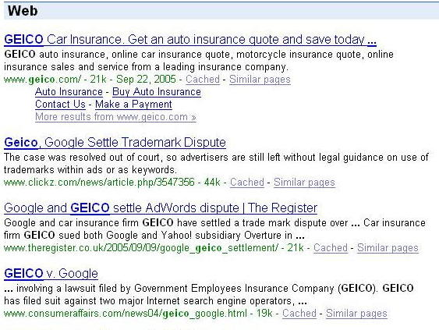
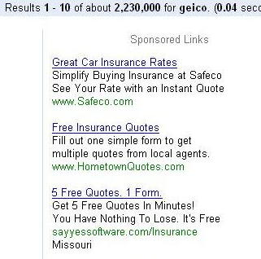
Ads vs. Search Results

Slide 15
Web 2.0
Performance-based advertising works!
  Multi-billion-dollar industry
Interesting problem:
What ads to show for a given query?
  (Today’s lecture)
If I am an advertiser, which search terms should I bid on and how much should I bid?
  (Not focus of today’s lecture)

Slide 16
Adwords Problem
Given:
  1. A set of bids by advertisers for search queries
  2. A click-through rate for each advertiser-query pair
  3. A budget for each advertiser (say for 1 month)
  4. A limit on the number of ads to be displayed with each search query
Respond to each search query with a set of advertisers such that:
  1. The size of the set is no larger than the limit on the number of ads per query
  2. Each advertiser has bid on the search query
  3. Each advertiser has enough budget left to pay for the ad if it is clicked upon

Slide 17
Adwords Problem
A stream of queries arrives at the search engine: q₁, q₂, …
Several advertisers bid on each query
When query q_{i} arrives, search engine must pick a subset of advertisers whose ads are shown
Goal: Maximize search engine’s revenues
  Simple solution: Instead of raw bids, use the “expected revenue per click” (i.e., Bid*CTR)
Clearly we need an online algorithm!

Slide 18
The Adwords Innovation
Advertiser
Bid
CTR
Bid * CTR
A
$1.00
1%
1 cent
B
$0.75
2%
1.5 cents
C
$0.50
2.5%
1.125 cents
Click through
rate
Expected
revenue

Slide 19
The Adwords Innovation
Advertiser
Bid
CTR
Bid * CTR
B
$0.75
2%
1.5 cents
C
$0.50
2.5%
1.125 cents
A
$1.00
1%
1 cent

Slide 20
Complications: Budget
Two complications:
  Budget
  CTR of an ad is unknown
Each advertiser has a limited budget
  Search engine guarantees that the advertiser
  will not be charged more than their daily budget

Slide 21
Complications: CTR
CTR: Each ad has a different likelihood of being clicked
  Advertiser 1 bids $2, click probability = 0.1
  Advertiser 2 bids $1, click probability = 0.5
  Clickthrough rate (CTR) is measured historically
    Very hard problem: Exploration vs. exploitation
    Exploit: Should we keep showing an ad for which we have
    good estimates of click-through rate
    or
    Explore: Shall we show a brand new ad to get a better sense of its click-through rate

Slide 22
BALANCE Algorithm [MSVV]
BALANCE Algorithm by Mehta, Saberi, Vazirani, and Vazirani
  For each query, pick the advertiser with the
  largest unspent budget
    Break ties arbitrarily (but in a deterministic way)

Slide 23
Example: BALANCE
Two advertisers A and B
  A bids on query x, B bids on x and y
  Both have budgets of $4
Query stream: x x x x y y y y
BALANCE choice: A B A B B B _ _
  Optimal: A A A A B B B B
In general: For BALANCE on 2 advertisers Competitive ratio = ¾

Slide 24
BALANCE: General Result
In the general case, worst competitive ratio of BALANCE is 1–1/e = approx. 0.63
  Interestingly, no online algorithm has a better competitive ratio!

Slide 25
2: Recommender Systems

Slide 26










Recommendations
Examples:
Search
Recommendations
Items
Products, web sites,
blogs, news items, …

Slide 27
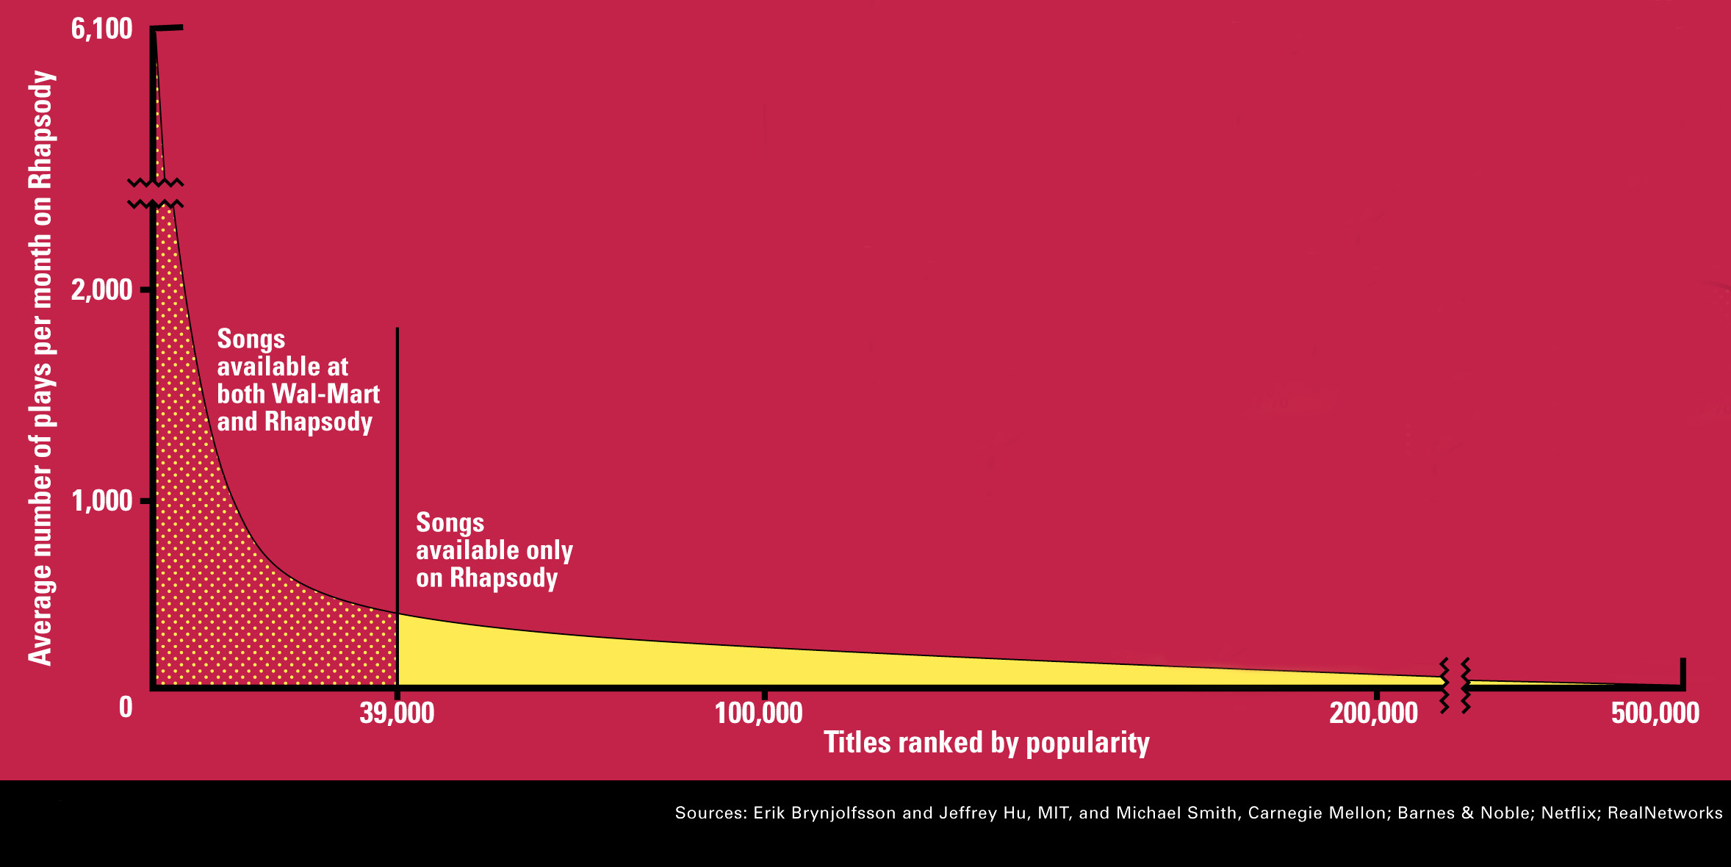
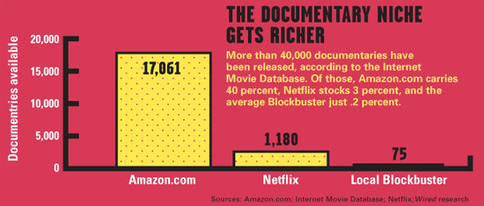
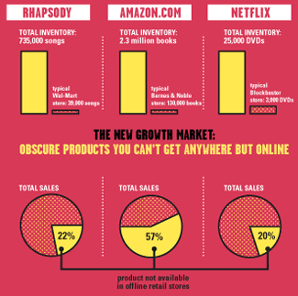
Sidenote: The Long Tail
Source: Chris Anderson (2004)

Slide 28
Formal Model
X = set of Customers
S = set of Items
Utility function u: X × S → R
  R = set of ratings
  R is a totally ordered set
  e.g., 0-5 stars, real number in [0,1]

Slide 29
Utility Matrix
Avatar
LOTR
Matrix
Pirates
Alice
Bob
Carol
David

Slide 30
Key Problems
(1) Gathering “known” ratings for matrix
  How to collect the data in the utility matrix
(2) Extrapolate unknown ratings from the
known ones
  Mainly interested in high unknown ratings
    We are not interested in knowing what you don’t like
    but what you like
(3) Evaluating extrapolation methods
  How to measure success/performance of
  recommendation methods

Slide 31
(1) Gathering Ratings
Explicit
  Ask people to rate items
  Doesn’t work well in practice – people
  can’t be bothered
Implicit
  Learn ratings from user actions
    E.g., purchase implies high rating
  What about low ratings?

Slide 32
(2) Extrapolating Utilities
Key problem: Utility matrix U is sparse
  Most people have not rated most items
  Cold start:
    New items have no ratings
    New users have no history
Three approaches to recommender systems:
  1) Content-based
  2) Collaborative
  3) Latent factor based

Slide 33
Content-based Recommendations
Main idea: Recommend items to customer x similar to previous items rated highly by x
Example:
Movie recommendations
  Recommend movies with same actor(s),
  director, genre, …
Websites, blogs, news
  Recommend other sites with “similar” content

Slide 34
Plan of Action
Item profiles
likes
build
recommend
match
Red
Circles
Triangles
User profile

Slide 35
Item Profiles
For each item, create an item profile
Profile is a set (vector) of features
  Movies: author, title, actor, director,…
  Text: Set of “important” words in document
How to pick important features?
  Usual heuristic from text mining is TF-IDF
  (Term frequency * Inverse Doc Frequency)
    Term … Feature
    Document … Item

Slide 36
Pros: Content-based Approach
+: No need for data on other users
  No cold-start or sparsity problems
+: Able to recommend to users with
unique tastes
+: Able to recommend new & unpopular items
  No first-rater problem
+: Able to provide explanations
  Can provide explanations of recommended items by listing content-features that caused an item to be recommended

Slide 37
Cons: Content-based Approach
–: Finding the appropriate features is hard
  E.g., images, movies, music
–: Recommendations for new users
  How to build a user profile?
–: Overspecialization
  Never recommends items outside user’s
  content profile
  People might have multiple interests
  Unable to exploit quality judgments of other users

Slide 38
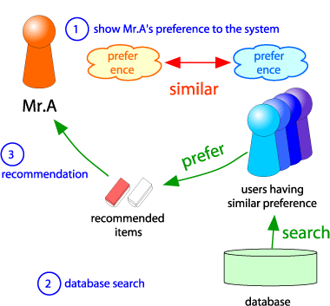
Collaborative Filtering
Consider user x
Find set N of other
users whose ratings
are “similar” to
x’s ratings
Estimate x’s ratings
based on ratings
of users in N
x
N

Slide 39
Item-Item CF (|N|=2)
users
12 | 11 | 10 | 9 | 8 | 7 | 6 | 5 | 4 | 3 | 2 | 1
 | 4 |  | 5 |  |  | 5 |  |  | 3 |  | 1 | 1
3 | 1 | 2 |  |  | 4 |  |  | 4 | 5 |  |  | 2
 | 5 | 3 | 4 |  | 3 |  | 2 | 1 |  | 4 | 2 | 3
 | 2 |  |  | 4 |  |  | 5 |  | 4 | 2 |  | 4
5 | 2 |  |  |  |  | 2 | 4 | 3 | 4 |  |  | 5
 | 4 |  |  | 2 |  |  | 3 |  | 3 |  | 1 | 6
movies
- unknown rating
- rating between 1 to 5

Slide 40
Item-Item CF (|N|=2)
users
12 | 11 | 10 | 9 | 8 | 7 | 6 | 5 | 4 | 3 | 2 | 1
 | 4 |  | 5 |  |  | 5 | ? |  | 3 |  | 1 | 1
3 | 1 | 2 |  |  | 4 |  |  | 4 | 5 |  |  | 2
 | 5 | 3 | 4 |  | 3 |  | 2 | 1 |  | 4 | 2 | 3
 | 2 |  |  | 4 |  |  | 5 |  | 4 | 2 |  | 4
5 | 2 |  |  |  |  | 2 | 4 | 3 | 4 |  |  | 5
 | 4 |  |  | 2 |  |  | 3 |  | 3 |  | 1 | 6
movies
- estimate rating of movie 1 by user 5

Slide 41
Item-Item CF (|N|=2)
users
12 | 11 | 10 | 9 | 8 | 7 | 6 | 5 | 4 | 3 | 2 | 1
 | 4 |  | 5 |  |  | 5 | ? |  | 3 |  | 1 | 1
3 | 1 | 2 |  |  | 4 |  |  | 4 | 5 |  |  | 2
 | 5 | 3 | 4 |  | 3 |  | 2 | 1 |  | 4 | 2 | 3
 | 2 |  |  | 4 |  |  | 5 |  | 4 | 2 |  | 4
5 | 2 |  |  |  |  | 2 | 4 | 3 | 4 |  |  | 5
 | 4 |  |  | 2 |  |  | 3 |  | 3 |  | 1 | 6
sim(1,m)
1.00
-0.18
0.41
-0.10
-0.31
0.59
movies
Neighbor selection:
Identify movies similar to
movie 1, rated by user 5
Here we use Pearson correlation as similarity:
1) Subtract mean rating m_{i} from each movie i
m₁ = (1+3+5+5+4)/5 = 3.6
row 1: [-2.6, 0, -0.6, 0, 0, 1.4, 0, 0, 1.4, 0, 0.4, 0]
2) Compute cosine similarities between rows

Slide 42
Item-Item CF (|N|=2)
users
12 | 11 | 10 | 9 | 8 | 7 | 6 | 5 | 4 | 3 | 2 | 1
 | 4 |  | 5 |  |  | 5 | ? |  | 3 |  | 1 | 1
3 | 1 | 2 |  |  | 4 |  |  | 4 | 5 |  |  | 2
 | 5 | 3 | 4 |  | 3 |  | 2 | 1 |  | 4 | 2 | 3
 | 2 |  |  | 4 |  |  | 5 |  | 4 | 2 |  | 4
5 | 2 |  |  |  |  | 2 | 4 | 3 | 4 |  |  | 5
 | 4 |  |  | 2 |  |  | 3 |  | 3 |  | 1 | 6
sim(1,m)
1.00
-0.18
0.41
-0.10
-0.31
0.59
movies
Compute similarity weights:
s_{1,3}=0.41, s_{1,6}=0.59

Slide 43
Item-Item CF (|N|=2)
users
12 | 11 | 10 | 9 | 8 | 7 | 6 | 5 | 4 | 3 | 2 | 1
 | 4 |  | 5 |  |  | 5 | 2.6 |  | 3 |  | 1 | 1
3 | 1 | 2 |  |  | 4 |  |  | 4 | 5 |  |  | 2
 | 5 | 3 | 4 |  | 3 |  | 2 | 1 |  | 4 | 2 | 3
 | 2 |  |  | 4 |  |  | 5 |  | 4 | 2 |  | 4
5 | 2 |  |  |  |  | 2 | 4 | 3 | 4 |  |  | 5
 | 4 |  |  | 2 |  |  | 3 |  | 3 |  | 1 | 6
movies
Predict by taking weighted average:
r_{1.5} = (0.41*2 + 0.59*3) / (0.41+0.59) = 2.6
$$r_{ix}=\frac{\sum_{j∈N(i;x)}{s_{ij}⋅r_{jx}}}{∑s_{ij}}$$

Slide 44
CF: Common Practice
Before:
Define similarity s_{ij} of items i and j
Select k nearest neighbors N(i; x)
  Items most similar to i, that were rated by x
Estimate rating r_{xi} as the weighted average:
baseline estimate for r_{xi}
μ = overall mean movie rating
b_{x} = rating deviation of user x
= (avg. rating of user x) – μ
b_{i} = rating deviation of movie i
$$b_{xi}=μ+b_{x}+b_{i}$$

Slide 45
Item-Item vs. User-User
Avatar
LOTR
Matrix
Pirates
Alice
Bob
Carol
David
In practice, it has been observed that item-item often works better than user-user
Why? Items are simpler, users have multiple tastes
Notes:
There is a difference in the typical behavior of users and items, as it
pertains to similarity. Intuitively, items tend to be classifiable in simple
terms. For example, music tends to belong to a single genre. It is impossi-
ble, e.g., for a piece of music to be both 60’s rock and 1700’s baroque. On
the other hand, there are individuals who like both 60’s rock and 1700’s
baroque, and who buy examples of both types of music.
The consequence is that it is easier to discover items that are similar because they belong
to the same genre, than it is to detect that two users are similar because
they prefer one genre in common, while each also likes some genres that
the other doesn’t care for.

Slide 46
Pros/Cons of Collaborative Filtering
+ Works for any kind of item
  No feature selection needed
- Cold Start:
  Need enough users in the system to find a match
- Sparsity:
  The user/ratings matrix is sparse
  Hard to find users that have rated the same items
- First rater:
  Cannot recommend an item that has not been
  previously rated
  New items, Esoteric items
- Popularity bias:
  Cannot recommend items to someone with
  unique taste
  Tends to recommend popular items

Slide 47
Hybrid Methods
Implement two or more different recommenders and combine predictions
  Perhaps using a linear model
Add content-based methods to
collaborative filtering
  Item profiles for new item problem
  Demographics to deal with new user problem

Slide 48
Problems with Error Measures
Narrow focus on accuracy sometimes
misses the point
  Prediction Diversity
  Prediction Context
  Order of predictions
In practice, we care only to predict high ratings:
  RMSE might penalize a method that does well
  for high ratings and badly for others

Slide 49
Collaborative Filtering: Complexity
Expensive step is finding k most similar customers: O(|X|)
Too expensive to do at runtime
  Could pre-compute
Naïve pre-computation takes time O(k ·|X|)
      X … set of customers
We already know how to do this!
  Near-neighbor search in high dimensions (LSH)
  Clustering
  Dimensionality reduction

Slide 50
Tip: Add Data
Leverage all the data
  Don’t try to reduce data size in an
  effort to make fancy algorithms work
  Simple methods on large data do best
Add more data
  e.g., add IMDB data on genres
More data beats better algorithms
http://anand.typepad.com/datawocky/2008/03/more-data-usual.html

Slide 51
The Netflix Prize
Training data
  100 million ratings, 480,000 users, 17,770 movies
  6 years of data: 2000-2005
Test data
  Last few ratings of each user (2.8 million)
  Evaluation criterion: Root Mean Square Error (RMSE)
  Netflix’s system RMSE: 0.9514
Competition
  2,700+ teams
  $1 million prize for 10% improvement on Netflix

Slide 52
The Netflix Utility Matrix R
480,000 users
Matrix R
1 | 3 | 4
 | 3 | 5 |  |  | 5
 |  | 4 | 5 |  | 5
 |  | 3
 |  | 3
2 |  |  | 2 |  | 2
 |  |  |  | 5
 | 2 | 1 |  |  | 1
 | 3 |  |  | 3
1
17,700 movies

Slide 53
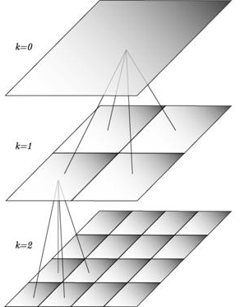
BellKor Recommender System
The winner of the Netflix Challenge!
Multi-scale modeling of the data:
Combine top level, “regional”
modeling of the data, with
a refined, local view:
  Global:
    Overall deviations of users/movies
  Factorization:
    Addressing “regional” effects
  Collaborative filtering:
    Extract local patterns
Global effects
Factorization
Collaborative filtering

Slide 54

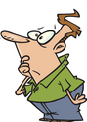

Modeling Local & Global Effects
Global:
  Mean movie rating: 3.7 stars
  The Sixth Sense is 0.5 stars above avg.
  Joe rates 0.2 stars below avg.
  ⇒ Baseline estimation:
  Joe will rate The Sixth Sense 4 stars
Local neighborhood (CF/NN):
  Joe didn’t like related movie Signs
  ⇒ Final estimate:
  Joe will rate The Sixth Sense 3.8 stars

Slide 55
Modeling Local & Global Effects
In practice we get better estimates if we model deviations:
^
baseline estimate for r_{xi}
Problems/Issues:
1) Similarity measures are “arbitrary”
2) Pairwise similarities neglect interdependencies among users
3) Taking a weighted average can be restricting
Solution: Instead of s_{ij} use w_{ij} that we estimate directly from data
$$b_{xi}=μ+b_{x}+b_{i}$$
μ = overall mean rating
b_{x} = rating deviation of user x
= (avg. rating of user x) – μ
b_{i} = (avg. rating of movie i) – μ
Notes:
Use a weighted sum instead of a weighted average

Slide 56
Recommendations via Optimization
1 | 3 | 4
 | 3 | 5 |  |  | 5
 |  | 4 | 5 |  | 5
 |  | 3
 |  | 3
2 |  |  | 2 |  | 2
 |  |  |  | 5
 | 2 | 1 |  |  | 1
 | 3 |  |  | 3
1
Goal: Make good recommendations
  Quantify goodness using RMSE:
  Lower RMSE ⇒ better recommendations
  Want to make good recommendations on items
  that user has not yet seen. Can’t really do this!
  Let’s set build a system such that it works well
  on known (user, item) ratings
  And hope the system will also predict well the unknown ratings

Slide 57
Recommendations via Optimization
Idea: Let’s set values w such that they work well
on known (user, item) ratings
How to find such values w?
Idea: Define an objective function
and solve the optimization problem
Find w_{ij} that minimize SSE on training data!
$$J\left(w\right)={\sum_{x,i}{{\left(\left[b_{xi}+\sum_{j∈N\left(i;x\right)}{w_{ij}\left(r_{xj}−b_{xj}\right)}\right]−r_{xi}\right)}^{2}}}$$
Think of w as a vector of numbers
True
rating
Predicted rating

Slide 58






Latent Factor Models (e.g., SVD)
Serious
Braveheart
The Color Purple
Amadeus
Lethal Weapon
Sense and Sensibility
Geared towards
females
Ocean’s 11
Geared towards
males
The Lion King
The Princess
Diaries
Independence Day
Dumb and Dumber
Funny

Slide 59
Latent Factor Models
Serious
Braveheart
The Color Purple
Amadeus
Lethal Weapon
Sense and Sensibility
Geared towards
females
Ocean’s 11
Factor 1
Geared towards
males
The Lion King
The Princess
Diaries
Factor 2
Independence Day
Dumb and Dumber
Funny
Notes:
Users fall into the same space as movies, where a user’s position in a dimension reflects the user’s preference for (or against) movies that score high on that dimension.
For example, BLUE tends to like male-oriented movies, but dislikes serious movies. Therefore, we would expect him to love “Dumb and Dumber” and hate “The Color Purple”.
Note that these two dimensions do not characterize Dave’s (DOCTOR) interests very well; additional dimensions would be needed.

Slide 60
Back to Our Problem
Want to minimize SSE for unseen test data
Idea: Minimize SSE on training data
  Want large k (# of factors) to capture all the signals
  But, SSE on test data begins to rise for k > 2
This is a classical example of overfitting:
  With too much freedom (too many free parameters) the model starts fitting noise
    That is it fits too well the training data and thus not generalizing well to unseen test data
1 | 3 | 4
 | 3 | 5 |  |  | 5
 |  | 4 | 5 |  | 5
 |  | 3
 |  | 3
2 |  |  | ? |  | ?
 |  |  |  | ?
 | 2 | 1 |  |  | ?
 | 3 |  |  | ?
1

Slide 61
Dealing with Missing Entries
1 | 3 | 4
 | 3 | 5 |  |  | 5
 |  | 4 | 5 |  | 5
 |  | 3
 |  | 3
2 |  |  | ? |  | ?
 |  |  |  | ?
 | 2 | 1 |  |  | ?
 | 3 |  |  | ?
1
To solve overfitting we introduce regularization:
  Allow rich model where there are sufficient data
  Shrink aggressively where data are scarce
“error”
“length”
λ₁, λ₂ … user set regularization parameters
Note: We do not care about the “raw” value of the objective function,
but we care in P,Q that achieve the minimum of the objective

Slide 62
The Effect of Regularization
serious
Braveheart
The Color Purple
Amadeus
Lethal Weapon
Sense and Sensibility
Geared towards
females
Ocean’s 11
Geared towards
males
Factor 1
The Princess
Diaries
The Lion King
Dumb and Dumber
Independence Day
Factor 2
min_{factors} “error” + λ “length”
funny
Notes:
Consider Gus.
This slide shows the position for Gus that best explains his ratings for the Training data—i.e., that minimizes his sum of squared errors.
If Gus has rated hundreds of movies, we could probably be confident of that we have estimated his true preferences accurately.
But what if Gus has only rated a few movies—say the ten on this slide? We should not be so confident.

Slide 63
The Effect of Regularization
serious
Braveheart
The Color Purple
Amadeus
Lethal Weapon
Sense and Sensibility
Geared towards
females
Ocean’s 11
Geared towards
males
Factor 1
The Princess
Diaries
The Lion King
Dumb and Dumber
Independence Day
Factor 2
min_{factors} “error” + λ “length”
funny
Notes:
We hedge our bet by tethering Gus to origin with an elastic cord that tries to pull Gus back towards the origin.
If Gus has rated hundreds of movies, he stays about where the data places him.

Slide 64
The Effect of Regularization
serious
Braveheart
The Color Purple
Amadeus
Lethal Weapon
Sense and Sensibility
Geared towards
females
Ocean’s 11
Geared towards
males
Factor 1
The Princess
Diaries
The Lion King
Dumb and Dumber
Independence Day
Factor 2
min_{factors} “error” + λ “length”
funny
Notes:
But if he has hated only a few dozen, he is pulled back towards the origin.

Slide 65
The Effect of Regularization
serious
Braveheart
The Color Purple
Amadeus
Lethal Weapon
Sense and Sensibility
Geared towards
females
Ocean’s 11
Geared towards
males
Factor 1
The Princess
Diaries
The Lion King
Dumb and Dumber
Independence Day
Factor 2
min_{factors} “error” + λ “length”
funny
Notes:
And if he has rated only a handful, he is pulled even further.

Slide 66
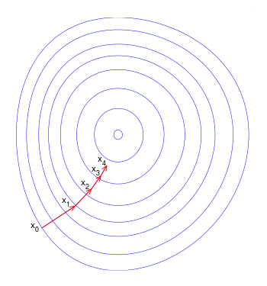
Stochastic Gradient Descent
Want to find matrices P and Q:
Gradient decent:
  Initialize P and Q (using SVD, pretend missing ratings are 0)
  Do gradient descent:
    P ← P - η ·∇P
    Q ← Q - η ·∇Q
    where ∇Q is gradient/derivative of matrix Q:
    and
      Here is entry f of row q_{i} of matrix Q
  Observation: Computing gradients is slow!
How to compute gradient of a matrix?
Compute gradient of every element independently!

Slide 67
Fitting the New Model
Solve:
Stochastic gradient decent to find parameters
  Note: Both biases b_{x}, b_{i} as well as interactions q_{i}, p_{x} are treated as parameters (we estimate them)
goodness of fit
regularization
λ is selected via grid-search on a validation set

Slide 68
Performance of Various Methods

Slide 69
Performance of Various Methods
Global average: 1.1296
User average: 1.0651
Movie average: 1.0533
Netflix: 0.9514
Basic Collaborative filtering: 0.94
Collaborative filtering++: 0.91
Latent factors: 0.90
Latent factors+Biases: 0.89
Grand Prize: 0.8563

