Slide 1
Stochastic SVD on Hadoop
Shannon Quinn
(with thanks to Gunnar Martinsson and Nathan Halko of UC Boulder, and Joel Tropp of CalTech)

Slide 2
Lecture breakdown
Part I
Stochastic SVD
Part II
Distributed stochastic SVD

Slide 3
Part I: Stochastic SVD

Slide 4
Basic goal
Matrix A
Find a low-rank approximation of A
Basic dimensionality reduction
Preconditioning
Notes:
Construct a low dimensional subspace that approximates the range of A.

Slide 5
Basic algorithm
INPUT: A, k, p
OUTPUT: Q
Draw Gaussian n x (k + p) test matrix Ω
Form product Y = AΩ
Orthogonalize columns of Y ➔Q
Notes:
-Matrix A is m by n
-k is the desired number of dimensions of the low-rank representation (e.g. 10, 100, something significantly smaller than n)
-p is the oversampling parameter

Slide 6
Basic evaluation
Notes:
Error of this approximation is no greater than the k + 1 singular value!
Provided the singular values decay quickly (a sign of a well-conditioned system…as in, you chose Q very well), this error becomes very small

Slide 7
Approximating the SVD
INPUT: Q
OUTPUT: Singular vectors U
Form k x n matrix B = Q^{T}A
Compute SVD of B = ÛΣV^{T}
Compute singular vectors U = QÛ

Slide 8
Demo

Slide 9
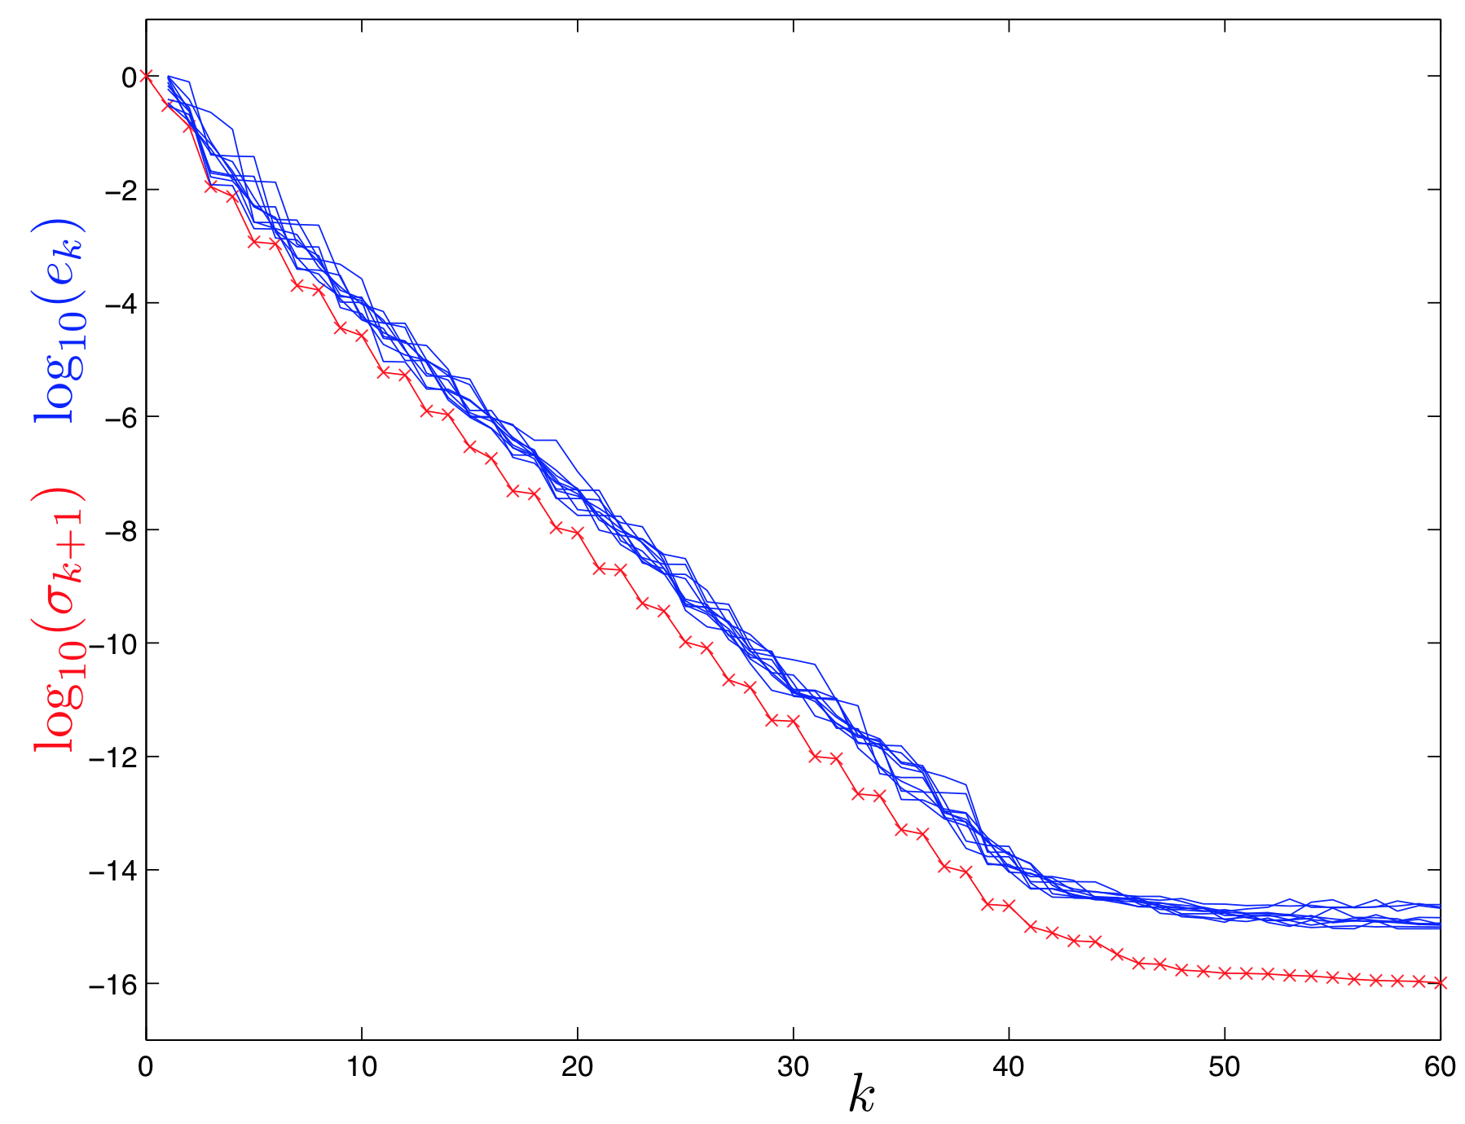
Empirical Results
1000x1000 matrix
Notes:
Blue lines: 10 iterations of SSVD
Red line: full SVD of original A

Slide 10
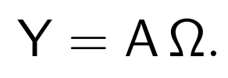
Power iterations
Affects decay of eigenvalues / singular values
Notes:
(sketch small proof of eigenvalue decay rate)

Slide 11
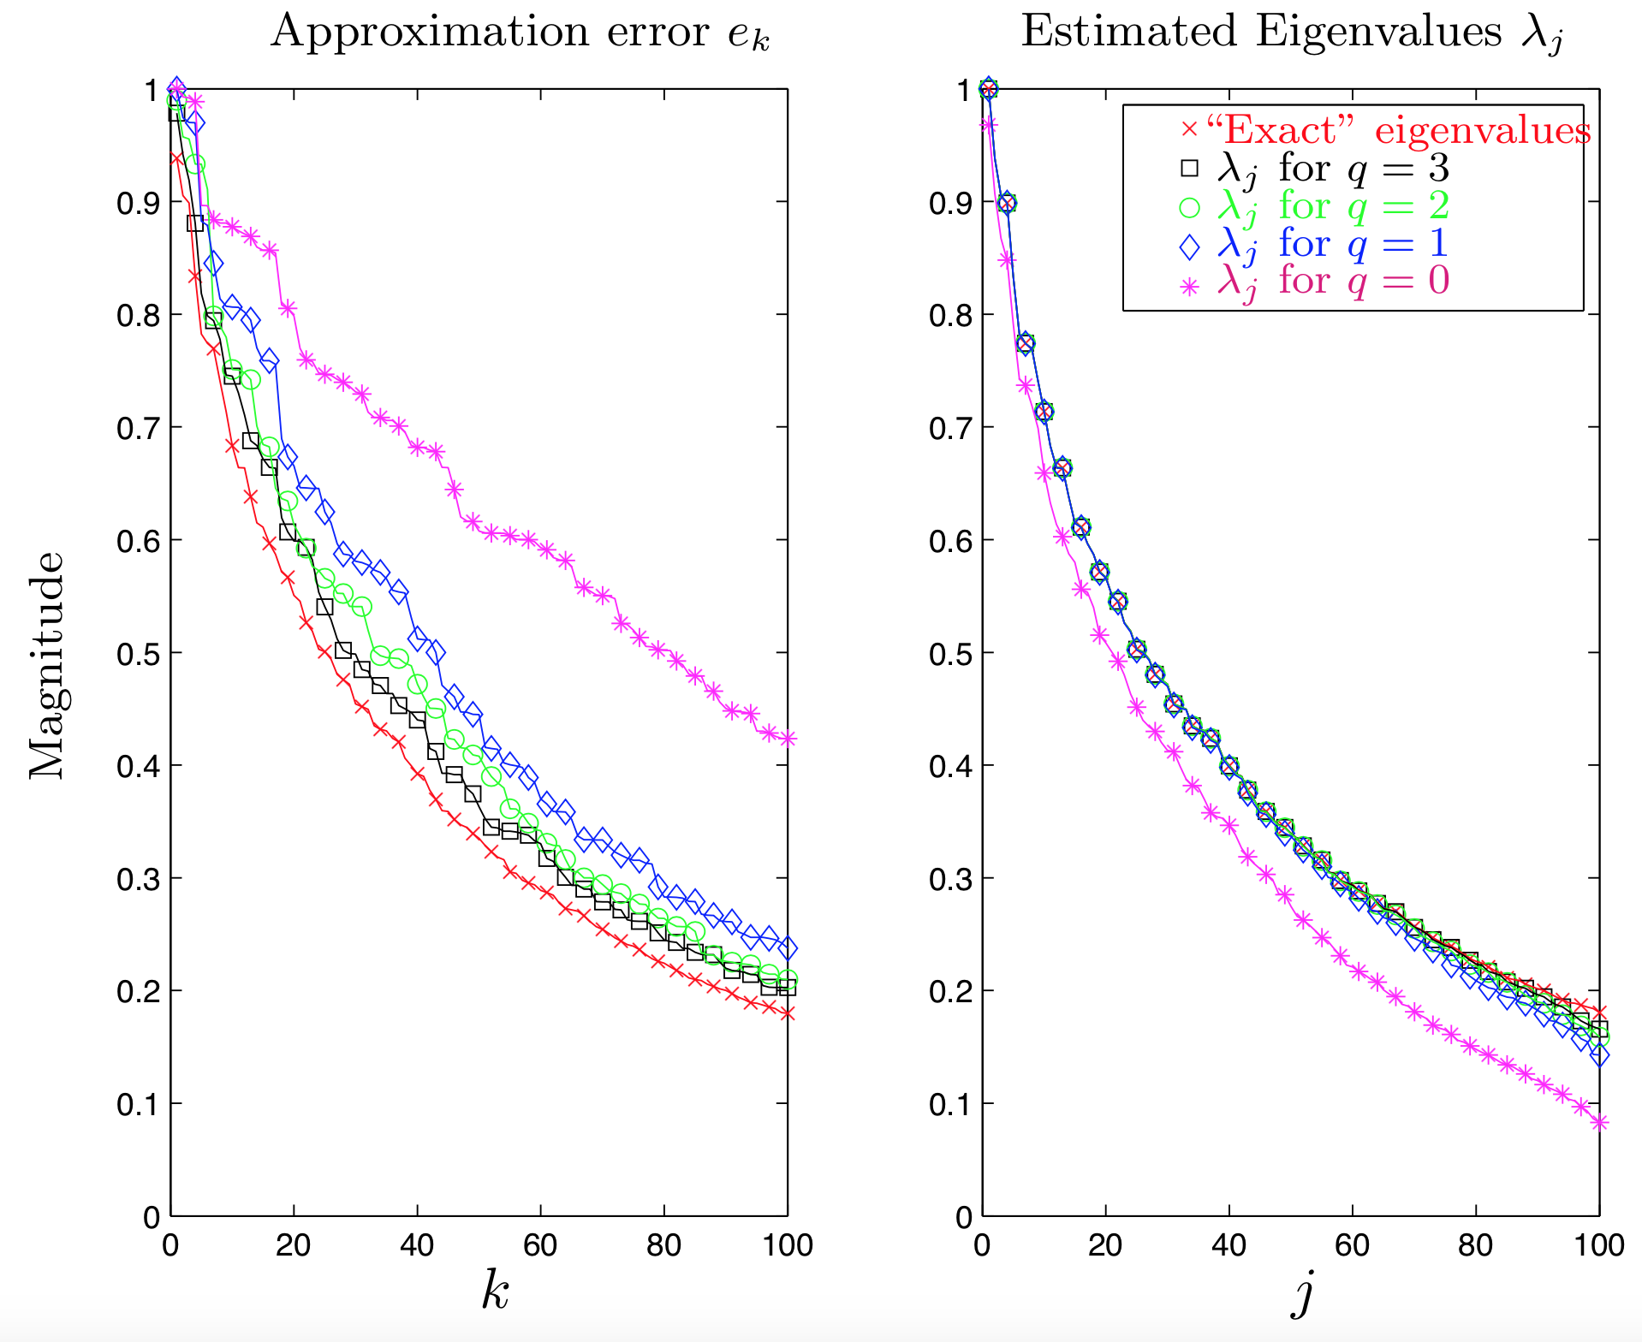
Empirical Results

Slide 12
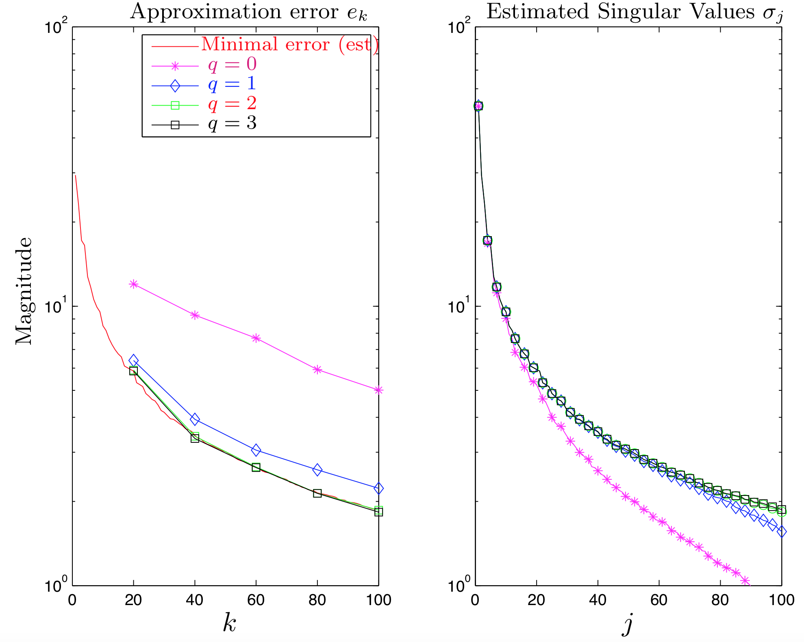
Empirical Results

Slide 13
Part II: Distributed SSVD

Slide 14
Algorithm Overview
QR factorization
Power iteration
QR factorization
In-core SVD

Slide 15
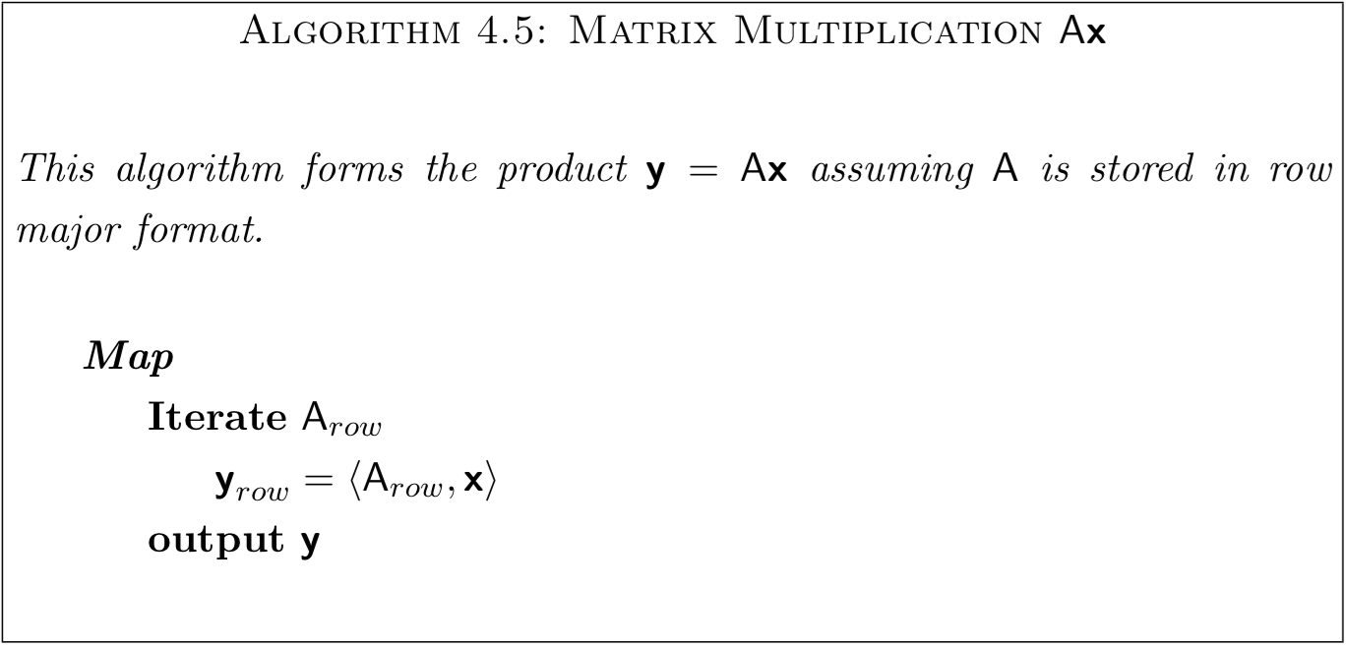
SSVD Primitives
Matrix-vector multiplication: y = Ax
(midterm, anyone?)
Notes:
You did this in the midterm

Slide 16
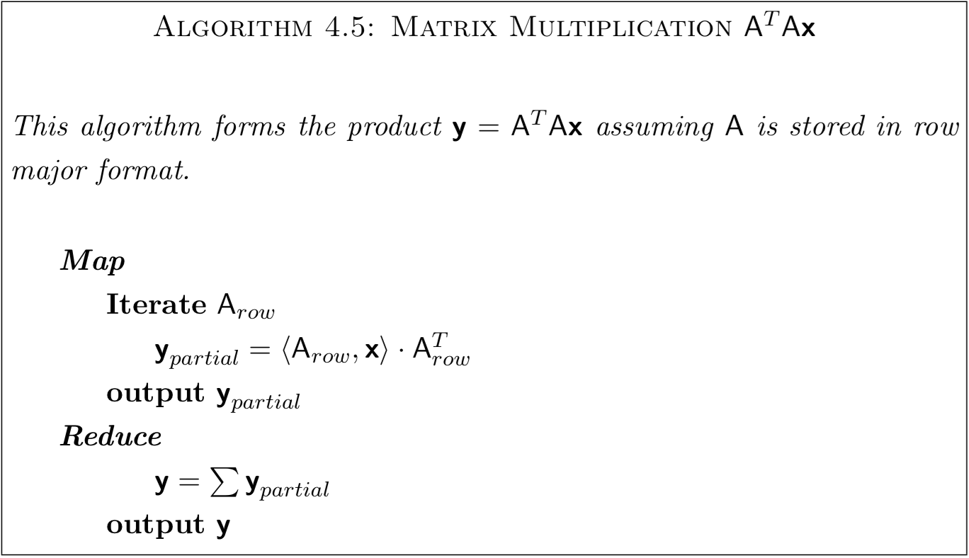
SSVD Primitives
Matrix-matrix multiplication: y = A^{T}Ax

Slide 17
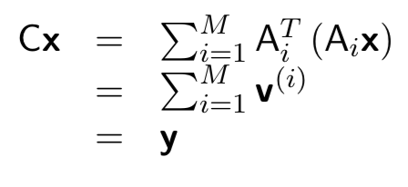
Matrix-matrix multiplication
Very clever use of map/reduce
Each Mapper outputs:
Notes:
J^(th) entry of the partial sum vector v^i

Slide 18
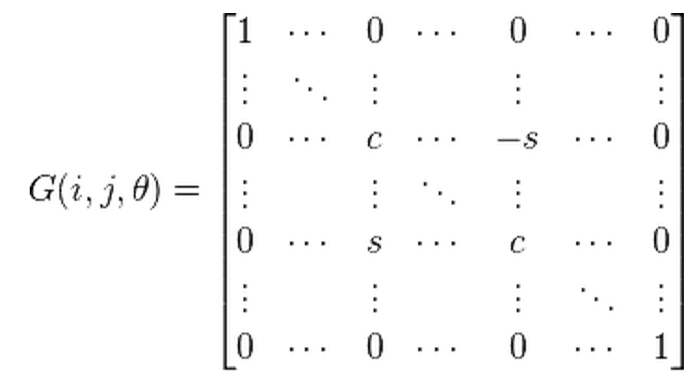
SSVD Primitives
Distributed orthogonalization: Y = AΩ
Givens rotation
Streaming QR
Sliding window
Merge factorizations
Merge R
Merge Q^{T}

Slide 19
SSVD
1
2
3
4
5

Slide 20
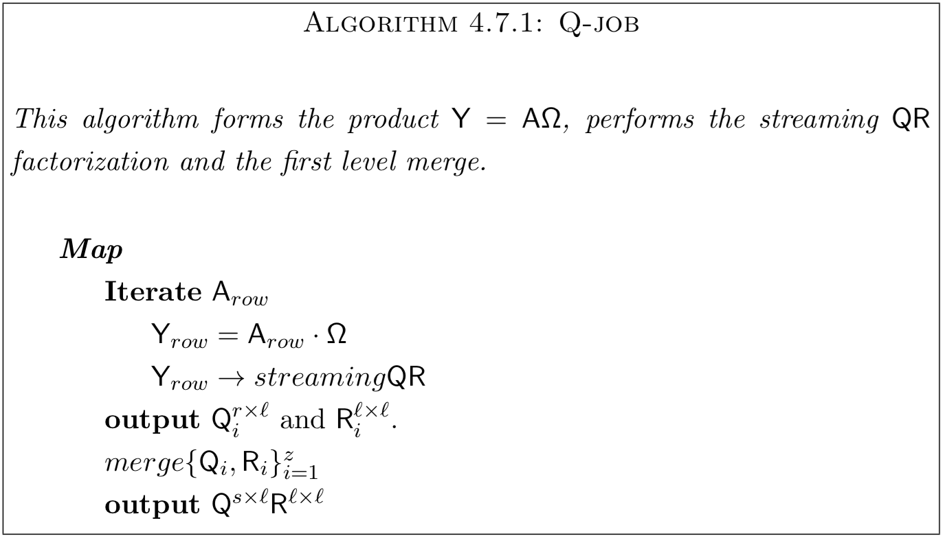
1: Q-job
Notes:
Q-job is a map only job that performs the multiplication, AΩ, and does the first two phases
of orthogonalization. Input is a block of s rows Ai and output is a thin QR factorization of the
corresponding block Yi. The number of rows s provided each mapper can vary if the density pattern
is non uniform across the rows. Recall, the input splits are determined by size in megabytes. The
rows are fed in one by one and multiplied by Ω to give a row of Yi as in Remark 29. As rows
of Yi become available they are sent to the streaming QR algorithm of §4.6.3 where an order
r factorization is computed from the sub-block Y(j) for j = 1, . . . , z. Once the z factorizations i
have been computed, the merge algorithm of §4.6.4 glues them together to output a thin QR decomposition for Yi.

Slide 21
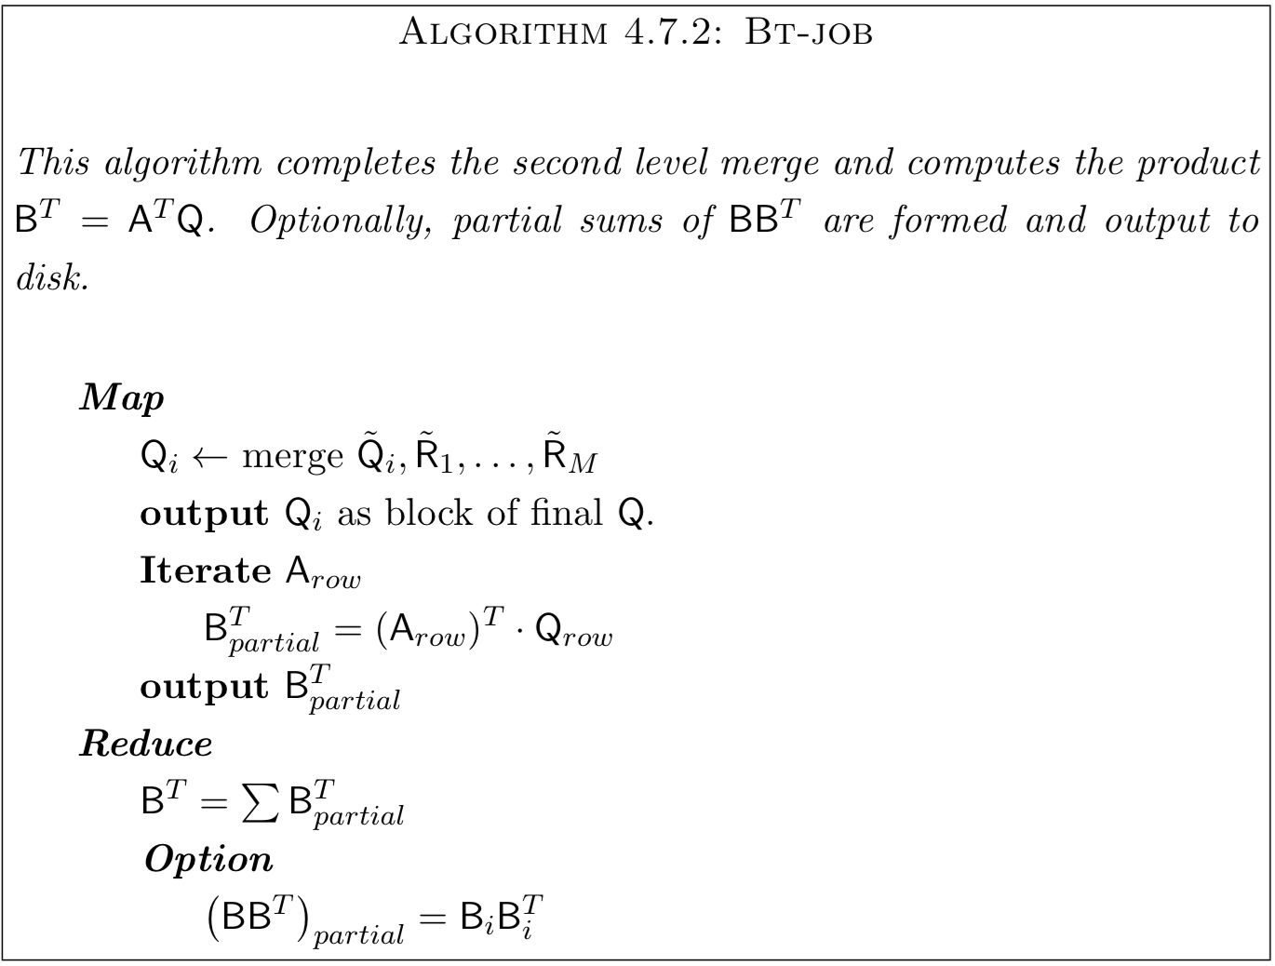
2: B^{T}-job
Notes:
The front end of the map job finalizes the orthogonalization started in Q-job. Then for map task i in Bt-job, we read Q ̃i and R ̃1,...,R ̃M from disk in order to form the final block of Q.
Matrix-matrix multiplication of A and Q (using primitive from before)
In the reduce job, if there are no power iterations, output the partial of BB^T

Slide 22
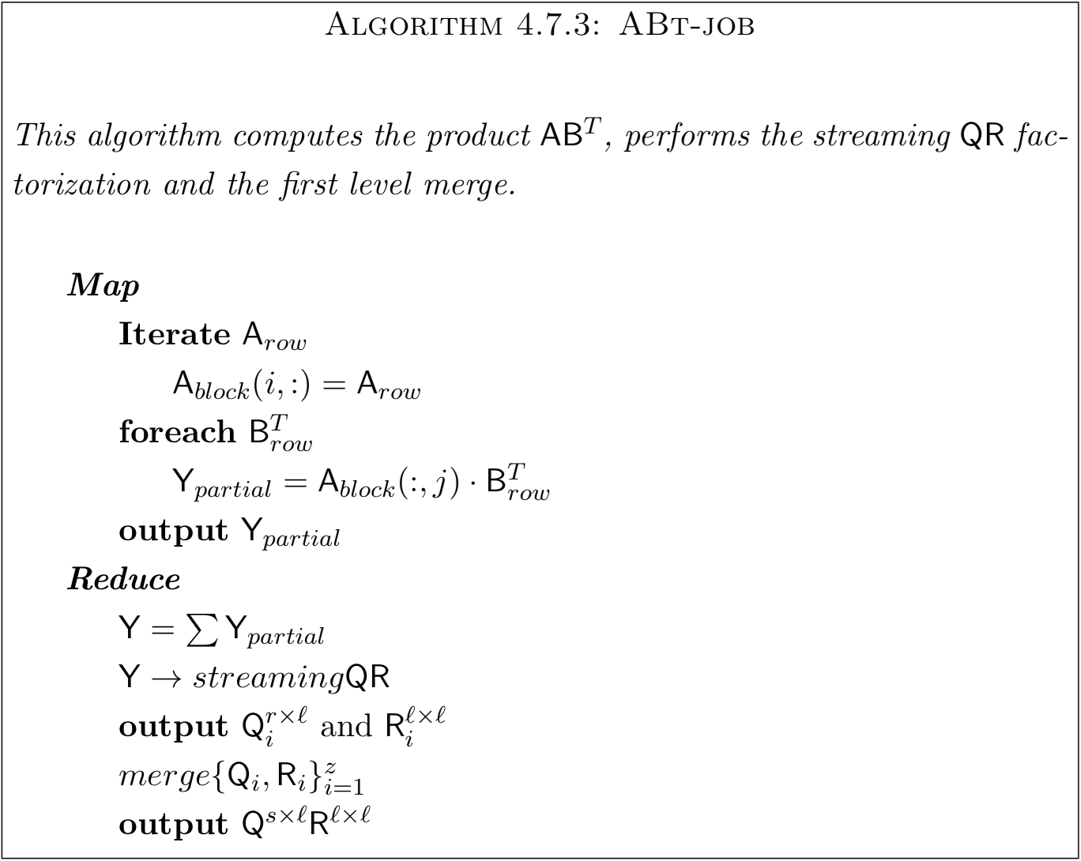
3: AB^{T}-job
Notes:
ABt-job has much the same functionality as Q-job. We need to do a matrix multiplication ABT = AAT Q and orthogonalize the result.
Unfortunately it is more complicated than Q-job since we cannot produce BT on the fly as we could with Ω, instead, BT is stored on disk. To limit access to BT the rows of A are preloaded into memory so that we can use the partial columns, that is, columns of the row blocks Ai, for outer products and read the sequence of BT blocks only once per mapper.
In Q-job, our blocks Yi were available in the mapper. With ABt-job, we need to accumulate partial sums of Yi in the reducer so we bring the streaming QR and first level merge computation there as well.

Slide 23
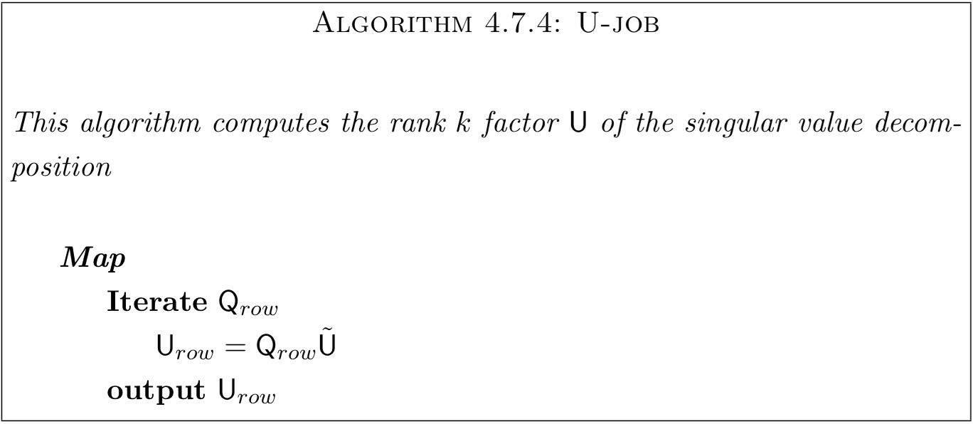
4: U-job
Notes:
U is k by k so it fits comfortably in memory.

Slide 24
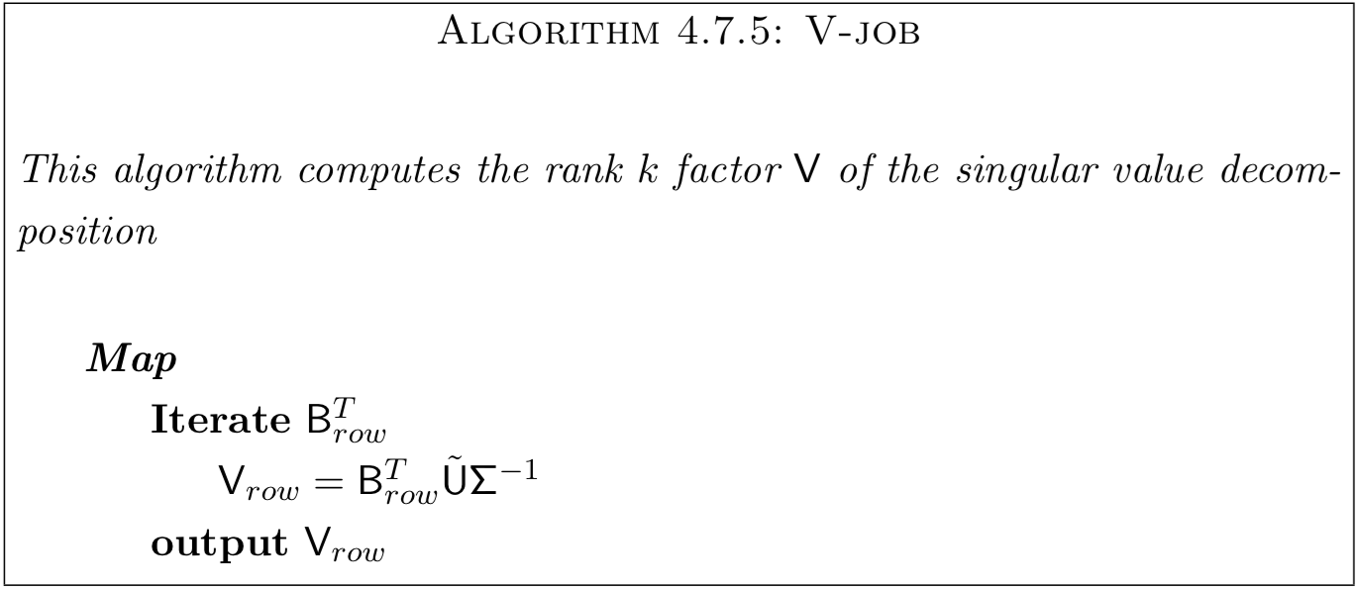
5: V-job
Notes:
V-job is again a map only job forming the rows of the rank k factor V V(i, : ) = (B(: ,i))T U ̃Σ−1 (4.38)
where U ̃ is as in (4.37) and Σ is the uppermost leftmost block of k singular values. Recall that B is stored columnwise as rows of BT .

Slide 25
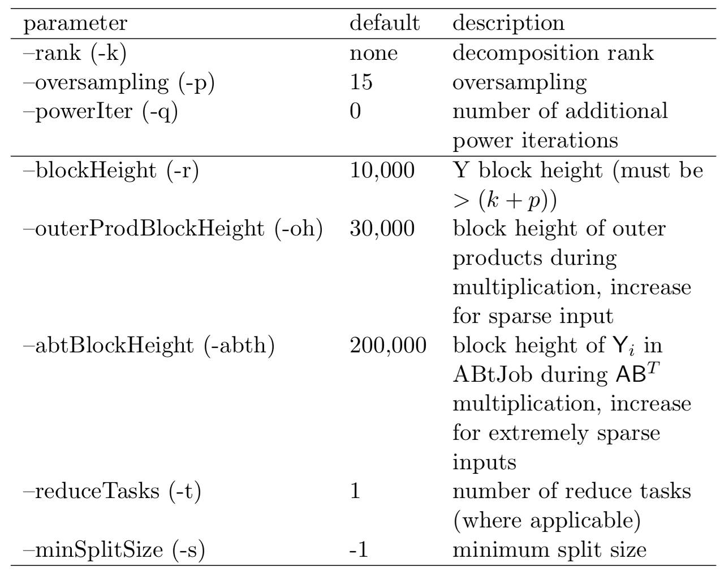
Mahout SSVD Parameters
Notes:
Top set: mathematical or algorithmic parameters
Bottom set: computational parameters

Slide 26
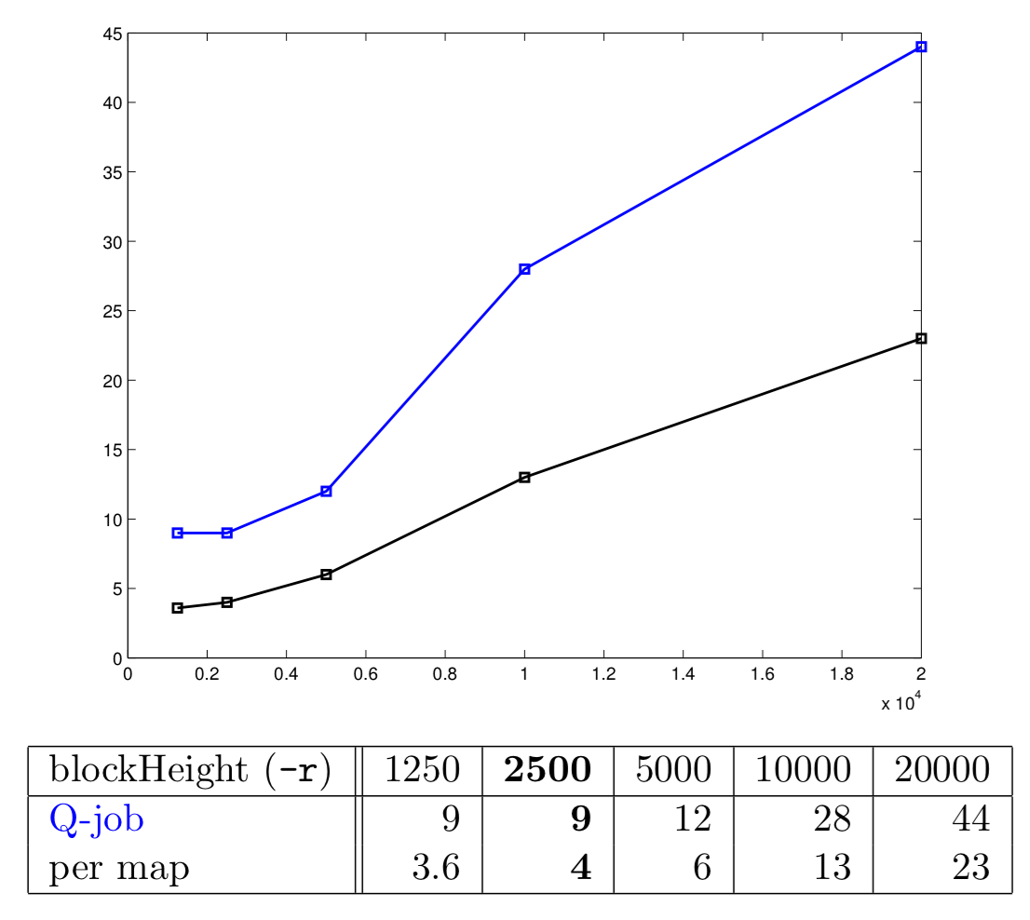
Block height
Notes:
Time in minutes for the given block height. Authors chose r = 2500 as the optimal.

Slide 27
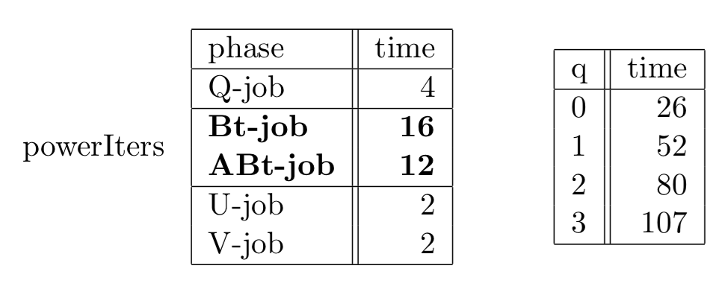
Power iterations
Notes:
(left) Timings in minutes for the various phases of the algorithm on an 8 node m1.large cluster. The bulk of the processing time is in Bt-job and ABt-job which are recomputed for each power iteration.
(right) Timings in minutes for values of q.

Slide 28
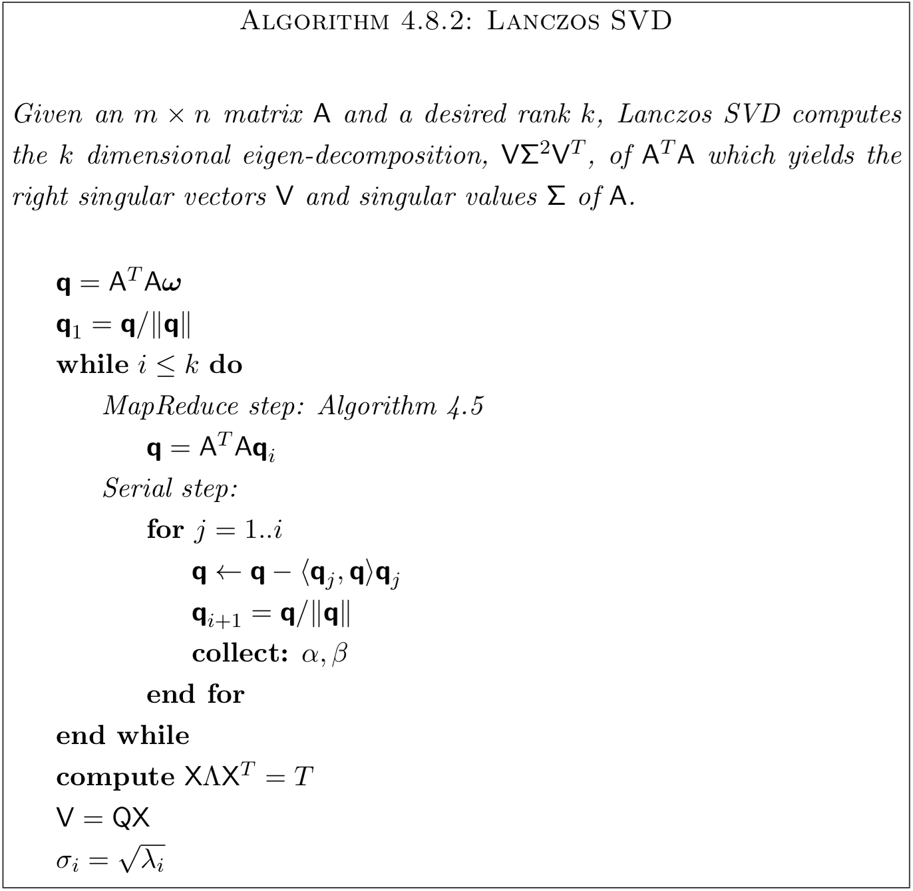
Comparison to Lanczos

Slide 29
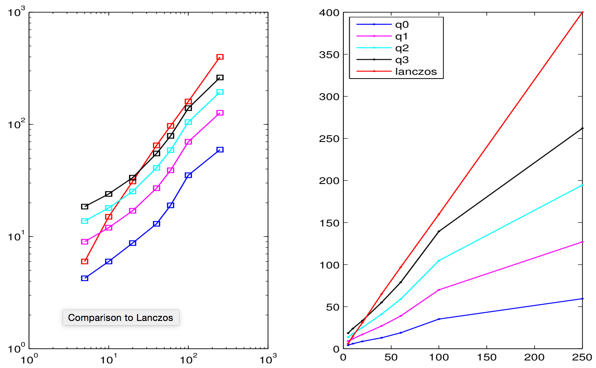
Comparison to Lanczos
Notes:
Time in minutes for various values of k on the wiki-million data set. Lanczos time is extrapolated for k > 60. The loglog plot on the left is to illustrate the activity for small k.

Slide 30
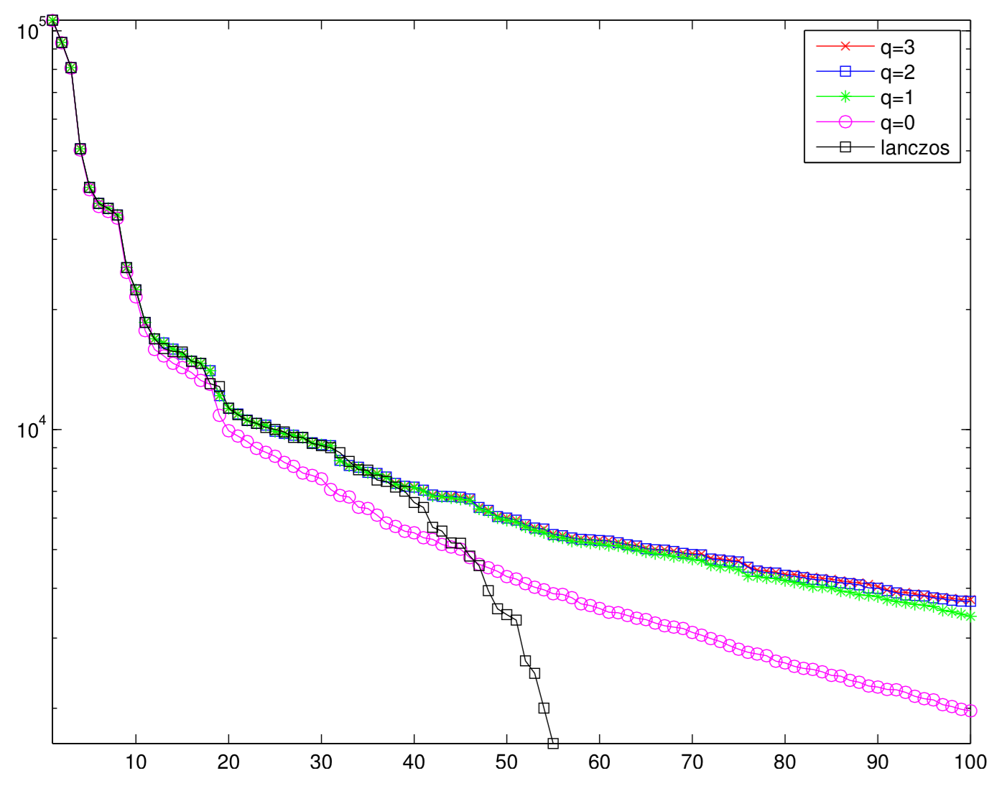
Comparison to Lanczos
Notes:
Computed spectrum of the Wikipedia million data set with k = 100 and p = 25. Only 60 values were computed for Lanczos before running out of memory (Java Heap). Just one power iteration gives excellent accuracy. Singular values for q = 2, 3 are indistinguishable in the plot and appear as a red x inside a blue square.

Slide 31
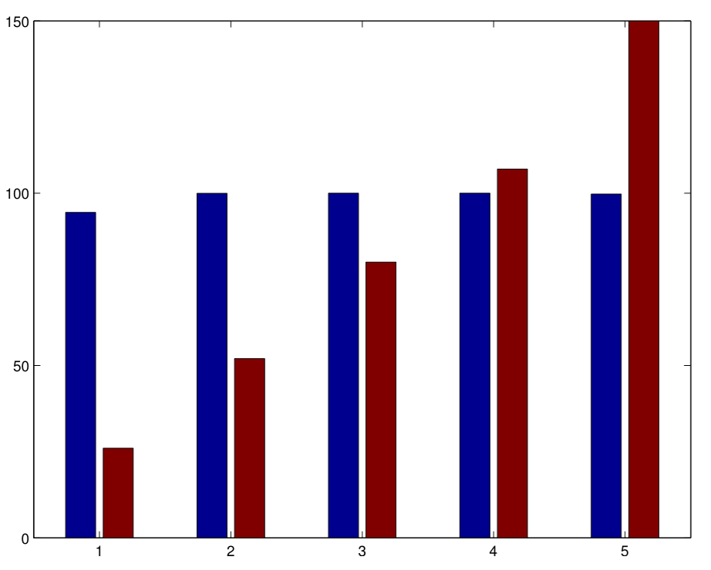
Comparison to Lanczos
Notes:
Accuracy as a percentage and time in minutes. From left to right ssvd with q = 0, 1, 2, 3 and lanczos. Accuracy is computed as the sum of the first 40 singular values obtained from each method. The sum is scaled by the largest sum and multiplied by 100 to produce a percentage. Orderofaccuracyisq=3, q=2, q=1,lanczos,q=0.

Slide 32
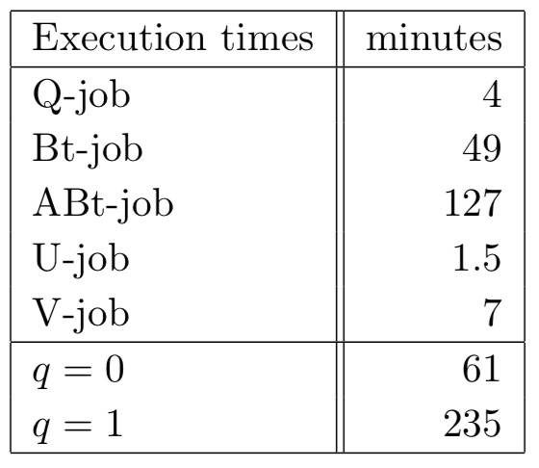
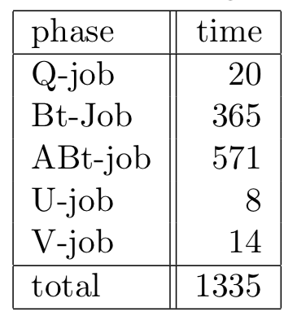
Datasets
Wikipedia-all
Wikipedia-MAX
Notes:
Our dataset is a term-frequency document-frequency (tf-df) matrix of Wikipedia articles.
Wikipedia-all: full corpus of 6.4 million articles (15GB)
Wikipedia-max: full corpus replicated 6 times (38.4M articles, 37.2M terms, 90GB)

Slide 33
That’s SSVD!

Slide 34
Resources
Randomized methods for computing the SVD of very large matrices
http://web.stanford.edu/group/mmds/slides2010/Martinsson.pdf
Randomized methods for computing low-rank approximations of matrices
https://amath.colorado.edu/faculty/martinss/Pubs/2012_halko_dissertation.pdf
SSVD on Mahout
https://mahout.apache.org/users/algorithms/d-ssvd.html

