Slide 1
Scaling up Decision Trees
Shannon Quinn
(with thanks to William Cohen of CMU, and B. Panda, J. S. Herbach, S. Basu, and R. J. Bayardo of IIT)

Slide 2
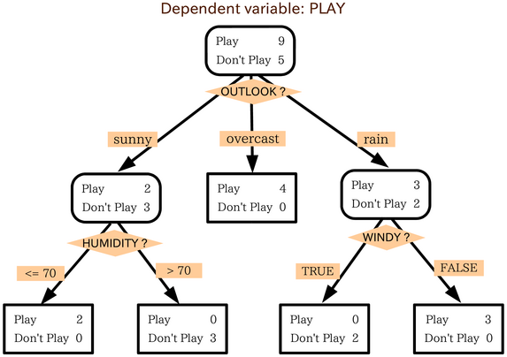
A decision tree

Slide 3
A regression tree
Play ~= 33
Play ~= 24
Play ~= 48
Play ~= 18
Play = 45m,45,60,40
Play ~= 37
Play ~= 5
Play ~= 0
Play ~= 32
Play = 30m, 45min
Play = 0m, 0m, 15m
Play = 0m, 0m
Play = 20m, 30m, 45m,

Slide 4
Most decision tree learning algorithms
Given dataset D:
return leaf(y) if all examples are in the same class y … or if blahblah...
pick the best split, on the best attribute a
a<θ or a ≥ θ
a or not(a)
a=c₁ or a=c₂ or …
a in {c₁,…,c_{k}} or not
split the data into D₁ ,D₂ , … D_{k} and recursively build trees for each subset
“Prune” the tree

Slide 5
Most decision tree learning algorithms
Given dataset D:
return leaf(y) if all examples are in the same class y … or if blahblah...
pick the best split, on the best attribute a
a<θ or a ≥ θ
a or not(a)
a=c₁ or a=c₂ or …
a in {c₁,…,c_{k}} or not
split the data into D₁ ,D₂ , … D_{k} and recursively build trees for each subset
“Prune” the tree
Popular splitting criterion: try to lower entropy of the y labels on the resulting partition
i.e., prefer splits that contain fewer labels, or that have very skewed distributions of labels

Slide 6
Most decision tree learning algorithms
Find Best Split
Choose split point that minimizes weighted impurity (e.g., variance (regression) and information gain (classification) are common)
Stopping Criteria (common ones)
Maximum Depth
Minimum number of data points
Pure data points (e.g., all have the same Y label)

Slide 7
Most decision tree learning algorithms
“Pruning” a tree
avoid overfitting by removing subtrees somehow
trade variance for bias
15
13

Slide 8
Most decision tree learning algorithms
Given dataset D:
return leaf(y) if all examples are in the same class y … or if blahblah...
pick the best split, on the best attribute a
a<θ or a ≥ θ
a or not(a)
a=c₁ or a=c₂ or …
a in {c₁,…,c_{k}} or not
split the data into D₁ ,D₂ , … D_{k} and recursively build trees for each subset
“Prune” the tree
Same idea

Slide 9
Decision trees: plus and minus
Simple and fast to learn
Arguably easy to understand (if compact)
Very fast to use:
often you don’t even need to compute all attribute values
Can find interactions between variables (play if it’s cool and sunny or ….) and hence non-linear decision boundaries
Don’t need to worry about how numeric values are scaled

Slide 10
Decision trees: plus and minus
Hard to prove things about
Not well-suited to probabilistic extensions
Don’t (typically) improve over linear classifiers when you have lots of features
Sometimes fail badly on problems that linear classifiers perform well on

Slide 11
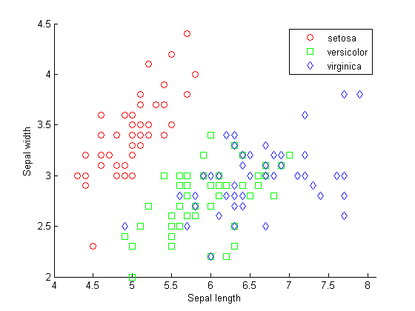
Another view of a decision tree

Slide 12
Another view of a decision tree
Sepal_length<5.7
Sepal_width>2.8

Slide 13
Another view of a decision tree

Slide 14
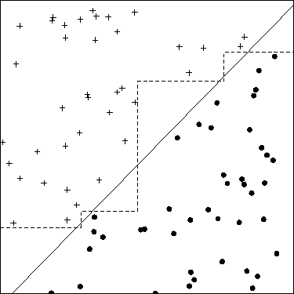
Another picture…

Slide 15
Fixing decision trees….
Hard to prove things about
Don’t (typically) improve over linear classifiers when you have lots of features
Sometimes fail badly on problems that linear classifiers perform well on
Solution is two build ensembles of decision trees

Slide 16
Most decision tree learning algorithms
“Pruning” a tree
avoid overfitting by removing subtrees somehow
trade variance for bias
15
13
Alternative - build a big ensemble to reduce the variance of the algorithms - via boosting, bagging, or random forests

Slide 17
Example: random forests
Repeat T times:
Draw a bootstrap sample S (n examples taken with replacement) from the dataset D.
Select a subset of features to use for S
Usually half to 1/3 of the full feature set
Build a tree considering only the features in the selected subset
Don’t prune
Vote the classifications of all the trees at the end
Ok - how well does this work?

Slide 18
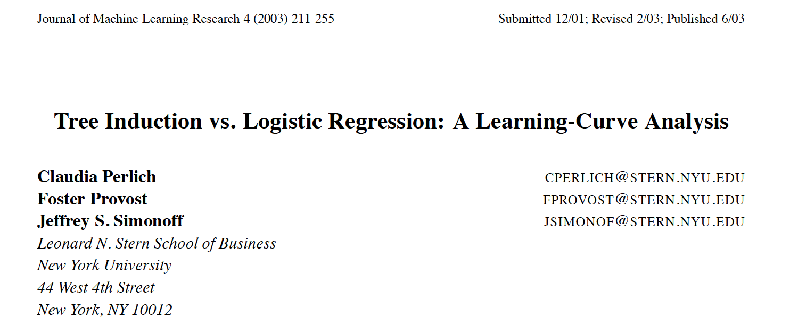

Slide 19
Scaling up decision tree algorithms
Given dataset D:
return leaf(y) if all examples are in the same class y
pick the best split, on the best attribute a
a<θ or a ≥ θ
a or not(a)
a=c₁ or a=c₂ or …
a in {c₁,…,c_{k}} or not
split the data into D₁ ,D₂ , … D_{k} and recursively build trees for each subset
“Prune” the tree

Slide 20
Scaling up decision tree algorithms
Given dataset D:
return leaf(y) if all examples are in the same class y
pick the best split, on the best attribute a
a<θ or a ≥ θ
a or not(a)
a=c₁ or a=c₂ or …
a in {c₁,…,c_{k}} or not
split the data into D₁ ,D₂ , … D_{k} and recursively build trees for each subset
“Prune” the tree
easy cases!

Slide 21
Scaling up decision tree algorithms
Given dataset D:
return leaf(y) if all examples are in the same class y
pick the best split, on the best attribute a
a<θ or a ≥ θ
a or not(a)
a=c₁ or a=c₂ or …
a in {c₁,…,c_{k}} or not
split the data into D₁ ,D₂ , … D_{k} and recursively build trees for each subset
“Prune” the tree
Numeric attribute:
sort examples by a
retain label y
scan thru once and update the histogram of y|a<θ and y|a>θ at each point θ
pick the threshold θ with the best entropy score
O(nlogn) due to the sort
but repeated for each attribute

Slide 22
Scaling up decision tree algorithms
Given dataset D:
return leaf(y) if all examples are in the same class y
pick the best split, on the best attribute a
a<θ or a ≥ θ
a or not(a)
a=c₁ or a=c₂ or …
a in {c₁,…,c_{k}} or not
split the data into D₁ ,D₂ , … D_{k} and recursively build trees for each subset
“Prune” the tree
Numeric attribute:
or, fix a set of possible split-points θ in advance
scan through once and compute the histogram of y’s
O(n) per attribute

Slide 23
Scaling up decision tree algorithms
Given dataset D:
return leaf(y) if all examples are in the same class y
pick the best split, on the best attribute a
a<θ or a ≥ θ
a or not(a)
a=c₁ or a=c₂ or …
a in {c₁,…,c_{k}} or not
split the data into D₁ ,D₂ , … D_{k} and recursively build trees for each subset
“Prune” the tree
Subset splits:
expensive but useful
there is a similar sorting trick that works for the regression case

Slide 24
Scaling up decision tree algorithms
Given dataset D:
return leaf(y) if all examples are in the same class y
pick the best split, on the best attribute a
a<θ or a ≥ θ
a or not(a)
a=c₁ or a=c₂ or …
a in {c₁,…,c_{k}} or not
split the data into D₁ ,D₂ , … D_{k} and recursively build trees for each subset
“Prune” the tree
Points to ponder:
different subtrees are distinct tasks
once the data is in memory, this algorithm is fast.
each example appears only once in each level of the tree
depth of the tree is usually O(log n)
as you move down the tree, the datasets get smaller

Slide 25
Scaling up decision tree algorithms
Given dataset D:
return leaf(y) if all examples are in the same class y
pick the best split, on the best attribute a
a<θ or a ≥ θ
a or not(a)
a=c₁ or a=c₂ or …
a in {c₁,…,c_{k}} or not
split the data into D₁ ,D₂ , … D_{k} and recursively build trees for each subset
“Prune” the tree
Bottleneck points:
what’s expensive is picking the attributes
especially at the top levels
also, moving the data around
in a distributed setting

Slide 27
Key ideas
A controller to generate Map-Reduce jobs
distribute the task of building subtrees of the main decision trees
handle “small” and “large” tasks differently
small:
build tree in-memory
large:
build the tree (mostly) depth-first
send the whole dataset to all mappers and let them classify instances to nodes on-the-fly

Slide 28
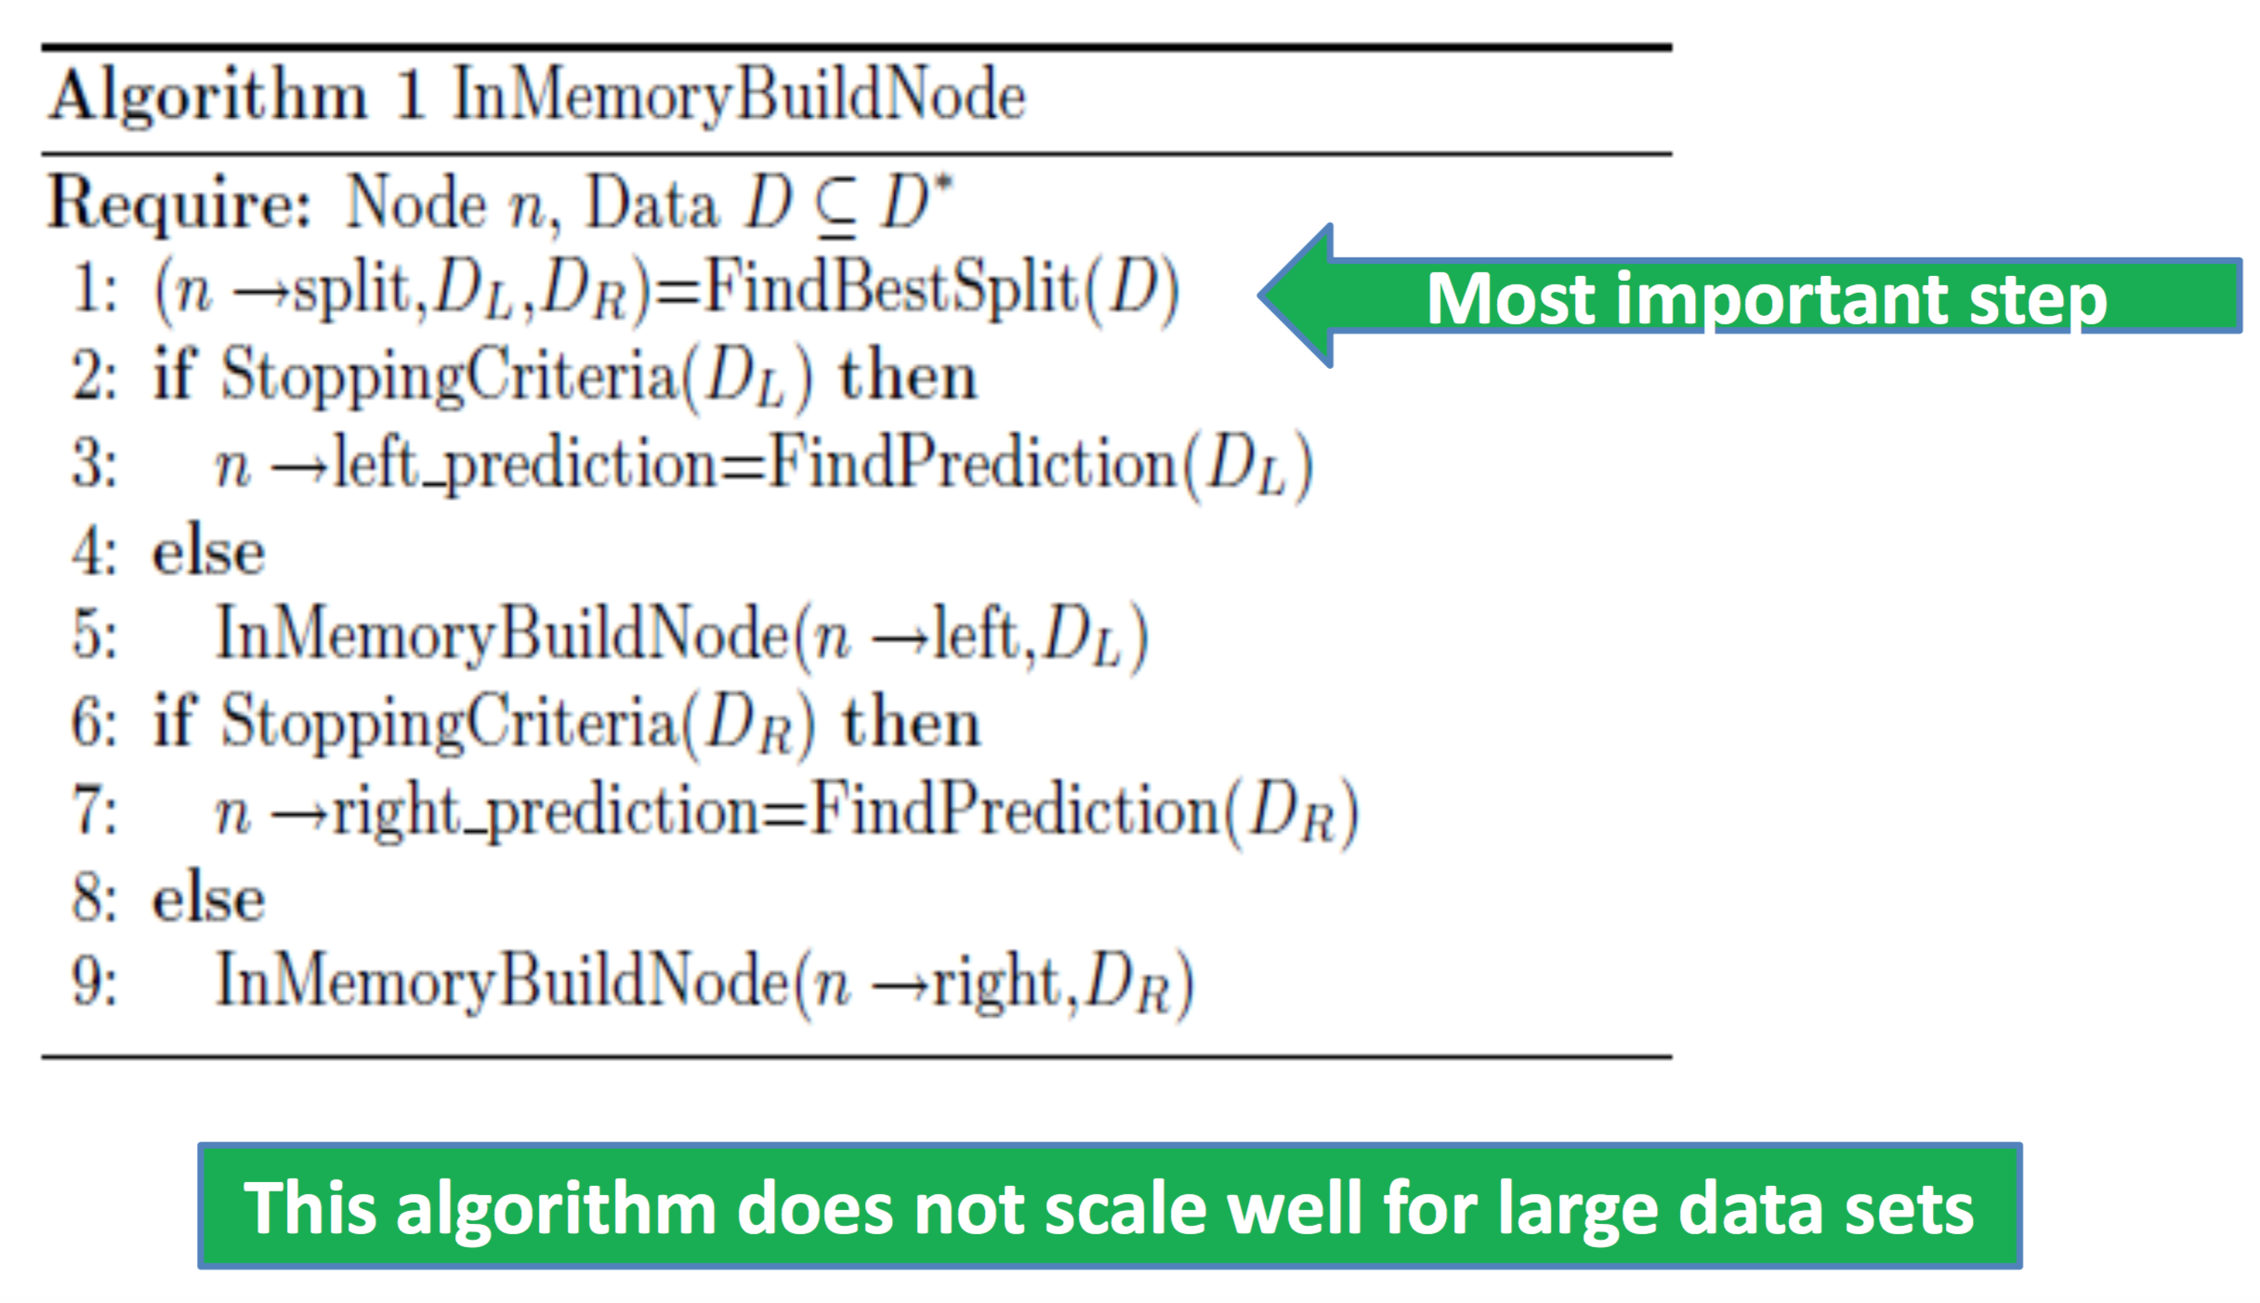
Greedy top-down tree assembly

Slide 29
FindBestSplit
Continuous attributes
Treating a point as a boundary (e.g., <5.0 or >=5.0)
Categorical attributes
Membership in a set of values (e.g., is the attribute value one of {Ford, Toyota, Volvo}?)

Slide 30
FindBestSplit(D)
Let Var(D) be the variance of the output attribute Y measured over all records in D (D refers to the records that are input to a given node). At each step the tree learning algorithm picks a split which maximizes
Var(D) is the variance of the output attribute Y measured over all records in D
DL and DR are the training records in the left and right subtree after splitting D by a predicate

Slide 31
StoppingCriteria(D)
A node in the tree is not expanded if the number of records in D falls below a threshold

Slide 32
FindPrediction(D)
The prediction at a leaf is simply the average of all the Y values in D

Slide 33
What about large data sets?
Full scan over the input data is slow (required by FindBestSplit)
Large inputs that do not fit in memory (cost of scanning data from a secondary storage)
Finding the best split on high dimensional data sets is slow (2^{M} possible splits for categorical attribute with M categories)

Slide 34
PLANET
Controller
Monitors and controls everything
MapReduce initialization task
Identifies all feature values that need to be considered for splits
MapReduce FindBestSplit task (the main part)
MapReduce job to find best split when there’s too much data to fit in memory (builds different parts of the tree)
MapReduce inMemoryGrow task
Task to grow an entire subtree once the data for it fits in memory (in memory MapReduce job)
ModelFile
A file describing the state of the model

Slide 35
PLANET – Controller
Controls the entire process
Periodically checkpoints system
Determine the state of the tree and grows it
Decides if nodes should be split
If there’s relatively little data entering a node, launch an InMemory MapReduce job to grow the entire subtree
For larger nodes, launches MapReduce to find candidates for best split
Collects results from MapReduce jobs and chooses the best split for a node
Updates model

Slide 36
PLANET – Model File
The controller constructs a tree using a set of MapReduce jobs that are working on different parts of the tree. At any point, the model file contains the entire tree constructed so far
The controller checks with the model file the nodes at which split predicates can be computed next. For example, if the model has nodes A and B, then the controller can compute splits for C and D.

Slide 37
Two node queues
MapReduceQueue (MRQ) – Contains nodes for which D is too large to fit in memory
InMemoryQueue(InMemQ) – Contains nodes for which D fits in memory

Slide 38
Two MapReduce jobs
MR_ExpandNodes
Process nodes from the MRQ. For a given set of nodes N, computes a candidate of good split predicate for each node in N.
MR_InMemory
Process nodes from the InMemQ. For a given set of nodes N, completes tree induction at nodes in N using the InMemoryBuildNode algorithm.

Slide 39
Walkthrough

Slide 40
Walkthrough
Initially: M, MRQ, and InMemQ are empty.
Controller can only expand the root
Finding the split for the root requires the entire training set D* of 100 records (does not fit in memory)
A is pushed onto MRQ; InMemQ stays empty.

Slide 41
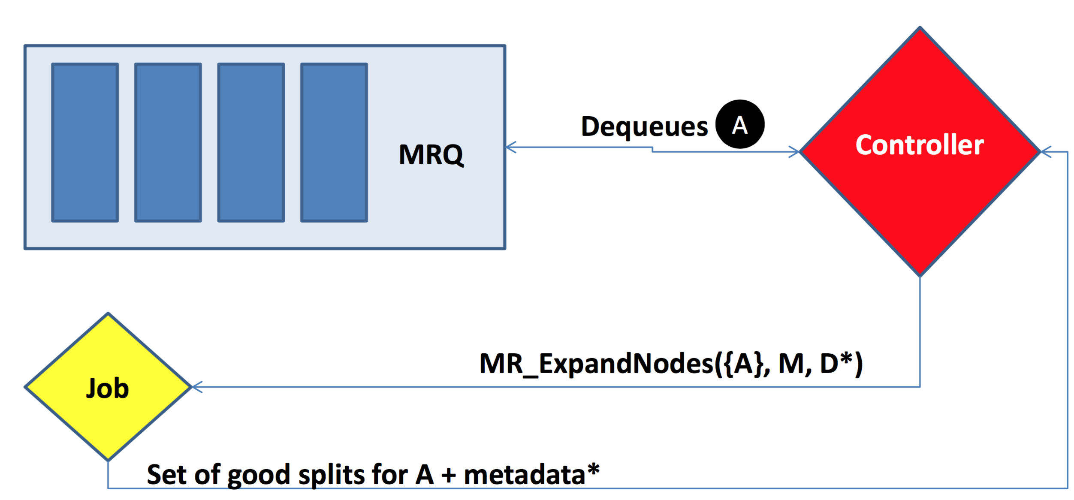
Walkthrough
Quality of the split
Predictions in L and R branches
Number of training records in L and R branches

Slide 42
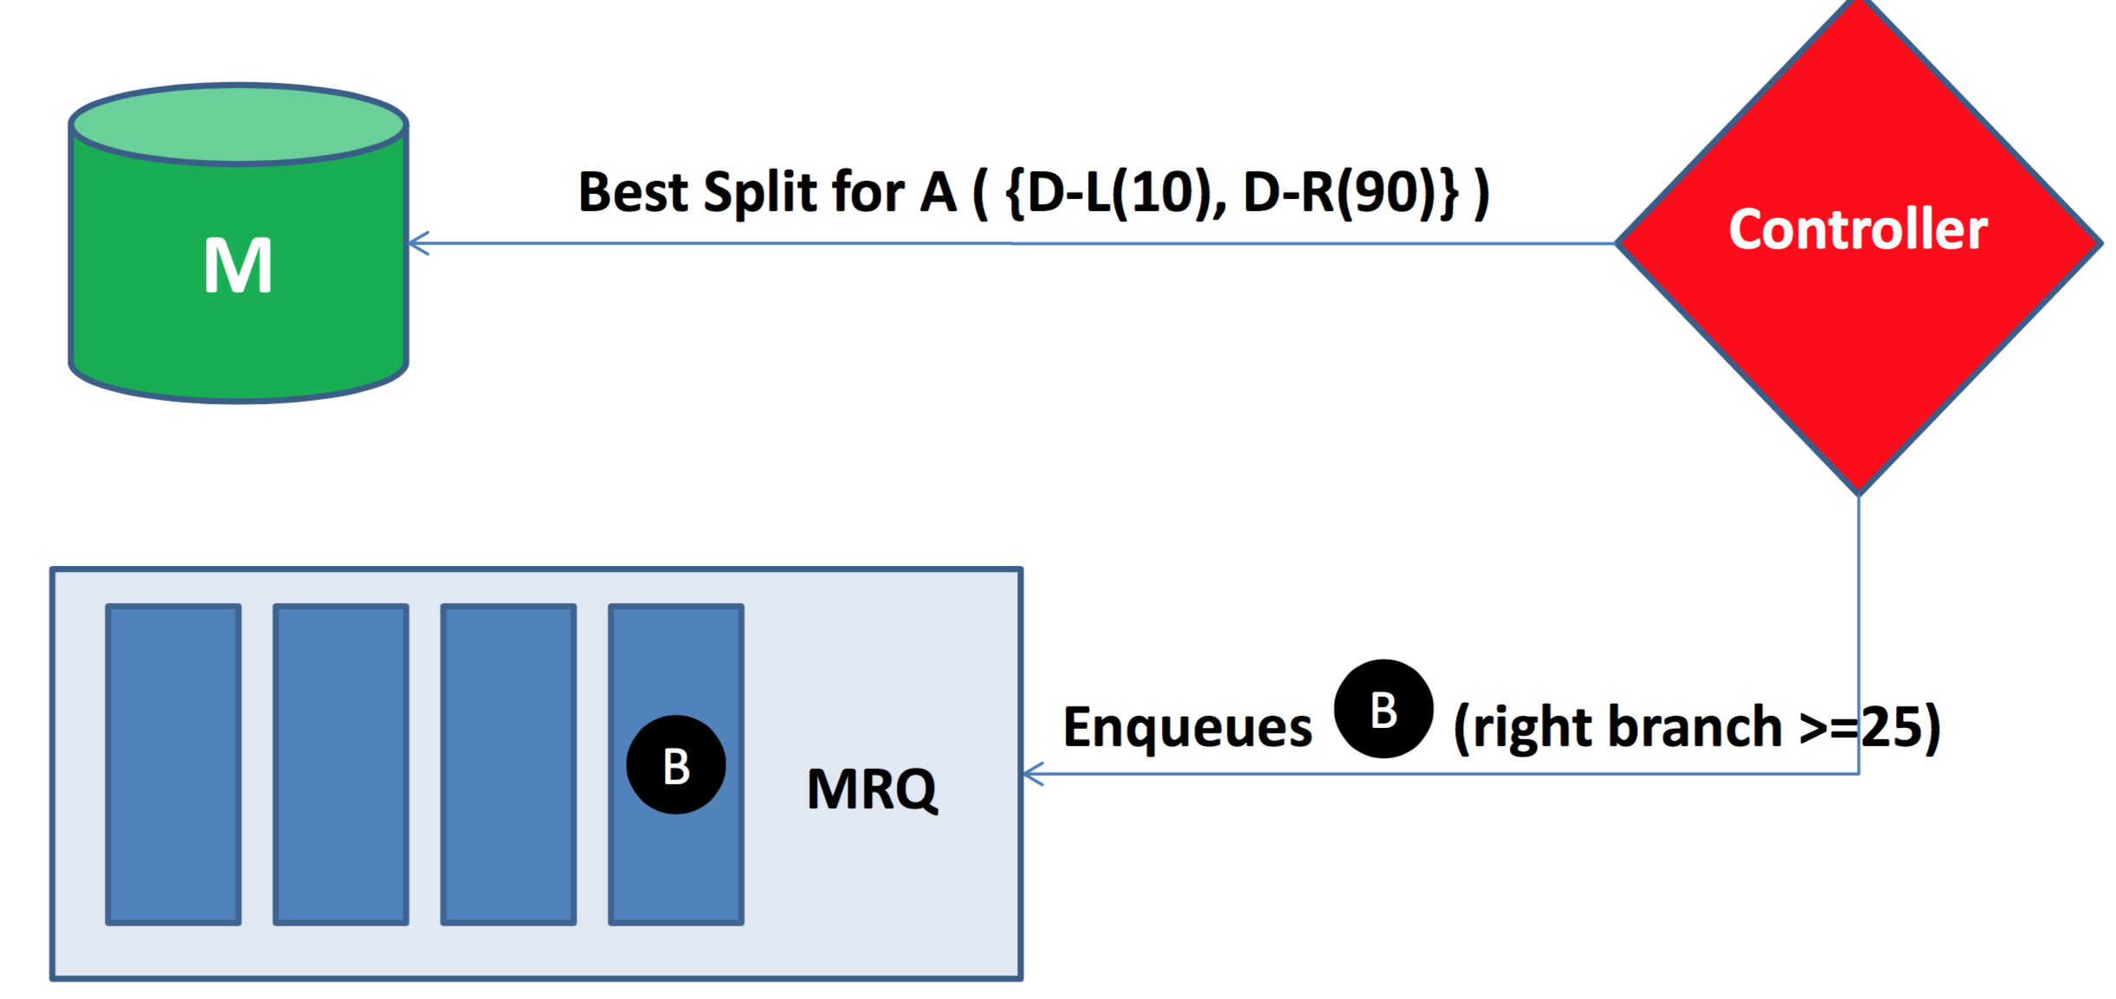
Walkthrough
Controller selects the best split
Do any branches match stopping criteria? If so, don’t add any new nodes

Slide 43
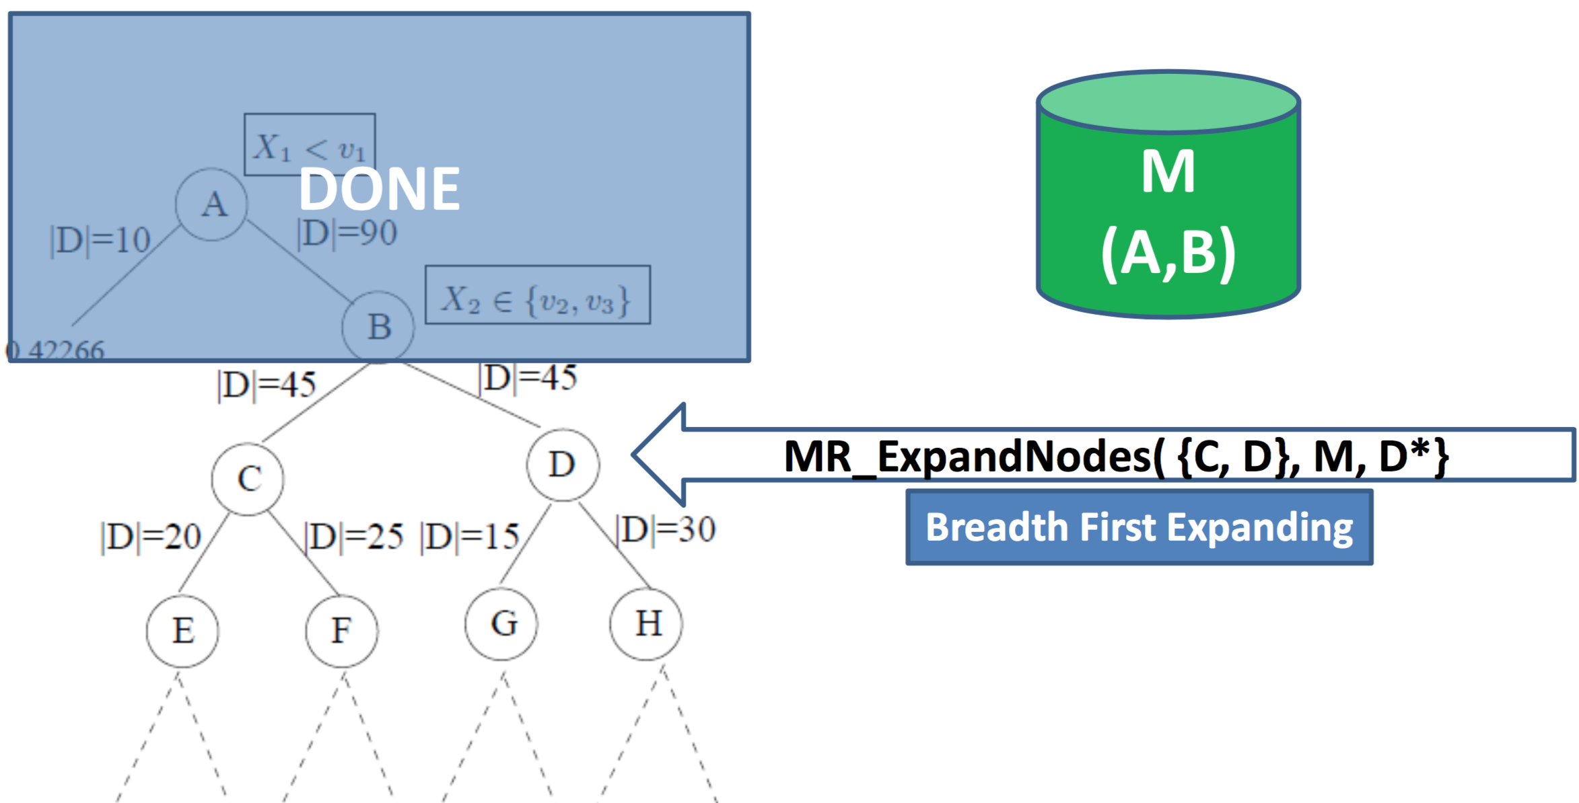
Walkthrough
Expand C and D
The controller schedules a single MR_ExpandNodes for C and D that is done in a single step
PLANET expands trees breadth first as opposed to the depth first process used by the inMemory algorithm.

Slide 44
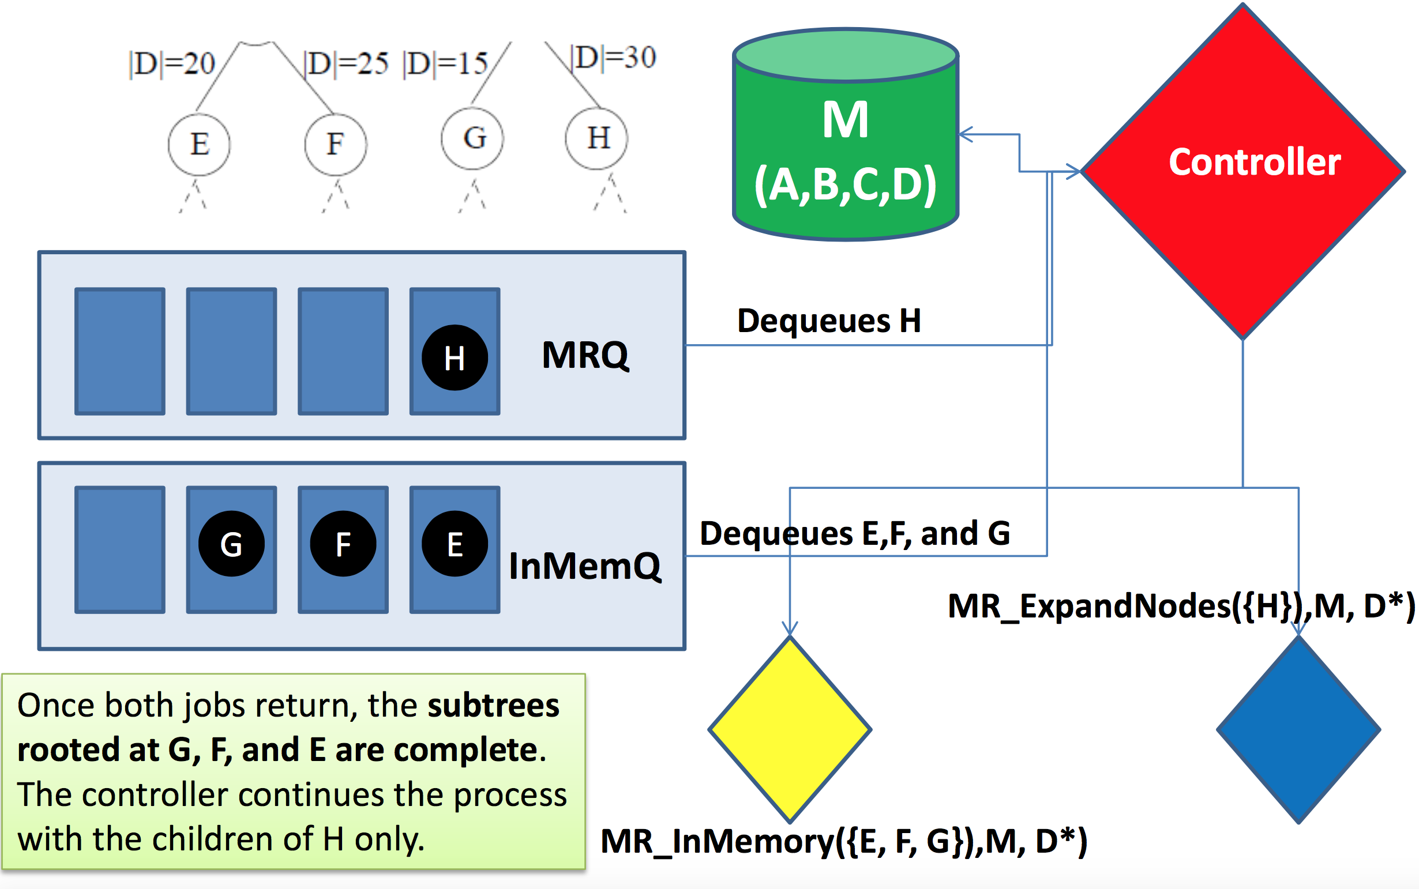
Walkthrough
Scheduling jobs simultaneously

Slide 45
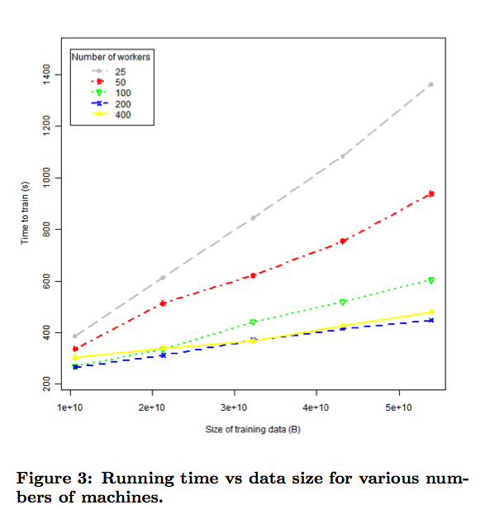

Slide 46
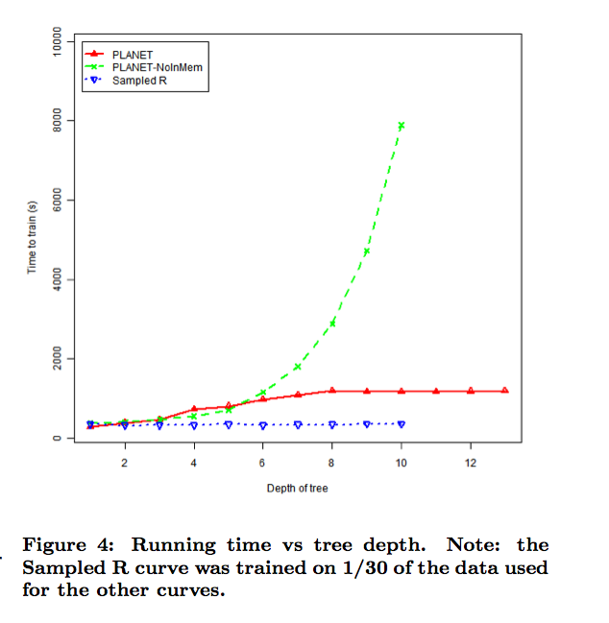

Slide 47
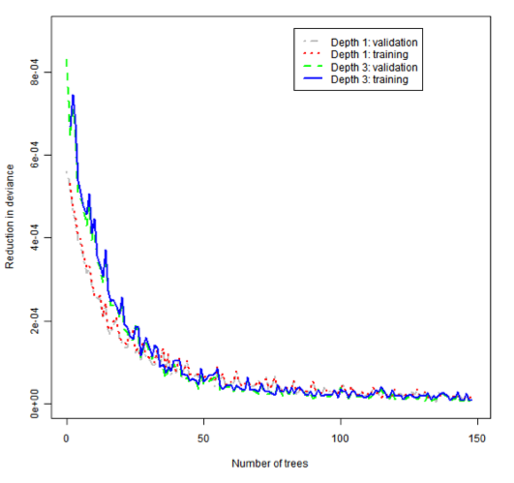

Slide 48
Questions

Slide 49
What’s left?

Slide 50
Tomorrow
Alternative distributed frameworks
Hadoop
Spark
??? [tune in to find out!]

Slide 51
Next week
Project presentations!
25-30 minute talk
5-10 minutes of questions
Tuesday, April 21
Joey Ruberti and Michael Church
Zhaochong Liu
Wednesday, April 22
Bita Kazemi and Alekhya Chennupati
Thursday, April 23
Roi Ceren, Will Richardson, Muthukumaran Chandrasekaran
Ankita Joshi, Bahaa AlAila, Manish Ranjan

Slide 52
Finals week
NO FINAL
Final project write-up: Friday, May 1
NIPS format
https://nips.cc/Conferences/2015/PaperInformation/StyleFiles
6-10 pages (not including references)
Email or BitBucket

