Slide 1
CSCI 6900: Mining Massive Datasets
Shannon Quinn
(with content graciously and viciously borrowed from William Cohen’s 10-605
Machine Learning with Big Data and Stanford’s MMDS MOOC http://www.mmds.org/ )

Slide 2
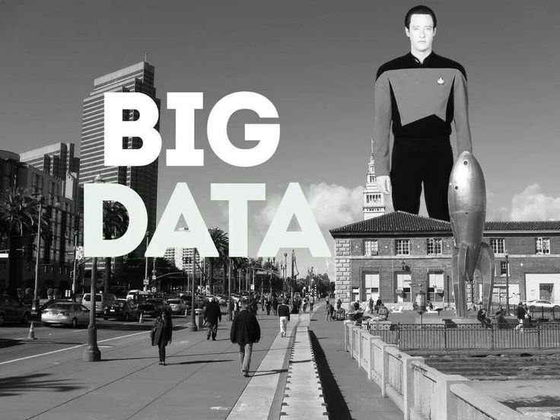
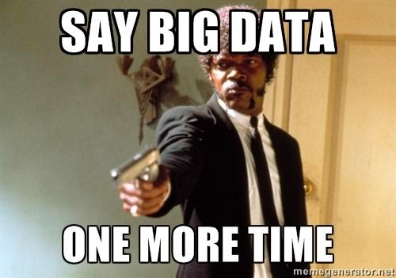
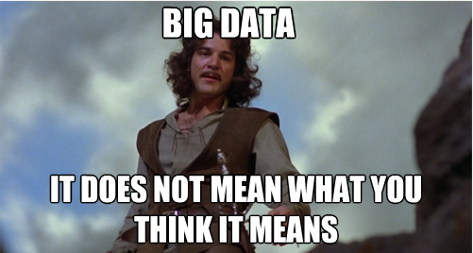
“Big Data”

Slide 3
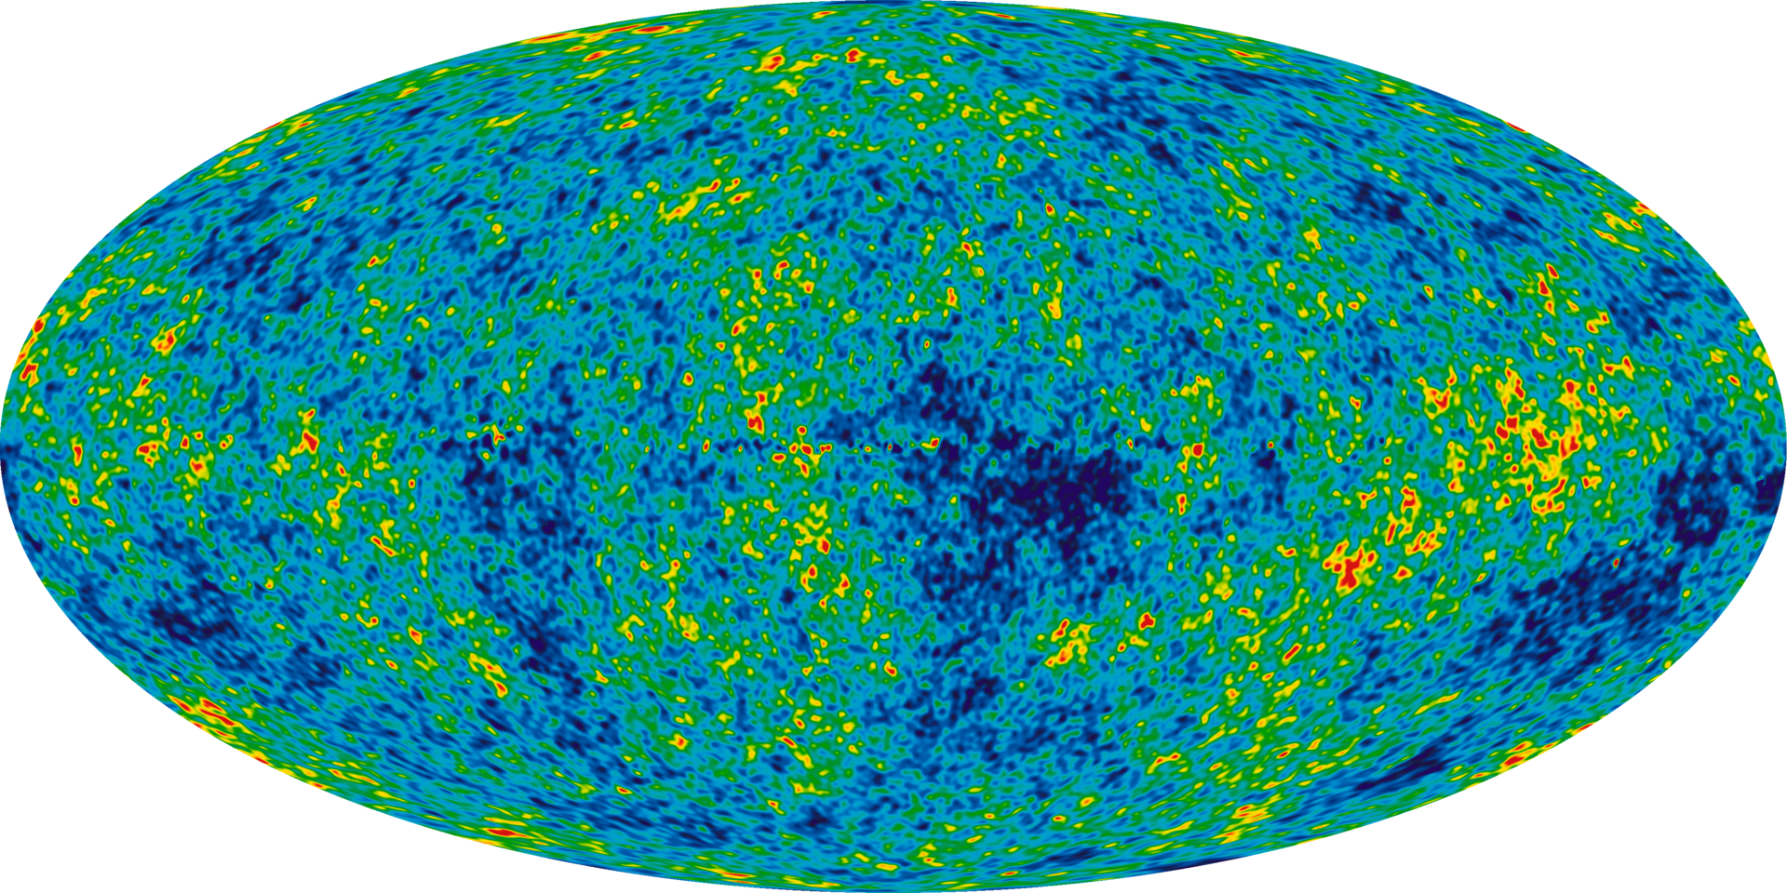
Astronomy
Sloan Digital Sky Survey
New Mexico, 2000
140TB over 10 years
Large Synoptic Survey Telescope
Chile, 2016
Will acquire 140TB every five days¹
1 http://www.economist.com/node/15557443

Slide 4
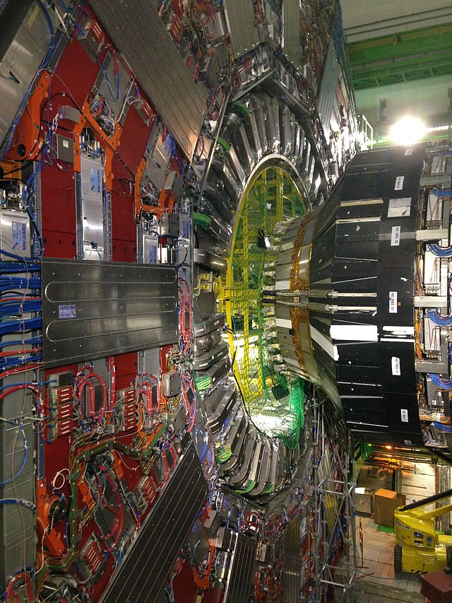
Particle Physics
Large Hadron Collider (LHC)
150 million sensors
40 million data points / second (before filtering)
100 collisions of interest (after filtering)¹
Even after rejecting 199,999 of every 200,000 collisions, generates 15PB of data per year^{1,2}
If all collisions were recorded, LHC would generate 500EB of data per day
~900EB transmitted over IP per year³
1 http://cds.cern.ch/record/1092437/files/CERN-Brochure-2008-001-Eng.pdf
2 http://www.nature.com/news/2011/110119/full/469282a.html
3 http://www.cisco.com/en/US/solutions/collateral/ns341/ns525/ns537/ns705/ns827/VNI_Hyperconnectivity_WP.html

Slide 5
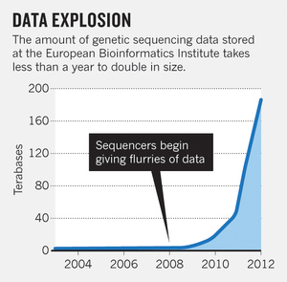
Biology
Nucleotide sequences from 120,000+ species in GenBank¹
European Bioinformatics Institute (EBI)
20PB of data (genomic data doubles in size each year)²
A single sequenced human genome can be around 140GB in size²
Heterogeneous data, spread out over many labs
1 http://www.nature.com/nature/journal/v455/n7209/full/455047a.html
2 http://www.nature.com/nature/journal/v498/n7453/full/498255a.html

Slide 6
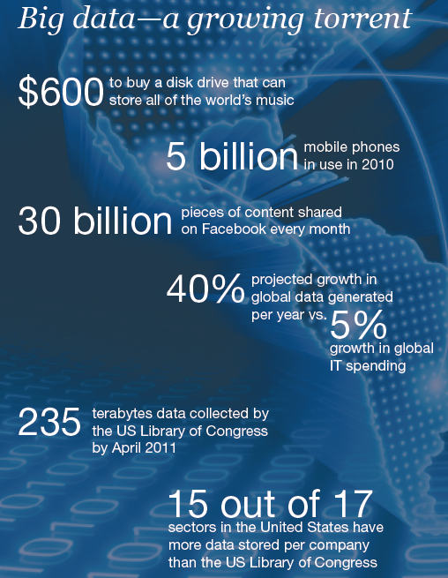

Slide 7
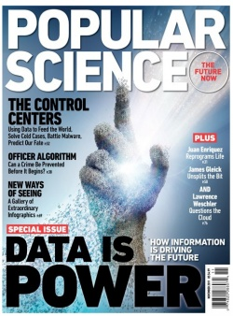
Data Mining
Knowledge discovery
“Big Data”
“Predictive Analysis”
“Data Science”

Slide 8
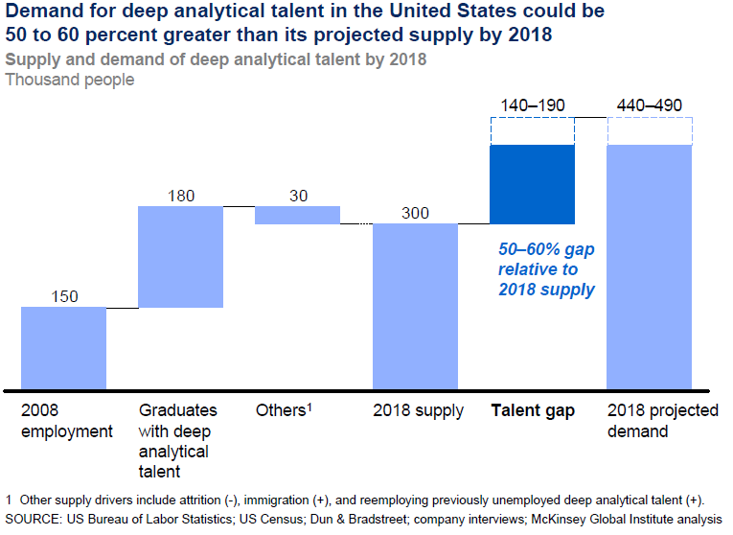
Data Scientists in demand

Slide 9
Why is large-scale data mining a thing?
Why not use the same algorithms on larger data?

Slide 10
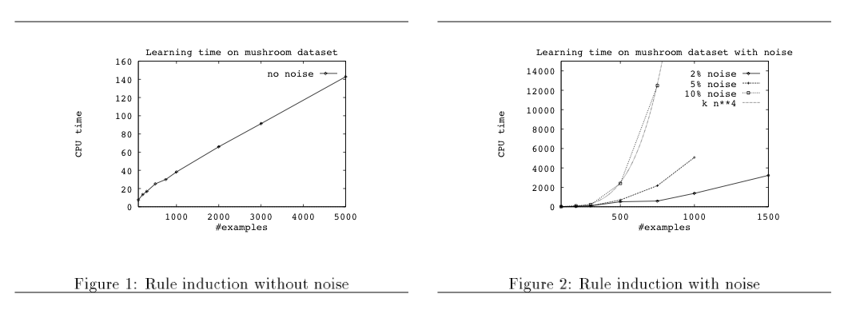
Big ML c. 1993 (Cohen, “Efficient…Rule Learning”, IJCAI 1993)

Slide 11
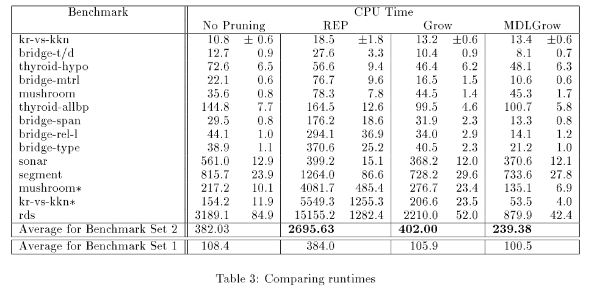

Slide 12
Related paper from 1995…

Slide 13
So in mid 1990’s…..
Experimental datasets were small
Many commonly used algorithms were asymptotically “slow”

Slide 14
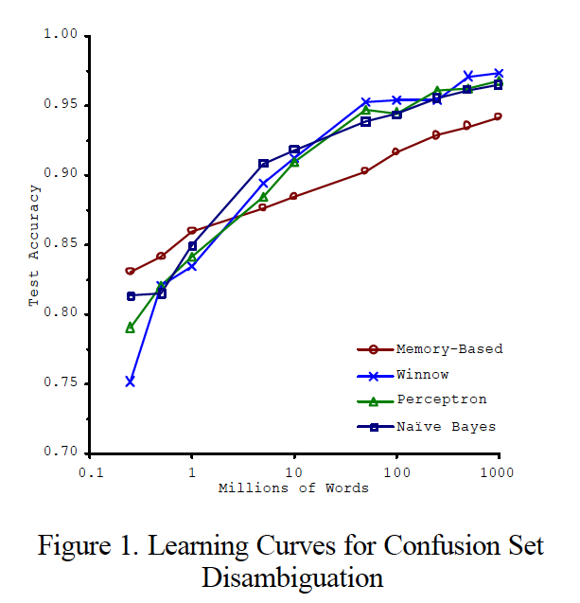
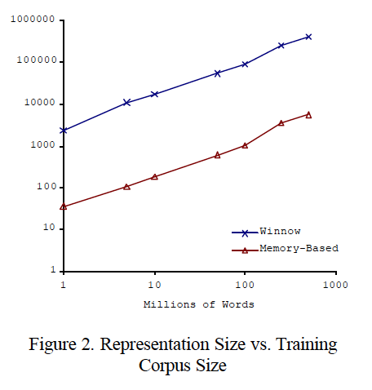
Big ML c. 2001 (Banko & Brill, “Scaling to Very Very Large…”, ACL 2001)
Task: distinguish pairs of easily-confused words (“affect” vs “effect”) in context

Slide 15
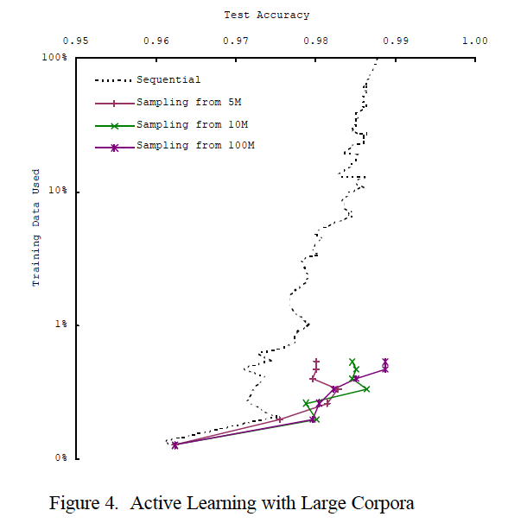
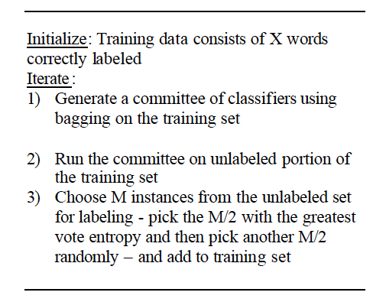
Big ML c. 2001 (Banko & Brill, “Scaling to Very Very Large…”, ACL 2001)

Slide 16
So in 2001…..
We’re learning:
“there’s no data like more data”
For many tasks, there’s no real substitute for using lots of data

Slide 17
…and in 2009
Eugene Wigner’s article “The Unreasonable Effectiveness of Mathematics in the Natural Sciences” examines why so much of physics can be neatly explained with simple mathematical formulas such as f = ma or e = mc². Meanwhile, sciences that involve human beings rather than elementary particles have proven more resistant to elegant mathematics. Economists suffer from physics envy over their inability to neatly model human behavior. An informal, incomplete grammar of the English language runs over 1,700 pages.
Perhaps when it comes to natural language processing and related fields, we’re doomed to complex theories that will never have the elegance of physics equations. But if that’s so, we should stop acting as if our goal is to author extremely elegant theories, and instead embrace complexity and make use of the best ally we have: the unreasonable effectiveness of data.
Norvig, Pereira, Halevy, “The Unreasonable Effectiveness of Data”, 2009

Slide 18
…and in 2012
Dec 2011

Slide 19
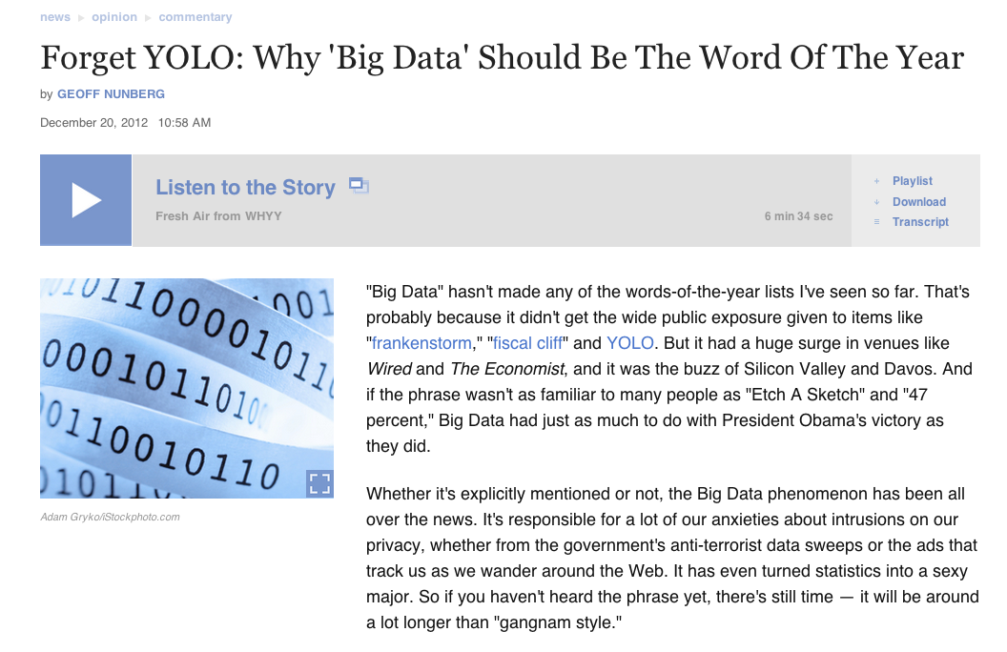
…and in 2013

Slide 20
How do we use very large amounts of data?
*
Working with big data is not about
code optimization
learning details of todays hardware/software:
GraphLab, Hadoop, parallel hardware, ….
Working with big data is about
Understanding the cost of what you want to do
Understanding what the tools that are available offer
Understanding how much can be accomplished with linear or nearly-linear operations (e.g., sorting, …)
Understanding how to organize your computations so that they effectively use whatever’s fast
Understanding how to test/debug/verify with large data
* according to William Cohen / Shannon Quinn

Slide 21
Asymptotic Analysis: Basic Principles
Usually we only care about positive f(n), g(n), n here…

Slide 22
Asymptotic Analysis: Basic Principles
Less pedantically:
Some useful rules:
Only highest-order terms matter
Leading constants don’t matter
Degree of something in a log doesn’t matter

Slide 23
Empirical analysis of complexity: plot run-time on a log-log plot and measure the slope (using linear regression)

Slide 24
Where do asymptotics break down?
When the constants are too big
or n is too small
When we can’t predict what the program will do
Eg, how many iterations before convergence? Does it depend on data size or not?
When there are different types of operations with different costs
We need to understand what we should count

Slide 25
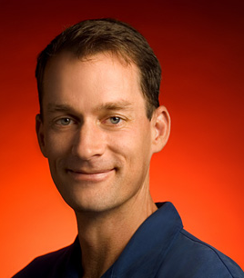
What do we count?
Compilers don’t warn Jeff Dean. Jeff Dean warns compilers.
Jeff Dean builds his code before committing it, but only to check for compiler and linker bugs.
Jeff Dean writes directly in binary. He then writes the source code as a documentation for other developers.
Jeff Dean once shifted a bit so hard, it ended up on another computer.
When Jeff Dean has an ergonomic evaluation, it is for the protection of his keyboard.
gcc -O4 emails your code to Jeff Dean for a rewrite.
When he heard that Jeff Dean's autobiography would be exclusive to the platform, Richard Stallman bought a Kindle.
Jeff Dean puts his pants on one leg at a time, but if he had more legs, you’d realize the algorithm is actually only O(logn)

Slide 26
Numbers (Jeff Dean says) Everyone Should Know

Slide 27
A typical CPU (not to scale)
K8 core in the AMD Athlon 64 CPU
Hard disk (1Tb)
128x bigger
16x bigger
256x bigger
Notes:
16 – me vs chihuhua – or vs midsize car
256 – me vs 2 iphones – or vs a sperm whale or 3 elephants

Slide 28
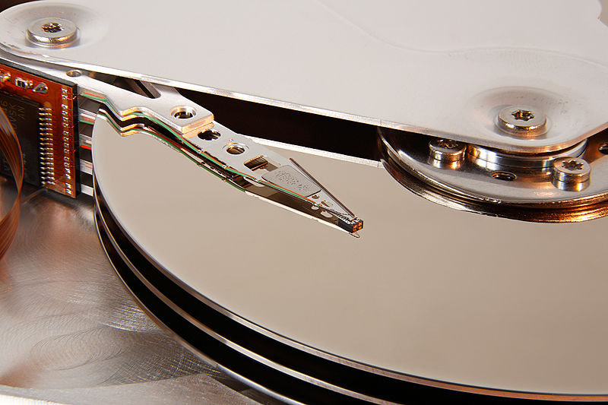
A typical disk
Notes:
16 – me vs chihuhua – or vs midsize car
256 – me vs 2 iphones – or vs a sperm whale or 3 elephants

Slide 29
Numbers (Jeff Dean says) Everyone Should Know
~= 10x
~= 15x
40x
~= 100,000x
Notes:
150x – commercial flight vs a brisk walk
100,000x – 5 hr flights would take 57 years
100,000x – 500 miles vs about 8 meters
15,000,000x – here to beijing vs 100 meters

Slide 30
What do we count?
Compilers don’t warn Jeff Dean. Jeff Dean warns compilers.
….
Memory access/instructions are qualitatively different from disk access
Seeks are qualitatively different from sequential reads on disk
Cache, disk fetches, etc work best when you stream through data sequentially
Best case for data processing: stream through the data once in sequential order, as it’s found on disk.

Slide 31
Other lessons -?
*
* but not important enough for this class’s assignments….

Slide 32
What this course *is*
Overview of the current “field” of data science and current frameworks
First-hand experience with developing algorithms for large datasets
Hadoop, Spark
Deployment on Amazon EC2
Emphasis on software engineering principles

Slide 33
What this course is *not*
Introduction to programming
*Must* know Java
Introduction to statistics and linear algebra
Self-evaluation on course website
I will help with git and BitBucket
I will help with Hadoop and Spark
I will help with stats and linear algebra

Slide 34
Administrivia
Office Hours: [TBD]
Mailing list: csci6900-s15@listserv.cc.uga.edu
Course website: http://cobweb.cs.uga.edu/~squinn/mmd_s15/
Shannon Quinn (that’s me)
2008: Graduated from Georgia Tech [go Jackets!] in Computer Science (B.S.)
2010: Graduated from Carnegie Mellon in Computational Biology (M.S.)
2014: Graduated from University of Pittsburgh in Computational Biology (Ph.D.)
Worked at IBM, Google

Slide 35
Administrivia
Programming Language:
Java and Hadoop
Scala / Python / Java and Spark
Most assignments will not use anything else
Resources:
Your desktop/laptop
GSRC Hadoop virtual cluster
Getting this set up now…stay tuned
Amazon Elastic Cloud
Amazon EC2 [http://aws.amazon.com/ec2/]
Allocation: $100 worth of time per student

Slide 36
Grading breakdown
40% assignments
Triweekly programming assignments
Not a lot of lines of code, but it will take you time to get them right
There are 4 possible assignments, you only need to do 3
35% project
5-week project at end of course
I strongly encourage groups of 2
25% midterm
10% student research presentations

Slide 37
Coding
All assignments will be committed to our team page on BitBucket
https://bitbucket.org/csci6900-s15/
Concurrent versioning system: git
I want to see progress!
First two assignments: Java and Hadoop
Second two assignments: Spark
Spark has Python, Scala, and Java handles

Slide 38
Midterm
Come to lecture
(that’s not the midterm, but if you come to lecture, the midterm will be easy)

Slide 39
Student research presentations
Each student presents once over the course of the semester
Basic idea:
Pick a paper from the “big data” literature
Prepare a 30-40 minute presentation
Lead a 20-30 minute discussion
???
Profit!

Slide 40
Project
More later
We will add a page with pointers to datasets and ideas for projects
Lots about scalable ML is still not well-understood so there’s lots of opportunities for a meaningful study

Slide 41
To-do lists
YOU!
Me
Install git
Create an account on BitBucket
Email me your account name so I can add you to the BitBucket team
Check out the “Administration” repository on BitBucket, and edit the STUDENT_LECTURES.md file to sign up for a presentation slot
Check the “MAILING_LIST.md” file to ensure your information is correct
Post suggested papers for student presentations on website
Post updated syllabus on website

Slide 42
Questions?

