Slide 1
Other Distributed Frameworks
Shannon Quinn

Slide 2
Distinction
General Compute Engines
Hadoop
User-facing APIs
Cascading
Scalding

Slide 3
Alternative Frameworks
Apache Mahout
Apache Giraph
GraphLab
Apache Storm
Apache Tez
Apache Flink
Notes:
Microsoft Dryad—discontinued in 2011, as MS switched to Hadoop.

Slide 4
Alternative Frameworks
Apache Mahout
Apache Giraph
GraphLab
Apache Storm
Apache Tez
Apache Flink

Slide 5
Apache Mahout
A Tale of Two Frameworks
Distributed machine learning on Hadoop
0.1 to 0.9
“Samsara”
New in 0.10+

Slide 6
Machine learning on Hadoop
Born out of the Apache Lucene project
Built on Hadoop (all in Java)
Pragmatic machine learning at scale

Slide 7
1: Recommendation
Notes:
The first area, and perhaps the most well-known (within the open source community) aspect of Mahout is its recommendation engine. Like the Twitter social network example, this involves analyzing user preferences and item similarity to provide recommendations to users on items that the user has not explicitly interacted with. You’ve seen many examples of this all over the web: potential twitter and facebook friends, amazon book recommendations, netflix suggestions, and youtube related videos, just to name a few.

Slide 8
2: Classification
Notes:
The second area, and one which folks with machine learning experience may recognize more readily, is that of classification. This pertains to training models based on labeled data, and then running the model on new data coming into the system for which you need to assign a specific, discrete category. For example, spam filters are models of classification: for every new email that comes in, they need to be able to determine if the email is spam or not spam, or “classify” it as one or the other. Gmail, for instance, trains its own classification model on the billions of spam messages that sit in its servers so it can recognize the properties of a new, unobserved spam message when it arrives. Mahout implements several different classification algorithms depending on your data and specific circumstances, but Mahout would be ideal for a situation like Gmail which sees literally billions of messages every single day and needs to be able to make very accurate decisions based on a huge amount of information.

Slide 9
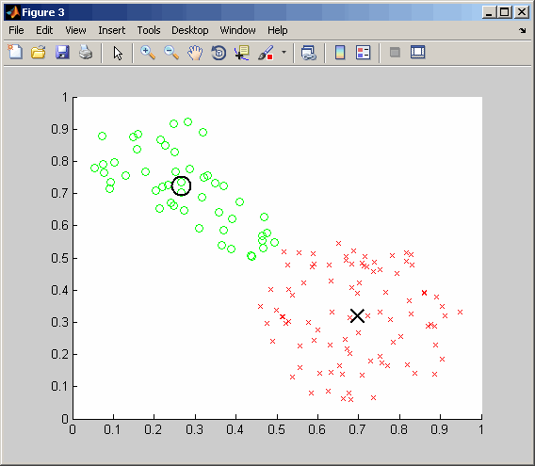
3: Clustering
Notes:
The third and final category of focus of Mahout is that of clustering. Like classification, clustering aims to categorize data, but the difference here is that there is no training step involving labeled data. That is, we could not use clustering for spam filtering, as clustering inherently says “we do not know what categories exist in the data, or even how many distinct categories there are in the data”. For this reason, clustering is often called “unsupervised machine learning”, since there is no a priori knowledge of data categories (contrasted with classification, or “supervised machine learning”, in which the training of the model relies on labeled data from the user). A possible application could be analyzing flickr images and grouping all those together with similar properties; you would probably expect to see pictures of people grouped together, as well as pictures of animals, and pictures of beaches, and so on.

Slide 10
Other MapReduce algorithms
Dimensionality reduction
Lanczos
SSVD
LDA
Regression
Logistic
Linear
Random Forest
Evolutionary algorithms
Notes:
Apart from the three big categories, Mahout has other algorithms that are extremely useful on their own and complement algorithms within the primary three categories very well. Dimensionality reduction, such as singular value decomposition, provides a robust way of trying to lessen the effects of the “curse of dimensionality”, or the case seen all too often in machine learning where the dimensionality of the data far exceeds the amount of data we have at our disposal for analysis. Dimensionality reduction typically involves projecting the data from its original, high-dimensional space into a lower-dimensional subspace that still maintains the majority of the data’s information, making analysis methods more effective while maintaining as much of the data’s original meaning as possible.
We saw previously with classification that we sought to map a new instance of data to a discrete category, or label. With regression, we are instead mapping a new instance of data to some continuous, numeric value. Logistic regression, to those familiar with machine learning, is a form of classification that uses regression—mapping input instances to real values—and then uses a threshold on the real values to assign the data instances to a discrete category.
Finally, evolutionary or genetic algorithms exist in Mahout as well. These typically involve simulating some sort of stochastic system for a large amount of time, like a random walk, to observe the properties of the system and provide insight as to the topology of the system involved. The classic computer science problem of the Traveling Salesman falls under this category, and Mahout provides a working example of this problem within its genetic algorithm implementation.

Slide 11
Mahout-Samsara
Programming “environment” for distributed machine learning
R-like syntax
Interactive shell (like Spark)
Under-the-hood algebraic optimizer
Engine-agnostic
Spark
H2O
Flink
?

Slide 12
Mahout-Samsara
Notes:
Formula for distributed sparse PCA.
The main idea is that a scientist writing algebraic expressions cannot care less of distributed operation plans and works entirely on the logical level just like he or she would do with R.
Another idea is decoupling logical expression from distributed back-end. As more back-ends are added, this implies "write once, run everywhere".
The linear algebra side works with scalars, in-core vectors and matrices, and Mahout Distributed Row Matrices (DRMs).
The ecosystem of operators is built in the R's image, i.e. it follows R naming such as %*%, colSums, nrow, length operating over vectors or matices.
Important part of Spark Bindings is expression optimizer. It looks at expression as a whole and figures out how it can be simplified, and which physical operators should be picked. For example, there are currently about 5 different physical operators performing DRM-DRM multiplication picked based on matrix geometry, distributed dataset partitioning, orientation etc. If we count in DRM by in-core combinations, that would be another 4, i.e. 9 total -- all of it for just simple x %*% y logical notation.

Slide 13
Mahout
3 main components
Engine-agnostic environment for building scalable ML algorithms
(Samsara)
Engine-specific algorithms (Spark, H2O)
Legacy MapReduce algorithms

Slide 14
Mahout
v0.10.0 released April 11 (as in, 5 days ago!)
0.10.1
More base linear algebra functionality
0.11.0
Compatible with Spark 1.3
1.0
?

Slide 15
Mahout features by engine

Slide 16
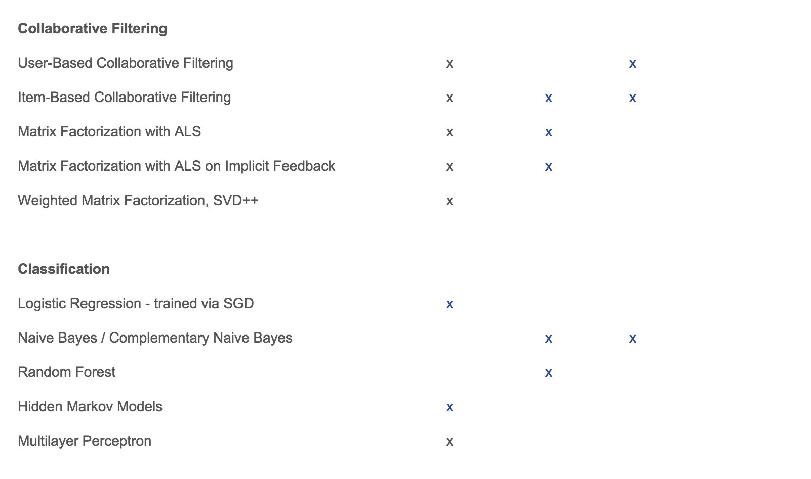
Mahout features by engine

Slide 17
Mahout features by engine
No engine-agnostic clustering algorithms yet
Still the domain of legacy MapReduce
H2O and especially Flink still highly experimental

Slide 18
Alternative Frameworks
Apache Mahout
Apache Giraph
GraphLab
Apache Storm
Apache Tez
Apache Flink

Slide 19
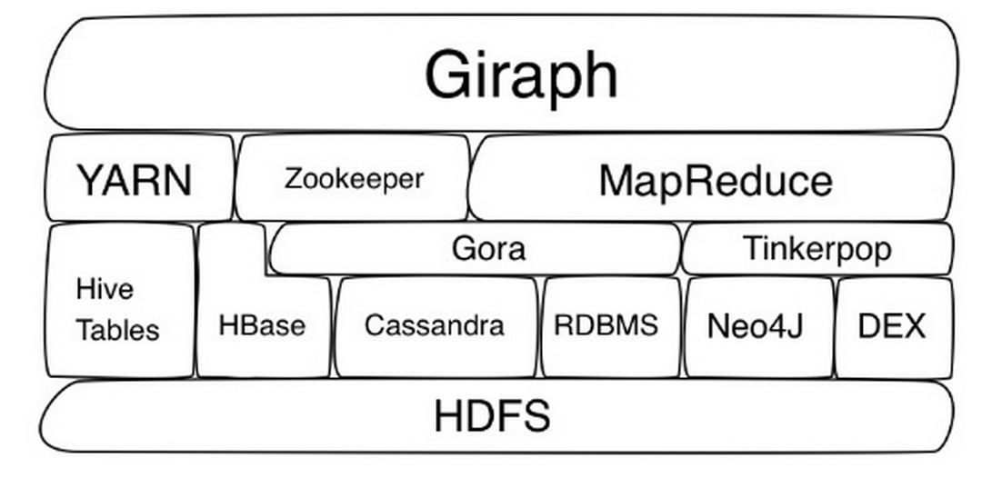
Apache Giraph
Vertex-centric alternative to Hadoop
Runs on Hadoop

Slide 20
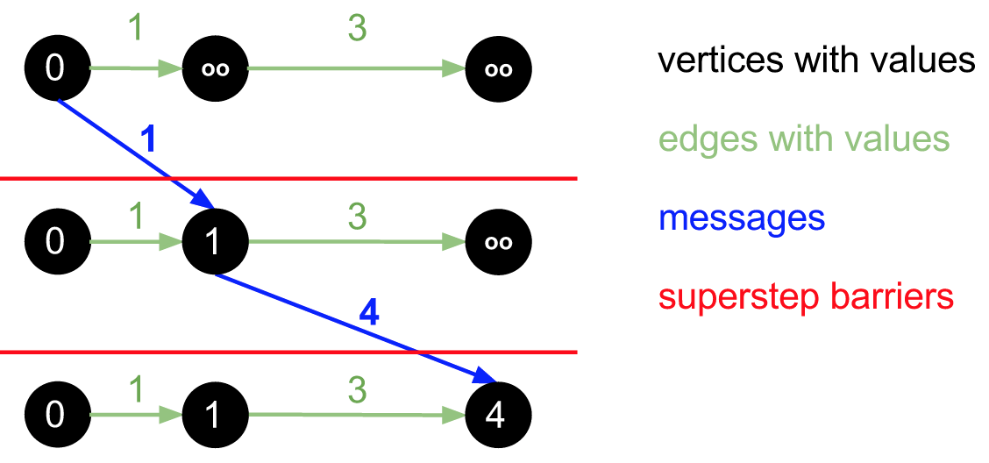
Giraph
“…an iterative graph processing system built for high scalability.”
Bulk-synchronous Parallel (BSP) model of distributed computation
Notes:
Shortest path algorithm, where vertices denote individuals and edges denote number of hops to get to the individual.

Slide 21
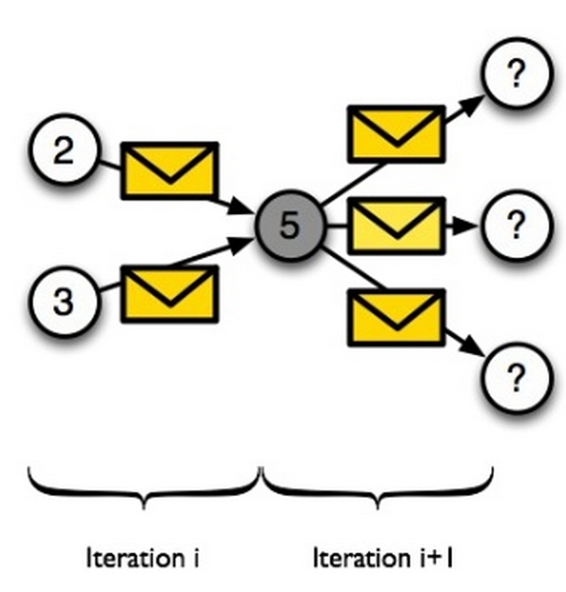
Bulk-synchronous Parallel
Vertex-centric model

Slide 22
Giraph terminology
Superstep
Sequence of iterations
Each “active” vertex invokes a compute() method
receives messages sent to the vertex in the previous superstep,
computes using the messages, and the vertex and outgoing edge values, which may result in modifications to the values, and
may send messages to other vertices.

Slide 23
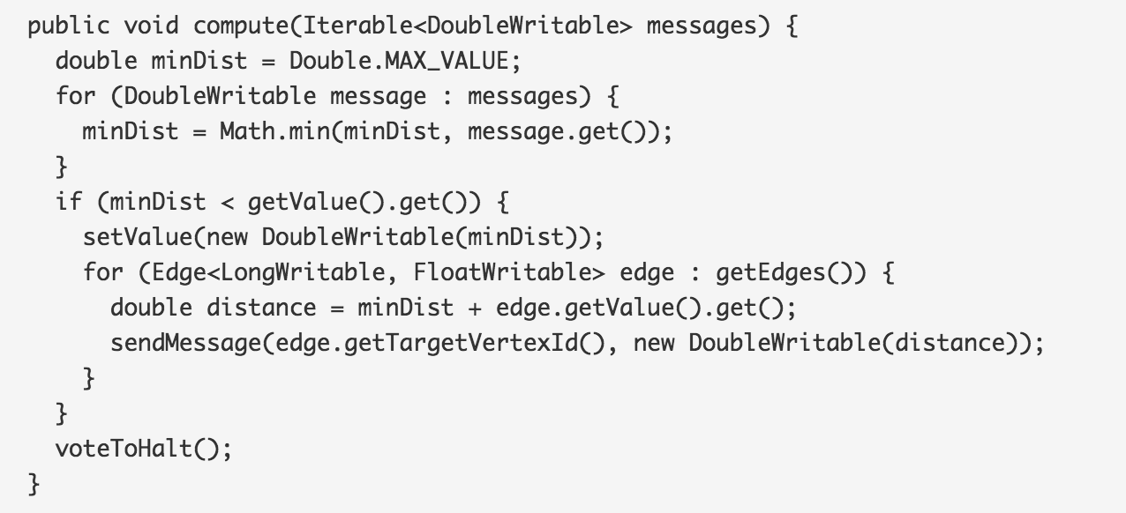
Shortest path
Example compute() method

Slide 24
Giraph terminology
Barrier
The messages sent in any current superstep get delivered to the destination vertices only in the next superstep
Vertices start computing the next superstep after every vertex has completed computing the current superstep

Slide 25
Alternative Frameworks
Apache Mahout
Apache Giraph
GraphLab
Apache Storm
Apache Tez
Apache Flink

Slide 26
GraphLab / Dato
Began as a PhD thesis at Carnegie Mellon University
Like Mahout, a Tale of Two Frameworks
GraphLab 1.0, 2.0
Vertex-centric alternative to Hadoop for graph analytics (a la Apache Giraph)
Dato, GraphLab Create
???
SaaS: front-facing Python API for interacting with [presumably] C++ backend on AWS

Slide 27
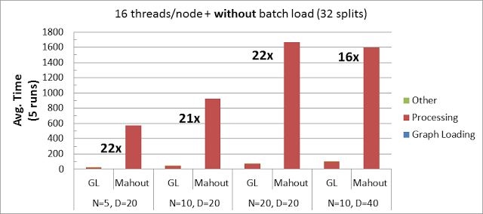
GraphLab: the early years
Envisioned as a vertex-centric alternative to Hadoop and, in particular, Mahout
Built in C++
Liked to compare apples and oranges…
Notes:
Used suboptimal HDFS block size
Used outdated version of Mahout
Mahout -> practical machine learning (used the framework that was available, aka Hadoop)
GraphLab was designed specifically to be cutting-edge

Slide 28
GraphLab to Dato
Data Engineering
Extraction, transformation
Visualization
Data Intelligence
Recommendation
Clustering
Classification
Deployment
Creating services

Slide 29
Dato data structures
SArray
An immutable, homogeneously typed array object backed by persistent storage. SArray is scaled to hold data that are much larger than the machine’s main memory. It fully supports missing values and random access. The data backing an SArray is located on the same machine as the GraphLab Server process. Each column in an SFrame is an SArray.
SFrames
A tabular, column-mutable dataframe object that can scale to big data. The data in SFrame is stored column-wise on the GraphLab Server side, and is stored on persistent storage (e.g. disk) to avoid being constrained by memory size. Each column in an SFrame is a size-immutable SArray, but SFrames are mutable in that columns can be added and subtracted with ease. An SFrame essentially acts as an ordered dict of SArrays.
SGraph
A scalable graph data structure. The SGraph data structure allows arbitrary dictionary attributes on vertices and edges, provides flexible vertex and edge query functions, and seamless transformation to and from SFrame.

Slide 30
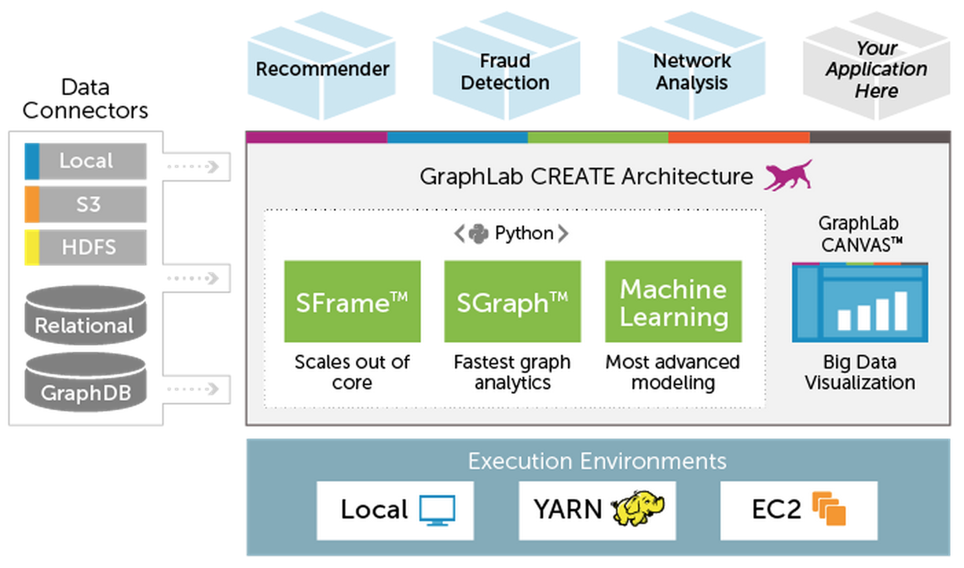
Architecture

Slide 31
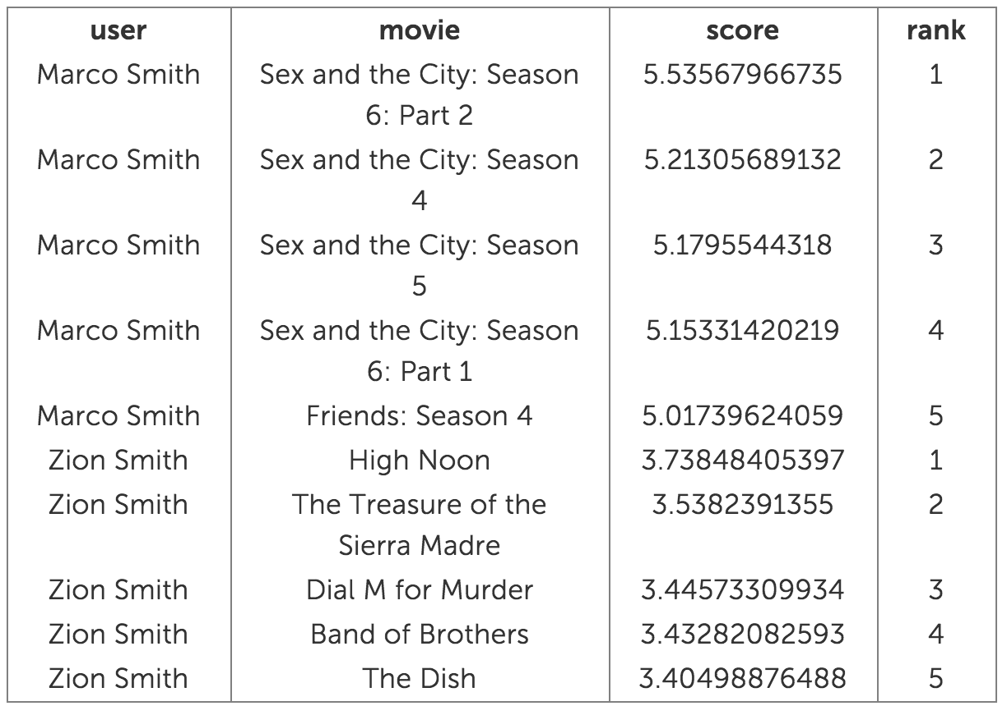
GraphLab Create
“Five-line recommender”

Slide 32
Alternative Frameworks
Apache Mahout
Apache Giraph
GraphLab
Apache Storm
Apache Tez
Apache Flink

Slide 33
Apache Storm
“…doing for realtime processing what Hadoop did for batch processing.”
Distributed realtime computation system
Reliably process unbounded streams of data
Common use cases
Realtime analytics
Online learning
Distributed RPC
[Your use case here]

Slide 34
Powered by Storm

Slide 35
Storm terminology
Spouts
Source of streaming data
Kestrel, RabbitMQ, Kafka, JMS, databases (brokers)
Twitter Streaming API
Bolts
Processes input streams to produce output streams
Functions, filters, joins, aggregations
Topologies
Network of sprouts (vertices) and bolts (edges)
Arbitrarily complex multi-stage streaming operation
Run indefinitely once deployed

Slide 36
Storm

Slide 37
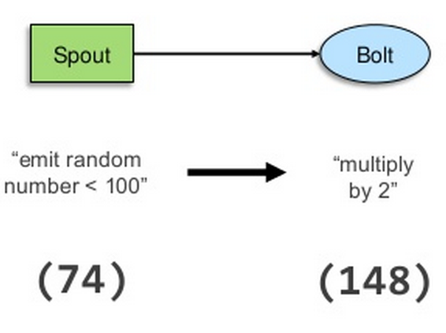
Storm

Slide 38
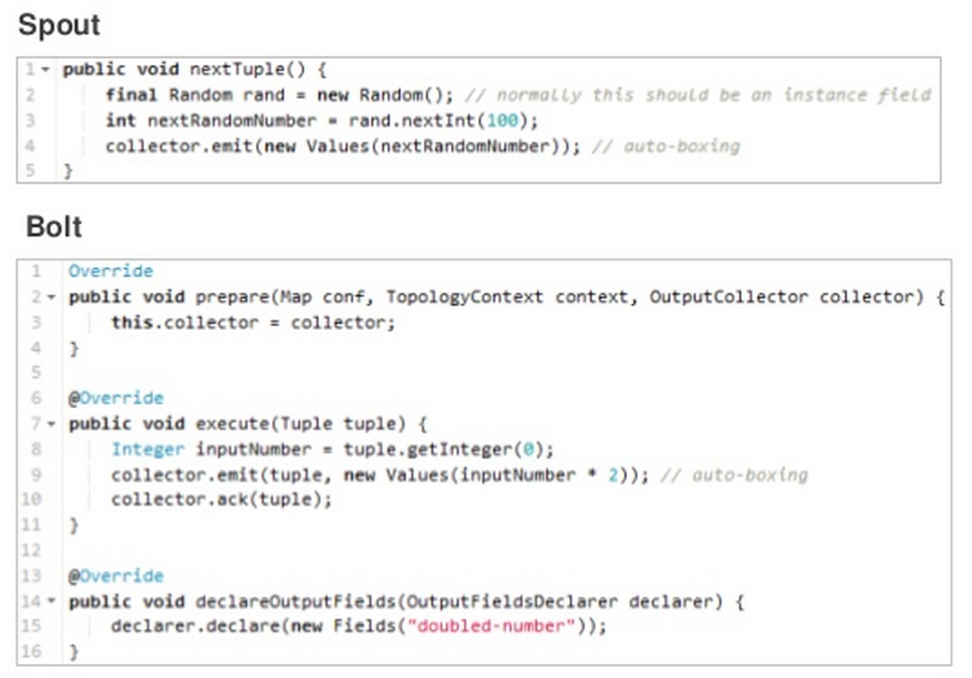
Storm
Notes:
If you want to write your own bolt or understand someone else’s, start with the execute() method.
prepare() is much like Hadoop’s setup() method, fully initializing the bolt.
declareOutputFields() tells downstream bolts about the format of this bolt’s output; goes without saying that the output needs to match what is specified here.

Slide 39
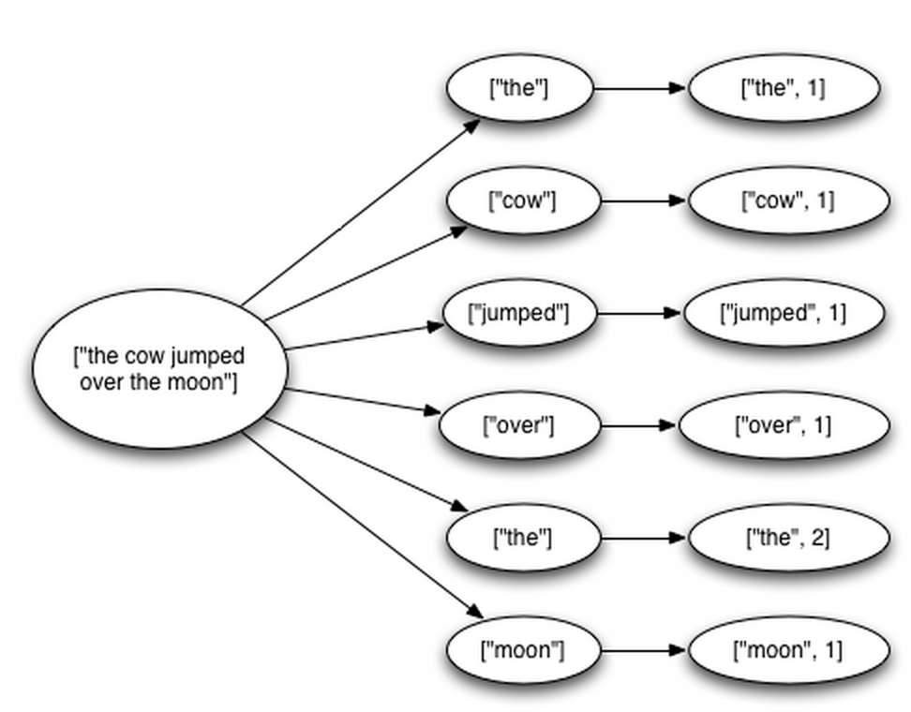
Performance
1M 100-byte messages per second per node
Storm automatically restarts workers that fail
Workers which cannot be restarted on the original node are restarted on different nodes
Nimbus and Supervisor
Guarantees each tuple will be fully processed

Slide 40
Highly configurable
Usable with [virtually] any language
Thrift definition for defining topologies
Thrift is language-agnostic, so topologies are as well
So are spouts and bolts!
Non-JVM languages communicate over JSON protocols
Adapters available for Ruby, Python, JavaScript, and Perl

Slide 41
Alternative Frameworks
Apache Mahout
Apache Giraph
GraphLab
Apache Storm
Apache Tez
Apache Flink

Slide 42
Apache Tez
“…aimed at building an application framework which allows for a complex directed-acyclic-graph [DAG] of tasks for processing data.”
Distributed execution framework
Express computation as a data flow graph
Built on Hadoop’s YARN

Slide 43
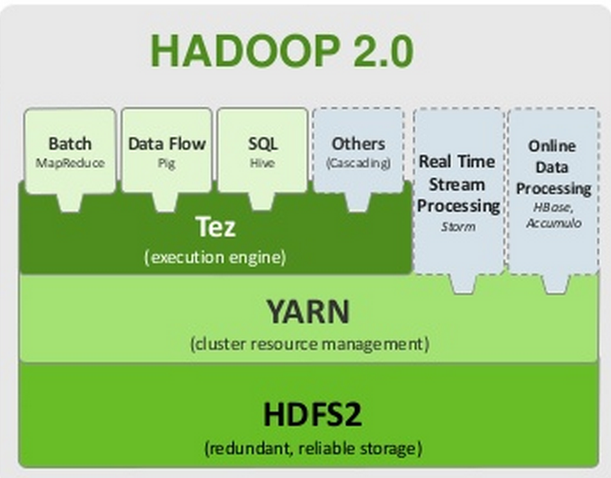
The software stack

Slide 44
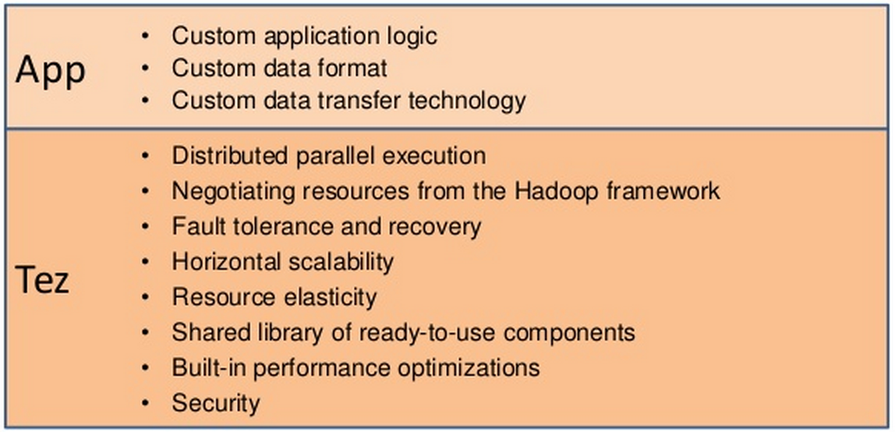
Apache Tez
Separates application logic from parallel execution, resource allocation, and fault tolerance

Slide 45
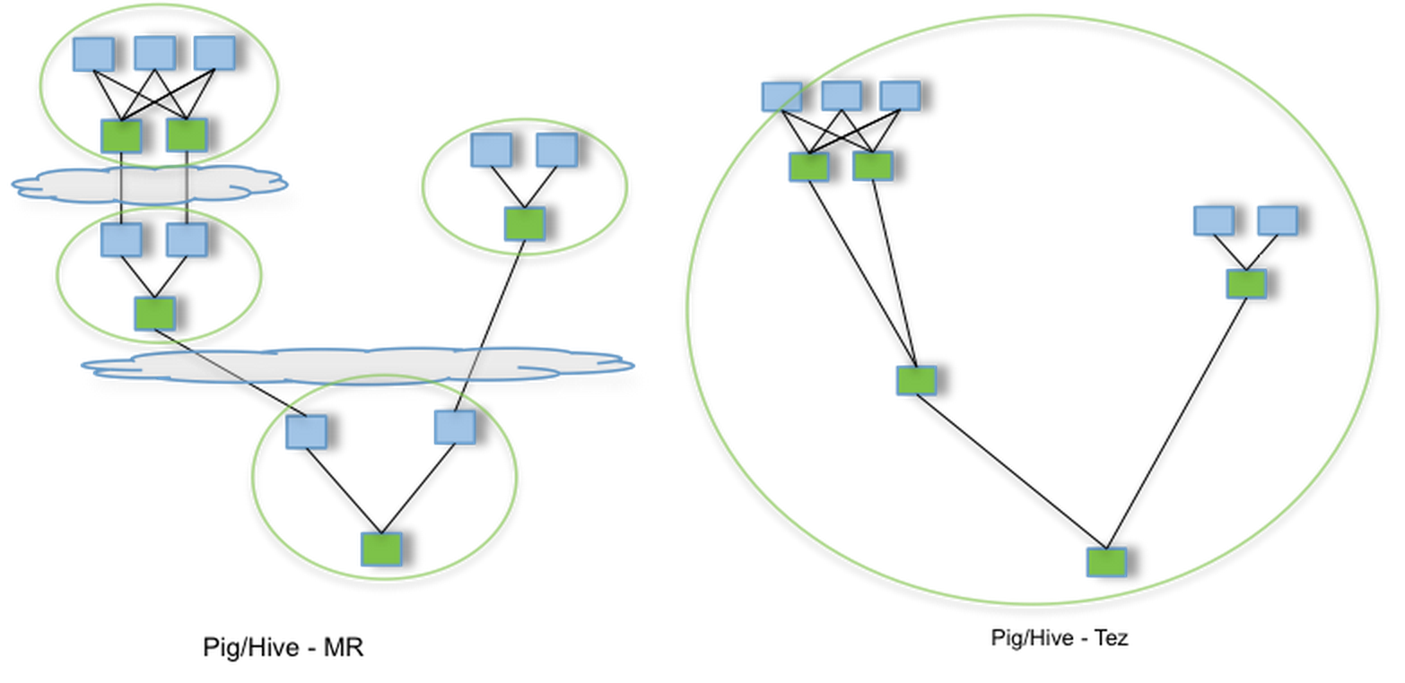
Workflow optimization
Workflows that previous required multiple MR passes can be done in only one

Slide 46
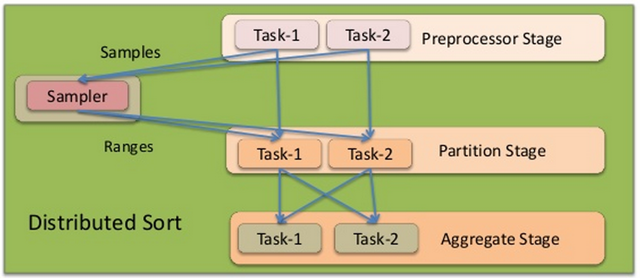
Directed acyclic execution
Vertices are data transformations
Edges are data movement

Slide 47
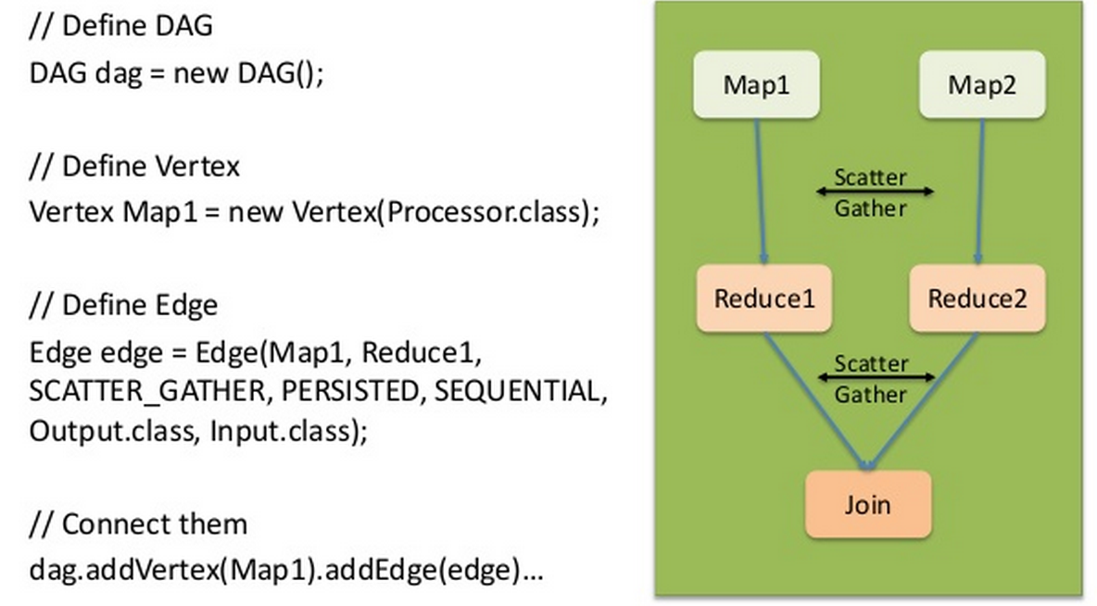
Directed acyclic execution

Slide 48
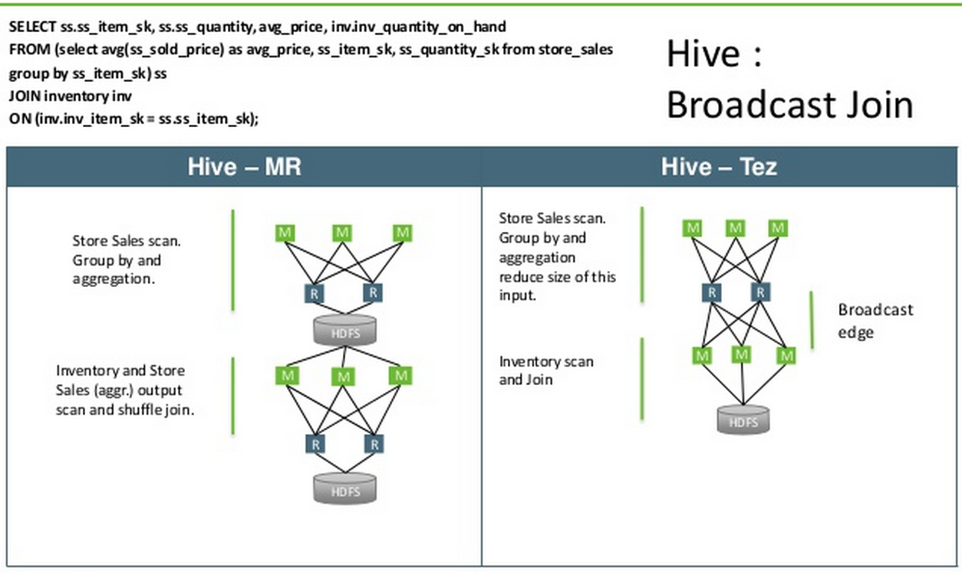
Comparison

Slide 49
Comparison
Read/write barrier between successive computations
Overhead of launching a new job
map() reads at the start of every job
Engine has a global picture of the workflow

Slide 50
Alternative Frameworks
Apache Mahout
Apache Giraph
GraphLab
Apache Storm
Apache Tez
Apache Flink

Slide 51
Apache Flink
[formerly StratoSphere]
“Fast and reliable large-scale data processing engine”
Incubation in April 2014, TLP in December 2014

Slide 52
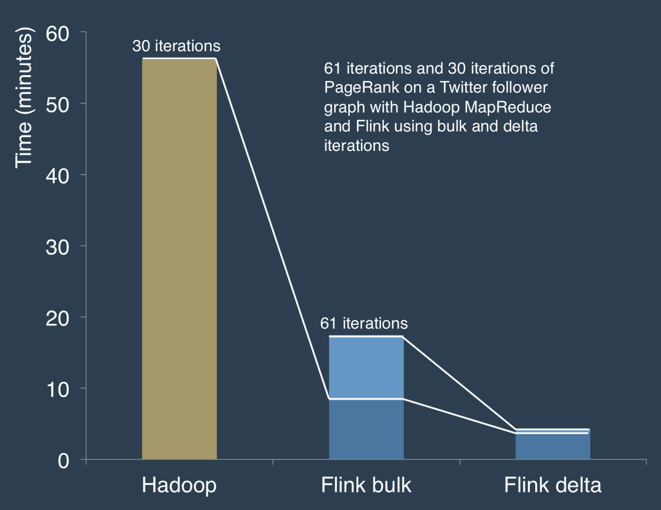
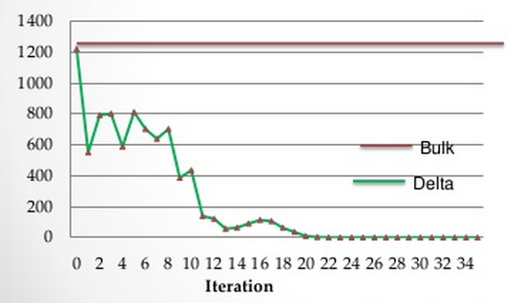
Selling points
Fast
In-memory computations (like Spark)
Integrates iterative processing

Slide 53
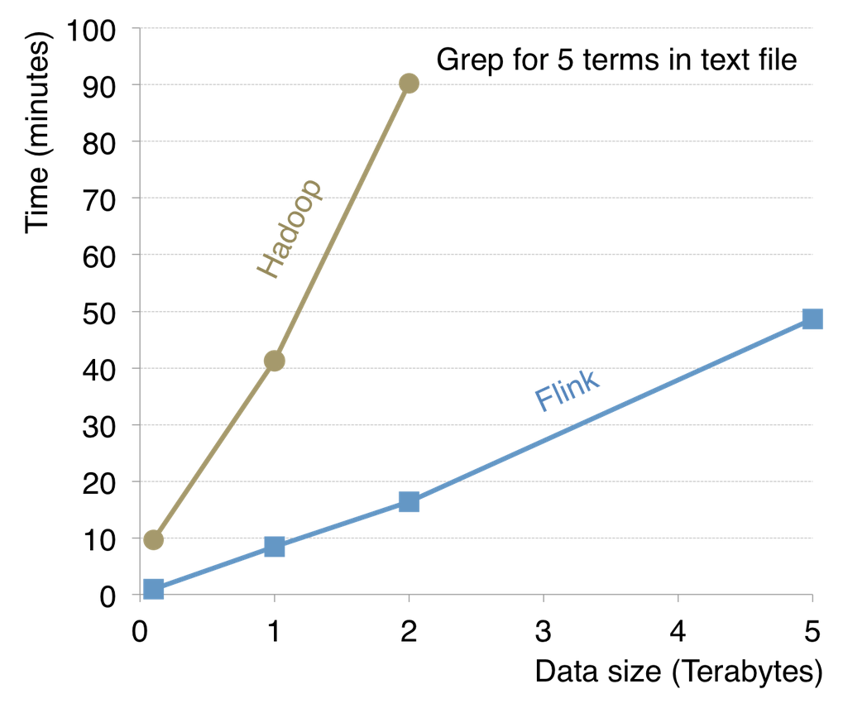
Selling points
Reliable and scalable
Designed to keep working when memory runs out
Contains its own memory management, serialization, and type inference frameworks

Slide 54
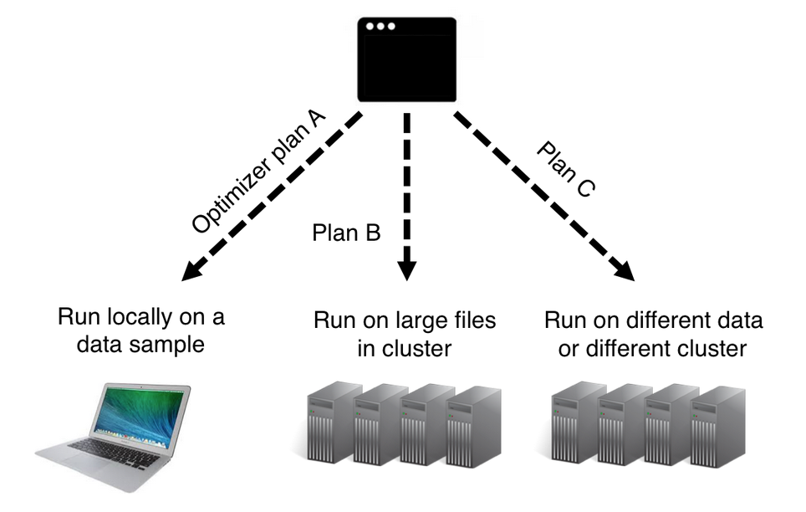
Selling points
Ease of use
Very few configuration options required
Infers most of the configuration itself
Notes:
If running locally, need only to set JAVA_HOME
If running on a cluster, need to set JAVA_HOME on each machine, plus
jobmanager.rpc.address to point to master
Jobmanager and taskmanager heap sizes
List of slave nodes

Slide 55
Ease of use
No memory thresholds to configure
Flink manages its own memory
Requires no network configuration
Only needs slave information
Needs no configured serializers
Flink handles this internally
Programs automatically adjust to data type
Flink’s internals dynamically choose execution strategies

Slide 56
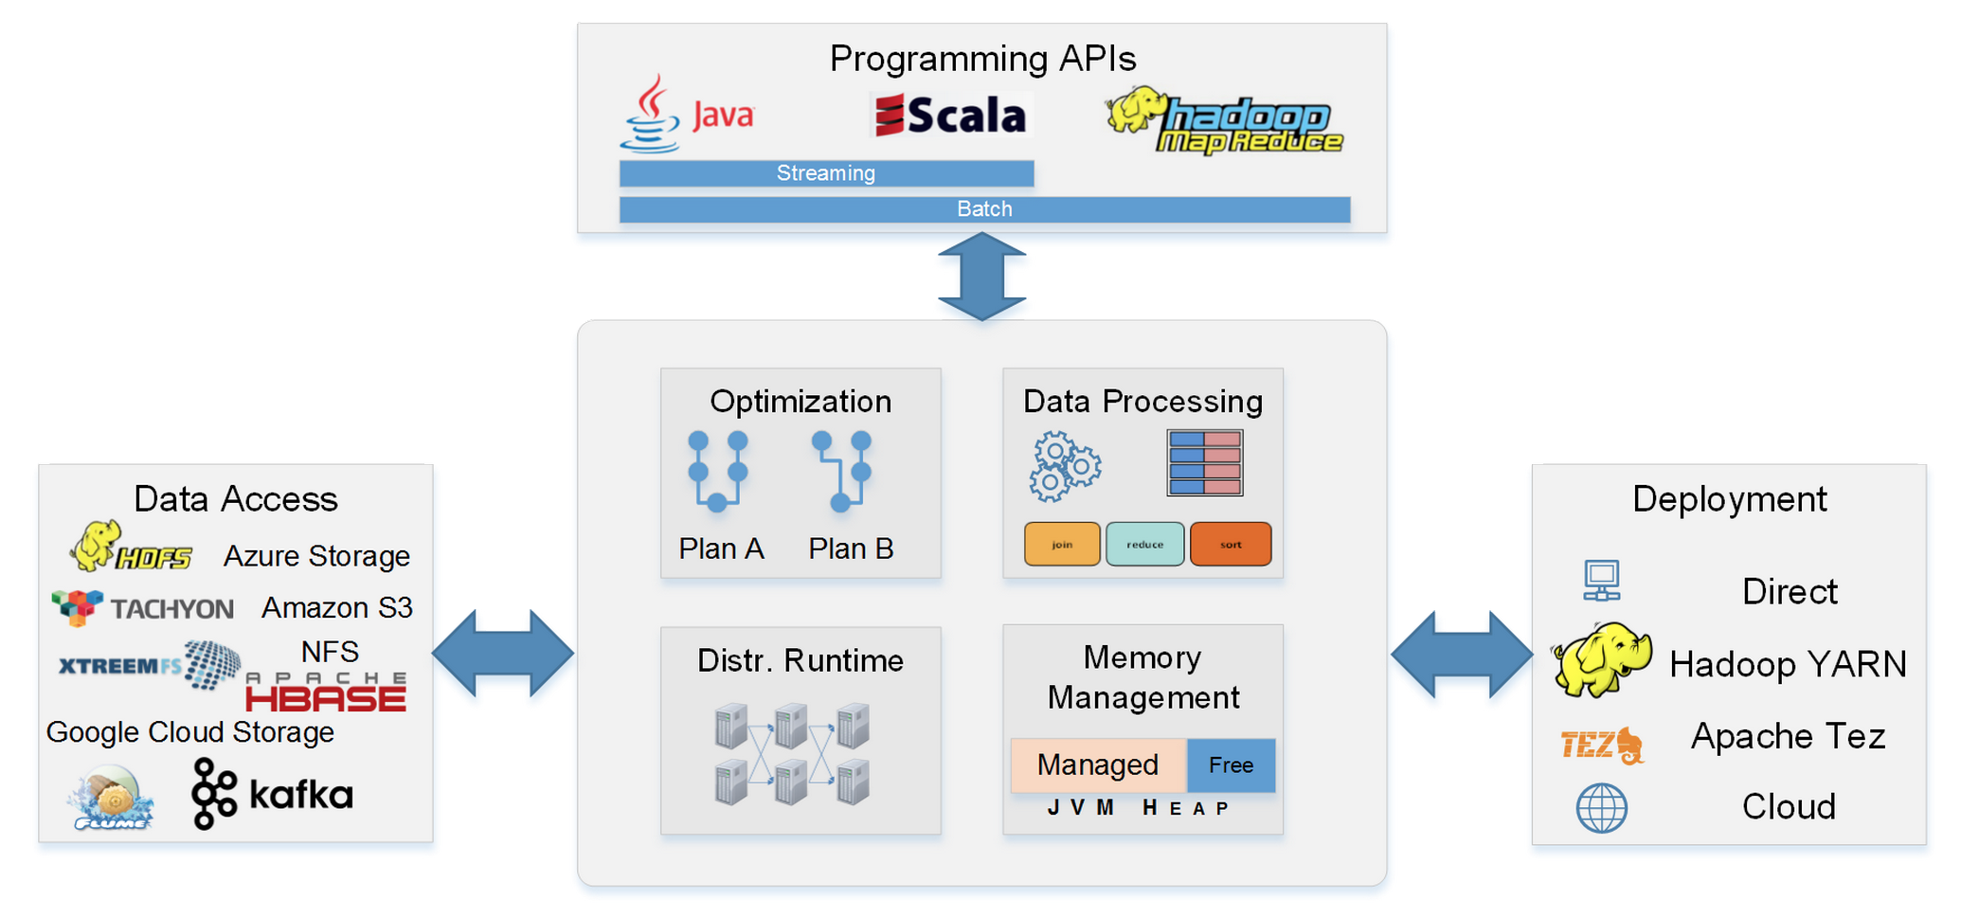
Architecture

Slide 57
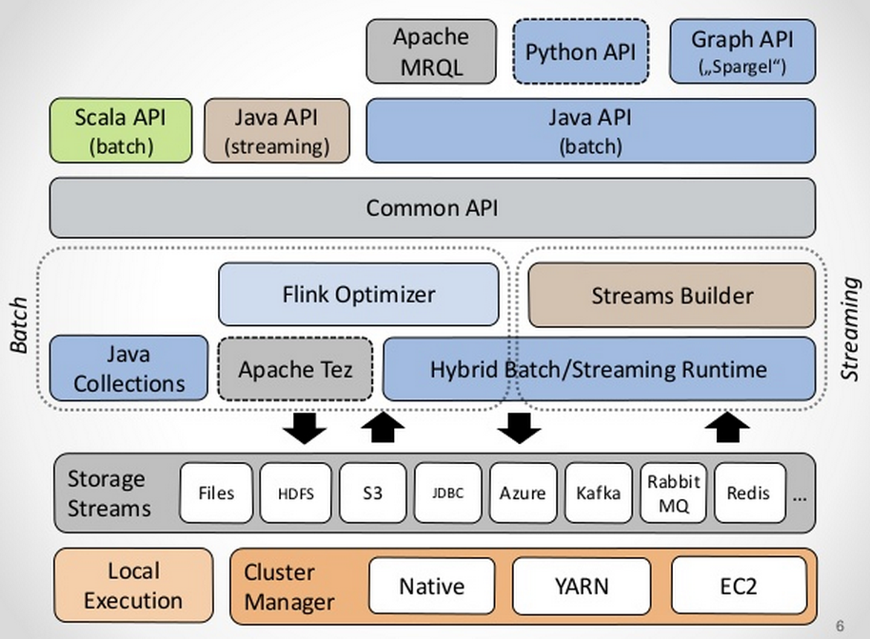
Architecture

Slide 58
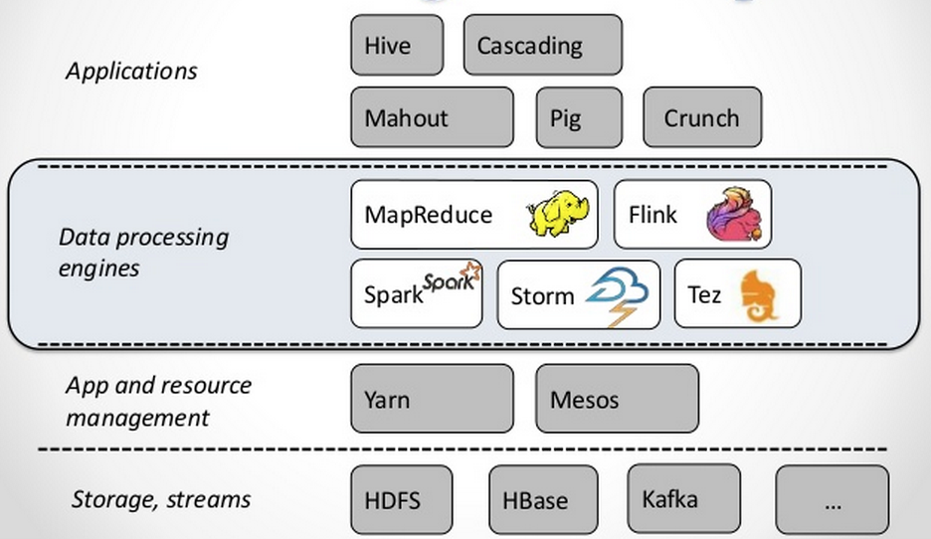
Software stack

Slide 59
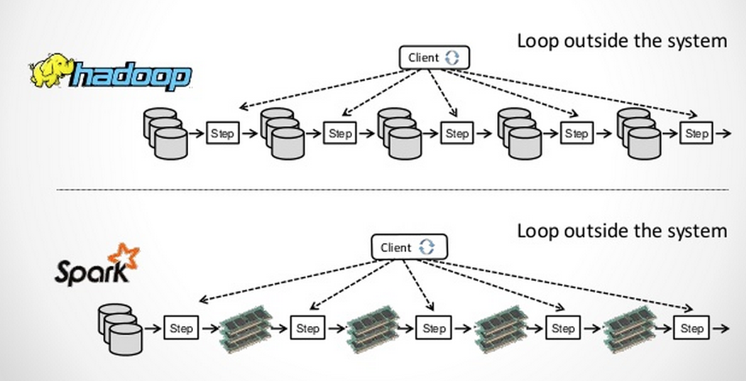
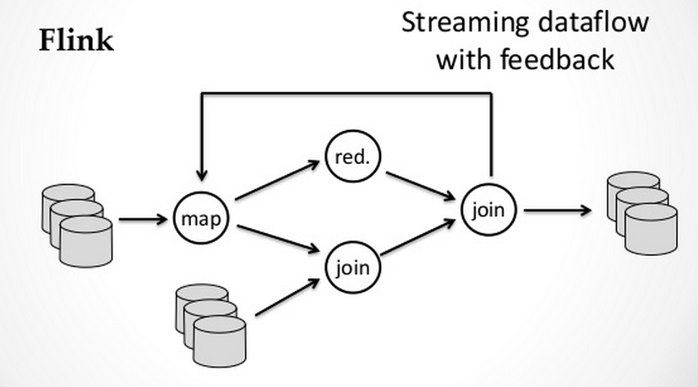
Flink engine

Slide 60
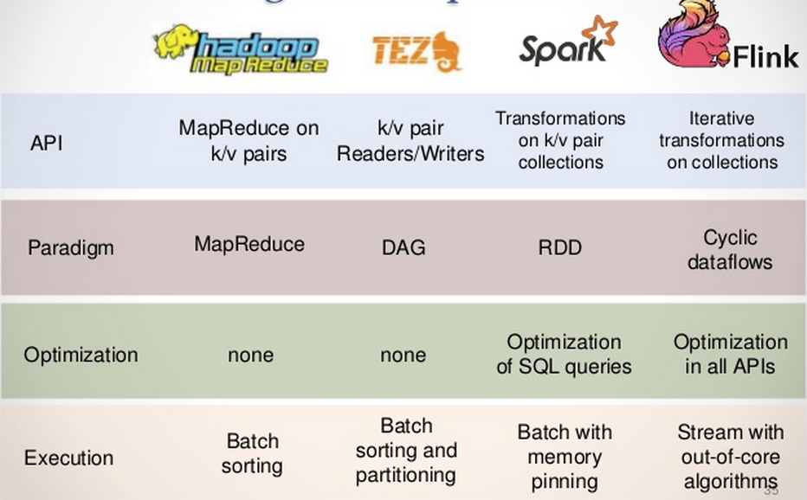
Flink engine

Slide 61
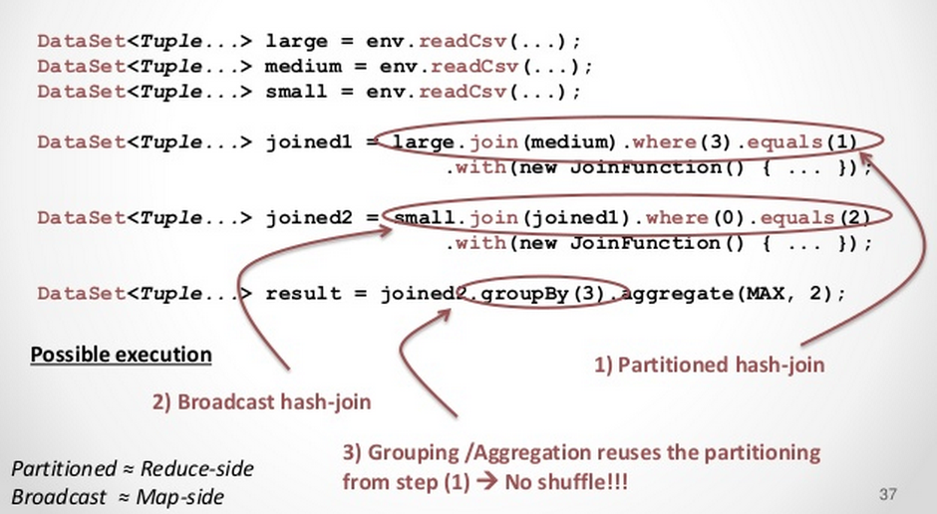
Flink engine
On-the-fly program optimization
Notes:
Flink Optimizer: devs tell everyone to think of it as an AI manipulating your program and choosing the optimal execution route.

Slide 62
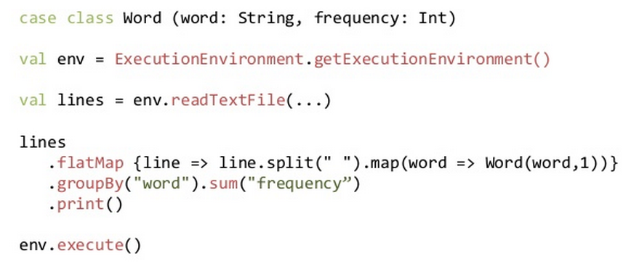
WordCount!
Uses Scala, just like Spark

Slide 63
Flink API
map, flatMap, filter, groupBy, reduce, reduceGroup, aggregate, join, coGroup, cross, project, distinct, union, iterate, iterateDelta…
All Hadoop InputFormats supported
Windowing functions for streaming data
Counters, accumulators, broadcast variables
Local standalone mode for testing/debugging

Slide 64
Flink philosophy
Developers made a concerted effort to hide internals from Flink users
The Good
Anyone who has had OutOfMemoryExceptions in Spark will probably agree this is a very good thing
The Bad
Execution model is much more complicated than Hadoop or Spark

Slide 65
Flink internals
Programs are *not* executed eagerly
Flink compiles program to an “execution plan”
Essentially a pipeline, rather than a staged or batched execution

Slide 66
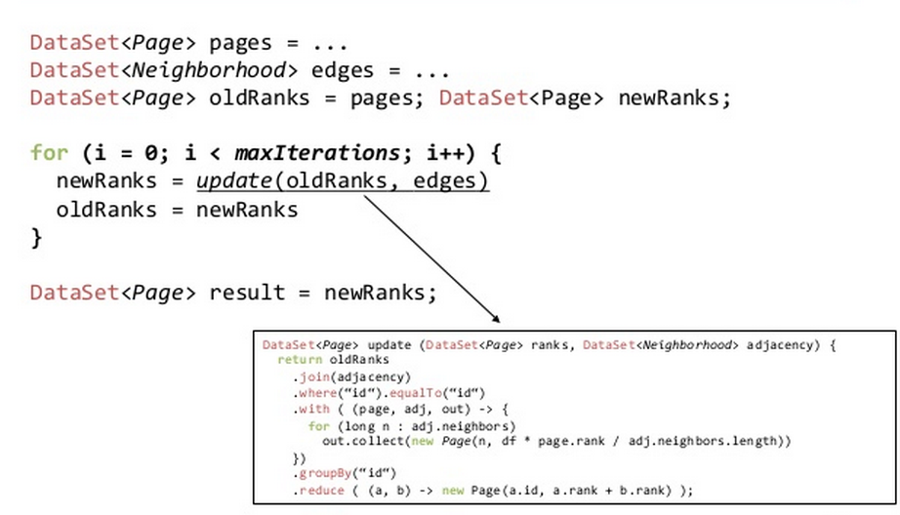
Iterative processing on Flink

Slide 67
Iterative processing
Hadoop, Spark, etc
Iterate by unrolling: loop submits one job per iteration
Data reuse by caching in memory and/or disk

Slide 68
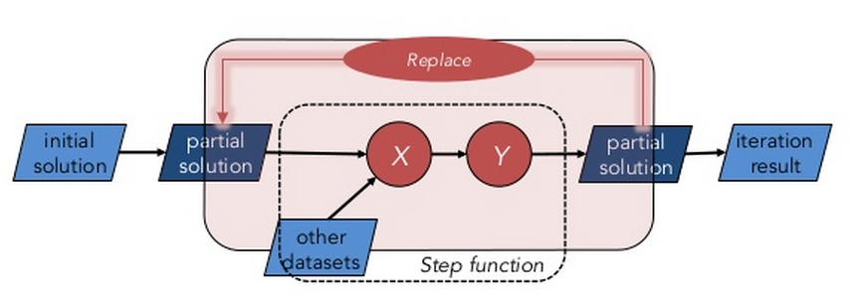
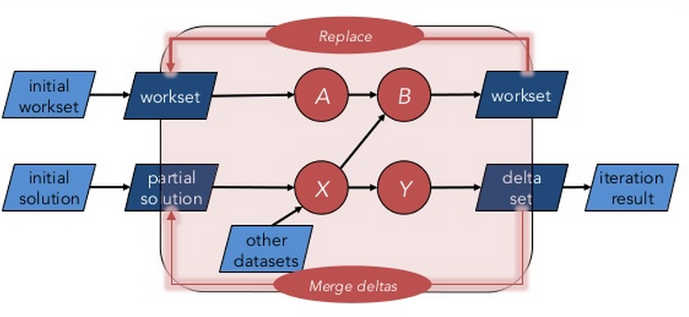
Iterate natively [with delta]

Slide 69
Flink summary
Flink decouples API from execution
Same program can be executed in many different ways
Ideally users do not care about this
Pipelined execution, native iterations, program optimizer, serialized data manipulation
Equivalent or better performance to Spark

Slide 70
Resources
Apache Mahout
http://mahout.apache.org/users/sparkbindings/home.html
Apache Giraph
http://www.slideshare.net/ClaudioMartella/giraph-at-hadoop-summit-2014
GraphLab / Dato
https://dato.com/
Apache Storm
http://www.slideshare.net/miguno/apache-storm-09-basic-training-verisign
Apache Tez
http://www.slideshare.net/Hadoop_Summit/w-1205phall1saha
Apache Flink
https://flink.apache.org/material.html

