Slide 1
Naïve Bayes and Hadoop
Shannon Quinn

Slide 2
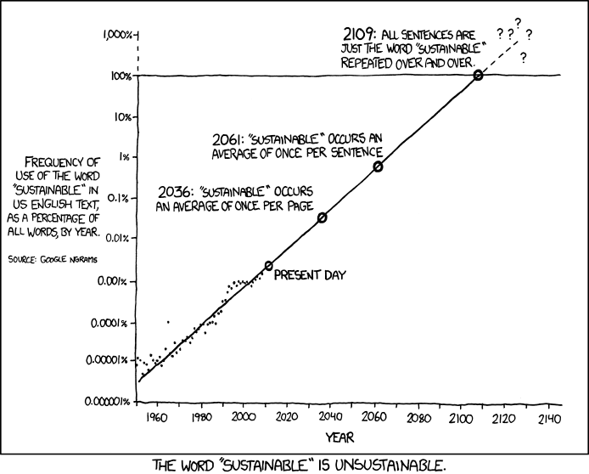
http://xkcd.com/ngram-charts/

Slide 3
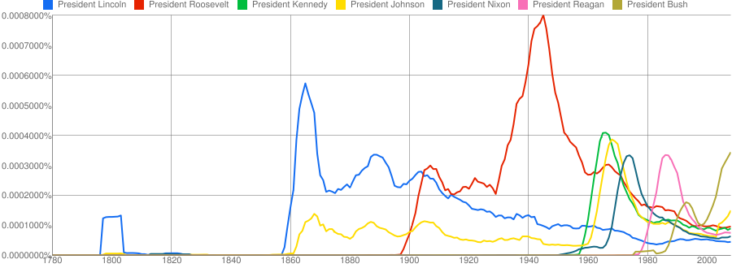
Coupled Temporal Scoping of Relational Facts. P.P. Talukdar, D.T. Wijaya and T.M. Mitchell. In Proceedings of the ACM International Conference on Web Search and Data Mining (WSDM), 2012
Understanding Semantic Change of Words Over Centuries. D.T. Wijaya and R. Yeniterzi. In Workshop on Detecting and Exploiting Cultural Diversity on the Social Web (DETECT), 2011 at CIKM 2011

Slide 4
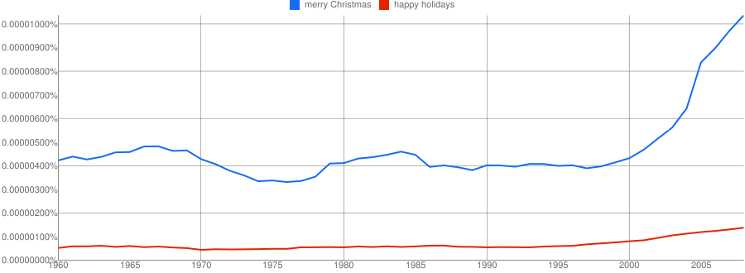
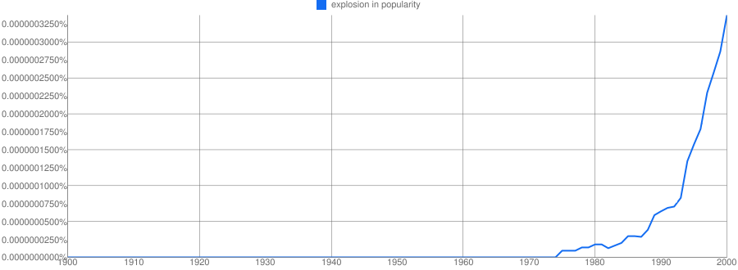

Slide 5
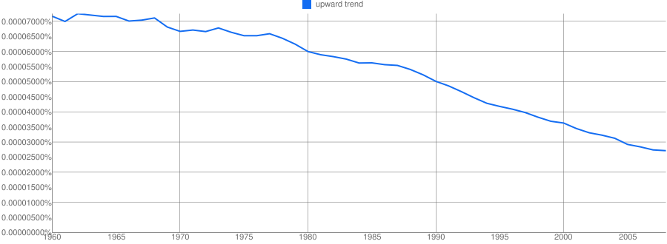

Slide 6
Some of A Joint Distribution
A | B | C | D | E | p
is | the | effect | of | the | 0.00036
is | the | effect | of | a | 0.00034
. | The | effect | of | this | 0.00034
to | this | effect | : | “ | 0.00034
be | the | effect | of | the | …
 | … | … | … | … | …
not | the | effect | of | any | 0.00024
 | … | … | … | … | …
does | not | affect | the | general | 0.00020
does | not | affect | the | question | 0.00020
any | manner | affect | the | principle | 0.00018

Slide 7
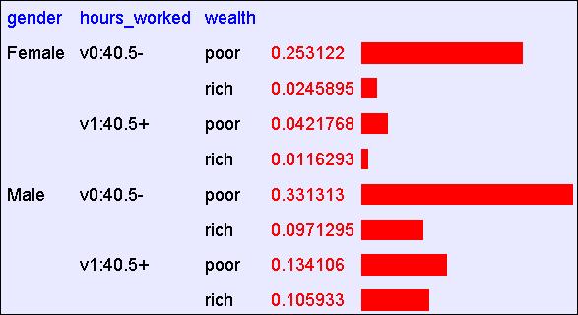
Flashback
Size of table:
2¹⁵=32768 (if all binary) ➔ avg of 1.5 examples per row
Actual m = 1,974,927, 360 (if continuous attributes binarized)
Abstract: Predict whether income exceeds $50K/yr based on census data. Also known as "Census Income" dataset. [Kohavi, 1996]
Number of Instances: 48,842
Number of Attributes: 14 (in UCI’s copy of dataset) + 1; 3 (here)

Slide 8
Naïve Density Estimation
The problem with the Joint Estimator is that it just mirrors the training data (and is *hard* to compute).
We need something which generalizes more usefully.
The naïve model generalizes strongly:
Assume that each attribute is distributed independently of any of the other attributes.

Slide 9
Using the Naïve Distribution
Once you have a Naïve Distribution you can easily compute any row of the joint distribution.
Suppose A, B, C and D are independently distributed. What is P(A ^ ~B ^ C ^ ~D)?

Slide 10
Using the Naïve Distribution
Once you have a Naïve Distribution you can easily compute any row of the joint distribution.
Suppose A, B, C and D are independently distributed. What is P(A ^ ~B ^ C ^ ~D)?
P(A) P(~B) P(C) P(~D)

Slide 11
Naïve Distribution General Case
Suppose X₁,X₂,…,X_{d} are independently distributed.
So if we have a Naïve Distribution we can construct any row of the implied Joint Distribution on demand.
How do we learn this?

Slide 12
Learning a Naïve Density Estimator
MLE
Dirichlet (MAP)
Another trivial learning algorithm!

Slide 13
Independently Distributed Data
Review: A and B are independent if
Pr(A,B)=Pr(A)Pr(B)
Sometimes written:
A and B are conditionally independent given C if Pr(A,B|C)=Pr(A|C)*Pr(B|C)
Written

Slide 14
Bayes Classifiers
If we can do inference over Pr(X,Y)…
… in particular compute Pr(X|Y) and Pr(Y).
We can compute

Slide 15
Can we make this interesting? Yes!
Key ideas:
Pick the class variable Y
Instead of estimating P(X₁,…,X_{n},Y) = P(X₁)*…*P(X_{n})*Y, estimate P(X₁,…,X_{n}|Y) = P(X₁|Y)*…*P(X_{n}|Y)
Or, assume P(X_{i}|Y)=Pr(X_{i}|X₁,…,X_{i-1},X_{i+1},…X_{n},Y)
Or, that X_{i} is conditionally independent of every X_{j}, j!=i, given Y.
How to estimate?
MLE

Slide 16
The Naïve Bayes classifier – v1
Dataset: each example has
A unique id id
Why? For debugging the feature extractor
d attributes X₁,…,X_{d}
Each X_{i} takes a discrete value in dom(X_{i})
One class label Y in dom(Y)
You have a train dataset and a test dataset

Slide 17
The Naïve Bayes classifier – v1
You have a train dataset and a test dataset
Initialize an “event counter” (hashtable) C
For each example id, y, x₁,….,x_{d} in train:
C(“Y=ANY”) ++; C(“Y=y”) ++
For j in 1..d:
C(“Y=y ^ X_{j}=x_{j}”) ++
For each example id, y, x₁,….,x_{d} in test:
For each y’ in dom(Y):
Compute Pr(y’,x₁,….,x_{d}) =
Return the best y’

Slide 18
The Naïve Bayes classifier – v1
You have a train dataset and a test dataset
Initialize an “event counter” (hashtable) C
For each example id, y, x₁,….,x_{d} in train:
C(“Y=ANY”) ++; C(“Y=y”) ++
For j in 1..d:
C(“Y=y ^ X_{j}=x_{j}”) ++
For each example id, y, x₁,….,x_{d} in test:
For each y’ in dom(Y):
Compute Pr(y’,x₁,….,x_{d}) =
Return the best y’
This will overfit, so …

Slide 19
The Naïve Bayes classifier – v1
You have a train dataset and a test dataset
Initialize an “event counter” (hashtable) C
For each example id, y, x₁,….,x_{d} in train:
C(“Y=ANY”) ++; C(“Y=y”) ++
For j in 1..d:
C(“Y=y ^ X_{j}=x_{j}”) ++
For each example id, y, x₁,….,x_{d} in test:
For each y’ in dom(Y):
Compute Pr(y’,x₁,….,x_{d}) =
Return the best y’
where:
q_{j} = 1/|dom(X_{j})|
q_{y} = 1/|dom(Y)|
m=1
This will underflow, so …

Slide 20
The Naïve Bayes classifier – v1
You have a train dataset and a test dataset
Initialize an “event counter” (hashtable) C
For each example id, y, x₁,….,x_{d} in train:
C(“Y=ANY”) ++; C(“Y=y”) ++
For j in 1..d:
C(“Y=y ^ X_{j}=x_{j}”) ++
For each example id, y, x₁,….,x_{d} in test:
For each y’ in dom(Y):
Compute log Pr(y’,x₁,….,x_{d}) =
Return the best y’
where:
q_{j} = 1/|dom(X_{j})|
q_{y} = 1/|dom(Y)|
m=1

Slide 21
The Naïve Bayes classifier – v2
For text documents, what features do you use?
One common choice:
X₁ = first word in the document
X₂ = second word in the document
X₃ = third …
X₄ = …
…
But: Pr(X₁₃=hockey|Y=sports) is probably not that different from Pr(X₁₁=hockey|Y=sports)…so instead of treating them as different variables, treat them as different copies of the same variable

Slide 22
The Naïve Bayes classifier – v1
You have a train dataset and a test dataset
Initialize an “event counter” (hashtable) C
For each example id, y, x₁,….,x_{d} in train:
C(“Y=ANY”) ++; C(“Y=y”) ++
For j in 1..d:
C(“Y=y ^ X_{j}=x_{j}”) ++
For each example id, y, x₁,….,x_{d} in test:
For each y’ in dom(Y):
Compute Pr(y’,x₁,….,x_{d}) =
Return the best y’

Slide 23
The Naïve Bayes classifier – v2
You have a train dataset and a test dataset
Initialize an “event counter” (hashtable) C
For each example id, y, x₁,….,x_{d} in train:
C(“Y=ANY”) ++; C(“Y=y”) ++
For j in 1..d:
C(“Y=y ^ X_{j}=x_{j}”) ++
For each example id, y, x₁,….,x_{d} in test:
For each y’ in dom(Y):
Compute Pr(y’,x₁,….,x_{d}) =
Return the best y’

Slide 24
The Naïve Bayes classifier – v2
You have a train dataset and a test dataset
Initialize an “event counter” (hashtable) C
For each example id, y, x₁,….,x_{d} in train:
C(“Y=ANY”) ++; C(“Y=y”) ++
For j in 1..d:
C(“Y=y ^ X=x_{j}”) ++
For each example id, y, x₁,….,x_{d} in test:
For each y’ in dom(Y):
Compute Pr(y’,x₁,….,x_{d}) =
Return the best y’

Slide 25
The Naïve Bayes classifier – v2
You have a train dataset and a test dataset
Initialize an “event counter” (hashtable) C
For each example id, y, x₁,….,x_{d} in train:
C(“Y=ANY”) ++; C(“Y=y”) ++
For j in 1..d:
C(“Y=y ^ X=x_{j}”) ++
For each example id, y, x₁,….,x_{d} in test:
For each y’ in dom(Y):
Compute log Pr(y’,x₁,….,x_{d}) =
Return the best y’
where:
q_{j} = 1/|V|
q_{y} = 1/|dom(Y)|
m=1

Slide 26
Complexity of Naïve Bayes
Sequential reads
You have a train dataset and a test dataset
Initialize an “event counter” (hashtable) C
For each example id, y, x₁,….,x_{d} in train:
C(“Y=ANY”) ++; C(“Y=y”) ++
For j in 1..d:
C(“Y=y ^ X=x_{j}”) ++
For each example id, y, x₁,….,x_{d} in test:
For each y’ in dom(Y):
Compute log Pr(y’,x₁,….,x_{d}) =
Return the best y’
Complexity: O(n), n=size of train
where:
q_{j} = 1/|V|
q_{y} = 1/|dom(Y)|
m=1
Sequential reads
Complexity: O(|dom(Y)|*n’), n’=size of test

Slide 27
MapReduce!

Slide 28
Inspiration not Plagiarism
This is not the first lecture ever on Mapreduce
I borrowed from William Cohen, who borrowed from Alona Fyshe, and she borrowed from:
Jimmy Lin
http://www.umiacs.umd.edu/~jimmylin/cloud-computing/SIGIR-2009/Lin-MapReduce-SIGIR2009.pdf
Google
http://code.google.com/edu/submissions/mapreduce-minilecture/listing.html
http://code.google.com/edu/submissions/mapreduce/listing.html
Cloudera
http://vimeo.com/3584536
Notes:
Before we get started - is anyone familiar with map reduce?

Slide 29
Introduction to MapReduce
3 main phases
Map (send each input record to a key)
Sort (put all of one key in the same place)
Handled behind the scenes in Hadoop
Reduce (operate on each key and its set of values)
Terms come from functional programming:
map(lambda x:x.upper(),[”shannon",”p",”quinn"])➔[’SHANNON', ’P', ’QUINN']
reduce(lambda x,y:x+"-"+y,[”shannon",”p",”quinn"])➔”shannon-p-quinn”

Slide 30
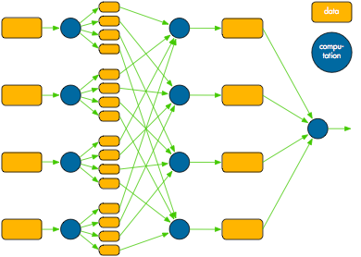
MapReduce overview
Map
Shuffle/Sort
Reduce

Slide 31
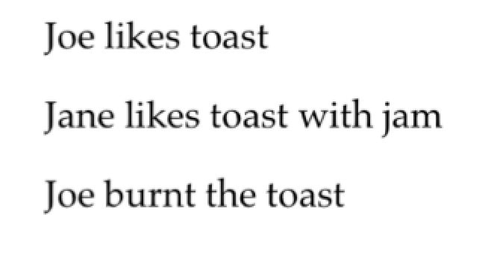
MapReduce in slow motion
Canonical example: Word Count
Example corpus:

Slide 33
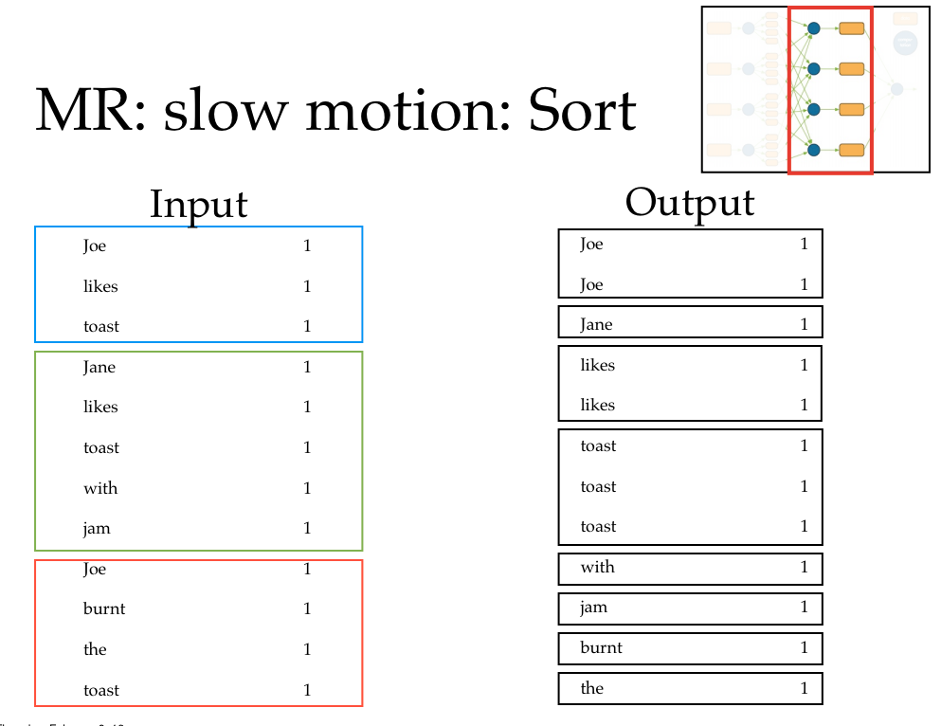

Slide 34
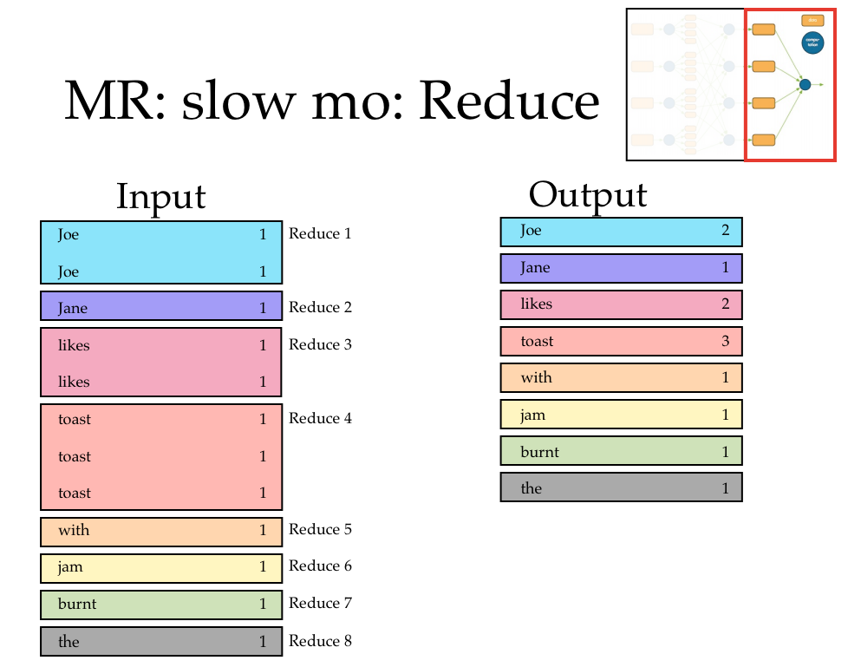

Slide 35
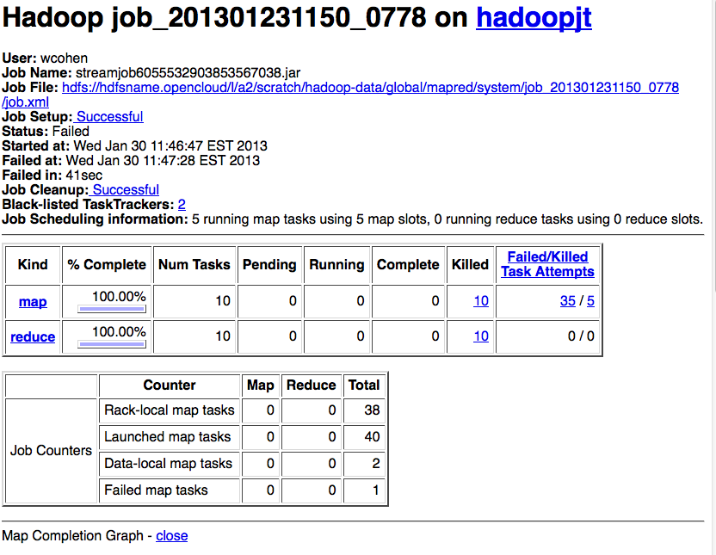

Slide 36
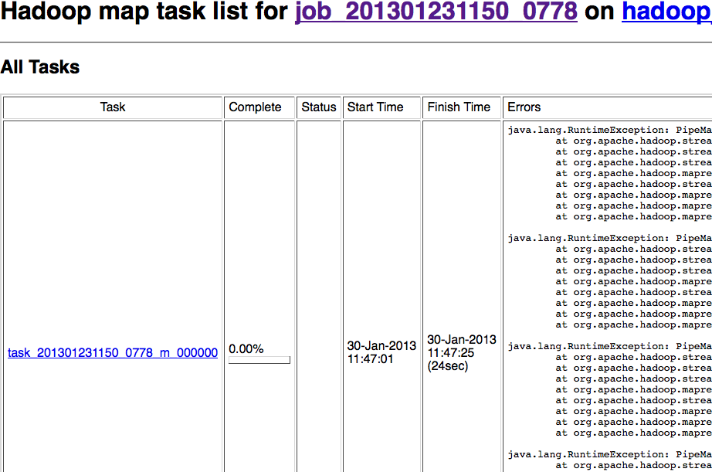

Slide 37
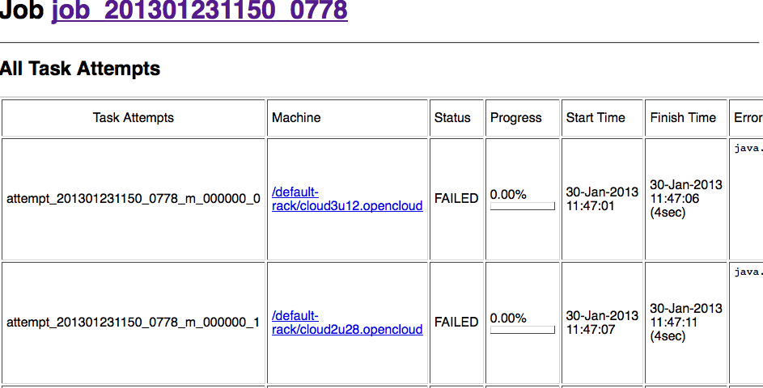

Slide 38
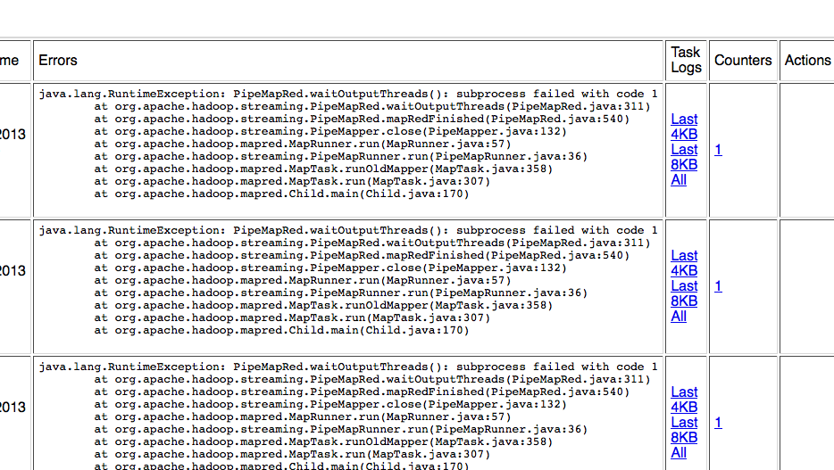

Slide 39
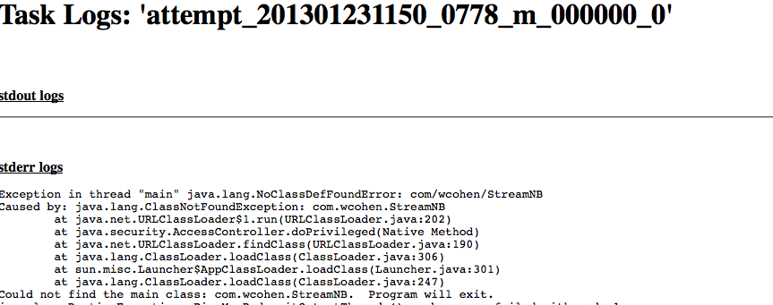

Slide 40
others:
KeyValueInputFormat
SequenceFileInputFormat

Slide 43
Is any part of this wasteful?
Remember - moving data around and writing to/reading from disk are very expensive operations
No reducer can start until:
all mappers are done
data in its partition has been sorted

Slide 44
Common pitfalls
You have no control over the order in which reduces are performed
You have “no” control over the order in which you encounter reduce values
Sort of (more later).
The only ordering you should assume is that Reducers always start after Mappers

Slide 45
Common pitfalls
You should assume your Maps and Reduces will be taking place on different machines with different memory spaces
Don’t make a static variable and assume that other processes can read it
They can’t.
It appear that they can when run locally, but they can’t
No really, don’t do this.

Slide 46
Common pitfalls
Do not communicate between mappers or between reducers
overhead is high
you don’t know which mappers/reducers are actually running at any given point
there’s no easy way to find out what machine they’re running on
because you shouldn’t be looking for them anyway

Slide 47
Assignment 1
Naïve Bayes on Hadoop
Document classification
Due Thursday, Jan 29 by 11:59:59pm

Slide 48
Other reminders
If you haven’t yet signed up for a student presentation, do so!
I will be assigning slots starting Friday at 5pm, so sign up before then
You need to be on BitBucket to do this
Mailing list for questions
Office hours Mondays 9-10:30am

