Slide 1
Basics of MapReduce
Shannon Quinn

Slide 2
Today
Naïve Bayes with huge feature sets
i.e. ones that don’t fit in memory
Pros and cons of possible approaches
Traditional “DB” (actually, key-value store)
Memory-based distributed DB
Stream-and-sort counting
Other tasks for stream-and-sort
…MapReduce?

Slide 3
Complexity of Naïve Bayes
Assume hashtable holding all counts fits in memory
Sequential reads
You have a train dataset and a test dataset
Initialize an “event counter” (hashtable) C
For each example id, y, x₁,….,x_{d} in train:
C(“Y=ANY”) ++; C(“Y=y”) ++
For j in 1..d:
C(“Y=y ^ X=x_{j}”) ++
For each example id, y, x₁,….,x_{d} in test:
For each y’ in dom(Y):
Compute log Pr(y’,x₁,….,x_{d}) =
Return the best y’
Complexity: O(n), n=size of train
where:
q_{j} = 1/|V|
q_{y} = 1/|dom(Y)|
m=1
Sequential reads
Complexity: O(|dom(Y)|*n’), n’=size of test

Slide 4
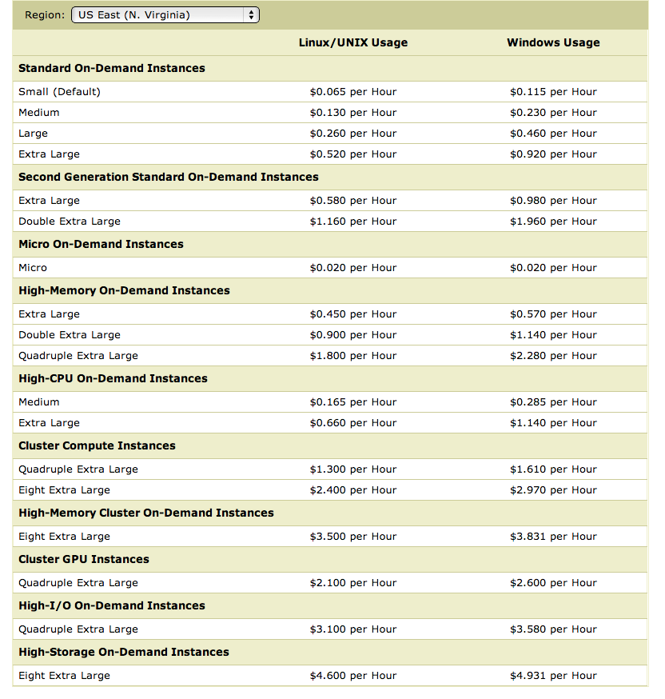
What’s next
How to implement Naïve Bayes
Assuming the event counters do not fit in memory
Why?
Micro:
0.6G memory
Standard:
S: 1.7Gb
L: 7.5Gb
XL: 15Mb
Hi Memory:
XXL: 34.2
XXXXL: 68.4

Slide 5
What’s next
How to implement Naïve Bayes
Assuming the event counters do not fit in memory
Why?
Zipf’s law: many words that you see, you don’t see often.

Slide 6
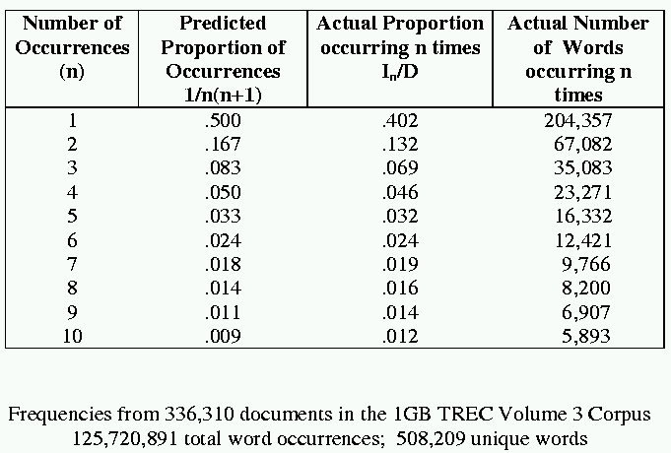
[Via Bruce Croft]

Slide 7
What’s next
How to implement Naïve Bayes
Assuming the event counters do not fit in memory
Why?
Heaps’ Law: If V is the size of the vocabulary and the n is the length of the corpus in words:
Typical constants:
K ≈ 1/10−1/100
β ≈ 0.4−0.6 (approx. square-root)
Why?
Proper names, missspellings, neologisms, …
Summary:
For text classification for a corpus with O(n) words, expect to use O(sqrt(n)) storage for vocabulary.
Scaling might be worse for other cases (e.g., hypertext, phrases, …)

Slide 8
What’s next
How to implement Naïve Bayes
Assuming the event counters do not fit in memory
Possible approaches:
Use a database? (or at least a key-value store)

Slide 9
Numbers (Jeff Dean says) Everyone Should Know
~= 10x
~= 15x
40x
~= 100,000x
Notes:
150x – commercial flight vs a brisk walk
100,000x – 5 hr flights would take 57 years
100,000x – 500 miles vs about 8 meters
15,000,000x – here to beijing vs 100 meters

Slide 10
Using a database for Big ML
We often want to do random access on big data
E.g., different versions of examples for q/a
E.g., spot-checking parameter weights to see if they are sensible
Simplest approach:
Sort the data and use binary search ➔ O(log₂n) seeks to find query row

Slide 11
Using a database for Big ML
We often want to do random access on big data
E.g., different versions of examples for q/a
E.g., spot-checking parameter weights to see if they are sensible
Almost-as-simple idea based on fact that disk seek time ~= reading 1Mb
Let K=rows/Mb (e.g., K=1000)
Scan through data once and record the seek position of every K-th row in an index file (or memory)
To find row r:
Find the r’, last item in the index smaller than r
Seek to r’ and read the next megabyte
Cheap since index is size n/1000
Cost is ~= 2 seeks

Slide 12
Using a database for Big ML
Summary: we’ve gone from ~= 1 seek (best possible) to ~= 2 seeks---plus finding r’ in the index.
If index is O(1Mb) then finding r’ is also like 1 seek
So we’re paying about 3 seeks per random access in a Gb
What if the index is still large?
Build (the same sort of index) for the index!
Now we’re paying 4 seeks for each random access into a Tb
….and repeat recursively if you need
This is called a B-tree
It only gets complicated when we want to delete and insert.

Slide 13
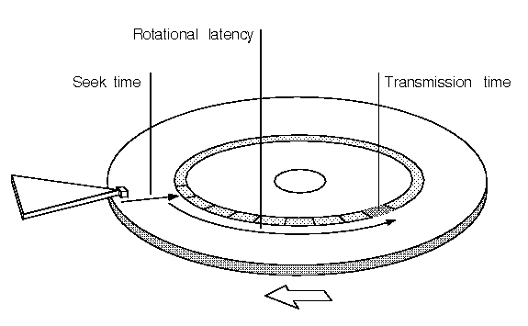

Slide 14
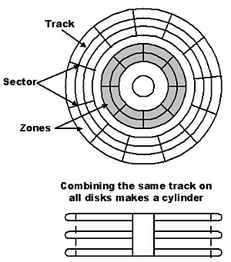

Slide 15
Numbers (Jeff Dean says) Everyone Should Know
~= 10x
~= 15x
40x
~= 100,000x
Best case (data is in same sector/block)
Notes:
150x – commercial flight vs a brisk walk
100,000x – 5 hr flights would take 57 years
100,000x – 500 miles vs about 8 meters
15,000,000x – here to beijing vs 100 meters

Slide 16
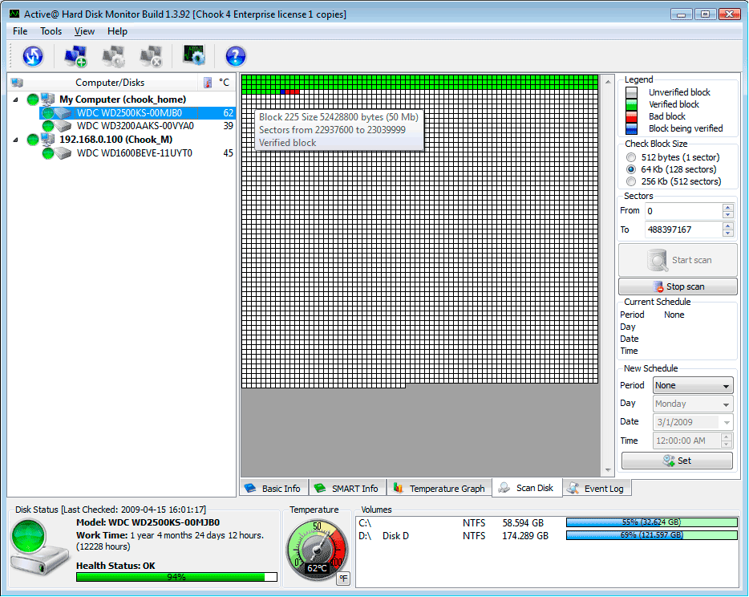
A single large file can be spread out among many non-adjacent blocks/sectors…
and then you need to seek around to scan the contents of the file…
Question: What could you do to reduce this cost?

Slide 17
What’s next
How to implement Naïve Bayes
Assuming the event counters do not fit in memory
Possible approaches:
Use a database?
Counts are stored on disk, not in memory
…So, accessing a count might involve some seeks
Caveat: many DBs are good at caching frequently-used values, so seeks might be infrequent …..
O(n*scan) ➔ O(n*scan*4*seek)

Slide 18
What’s next
How to implement Naïve Bayes
Assuming the event counters do not fit in memory
Possible approaches:
Use a memory-based distributed database?
Counts are stored on disk, not in memory
…So, accessing a count might involve some seeks
Caveat: many DBs are good at caching frequently-used values, so seeks might be infrequent …..
O(n*scan) ➔ O(n*scan*???)

Slide 19
Counting
example 1
example 2
example 3
….
“increment C[x] by D”
Hash table, database, etc
Counting logic

Slide 20
Counting
example 1
example 2
example 3
….
“increment C[x] by D”
Hash table, database, etc
Counting logic
Hashtable issue: memory is too small
Database issue: seeks are slow

Slide 21
Distributed Counting
Hash table1
example 1
example 2
example 3
….
Machine 1
Hash table2
Machine 2
“increment C[x] by D”
Counting logic
. . .
Hash table2
Machine K
Machine 0
Now we have enough memory….

Slide 22
Distributed Counting
Hash table1
example 1
example 2
example 3
….
Machine 1
Hash table2
Machine 2
“increment C[x] by D”
Counting logic
. . .
New issues:
Machines and memory cost $$!
Routing increment requests to right machine
Sending increment requests across the network
Communication complexity
Hash table2
Machine K
Machine 0

Slide 23
Numbers (Jeff Dean says) Everyone Should Know
~= 10x
~= 15x
40x
~= 100,000x
Notes:
150x – commercial flight vs a brisk walk
100,000x – 5 hr flights would take 57 years
100,000x – 500 miles vs about 8 meters
15,000,000x – here to beijing vs 100 meters

Slide 24
What’s next
How to implement Naïve Bayes
Assuming the event counters do not fit in memory
Possible approaches:
Use a memory-based distributed database?
Extra cost: Communication costs: O(n) … but that’s “ok”
Extra complexity: routing requests correctly
Note: If the increment requests were ordered seeks would not be needed!
O(n*scan) ➔ O(n*scan+n*send)
1) Distributing data in memory across machines is not as cheap as accessing memory locally because of communication costs.
2) The problem we’re dealing with is not size. It’s the interaction between size and locality: we have a large structure that’s being accessed in a non-local way.

Slide 25
What’s next
How to implement Naïve Bayes
Assuming the event counters do not fit in memory
Possible approaches:
Use a memory-based distributed database?
Extra cost: Communication costs: O(n) … but that’s “ok”
Extra complexity: routing requests correctly
Compress the counter hash table?
Use integers as keys instead of strings?
Use approximate counts?
Discard infrequent/unhelpful words?
Trade off time for space somehow?
Observation: if the counter updates were better-ordered we could avoid using disk
O(n*scan) ➔ O(n*scan+n*send)
Great ideas which we’ll discuss more later

Slide 26
Large-vocabulary Naïve Bayes
Counting
One way trade off time for space:
Assume you need K times as much memory as you actually have
Method:
Construct a hash function h(event)
For i=0,…,K-1:
Scan thru the train dataset
Increment counters for event only if h(event) mod K == i
Save this counter set to disk at the end of the scan
After K scans you have a complete counter set
Comment:
this works for any counting task, not just naïve Bayes
What we’re really doing here is organizing our “messages” to get more locality….

Slide 27
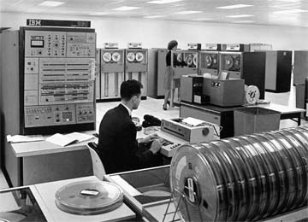
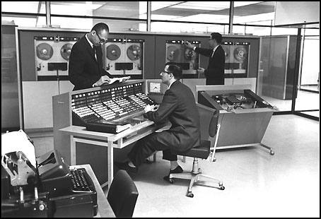
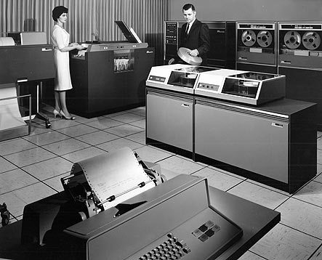

Slide 28
Large vocabulary counting
Another approach:
Start with
Q: “what can we do for large sets quickly”?
A: sorting
It’s O(n log n), not much worse than linear
You can do it for very large datasets using a merge sort
sort k subsets that fit in memory,
merge results, which can be done in linear time

Slide 29
Large-vocabulary Naïve Bayes
Create a hashtable C
For each example id, y, x₁,….,x_{d} in train:
C(“Y=ANY”) ++; C(“Y=y”) ++
For j in 1..d:
C(“Y=y ^ X=x_{j}”) ++

Slide 30
Large-vocabulary Naïve Bayes
Create a hashtable C
For each example id, y, x₁,….,x_{d} in train:
C(“Y=ANY”) ++; C(“Y=y”) ++
Print “Y=ANY += 1”
Print “Y=y += 1”
For j in 1..d:
C(“Y=y ^ X=x_{j}”) ++
Print “Y=y ^ X=x_{j} += 1”
Sort the event-counter update “messages”
Scan the sorted messages and compute and output the final counter values
Think of these as “messages” to another component to increment the counters
java MyTrainertrain | sort | java MyCountAdder > model

Slide 31
Large-vocabulary Naïve Bayes
Y=business += 1
Y=business += 1
…
Y=business ^ X =aaa += 1
…
Y=business ^ X=zynga += 1
Y=sports ^ X=hat += 1
Y=sports ^ X=hockey += 1
Y=sports ^ X=hockey += 1
Y=sports ^ X=hockey += 1
…
Y=sports ^ X=hoe += 1
…
Y=sports += 1
…
Create a hashtable C
For each example id, y, x₁,….,x_{d} in train:
C(“Y=ANY”) ++; C(“Y=y”) ++
Print “Y=ANY += 1”
Print “Y=y += 1”
For j in 1..d:
C(“Y=y ^ X=x_{j}”) ++
Print “Y=y ^ X=x_{j} += 1”
Sort the event-counter update “messages”
We’re collecting together messages about the same counter
Scan and add the sorted messages and output the final counter values

Slide 32
Large-vocabulary Naïve Bayes
Scan-and-add:
streaming
previousKey = Null
sumForPreviousKey = 0
For each (event,delta) in input:
If event==previousKey
sumForPreviousKey += delta
Else
OutputPreviousKey()
previousKey = event
sumForPreviousKey = delta
OutputPreviousKey()
define OutputPreviousKey():
If PreviousKey!=Null
print PreviousKey,sumForPreviousKey
Y=business += 1
Y=business += 1
…
Y=business ^ X =aaa += 1
…
Y=business ^ X=zynga += 1
Y=sports ^ X=hat += 1
Y=sports ^ X=hockey += 1
Y=sports ^ X=hockey += 1
Y=sports ^ X=hockey += 1
…
Y=sports ^ X=hoe += 1
…
Y=sports += 1
…
Accumulating the event counts requires constant storage … as long as the input is sorted.

Slide 33
Distributed Counting → Stream and Sort Counting
Hash table1
example 1
example 2
example 3
….
Machine 1
Hash table2
Machine 2
“C[x] +=D”
Message-routing logic
Counting logic
. . .
Hash table2
Machine K
Machine 0

Slide 34
Distributed Counting → Stream and Sort Counting
example 1
example 2
example 3
….
C[x1] += D1
C[x1] += D2
….
“C[x] +=D”
Logic to combine counter updates
Sort
Counting logic
Machine A
Machine C
Machine B

Slide 35
Stream and Sort Counting → Distributed Counting
Standardized message routing logic
example 1
example 2
example 3
….
C[x1] += D1
C[x1] += D2
….
“C[x] +=D”
Logic to combine counter updates
Counting logic
Sort
Machines A1,…
Machines C1,..,
Machines B1,…,
Trivial to parallelize!
Easy to parallelize!

Slide 36
Large-vocabulary Naïve Bayes
For each example id, y, x₁,….,x_{d} in train:
Print Y=ANY += 1
Print Y=y += 1
For j in 1..d:
Print Y=y ^ X=x_{j} += 1
Sort the event-counter update “messages”
Scan and add the sorted messages and output the final counter values
Complexity: O(n), n=size of train
(Assuming a constant number of labels apply to each document)
Complexity: O(nlogn)
Complexity: O(n)
O(|V||dom(Y)|)
java MyTrainertrain | sort | java MyCountAdder > model
Model size: max O(n), O(|V||dom(Y)|)

Slide 37
Other stream-and-sort tasks
“Meaningful” phrase-finding

Slide 38
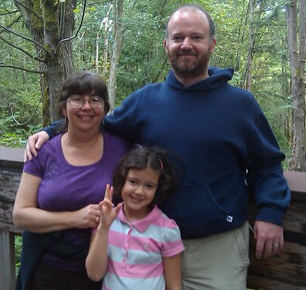
ACL Workshop 2003

Slide 40
Why phrase-finding?
There are lots of phrases
There’s not supervised data
It’s hard to articulate
What makes a phrase a phrase, vs just an n-gram?
a phrase is independently meaningful (“test drive”, “red meat”) or not (“are interesting”, “are lots”)
What makes a phrase interesting?

Slide 41
The breakdown: what makes a good phrase
Two properties:
Phraseness: “the degree to which a given word sequence is considered to be a phrase”
Statistics: how often words co-occur together vs separately
Informativeness: “how well a phrase captures or illustrates the key ideas in a set of documents” – something novel and important relative to a domain
Background corpus and foreground corpus; how often phrases occur in each

Slide 42
“Phraseness”₁ – based on BLRT
Binomial Ratio Likelihood Test (BLRT):
Draw samples:
n₁ draws, k₁ successes
n₂ draws, k₂ successes
Are they from one binominal (i.e., k₁/n₁ and k₂/n₂ were different due to chance) or from two distinct binomials?
Define
p₁=k₁ / n₁, p₂=k₂ / n_{2,} p=(k₁+k₂)/(n₁+n₂),
L(p,k,n) = p^{k}(1-p)^{n-k}

Slide 43
“Phraseness”₁ – based on BLRT
Binomial Ratio Likelihood Test (BLRT):
Draw samples:
n₁ draws, k₁ successes
n₂ draws, k₂ successes
Are they from one binominal (i.e., k₁/n₁ and k₂/n₂ were different due to chance) or from two distinct binomials?
Define
p_{i}=k_{i}/n_{i}, p=(k₁+k₂)/(n₁+n₂),
L(p,k,n) = p^{k}(1-p)^{n-k}

Slide 44
“Phraseness”₁ – based on BLRT
Define
p_{i}=k_{i} /n_{i}, p=(k₁+k₂)/(n₁+n₂),
L(p,k,n) = p^{k}(1-p)^{n-k}
Phrase x y: W₁=x ^ W₂=y
 |  | comment
k₁ | C(W₁=x ^ W₂=y) | how often bigram x y occurs in corpus C
n₁ | C(W₁=x) | how often word x occurs in corpus C
k₂ | C(W₁≠x^W₂=y) | how often y occurs in C after a non-x
n₂ | C(W₁≠x) | how often a non-x occurs in C
Does y occur at the same frequency after x as in other positions?

Slide 45
“Informativeness”₁ – based on BLRT
Define
p_{i}=k_{i} /n_{i}, p=(k₁+k₂)/(n₁+n₂),
L(p,k,n) = p^{k}(1-p)^{n-k}
Phrase x y: W₁=x ^ W₂=y and two corpora, C and B
 |  | comment
k₁ | C(W₁=x ^ W₂=y) | how often bigram x y occurs in corpus C
n₁ | C(W₁=* ^ W₂=*) | how many bigrams in corpus C
k₂ | B(W₁=x^W₂=y) | how often x y occurs in background corpus
n₂ | B(W₁=* ^ W₂=*) | how many bigrams in background corpus
Does x y occur at the same frequency in both corpora?

Slide 46
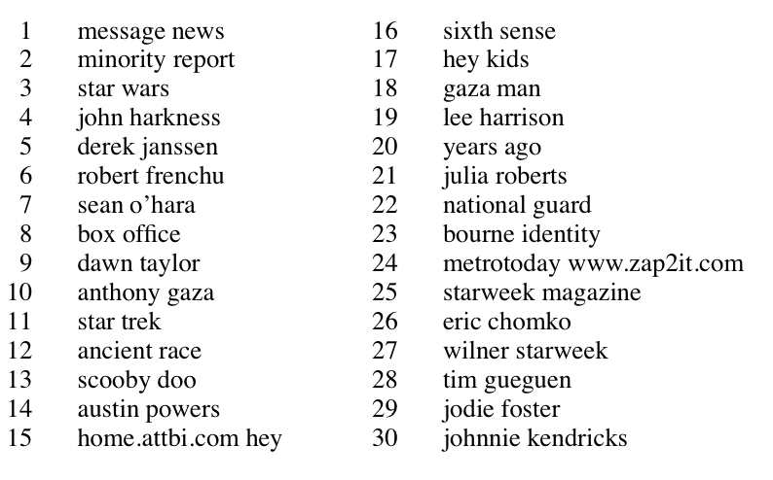

Slide 47
The breakdown: what makes a good phrase
Two properties:
Phraseness: “the degree to which a given word sequence is considered to be a phrase”
Statistics: how often words co-occur together vs separately
Informativeness: “how well a phrase captures or illustrates the key ideas in a set of documents” – something novel and important relative to a domain
Background corpus and foreground corpus; how often phrases occur in each
Another intuition: our goal is to compare distributions and see how different they are:
Phraseness: estimate x y with bigram model or unigram model
Informativeness: estimate with foreground vs background corpus

Slide 48
The breakdown: what makes a good phrase
Another intuition: our goal is to compare distributions and see how different they are:
Phraseness: estimate x y with bigram model or unigram model
Informativeness: estimate with foreground vs background corpus
To compare distributions, use KL-divergence
“Pointwise KL divergence”

Slide 49
The breakdown: what makes a good phrase
To compare distributions, use KL-divergence
Phraseness: difference between bigram and unigram language model in foreground
“Pointwise KL divergence”
Bigram model: P(x y)=P(x)P(y|x)
Unigram model: P(x y)=P(x)P(y)

Slide 50
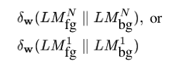
The breakdown: what makes a good phrase
To compare distributions, use KL-divergence
Informativeness: difference between foreground and background models
“Pointwise KL divergence”
Bigram model: P(x y)=P(x)P(y|x)
Unigram model: P(x y)=P(x)P(y)

Slide 51
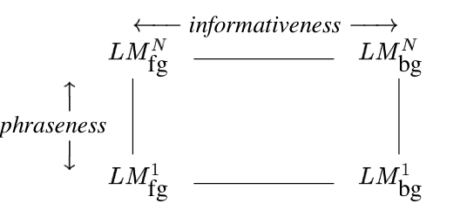
The breakdown: what makes a good phrase
To compare distributions, use KL-divergence
Combined: difference between foreground bigram model and background unigram model
“Pointwise KL divergence”
Bigram model: P(x y)=P(x)P(y|x)
Unigram model: P(x y)=P(x)P(y)

Slide 52
The breakdown: what makes a good phrase
To compare distributions, use KL-divergence
Subtle advantages:
BLRT scores “more frequent in foreground” and “more frequent in background” symmetrically, pointwise KL does not.
Phrasiness and informativeness scores are more comparable – straightforward combination w/o a classifier is reasonable.
Language modeling is well-studied:
extensions to n-grams, smoothing methods, …
we can build on this work in a modular way
Combined: difference between foreground bigram model and background unigram model

Slide 53
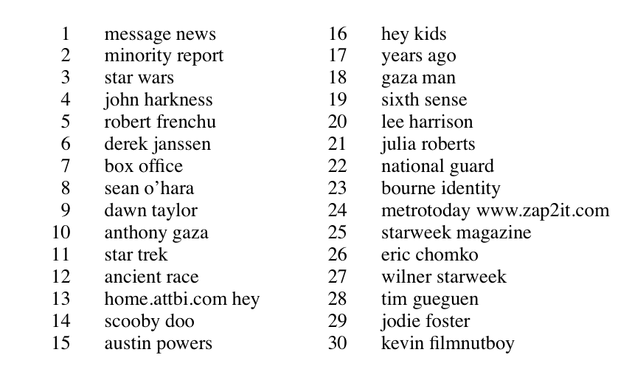
Pointwise KL, combined
Notes:
pointwise KL combined

Slide 54
Why phrase-finding?
Phrases are where the standard supervised “bag of words” representation starts to break.
There’s not supervised data, so it’s hard to see what’s “right” and why
It’s a nice example of using unsupervised signals to solve a task that could be formulated as supervised learning
It’s a nice level of complexity, if you want to do it in a scalable way.

Slide 55
Implementation
Request-and-answer pattern
Main data structure: tables of key-value pairs
key is a phrase x y
value is a mapping from a attribute names (like phraseness, freq-in-B, …) to numeric values.
Keys and values are just strings
We’ll operate mostly by sending messages to this data structure and getting results back, or else streaming thru the whole table
For really big data: we’d also need tables where key is a word and val is set of attributes of the word (freq-in-B, freq-in-C, …)

Slide 56
Generating and scoring phrases: 1
Stream through foreground corpus and count events “W₁=x ^ W₂=y” the same way we do in training naive Bayes: stream-and sort and accumulate deltas (a “sum-reduce”)
Don’t bother generating boring phrases (e.g., crossing a sentence, contain a stopword, …)
Then stream through the output and convert to phrase, attributes-of-phrase records with one attribute: freq-in-C=n
Stream through foreground corpus and count events “W₁=x” in a (memory-based) hashtable….
This is enough* to compute phrasiness:
ψ_{p}(x y) = f( freq-in-C(x), freq-in-C(y), freq-in-C(x y))
…so you can do that with a scan through the phrase table that adds an extra attribute (holding word frequencies in memory).
* actually you also need total # words and total #phrases….

Slide 57
Generating and scoring phrases: 2
Stream through background corpus and count events “W₁=x ^ W₂=y” and convert to phrase, attributes-of-phrase records with one attribute: freq-in-B=n
Sort the two phrase-tables: freq-in-B and freq-in-C and run the output through another “reducer” that
appends together all the attributes associated with the same key, so we now have elements like

Slide 58
Generating and scoring phrases: 3
Scan the through the phrase table one more time and add the informativeness attribute and the overall quality attribute
Summary, assuming word vocabulary n_{W} is small:
Scan foreground corpus C for phrases: O(n_{C}) producing m_{C} phrase records – of course m_{C} << n_{C}
Compute phrasiness: O(m_{C})
Scan background corpus B for phrases: O(n_{B}) producing m_{B}
Sort together and combine records: O(m log m), m=m_{B} + m_{C}
Compute informativeness and combined quality: O(m)
Assumes word counts fit in memory

Slide 59
Ramping it up – keeping word counts out of memory
Goal: records for xy with attributes freq-in-B, freq-in-C, freq-of-x-in-C, freq-of-y-in-C, …
Assume I have built built phrase tables and word tables….how do I incorporate the word attributes into the phrase records?
For each phrase xy, request necessary word frequencies:
Print “x ~request=freq-in-C,from=xy”
Print “y ~request=freq-in-C,from=xy”
Sort all the word requests in with the word tables
Scan through the result and generate the answers: for each word w, a₁=n₁,a₂=n₂,….
Print “xy ~request=freq-in-C,from=w”
Sort the answers in with the xy records
Scan through and augment the xy records appropriately

Slide 60
Generating and scoring phrases: 3
Summary
Scan foreground corpus C for phrases, words: O(n_{C})
producing m_{C} phrase records, v_{C} word records
Scan phrase records producing word-freq requests: O(m_{C} )
producing 2m_{C} requests
Sort requests with word records: O((2m_{C} + v_{C} )log(2m_{C} + v_{C}))
= O(m_{C}log m_{C}) since v_{C} < m_{C}
Scan through and answer requests: O(m_{C})
Sort answers with phrase records: O(m_{C}log m_{C})
Repeat 1-5 for background corpus: O(n_{B} + m_{B}logm_{B})
Combine the two phrase tables: O(m log m), m = m_{B} + m_{C}
Compute all the statistics: O(m)

Slide 61
Outline
Even more on stream-and-sort and naïve Bayes
Request-answer pattern
Another problem: “meaningful” phrase finding
Statistics for identifying phrases (or more generally correlations and differences)
Also using foreground and background corpora
Implementing “phrase finding” efficiently
Using request-answer
Some other phrase-related problems
Semantic orientation
Complex named entity recognition

Slide 62
Basically…
Stream-and-sort == ?

Slide 63
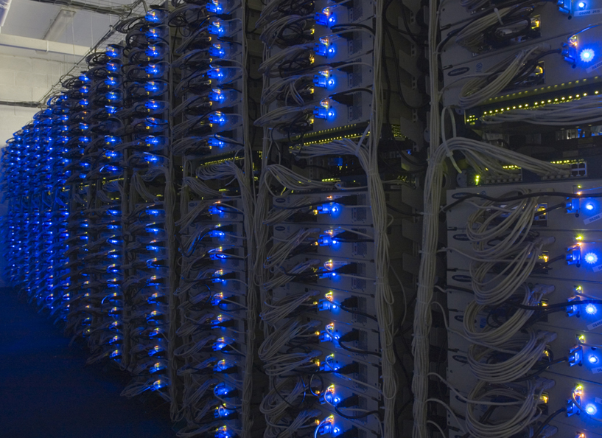

Slide 64
MapReduce!
Sequentially read a lot of data
Map:
Extract something you care about
Group by key: Sort and Shuffle
Reduce:
Aggregate, summarize, filter or transform
Write the result
Outline stays the same, Map and Reduce change to fit the problem

Slide 65
MapReduce: The Map Step
Input
key-value pairs
Intermediate
key-value pairs
k
v
map
k
v
k
v
map
k
v
k
v
…
…
k
v
k
v

Slide 66
MapReduce: The Reduce Step
Output
key-value pairs
Intermediate
key-value pairs
Key-value groups
reduce
k
v
k
v
v
v
k
v
Group
by key
reduce
k
v
k
v
v
k
v
k
v
…
…
…
k
v
k
v
k
v

Slide 67
More Specifically
Input: a set of key-value pairs
Programmer specifies two methods:
Map(k, v) → <k’, v’>*
Takes a key-value pair and outputs a set of key-value pairs
E.g., key is the filename, value is a single line in the file
There is one Map call for every (k,v) pair
Reduce(k’, <v’>*) → <k’, v’’>*
All values v’ with same key k’ are reduced together and processed in v’ order
There is one Reduce function call per unique key k’

Slide 68
Large-scale Computing
Large-scale computing for data mining problems on commodity hardware
Challenges:
How do you distribute computation?
How can we make it easy to write distributed programs?
Machines fail:
One server may stay up 3 years (1,000 days)
If you have 1,000 servers, expect to loose 1/day
People estimated Google had ~1M machines in 2011
1,000 machines fail every day!

Slide 69
Idea and Solution
Issue: Copying data over a network takes time
Idea:
Bring computation close to the data
Store files multiple times for reliability
Map-reduce addresses these problems
Google’s computational/data manipulation model
Elegant way to work with big data
Storage Infrastructure – File system
Google: GFS. Hadoop: HDFS
Programming model
Map-Reduce

Slide 70
Storage Infrastructure
Problem:
If nodes fail, how to store data persistently?
Answer:
Distributed File System:
Provides global file namespace
Google GFS; Hadoop HDFS;
Typical usage pattern
Huge files (100s of GB to TB)
Data is rarely updated in place
Reads and appends are common

Slide 71
Distributed File System
Chunk servers
File is split into contiguous chunks
Typically each chunk is 16-64MB
Each chunk replicated (usually 2x or 3x)
Try to keep replicas in different racks
Master node
a.k.a. Name Node in Hadoop’s HDFS
Stores metadata about where files are stored
Might be replicated
Client library for file access
Talks to master to find chunk servers
Connects directly to chunk servers to access data

Slide 72
Distributed File System
Reliable distributed file system
Data kept in “chunks” spread across machines
Each chunk replicated on different machines
Seamless recovery from disk or machine failure
C₀
C₁
D₀
C₁
C₂
C₅
C₀
C₅
…
C₅
Chunk server 1
C₂
C₅
Chunk server 2
C₃
D₀
Chunk server 3
D₁
D₀
Chunk server N
C₂
Bring computation directly to the data!
Chunk servers also serve as compute servers
Notes:
72

Slide 73
Programming Model: MapReduce
Warm-up task:
We have a huge text document
Count the number of times each distinct word appears in the file
Sample application:
Analyze web server logs to find popular URLs

Slide 74
Task: Word Count
Case 1:
File too large for memory, but all <word, count> pairs fit in memory
Case 2:
Count occurrences of words:
words(doc.txt) | sort | uniq -c
where words takes a file and outputs the words in it, one per a line
Case 2 captures the essence of MapReduce
Great thing is that it is naturally parallelizable

Slide 75
Data Flow
Input and final output are stored on a distributed file system (FS):
Scheduler tries to schedule map tasks “close” to physical storage location of input data
Intermediate results are stored on local FS of Map and Reduce workers
Output is often input to another MapReduce task

Slide 76
Coordination: Master
Master node takes care of coordination:
Task status: (idle, in-progress, completed)
Idle tasks get scheduled as workers become available
When a map task completes, it sends the master the location and sizes of its R intermediate files, one for each reducer
Master pushes this info to reducers
Master pings workers periodically to detect failures

Slide 77
Dealing with Failures
Map worker failure
Map tasks completed or in-progress at worker are reset to idle
Reduce workers are notified when task is rescheduled on another worker
Reduce worker failure
Only in-progress tasks are reset to idle
Reduce task is restarted
Master failure
MapReduce task is aborted and client is notified

Slide 78
How many Map and Reduce jobs?
M map tasks, R reduce tasks
Rule of a thumb:
Make M much larger than the number of nodes in the cluster
One DFS chunk per map is common
Improves dynamic load balancing and speeds up recovery from worker failures
Usually R is smaller than M
Because output is spread across R files

Slide 79
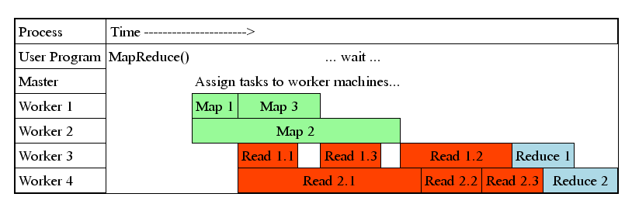
Task Granularity & Pipelining
Fine granularity tasks: map tasks >> machines
Minimizes time for fault recovery
Can do pipeline shuffling with map execution
Better dynamic load balancing

Slide 80
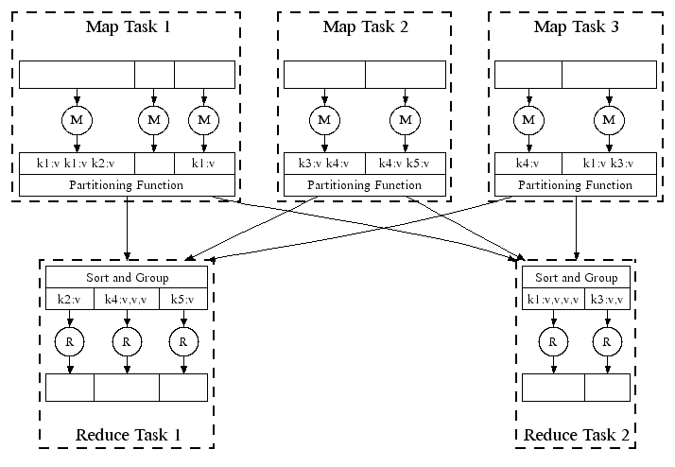
Refinement: Combiners
Often a Map task will produce many pairs of the form (k,v₁), (k,v₂), … for the same key k
E.g., popular words in the word count example
Can save network time by pre-aggregating values in the mapper:
combine(k, list(v₁)) → v₂
Combiner is usually same as the reduce function
Works only if reduce function is commutative and associative

Slide 81
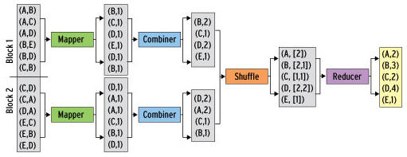
Refinement: Combiners
Back to our word counting example:
Combiner combines the values of all keys of a single mapper (single machine):
Much less data needs to be copied and shuffled!

Slide 82
Refinement: Partition Function
Want to control how keys get partitioned
Inputs to map tasks are created by contiguous splits of input file
Reduce needs to ensure that records with the same intermediate key end up at the same worker
System uses a default partition function:
hash(key) mod R
Sometimes useful to override the hash function:
E.g., hash(hostname(URL)) mod R ensures URLs from a host end up in the same output file

Slide 83
Cost Measures for Algorithms
In MapReduce we quantify the cost of an algorithm using
Communication cost = total I/O of all processes
Elapsed communication cost = max of I/O along any path
(Elapsed) computation cost analogous, but count only running time of processes
Note that here the big-O notation is not the most useful (adding more machines is always an option)

Slide 84
Example: Cost Measures
For a map-reduce algorithm:
Communication cost = input file size + 2 × (sum of the sizes of all files passed from Map processes to Reduce processes) + the sum of the output sizes of the Reduce processes.
Elapsed communication cost is the sum of the largest input + output for any map process, plus the same for any reduce process

Slide 85
What Cost Measures Mean
Either the I/O (communication) or processing (computation) cost dominates
Ignore one or the other
Total cost tells what you pay in rent from your friendly neighborhood cloud
Elapsed cost is wall-clock time using parallelism

Slide 86
Cost of Map-Reduce Join
Total communication cost = O(|R|+|S|+|R ⋈ S|)
Elapsed communication cost = O(s)
We’re going to pick k and the number of Map processes so that the I/O limit s is respected
We put a limit s on the amount of input or output that any one process can have. s could be:
What fits in main memory
What fits on local disk
With proper indexes, computation cost is linear in the input + output size
So computation cost is like comm. cost

Slide 87
Performance
IMPORTANT
You may not have room for all reduce values in memory
In fact you should PLAN not to have memory for all values
Remember, small machines are much cheaper
you have a limited budget

Slide 88
Implementations
Google
Not available outside Google
Hadoop
An open-source implementation in Java
Uses HDFS for stable storage
Download: http://hadoop.apache.org/
Spark
An open-source implementation in Scala
Uses several distributed filesystems
Download: http://spark.apache.org/
Others

Slide 89
Reading
Jeffrey Dean and Sanjay Ghemawat: MapReduce: Simplified Data Processing on Large Clusters
http://labs.google.com/papers/mapreduce.html
Sanjay Ghemawat, Howard Gobioff, and Shun-Tak Leung: The Google File System
http://labs.google.com/papers/gfs.html

Slide 90
Further Reading
Programming model inspired by functional language primitives
Partitioning/shuffling similar to many large-scale sorting systems
NOW-Sort ['97]
Re-execution for fault tolerance
BAD-FS ['04] and TACC ['97]
Locality optimization has parallels with Active Disks/Diamond work
Active Disks ['01], Diamond ['04]
Backup tasks similar to Eager Scheduling in Charlotte system
Charlotte ['96]
Dynamic load balancing solves similar problem as River's distributed queues
River ['99]

