Slide 1
Large-scale Classification and Regression
Shannon Quinn
(with thanks to J. Leskovec, A. Rajaraman, J. Ullman: Mining of Massive Datasets, http://www.mmds.org)

Slide 2
Supervised Learning
Would like to do prediction:
estimate a function f(x) so that y = f(x)
Where y can be:
Real number: Regression
Categorical: Classification
Complex object:
Ranking of items, Parse tree, etc.
Data is labeled:
Have many pairs {(x, y)}
x … vector of binary, categorical, real valued features
y … class ({+1, -1}, or a real number)
X
Y
X’
Y’
Training and test set
Estimate y = f(x) on X,Y. Hope that the same f(x) also works on unseen X’, Y’

Slide 3
Large Scale Machine Learning
We will talk about the following methods:
k-Nearest Neighbor (Instance based learning)
Perceptron (neural networks)
Support Vector Machines
Decision trees
Main question: How to efficiently train (build a model/find model parameters)?

Slide 4
Instance Based Learning
Instance based learning
Example: Nearest neighbor
Keep the whole training dataset: {(x, y)}
A query example (vector) q comes
Find closest example(s) x*
Predict y*
Works both for regression and classification
Collaborative filtering is an example of k-NN classifier
Find k most similar people to user x that have rated movie y
Predict rating y_{x} of x as an average of y_{k}

Slide 5
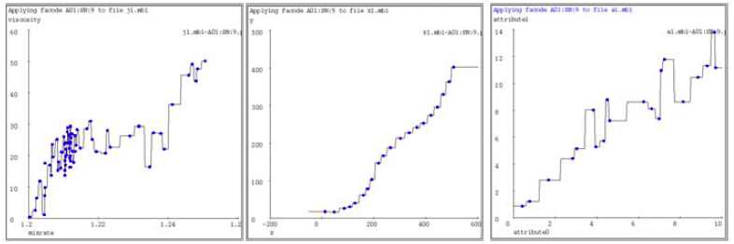
1-Nearest Neighbor
To make Nearest Neighbor work we need 4 things:
Distance metric:
Euclidean
How many neighbors to look at?
One
Weighting function (optional):
Unused
How to fit with the local points?
Just predict the same output as the nearest neighbor

Slide 6
k-Nearest Neighbor
Distance metric:
Euclidean
How many neighbors to look at?
k
Weighting function (optional):
Unused
How to fit with the local points?
Just predict the average output among k nearest neighbors
k=9

Slide 7
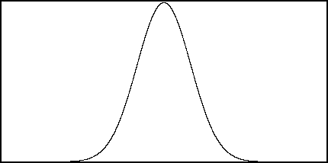
Kernel Regression
Distance metric:
Euclidean
How many neighbors to look at?
All of them (!)
Weighting function:
$w_{i}=exp⁡(−\frac{d{\left(x_{i},q\right)}^{2}}{K_{w}})$
Nearby points to query q are weighted more strongly. K_{w}…kernel width.
How to fit with the local points?
Predict weighted average: $\frac{\sum_{i}{w_{i}y_{i}}}{\sum_{i}{w_{i}}}$
w_{i}
d(x_{i}, q) = 0
K_{w}=10
K_{w}=20
K_{w}=80

Slide 8
How to find nearest neighbors?
Given: a set P of n points in R^{d}
Goal: Given a query point q
NN: Find the nearest neighbor p of q in P
Range search: Find one/all points in P within distance r from q
p
q

Slide 9
Algorithms for NN
Main memory:
Linear scan
Tree based:
Quadtree
kd-tree
Hashing:
Locality-Sensitive Hashing

Slide 10
Perceptron

Slide 11
Linear models: Perceptron
Example: Spam filtering
Instance space x ∈ X (|X|= n data points)
Binary or real-valued feature vector x of word occurrences
d features (words + other things, d~100,000)
Class y ∈ Y
y: Spam (+1), Ham (-1)

Slide 12
Linear models for classification
Binary classification:
Input: Vectors x^{(j)} and labels y^{(j)}
Vectors x^{(j)} are real valued where
Goal: Find vector w = (w₁, w₂ ,... , w_{d} )
Each w_{i} is a real number
{
Decision boundary is linear
f (x) =
+1 if w₁ x₁ + w₂ x₂ +. . . w_{d} x_{d} ≥ θ
-1 otherwise
w ⋅ x = θ
-
-
-
-
-
-
-
Note:
w ⋅ x = 0
-
-
-
-
-
w
-
-
-

Slide 13
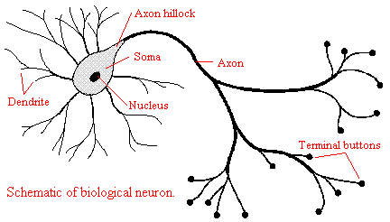
Perceptron [Rosenblatt ‘58]
(very) Loose motivation: Neuron
Inputs are feature values
Each feature has a weight w_{i}
Activation is the sum:
f(x) = Σ_{i} w_{i} x_{i} = w⋅ x
If the f(x) is:
Positive: Predict +1
Negative: Predict -1
w₁
w₂
w₃
w₄
x₁
x₂
x₃
x₄
∑
≥ 0?
w⋅x=0
nigeria
x⁽¹⁾
x⁽²⁾
Spam=1
w
Ham=-1
viagra

Slide 14
Perceptron: Estimating w
Note that the Perceptron is a conservative algorithm: it ignores samples that it classifies correctly.
Perceptron: y’ = sign(w⋅ x)
How to find parameters w?
Start with w₀ = 0
Pick training examples x^{(t)} one by one (from disk)
Predict class of x^{(t)} using current weights
y’ = sign(w^{(t)}⋅ x^{(t)})
If y’ is correct (i.e., y_{t} = y’)
No change: w^{(t+1)} = w^{(t)}
If y’ is wrong: adjust w^{(t)}
w^{(t+1)} = w^{(t)} + η ⋅ y ^{(t)} ⋅ x^{(t)}
η is the learning rate parameter
x^{(t)} is the t-th training example
y^{(t)} is true t-th class label ({+1, -1})
η⋅y^{(t)}⋅x^{(t)}
w^{(t)}
w^{(t+1)}
x^{(t)}, y^{(t)}=1

Slide 15
Perceptron Convergence
Perceptron Convergence Theorem:
If there exist a set of weights that are consistent (i.e., the data is linearly separable) the Perceptron learning algorithm will converge
How long would it take to converge?
Perceptron Cycling Theorem:
If the training data is not linearly separable the Perceptron learning algorithm will eventually repeat the same set of weights and therefore enter an infinite loop
How to provide robustness, more expressivity?

Slide 16
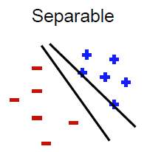
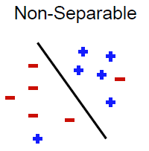
Properties of Perceptron
Separability: Some parameters get training set perfectly
Convergence: If training set is separable, perceptron will converge
(Training) Mistake bound: Number of mistakes
where
and
Note we assume x Euclidean length 1, then γ is the minimum distance of any example to plane u
Notes:
Gamma = margin
if we scale examples to have Euclidean length 1, then γ is the minimum distance of
any example to the plane

Slide 17
Updating the Learning Rate
Perceptron will oscillate and won’t converge
When to stop learning?
(1) Slowly decrease the learning rate η
A classic way is to: η = c₁/(t + c₂)
But, we also need to determine constants c₁ and c₂
(2) Stop when the training error stops chaining
(3) Have a small test dataset and stop when the test set error stops decreasing
(4) Stop when we reached some maximum number of passes over the data

Slide 18
Multiclass Perceptron
What if more than 2 classes?
Weight vector w_{c} for each class c
Train one class vs. the rest:
Example: 3-way classification y = {A, B, C}
Train 3 classifiers: w_{A}: A vs. B,C; w_{B}: B vs. A,C; w_{C}: C vs. A,B
Calculate activation for each class
f(x,c) = Σ_{i} w_{c,i} x_{i} = w_{c}⋅ x
Highest activation wins
c = arg max_{c} f(x,c)
w_{C}⋅x biggest
w_{C}
w_{B}
w_{B}⋅x biggest
w_{A}
w_{A}⋅x biggest

Slide 19
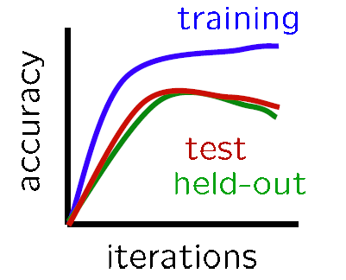
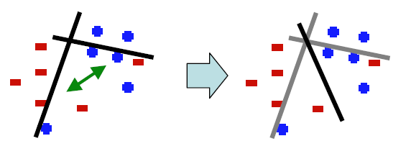
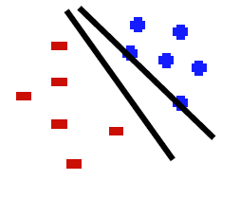
Issues with Perceptrons
Overfitting:
Regularization: If the data is not separable weights dance around
Mediocre generalization:
Finds a “barely” separating solution

Slide 20
Support Vector Machines
Want to separate “+” from “-” using a line
Data:
Training examples:
(x₁, y₁) … (x_{n}, y_{n})
Each example i:
x_{i} = ( x_{i}⁽¹⁾,… , x_{i}^{(d)} )
x_{i}^{(j)} is real valued
y_{i} ∈ { -1, +1 }
Inner product:
+
+
+
-
+
+
-
+
-
-
-
-
-
Which is best linear separator (defined by w)?

Slide 21
Largest Margin
Distance from the separating hyperplane corresponds to the “confidence” of prediction
Example:
We are more sure about the class of A and B than of C
A
C
+
+
+
+
-
+
B
-
+
+
-
+
-
-
+
-
-
-
-

Slide 22
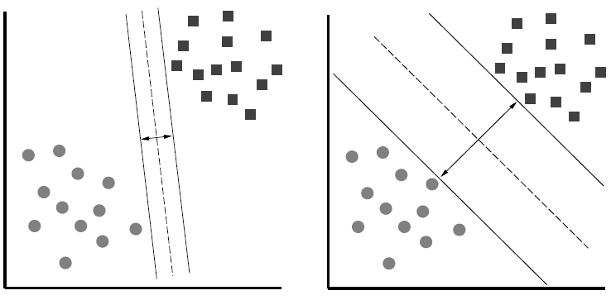
Largest Margin
Margin $γ$: Distance of closest example from the decision line/hyperplane
The reason we define margin this way is due to theoretical convenience and existence of generalization error bounds that depend on the value of margin.
Notes:
Why define margin as distance to the closest example, why not avg. or something else?
Purely theoretical

Slide 23
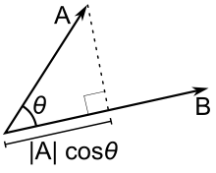
Why maximizing $γ$ a good idea?
Remember: Dot product $A⋅B=\left\|A\right\|⋅\left\|B\right\|⋅\cos{θ}$
$$\left\|A\right\|cosθ$$
$$|\left|A\right||=\sqrt{\sum_{j=1}^{d}{{\left(A^{(j)}\right)}^{2}}}$$

Slide 24
Why maximizing $γ$ a good idea?
Dot product
What is , ?
So, roughly corresponds to the margin
Bigger bigger the separation
$$w$$
x₂
+
+
w ⋅ x + b = 0
x₁
x₂
x₂
+
+
+
+
x₁
x₁
$$w$$
$$w$$
In this case $$γ_{1}≈{\left\|w\right\|}^{2}$$
In this case
$$γ_{2}≈{2\left\|w\right\|}^{2}$$

Slide 25
What is the margin?
Distance from a point to a line
L
Note we assume ${\left\|w\right\|}_{2}=1$
Let:
Line L: w∙x+b = w⁽¹⁾x⁽¹⁾+w⁽²⁾x⁽²⁾+b=0
w = (w⁽¹⁾, w⁽²⁾)
Point A = (x_{A}⁽¹⁾, x_{A}⁽²⁾)
Point M on a line = (x_{M}⁽¹⁾, x_{M}⁽²⁾)
w
A (x_{A}⁽¹⁾, x_{A}⁽²⁾)
w ∙ x + b = 0
+
d(A, L)
H
d(A, L) = |AH|
= |(A-M) ∙ w|
= |(x_{A}⁽¹⁾ – x_{M}⁽¹⁾) w⁽¹⁾ + (x_{A}⁽²⁾ – x_{M}⁽²⁾) w⁽²⁾|
= x_{A}⁽¹⁾ w⁽¹⁾ + x_{A}⁽²⁾ w⁽²⁾ + b
= w ∙ A + b
(0,0)
M (x₁, x₂)
Remember x_{M}⁽¹⁾w⁽¹⁾ + x_{M}⁽²⁾w⁽²⁾ = - b
since M belongs to line L

Slide 26
Support Vector Machine
Maximize the margin:
Good according to intuition, theory (VC dimension) & practice
is margin … distance from the separating hyperplane
+
+
w⋅x+b=0
+
+
+
-
+
γ
+
γ
-
-
-
+
γ
-
-
-
Maximizing the margin

Slide 27
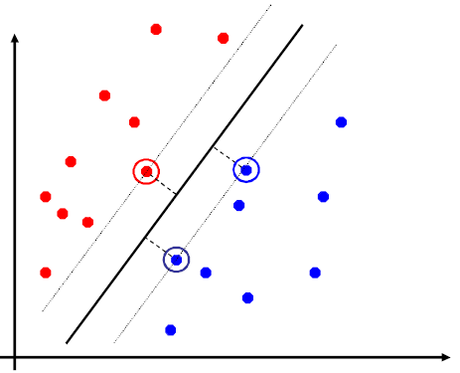
Support Vector Machines
Separating hyperplane is defined by the support vectors
Points on +/- planes from the solution
If you knew these points, you could ignore the rest
Generally, d+1 support vectors (for d dim. data)

Slide 28
Non-linearly Separable Data
If data is not separable introduce penalty:
Minimize ǁwǁ² plus the number of training mistakes
Set C using cross validation
How to penalize mistakes?
All mistakes are not equally bad!
+
+
w⋅x+b=0
+
-
+
+
-
+
-
-
+
-
+
-
-
-
-

Slide 29
Support Vector Machines
Introduce slack variables ξ_{i}
If point x_{i} is on the wrong side of the margin then get penalty ξ_{i}
+
w⋅x+b=0
+
+
-
+
ξ_{i}
+
+
ξ_{j}
-
-
+
+
-
-
-
For each data point:
If margin ≥ 1, don’t care
If margin < 1, pay linear penalty
Notes:
ksi

Slide 30
Slack Penalty $C$
What is the role of slack penalty C:
C=∞: Only want to w, b that separate the data
C=0: Can set ξ_{i} to anything, then w=0 (basically ignores the data)
small C
+
“good” C
+
+
+
+
big C
+
-
-
+
+
-
-
-
-
(0,0)

Slide 31
Support Vector Machines
SVM in the “natural” form
SVM uses “Hinge Loss”:
Margin
Empirical loss L (how well we fit training data)
Regularization parameter
penalty
0/1 loss
Hinge loss: max{0, 1-z}
-1 0 1 2

Slide 32
SVM: How to estimate w?
Want to estimate and !
Standard way: Use a solver!
Solver: software for finding solutions to “common” optimization problems
Use a quadratic solver:
Minimize quadratic function
Subject to linear constraints
Problem: Solvers are inefficient for big data!

Slide 33
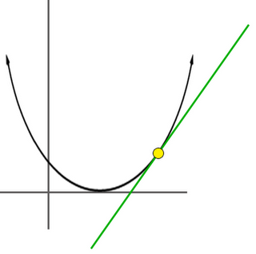
SVM: How to estimate w?
Want to estimate w, b!
Alternative approach:
Want to minimize f(w,b):
Side note:
How to minimize convex functions ?
Use gradient descent: min_{z} g(z)
Iterate: z_{t+1} ← z_{t} – η ∇g(z_{t})
g(z)
z

Slide 34
SVM: How to estimate w?
Want to minimize f(w,b):
Compute the gradient ∇(j) w.r.t. w^{(j)}
Empirical loss $L(x_{i} y_{i})$

Slide 35
SVM: How to estimate w?
Gradient descent:
Problem:
Computing ∇f^{(j)} takes O(n) time!
n … size of the training dataset
Iterate until convergence:
For j = 1 … d
Evaluate:
Update: w^{(j)} ← w^{(j)} - η∇f^{(j)}
η…learning rate parameter C… regularization parameter

Slide 36
SVM: How to estimate w?
We just had:
Stochastic Gradient Descent
Instead of evaluating gradient over all examples evaluate it for each individual training example
Stochastic gradient descent:
Notice: no summation over i anymore
Iterate until convergence:
For i = 1 … n
For j = 1 … d
Compute: ∇f^{(j)}(x_{i})
Update: w^{(j)} ← w^{(j)} - η ∇f^{(j)}(x_{i})

Slide 37
An observation
Key computational point:
If x^{i}=0 then the gradient of w^{j} is zero
so when processing an example you only need to update weights for the non-zero features of an example.

Slide 38
Example: Text categorization
Example by Leon Bottou:
Reuters RCV1 document corpus
Predict a category of a document
One vs. the rest classification
n = 781,000 training examples (documents)
23,000 test examples
d = 50,000 features
One feature per word
Remove stop-words
Remove low frequency words

Slide 39
Example: Text categorization
Questions:
(1) Is SGD successful at minimizing f(w,b)?
(2) How quickly does SGD find the min of f(w,b)?
(3) What is the error on a test set?
Training time Value of f(w,b) Test error
Standard SVM “Fast SVM”
SGD SVM
(1) SGD-SVM is successful at minimizing the value of f(w,b)
(2) SGD-SVM is super fast
(3) SGD-SVM test set error is comparable

Slide 40
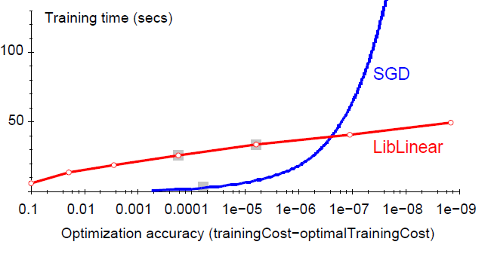
Optimization “Accuracy”
SGD SVM
Conventional SVM
Optimization quality: | f(w,b) – f (w^{opt},b^{opt}) |
For optimizing f(w,b) within reasonable quality SGD-SVM is super fast

Slide 41
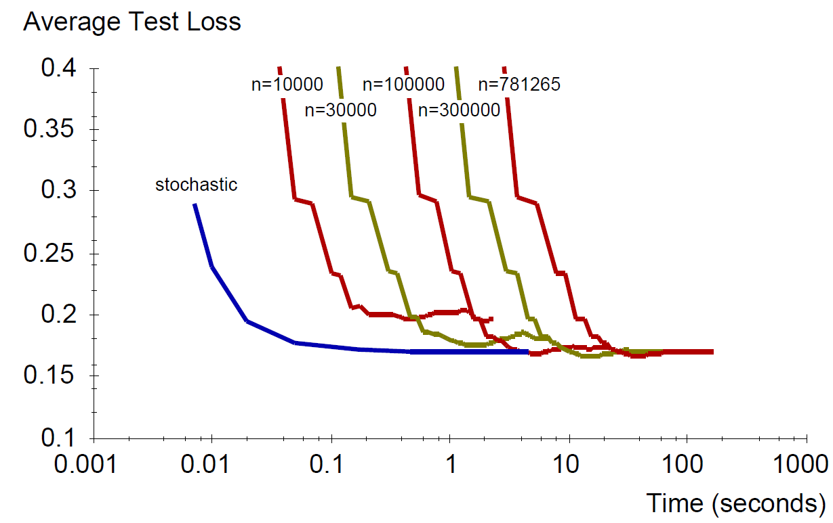
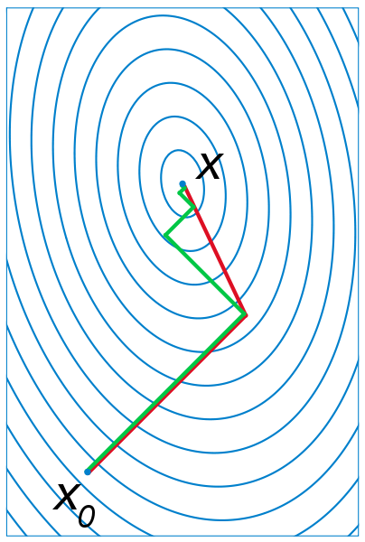
SGD vs. Batch Conjugate Gradient
SGD on full dataset vs. Conjugate Gradient on a sample of n training examples
Theory says: Gradient descent converges in linear time $k$. Conjugate gradient converges in $\sqrt{k}$.
Bottom line: Doing a simple (but fast) SGD update many times is better than doing a complicated (but slow) CG update a few times
$k$… condition number

Slide 42
Practical Considerations
Need to choose learning rate η and t₀
Leon suggests:
Choose t₀ so that the expected initial updates are comparable with the expected size of the weights
Choose η:
Select a small subsample
Try various rates η (e.g., 10, 1, 0.1, 0.01, …)
Pick the one that most reduces the cost
Use η for next 100k iterations on the full dataset

