Slide 1
Graphs (Part I)
Shannon Quinn
(with thanks to William Cohen of CMU and Jure Leskovec, Anand Rajaraman, and Jeff Ullman of Stanford University)

Slide 2
Why I’m talking about graphs
Lots of large data is graphs
Facebook, Twitter, citation data, and other social networks
The web, the blogosphere, the semantic web, Freebase, Wikipedia, Twitter, and other information networks
Text corpora (like RCV1), large datasets with discrete feature values, and other bipartite networks
nodes = documents or words
links connect document → word or word → document
Computer networks, biological networks (proteins, ecosystems, brains, …), …
Heterogeneous networks with multiple types of nodes
people, groups, documents

Slide 3
Properties of Graphs
Descriptive Statistics
Models of Growth/Formation
Number of connected components
Diameter
Degree distribution
…
Erdos-Renyi
Preferential attachment
Stochastic block models
….
Let’s look at some examples of graphs … but first, why are these statistics important?

Slide 4
An important question
How do you explore a dataset?
compute statistics (e.g., feature histograms, conditional feature histograms, correlation coefficients, …)
sample and inspect
run a bunch of small-scale experiments
How do you explore a graph?
compute statistics (degree distribution, …)
sample and inspect
how do you sample?

Slide 5
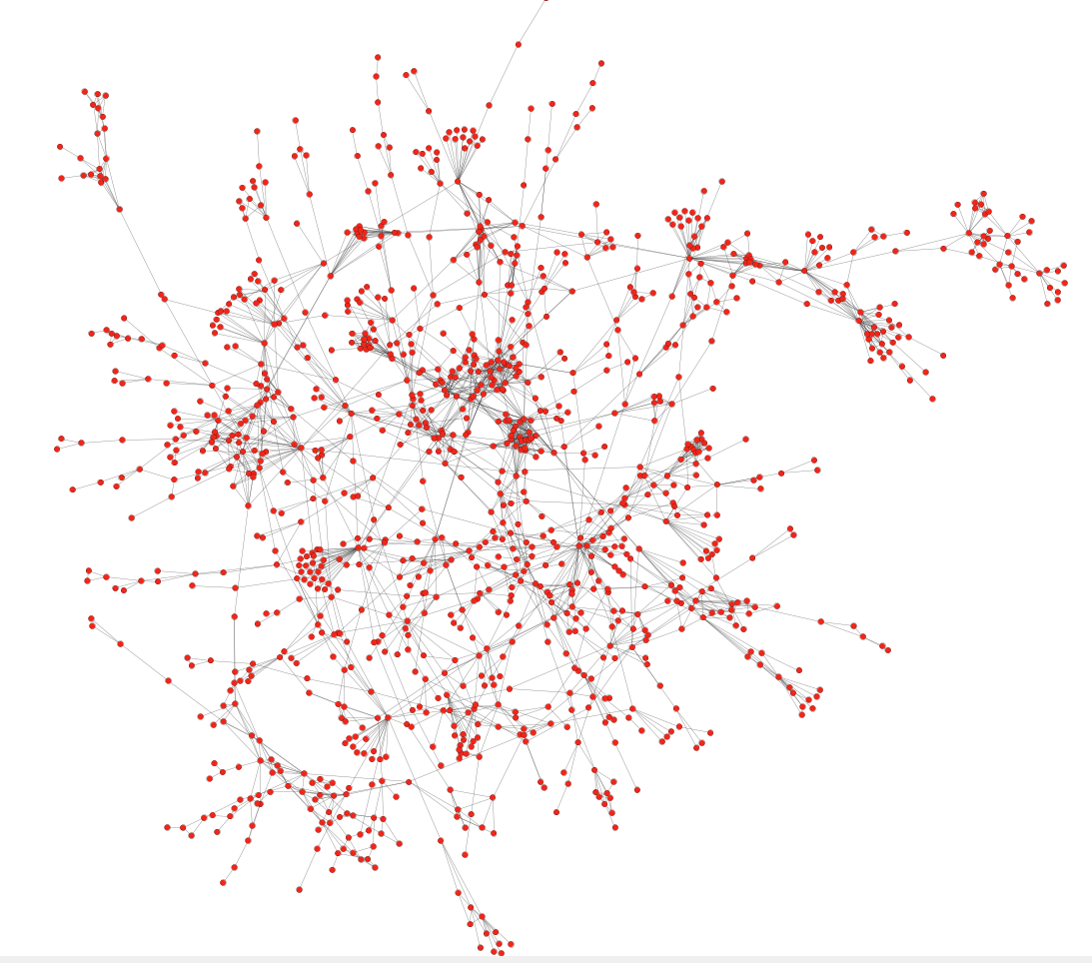
Protein-Protein Interactions
Can we identify functional modules?
Nodes: Proteins
Edges: Physical interactions

Slide 6
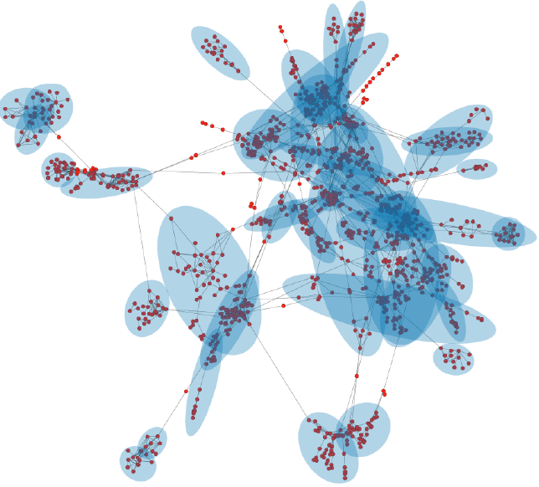
Protein-Protein Interactions
Functional modules
Nodes: Proteins
Edges: Physical interactions

Slide 7
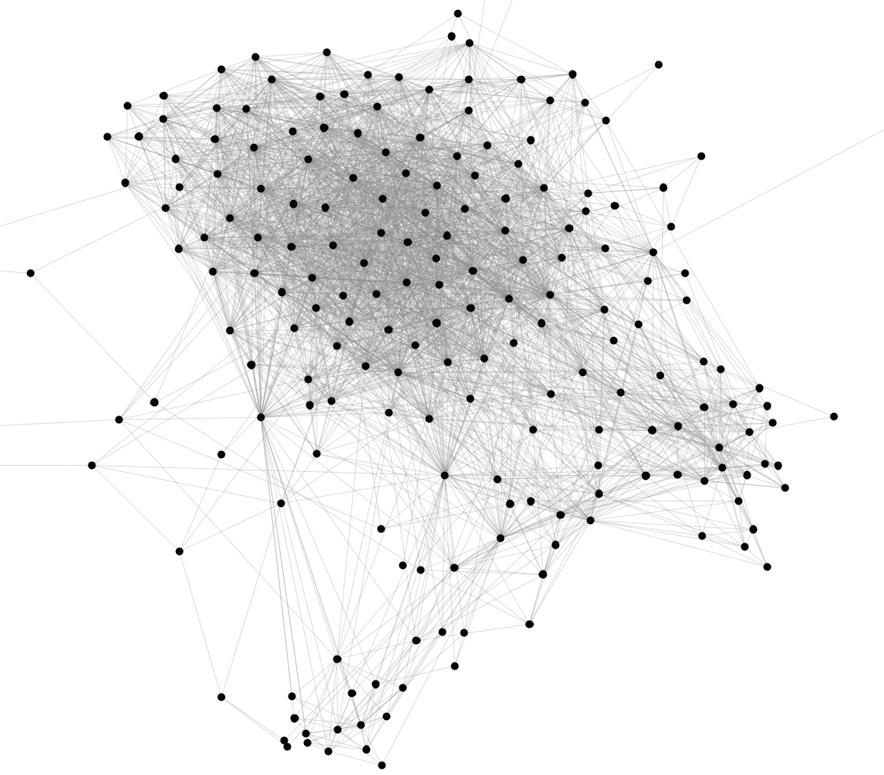
Facebook Network
Can we identify social communities?
Nodes: Facebook Users
Edges: Friendships

Slide 8
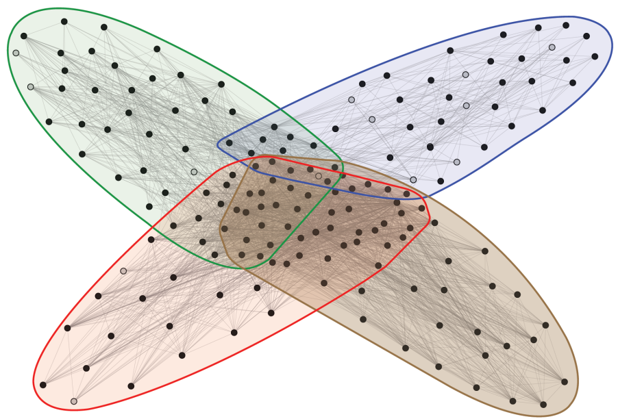
Facebook Network
Social communities
High school
Summer internship
Stanford (Basketball)
Stanford (Squash)
Nodes: Facebook Users
Edges: Friendships

Slide 9
Blogs

Slide 10
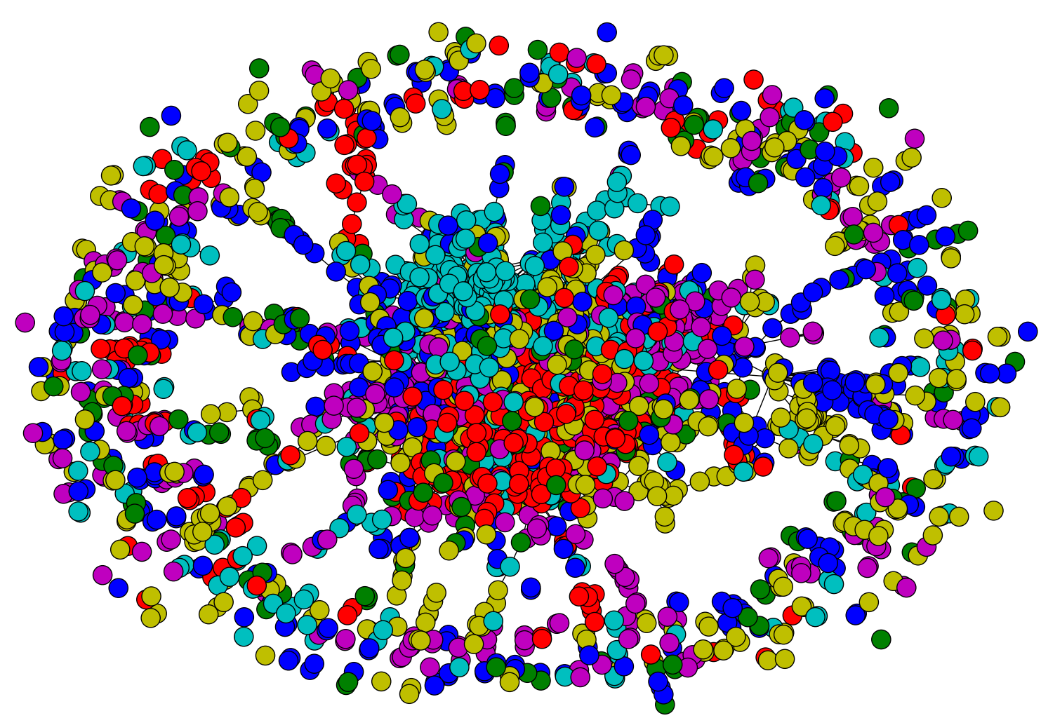
Citations
Notes:
citeseer

Slide 11
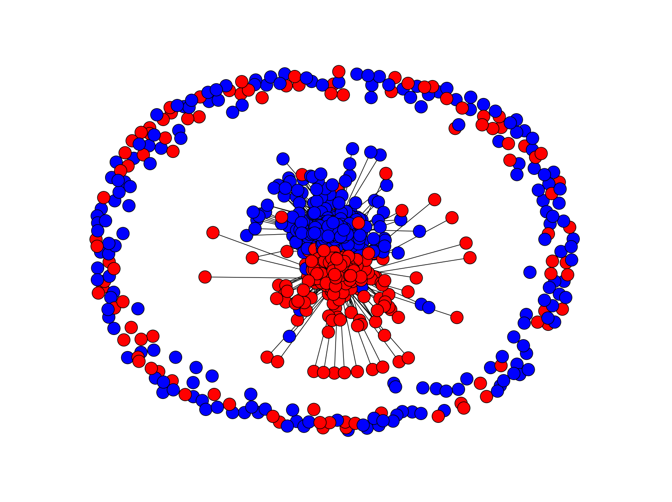
Blogs
Notes:
blogs

Slide 12
Blogs
Notes:
blogs

Slide 13
How do you model graphs?
Notes:
Height of italian men at military age, raw and adjusted for age

Slide 14
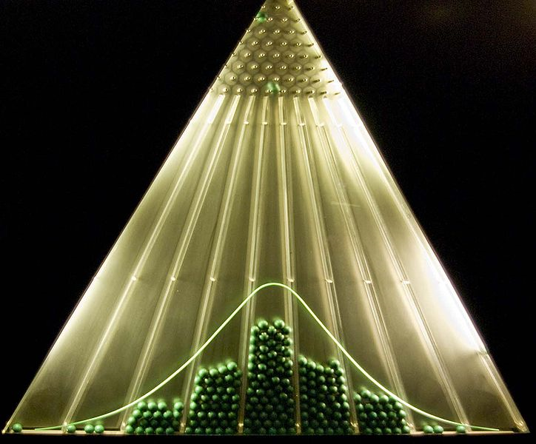
What are we trying to do?
Normal curve:
Data to fit
Underlying process that “explains” the data
Closed-form parametric form
Only models a small part of the data

Slide 15
Graphs
Set V of vertices/nodes v1,… , set E of edges (u,v),….
Edges might be directed and/or weighted and/or labeled
Degree of v is #edges touching v
Indegree and Outdegree for directed graphs
Path is sequence of edges (v0,v1),(v1,v2),….
Geodesic path between u and v is shortest path connecting them
Diameter is max _{u,v in V} {length of geodesic between u,v}
Effective diameter is 90th percentile
Mean diameter is over connected pairs
(Connected) component is subset of nodes that are all pairwise connected via paths
Clique is subset of nodes that are all pairwise connected via edges
Triangle is a clique of size three

Slide 16
Graphs
Some common properties of graphs:
Distribution of node degrees
Distribution of cliques (e.g., triangles)
Distribution of paths
Diameter (max shortest-path)
Effective diameter (90th percentile)
Connected components
…
Some types of graphs to consider:
Real graphs (social & otherwise)
Generated graphs:
Erdos-Renyi “Bernoulli” or “Poisson”
Watts-Strogatz “small world” graphs
Barbosi-Albert “preferential attachment”
…
Notes:
Watts-Strogatz
Account for triadic closures (cliques of friends)
Account for hubs (power law distribution, rather than Poisson of ER graphs)

Slide 17
Erdos-Renyi graphs
Take n nodes, and connect each pair with probability p
Mean degree is z=p(n-1)

Slide 18
Erdos-Renyi graphs
Take n nodes, and connect each pair with probability p
Mean degree is z=p(n-1)
Mean number of neighbors distance d from v is z^{d}
How large does d need to be so that z^{d} >=n ?
If z>1, d = log(n)/log(z)
If z<1, you can’t do it
So:
There tend to be either many small components (z<1) or one large one (z>1) giant connected component)
Another intuition:
If there are a two large connected components, then with high probability a few random edges will link them up.

Slide 20
Notes:
blogs

Slide 21
Erdos-Renyi graphs
Take n nodes, and connect each pair with probability p
Mean degree is z=p(n-1)
Mean number of neighbors distance d from v is z^{d}
How large does d need to be so that z^{d} >=n ?
If z>1, d = log(n)/log(z)
If z<1, you can’t do it
So:
If z>1, diameters tend to be small (relative to n)

Slide 22
Sociometry, Vol. 32, No. 4. (Dec., 1969), pp. 425-443.
64 of 296 chains succeed, avg chain length is 6.2

Slide 23
Illustrations of the Small World
Millgram’s experiment
Erdős numbers
http://www.ams.org/mathscinet/searchauthors.html
Bacon numbers
http://oracleofbacon.org/
LinkedIn
http://www.linkedin.com/
Privacy issues: the whole network is not visible to all

Slide 26
Erdos-Renyi graphs
Take n nodes, and connect each pair with probability p
Mean degree is z=p(n-1)
This is usually not a good model of degree distribution in natural networks

Slide 27
Degree distribution
Plot cumulative degree
X axis is degree
Y axis is #nodes that have degree at least k
Typically use a log-log scale
Straight lines are a power law; normal curve dives to zero at some point
Left: trust network in epinions web site from Richardson & Domingos

Slide 28
Degree distribution
Plot cumulative degree
X axis is degree
Y axis is #nodes that have degree at least k
Typically use a log-log scale
Straight lines are a power law; normal curve dives to zero at some point
This defines a “scale” for the network
Left: trust network in epinions web site from Richardson & Domingos

Slide 29
Friendship network in Framington Heart Study

Slide 32
Graphs
Some common properties of graphs:
Distribution of node degrees
Distribution of cliques (e.g., triangles)
Distribution of paths
Diameter (max shortest-path)
Effective diameter (90th percentile)
Connected components
…
Some types of graphs to consider:
Real graphs (social & otherwise)
Generated graphs:
Erdos-Renyi “Bernoulli” or “Poisson”
Watts-Strogatz “small world” graphs
Barbosi-Albert “preferential attachment”
…

Slide 33
Graphs
Some common properties of graphs:
Distribution of node degrees: often scale-free
Distribution of cliques (e.g., triangles)
Distribution of paths
Diameter (max shortest-path)
Effective diameter (90th percentile) often small
Connected components usually one giant CC
…
Some types of graphs to consider:
Real graphs (social & otherwise)
Generated graphs:
Erdos-Renyi “Bernoulli” or “Poisson”
Watts-Strogatz “small world” graphs
Barbosi-Albert “preferential attachment” generates scale-free graphs
…

Slide 34
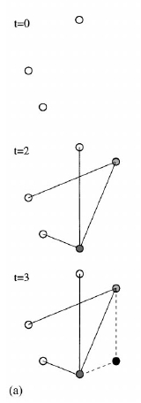
Barabasi-Albert Networks
Science 286 (1999)
Start from a small number of node, add a new node with m links
Preferential Attachment
Probability of these links to connect to existing nodes is proportional to the node’s degree
‘Rich gets richer’
This creates ‘hubs’: few nodes with very large degrees

Slide 35
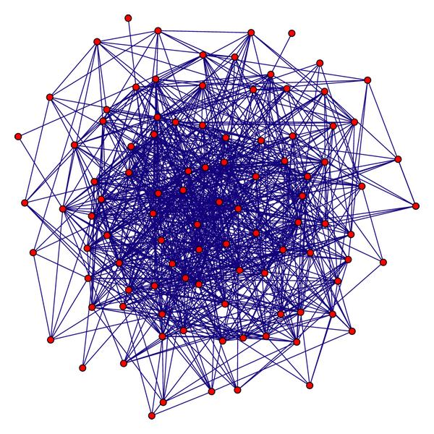
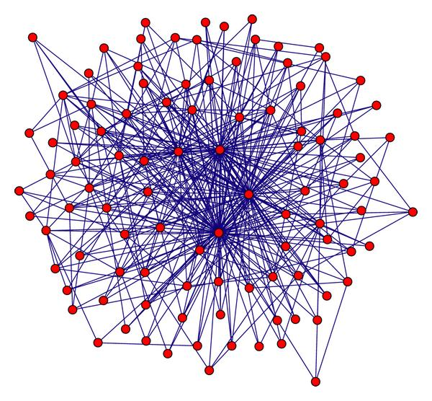
Random graph
(Erdos Renyi)
Preferential attachment
(Barabasi-Albert)
Notes:
Artificial graph

Slide 36
Graphs
Some common properties of graphs:
Distribution of node degrees: often scale-free
Distribution of cliques (e.g., triangles)
Distribution of paths
Diameter (max shortest-path)
Effective diameter (90th percentile) often small
Connected components usually one giant CC
…
Some types of graphs to consider:
Real graphs (social & otherwise)
Generated graphs:
Erdos-Renyi “Bernoulli” or “Poisson”
Watts-Strogatz “small world” graphs
Barbosi-Albert “preferential attachment” generates scale-free graphs
…

Slide 37
Homophily
One definition: excess edges between similar nodes
E.g., assume nodes are male and female and Pr(male)=p, Pr(female)=q.
Is Pr(gender(u)≠ gender(v) | edge (u,v)) >= 2pq?
Another def’n: excess edges between common neighbors of v

Slide 38
Homophily
Another def’n: excess edges between common neighbors of v

Slide 39
Homophily
In a random Erdos-Renyi graph:
In natural graphs two of your mutual friends might well be friends:
Like you they are both in the same class (club, field of CS, …)
You introduced them

Slide 40
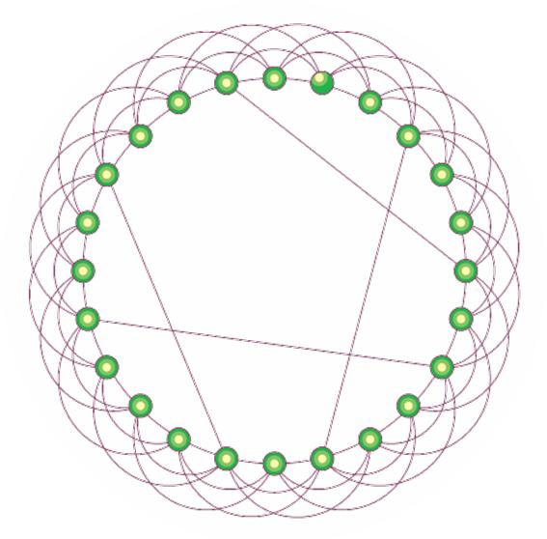
Watts-Strogatz model
Start with a ring
Connect each node to k nearest neighbors
➔ homophily
Add some random shortcuts from one point to another
➔ small diameter
Degree distribution not scale-free
Generalizes to d dimensions

Slide 42
An important question
How do you explore a dataset?
compute statistics (e.g., feature histograms, conditional feature histograms, correlation coefficients, …)
sample and inspect
run a bunch of small-scale experiments
How do you explore a graph?
compute statistics (degree distribution, …)
sample and inspect
how do you sample?

Slide 43
KDD 2006

Slide 44
Brief summary
Define goals of sampling:
“scale-down” – find G’<G with similar statistics
“back in time”: for a growing G, find G’<G that is similar (statistically) to an earlier version of G
Experiment on real graphs with plausible sampling methods, such as
RN – random nodes, sampled uniformly
…
See how well they perform

Slide 45
Brief summary
Experiment on real graphs with plausible sampling methods, such as
RN – random nodes, sampled uniformly
RPN – random nodes, sampled by PageRank
RDP – random nodes sampled by in-degree
RE – random edges
RJ – run PageRank’s “random surfer” for n steps
RW – run RWR’s “random surfer” for n steps
FF – repeatedly pick r(i) neighbors of i to “burn”, and then recursively sample from them

Slide 46
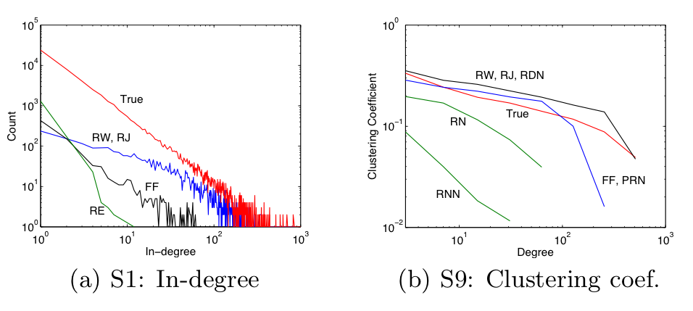
10% sample – pooled on five datasets

Slide 47
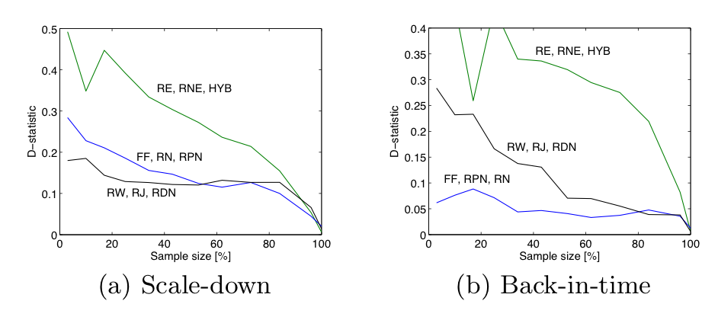
d-statistic measures agreement between distributions
D=max{|F(x)-F’(x)|} where F, F’ are cdf’s
max over nine different statistics

Slide 48
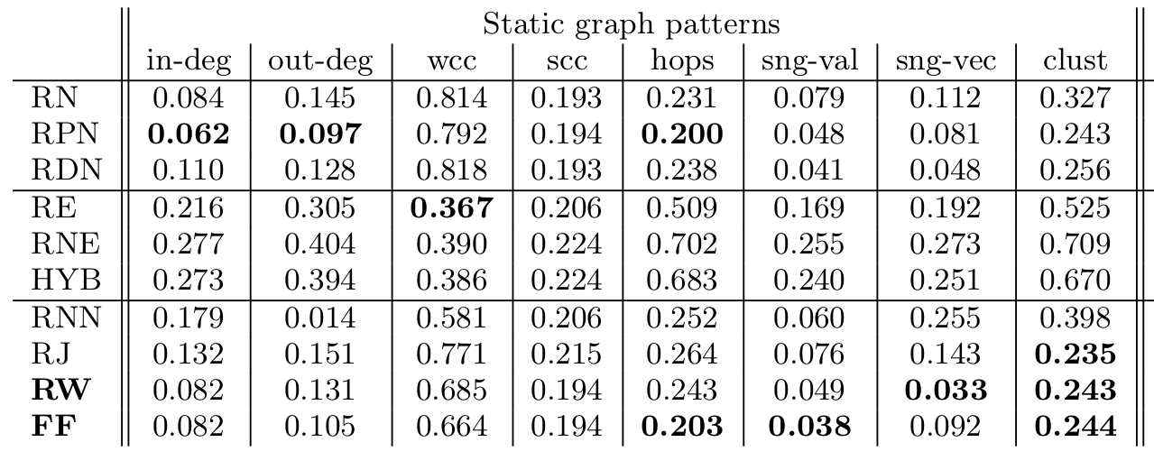

Slide 49
Graphs (Part II)
To be continued…

