Slide 1
Graphs (Part II)
Shannon Quinn
(with thanks to William Cohen and Aapo Kyrola of CMU, and J. Leskovec, A. Rajaraman, and J. Ullman of Stanford University)

Slide 2
Parallel Graph Computation
Distributed computation and/or multicore parallelism
Sometimes confusing. We will talk mostly about distributed computation.
Are classic graph algorithms parallelizable? What about distributed?
Depth-first search?
Breadth-first search?
Priority-queue based traversals (Djikstra’s, Prim’s algorithms)
Notes:
BFS is actually intrisincally parallel because can express as computation on frontiers.

Slide 3
MapReduce for Graphs
Graph computation almost always iterative
MapReduce ends up shipping the whole graph on each iteration over the network (map->reduce->map->reduce->...)
Mappers and reducers are stateless

Slide 4
Iterative Computation is Difficult
System is not optimized for iteration:
Iterations
Data
Data
Data
Data
CPU 1
CPU 1
CPU 1
Data
Data
Data
Data
Data
Data
Data
Data
CPU 2
CPU 2
CPU 2
Startup Penalty
Disk Penalty
Startup Penalty
Disk Penalty
Startup Penalty
Data
Data
Disk Penalty
Data
Data
Data
Data
Data
Data
CPU 3
CPU 3
CPU 3
Data
Data
Data
Data
Data
Data
Data
Data

Slide 5
MapReduce and Partitioning
Map-Reduce splits the keys randomly between mappers/reducers
But on natural graphs, high-degree vertices (keys) may have million-times more edges than the average
Extremely uneven distribution
Time of iteration = time of slowest job.

Slide 6
Curse of the Slow Job
Iterations
Data
Data
Data
Data
CPU 1
CPU 1
CPU 1
Data
Data
Data
Data
Data
Data
Data
Data
CPU 2
CPU 2
CPU 2
Data
Data
Data
Data
Data
Data
Data
Data
CPU 3
CPU 3
CPU 3
Data
Data
Data
Data
Data
Data
Data
Data
Barrier
Barrier
Barrier
http://www.www2011india.com/proceeding/proceedings/p607.pdf

Slide 7
Map-Reduce is Bulk-Synchronous Parallel
Bulk-Synchronous Parallel = BSP (Valiant, 80s)
Each iteration sees only the values of previous iteration.
In linear systems literature: Jacobi iterations
Pros:
Simple to program
Maximum parallelism
Simple fault-tolerance
Cons:
Slower convergence
Iteration time = time taken by the slowest node
Notes:
Keys “evenly” divided across reducers (partioner handles this)
No guarantees regarding the distribution of values
No preservation of “locality” between keys

Slide 8
Triangle Counting in Twitter Graph
Total:
34.8 Billion Triangles
40M Users 1.2B Edges
1536 Machines
423 Minutes
64 Machines, 1024 Cores
1.5 Minutes
Hadoop results from [Suri & Vassilvitskii '11]
Notes:
Hadoop [1] S. Suri and S. Vassilvitskii, “Counting triangles and the curse of the last reducer,” presented at the WWW '11: Proceedings of the 20th international conference on World wide web, 2011.

Slide 9
PageRank
5.5 hrs
1 hr
8 min
40M Webpages, 1.4 Billion Links (100 iterations)
Hadoop results from [Kang et al. '11]
Twister (in-memory MapReduce) [Ekanayake et al. ‘10]
Notes:
“Comparable numbers are hard to come by as everyone uses different datasets, but we try to equalize as much as possible giving the competition an advantage when in doubt”
Scaling to 100 iterations so costs are in dollars and not cents.
Numbers:
Hadoop: Ran on Kronecker graph of 1.1B edges, 50 M45 machines.
From available numbers, each machine is approximately 8 cores, 6 GB RAM or roughly a c1.xlarge instance. Putting total cost at $33 per hour
Spectral Analysis for Billion-Scale Graphs: Discoveries and Implementation U Kang Brendan Meeder Christos Faloutsos
Twister: Ran on ClueWeb dataset of 50M pages, 1.4B edges.
Using 64 Nodes of 4 cores each. 16GB RAM per node. Or roughly a m2.xlarge to m2.2xlarge instance. Putting total cost at $28-$56 per hour.
Jaliya Ekanayake, Hui Li, Bingjing Zhang, Thilina Gunarathne, Seung-Hee Bae, Judy Qiu, Geoffrey Fox, Twister: A Runtime for Iterative MapReduce," The First International Workshop on MapReduce and its Applications (MAPREDUCE'10) - HPDC2010
GraphLab: Ran on 64 cc1.4x large instances at $83.2 per hour

Slide 10
Graph algorithms
PageRank implementations
in memory
streaming, node list in memory
streaming, no memory
map-reduce
A little like Naïve Bayes variants
data in memory
word counts in memory
stream-and-sort
map-reduce

Slide 11
Google’s PageRank
Inlinks are “good” (recommendations)
Inlinks from a “good” site are better than inlinks from a “bad” site
but inlinks from sites with many outlinks are not as “good”...
“Good” and “bad” are relative.
web site xxx
web site xxx
web site xxx
web site a b c d e f g
web
site
pdq pdq ..
web site yyyy
web site a b c d e f g
web site yyyy

Slide 12
Google’s PageRank
web site xxx
Imagine a “pagehopper” that always either
follows a random link, or
jumps to random page
web site xxx
web site a b c d e f g
web
site
pdq pdq ..
web site yyyy
web site a b c d e f g
web site yyyy

Slide 13
Google’s PageRank (Brin & Page, http://www-db.stanford.edu/~backrub/google.html)
web site xxx
Imagine a “pagehopper” that always either
follows a random link, or
jumps to random page
PageRank ranks pages by the amount of time the pagehopper spends on a page:
or, if there were many pagehoppers, PageRank is the expected “crowd size”
web site xxx
web site a b c d e f g
web
site
pdq pdq ..
web site yyyy
web site a b c d e f g
web site yyyy

Slide 14
Random Walks
avoids messy “dead ends”….

Slide 15
Random Walks: PageRank

Slide 16
Random Walks: PageRank

Slide 17
Graph = Matrix Vector = Node → Weight
M
v
 | A | B | C | D | E | F | G | H | I | J
A | _ | 1 | 1 |  |  | 1
B | 1 | _ | 1
C | 1 | 1 | _
D |  |  |  | _ | 1 | 1
E |  |  |  | 1 | _ | 1
F | 1 |  |  | 1 | 1 | _
G |  |  |  |  |  |  | _ |  | 1 | 1
H |  |  |  |  |  |  |  | _ | 1 | 1
I |  |  |  |  |  |  | 1 | 1 | _ | 1
J |  |  |  |  |  |  | 1 | 1 | 1 | _
 | A
A | 3
B | 2
C | 3
D
E
F
G
H
I
J
C
A
B
G
I
H
J
F
D
E
M

Slide 18
PageRank in Memory
Let u = (1/N, …, 1/N)
dimension = #nodes N
Let A = adjacency matrix: [a_{ij}=1 ⬄ i links to j]
Let W = [w_{ij} = a_{ij}/outdegree(i)]
w_{ij} is probability of jump from i to j
Let v⁰ = (1,1,….,1)
or anything else you want
Repeat until converged:
Let v^{t+1} = cu + (1-c)Wv^{t}
c is probability of jumping “anywhere randomly”

Slide 19
Streaming PageRank
Assume we can store v but not W in memory
Repeat until converged:
Let v^{t+1} = cu + (1-c)Wv^{t}
Store A as a row matrix: each line is
i j_{i,1},…,j_{i,d} [the neighbors of i]
Store v’ and v in memory: v’ starts out as cu
For each line “i j_{i,1},…,j_{i,d} “
For each j in j_{i,1},…,j_{i,d}
v’[j] += (1-c)v[i]/d
Everything needed for update is right there in row….

Slide 20
Streaming PageRank: with some long rows
Repeat until converged:
Let v^{t+1} = cu + (1-c)Wv^{t}
Store A as a list of edges: each line is: “i d(i) j”
Store v’ and v in memory: v’ starts out as cu
For each line “i d j“
v’[j] += (1-c)v[i]/d
We need to get the degree of i and store it locally

Slide 21
Streaming PageRank: preprocessing
Original encoding is edges (i,j)
Mapper replaces i,j with i,1
Reducer is a SumReducer
Result is pairs (i,d(i))
Then: join this back with edges (i,j)
For each i,j pair:
send j as a message to node i in the degree table
messages always sorted after non-messages
the reducer for the degree table sees i,d(i) first
then j1, j2, ….
can output the key,value pairs with key=i, value=d(i), j

Slide 22
Preprocessing Control Flow: 1
I | J
i1 | j1,1
i1 | j1,2
… | …
i1 | j1,k1
i2 | j2,1
… | …
i3 | j3,1
… | …
I
i1 | 1
i1 | 1
… | …
i1 | 1
i2 | 1
… | …
i3 | 1
… | …
I
i1 | 1
i1 | 1
… | …
i1 | 1
i2 | 1
… | …
i3 | 1
… | …
I | d(i)
i1 | d(i1)
.. | …
i2 | d(i2)
… | …
i3 | d)i3)
… | …
MAP
SORT
REDUCE
Summing values

Slide 23
Preprocessing Control Flow: 2
I | J
i1 | ~j1,1
i1 | ~j1,2
… | …
i2 | ~j2,1
… | …
I | J
i1 | j1,1
i1 | j1,2
… | …
i2 | j2,1
… | …
I
i1 | d(i1)
i1 | ~j1,1
i1 | ~j1,2
.. | …
i2 | d(i2)
i2 | ~j2,1
i2 | ~j2,2
… | …
I
i1 | d(i1) | j1,1
i1 | d(i1) | j1,2
… | … | …
i1 | d(i1) | j1,n1
i2 | d(i2) | j2,1
… | … | …
i3 | d(i3) | j3,1
… | … | …
I | d(i)
i1 | d(i1)
.. | …
i2 | d(i2)
… | …
I | d(i)
i1 | d(i1)
.. | …
i2 | d(i2)
… | …
MAP
SORT
REDUCE
copy or convert to messages
join degree with edges

Slide 24
Control Flow: Streaming PR
I | J
i1 | j1,1
i1 | j1,2
… | …
i2 | j2,1
… | …
I | d/v
i1 | d(i1),v(i1)
i1 | ~j1,1
i1 | ~j1,2
.. | …
i2 | d(i2),v(i2)
i2 | ~j2,1
i2 | ~j2,2
… | …
to | delta
i1 | c
j1,1 | (1-c)v(i1)/d(i1)
… | …
j1,n1 | i
i2 | c
j2,1 | …
… | …
i3 | c
I | delta
i1 | c
i1 | (1-c)v(…)….
i1 | (1-c)…
.. | …
i2 | c
i2 | (1-c)…
i2 | ….
… | …
I | d/v
i1 | d(i1),v(i1)
i2 | d(i2),v(i2)
… | …
REDUCE
MAP
SORT
MAP
SORT
send “pageRank updates ” to outlinks
copy or convert to messages

Slide 25
Control Flow: Streaming PR
to | delta
i1 | c
j1,1 | (1-c)v(i1)/d(i1)
… | …
j1,n1 | i
i2 | c
j2,1 | …
… | …
i3 | c
I | delta
i1 | c
i1 | (1-c)v(…)….
i1 | (1-c)…
.. | …
i2 | c
i2 | (1-c)…
i2 | ….
… | …
I | v’
i1 | ~v’(i1)
i2 | ~v’(i2)
… | …
I | d/v
i1 | d(i1),v’(i1)
i2 | d(i2),v’(i2)
… | …
I | d/v
i1 | d(i1),v(i1)
i2 | d(i2),v(i2)
… | …
REDUCE
MAP
SORT
REDUCE
MAP
SORT
REDUCE
Summing values
Replace v with v’

Slide 26
Control Flow: Streaming PR
I | J
i1 | j1,1
i1 | j1,2
… | …
i2 | j2,1
… | …
and back around for next iteration….
I | d/v
i1 | d(i1),v(i1)
i2 | d(i2),v(i2)
… | …
MAP
copy or convert to messages

Slide 27
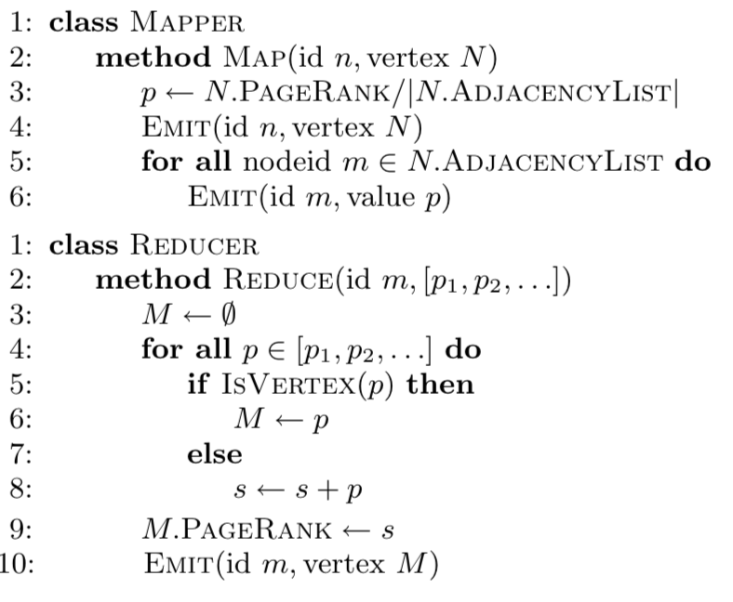
PageRank in MapReduce
Notes:
Pseudo-code for simplified PageRank in MapReduce (does not handle damping factor or sinks)
- In the map phase we evenly divide up each vertex’s PageRank mass and pass each piece along outgoing edges to neighbors.
In the reduce phase PageRank contributions are summed up at each destination vertex.
Each MapReduce job corresponds to one iteration of the algorithm.
NOTE: TWO effective algorithms happening at once here.
1: Passing the PageRank values of the graph.
2: Passing the graph structure itself.
*** Need to be able to discern the difference in the Reducer
(kind of like in the next homework…centroids vs points)

Slide 28
More on graph algorithms
PageRank is a one simple example of a graph algorithm
but an important one
personalized PageRank (aka “random walk with restart”) is an important operation in machine learning/data analysis settings
PageRank is typical in some ways
Trivial when graph fits in memory
Easy when node weights fit in memory
More complex to do with constant memory
A major expense is scanning through the graph many times
… same as with SGD/Logistic regression
disk-based streaming is much more expensive than memory-based approaches
Locality of access is very important!
gains if you can pre-cluster the graph even approximately
avoid sending messages across the network – keep them local

Slide 29
Machine Learning in Graphs - 2010

Slide 30
Some ideas
Combiners are helpful
Store outgoing incrementVBy messages and aggregate them
This is great for high indegree pages
Hadoop’s combiners are suboptimal
Messages get emitted before being combined
Hadoop makes weak guarantees about combiner usage
Notes:
Hadoop makes no explicit guarantees a Combiner will be executed
“The combiner is provided as a semantics-preserving optimization to the execution framework, which has the option of using, perhaps multiple times, or not at all.”
Data is serialized locally (and deserialized) before Combiner execution
Still more efficient than added network traffic but more overhead than is needed if we’re not leaving the same machine

Slide 31
This slide again!

Slide 32
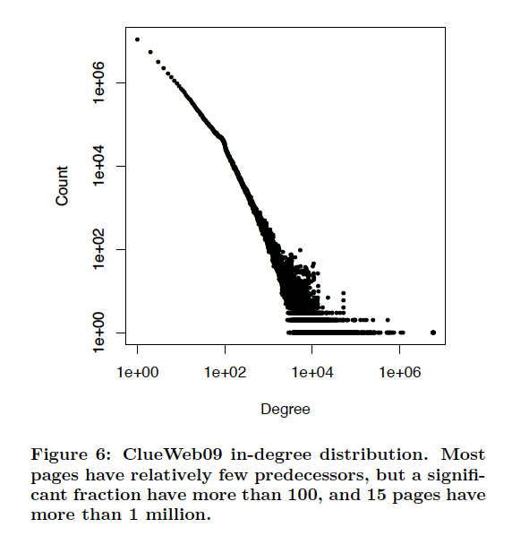

Slide 33
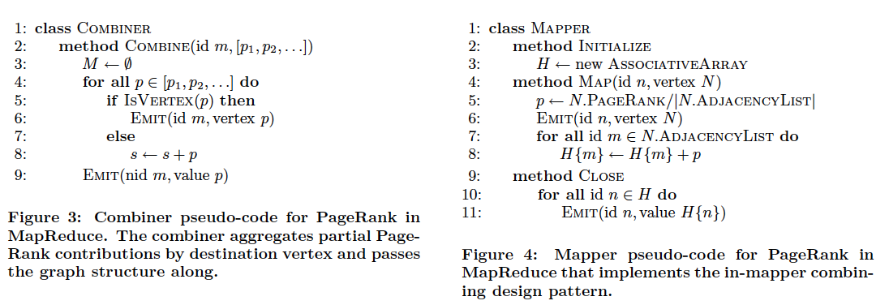
Notes:
Prior to processing input, the mapper initializes an associative array (i.e., map) for accumulating partial PageRank scores, with the destination vertex id as the key. When mapping over graph vertices, this associative array is updated with partial PageRank contributions. Intermediate key-value pairs are not emitted until all inputs have been processed. This design pattern is so called because, in effect, we are moving the functionality of the combiner inside the mapper itself. We eliminate multiple messages with the same destination vertex that would have been otherwise emitted by the mapper, and instead only emit a single message that contains an aggregated value.

Slide 34
Some ideas
Most hyperlinks are within a domain
If we keep domains on the same machine this will mean more messages are local
To do this, build a custom partitioner that knows about the domain of each nodeId and keeps nodes on the same domain together
Assign node id’s so that nodes in the same domain are together – partition node ids by range
Change Hadoop’s Partitioner for this
Notes:
In many algorithms the topology of the graph and associated metadata do not change (only each vertex’s state does), making repeated shuffling of the graph structure even more wasteful.

Slide 35
Some ideas
Repeatedly shuffling the graph is expensive
We should separate the messages about the graph structure (fixed over time) from messages about pageRank weights (variable)
compute and distribute the edges once
read them in incrementally in the reducer
not easy to do in Hadoop!
call this the “Schimmy” pattern

Slide 36
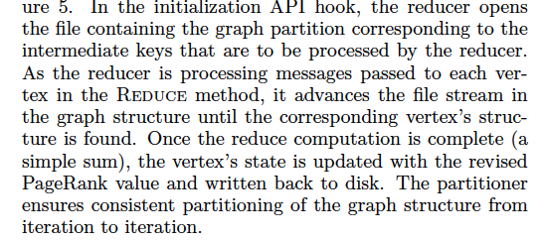
Schimmy
Relies on fact that keys are sorted, and sorts the graph input the same way…..

Slide 37
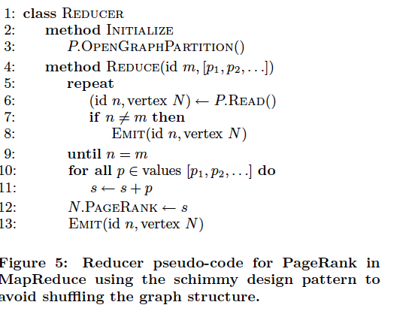
Schimmy
Notes:
The intuition behind the schimmy design pattern is the parallel merge join, which is a well known join technique in the database community. Let’s say we wish to join two relations, S and T, and the tuples in both relations were sorted by the join key. If this were the case, we can perform a join by scanning through both relations simultaneously. This process can be parallelized by partitioning and sorting both relations in the same way. For example, suppose S and T were both divided into ten files, partitioned in the same manner by the join key. Further suppose that in each file, the tuples were sorted by the join key. In this case, we simply need to merge join the first file of S with the first file of T, the second file with S with the second file of T, etc.; these merge joins could happen in parallel.
Set the number of reducers equal to the number of input files (i.e., parts)--we no longer need to emit the graph structure in the map phase of processing.
In the initialization API hook, the reducer opens the file containing the graph partition corresponding to the intermediate keys that are to be processed by the reducer. As the reducer is processing messages passed to each vertex in the Reduce method, it advances the file stream in the graph structure until the corresponding vertex’s structure is found. Once the reduce computation is complete (a simple sum), the vertex’s state is updated with the revised PageRank value and written back to disk. The partitioner ensures consistent partitioning of the graph structure from iteration to iteration.

Slide 38
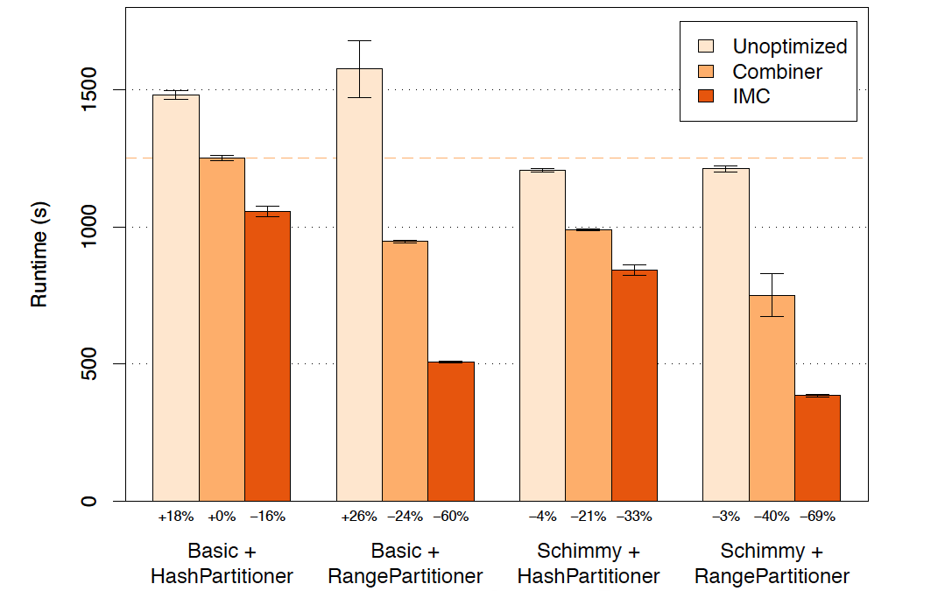
Results
Notes:
Evaluation of enhanced design patterns on the ClueWeb09 graph. Each bar shows the average and standard deviation runtimes across 5 iterations of PageRank using the indicated set of optimizations. The value below each bar shows the percent change in runtime relative to the baseline configuration using basic message passing (non-schimmy), HashPartitioner, and standard combiner (shown as a dashed orange line).

Slide 39
More details at…
Overlapping Community Detection at Scale: A Nonnegative Matrix Factorization Approach by J. Yang, J. Leskovec. ACM International Conference on Web Search and Data Mining (WSDM), 2013.
Detecting Cohesive and 2-mode Communities in Directed and Undirected Networks by J. Yang, J. McAuley, J. Leskovec. ACM International Conference on Web Search and Data Mining (WSDM), 2014.
Community Detection in Networks with Node Attributes by J. Yang, J. McAuley, J. Leskovec. IEEE International Conference On Data Mining (ICDM), 2013.

Slide 40
Resources
Stanford SNAP datasets:
http://snap.stanford.edu/data/index.html
ClueWeb (CMU):
http://lemurproject.org/clueweb09/
Univ. of Milan’s repository:
http://law.di.unimi.it/datasets.php

