Slide 1





A Framework for Machine Learning and Data Mining in the Cloud
Yucheng Low
Joseph
Gonzalez
Aapo
Kyrola
Danny
Bickson
Carlos
Guestrin
Joe
Hellerstein

Slide 2
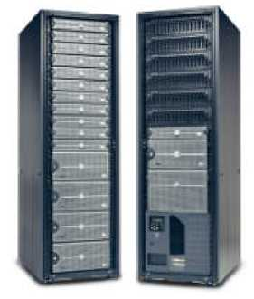
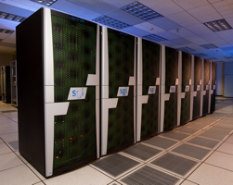
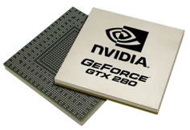
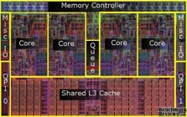



Shift Towards Use Of Parallelism in ML
GPUs
Multicore
Clusters
Clouds
Supercomputers
ML experts repeatedly solve the same parallel design challenges:
  Race conditions, distributed state, communication…
Resulting code is very specialized:
  difficult to maintain, extend, debug…
Graduate students
Avoid these problems by using
high-level abstractions
Notes:
- shift towards parallelism in different forms: …
- addressing
- built to solve very specific tasks.

Slide 3
Abstract
High level data parallel frameworks like MapReduce do not efficiently support many important data mining and machine learning algorithms and can lead to inefficient learning systems(Works well with independent data)
GraphLab Abstaction: expresses asynchronous, dynamic, graph parallel computation in shared memory.

Slide 4
Introduction
Problems with distributed Machine Learning and Data Mining algorithms?
How does GraphLab solves these issues?
Major Contributions
  A summary of common properties of MLDM algorithms and the limitations of existing large-scale frameworks
  A modified version of the GraphLab abstraction and execution model tailored to the distributed setting

Slide 5
Contributions..
Two substantially different approaches to implementing the new distributed execution model
  Chromatic Engine
  Locking Engine
Fault tolerance through two snapshotting schemes.
Implementations of three state-of-the-art machine learning algorithms on-top of distributed GraphLab.
An extensive evaluation of Distributed GraphLab using a 512 processor (64 node) EC2 cluster, including comparisons to Hadoop, Pregel, and MPI implementations.

Slide 6
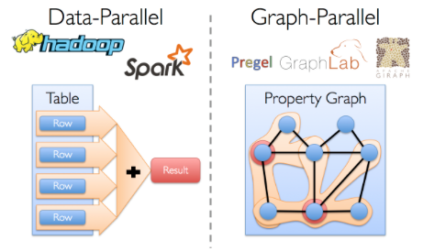
Machine Learning and Data Mining Algorithm Properties
Graph Structured Computation

Slide 7
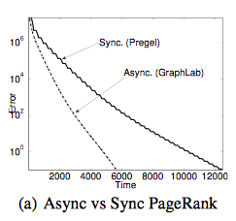
Machine Learning and Data Mining Algorithm Properties
Asynchronous Iterative Computation:
  synchronous systems update all parameters simultaneously (in parallel) using parameter values from the previous time step as input
  Asynchronous systems update parameters using the most recent parameter values as input.

Slide 8
Asynchronous Iterative Computation
Synchronous computation incurs costly performance penalties since the runtime of each phase is determined by the slowest machine.
Abstractions based on bulk data processing, such as MapReduce and Dryad were not designed for iterative computation, Spark has the iterative setting. However, these abstractions still do not support asynchronous computation. Bulk Synchronous Parallel (BSP) abstractions such as Pregel, Pic- colo , and BPGL do not naturally express asynchronicity. On the other hand, the shared memory GraphLab abstraction was designed to efficiently and naturally express the asynchronous iterative algorithms common to advanced MLDM.

Slide 9
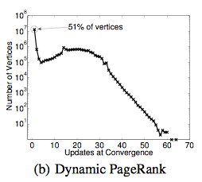
Machine Learning and Data Mining Properties
Dynamic Computation:
In many MLDM algorithms, iterative computation converges asymmetrically.

Slide 10
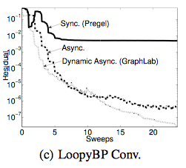
Dynamic Computation:
prioritizing computation can further accelerate convergence for a variety of graph algorithms including PageRank. If we update all parameters equally often, we waste time recomputing parameters that have effectively converged. Conversely, by focusing early computation on more challenging parameters, we can potentially accelerate convergence.

Slide 11
Machine Learning and Data Mining Algorithm Properties
Serializability:
By ensuring that all parallel executions have an equivalent sequential execution, serializability eliminates many challenges associated with designing, implementing, and testing parallel MLDM algorithms. In addition, many algorithms converge faster if serializability is ensured, and some even require serializability for correctness.
GraphLab supports a broad range of consistency settings, allowing a program to choose the level of consistency needed for correctness.

Slide 12


The GraphLab Framework
Update Functions
User Computation
Graph Based
Data Representation
Consistency Model
Notes:
- overview
- - -

Slide 13
Data Graph
Data associated with vertices and edges
Graph:
Social Network
Vertex Data:
User profile
Current interests estimates
Edge Data:
Relationship
(friend, classmate, relative)
Notes:
Core GL datastrucutre.
Arbitrary graph
(5)

Slide 14
Distributed Graph
Partition the graph across multiple machines.
Notes:
- cut along edges
- gaps. Local-> remote

Slide 15
Distributed Graph
Ghost vertices maintain adjacency structure and replicate remote data.
“ghost” vertices
Notes:
- ghost. Maintain adjacency. replicate data.

Slide 16
Distributed Graph
Cut efficiently using HPC Graph partitioning tools (ParMetis / Scotch / …)
“ghost” vertices
Notes:
- Too difficult -> random

Slide 17
The GraphLab Framework
Graph Based
Data Representation
Update Functions
User Computation
Consistency Model
Notes:
- However, given this data, what can I do with it?

Slide 18
Update Functions
User-defined program: applied to a
vertex and transforms data in scope of vertex
Update function applied (asynchronously)
in parallel until convergence
Many schedulers available to prioritize computation
Pagerank(scope){
// Update the current vertex data
// Reschedule Neighbors if needed
if vertex.PageRank changes then
reschedule_all_neighbors;
}
Why Dynamic?
Dynamic
computation
Notes:
weighted sum
Neighbors needs to be recomputed

Slide 19
PageRank update function
Input: Vertex data R(v) from Sv
Input: Edge data {wu,v : u ∈ N[v]} from Sv
Input: Neighbor vertex data {R(u) : u ∈ N[v]} from Sv
Rold(v) ← R(v) // Save old PageRank
R(v) ← α/n
For each u ∈ N[v] do // Loop over neighbors
R(v) ← R(v) + (1 − α) ∗ wu,v ∗ R(u)
// If the PageRank changes sufficiently
if |R(v) − Rold(v)| > ǫ then
// Schedule neighbors to be updated
return {u : u ∈ N[v]}
Output: Modified scope Sv with new R(v)

Slide 20
The GraphLab Execution Model
Input: Data Graph G = (V, E, D)
Input: Initial vertex set T = {v1, v2, ...}
while T is not Empty do
v ← RemoveNext(T )
(T′, Sv) ← f(v, Sv)
T ← T ∪ T ′
Output: Modified Data Graph G = (V, E, D′)

Slide 21
Serializability
For every parallel execution, there exists a sequential execution of update functions which produces the same result.
CPU 1
time
Parallel
CPU 2
Sequential
Single
CPU
Notes:
- defines race free operation using notion of serializability.
- serializability.

Slide 22
Serializability Example
Write
Stronger / Weaker
consistency levels available
User-tunable consistency levels
trades off parallelism & consistency
Read
Overlapping regions
are only read.
Update functions one vertex apart can be run in parallel.
Edge Consistency
Notes:
Example: …
- expert user.
- only focus on edge consistency.

Slide 23
Distributed Consistency
Solution 1
Solution 2
Graph Coloring
Distributed Locking

Slide 24
Edge Consistency via Graph Coloring
Vertices of the same color are all at least one vertex apart.
Therefore, All vertices of the same color can be run in parallel!

Slide 25

Chromatic Distributed Engine
Execute tasks
on all vertices of
color 0
Execute tasks
on all vertices of
color 0
Ghost Synchronization Completion + Barrier
Execute tasks
on all vertices of
color 1
Execute tasks
on all vertices of
color 1
Time
Ghost Synchronization Completion + Barrier
Notes:
simple

Slide 26
Matrix Factorization
Netflix Collaborative Filtering
  Alternating Least Squares Matrix Factorization
Model: 0.5 million nodes, 99 million edges
Users
Users
Movies
Netflix
d
Movies
Notes:
- factor sparse matrix
-easy to color

Slide 27

Netflix Collaborative Filtering
Ideal
MPI
Hadoop
D=100
D=20
GraphLab
# machines
# machines
Notes:
- good performance with D. D.
- two orders. MPI.

Slide 28
The Cost of Hadoop
Price Performance
ratio of GraphLab and Hadoop on Amazon EC2 HPC machine
on a log-log scale. Costs assume fine-grained billing.
Notes:
- less discussed. Cost. Time is money. Wrong Abstraction costs money.
- runtime and cost, difference cluster sizes on EC2.
- 100x more, 100x longer. Logarithmic axes.

Slide 29
CoEM (Rosie Jones, 2005)
Named Entity Recognition Task
the cat
<X> ran quickly
Is “Cat” an animal?
Is “Istanbul” a place?
Australia
travelled to <X>
Vertices: 2 Million
Edges: 200 Million
Istanbul
<X> is pleasant
0.3% of Hadoop time
Hadoop | 95 Cores | 7.5 hrs
GraphLab | 16 Cores | 30 min
Distributed GL | 32 EC2 Nodes | 80 secs
Notes:
-Answer questions
- Construct bipartite graph from corpus

Slide 30
Problems
Require a graph coloring to be available.
Frequent Barriers make it extremely inefficient for highly dynamic systems where only a small number of vertices are active in each round.
Notes:
- Complex graphs, user cannot provide a graph coloring. And we cannot use the chromatic engine to find a graph coloring.
-

Slide 31
Distributed Consistency
Solution 1
Solution 2
Graph Coloring
Distributed Locking

Slide 32

Distributed Locking
Edge Consistency can be guaranteed through locking.
: RW Lock
Notes:
We associate a rw-lock with each vertex.

Slide 33
Consistency Through Locking
Acquire write-lock on center vertex, read-lock on adjacent.
Notes:
- write on center, read on adjacent, taking care to acquire locks in canonical ordering
- read lock acquired more than once
- minor variations.

Slide 34
Consistency Through Locking
Acquire write-lock on center vertex, read-lock on adjacent.
Notes:
- write on center, read on adjacent, taking care to acquire locks in canonical ordering
- read lock acquired more than once
- minor variations.

Slide 35




Consistency Through Locking
Multicore Setting
PThread RW-Locks
A
C
Distributed Setting
B
D
Distributed Locks
CPU
Machine 1
Challenges
  Latency
A
C
A
B
D
Solution
  Pipelining
Machine 2
A
C
B
D
Notes:
- easy in shared.
- distributed, latency, limiting.

Slide 36
No Pipelining
lock scope 1
Process request 1
scope 1 acquired
Time
update_function 1
release scope 1
Process release 1
Notes:
- visualize
- acquire a remote lock, send a message.
- only when locks are acquire then machine can run the update function.

Slide 37
Pipelining / Latency Hiding
Hide latency using pipelining
lock scope 1
lock scope 2
Process request 1
lock scope 3
Process request 2
scope 1 acquired
Process request 3
Time
scope 2 acquired
scope 3 acquired
update_function 1
release scope 1
update_function 2
Process release 1
release scope 2
Notes:
- large number (10K) simultaneous.
- update function when locks ready. In flight.
- Hide latency of individual.

Slide 38

Latency Hiding
Hide latency using request buffering
Residual BP on 190K Vertex 560K Edge Graph
4 Machines
No Pipelining | 472 s
lock scope 1
Pipelining | 10 s
lock scope 2
Process request 1
lock scope 3
Process request 2
scope 1 acquired
47x Speedup
Process request 3
Time
scope 2 acquired
scope 3 acquired
update_function 1
release scope 1
update_function 2
Process release 1
release scope 2
Notes:
- Small problem

Slide 39
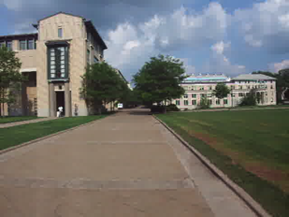
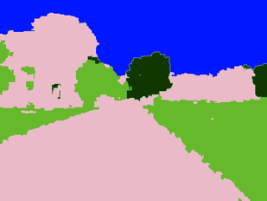

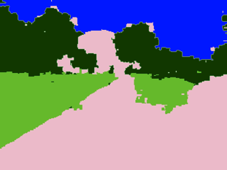
Video Cosegmentation
Segments mean the same
Probabilistic Inference Task
1740 Frames
Model: 10.5 million nodes, 31 million edges
Notes:
- To evaluate…

Slide 40
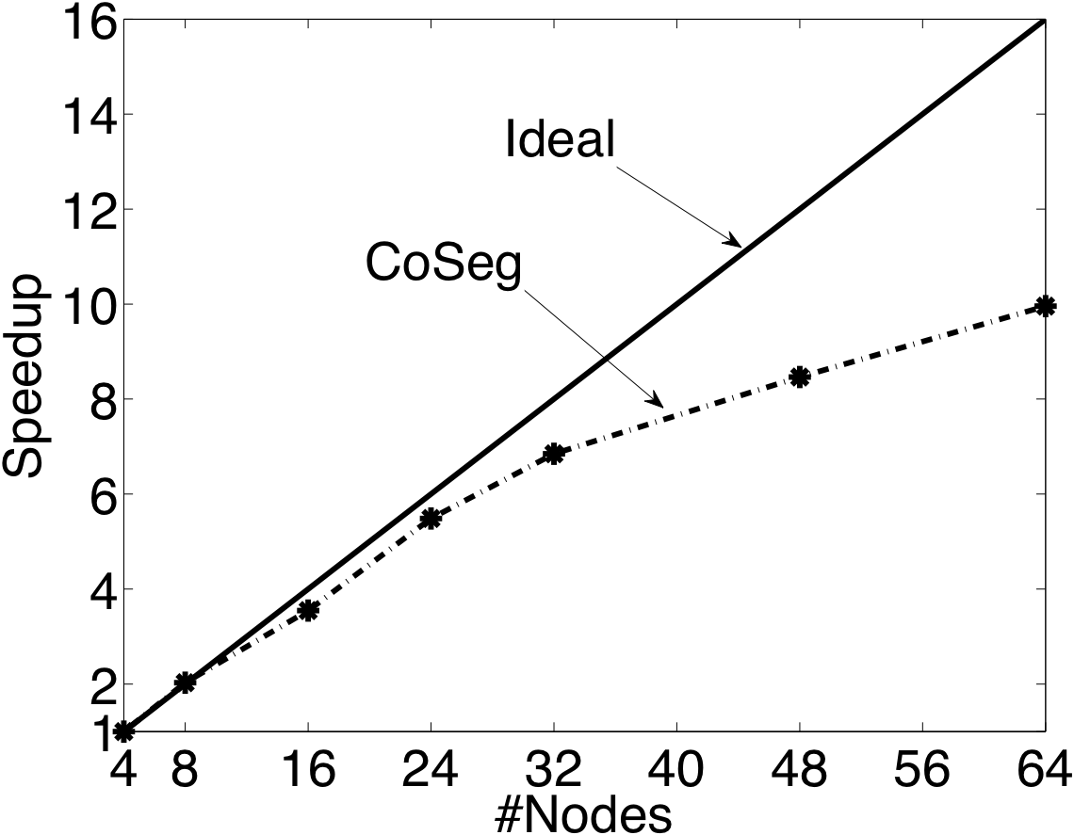
Video Coseg. Speedups
Ideal
GraphLab
# machines
Notes:
Highly dynamic and stresses the locking engine. We do pretty well.

Slide 41
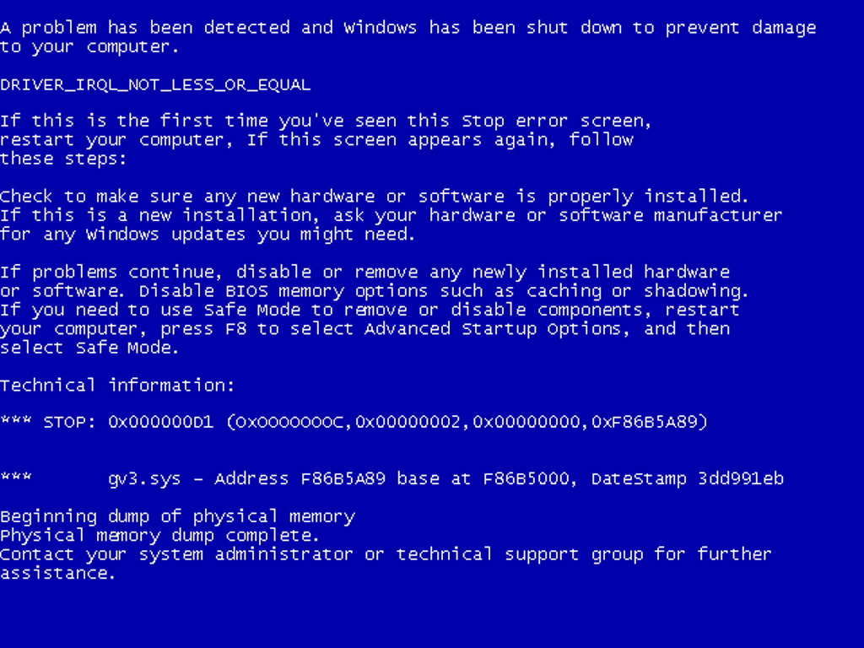
What if machines fail?
How do we provide fault tolerance?

Slide 42
Checkpoint
1: Stop the world
2: Write state to disk

Slide 43
Snapshot Performance
Because we have to stop the world,
One slow machine slows everything down!
No Snapshot
Snapshot
Snapshot time
One slow machine
Slow machine
Notes:
- evaluate behavior. Plot progress.
- linear progress
- Introduce one slow machine into the system

Slide 44
How can we do better?
Take advantage of consistency

Slide 45

Checkpointing
1985: Chandy-Lamport invented an asynchronous snapshotting algorithm for distributed systems.
snapshotted
Not snapshotted
Notes:
- Typically hard to implement.
- Our comm layer design makes it hard to implement this.

Slide 46
Checkpointing
Fine Grained Chandy-Lamport.
Easily implemented within GraphLab as an Update Function!
Notes:
- instead of snapshotting machines, lets think extremely fine grained. We have a graph. Lets map this to the graph.
- On such granularity, did we make the problem harder?
given edge consistency, extremely easy in GraphLab!
GraphLab’s async checkpointing can be done entirely within GraphLab!

Slide 47
Async. Snapshot Performance
No penalty incurred by the slow machine!
No Snapshot
Snapshot
One slow machine
Notes:
Lets see the behavior of this Asynchronous Snapshot procedure.
Instead of a flat-line, we get a little curve.

Slide 48
Summary
Extended GraphLab abstraction to distributed systems
Two different methods of achieving consistency
  Graph Coloring
  Distributed Locking with pipelining
Efficient implementations
Asynchronous Fault Tolerance with fined-grained Chandy-Lamport
Performance
Efficiency
Scalability
Usability
Notes:
Obtain Performance ,efficiency and scalability while as a high level abstraction, while as a high level abstraction without sacrificing useability

Slide 49
Future Work
Extending the abstraction and runtime to support dynamically evolving graphs and external storage in graph databases. These features will enable Distributed GraphLab to continually store and processes the time evolving data commonly found in many real-world applications (e.g., social-networking and recommender systems)

Slide 50
References
www.cs.cmu.edu/~ylow/vldb5.pptx
http://bickson.blogspot.com/2013/02/co-em-algorithm-in-graphchi_19.html
www.cs.cmu.edu/~ylow/vldb5.pptx
http://en.wikipedia.org/wiki/Message_Passing_Interface

Slide 51
Questions?

