Slide 1
Distributed Approximate Spectral Clustering for Large-Scale Datasets
Fei Gao, Wael Abd-Almageed, Mohamed Hefeeda
Presented by : Bita Kazemi Zahrani

Slide 2
Outline
Introduction
Terminologies
Related Works
Distributed Approximate Spectral Clustering (DASC)
Analysis
Evaluations
Conclusion
Summary
References

Slide 3
The idea ….
Challenge : High time and Space complexity in Machine Learning algorithms
Idea : propose a novel kernel-based machine learning algorithm to process large datasets
Challenge : kernel-based algorithms suffer from scalability O(n²)
Claim : reduction in computation and memory with insignificant accuracy loss and providing a control over accuracy and reduction tradeoff
Developed a spectral clustering algorithm
Deployed on Amazon Elastic MapReduce service

Slide 4
Terminologies
Kernel based methods : one of the methods for pattern analysis,
Based on kernel methods : analyzing raw representation of data by a similarity function over pairs instead of a feature vector
In another word manipulating data or looking at data from another dimension
Spectral clustering : using eigenvalues( characteristic values) of similarity matrix

Slide 5
Introduction
Proliferation of data in all fields
Use of Machine Learning in science and engineering
The paper introduces the class of Machine Learning Algorithms efficient for large datasets
Two main techniques :
Controlled Approximation ( tradeoff between accuracy and reduction)
Elastic distribution of computation ( machine learning technique harnessing the distributed flexibility offered by clouds)
THE PERFORMANCE OF KERNEL-BASED ALGORITHMS IMPROVES WHEN SIZE OF TRAINING DATASET INCREASES!

Slide 6
Introduction
Kernel-based algorithms -> O(n²) similarity matrix
Idea : design an approximation algorithm for constructing the kernel matrix for large datasets
The steps :
Design an approximation algorithm for kernel matrix computation scalable to all ML algorithms
Design a Spectral Classification on top of that to show the effect on accuracy
Implemented with MapReduce tested on lab cluster and EMR
Experiments on both real and synthetic data

Slide 7
Distributed Approximate Spectral Clustering (DASC)
Overview
Details
Mapreduce Implementation

Slide 8
Overview
Kernel-based algorithms : very popular in the past decade
Classification
Dimensionality reduction
Data clustering
Compute kernel matrix i.e kernelized distance between data pair
1. create compact signatures for all data points
2. group the data with similar signature ( preprocessing)
3. compute similarity values for data in each group to construct similarity matrix
4. perform Spectral Clustering on the appx’s similarity matrix (SC can be replaces by any other kernel base approach)

Slide 9
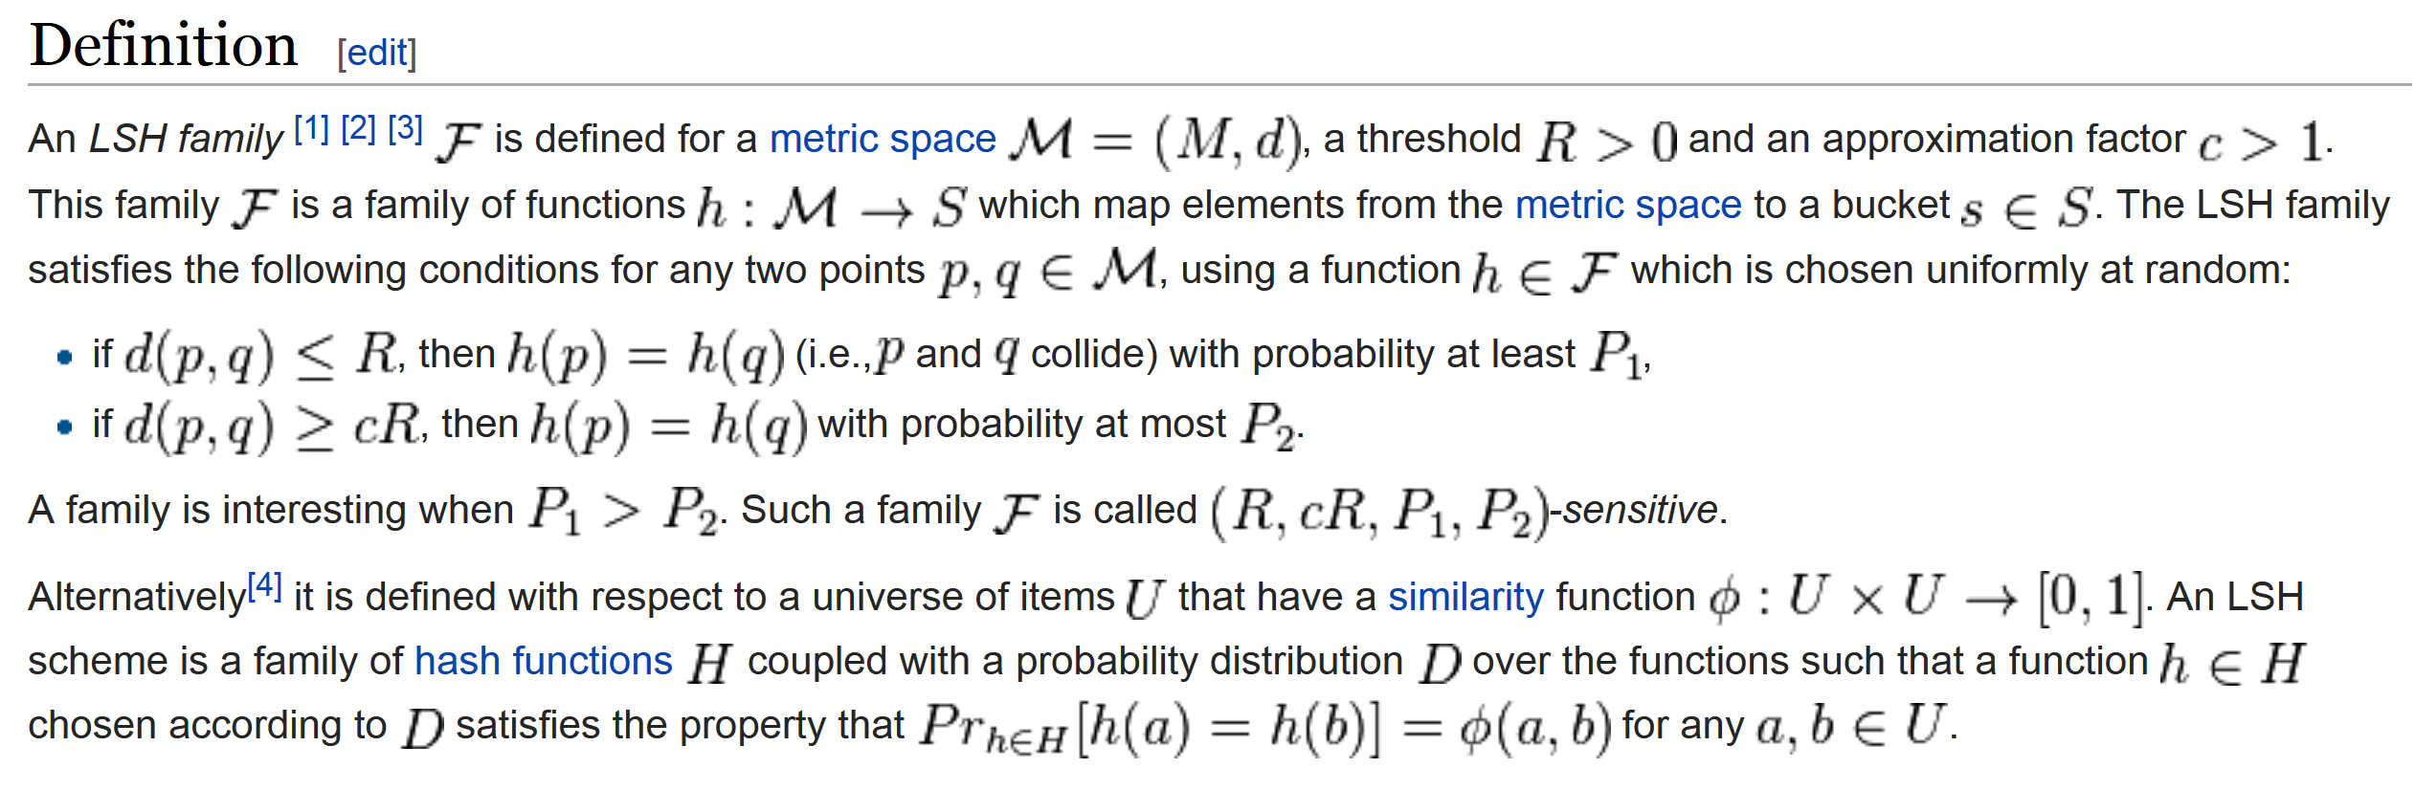
Detail
The first step is preprocessing with Locality Sensitive Hashing(LSH)
LSH -> probability reduction technique
Dimension reduction technique : hash input, map similar items to the same bucket, reduce the size of input universe
The idea : if distance of two points is less than a
Threshold with probability p1, and distance of those
Points is higher than the threshold by appx factor of c
Then group them together or output the same hash!!
Points with higher collision fall in the same bucket!
Courtesy: Wikipedia

Slide 10
Details
LSH : different techniques
Random projection
Stable distribution
….
Random projection :
Choose a random hyperplane
Designed to appx the cosine distance
$h\left(ν\right)=sgn(ν.r)$ when r is the hyperplane ( h is + or -)
$θ\left(u,v\right) the angle between u and v$
The formula is an appx of cosine($θ\left(u,v\right)$)
Courtesy: Wikipedia

Slide 11
Details
Given N data points
Random projection hashing to produce a M-bit signature fro each data point
Choose an arbitrary dimension
Compare with threshold
If feature value in the dimension is larger than threshold -> 1
Otherwise 0
M arbitrary dimensions, M bit
O(MN)

Slide 12
Details
M-bit signatures
Near-duplicate signatures ( at least P bit in common )go to the same bucket
Let’s say we have T buckets, each bucket Ni points : $\sum{\text{N}\text{i}}$ = N
$\sum_{i=0}^{T−1}{{(Ni)}^{2} }$
Gaussian similarity to compute the distance between signatures
Last step running Spectral Clustering on the buckets

Slide 13
Detail
Compute Laplacian Matrix for each similarity matrix Si
The complexity is $\sum_{i=0}^{T−1}{{(Ni)}^{2} }$
Compute the first K eigenvectors with QR decomposition
QR : decomposing of a matrix A into a product QR of an orthogonal Q and an upper triangular matrix R ( O(K_{i} ³))
Reduction of Laplacian to triangular symmetric Ai
QR becomes O(Ki)
O(Ki. $\sum_{i=0}^{T−1}{{(Ni)}^{2} }$)
Adding up :
T DASC = O(M.N) + O(T²) + O(Ki. $\sum_{i=0}^{T−1}{{(Ni)}^{2} }$)

Slide 14
Mapreduce Implementation
Two MapReduce stages :
1. applies LSH on input and computes signatures
Mapper : (index , inputVector) --- > (signature, index)
Reducer : (signature,index) ---→ ( signature, listof (index)) [ based on similarity]
For the approximation P is introduced to restrict the appx
If P bits out of M are similar : put in the same bucket
Compare two M-bit signature A and B by bit manipulation :
$Ans=\left(A⨁B\right)\left(A⨁B −1\right)$
Ans =0 -> A and B have one bit difference O(1)
2. Standard MapReduce implementation of spectral clustering in Mahout library

Slide 15
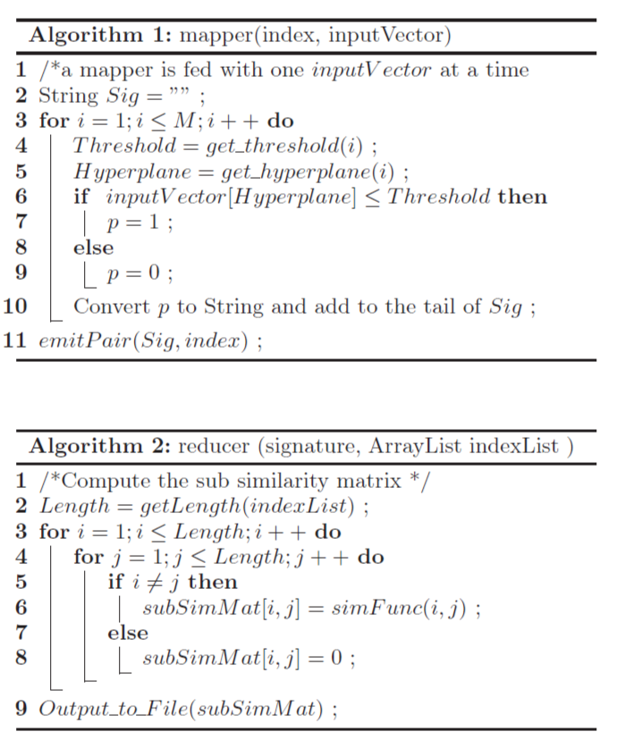
Courtesy: reference [1]

Slide 16
Analysis and Complexity
Complexity Analysis
Accuracy Analysis

Slide 17
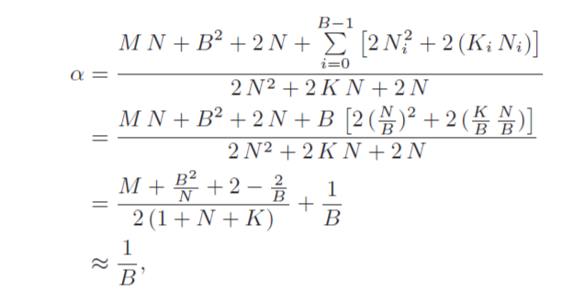
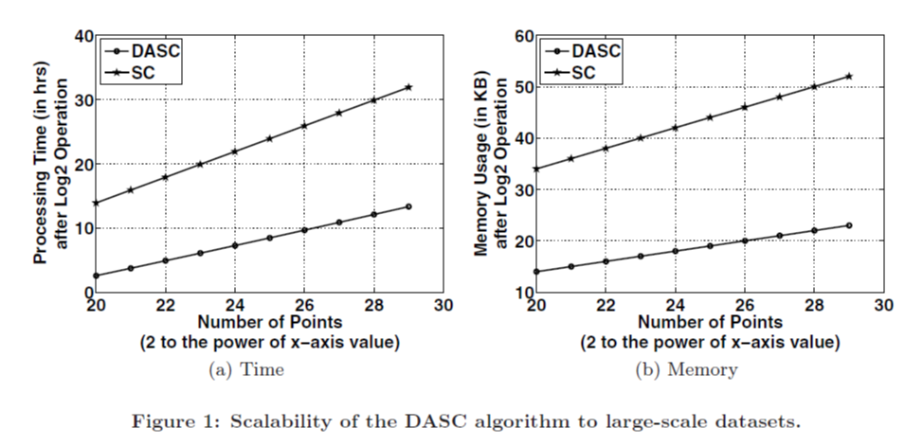
Complexity Analysis
Computation analysis
Memory analysis
Courtesy: reference [1]
Courtesy: reference [1]
Courtesy: reference [1]

Slide 18
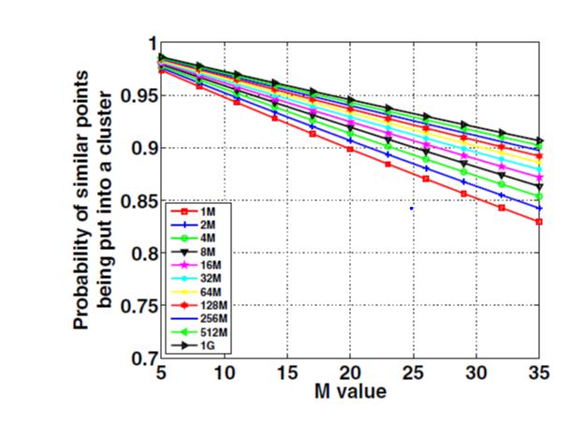
Accuracy analysis
Increasing #hash functions probability of clustering adjacent points in a bucket decreases
The incorrectly clustering increases
Increasing M , collision probability decreases
Hash function increase : more parallel
Use M value to partition
Tuning of M controls the tradeoff
Courtesy: reference [1]

Slide 19
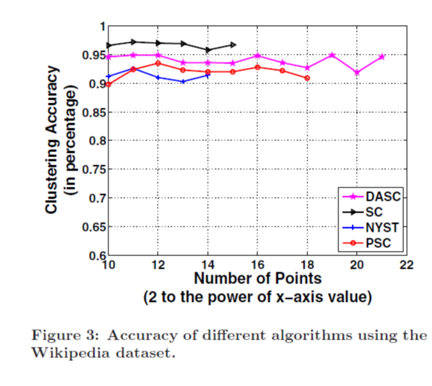
Accuracy Analysis
Randomly selected documents
Ratio :Correctly classified points to the total number
DASC better than PSC, close to SC
NYST on MATLAB [no cluster]
Clustering didn’t affect accuracy too much
Courtesy: reference [1]

Slide 20
Experimental Evaluations
Platform
Datasets
Performance Metrics
Algorithm Implemented and Compared Agains
Results for Clustering
Results for Time and Space Complexities
Elasticity and Scalability

Slide 21
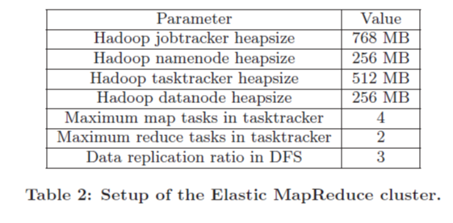
Platform
Hadoop MapReduce Framework
Local cluster and Amazon EMR
Local : 5 machines (1 master/ 4 slaves)
Intel Core2 Duo E6550
1GB DRAM
Hadoop 0.20.2 on Ubunto, Java 1.6.0
EMR :variable configs : 16,32,64 machines
1.7GB Memory, 350 GB disk
Hadoop 0.20.2 on Debian Linux
Courtesy: reference [1]

Slide 22
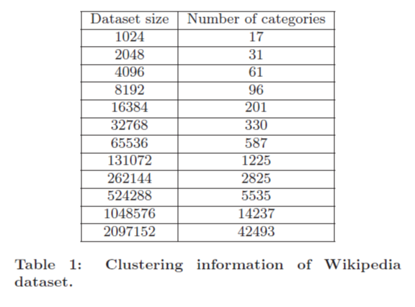
Dataset
Synthetic
Real : Wikipedia
Courtesy: reference [1]

Slide 23
Job flow on EMR
Job Flow: collection of steps on a dataset
First partition dataset into buckets with LSH
Each bucket stored in a file
SC applied to each bucket
Partitions are processed based on mappers available
Data dependent hashing can be used instead of LSH
Locality is achieved through the first step LSH
Highly scalable if nodes are increased or decreased dynamically allocates fewer or more number of partitions to nodes

Slide 24
Algorithms and Performance metrics
Computational and space complexity
Clustering accuracy
Ratio of correct #clustered points / #total points
DBI : Davies-Bouldin Index and ASE average squared error
Fnorm to similarity of original and approximate kernel matrix
Implemented DASC, PSC and SC, NYST
DASC modifying Mahout Library M = [(logN)/2−1[ , and P = M-1 to have O(1) comparison
SC Mahout
PSC C++ implementation of SC by PARPACK lib
NYST implemented by MATLAB

Slide 25
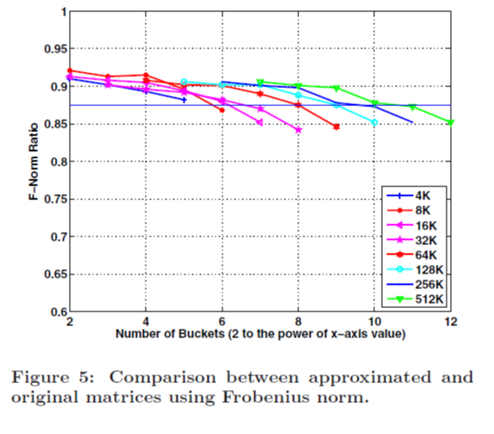
Results for Clustering Accuracy
Similarity between approximate and original Gram matrices
Using low-level F-norm
4K to 512K data points
Not able to use more than 512 K
Needs square of the input size
Different number of buckets ! 4 to 4K
Larger the number of buckets, more partitioning
Lesser accuracy
Increase #buckets, decrease F-norm ratio, less similar
Increase #buckets before Fnorm drops
Courtesy: reference [1]

Slide 26
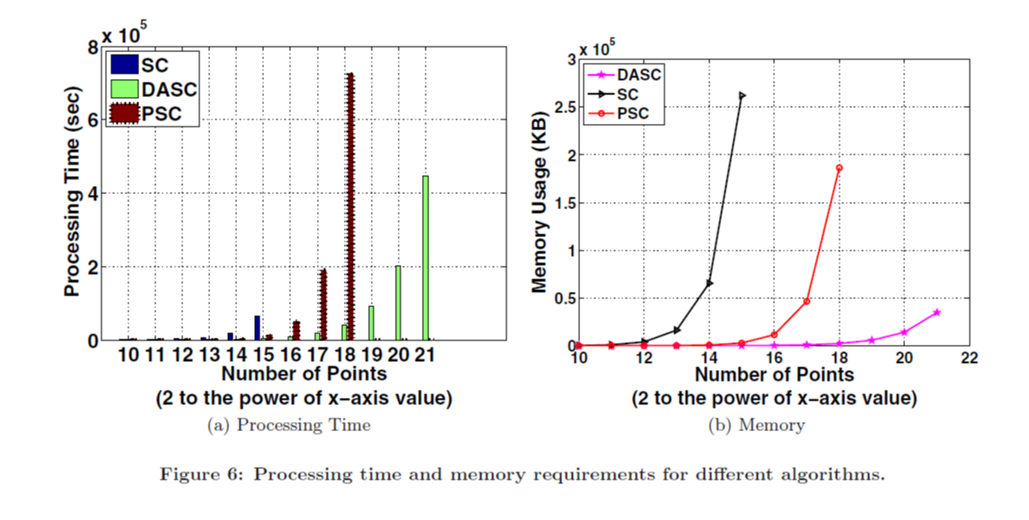
Results for Time and Space Complexities
DASC, PSC and SC comparison:
PSC implemented in C++ with MPI
DASC implemented in Java with Mapreduce framework
SC implemented with Mahout library
Order of magnitude : DASC runs
one order of magnitude faster than PSC
Mahout SC didn’t scale
to more than 15
Courtesy: reference [1]

Slide 27
Conclusion
Kernel-based Machine Learning
Approximation for computing kernel matrix
LSH to reduce the kernel computation
DASC O(B) reduction in size of problem (B number of buckets)
B depends on number of bits in signature
Tested on real and synthetic dataset -> Real : Wikipedia
90% accuracy

Slide 28
Critics
The approximation factor depends on the size of the problem
The algorithm is scaled just to kernel-based machine learning methods which are applicable just to a limited number of datasets
Algorithms compared are each implemented in different frameworks, i.e MPI implementation might be really inefficient, thus the comparison is not really fair!

Slide 29
References
Hefeeda, Mohamed, Fei Gao, and Wael Abd-Almageed. "Distributed approximate spectral clustering for large-scale datasets." Proceedings of the 21st international symposium on High-Performance Parallel and Distributed Computing. ACM, 2012.
Wikipedia
Tom M Mitchell slides : https://www.cs.cmu.edu/~tom/10701_sp11/slides

