Slide 1
Discretized Streams: Fault-Tolerant Streaming Computation at Scale
Matei Zaharia, Tathagata Das, Haoyuan Li, Scott Shenker, Ion Stoica University of California, Berkeley

Slide 2
Stream processing and the problem
Processing real time data as they arrive:
Site Activity Statistics: Facebook users clicking on ads
Computer Clusters Monitoring: mining real time logs
Spam detection and prevention: detecting spam tweets before it’s too late
Problems:
Scalability to 100s of nodes:
Fault tolerance ?
stragglers?
Generic enough to model a wide variety of systems ?

Slide 3
Goals
Scalability to 100s of nodes
Minimal cost beyond base processing (little over head)
Second-scale latency
Second-scale recovery from faults and stragglers

Slide 4
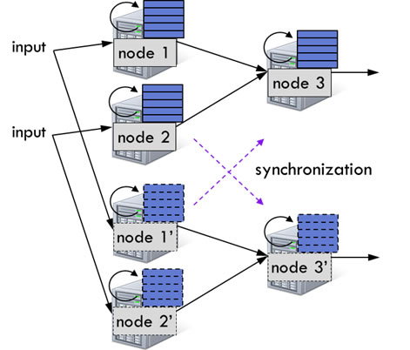
Existing Systems
Mostly, stateful continuous operators
Difficult to handle faults and stragglers
Internal states
Non-determinism (possible out of order messages)
Replication (copies of each node)
Relatively quick recovery, but …
Costly (2x Hardware)
Needs synchronization (special protocols, eg. Flux)
Possible delays!

Slide 5
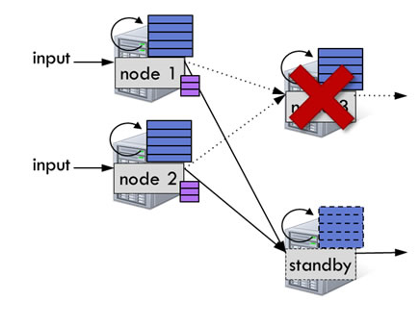
Upstream backup (buffer messages to replay)
Buffer out-messages up to some checkpoint to be replayed
Upon a node failure, a stand-by node steps in
Parents replay buffered messages to the step-in node so that it reaches the desired state
Incurs system delay! (waiting till the step-in node to get in state to start processing new data)
Storm*, MapReduce Online, Time Stream

Slide 6
Stragglers?
Neither handles stragglers
Replicas would be delayed (synchronization!)
Upstream-backup would treat stragglers as failures
Recovery mechanism kicks-in again, incurring more delay!

Slide 7
Discretized Streams (D-Streams)
Computations structured in a set of short, stateless, and deterministic tasks
Finer-granularity dependencies
Allows parallel recovery and speculation
State stored in-memory as Resilient Distributed Datasets (RDDs)
Unification with batch processing

Slide 8
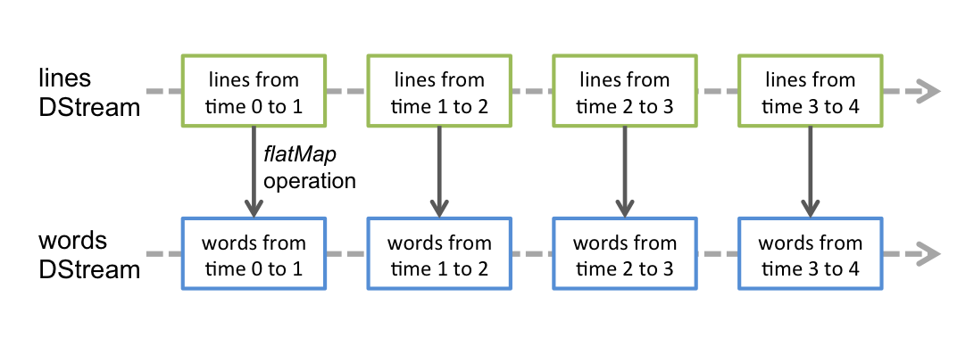
D-Streams
Stream of deterministic batch computations on small time intervals
Map, filter, reduce, groupBy, …etc
Produce either intermediate state (RDDs) or program outputs (pushed to external storage maybe)

Slide 9
RDDs
Immutable (read-only) dataset
Data partitioned between workers
Keeps the lineage of how the RDD was computed
Eg., by doing a map on another RDD (a dependency)
Avoids replication by recomputing lost partitions from dependencies using linage
Usually in-memory, but RDD partitions data can be persisted to disk

Slide 10
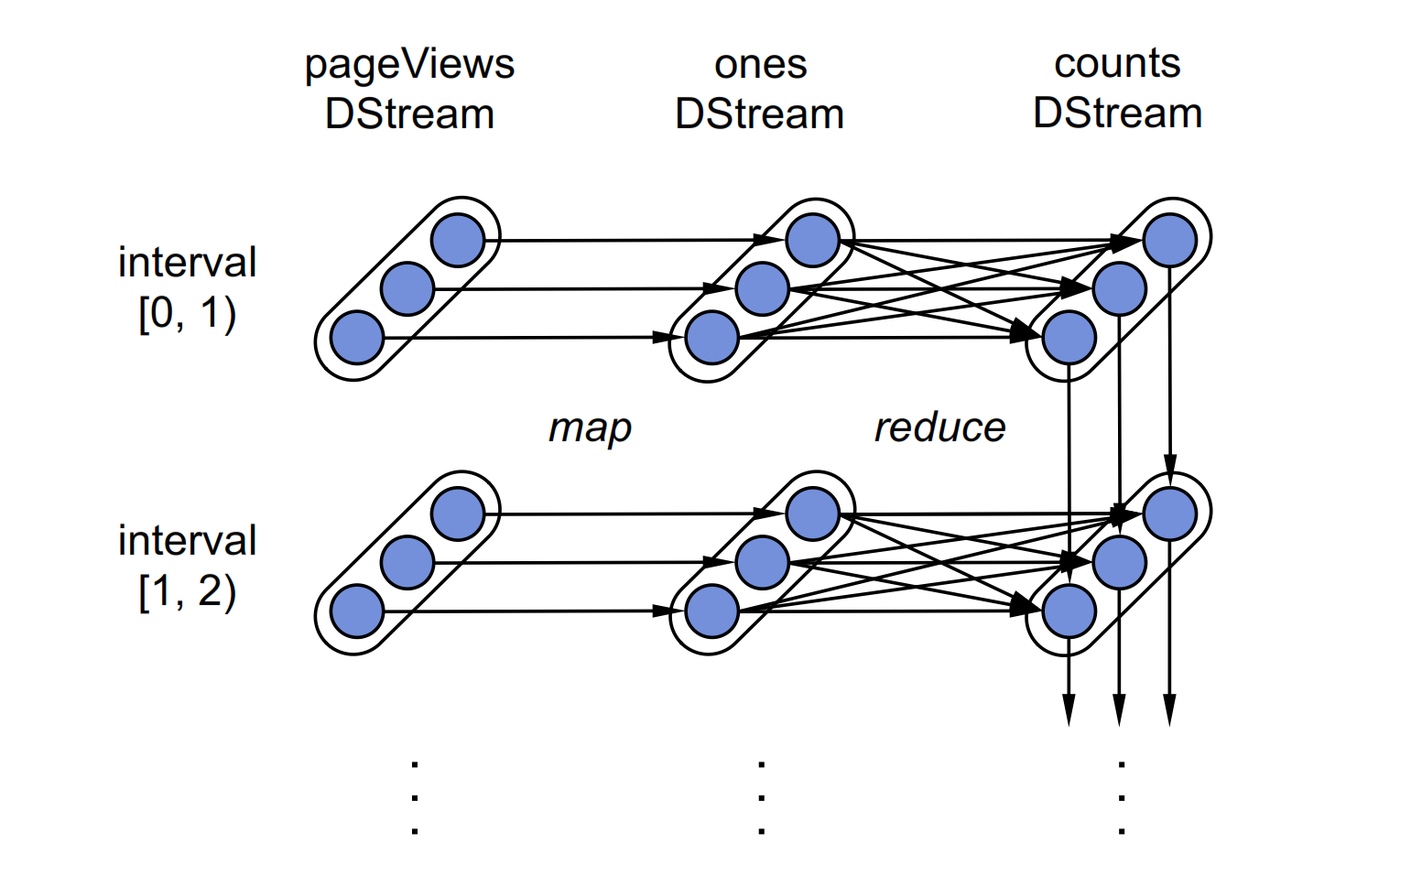
Example
pageViews = readStream(“http://...”, “1s”) ones = pageViews.map( event => (event.url, 1 ) ) counts = ones.runningReduce( (a, b) => a + b)

Slide 11
RDDs cont’d
Periodic checkpoints
System will replicate every, say, tenth RDD
Prevents infinite recomputations
Recovery is often fast: parallel recomputation of lost partitions on separate nodes
Parallel in respect to partitions, and time-intervals
Computing different partitions of different timer-intervals in the same time
More parallelism than upstream backup even when having more continuous operators per node

Slide 12
Timing ?
Assumes data arriving between [t, t+1) are actually [t, t+1) records
Late records (according to embedded timestamp)?
Two possible solutions:
System can wait for slack time before starting processing
[t, t+1) batch would wait till, say, t+5 before it packages the RDD and starts processing so it can catch late [t, t+1) messages that are arriving between [t+1, t+5)
Output is delayed (here by 4 time units)
Application level updates
Compute for [t, t+1) and output its result
catch any late [t, t+1) record, arriving up till, say, t+5
Aggregate, reduce and output an updated value for [t, t+1) based on the records caught in [t, t+5)

Slide 13
D-Streams API
Connect to streams:
External streams (eg. listening on a port)
Loading periodically from a storage system (eg. HDFS)
D-Streams support:
Transformations: create a new D-Stream from one or more D-Streams
Map, reduce, groupBy, join …etc
Output operations: write data to external systems
save, foreachRDD

Slide 14
D-Stream API cont’d
Windowing
Group records from a sliding window into one RDD
words.window(“5s”) // “words” is the D-Stream of words as they are arriving
A D-Stream of 5-second intervals, each is an RDD having the words that arrived in that time period partitioned over workers, ie., words in [0,5), [1,6), [2,7) ..etc
window length
DStream of data
sliding interval

Slide 15
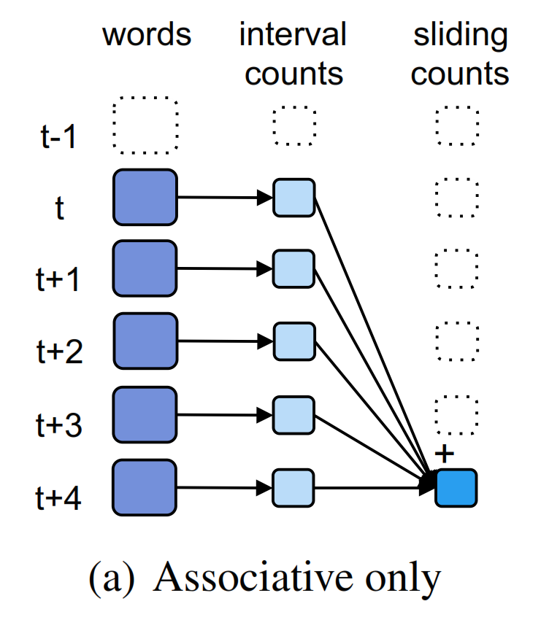
D-Stream API cont’d
Incremental Aggregation
Computing an aggregate (max, count ..etc) over a sliding window
Eg., pairs.reduceByWindow(“5s”, _+_ ) //”pairs” is the (word,1) D-Stream
Computes aggregate per interval, aggregates by the last 5 seconds
Function has to be associative

Slide 16
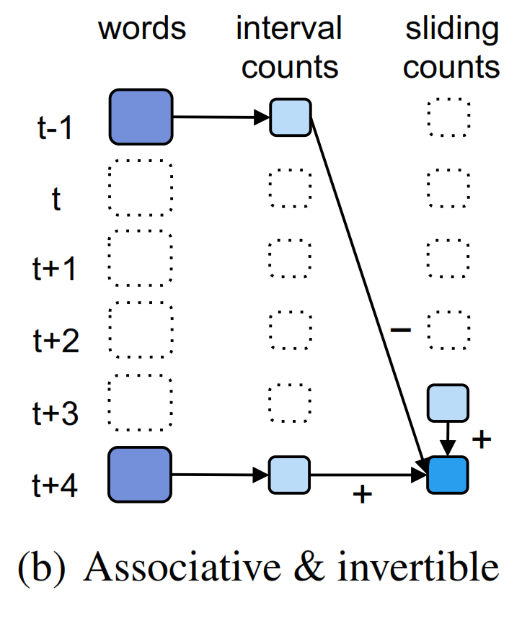
D-Stream API cont’d
Incremental Aggregation
Associatve and invertible
Efficient
Eg, pairs.reduceByWindow(“5s”, _ + _ , _ - _ )

Slide 17
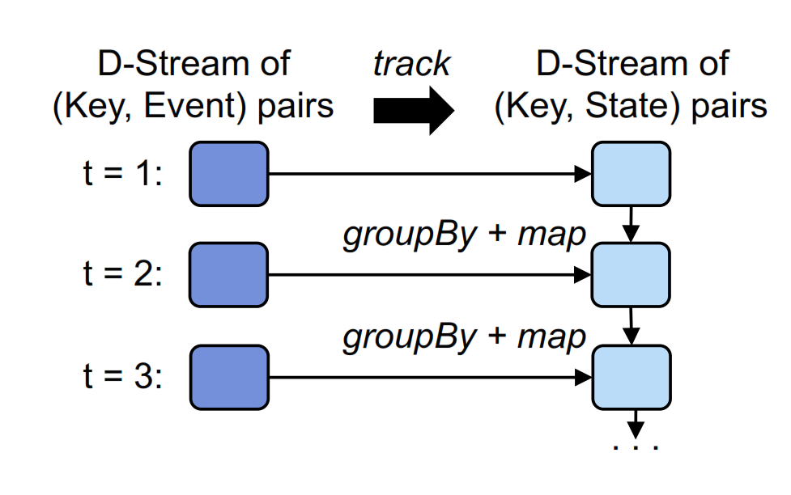
D-Stream API cont’d
State tracking
(Key, Event) -> (Key, State)
Initialize: create state from event
Update: (State,Event) -> NewState
Timeout: drop old states
eg.:
Sessions = events.track(
(key, ev) => 1,
(key, state, ev) =>
ev == Exit? null : 1,
“30s”)
//(ClientID, 1) for each active session
// .count()

Slide 18
D-Streams
Consistency?
No chance of out of sync outputs
Microbatched temporal data and clear states (determinism)
It’s all RDDs
Can play well with offline data loaded into RDDs
Perform ad-hoc queries
Attach console shell, perform queries on available RDDs
Query the state without the need to output! (debugging)

Slide 19
Summary
Aspect | D-Streams | Continuous processing Systems
Latency | 0.5-2s | 1-100ms unless micro-batched for consistency
Consistency | Records processed atomically with the interval they arrive in | May wait short of time to sync operators before proceeding
Late Records | Slack time or application level correction | Slack time or out of order processing
Fault Recovery | Fast parallel recovery | Replication or serial recovery on one node
Straggler Recovery | Possible via speculative execution | Typically not handled
Mixing with batching | Simple unification through RDDs API | Some DBs do, but not in message queueing systems

Slide 20
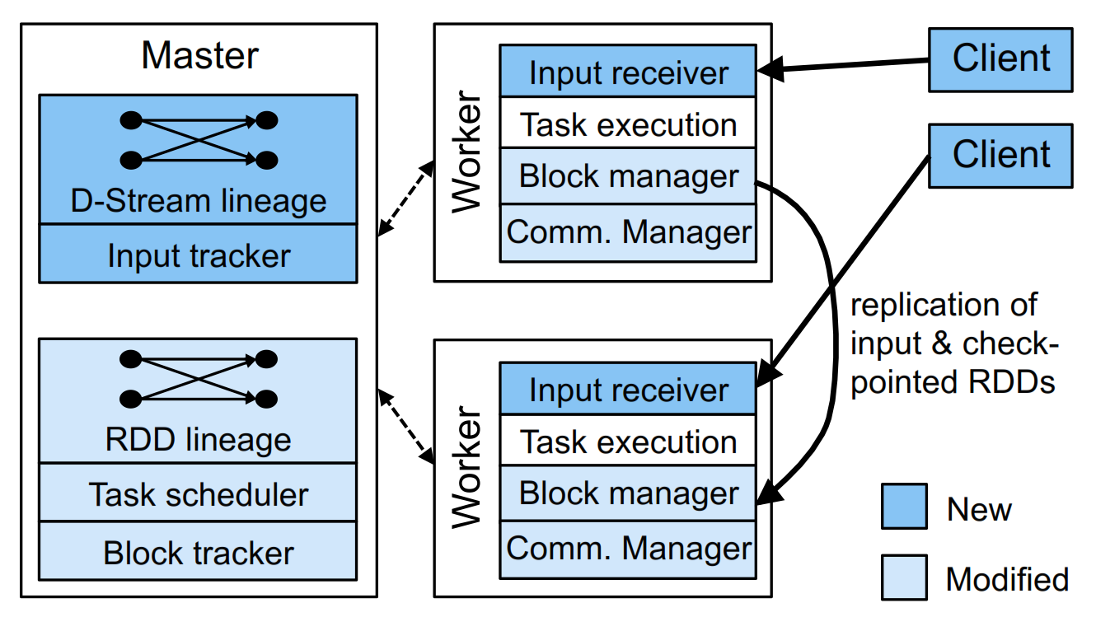
System Architecture
Implemented into Spark Streaming, based on modified Spark processing engine
A master : Tracks D-Stream lineage graph and schedules tasks to compute new RDD partitions
Workers: receive data, store the partitions of input and computed RDDs, and execute tasks
A Client Library: used to send data into the system

Slide 21
Application Execution
Defining one or more stream inputs
Ensure that data is replicated across two worker nodes before acknowledging source
If a worker fails, unacknowledged data is sent to another worker (by source)
Block store on each worker manages the data, tracked by the master, so that every node can find dependency partitions
A uniqueID for each block, any node has a particular block ID can serve it (if multiple nodes compute it)
Dropped in LRU fashion
Nodes have their clocks synchronized via NTP
Each node sends master a list of block IDs it has
Let the tasks begin, master (no further synchronization needed – determinism!)
Tasks carried out as their parents finish

Slide 22
Execution level optimization
Operators that can be grouped get pipelined into a single task
Map, map, filter ..etc (narrow-dependencies)
Tasks placed based on data locality
Controls partitioning of RDDs
As local as possible across interval for reused data

Slide 23
Optimization for Stream Processing
Network Communication
Now uses async IO to let tasks with remote input, such as reduce, fetch them faster
Timestep Pipelining
Allow running overlapping timestep tasks tasks to utilize all nodes
Task Scheduling
Multiple optimizations, eg., hand-tuning the size of control messages to be able to launch parallel jobs of hundreds of tasks every few hundred milliseconds.
Storage Layer
Async checkpointing of RDDs, zero-copy when possible.
Lineage cutoff
Forget lineage after an RDD has been checkpointed.

Slide 24
Optimization cont’d
Master Recovery
Mitigate single point of failure
These optimizations also benefited Spark batch operations and showed 2x improvement

Slide 25
Memory Management
Least Recently Used dropping of partitions
Data spilled to disk if no enough memory
Configurable maximum history timeout
System will forget timed-out blocks (think garbage collection)
History timeout > checkpoint interval
In many applications, memory use is not onerous
State within computation is much smaller than the input data

Slide 26
Fault Recovery
Deterministic nature of D-Streams allows parallel recovery
RDDs are immutable
State is fully explicit
Fine-granularity dependencies
Regular checkpoints helps speed up recomputations
Parallel Recovery
A node fails -> different partitions in different RDDs are lost
Master identifies lost partitions and sends out tasks to nodes to recompute time according to lineage and dependencies
The whole cluster partakes in recovery
Parallel both in partitions in each timestep and across timesteps (if dependency allows)

Slide 27
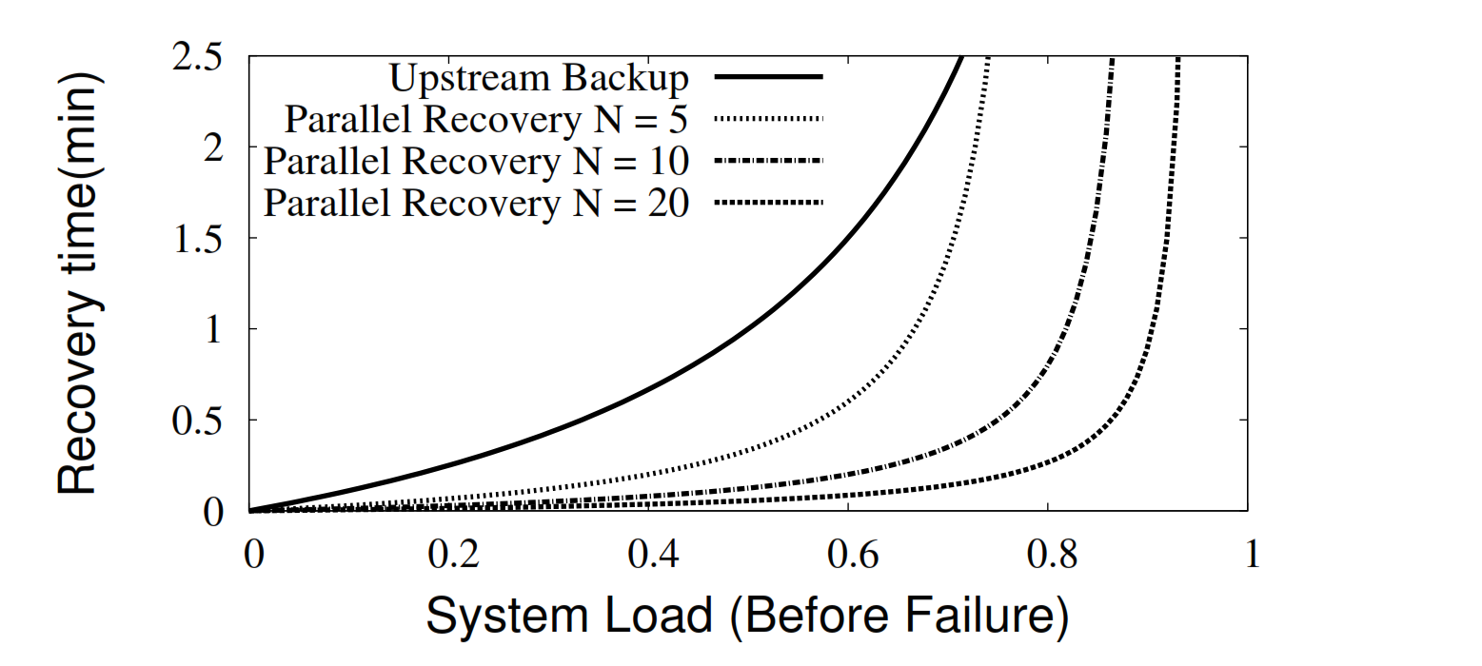
Parallel Recovery
1 min since last checkpoint

Slide 28
Handling Stragglers
Detection: eg., 1.4x slower than the median task in its job stage
Run speculative backup copies of slow tasks
recompute straggled partitions on other nodes, in parallel
Produces same results (determinism)

Slide 29
Master Recovery
Writing the state of computation reliably when starting each time step
Graph of the user D-Streams and Scala function objects representing user code
Time of the last checkpoint
IDs of RDDs since the checkpoint
Having workers connect to a new master and report their RDD partitions
No problem if an RDD is computed twice (no difference)
Fine to lose some running tasks while a new master loads up, can be recomputed
Idempotent output operators; not to overwrite what has been outputted

Slide 30
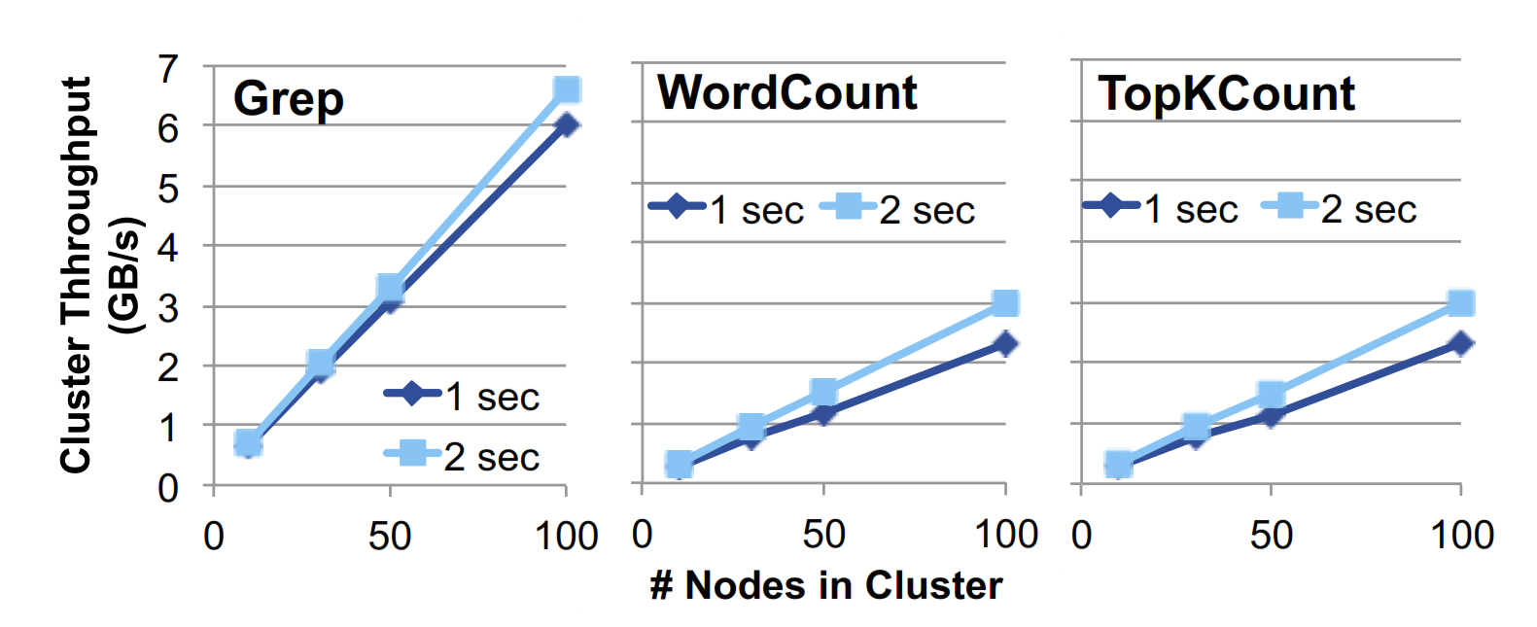
Evaluation
Lots of benchmarks and comparisons
Seriously … lots
Scaling Performance
Grep: finding patterns
WordCount, sliding window over 30s
TopKCount, most k frequent words over the past 30s
WordCount, TopKCount : reduceByWindow
All use m1.xlarge EC2 (4 cores, 15GB RAM)
1s latency : 500ms intervals (microbatches)
2s latency : 1s intervals
100-bytes input records

Slide 31
Evaluation cont’d
Linear scaling to 100 nodes
64M records/s Grep, at sub-second latency (640K records/s/node)
25M records/s TopK, WC at sub-second latency (250K records/s/node)
Comparison with Commercial Systems
Oracle CEP 1M records/s on a 16-core machine
StreamBase 245K records/s on 8 cores
Esper 500K records/s on 4 cores
Spark advantage, scales linearly

Slide 32
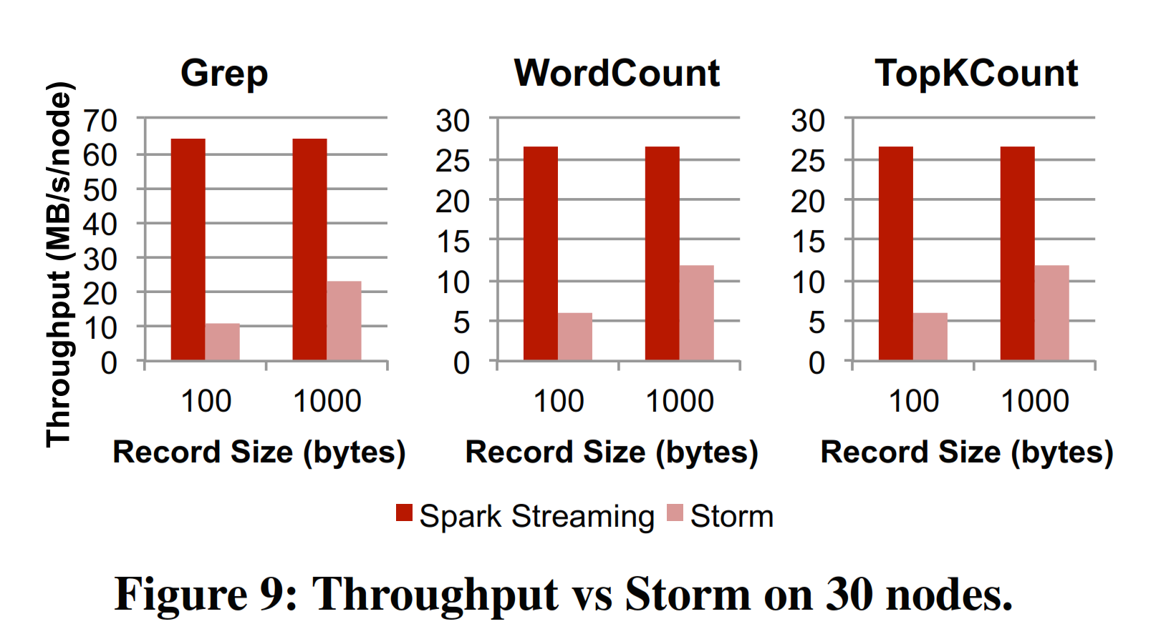
Evaluation cont’d
Comparison with S4 and Storm
S4: no fault tolerance guarantees
Storm: at-least-once delivery guarantee
S4: 7.5K records/s/node for Grep 1K records/s/node for WC
Storm: both 100-byte and 1000-byte records
115K records/s/node for 100-byte Grep
Even with precautions to improve performance
Faster with 1000-byte, but still 2x slower than Spark

Slide 33
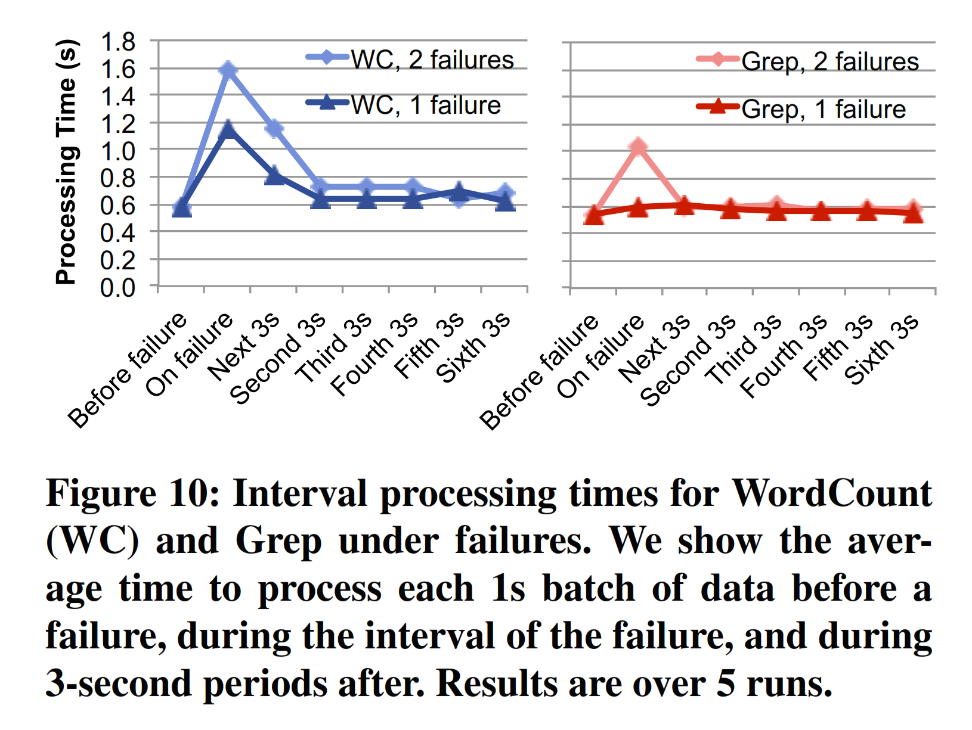
Fault Recovery time

Slide 34
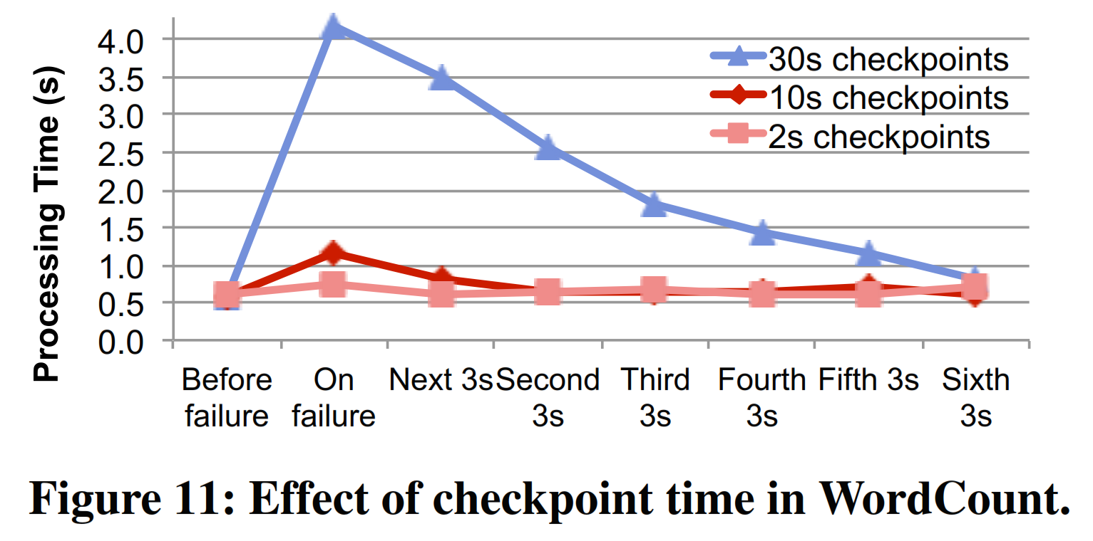

Slide 35
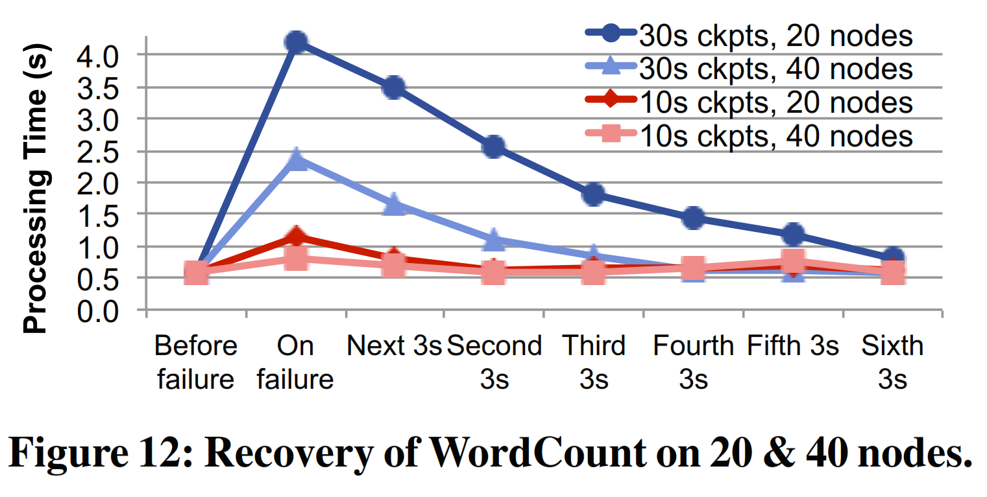

Slide 36
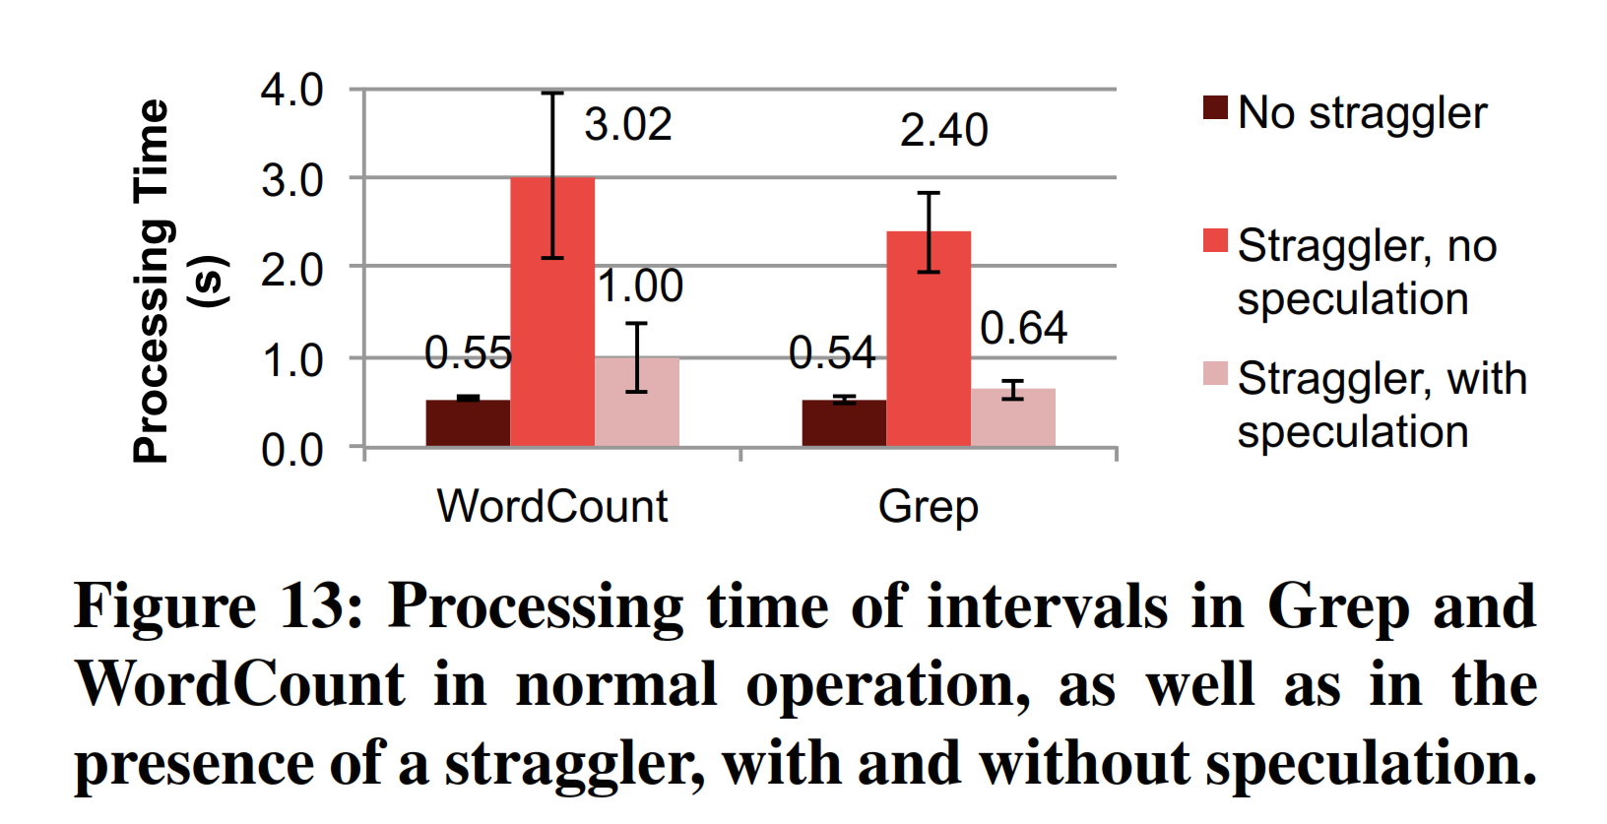
Response to Stragglers

Slide 37
Evaluation on Real World Applications
Video distribution Monitoring (Conviva’s)
Identify and respond to video delivery problems across geography, CDNs, ISPs, and devices
Receives events from video players
Complex analysis, more than 50 metrics computed
Two separate systems online (custom system), offline data (Hadoop/Hive)
have to be kept in sync (metrics computed in the same way)
Several minutes lag before ready for ad-hoc queries
Porting to Spark
Wrapping Hadoop’s map/reduce, 2 seconds batches
Uses track to update state from events, and sliding reduceByKey to aggregate metrics over sessions
Unification of the online/offline systems, runs ad-hoc queries

Slide 38
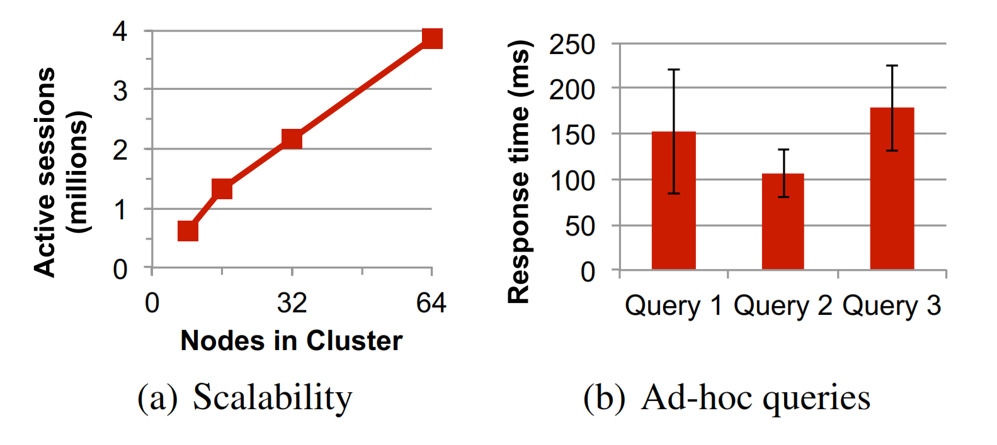
Video Distribution Monitoring Evaluation

Slide 39
Crowd Sourced Traffic Estimation
Mobile Millennium: Machine Learning system to estimate automobile traffic conditions in cities
Aerial roads lack sensors -> use GPS signals from vehicles
Data is noisy (inaccurate near tall buildings) and sparse (one signal from each car per minute)
Highly compute intensive EM algorithm to infer conditions
MCMC and a traffic model to estimate a travel time distribution for each road link
Previous implementation: 30-minute window batch iterative jobs in Spark
Ported to online EM, merges new data every 5 seconds
Used offline data to avoid overfitting (sparse data), up to 10 days back data

Slide 40
