Slide 1
Event Detection Via Communication Pattern Analysis
Flavio, Jon, Ravi, Mohammad, and Sandeep
Presented By:
Muthu Chandrasekaran
Published in AAAI 2014

Slide 2
The Outline
Big Picture
Contributions
Approach
Results
Discussion

Slide 3
Rise of Social Media
Social media is a Phenomenon
Uses of Social media
“Narcissism” – Sharing your own news/creating information
Marketing – Promoting a business venture
Enabling Narcissism through Marketing – Pic Stic (my start-up!)
Reporting – Sharing others news/events
Etc
Tapping into social media feeds is a challenge – why?

Slide 4
Real-time Event detection
What is an “Event”?
A football game
Whatever Miley Cyrus does..
Release of the Apple watch
Elections / Political protests
Natural Disaster
How do you detect an event through social media?
People talk about them
Share others news/video etc
How would a computer differentiate an “Event” from other posts?
How does the user’s behavior change when an event occurs?

Slide 5
Event detection contd..
User Behavior during an event
Reporting by participants AND observers
Coordinating/communicating between participants
Expression of collective sentiment
..
..
..
Few people still talk about themselves even when there’s an earthquake out there!!

Slide 6
Twitter Problems
140 character limit
Diverse languages
Noise (fake news/sarcasm)
Fast-evolving linguistic norms – YOLO, SELFIES
Acronyms
NLP for “TLP” is complex!

Slide 7
Authors’ Contributions
Detect real-time events from tweets
Classify events based on tweet sentiment
ALL WHILE USING ONLY non-textual features
Advantages:
Robust
Language-independent
Understand user behavior in Social Media websites

Slide 8
Pressing Questions
How to identify new developments with only non-textual features?
How do these new developments influence user tweets?
Non-textual Features?
Raw numbers of tweets and retweets

Slide 9
Approach Abstract
A linear classifier for classifying a tweet as an “event” or otherwise
Study user behavior during “events” and “non-events”
Explain the behavior through a model.. i.e. find the
Balance between creating new information and forwarding existing information
Level of communication between individuals

Slide 10
Finally, the Data!
3 episodes (of varying lengths)
2010 Soccer World Cup (1-month)
2011 Academy Awards
2011 Super Bowl
Key:
Nested Sub-events (eg. games > goals) are known (with time-stamps)
Strong user involvement observed (incl. emotions and active communication)
Supporting divergent outcomes

Slide 11
The Approach
The World Cup example
1 month long
Short intense sub-events (eg. Brazil Vs Argentina game)
Shorter sub-sub-events (eg. Brazil scores a goal) and so on…
Consider levels of user communication during these sub-events
What ppl say in the lead up to a big game?
Or right after a team scores a goal?

Slide 12
The Approach
Secondary information
Retweets (forwarding of information)
Operating on top of base-level tweets
Primary information
Base-level of tweets (new information)

Slide 13
The “Heartbeat” Pattern
During an intense sub-event:
Primary information starts appearing
Secondary information generation diminishes
Right after an intense sub-event:
Primary information generation diminishes
Secondary information generation at an elevated rate

Slide 14
The “Heartbeat” Pattern
Detecting Sub-events:
Several spikes in tweet volume – not very discriminating!
Tracking balance between Primary + Secondary tweets – more meaningful!
Simultaneous peak in primary and drop in secondary info & viceversa
Extent of peak & drop measures intensity of sub-event
Authors build a mathematical model to capture the “heartbeat” pattern

Slide 15
The Model
Absence of an “unusual” event:
Every user has the same probability of tweeting/retweeting
Occurrence of an “unusual” event:
Each user becomes “interested” independently by flipping a coin
“interested” user – tweet/retweet about event before tweeting anything else
This simplistic model naturally produces the “heartbeat” pattern
i.e. generates aggregate behavior observed in temporal vicinity of sub-events
Intuitively, “interested” folks need to tweet new info before becoming able to retweet already-shared info

Slide 16
Experimental Setup
Dataset:
From the Twitter Firehose – ALL tweets in Twitter!
Tweet (meta-info):
Text, geo location of tweet and user, time-stamp, tweet response to a tweet
Tweet Text:
Special tokens: @username, #hashtag
During the period of interest:
> 100M tweets a day!
Total of 10s of Billions of tweets
Map-reduce for distributed processing

Slide 17
Data Recap
3 major events:
2010 Soccer World Cup (1-month)
2011 Academy Awards
2011 Super Bowl
Broad spectrum of social episodes
Geographic localization (city to country)
Different time periods (Single day to almost half a year)
Multiple sub-episodes (world cup) vs. single episode
Different Genre (sporting and entertainment)

Slide 18
Data Collection
Features:
Timeline – start and end time of episode
Events – all events in an episode incl. features for each event (key event)
All events had at least 1 person denoted by first and last names
Hashtags – list of all hashtags referring the episode
Tweets without hashtags ignored (claimed to not have a great impact)

Slide 19
Data Collection
Active Users:
Used at least 10 episode-related tags during at least 1 of the sub-episodes
Manually examined for bots, if tweet-count was higher than a threshold
Extract from the twitter gen-pop:
Volume of tweets
Word-usage frequency etc.
2 kinds of social interactions:
Retweeting
Replying

Slide 20
Dataset Assembly
World Cup Example:
Soccerstand.com
64 games
Non-key events: 253 yellow cards, 17 red cards
Each of the 32 countries has a hashtag

Slide 21
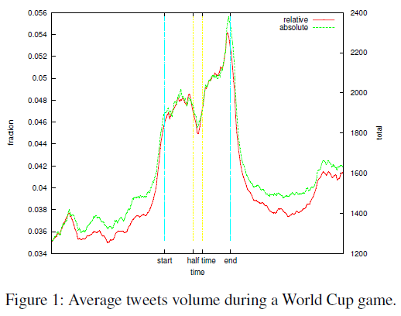
Key Events & Tweet Volume
World Cup Example:
105 min
Good co-relation between absolute time and time divided by no. of tweets
Notice drop during half-time!

Slide 22
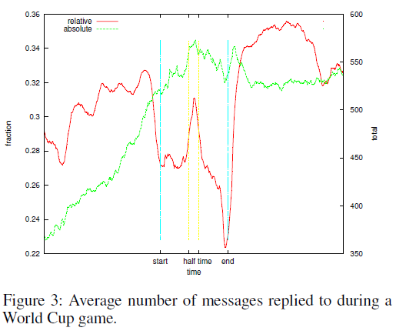
Info. production Vs. Social Interaction
Communication Pattern:
Avg num of messages replied to during a game
Relative numbers are mirror image of that in fig.1

Slide 23
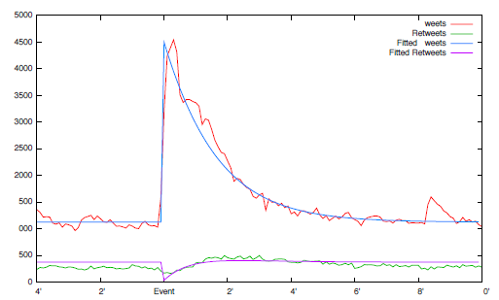
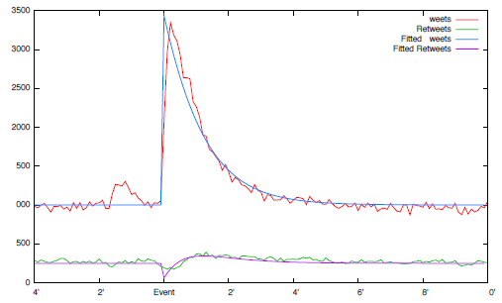
Info. production Vs. Social Interaction
Digging deeper into a sub-event:
A goal.. See the heartbeat pattern emerging!
1st Goal Brazil Vs North Korea
1st Goal Mexico Vs Argentina

Slide 24
Event Detection
Finding key events using just tweet and retweet counts:
A simple logistic regression approach
Pinpoints goals with a precision of 15 seconds!
Plenty of information in non-textual features
Pattern of tweeting plays an important role in accuracy of prediction
Specs:
159 positive instances (15 sec intervals)
38070 negative instances
(no key-event during this time)
Results:
16 false negatives and 17 false positives!
5-fold cross validated error – 0.197%
Matthews co-relation coefficient – 0.707

Slide 25
Event Labeling
Find out who is playing - Team A, Team B
non-text features
Find out which team won – Team A or Team B?
Will need info on supporters of A and B
Relaxed the non-text constraint
Tweet volume heavily skewed toward winners
Results:
20-sec window
Classifier error rate – 19.8%

Slide 26
Discussion
Twitter is a powerful medium
Non-textual features like tweet and retweet counts are useful indicators
The “heartbeat” phenomenon – tweeting patterns
Mathematical model to explain such a phenomenon
A simple classifier was enough to detect key events using only non-textual features
Performed much better than baseline methods (without having to use complicated NLP)

Slide 27
Questions ???
Thanks for listening!

