Slide 1
AN ALGORITHM FOR THE PRINCIPAL COMPONENT ANALYSIS OF LARGE DATA SETS
ANTHAN HALKO, PER-GUNNAR MARTINSSON, YOEL SHAOLNISKY, AND MARK TYGERT
PRESENTER: ZHAOCHONG LIU

Slide 2
OUTLINE
Introduction
Algorithm
Out-of-core computation
Computational costs
Examples
Conclusion

Slide 3
Introduction
Use with data sets that are too large to be stored in the random-access memory(RAM) of a typical computer system.
SVD
Minimize the total number of times that the algorithm has to access each entry of the matrix A being approximated.

Slide 4
Algorithm
G: a real n × l matrix with independent and identically distributed entries.

Slide 5
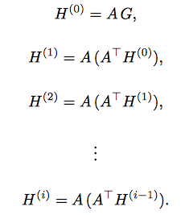
Algorithm

Slide 6
Algorithm
2. Using a pivoted QR-decomposition
H = Q R
Q : real m × ((i+1)l) matrix and its columns are orthonormal
R: real ((i + 1)l) × ((i + 1)l) matrix

Slide 7
Algorithm
3. Compute the n × ((i+1)l) product matrix
4. Form an SVD of T

Slide 8
Algorithm
5. Compute the m × ((i+1)l) product matrix
6. Retrieve the leftmost m × k block U of , the leftmost n × k block V of , and the leftmost uppermost k × k block Σ of

Slide 9
Out-of-core Computation
Computation with on-the-fly evaluation of matrix entries
Matrix not fit in memory
Have access to a computational routine that can evaluate each entry of the matrix individually

Slide 10
Out-of-core Computation
Computation with storage on disk
Retrieve as many rows of the matrix from disk as will fit in memory
Calculate the products of the retrieved rows of the matrix and columns of G
Then repeat

Slide 11
Computational costs
Costs with on-the-fly evaluation of matrix entries
--------------
--------------
--------------

Slide 12
Computational cost
Cost of the first step is
Cost of step two is
Cost of step three is
Cost of step four is
Cost of step five is
Cost of step six is
Summing up :

Slide 13
Computational cost
Cost with storage on disk
Each equation in step one need at most flops, the total is
We can see that step two, four, five and six are not using A matrix, so the result are the same with the previous
Cost of step three is
Summing up:

Slide 14
Numerical Example
First example:
Apply the algorithm to the m × n matrix
A = E S F

Slide 15
Numerical Example

Slide 16
Numerical Example
Second example:
Same as the first one, but the singular values are different.

Slide 17
Numerical Example

Slide 18
Numerical Example
Third example:
Apply the algorithm with k = 3 to an m × 1000 matrix whose rows are independent and identically distributed realizations of the random vector

Slide 19
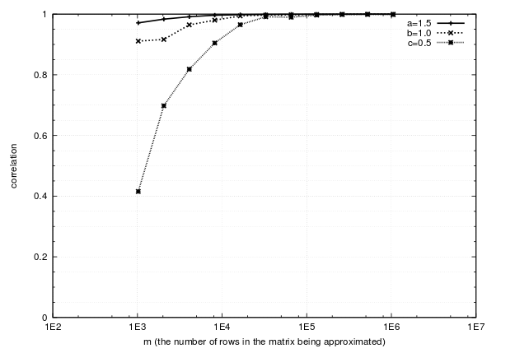
Numerical Example

Slide 20
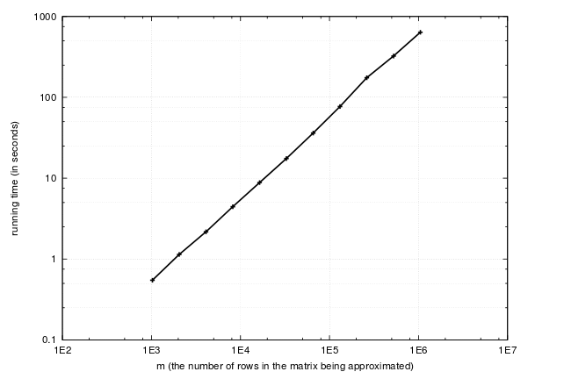
Numerical Example

Slide 21
Measured Data
Perform the algorithm with PCA of images of faces
K = 50
393,216 * 102,042 matrix whose column consist of images

Slide 22
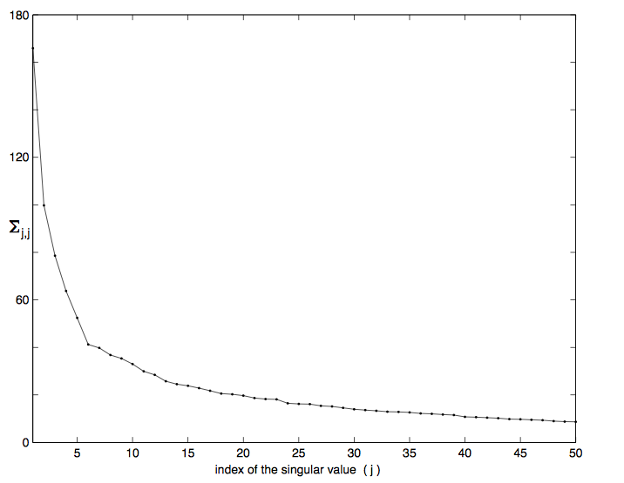
Measured Data

Slide 23
Measured Data

Slide 24
Last Example
This data set consists of 10000 two-dimensional images
Each image is 129 pixels wide and high
K = 250

Slide 25
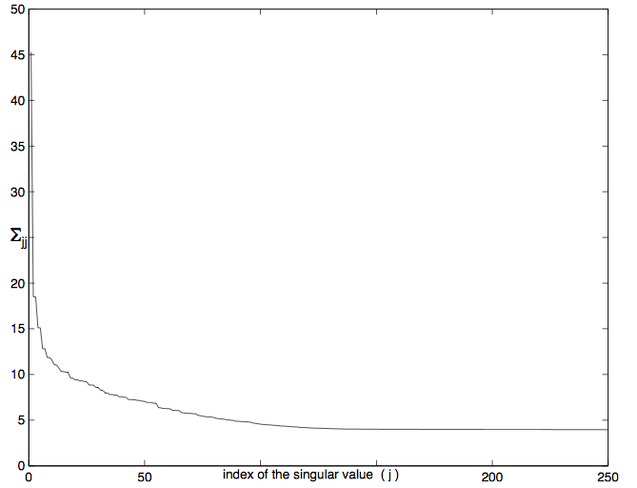
Last Example

Slide 26
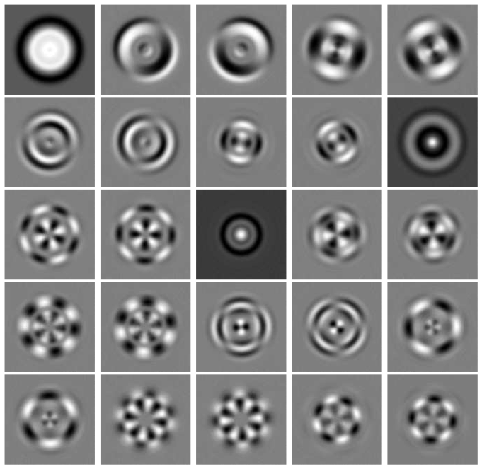

Slide 27
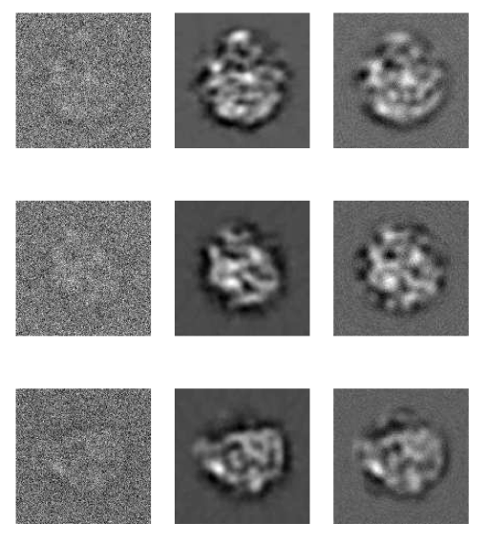

Slide 28
Conclusion
This paper describes techniques for the principal component analysis of data sets that are too large to be sorted in random-access memory, and illustrates the performance of the methods on data from various sources, including standard test sets and numerical simulations.
The core steps of the procedures parallelize easily; with the advent of widespread multicore and distributed processing.

Slide 29
Pros and Cons
Pros: the algorithm is described very clear.
the numerical examples are comprehensive
Cons: There is no compare on the example evaluation.

Slide 30
Thank you!

